Slide 1
STAC progress report
WGISS-58 10/15-18/2024
Doug Newman
NASA ESDIS Project, Goddard Space Flight Center
Notes:
STAC - Spatio-Temporal Asset Catalog
WGISS - Working Group on Information Systems and Services

Slide 2
Agenda
Introduction to STAC in WGISS
CEOS STAC Collection & Granule discovery BP
ESIP STAC Summit
Notes:
CEOS - Committee on Earth Observation Satellites
ESIP - Earth Science Information Partners

Slide 3
Introduction
Why STAC?

Slide 4
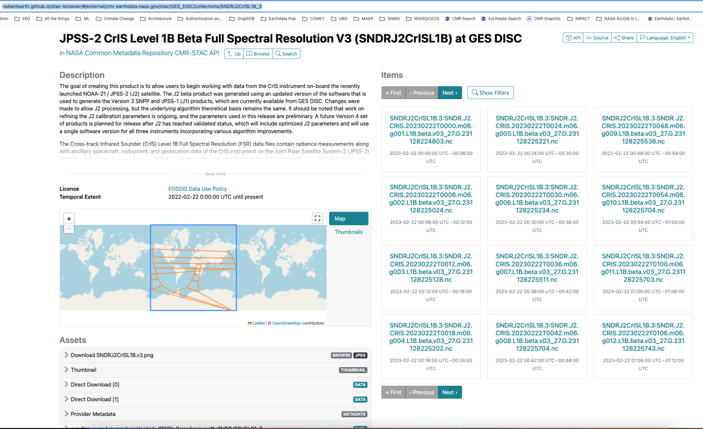
Why STAC?
Federation & CWIC - easy swap for Open Search
Widespread adoption
Thriving ecosystem
PGSTAC
STACBrowser
Notes:
CWIC - CEOS WGISS Integrated Catalog
PGSTAC - PostGres STAC
STACBrowser using CMR STAC API - https://radiantearth.github.io/stac-browser/#/external/cmr.earthdata.nasa.gov/stac/GES_DISC/collections/SNDRJ2CrISL1B_3

Slide 5
Why I like STAC for CWIC
Hypermedia as the engine of application state (HATEOAS)
‘collection’ and ‘items’ implements two-step
JSON result format
Machine-readable API
{
"stac_version": "0.9.0",
"stac_extensions": [
"https://stac-extensions.github.io/eo/v1.0.0/schema.json",
“https://stac-extensions.github.io/projection/v1.0.0/schema.json”
],
…
}
Notes:
JSON - Javascript Object Notation
API - Application Programming Interface

Slide 6
Our STAC efforts
STAC Best Practices
Replacing our CWIC OpenSearch implementation with STAC
CMR collection API/Catalog
Linked STAC catalog APIs at other agencies
Notes:
CMR - Common Metadata Repository

Slide 7
CEOS STAC Collection & Granule discovery BP
Our Best Practices for using STAC for discovery
Notes:
BP - Best Practices

Slide 8
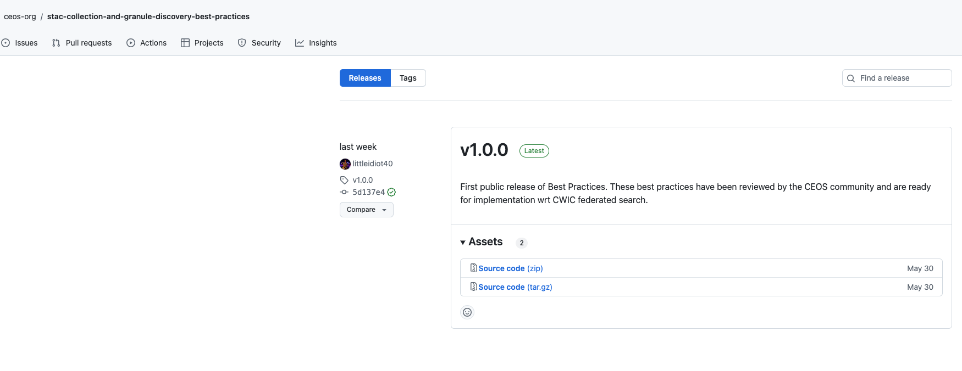
Current status
We have created our first release (1.0)!
INPE/FedEO have integrated using our Best Practices
CMR are working on conformance for CWIC
Notes:
https://github.com/ceos-org/stac-collection-and-granule-discovery-best-practices/releases

Slide 9
NASA CMR STAC
Progress report
Notes:
BP - Best Practices

Slide 10
CMR STAC roadmap
4th Quarter 2024 - implementation of Collection Search extension for CWIC and BP compliance
Collection Search implemented.
Functionality to link CWIC catalogs, via UMM-C records, to CMR implemented.
To do: Update INPE collection metadata with STAC endpoints
2025 - begin adding other high-value extensions
Electro-Optical
Projection
View Geometry
Hyperspectral Imagery
Satellite
Query
Sort

Slide 11
STOP!
I will return after the following messages

Slide 12
ESIP STAC Summit
A report on the Summer 2024 ESIP STAC summit

Slide 13
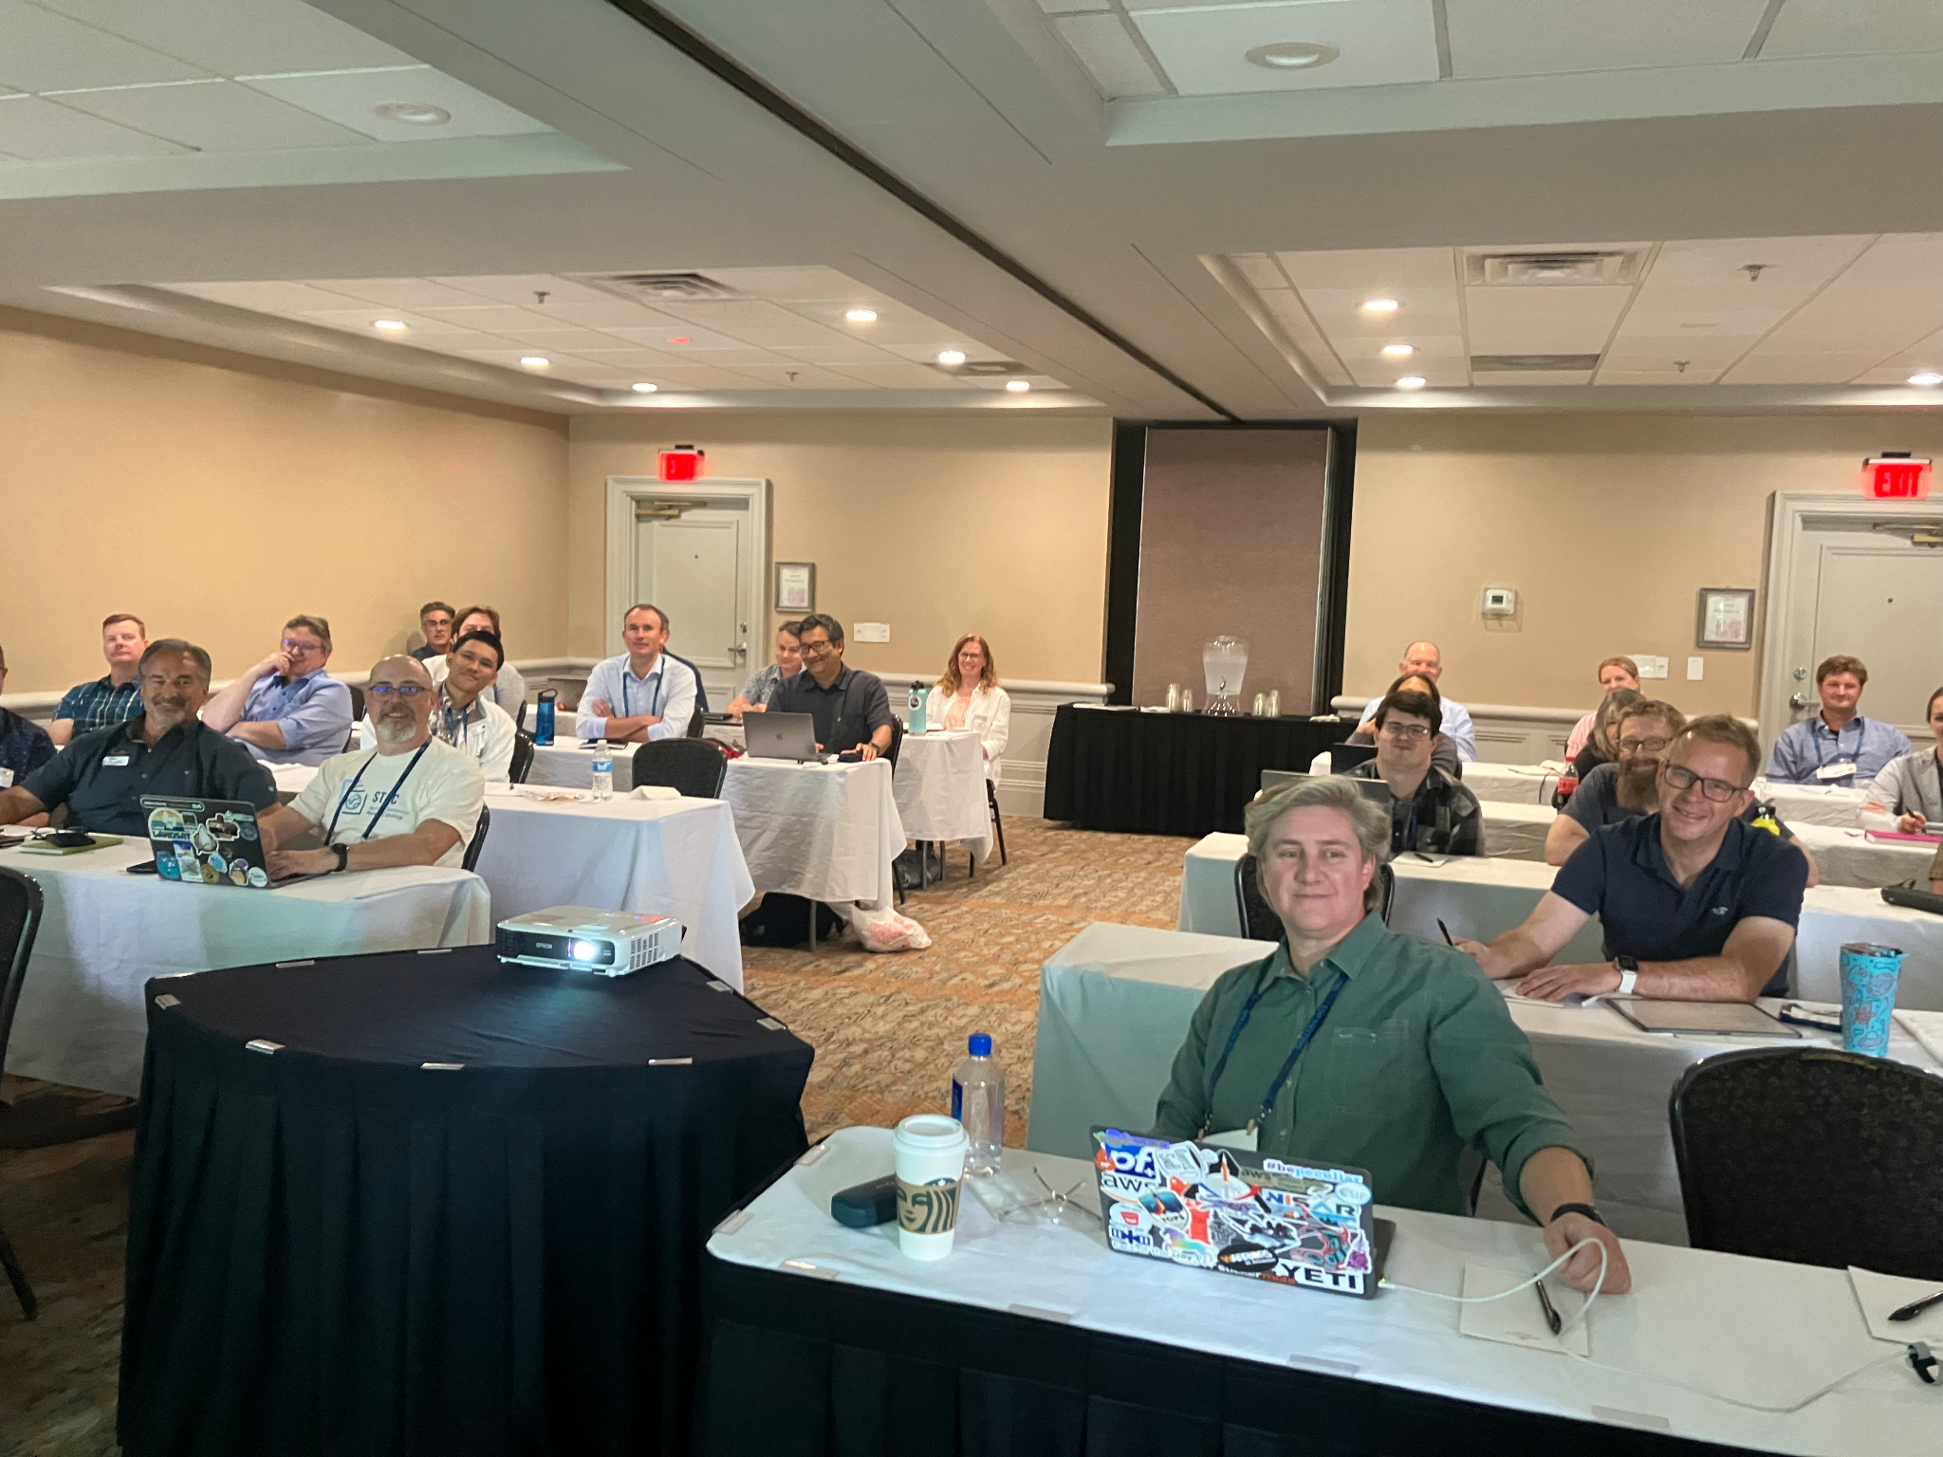
The pictures you demanded
Primary discussion point: ‘Super STAC’ - various takes on federated STAC.
Lightning talk on CWIC federated approach
Google form to determine popular STAC extensions
ESIP STAC summit - Asheville, North Carolina, 07/21/24

Slide 14
‘Super STAC’
‘There is a need for a globally searchable catalog of all geospatial and environmental data that is open to the public’
Super STAC - a catalog of catalogs.
CWIC have done this already (albeit with OpenSearch).

Slide 15
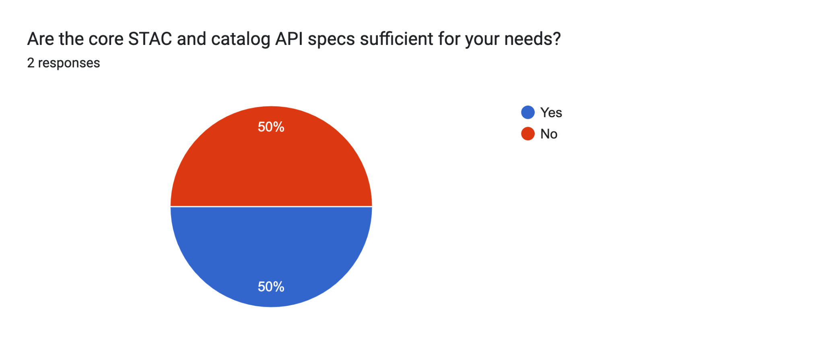
Essential extensions results
Notes:
Survey Form: https://forms.gle/igXjEcRYYLTe6gS79
API - Application Programming Interface

Slide 16
Essential API extensions
Collection Search
Query
Sort

Slide 17
Essential Catalog extensions
Electro-optical
Hyperspectral Imagery
Landsat
Projection
Satellite
View Geometry

Slide 18
Let’s replace Open Search with STAC
CONTACT
douglas.j.newman@nasa.gov
WEBSITE
earthdata.nasa.gov
SOCIAL MEDIA
@NASAEarthData
Contact me at…

