Slide 1
Data Preservation & Stewardship Interest Group (DSIG) Work Plan
Mirko Albani, ESA
Agenda Item 1.2
WGISS-58
16-17 October 2024
Sioux Falls, South Dakota, USA

Slide 2
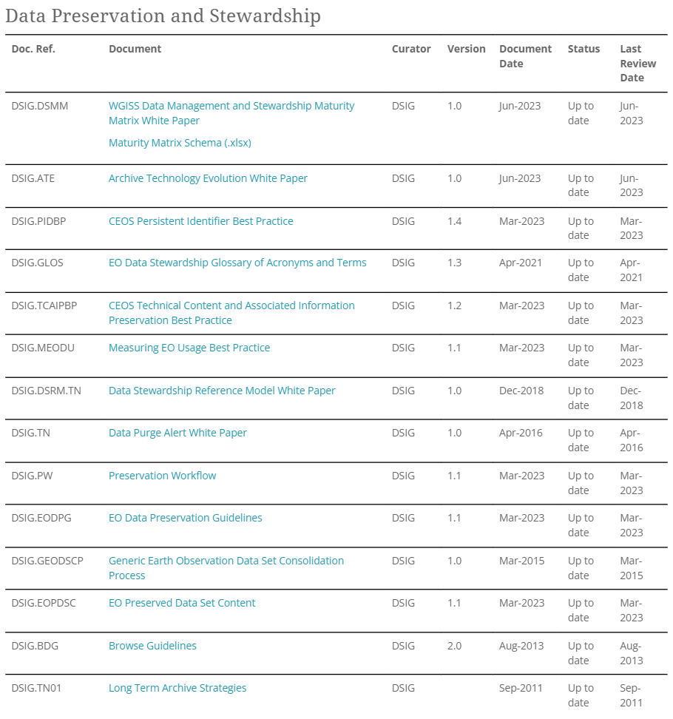
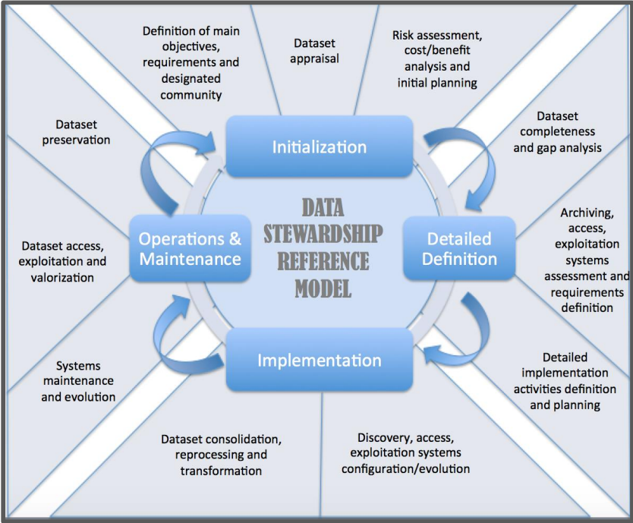
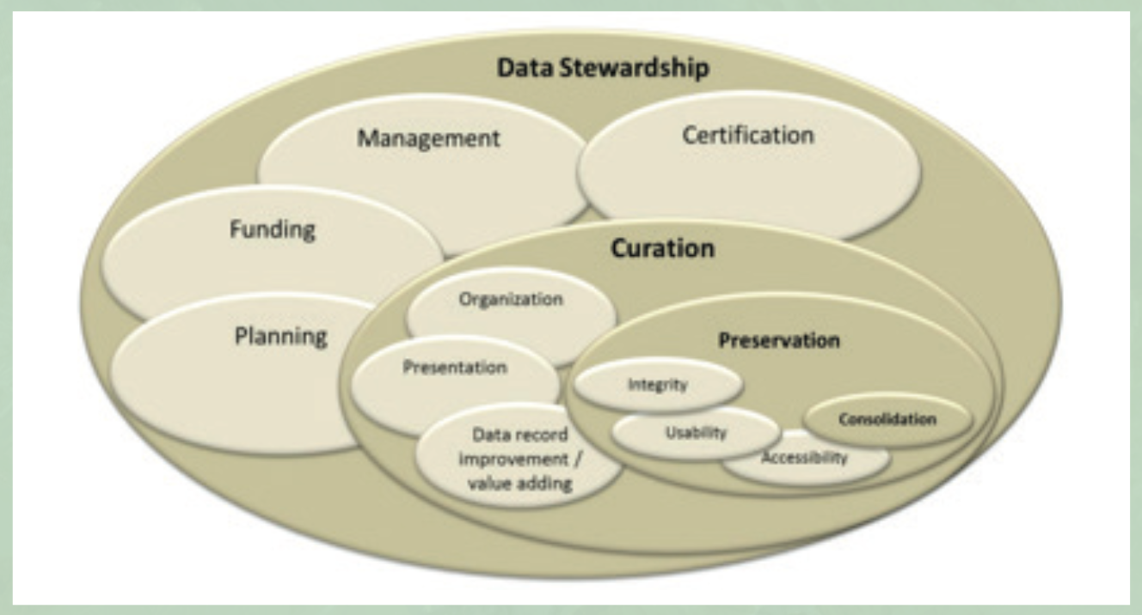
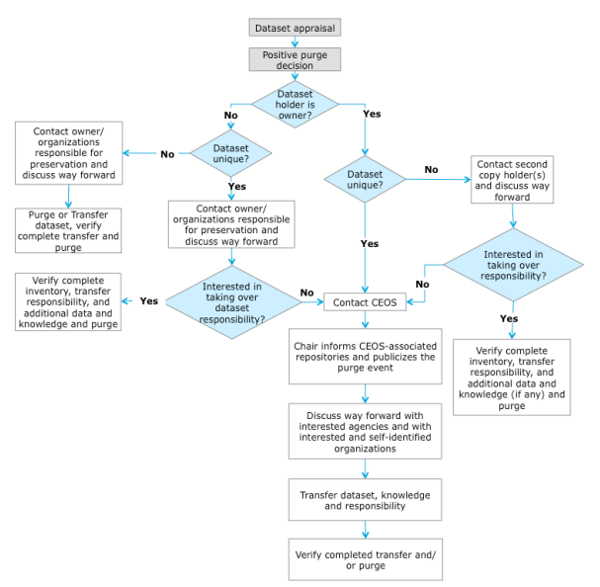
DSIG Overview
Enable the sharing of agencies’ investigations, developments, experiences, and lessons learned relating to EO data stewardship;
Issue common cross-agency best practices or guidelines of data stewardship for possible adoption by CEOS members;
Sponsor technical exchanges and the conduction of joint activities and/or pilot projects on specific data stewardship topics;
Establish and maintain a CEOS “Data Purge Alert” service;
Contribute to the Group on Earth Observation (GEO) and international standardization bodies’ activities.

Slide 3
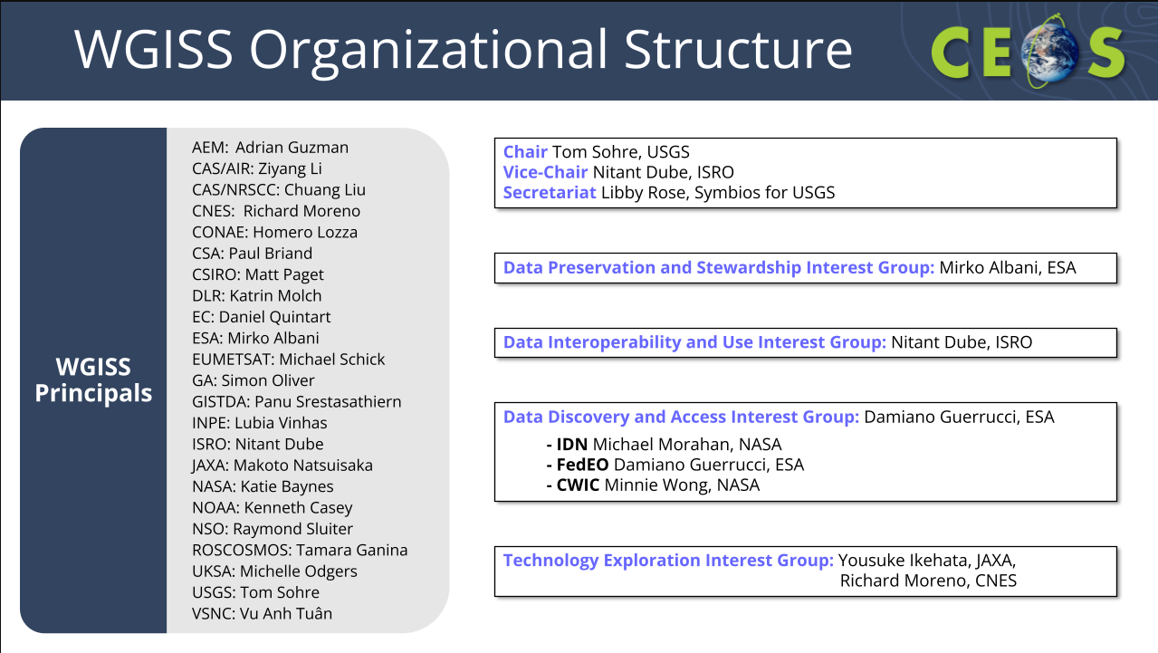
DSIG Leadership and current members
DSIG Chair: ESA Mirko Albani
Current DSIG members:
UKSA Niall Bradshaw
UKRI UKSA Michelle Odgers
STFC UKRI Esther Conway
INPE Lubia Vinhas
ISRO Nitant Dube
JAXA Natsuisaka Makoto
JAXA Ikehata Yousuke
CONAE Homero Lozza
USGS Tom Sohre
USGS Ryan Longhenry
USGS Tom Maiersperger
CNES Pierre Marie Brunet
NRAE Richard Moreno
NOAA Nancy Ritchey
NOAA Kenneth Casey
GA Simon Oliver
DLR Felix Feckler
DLR Katrin Molch
WMO Ge Peng
ISO TC 211: Liping DI
CSIRO Edward King
NASA Dana Ostrenga
NASA Justin L.Rice
data-stewardship@wgiss.ceos.org

Slide 4
DSIG Accomplishments
Not Exhaustive List:
Raised awareness on EO data stewardship
Shared investigations, developments, experiences, and lessons learned relating to EO data preservation approaches and technologies
Several documents (White Papers, Best Practices, Guidelines, and recommendations) produced and accessible on the WGISS website
CEOS “Data Purge Alert” and “New Agency Dataset Availability” services
Addressed recovery of Historical Data and started AVHRR project
PRESERVE AND KNOW THE PAST
UNDERSTAND THE PRESENT
SHAPE AND ENABLE THE FUTURE

Slide 5
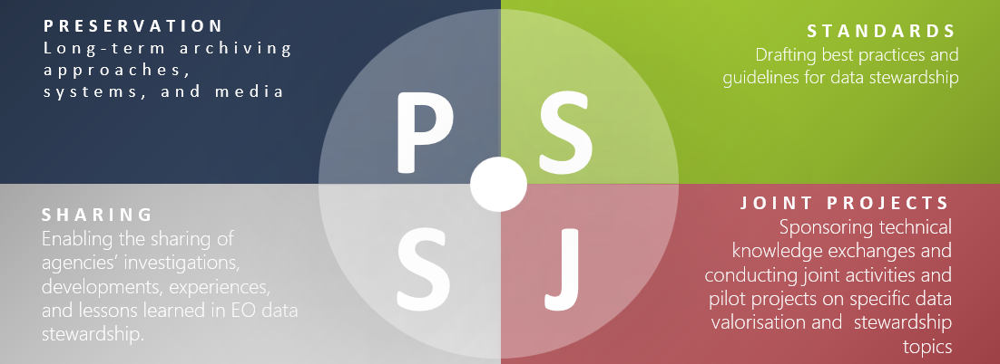
Current Work
Not Exhaustive List:
AVHRR Worldwide 1 Km Archives Recovery Project
EO Data Collections Management and Governance White Paper
WGISS Best Practices and WGISS web site Review Procedure
Technical Sessions on Archives Technologies Evolution and Archiving Policies
Data Preservation and Stewardship Joint activities with other WGs (e.g. CEOS Data Stewardship and Management Maturity Matrix)

Slide 6
DSIG Vision – Future Work (for discussion)
Focus on the following main topics:
Heritage data recovery
Archive holdings and technology (including interoperability between archives)
Data associated information and software preservation
Collections management and governance
Interaction with standardization bodies

Slide 7
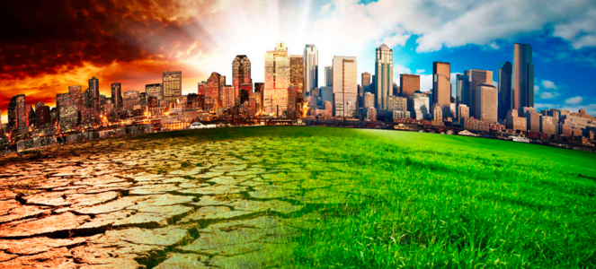
Heritage Data Recovery
Climate related applications are requiring more and more to extend critical long-term science observations back in time through the use of heritage (historical) datasets.
Objective: identify historical/heritage datasets currently not accessible to users and trigger potential joint recovery actions.
Activities:
Identify historical/heritage datasets of interest for climate/scientific application at preservation risk and/or currently not accessible to users (e.g. because on old media, not kept online, not processed, etc.)
Define recovery criteria and prioritization model (technical aspects, actual/potential user needs/interest, data property rights, etc)
Define priorities and trigger recovery actions, possibly joint within WGISS, liaising/interacting as needed with other international partners

Slide 8
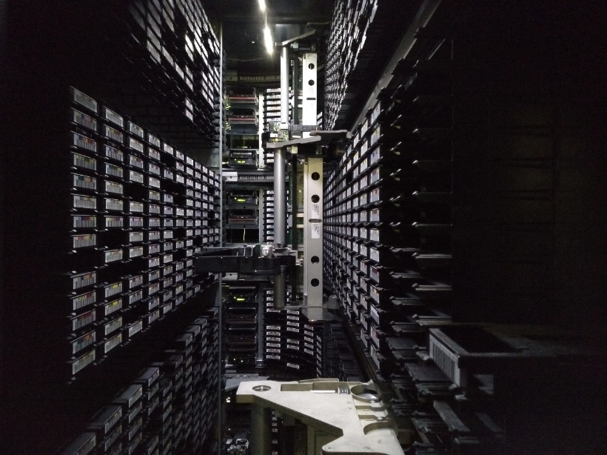
Archive Holdings and Technology
Archived data volume is growing exponentially. At the same time archiving technology is changing very rapidly. Main challenges for EO data archives are the sheer volume of data, the copious number of files, the diversity of formats and the fast data increase.
Objective: Share information on new technologies and approaches and draft best practices to facilitate archives upgrade and evolution.
Activities:
Exchange information on EO data archives content, archiving and preservation processes, infrastructure and technologies; Sharing of know-how, main challenges, issues and lessons learned
Explore interoperability and federation approaches between archives (e.g. use cases, technical solutions)
Liaise/interact with other international partners
Monitor and assess new archiving solutions and technologies and future trends
Draft Best Practices/White Papers to facilitate archive owners in their activities; joint research and piloting activities

Slide 9
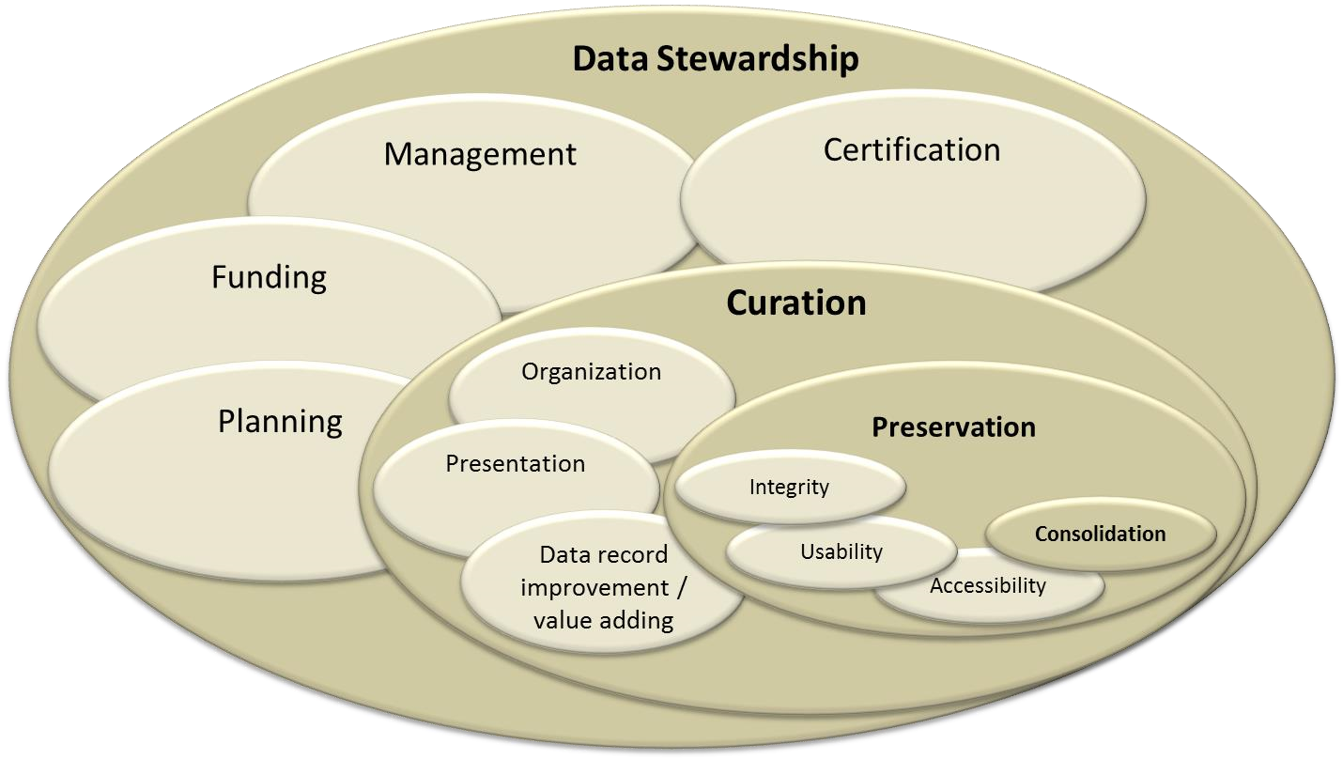
Data associated information and software preservation
Earth observation data constitute a humankind asset, which needs to be preserved, i.e. safeguarded against loss and kept accessible and useable for current and future generations. Use and exploitation of preserved data requires also the availability of associated technical information and software. Hence, software and technical information preservation can be considered as a logical extension of the data preservation and stewardship process.
Objective: Share information on approaches and technologies used for technical content and software preservation.
Activities:
Exchange information concerning data associated information and software preservation activities, approaches and technologies used by WGISS members
Identify potential common approaches (e.g. use cases and solutions) and draft Guidelines, Best Practices and White Papers liaising/interacting with other international partners as needed
Joint research and piloting activities

Slide 10
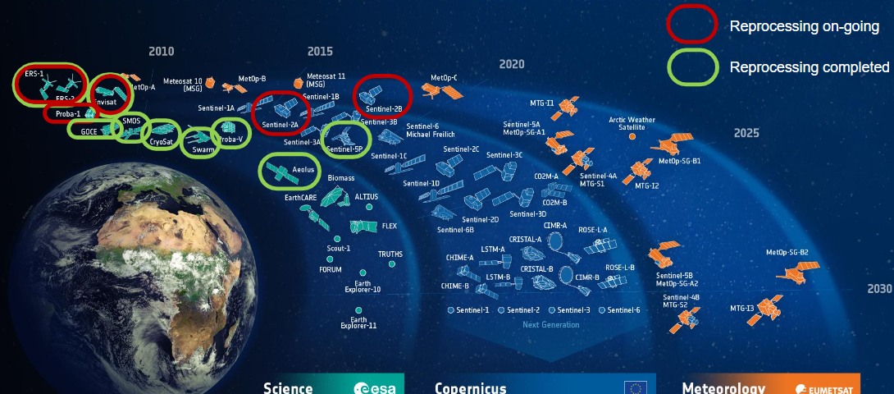
Collections management and governance
A Data collection is a major release of a data product, or of a set of closely related data products. The collection management and governance concept concerns the capability that enables an organization to ensure that high data quality exists throughout the lifecycle of the collection, and data controls are implemented that support business objectives. Many challenges are today experienced on data integrity, authenticity, replica management (in the cloud and/or archived), reproducibility and citation. Every Agency needs to ensure data collections are secure, accurate, available and usable.
Objective: Share information on collections management and governance approach and define Best Practices/Guidelines
Activities:
Discuss “Data Collections Management practices” starting from approaches in place at Agency members;
Share experiences and lessons learned and prepare a summary and/or recommendations.

Slide 11
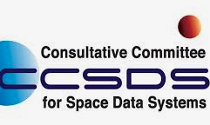
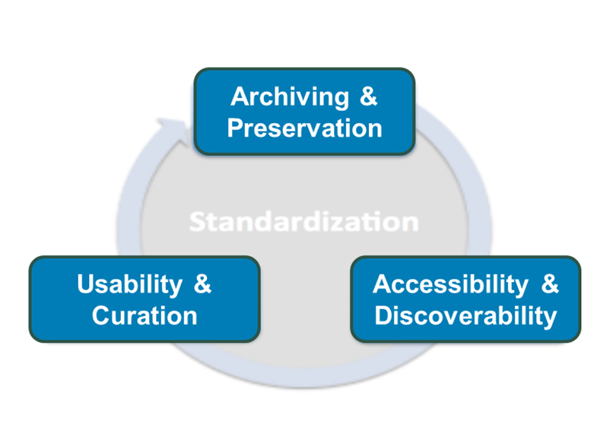

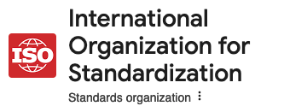

Standardisation
Adherence to internationally recognized standards might improve quality, increase efficiency and facilitate interoperability. CEOS has several times contributed to drafting international standards and produces Best Practices and recommendations to complement outputs from standardization bodies.
Objective: Share information on international standards relevant for WGISS activities and contribute to standardization activities.
WGISS
Activities:
Identify standards and technical evolutions that might have impact on WGISS DSIG (e.g. CCSDS Archive interoperability, OGC APIs, GeoTIFF SWG), follow their evolutions and share information with WGISS
Liaise, cooperate and contribute to the CCSDS DAI WG on data archiving standards, and with other international standardization bodies when relevant
Trigger actions liaising/interacting as needed with other international partners

