Slide 1
NOAA’s Collection Metadata Editing Tool (CoMET)
Sarah Menassian, NOAA
Agenda Item 5.1
WGISS-58
16-17 October 2024
Sioux Falls, South Dakota, USA

Slide 2
Summary
NOAA’s CoMET application enables users to perform a variety of tasks to create, manage, and assess collection metadata
This includes a Data Stewardship Maturity Questionnaire (DSMQ) which allows users to assess and quantify stewardship practices
NCEI team is awaiting approval to deploy updates to CoMET that will enable login.gov authentication by non-NOAA users
NCEI team has also begun migrating CoMET application to the NESDIS Common Cloud Framework (NCCF)

Slide 3
Collection Manager Tools Overview
COMET | Collection metadata registry. Responsible for supporting the ISO 19115-2 standard and provides a user interface (UI) and application programming interface (API) allowing users to manage metadata records
DOCUCOMP | Responsible for storing extensible markup language (XML) components that are reusable by the data management and scientific community
METASERVER | Responsible for Web Accessible Folders (WAF) configuration and management, storing and tracking metrics, and frequency of processing aforementioned WAFs
METAVIEW | Utility web application to view XML content in various ways via extensible stylesheet language transformations (XSLT)
RWAF PIPELINES PROCESSING | A Java application that resolves metadata records, performs WAF processing and generates metrics, and publishes resolved records to a WAF and to OneStop Inventory Manager for search and discovery
WEB ACCESSIBLE FOLDERS (WAFs) | File system where XML metadata files are stored and can be harvested or downloaded
Web app | Java app | File system
Notes:
The CoMET application is part of an enterprise suite of tools for managing and publishing collection-level metadata at NOAA

Slide 4
The CoMET Application
Today, the CoMET application supports a number of functions, such as:
Creating / importing collection metadata records
Validating and resolving XML metadata (19139 schema)
Completing and evaluating a Data Stewardship Maturity Questionnaire (DSMQ) and receiving section-level scores

Slide 5
CoMET, continued
CoMET allows users to interact with the application in different ways, including directly via a graphical user interface (GUI) and programmatically, with an application programming interface (API)

Slide 6
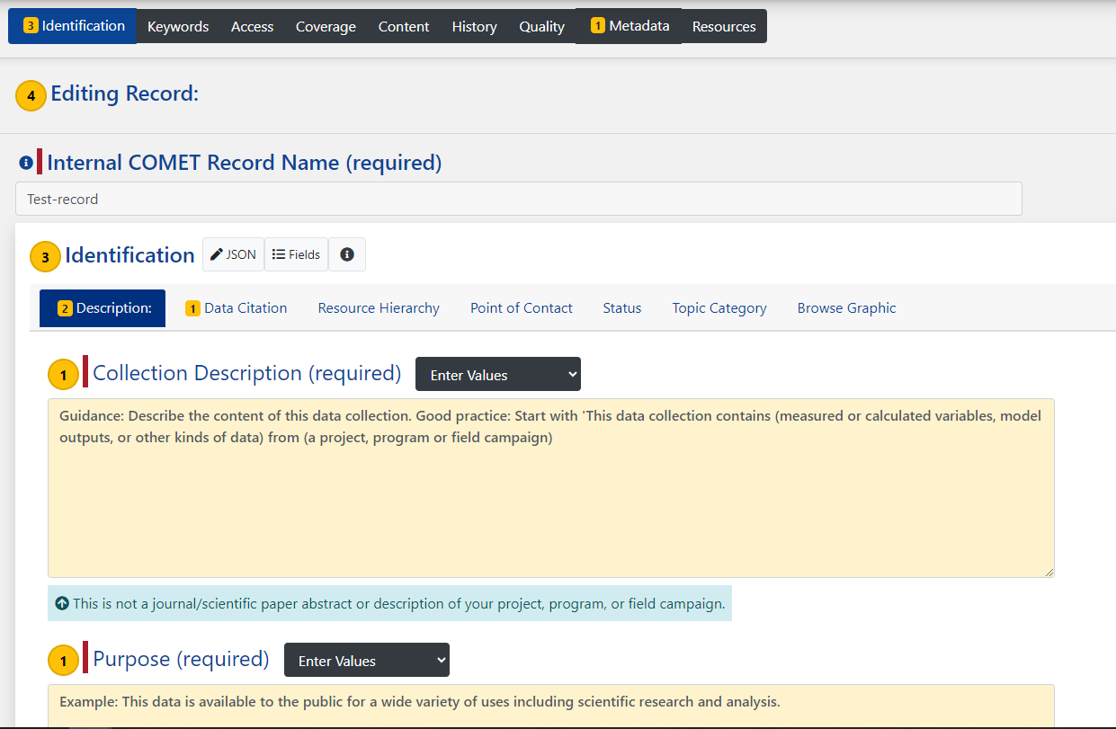
CoMET Metadata Editor
Supports ISO 19115-2 standard
Follows NOAA and NCEI guidance
Implements version control and history
Enables import of ISO components from external sources

Slide 7
Data Stewardship Maturity Matrix (DSMM)
A unified framework for measuring Stewardship Practices applied to individual digital earth sciences data products
Allows for greater stewardship quality transparency; contributes to the reproducibility of NOAA’s data products
With DSMQ scores in the metadata, can assist in machine automated selection of data fit for purpose
Developed jointly by domain experts leveraging institutional knowledge and community best practices and standards
Vetted through use case studies with diverse datasets managed by different organizations, in collaboration with NC State University, NCEI Data Stewardship Division, and U.S. and international data stewardship groups

Slide 8
CoMET DSMQ
Provides a user friendly set of questions to input and obtain maturity score for each key component and overall
User doesn’t need to understand the DSMM to answer the questions
Questionnaire covers all nine key components of the maturity model
Green “Evaluate Questionnaire” button (see next slide) provides a score for each section

Slide 9
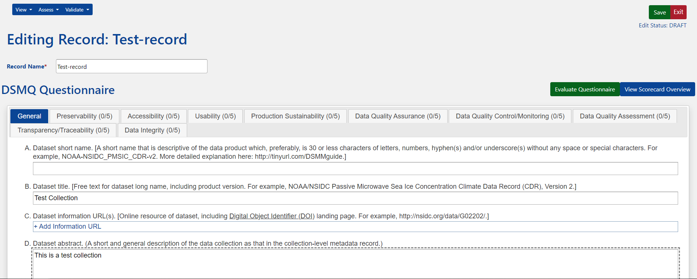
CoMET DSMQ, continued

Slide 10
DSMM Scores
In CoMET, for collections with a DSMQ, the ratings are inserted into the collection metadata record
The overall score is displayed in NOAA’s official data catalog, OneStop

Slide 11
CoMET Availability Outside NOAA
Development team has worked to enable user authentication via login.gov in our development and test environments
Working toward deployment in the on-prem production environment
Once deployed, users who do not have a noaa.gov email address will be able to access the application via login.gov
Upon initial login, CoMET will automatically create user’s ‘Personal Repository’ in which records can be created, including DSMQs

Slide 12
Migration to the Cloud
NOAA NESDIS continues making progress in migrating to NCCF
NCEI developers were asked to begin migrating the CoMET application to NCCF this past fiscal year
Application is now deployed to our cloud development environment
Timeline for cutover of the application to the cloud is still to be determined; likely 1+ years out

Slide 13
CoMET in the Cloud

Slide 14
Appendix

Slide 15
Acronyms
Term | Definition
CoMET | Collection Metadata Editing Tool, a NOAA application
DSMM | Data Stewardship Maturity Matrix
DSMQ | Data Stewardship Maturity Questionnaire
NCCF | NESDIS Common Cloud Framework
NCEI | NOAA’s National Centers for Environmental Information (part of NESDIS)
NESDIS | NOAA’s National Environmental Satellite, Data, and Information Service

