Slide 1
WGISS-58 Australian AVHRR update
Matt Paget, CSIRO
Agenda Item 4.4
WGISS-58
16-17 October 2024
Sioux Falls, South Dakota, USA

Slide 2
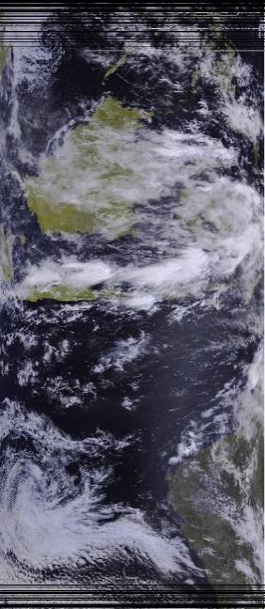
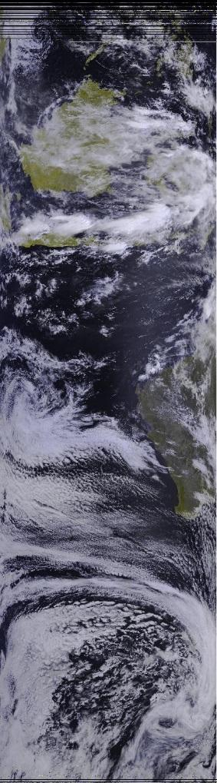
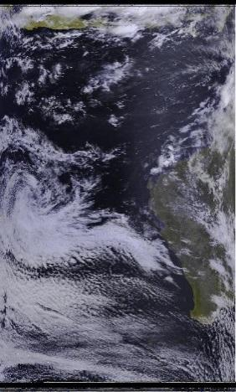
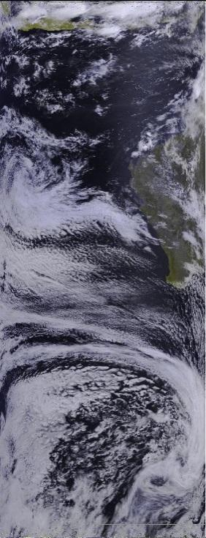
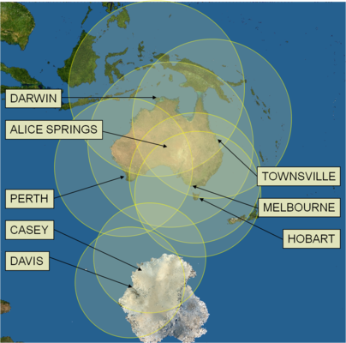
Australian AVHRR archive
Darwin
Stitched
Record goes back to 1992 April (working on recovering data back to 1983)
All passes that were acquired were kept with up to 35 stitched passes per day at times (any transmitting satellites)
Stitched 1 km HRPT geolocated, calibrated top-of-atmosphere reflectances and brightness temperatures
Alice Springs
Perth
N17, 02:30 GMT, 2006-01-26
Data received from NOAA/POES sats (not MetOps)
For more info on AVHRR stitched contact Edward King (edward.king@csiro.au)

Slide 3
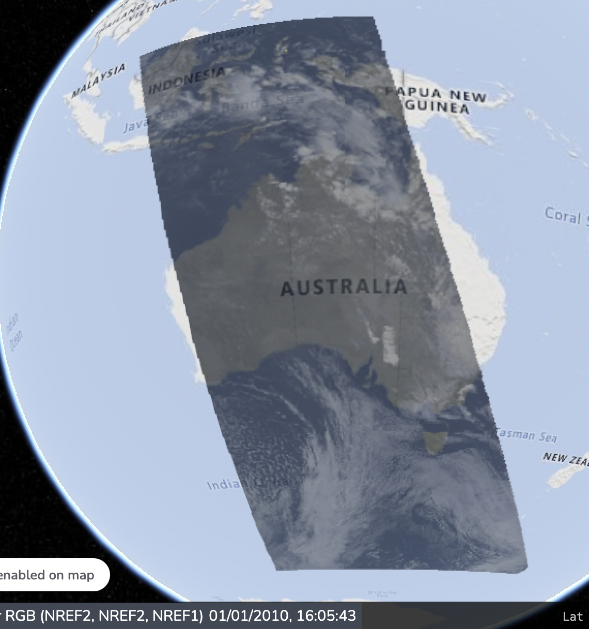
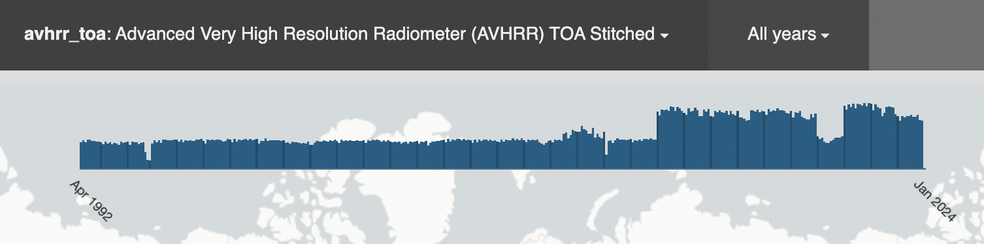
Online access to Australian TOA
Public access:
  "EASI" cloud - Scene metadata and WMS
  TERN Landscapes (forthcoming) – download
Data and analytics:
  Remapped to WGS84 COG
  "EASI" cloud (inc. ODC) – CSIRO partner login
Should we look to make these data available at CAL too?
For more info on AVHRR on EASI/ODC contact Matt Paget (matt.paget@csiro.au)
Coverage & metadata, https://explorer.csiro.easi-eo.solutions/products/avhrr_toa
Pseudo-RGB WMS, https://map.csiro.easi-eo.solutions/#share=s-a4lVkH26vFQENph5

Slide 4
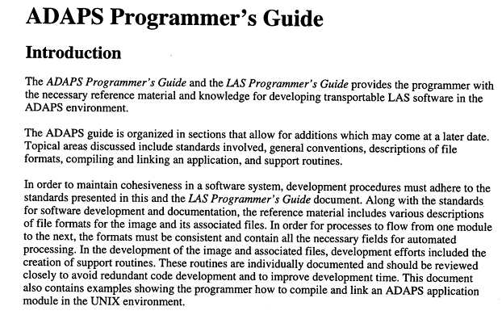
ADAPS, ARCH, AHDR formats
USGS Land Analysis System (LAS) originally targeted Landsat
Added the AVHRR Data Analysis & Processing System (ADAPS) to accommodate AVHRR processing. The *.{arch,ahdr} format arose within ADAPS
In the mid-90s LAS/ADAPS was used at CSIRO and formed the basis of the CSIRO v1 stitching system
Shared with Mirko and Iolanda (re: WGISS-57)
ADAPS documentation
C and Perl code to unpack headers
http://mrs-data.csiro.au/IN-PREP/adaps/

Slide 5
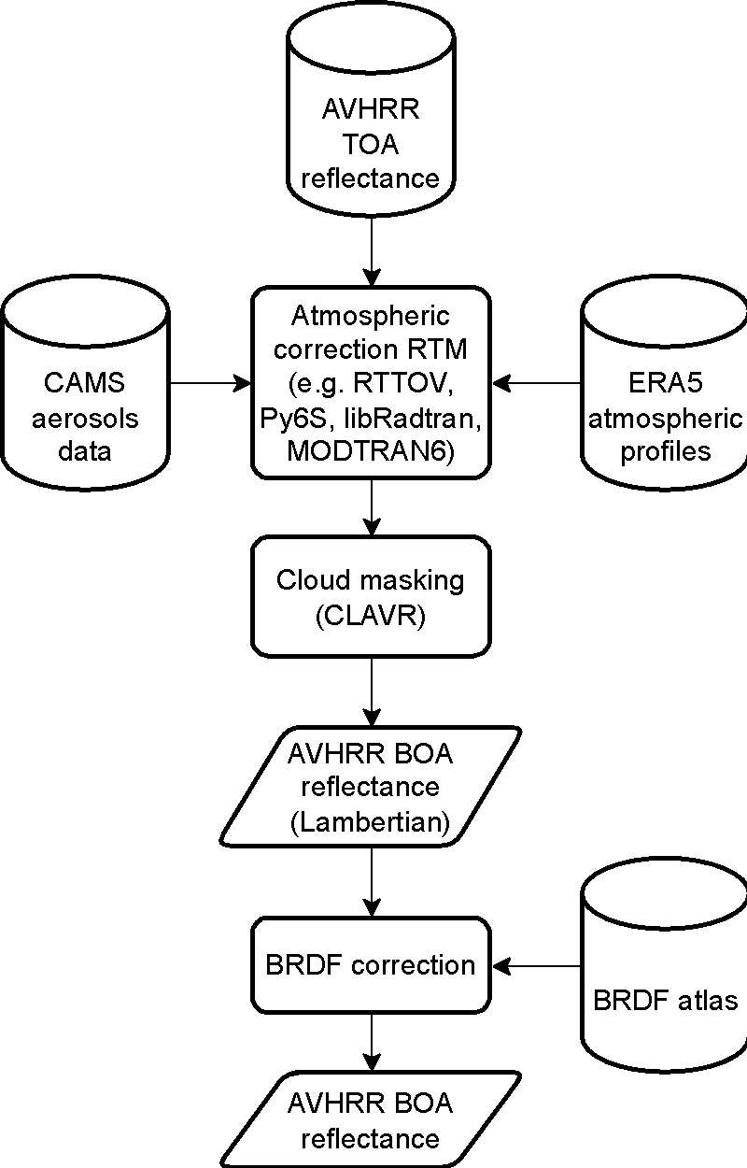
Atmospheric correction
Adopt a physics-based approach using a radiative transfer model
Modern, fast, cloud-friendly software to process at scale
Ideal to have consistent, state-of-the-art, meteorological data spanning 1992-present
Ability to simulate both thermal and solar channels
Consider BRDF effects and aerosols
Current activity:
Testing multiple at.corr. and BRDF options

Slide 6
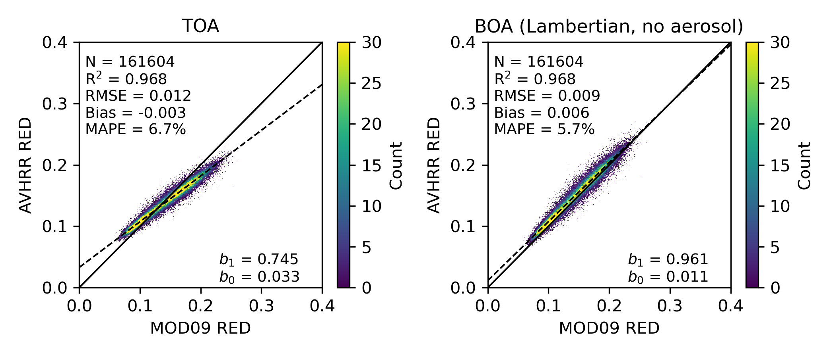
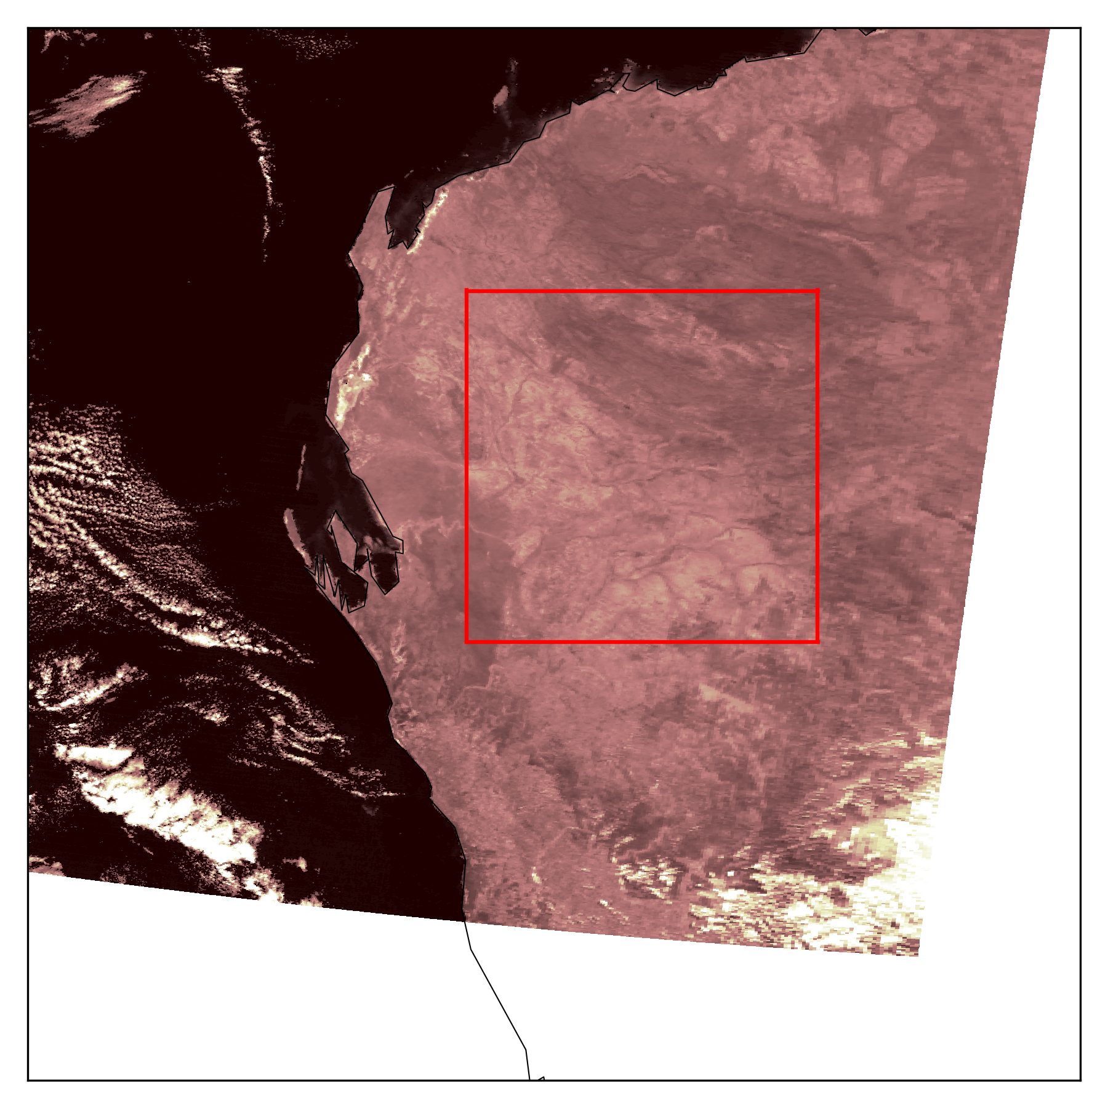
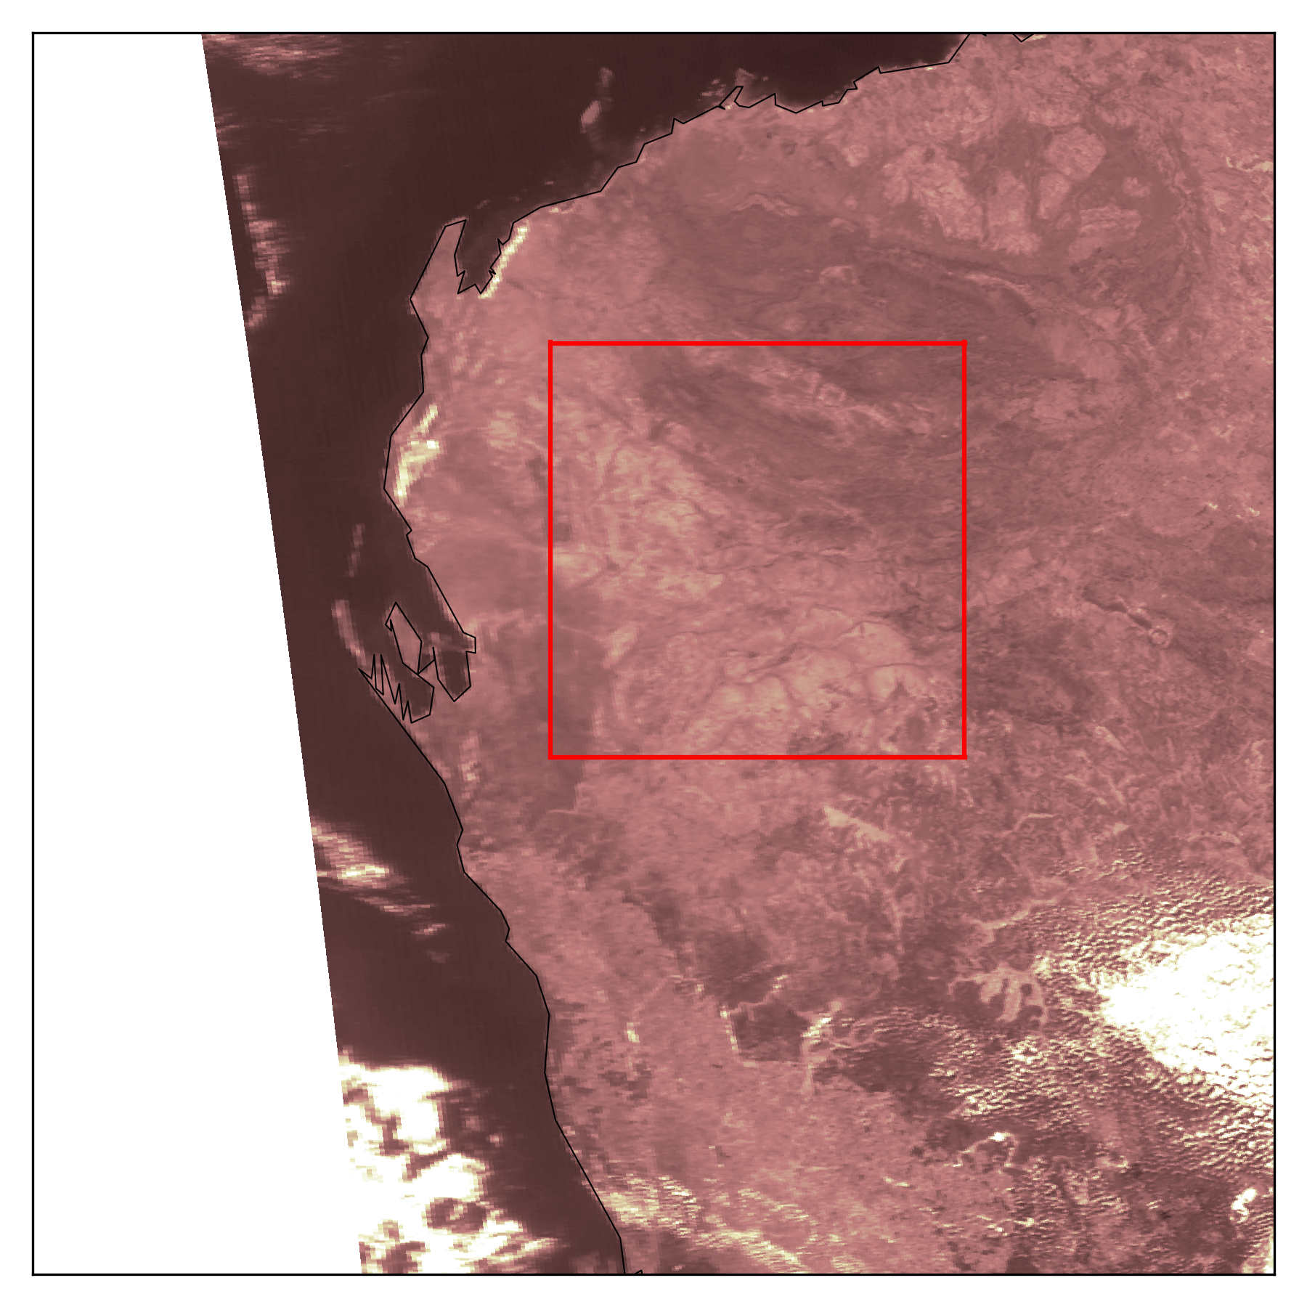
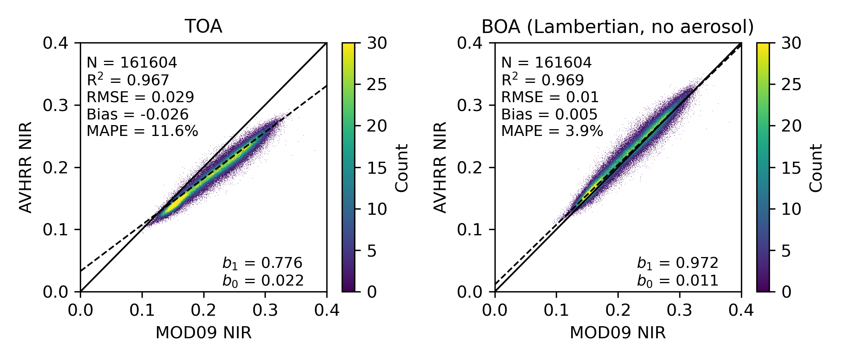
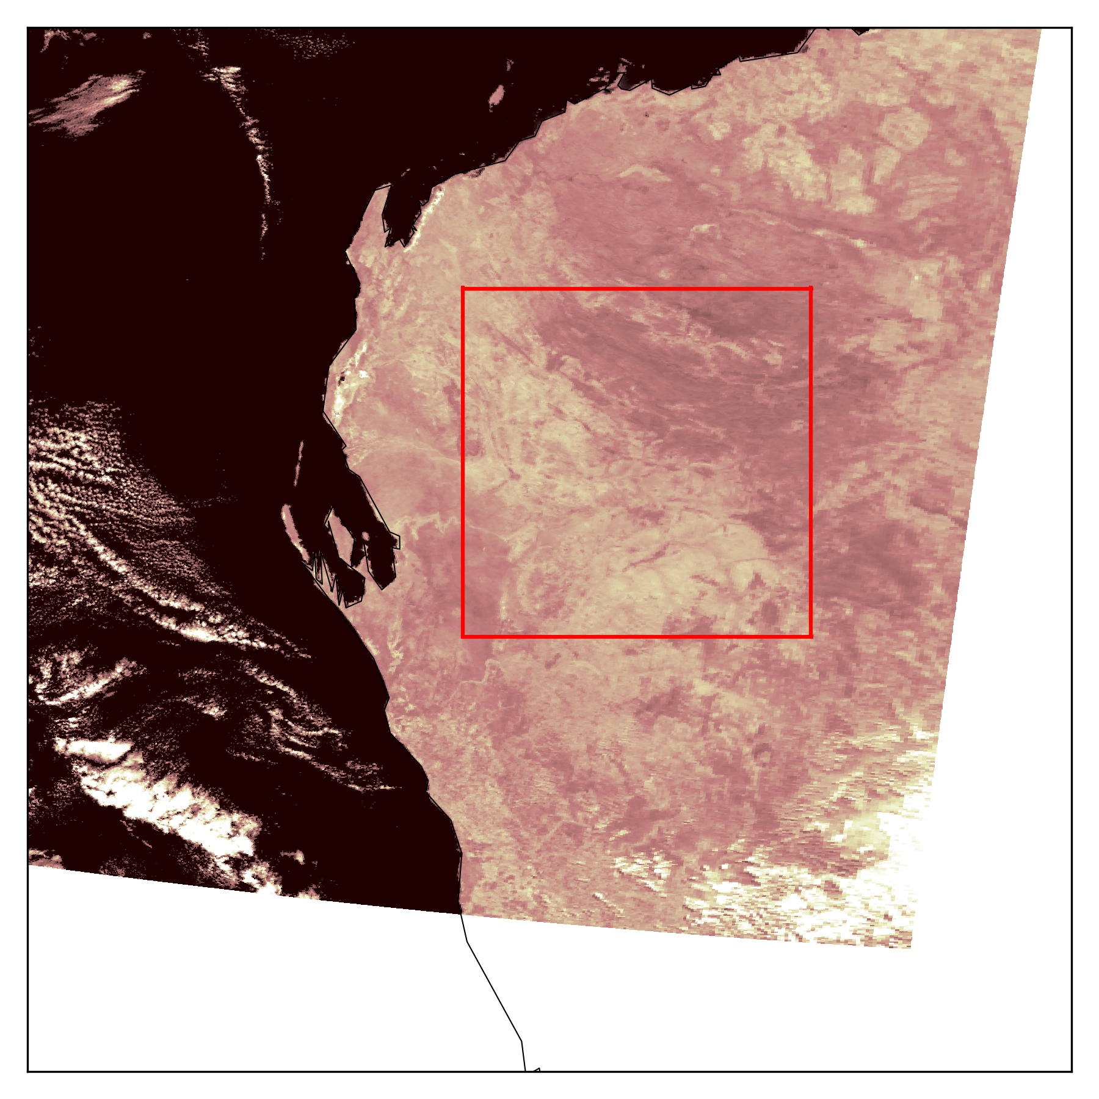
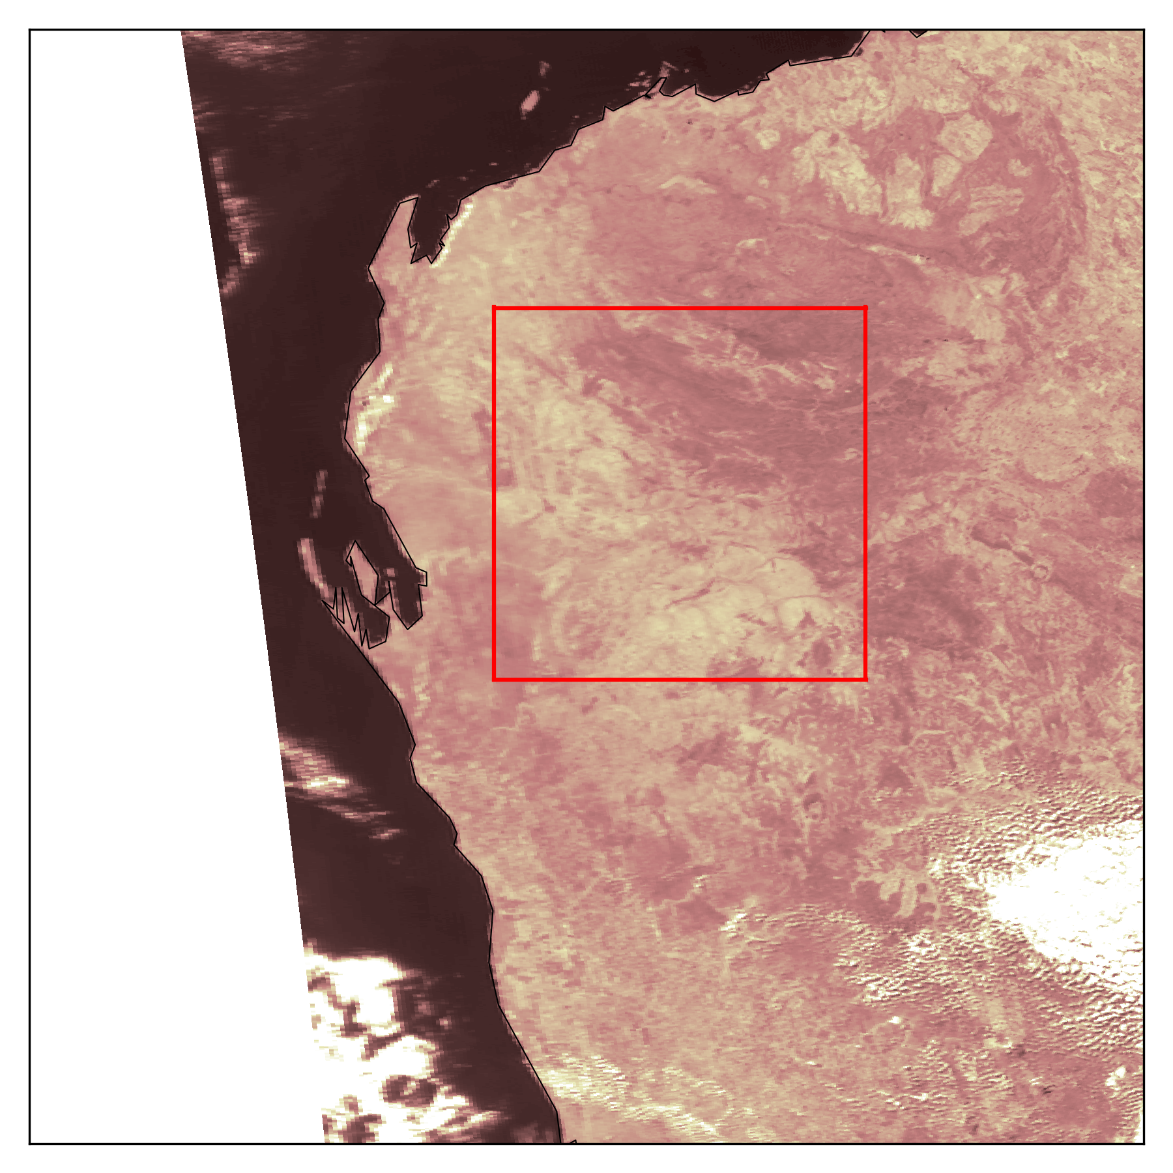
Evaluation: Compare with MOD09
MODIS (MOD09)
AVHRR BOA (RTTOV)
Processing and analysis: Andrew Prata (andrew.prata@csiro.au)
Red
* Lambertian, no aerosol
NIR
AVHRR atcorr (RTTOV) compares well with MOD09 Lambertian product

Slide 7
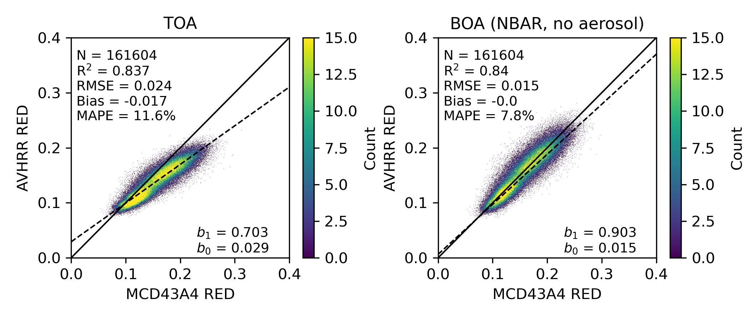
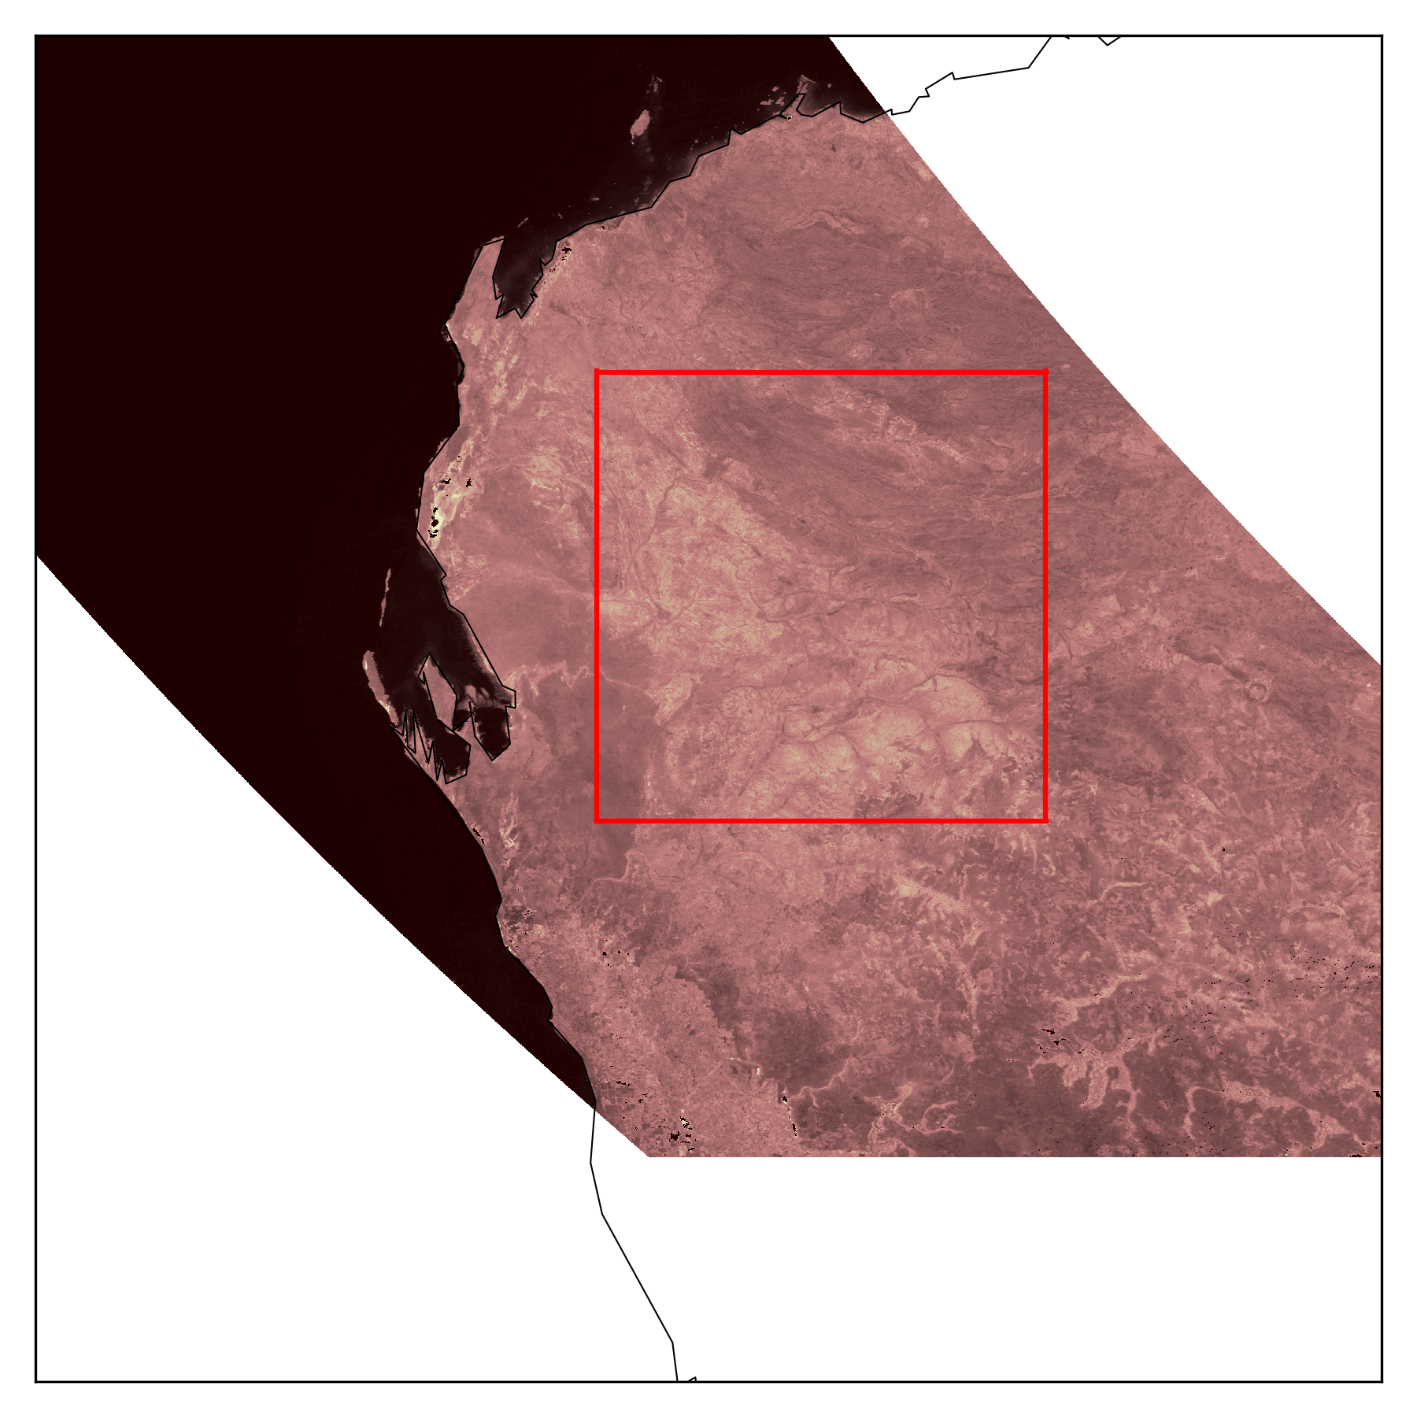
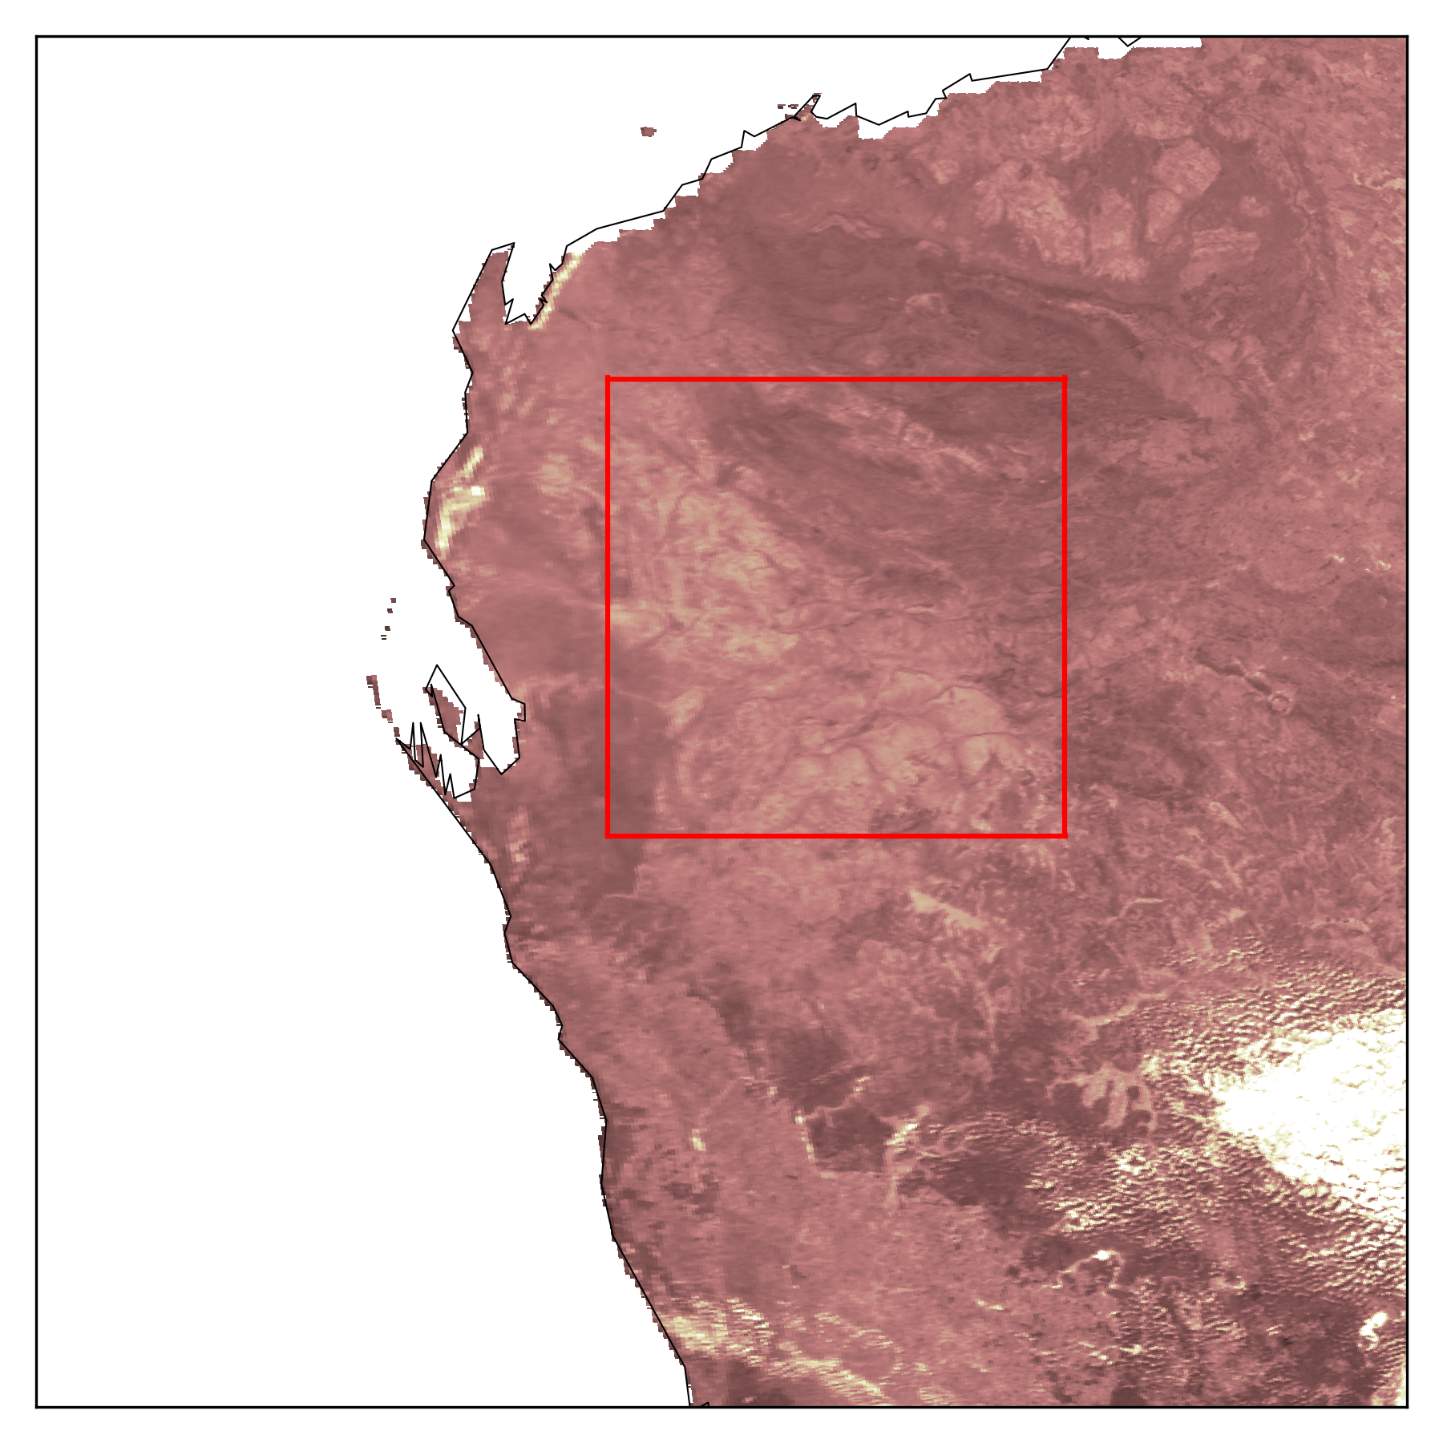
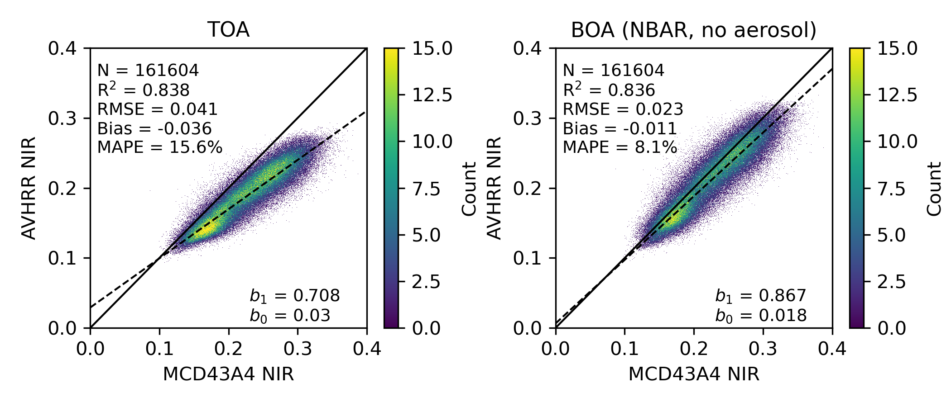
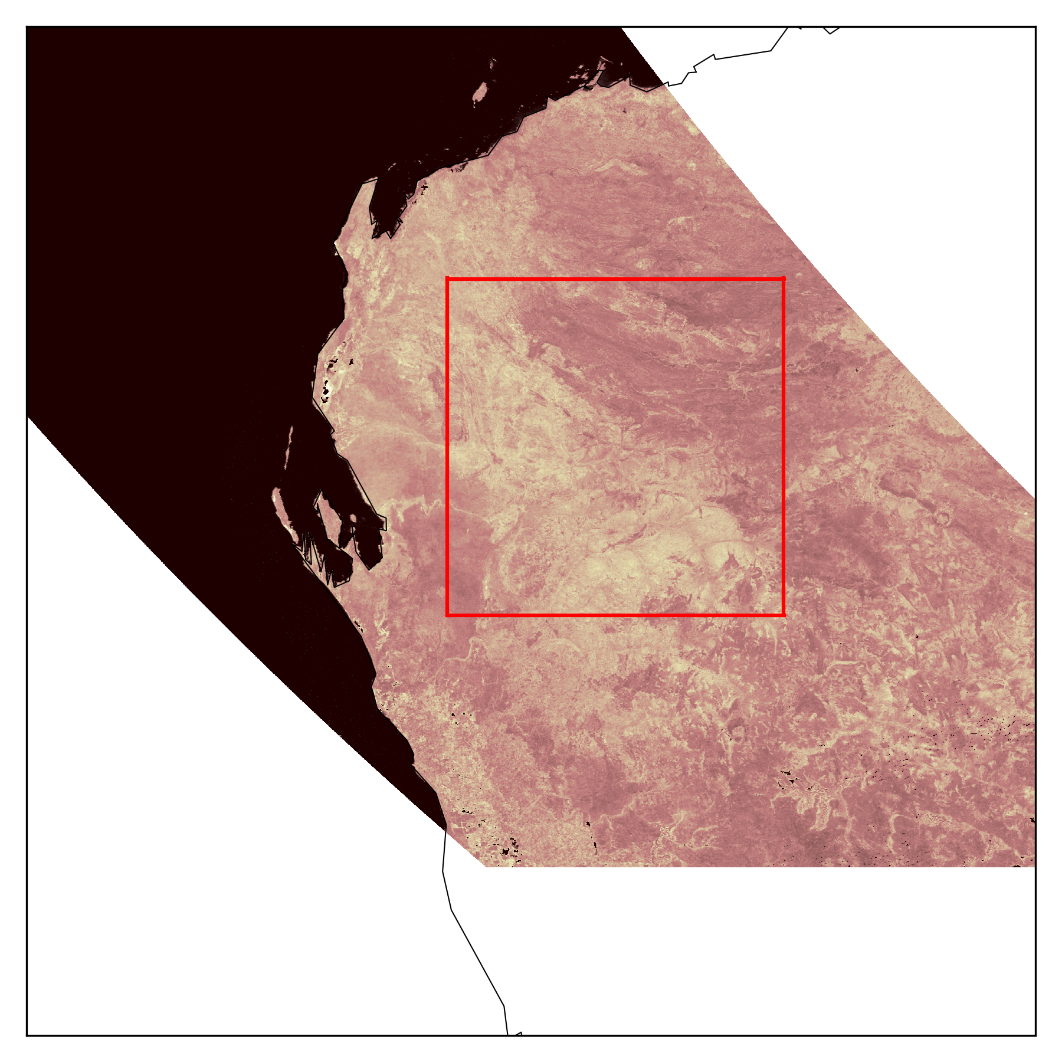
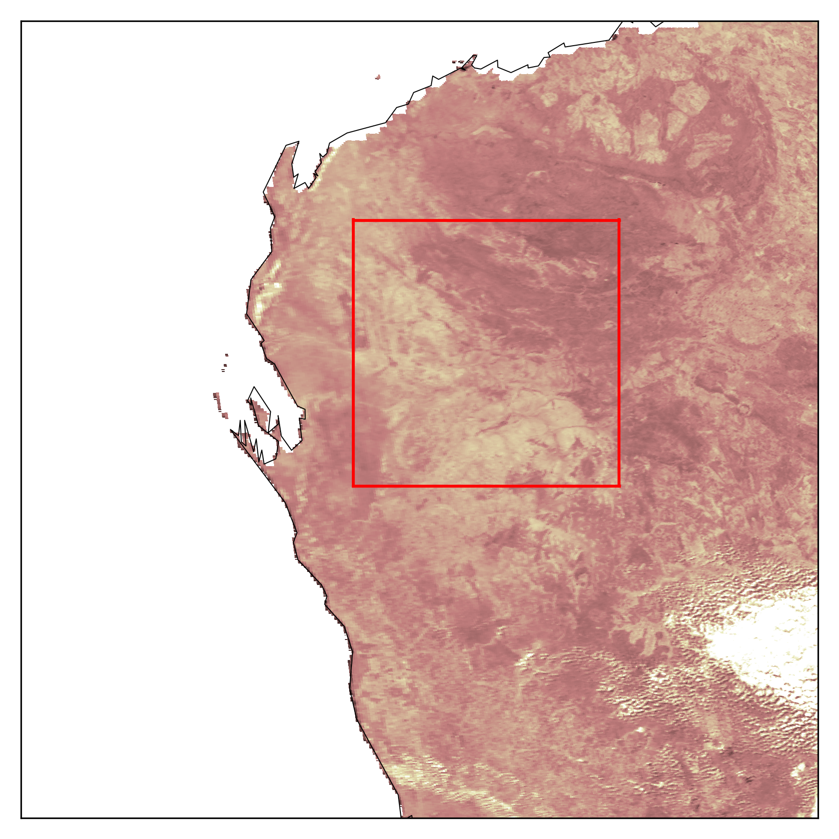
Evaluation: Compare with MCD43
MODIS (MOD09)
AVHRR NBAR (RTTOV)
Processing and analysis: Andrew Prata (andrew.prata@csiro.au)
Red
* BRDF corrected, no aerosol
NIR
AVHRR NBAR (RTTOV) compares well with MCD43A4 NBAR product

Slide 8
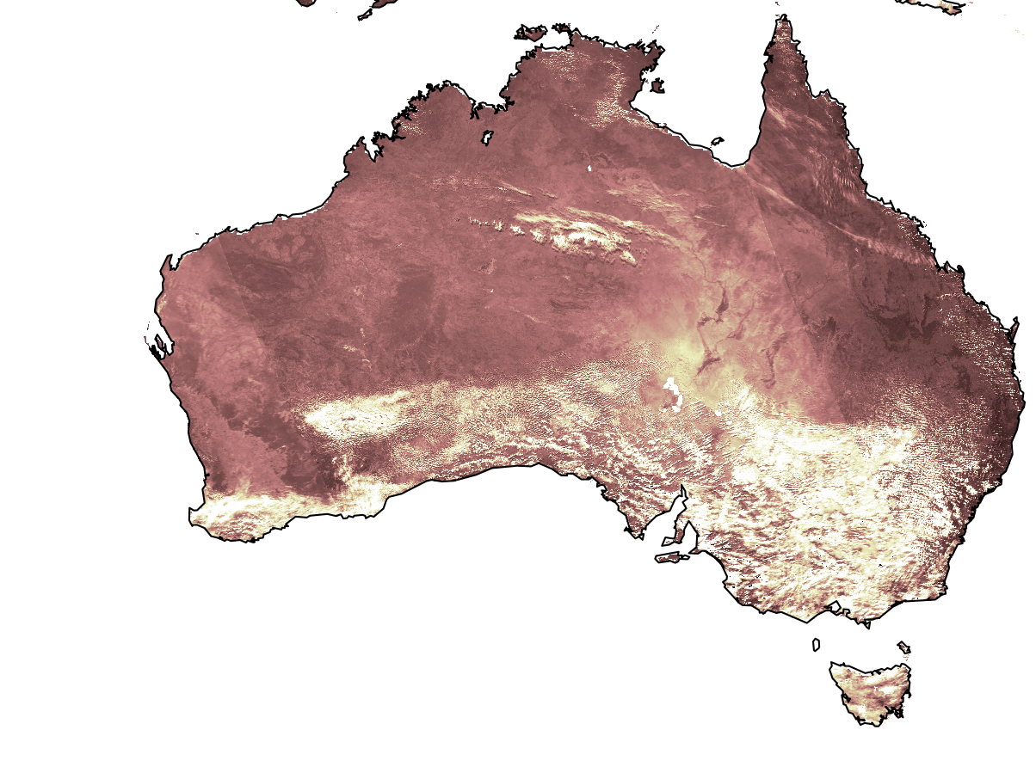
Summary
AVHRR atmospheric correction and BRDF
Lambertian (+aerosols) and BRDF atcorr implemented with RTTOV
Encouraging preliminary results for comparison against MOD09 and MCD43A4
… next steps
Evaluate RTTOV approach with other methods (e.g., 6SV/MODTRAN6, CLAVR cloud masking, CAMS aerosol dataset)
Quantify uncertainty in the retrieved SR
Account for stratospheric aerosols (Pinatubo)
At.Corr. thermal channels over land
Consider at.corr. over ocean (solar and thermal channels)
Data management and processing
Share ADAPS documentation and code
… next steps
Demonstrate time series analyses with notebooks
Add ARD metadata and submit for assessment
Make available in CAL
Extract what we can from the pre-1992 acquisitions

Slide 9









Acknowledgements
Present Effort
Australian National Collaborative Research Infrastructure
  Terrestrial Ecosystem Research Network (TERN)
  Integrated Marine Observing System (IMOS)
CSIRO Environment
Honorary mention: Simon Pinnock (ESA)
40 years of data collection (ongoing)
CSIRO (several Divisions/Units)
Australian Bureau of Meteorology
Geoscience Australia
Australian Institute of Marine Science
Landgate (Western Australia)
Australian Universities (several)
Many colleagues – mostly retired

