Slide 1
WGISS-58 AVHRR Data Recovery Project Updates
M.Albani, ESA
Agenda Item 4.1
WGISS-58
16-17 October 2024
Sioux Falls, South Dakota, USA

Slide 2
AVHRR a unique long time data series
AVHRR data available as GAC (4 km) or LAC (1km). 1-km AVHRR LAC data gives new insights on structural changes on land in comparison of coarse resolution AVHRR GAC data.
GAC DATASETS
NOAA POES AVHRR GAC global archive: 1978 onwards
LAC DATASETS
EUMETSAT MetOp AVHRR 1km FRAC global archive: March 2008 onwards
Global Land 1-km AVHRR data set covering the period 1992-99 “1Km project”
Many national / regional data archives of LAC data around the world covering a longer period with high value for the retrieval of ECVs. Some of them accessible to users, others not due to unknown accessibility, responsibility, data format and structure.

Slide 3
AVHRR 1 Km digital data archives (excerpt)
Europe: ESA & University of Bern (Switzerland), STFC CEDA (UK, including Dundee Satellite Receiving Station), MeteoFrance (France), DLR (Germany), METoffice (UK), IGiK (Poland);
Americas: NOAA and USGS (USA), NRCan/CCMEO (Canada), GiDyC-Servicio Meteorológico Nacional (Argentina), INPE (Brazil);
Africa: SANSA (South Africa), ASI / University of Rome (Kenya);
Asia: CMA (China), IRIM (Mongolia), GITSDA (Thailand), Jaxa (Japan), ISRO (India);
Australia: CSIRO.
Datasets from Meteorological Institutes, Universities and other organizations all over the globe
Fundamental to ensure accessibility of 1-km LAC data from all available sources (in particular in the period before 2008)

Slide 4
Cooperation Activities on AVHRR
Objective: Build a worldwide coverage AVHRR LAC data series from 1978 onwards
Unfolding and making accessible 1km AVHRR data from regional archives (possibly open and free);
Transcribing unique data from heritage media;
Identifying a common format for AVHRR Level-1b and Level-1c data and pursuing (re)processing from AVHRR data owners/holders and data accessibility;
Facilitating data discovery through the WGISS Connected Data Assets Infrastructure.

Slide 5

WGISS
Committee on Earth Observation Satellites
AVHRR Global Land 1km Dataset

Slide 6
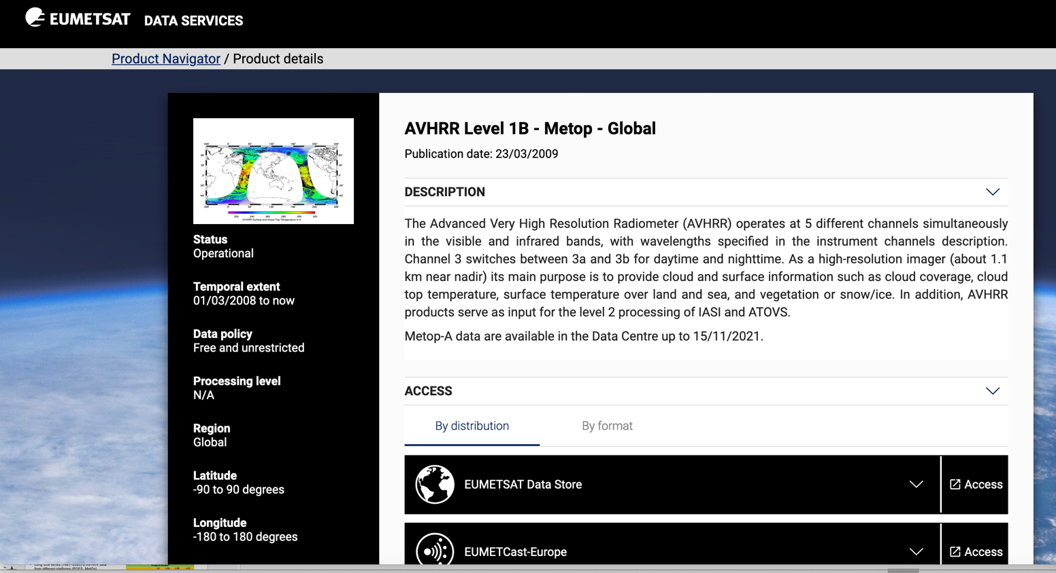
Global 1km AVHRR dataset 2008 - today
Metop satellites operated by EUMETSAT
Temporal extent: 01/03/2008 to today
Level-1b data
Open and Free

Slide 7
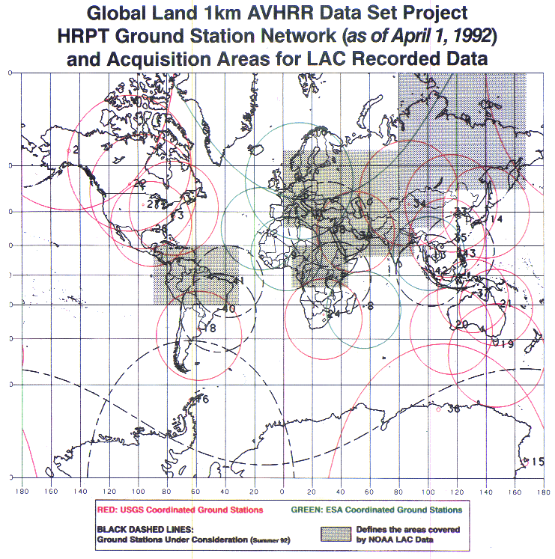
Global 1km AVHRR dataset 1992-1999
Two different global Land 1-km AVHRR datasets covering the period 1992-1999 are available at ESA :
Data acquired at ESA network stations (Terranova, Nairobi, Manila, etc..) were processed up to L1C and published in the ESA web page as dataset Out-of-Europe.
Data in stitched format (.arch files) from USGS network stations not accessible at USGS/NOAA and not processable at ESA due to unknown data format.
Support received from CSIRO (email exchange) on data format and names of reading tools/processors:
Recently digitised old documentation retrieved at ESA with description of stitched product format (.arch files).
Stitched product reader tool also retrieved at ESA.
Software converter from stitched format to HRPT files is under development.
Next Steps: conversion, full processing into level-1B and Level-1C, open access to users.
AVHRR receiving stations contributing to global land 1km AVHRR data set. (https://lta.cr.usgs.gov/1km/hrpt_image)
Products Number*
 | L0 | L1A | L1B | L1C
1Km-Project (out of Europe) |  | 3901 | 3901 | 2991
* No L0 available.

Slide 8
WGISS
Committee on Earth Observation Satellites
AVHRR Regional LAC Archives

Slide 9
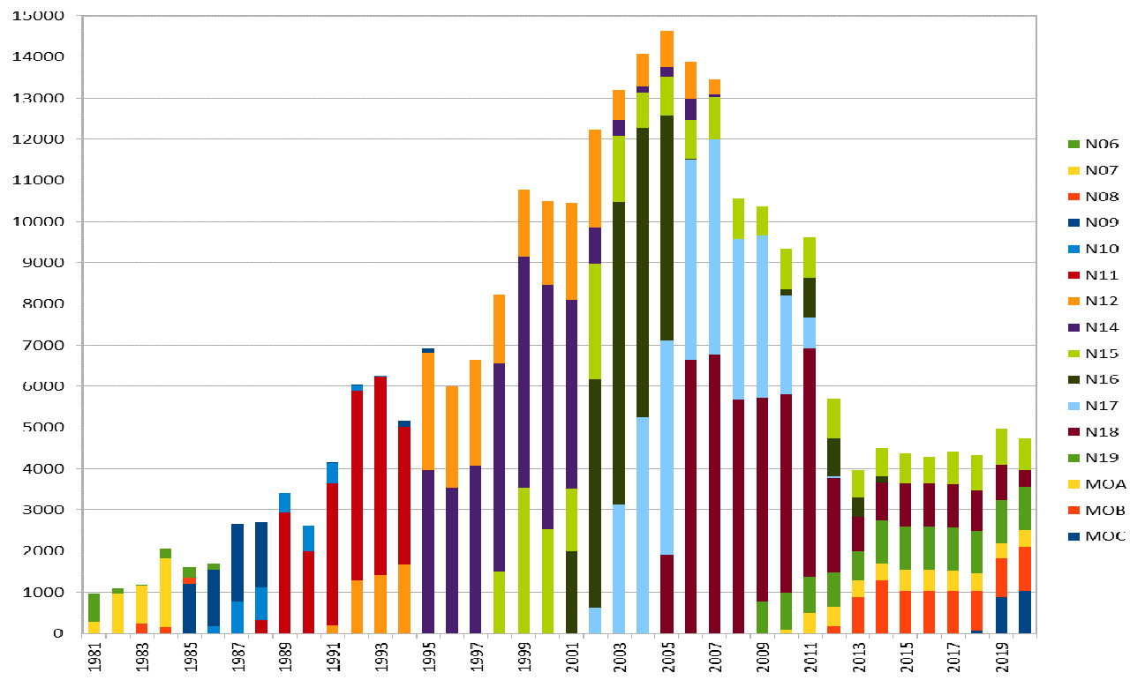
Europe – ESA & University of Bern
Long time series (1981–2020) of AVHRR data from different platforms (POES, MetOp)
Unique source to retrieve Essential Climate Variables (ECV) to investigate climate change over last 40 years.
Products Number*
 | L0 | L1A | L1B | L1C
Europe | 145231 | 259747 | 260060 | 259164
*The L0, L1A and L1B input data are scattered.
European dataset includes data from University of Bern, Dundee Station and ESA holdings: 260.000 products. harmonized and consolidated through a dedicated ESA project (Heritage Space Programme).
All data accessible free of charge via ESA dissemination services and safely archived at ESA.
Processing to Level-1c completed, data will be opened to users in Oct’24.
Presentation at WGISS#56

Slide 10
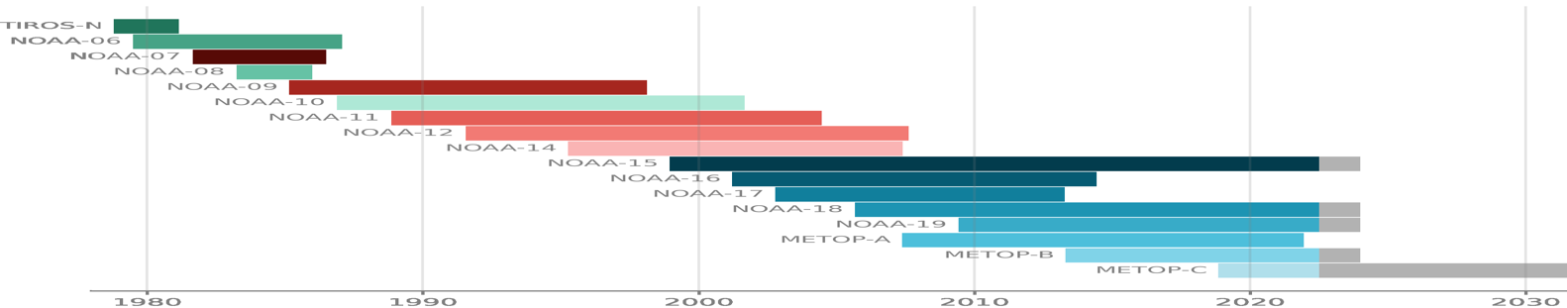
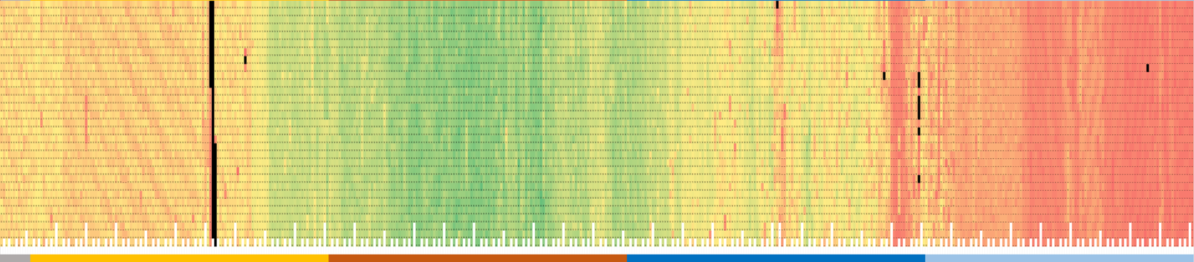
Europe - ESA Data temporal coverage
1980
1990
2000
2010
2020
D
A
Y
of
M
O
N
T
h
31
1
Missing data
Metadata extracted from ESA L1C products to build a heat chart on data acquisition frequency per day:
  min value: 1
  max value: 50
  Missing data: black
Data gap will be closed getting missing products from other sources

Slide 11
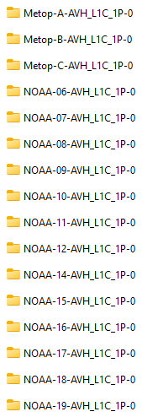
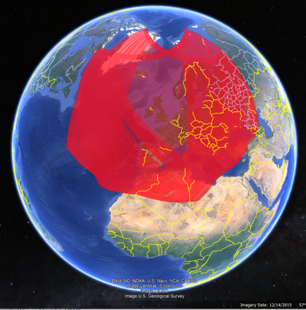

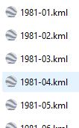
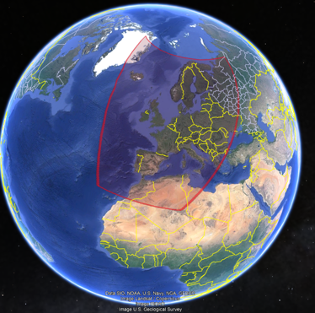
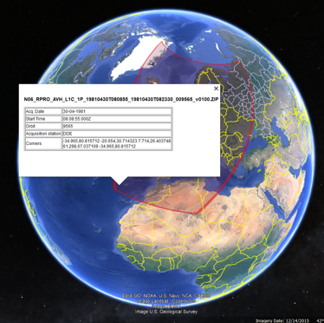
Metadata extracted from ESA L1C products
Built a KML file for each mission, year and month;
Each pass can be selected with metadata

Slide 12

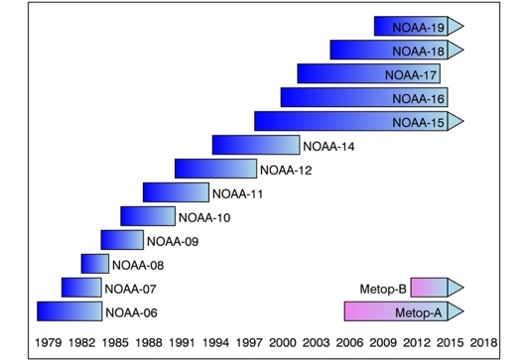




FDR for Advanced Very-High-Resolution Radiometer instrument (FDR4AVHRR)
  New project started in Q1/2024:
  Reprocessing AVHRR series LAC products (NOAA & MetOp missions) 40+ years of length 🡪 climate record;
  Generating innovative Earth system data records;
    FDRs for TIR and VNIR channels mainly over Europe +
    Cross-mission calibrated AVHRR FDR dataset at 1km spatial resolution for all channels;
    Generating dataset including new modules for improved geocoding / orthorectification, error propagation and accurate uncertainty estimates in the calibration module with related documentation;
    Extending ESA 2020 AVHRR European Data Set Version 1.0: 1) with data beyond 2020 over Europe; 2) adding data covering Greenland and northers areas; 3) adding selected regions across the world (Argentina, Kenya, South Africa, etc…)
FDR4AVHRR
Presentation at WGISS#57 and #58

Slide 13
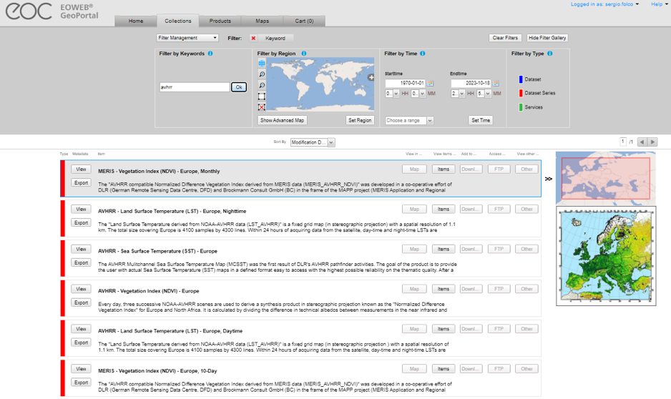
Europe – DLR
Four AVHRR datasets over Europe (N14,N16,N17,N18,N19) available in the DLR catalogue:
  AVHRR - Land Surface Temperature (LST) - Europe, Nighttime;
  AVHRR - Sea Surface Temperature (SST) - Europe;
  AVHRR - Vegetation Index (NDVI) - Europe;
  AVHRR - Land Surface Temperature (LST) - Europe, Daytime.
High redundancy with ESA dataset; not clear if L0 data available at DLR.
Presentation at WGISS#57

Slide 14
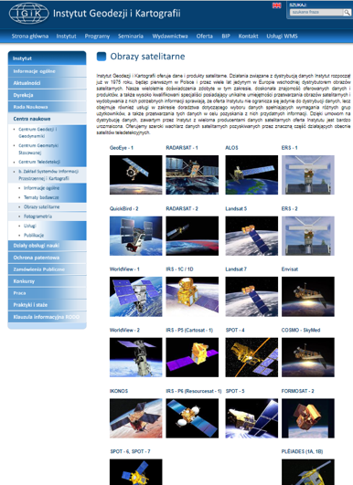
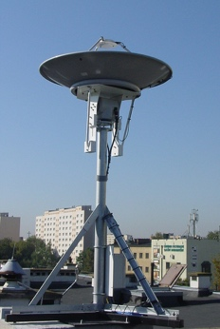
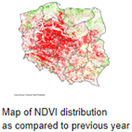
Europe – IGIK (Poland)
Polish Institute of Geodesy and Cartography.
Department of Remote Sensing maintains a database of satellite images and products derived from NOAA satellites since 1996 and used for agriculture studies
The receiving station recorded data in HRPT, SeaWiFS (and other formats) from NOAA, Seastar, Metop and NPOESS polar-orbiting satellites.
AVHRR products are not accessible from the web site.
Point of contact:
Dr. Dariusz Dukaczewski (dariusz.dukaczewski@igik.edu.pl)
Dr. Jan Musial (jan.musial@igik.edu.pl)
ESA contacted the IGIK point of contact in 2023 and 2024, still waiting for feedback.

Slide 15
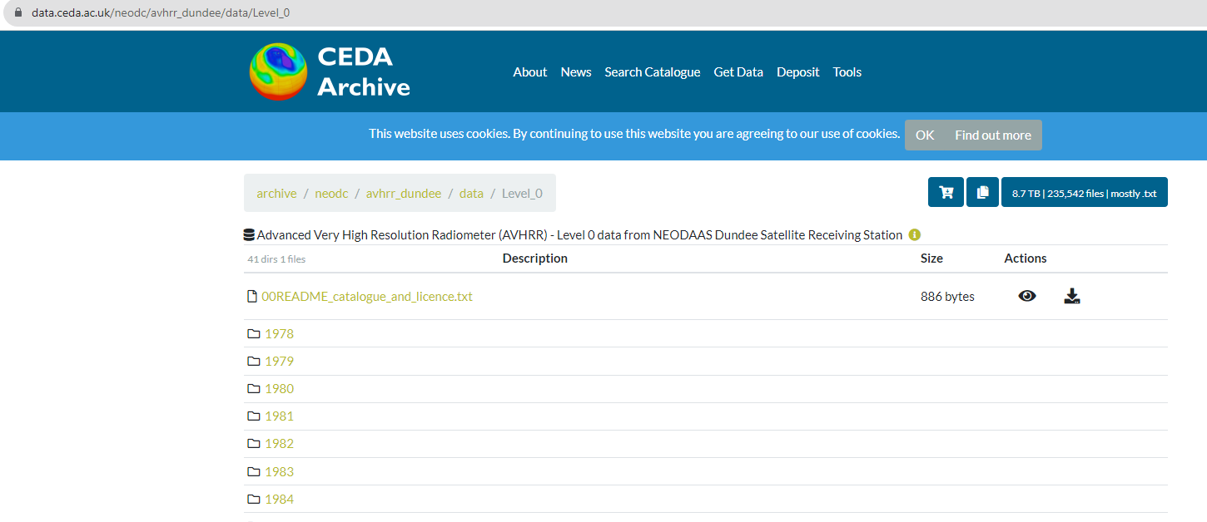
Europe – Dundee Station data at CEDA
1978 – 2018 AVHRR L0 data available with free and open access.
ESA has downloaded the full Dundee NOAA L0 products (8.9TB and 235541 L0 products). ESA partially reprocessed this level 0 dataset (AVHRR Data Curation Project) to extend the European Master Dataset to the early 80’s. 🡪 Credits already provided to Dundee
Other data will be integrated to further extend geographical coverage towards Greenland and extend in time back to 1978
Presentation at WGISS#56

Slide 16
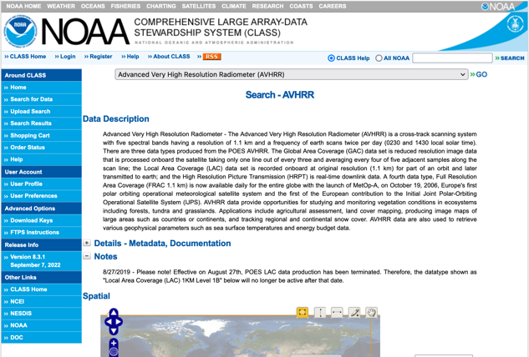
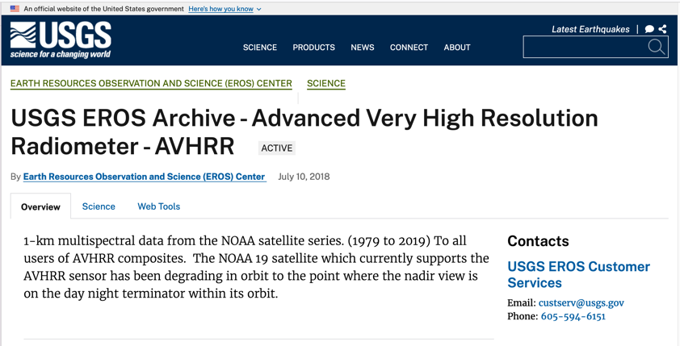
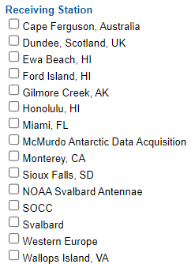
North America – NOAA & USGS
NOAA presentation at WGISS#55
Next Steps: USGS will be invited to make a presentation at WGISS#59

Slide 17
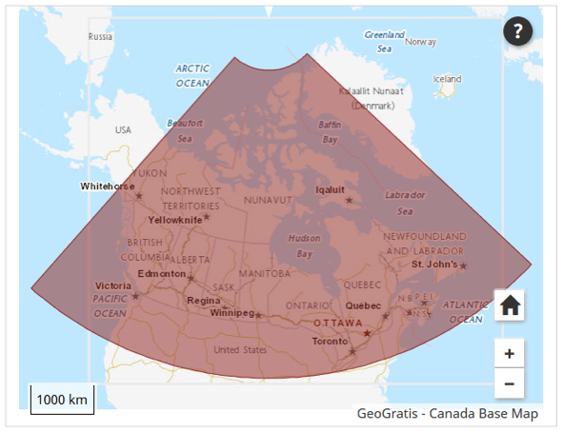
Canada – NRCan/CCMEO (1/2)
1981 – 2013 (+ AVHRR L1B LAC/HRPT received after that date); L1C at CCMEO
These are open source data covered by WMO CGMS data distribution policy, they can be shared freely and without charge
The Canadian sector is of high value to analyze changes of the environment.
The former developed pre-processing and retrieval of ECVs by A. Trishchenko and K.Klopenkov was of high quality and the standard for many other AVHRR processing chains.
Further development and processing was stopped some years ago but raw AVHRR data are available by NRCan.
https://open.canada.ca/data/en/dataset/9045136a-d6e7-a825-491d-ee5dc77a2620
.

Slide 18

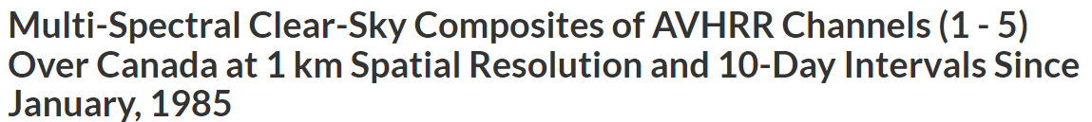
Next Steps: NRCan/CCMEO will be invited to make a presentation at WGISS#59

Slide 19
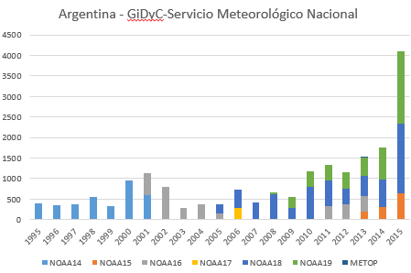
Argentina - GiDyC-Servicio Meteorológico Nacional
Initial products Metadata
Source: Jefa Departamento Teledetección Y Aplicaciones Ambientales, GiDyC-Servicio Meteorológico Nacional, Buenos Aires, Argentina
Number of products: 19360
Volume size: 740GB
Satellites: N14, N15, N16, N17, N18, MetopA/B
Time Period: 1995 – 2015
Extent: roughly Lat=[-30,15] Lon=[-60,-15]
Format: QUO (HRPT)
Downloaded products metadata*:
Number of products: 25504
Volume size: 1.02 TB
Time Period: 1995-2017
Format: .rar, .quo, .WI
Data transfer to ESA is on-going. Downloading was stopped in April 2024 to upload new data in the GiDyC servers, restarted in October.
Next steps: complete transfer, full processing into level-1B and Level-1C, open access to users.

Slide 20
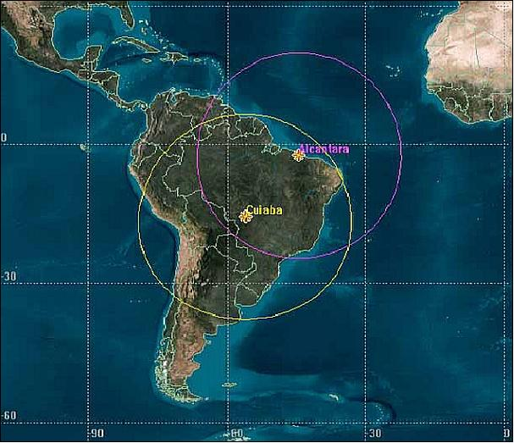
Brazil - INPE
Satellites: METOP-A, METOP-B, N12, N14, N15, N16, N17, N18, N19,
Number of L0/L1A : 287325
Volume size < 18TB
Time Period: 1998 - 2024
Extent: Brazil
Format: HRPT and others
METOP-B | May 2013-Ma-2024 | HRPT | 29237
METOP-C | Dec 2019-Mar 2024 | HRPT | 7924
NOAA_12 | Aug 1998-Aug 2007 | HRPT | 16333
NOAA_14 | Aug 1998-Jun 2007 | HRPT | 10976
NOAA_15 | Jul 2001-Aug 2019 | HRPT | 36816
NOAA_16 | Aug 2001-Dec 2014 | HRPT | 20692
NOAA_17 | Jan 2003 - Mar 2013 | HRPT | 24575
NOAA_18 | May 2005 – Mar 2024 | HRPT | 52626
NOAA_19 | Jan 2012 - Mar 2024 | HRPT | 39791
S1* | --- | Unknown | 48355
Data transfer to ESA completed.
Next Steps: full processing into level-1B and Level-1C, open access to users.
* The S1* files are under investigation because they could be single data/calibration for channel.

Slide 21
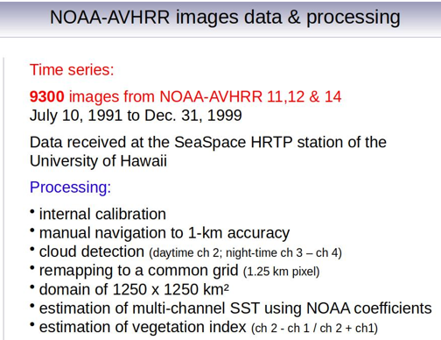
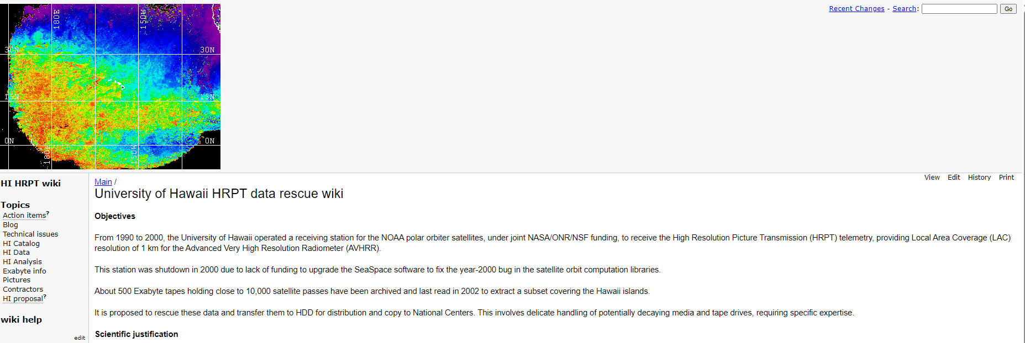
Hawaii – University of Hawaii
An AVHRR dataset was acquired at the Hawaii University between 1990 and 2000. Data are still on Exabyte tapes, some were extracted covering the islands but accessibility not clear.
All exabyte tapes and hardware were shipped to ESA/ESRIN.
Transcription chain is being assembled.
The ESRIN laboratory is manufacturing a special device to roll/unroll the tapes at very slow speed and clean the tape surface from moisture.
Next steps: transcription, full processing into level-1B and Level-1C, open access to users.
Metadata from the website

Slide 22
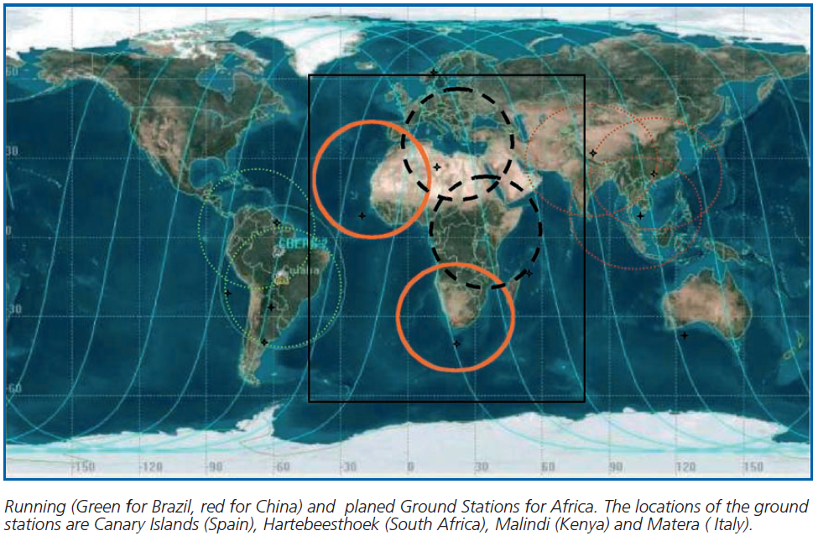
African Coverage
The combination of AVHRR data acquired in Maspalomas (Spain), Matera (Italy), Cairo (Egypt), Niamey (Niger), Hartebeesthoek (South Africa) and Malindi/Nairobi (Kenya) can provide full coverage of Africa;

Slide 23
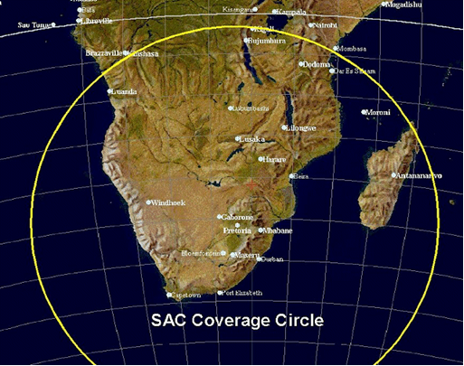
South Africa - SANSA
1km NOAA AVHRR data received at Hartebeesthoek, South Africa (25°53' S 027°42’ E) and maintained by SAC/SANSA – South African National Space Agency
NOAA 9 | 1985-1987
NOAA 11 | 1989-1993
NOAA 14 | 1995-2001
NOAA 16 | 2001-2005
NOAA 17 | 2005-2010
NOAA 18 | 2005-2009
Number of products: 7684
Volume size: 464GB
Data transfer to ESA completed.
Next steps: full processing into level-1B and Level-1C, open access to users.

Slide 24
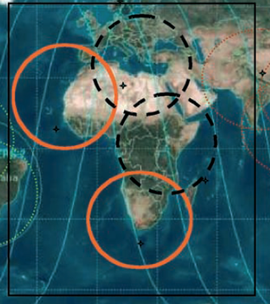
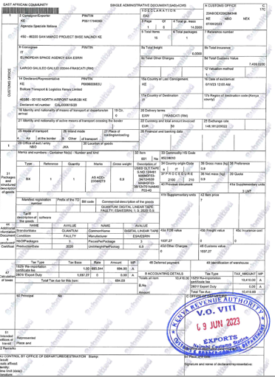
Central Africa (Kenya) - ASI/UniRoma
Data acquired at the Malindi station in Kenya from 2001 to 2009 and stored on 44 DLT tapes.
8452 products in L1B sharp format.
Volume: 614 GB
ESA transcribed the DLTs content successfully.
Next steps: complete transfer, full processing into level-1B and Level-1C, open access to users.

Slide 25

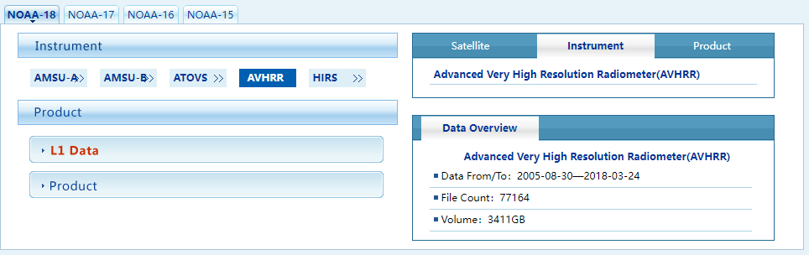
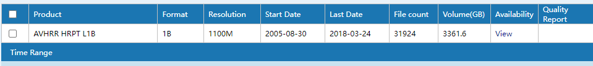
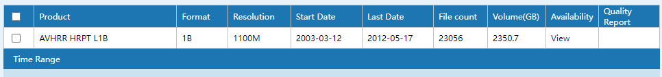
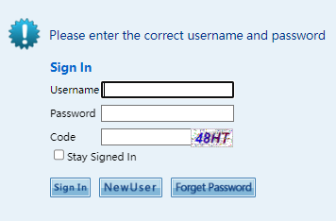
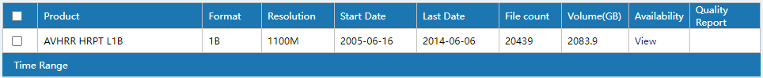
China – CMA/NSMC
AVHRR-receiving stations for global 1km land product (coordinated by USGS): Beijing, Urumqi, Guanzhou
AVHRR 1-km data covering Himalaya-Hindukush of the period 1981 – 1992 would be of exceptional value
http://satellite.nsmc.org.cn/PortalSite/Data/Satellite.aspx
Sent request for accessing the data download data area.
Next Steps: CMA will be contacted and invited to make a presentation at WGISS-59.
NO-15 AVHRR data not found

Slide 26
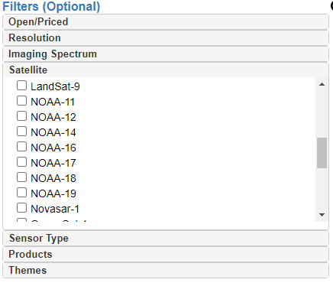
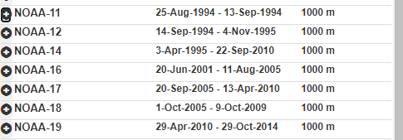
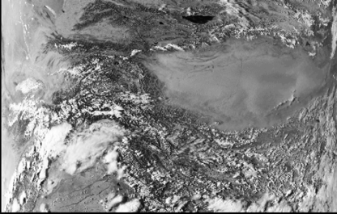
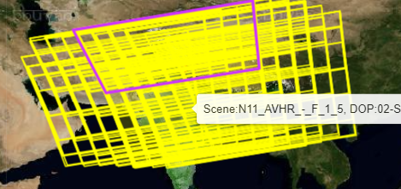
India - ISRO
https://bhoonidhi.nrsc.gov.in/bhoonidhi/index.html
Presentation at WGISS#57
Example over Hymalaya region
NOAA products are open-data and, after user registration, the products are downloadable.
No products number or volume can be extracted from the web site.

Slide 27
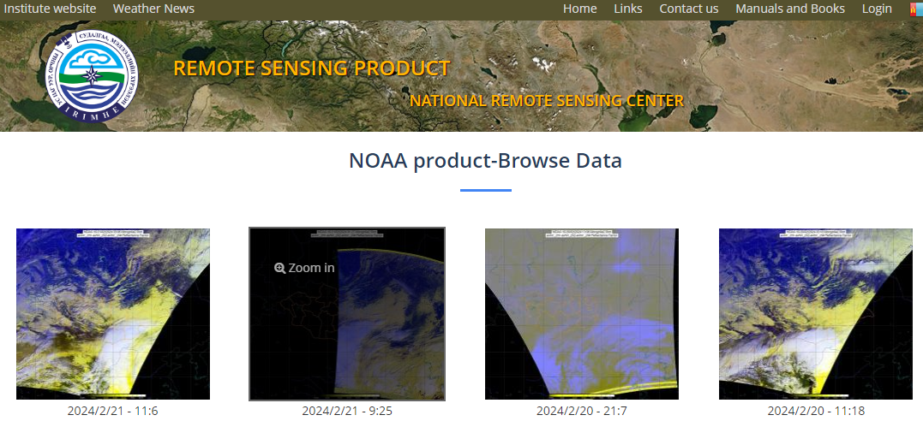
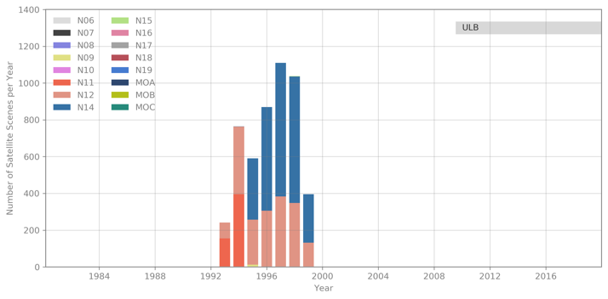
Mongolia - Remote Sensing Department, Information and Research Institute of Meteorology, Hydrology and Environment
From UniBern
AVHRR UBM data
Source: Remote Sensing Department, Information and Research Institute of Meteorology, Hydrology and Environment, Ulaanbatar, Mongolia
Number of Scenes: 5.016
Satellites: N09, N11, N12, N14, N15
Time Period: 1993 – 1999
Extent: roughly Lat=[20,70] Lon=[80,120]
Format: hmf (origin: dat, grid, lut)
Further info:- UBMx station data were included in the Global Land 1km AVHRR Data Project
Browsing the NOAA data, the acquisitions are from 01/01/2017 up to now.
Available data (raw,L1b,L1c) to download from 10/12/2023 (http://119.40.97.75:8080/thredds/catalog.html)
Next steps: The institute will be contacted to get information on data volume and status of accessibility

Slide 28
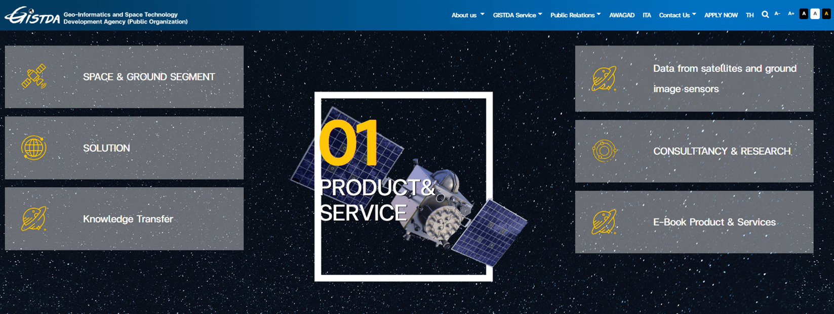
Thailand - GITSDA
GITSDA has been contacted and confirms they keep data from last six months. No further action.

Slide 29
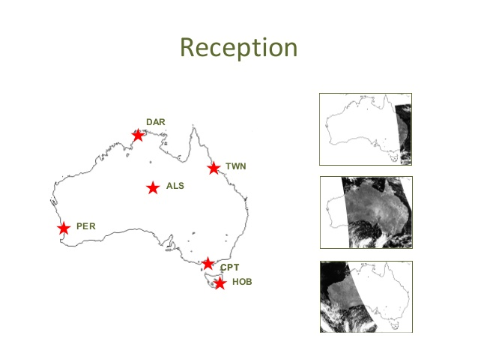
Australia – CSIRO (1/2)
AVHRR reception based on 6 stations for continuous 1-km data set.
Multiple state and federal agencies have been acquiring the data in this manner with reception stations in Hobart, Melbourne, Perth, Alice Springs, Darwin and Townsville.
Since the early 1990s CSIRO has been merging these separate local data sets to produce a stitched archive which makes use of the redundancy arising from overlap between reception stations to produce a higher quality and consistently formatted data set with national coverage.
The assembly of this data set continues within CSIRO today, though it is likely to come to an end sometime this decade as the last of the AVHRR sensors has now been launched.
Data availability: 1981 (NOAA-7) onwards.
Ian Grant, Bureau of Meteorology, Australia
https://link.fsdf.org.au/dataset/advanced-very-high-resolution-radiometer-avhrr
Presentation at WGISS#56/57/58

Slide 30
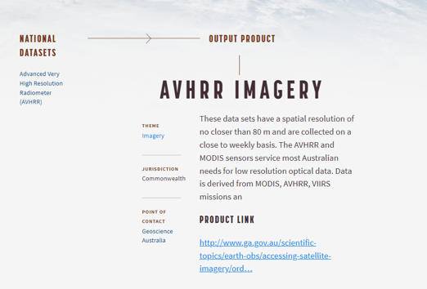
https://link.fsdf.org.au/dataset/avhrr-imagery
ESA and CSIRO will continue to exchange information

Slide 31
Inventory of existing national/regional HRPT and LAC data archives Version 3 has been produced in Q1 2024
List of Met offices and other organizations around the world who might have AVHRR LAC data being compiled at ESA
ESA will perform a worldwide AVHRR LAC data gap analysis extending the one done for Europe
ESA will contact additional organizations who might have AVHRR LAC data to investigate possibility to fill identified gaps

Slide 32
WGISS
Committee on Earth Observation Satellites
AVHRR Media Transcription

Slide 33
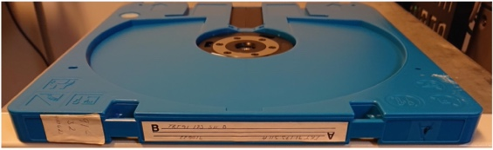
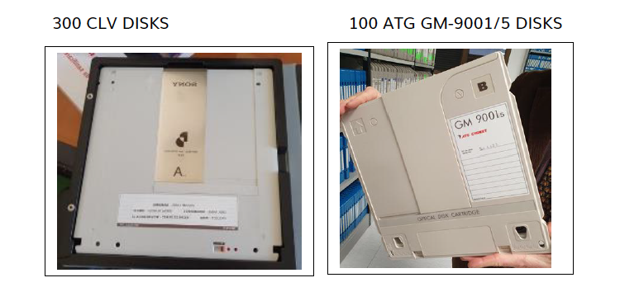
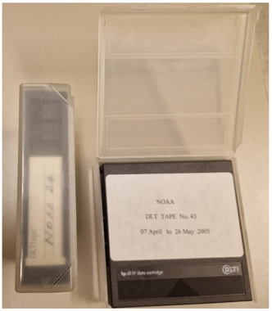
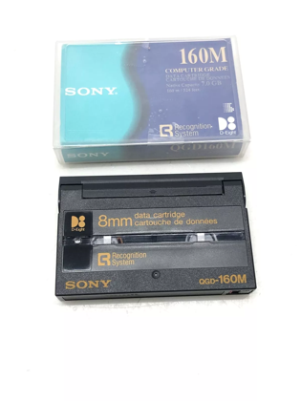
AVHRR 1 Km data on media
Several hundred heritage media (optical disks, DLTs, Exabytes) with potentially unique AVHRR LAC data identified:
  ESA (Optical Disks)
  University of Reading (Optical Disks)
  University of Rome / ASI (DLTs)
  University of Hawaii (Exabytes)
LM 1200 optical Disk 2.4GB
Exabyte tapes
DLT cassettes

Slide 34
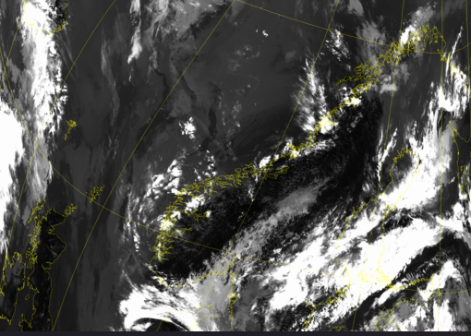


Optical Disks
ESA pilot activity completed in 2023 with successful transcription of 2 different brands of optical disks originally held at ESA and University of Reading.
Transcription of the full batch of available optical disks (around 522) contracted to a commercial company.
In Oct23, ESA received the content of the first 15 transcribed optical disks. L1B products successfully processed using the ESA processor.
In Feb ’24, 50 media were successfully transcribed and data inventory/screening under finalization (media containing both AVHRR and Nimbus CZCS data).
Transcription of additional media ongoing with some delays due to hardware failures.

Slide 35
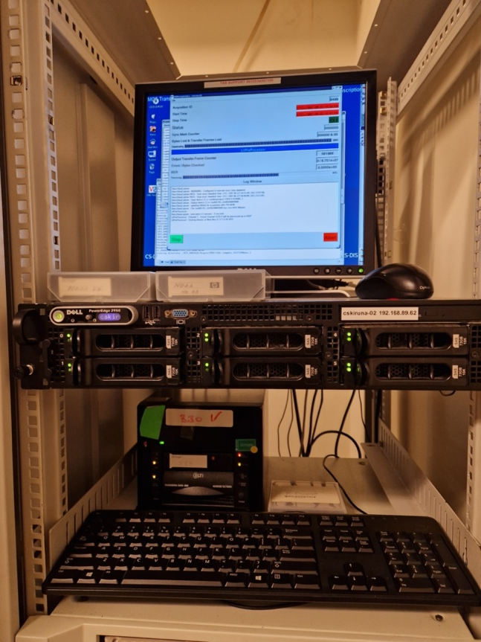
DLT Tapes
DLT transcription chain set-up at ESA/ESRIN to transcribe tapes containing unique AVHRR / SPOT and ERS data.
Tapes received from ASI / University of Rome successfully transcribed and 8452 AVHRR products acquired in Malindi (Kenya) from 2001-2009 now safely archived on disks at ESA.

Slide 36


Exabyte Tapes
Exabyte transcription chain being set-up at ESA/ESRIN to transcribe tapes containing unique Hawaii AVHRR data.
The ESRIN laboratory is manufacturing a special device to roll/unroll the tapes at very slow speed and clean the tape surface from moisture.

Slide 37
WGISS
Committee on Earth Observation Satellites
AVHRR Data Processing and Access

Slide 38
Next Steps
Continue ongoing transcription activities, coordination and projects and contact additional organizations with potentially unique AVHRR LAC data
Provide AVHRR points of contact and stakeholders with the AVHRR Dataset Consolidation Procedure and Processing Format used in the European consolidation project run at ESA. Collect feedback and discuss possibility to have a common/harmonised format (Q1/Q2 2025)
Check status of Discoverability of AVHRR datasets worldwide and pursue common entry point through WGISS CDA infrastructure (Q1 2025)
  AVHRR Session follow-on will be held at WGISS#59

