Slide 1
Approval process for WGISS documents -
Revision process
I.Maggio, Starion for ESA
Agenda Item 3.1
WGISS-58
16-17 October 2024
Sioux Falls, South Dakota, USA

Slide 2


Slide 3
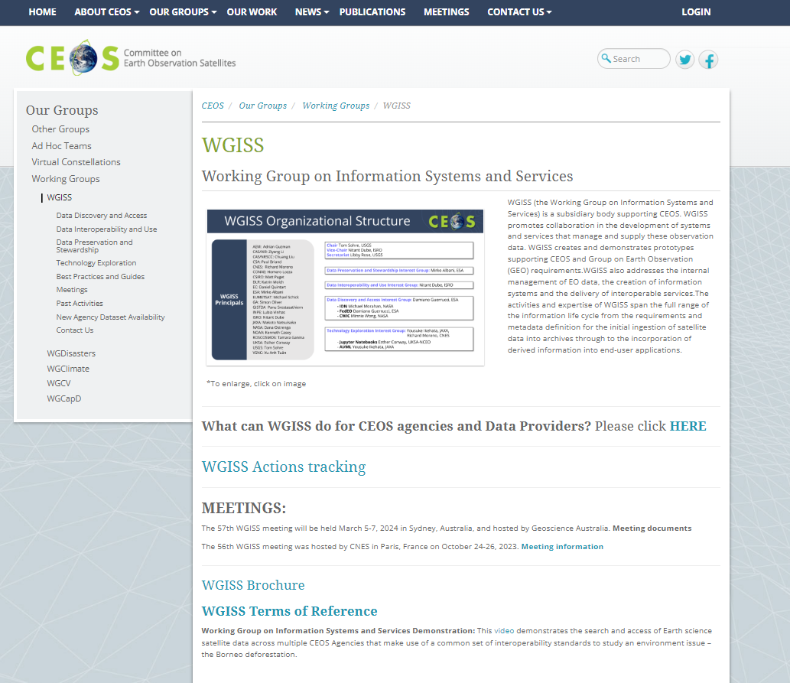
WGISS Internal Approval Process
The WGISS website encompasses all Interest Groups information, activities and documentation. It is a good way to publicise the WGISS activities, collaborations, outcomes and for this reason it needs to be periodically reviewed to be maintained up to date with respect the activities performed in the frame of CEOS WGISS periodic meetings. The review involves documents (Best Practices, White Paper and Guides) and all relevant Interest Groups web pages.
DECISION taken during last WGISS#57
REVIEW of WGISS Webpages should be performed every 2 years (e.g. when new chair takes lead):
Organisation
Terms of Reference
Interest Groups definitions
Collaborations projects
…
(https://ceos.org/ourwork/workinggroups/wgiss/)

Slide 4
WGISS Internal Documents Review Cycle
Document creation
Confirm need of a new document
Document review and formal approval
New document circulated for review to all IGs
Document storage and discovery
Approved document distribution to WGISS_ALL and storage on WGISS website (discoverable and accessible)
Document periodic review and (if needed) disposal
Review cycle every 2 years or on-demand
Selection of the relevant IG as owner
Final issue and formal approval
Action EXEC
Action Owner IG
Action WGISS Secretariat
Action Owner IG
Internal or external request
Refreshment for Technology changes, verification of links and references and/or adding more details, etc.

Slide 5
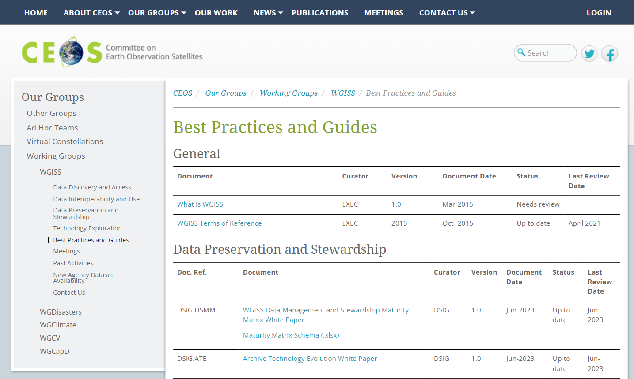
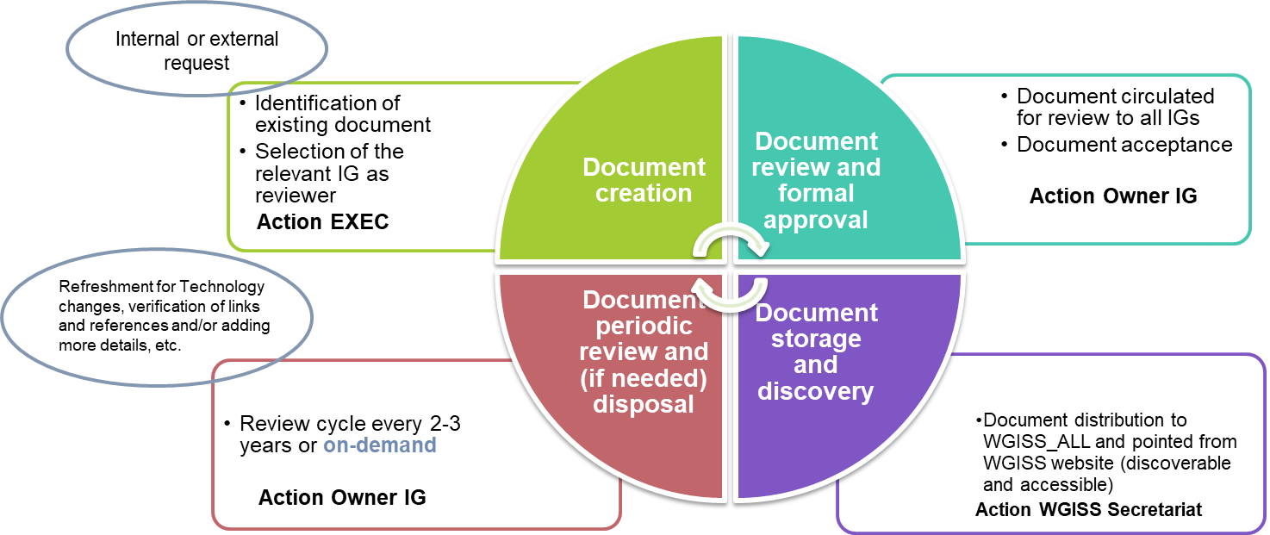
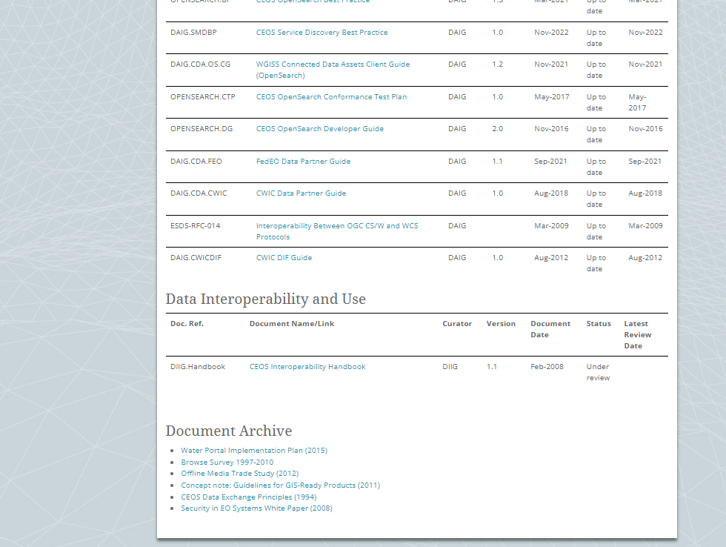
Documents from other sources
Existing documents from other sources (CEOS agencies, CGMS, etc.) might be of interest for WGISS
Additional section in Best Practices and Guides web page might be added to point to the relevant documents
Document from other sources

Slide 6

New Discussion including the case of endorsement by CEOS Principals and at SIT or Plenary

Slide 7
Guideline on approval of documents produced by WGISS
This outlines how documents produced by WGISS can be approved, and how it differs for different types of documents.
There are two cases:
A document is ‘asking’ something from CEOS Agencies, e.g. asking them to implement recommendations, follow best practices, or supply more resources to tackle a specific topic. In this case, endorsement by CEOS Principals and at SIT or Plenary meeting is required to ensure visibility of the request.
A document is a research paper - compiling activities from different agencies to put together a comprehensive overview of a specific topic. As there is no ‘ask’ for agencies in this case, it is not required that CEOS Principals endorse this document. However, it is recommended that the document is presented to Principals for information, at either a SIT or Plenary meeting.

Slide 8
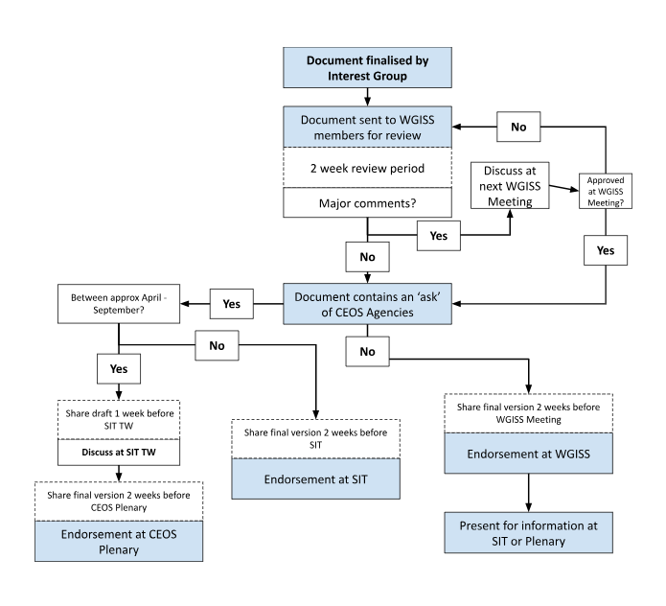
Approval process to be discussed
To receive endorsement at a SIT or Plenary meeting, the document should be provided to CEOS Principals at least two weeks in advance. In the case of CEOS Plenary, the SIT Technical Workshop provides an opportunity for community review, and any document targeting endorsement at CEOS Plenary should be presented for discussion.
To prepare for these meetings, WGISS members should be given a chance to review and provide feedback on the documents. Ideally, this would happen at the WGISS meeting preceding SIT or CEOS Plenary, however may also be done via email.
Documents not requiring endorsement by CEOS Principals should be reviewed and accepted by WGISS members at a WGISS meeting.

Slide 9


