Slide 1
Archiving Policy at JAXA
Yousuke Ikehata, JAXA
Agenda Item 2.5
WGISS-58
16-17 October 2024
Sioux Falls, South Dakota, USA

Slide 2
Data Category and Archive Policy
Master Data
  defined as those which can’t be obtained nor reprocessed if lost
  must be doble archived with processing code and related documents
Products
  defined as those processed from master data
  mostly archived in mission operation systems (MOSs) and data dissemination systems like G-Portal, AUIG-2 (ALOS and ALOS-2), Bousai-IF (disaster-related products), etc. to provide those to users
This slides focuses shared storage system.
  Some projects have own storage system and those are out of scope in this slides.

Slide 3
Master data
Policy
  The data is stored and managed the data without period.
    The data is mirrored 2 data centers to avoid disaster.
  Processing systems aren’t defined about preservation.
    The preservation policy about documents describing processing software is decided by each project.
Example
  RAW data, ASD(APID Sorted Data), Level 0 data

Slide 4
Without master data
Policy
  The data is only stored fixed term.
    But document define fixed term = the term for user wants to download.
    It is almost same as indefinite.
  The data is only stored 1 data center.
    Archive system: data dissemination system & archive storage.
Example
  Level1, 2, 3, format conversion and so on.

Slide 5
Product life cycle
Nominal processing
  Downlink from satellite at ground station.
  Download data to JAXA/Tsukuba center.
  Copy “Master Data” to JAXA/Chofu center.
  Generate “Products” at MOSs.
  Archive “Products” to JAXA/Tsukuba and Chofu center.
  Upload “Products” to dissemination system.
Reprocessing(Product version up)
  Reprocessing “Products” at JAXA/Chofu center.
  Archive “Products” to JAXA/Tsukuba and Chofu center.
  Upload “Products” to dissemination system.

Slide 6
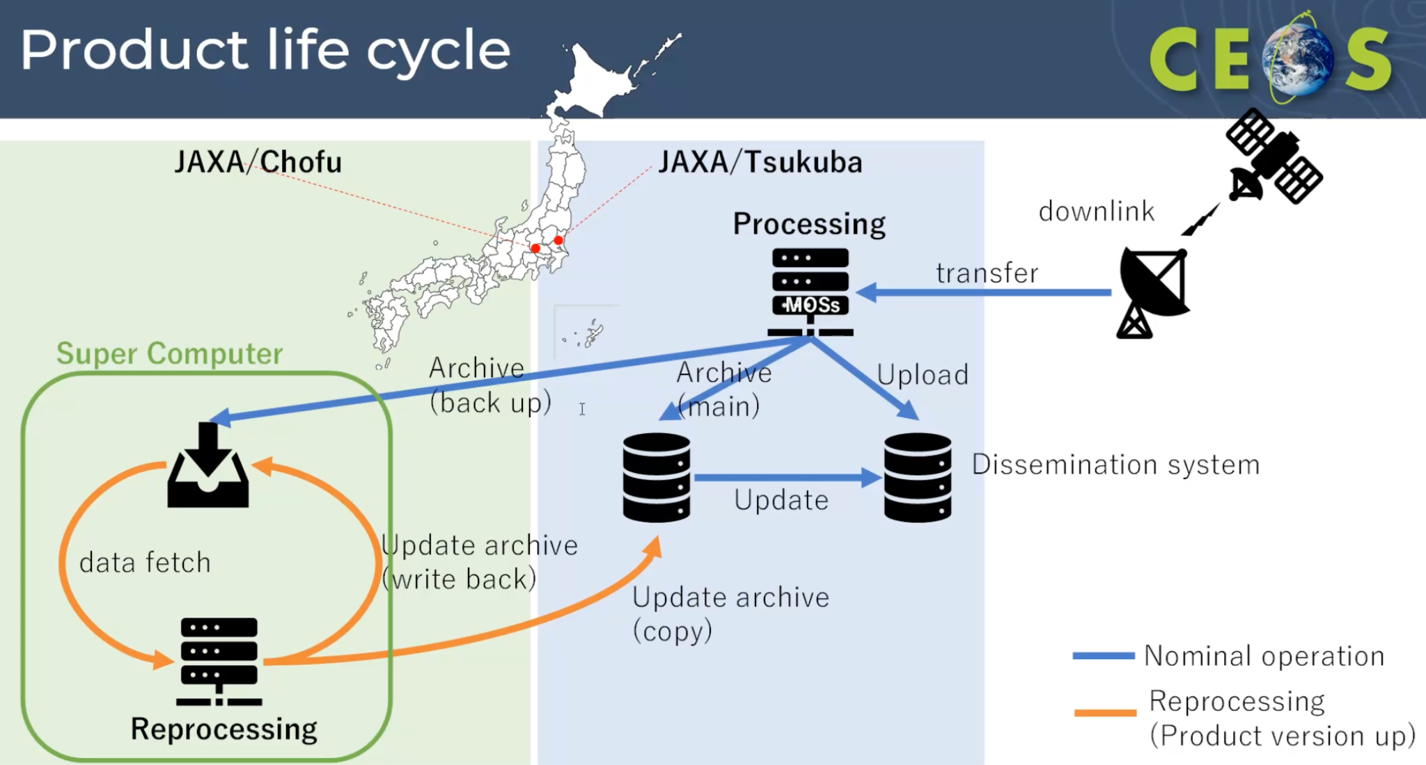

Slide 7
System design
Tsukuba
  Realtime processing
  Archiver as hot storage
  Dissemination system
Chofu
  Re-processing
  Archiver as cold storage

Slide 8
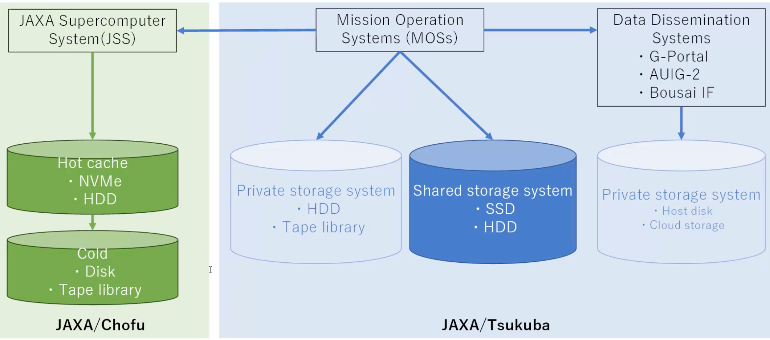
JAXA Archiving System

Slide 9
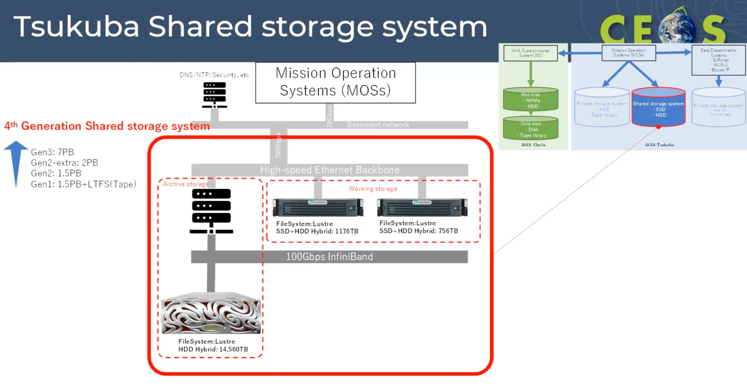

Slide 10
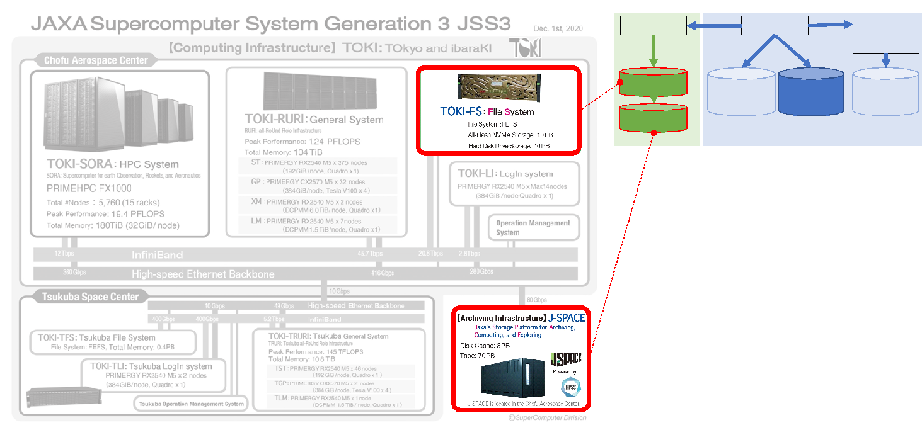
JAXA Supercomputer System(JSS)

Slide 11
JAXA Supercomputer System(JSS)
Tape library | Tape drive | Tape
TS4500 (L25x1, D25x3, S25x2) | TS1160x(40+4) | 3592JC x 816 3592JE x 2602 Cleaning x 7
TS3500 (L23x1, D23x3, HA1x1, S24x11) | TS1150x4 TS1155x4 TS1160x20 | 3592JC x 10585 3592JD x 600 3592JE x 8 CLEANING x 2
HPSS(https://hpss-collaboration.org/)

Slide 12
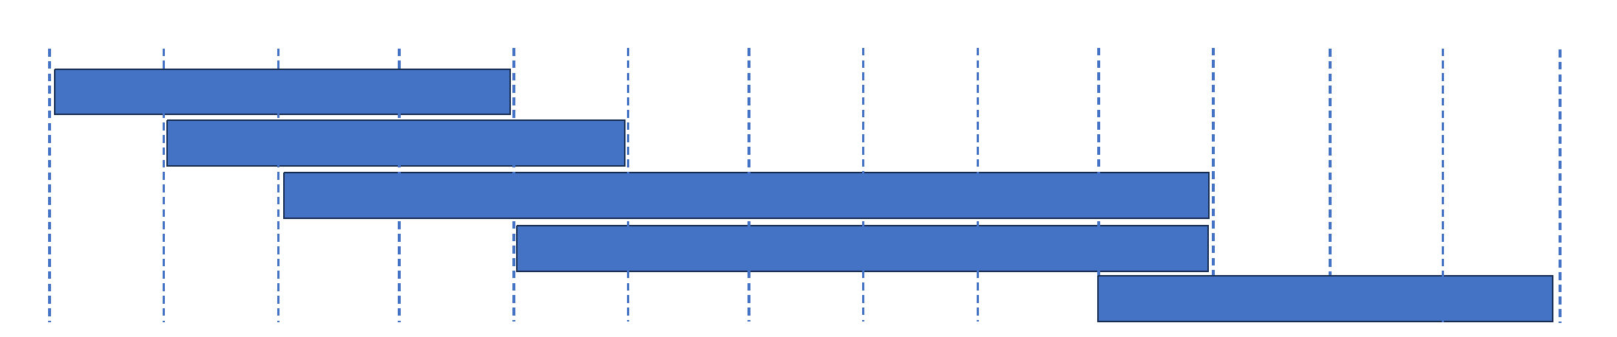
System migration(Tsukuba)
Shared storage systems are replaced almost every 5 years.
  Gen.1 (2013~2017): 1.5PB+LTFS(Tape)
  Gen.2 (2014~2018): 1.5PB
  Gen.2-extra (2015~2023): 2PB
  Gen.3 (2017~2023): 7PB
  Gen.4 (2022~2026):16.4PB(14.5+1.2+0.7)

Slide 13
System migration(Chofu)
Earth observation missions start using supercomputer from 2nd generation’s one.
  JSS2(2014~2020)
  JSS3(2020~)
  But J-Space continue to be used for archive system both 2nd and 3rd generation.
  (plan)JSS4(2026~)

Slide 14
Challenges and Needs
Archiving Cost is serious problem and needs to be solved.
Distributed archiving systems among the JAXA centers might be needed to efficiently use computer resources. Introduction of JAXA DAB etc..
New technology like cloud, object storage might be needed to give flexibility
A professional group for long-term preservation might be needed.

Slide 15
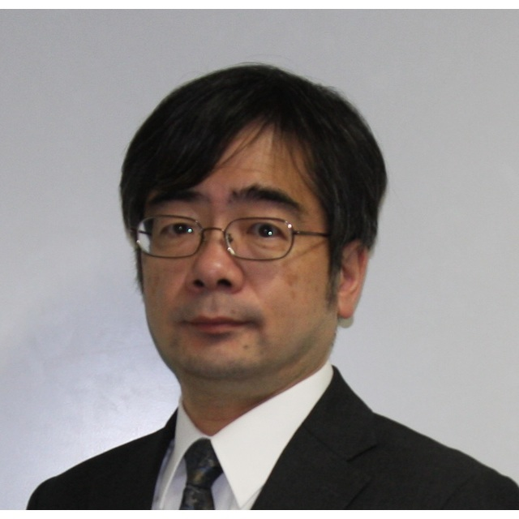
Acknowledgements
Special thanks to Naoyuki Fujita.
JAXA Supercomputer Division

Slide 16
Answer for survey(1/4)
Nomenclature: meaning of Datasets, meaning of Master Dataset (or last version of consolidated dataset)
  Dataset https://eolp.jaxa.jp/
  “Master dataset” defined as those which can’t be obtained nor reprocessed if lost

Slide 17
Answer for survey(2/4)
Which datasets you preserve for long time?
Do you have a retention time?
  “Master data” is stored and managed the data without period.
  “Without Master data” is only stored fixed term.
    But document define fixed term = the term for user wants to download.
    It is almost same as indefinite.

Slide 18
Answer for survey(3/4)
How many copies you maintain for long time? and where?
  “Master data” is mirrored 2 data centers to avoid disaster.
  “Without Master data” is only stored 1 data center.

Slide 19
Answer for survey(4/4)
Are you following the CEOS Preservation Guideline?
  We constitute rules for preservation but have not evaluate our preservation rule by CEOS’s one.
Are you considering to preserve technical documentation and/or relevant software?
  The preservation policy about documents describing processing software is decided by each project.

Slide 20
Appendix

Slide 21
Master data list
Platform | Instrument | Level | Master | Dessemination
MOS-1/1b | MESSR | 0 | 〇
 |  | 2 |  | 〇
 | MSR | 0 | 〇
 | VTIR | 0 | 〇
JERS-1 | SAR | 0 | 〇
 |  | L0 | 〇 | 〇
 |  | L2.1 | 〇 | 〇
 | SWIR | 0 | 〇
 |  | L2 | 〇 | 〇
 | VNIR | 0 | 〇
 |  | L2 | 〇 | 〇

Slide 22
Master data list
Platform | Instrument | Level | Master | Dissemination
ADEOS | AVNIR | 1A | 〇 | 〇
 |  | 1B2 | 〇 | 〇
 | OCTS | L1A | 〇 | 〇
 |  | L2 | 〇 | 〇
 |  | L3 | 〇 | 〇

Slide 23
Master data list
Platform | Instrument | Level | Master | Dissemination
ADEOS-II | AMSR | L0 | 〇 | 〇
 |  | L1A/B |  | 〇
 |  | L2 |  | 〇
 |  | L3 |  | 〇
 | GLI | L0 | 〇 | 〇
 |  | L1A/B |  | 〇
 |  | L2 |  | 〇
 |  | L3 |  | 〇

Slide 24
Master data list
Platform | Instrument | Level | Master | Dissemination
TRMM | PR | L1 | 〇 | 〇
 |  | L2 |  | 〇
 |  | L3 |  | 〇
 | TMI | L1B |  | 〇
 |  | L2A |  | 〇
 |  | L3 |  | 〇
 | VIRS | L1B |  | 〇
 | Combine | L2 |  | 〇
 |  | L3 |  | 〇

Slide 25
Master data list
Platform | Instrument | Level | Master | Dissemination
Aqua | AMSRE | L0 | 〇
 |  | L1B/R |  | 〇
 |  | L2 |  | 〇
 |  | L3 |  | 〇
GOSAT/ GOSAT-2 |  | L0 | 〇
 |  | CAM | 〇
 |  | High Level |  | *JAXA/EORC *NIES

Slide 26
Master data list
Platform | Instrument | Level | Master | Dissemination
GCOM-W | AMSR2 | L0 | 〇
 |  | L1A/B/R |  | 〇
 |  | L2 |  | 〇
 |  | L3 |  | 〇
GPM | DPR | L1A | 〇*
 |  | L2 |  | 〇
 |  | L3 |  | 〇
 | GMI | L1B/C |  | 〇
 |  | L2A |  | 〇
 |  | L3A |  | 〇
 | Combine | L2 |  | 〇
 |  | L3 |  | 〇
* Including
Environmental data.

Slide 27
Master data list
Platform | Instrument | Level | Master | Dissemination
GCOM-C | SGLI | L0
 |  | L1A | 〇 | 〇
 |  | L2 |  | 〇
 |  | L3 |  | 〇
EarthCARE | CPR | L0 | 〇*
 |  | L1A
 |  | L1b |  | 〇
 |  | L2 |  | 〇
* Including Aux. data.

