Slide 1
Archiving Policy at NOAA
Nancy Ritchey NOAA/NCEI
Agenda Item 2.3
WGISS-58
16-17 October 2024
Sioux Falls, South Dakota, USA

Slide 2
Nomenclature
Granule - smallest unit of data that can be searched & retrieved
Dataset - aggregation of granules based on similarity (instrument, platform, etc.)
Collection - the highest level of aggregation (granules, datasets) that receives a collection metadata record & Digital Object Identifier (DOI). Could represent a single file or an aggregation of multiple datasets such as an entire cruise with multiple platforms, instruments. Aggregation is based on user community needs.
Master Dataset or Authoritative Dataset aren’t terms we use

Slide 3
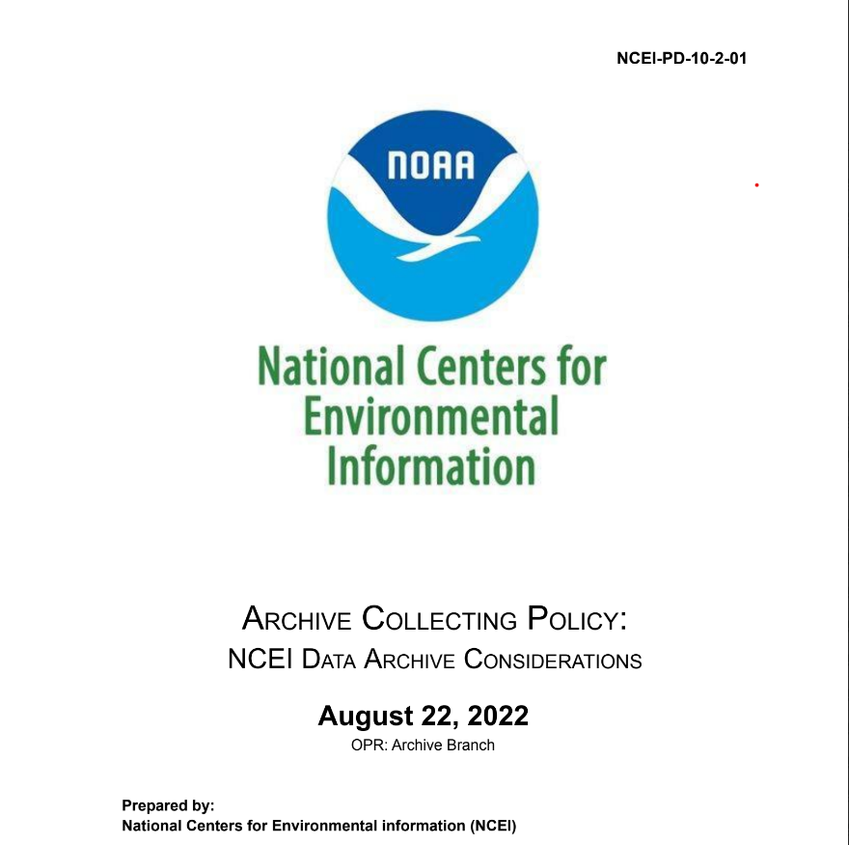
Archive Collecting Policy
Defines the types of environmental and geospatial data that NCEI archives in support of NOAA’s mission, including complementary data
Working with partners to preserve the global environmental data record, including participation in the World Data System
Characteristics considered for data appraisals

Slide 4
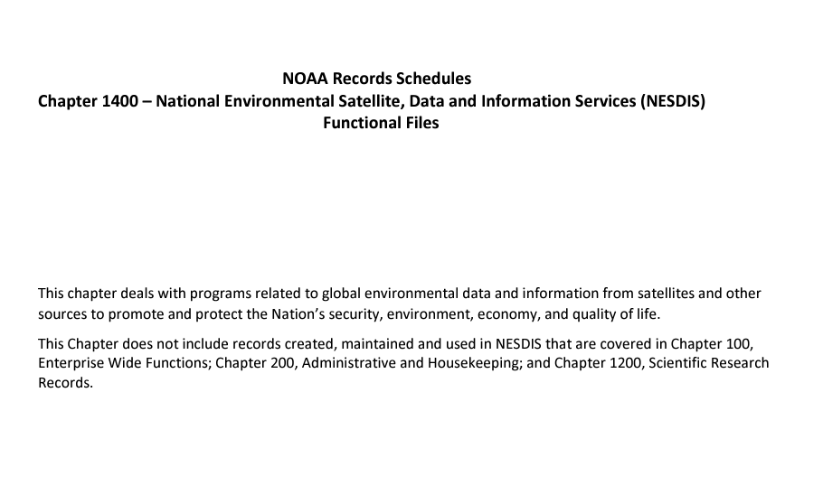
Records Retention
Federal Records Management law requires Federal Agencies to document policies and transactions and adhere to National Archives and Records Administration (NARA) guidelines
NOAA also has a records retention schedule which in collaboration with NCEI, has specific guidance for some environmental data.
NCEI develops Archive Recommendation Packages for NOAA programs that define what to archive and how long to retain

Slide 5
Data Retention
Preserved permanently: Original Observations
75 years: Oceanographic, geophysical data
10 years: Products and product versions, related documentation and metadata
Each of these categories will be reassessed for community needs prior to disposition

Slide 6
Redundancy
For NCEI on prem systems there are 2 copies of all digital data. 1 copy is geographically distanced from the data center.
We’re reassessing the continuity of operations in the cloud. Currently the cloud archive is in 1 region and the cloud provider creates multiple copies. The NESDIS Common Cloud Framework also has multiple copies of data, with each location (ingestion, archive, access) having different retention periods.

Slide 7

Other considerations
Focused on Open Science and Scientific integrity and reproducibility:
PIDs for data✓, tech reports✓, publications✓, software✓, events✓, grants, programs, etc.
Additional provenance for data workflows
NCEI does archive some software as documentation
Coordinate with the NOAA Central Library on technical documents and linking them to the data & vice versa
Notes:
White House(WH) Office of Science and Technology (OSTP) memo Ensuring Free, Immediate, and Equitable Access to Federally Funded Research
WH OSTP 2023 Year of Open Science fact sheet
WH OSTP Year of Open Science Anniversary fact sheet

Slide 8
References
White House(WH) Office of Science and Technology (OSTP) memo Ensuring Free, Immediate, and Equitable Access to Federally Funded Research
WH OSTP 2023 Year of Open Science fact sheet
WH OSTP Year of Open Science Anniversary fact sheet

