Slide 1
EO Data Collections Management and Governance Introduction
Mirko Albani, ESA
Agenda Item 2.1
WGISS-58
16-17 October 2024
Sioux Falls, South Dakota, USA

Slide 2
Collections management - Background
Challenges to be mitigated and managed:
Data collections integrity
Data collections authenticity
Data collections replica management (in the cloud and/or archived)
Data collections reproducibility
Data collections citation
Data collections archiving policy

Slide 3
Collections management – objectives
Start discussion on “Collection Governance practices” from the various organizations;
Share experiences and lessons learned;
Produce a CEOS deliverable “White Paper on EO Data Collections Management and Governance”.

Slide 4
Collection management – topics
Topics related to Collections management :
Common understanding of the concept of collection;
Preservation of “master" collections and Archiving Policy
Reproducibility of master collections (algorithm availability);
Master collections data citation;
Cross-collection validation (for example, NASA has the concept of the "golden month");
Approach to transitioning from one collection to another (time overlap, communication, etc.);
General Interoperability and Governance approaches.
Notes:
Dataset Collection of homogeneous data, part of the Data Offer

Slide 5
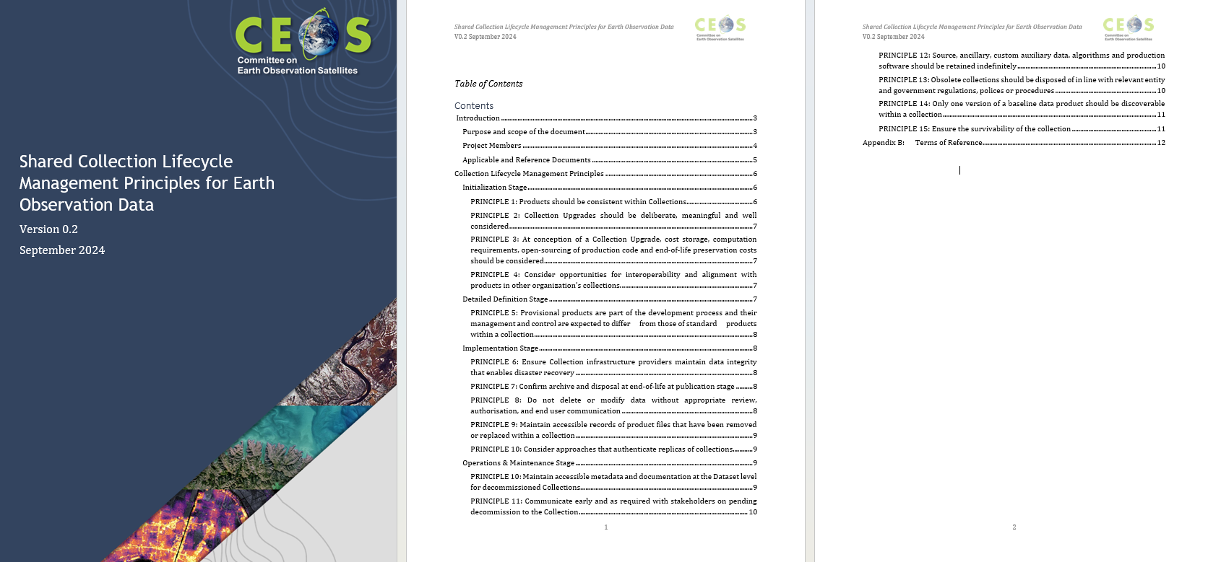
Collection management - Document Status

Slide 6
Dedicated Session on Archiving Policy
Session Guidelines:
Nomenclature: meaning of Datasets, Master Dataset, collections.
What datasets you preserve for long time?
Do you have a defined retention time?
How many copies you maintain for long time? and where?
Are you following the CEOS Preservation Guideline?
Are you considering to preserve technical documentation and/or relevant software?

