Slide 1
WGISS Action Review
Libby Rose
WGISS Secretariat
Agenda Item 2.2
WGISS-57
4-7 March 2023
Sydney, Australia

Slide 2
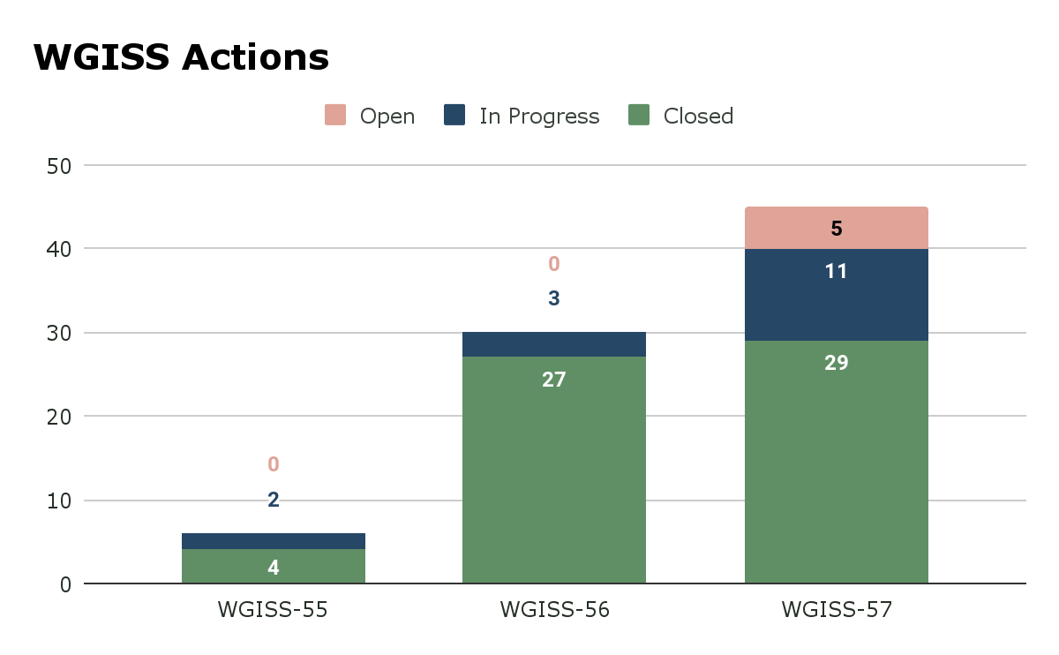
Summary
5 Open
16 In Progress

Slide 3
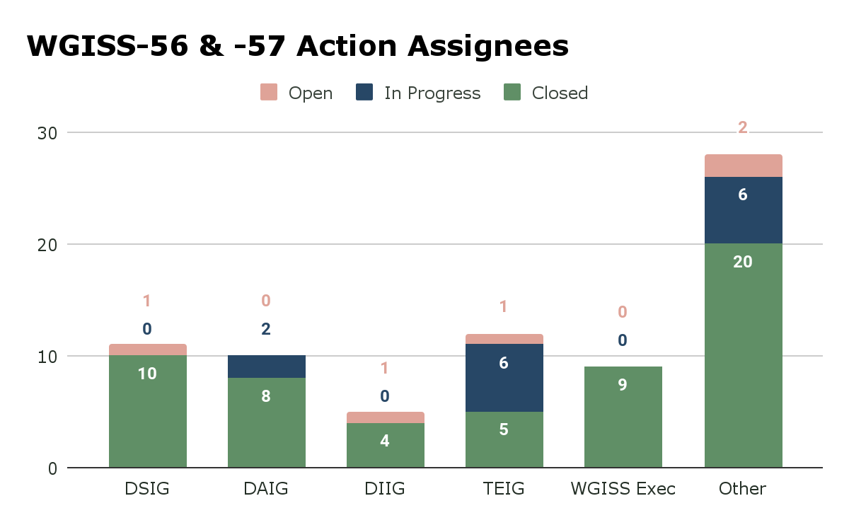
Summary

Slide 4
Any updates on these?
WGISS-57-22: TEIG to work with SEO to ensure CEOS Analytics Lab notebooks are compliant with the Jupyter Notebooks best practices.
WGISS-57-26: Liping Di to write up some feedback for CEOS Agencies about the use of EO data in CropSmart, in particular the search, discovery, access and exploitation aspects.

Slide 5
WGISS-57-08: Update ToR
Main Change - Stakeholders Section:
Was:
These include the other Working Groups, Virtual Constellations and other Ad-hoc Groups working within CEOS, together with external organisations, such as GEO, the Global Spatial Data Infrastructure Association (GSDI), the Consultative Committee for Space Data Systems (CCSDS), ICSU Committee for Data for Science and Technology (CODATA), commercial satellite data providers, and relevant bodies within the UN.
Proposed:
These include the other Working Groups, Virtual Constellations and Ad Hoc Teams within CEOS, together with external organisations and the commercial sector.
New document here
List of proposed changes
To be endorsed next week at CEOS Plenary

