Slide 1
Geoscience Australia Collection Management Practices
Simon Oliver
Geoscience Australia
Agenda Item 10.5
WGISS-57
4-7 March 2023
Sydney, Australia

Slide 2
Overview
Attributes of an EO Collection
Overview of EO Collections at Geoscience Australia
Collection Governance – how/who decides?
Upgrades versus Updates
Principles
Options for a WGISS activity?

Slide 3
Attributes of a Collection
Consistent base
Contains multiple datasets derived from a common root
Some change is allowed, within tolerance
Multiple factors can drive decisions regarding management of collections

Slide 4
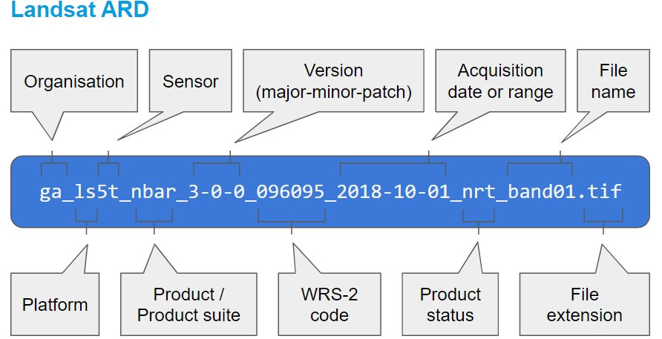
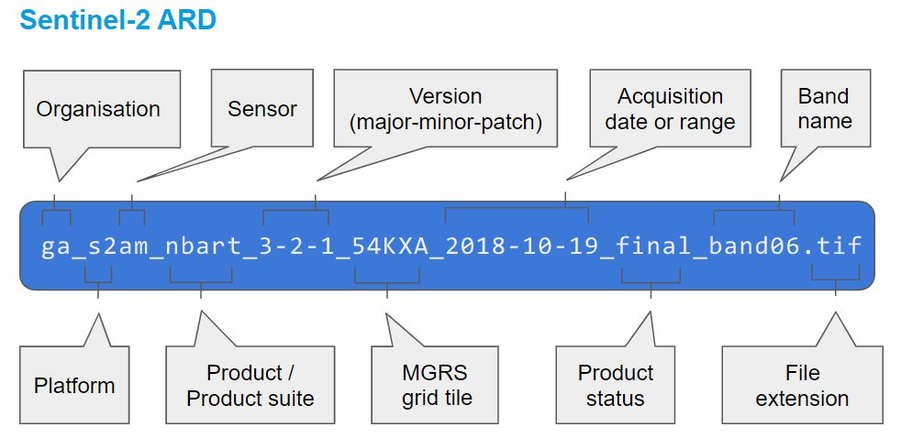
Advantages of Consistency
Notes:
Geoscience Australia maintains collections of Landsat and Sentinel-2 derived products. In both cases the underlying input is a Level 1 product, which runs through a custom Analysis Ready Data pipeline to create baseline product that feeds into downstream or derivative products. We use the same algorithm and auxiliary inputs to both datasets in order to create a harmonizable set of ARD whereby like spectral bands can be used relatively interchangeably. Where possible, formatting, metadata, naming conventions etc are common between our Landsat and Sentinel-2 products in order to ease integration into downstream services and to make life easier for users of the data.

Slide 5
Advantages of Consistency
Consistency between collections maintained through a common code base
Consistent approaches to ARD generation
Algorithmic
Minimise mission data interoperation issues
Maximise fused product quality
Auxiliary inputs
Formatting
Geometric baseline
Quality assurance
Metadata
Geometric Quality Assessment
Data access and analytics from a common codebase
Notes:
To simplify management of the data across our Landsat and Sentinel-2 Collections - forrmatting, metadata, naming conventions etc are common between our Landsat and Sentinel-2 products. This aids integration into downstream services and make life easier for users of the data.

Slide 6
GA Landsat Collection Structure
Operational
Level | Spatial Manifestation | Landsat Mission
1 | USGS Replica C1/ C2 Scenes | TM (4-5) | ETM+ (7) | OLI/TIRS (8-9)
2 | UTM Scenes | ARD (NBAR-T + OA)
3 | UTM Scenes | Fractional Cover
3 | UTM Scenes | Water Observations
4 | UTM Scenes | NBAR-T Geometric Median
4 | Australian Albers EA Tiles | Water Observations Frequency
4 | Australian Albers EA Tiles | Fractional Cover Percentiles
4 | Australian Albers EA Tiles | Tasseled Cap Percentiles
4 | Australian Albers EA Tiles | Landcover
4 | Australian Albers EA Tiles | Mangroves
4 | Vectors | Waterbodies
4 | Vectors | Coastlines
Notes:
Our collections are evolving. As an example, Landsat 9 was introduced relatively recently. It's slowly being integrated into downstream data products. The reason I'm showing this slide is to highlight the idea that far from being static, Collections must evolve as the primary inputs to the Collection evolve.

Slide 7
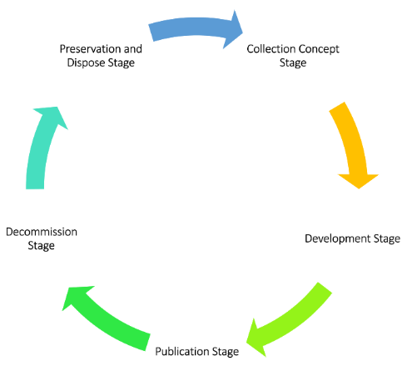
Collection Lifecycle
Notes:
Collections have a Lifecycle which may be represented like this, with 5 discrete stages representing the transition from one Collection to the next.
The Collection Concept stage, where an idea of a new collection is evolved and elaborated.
The Development Stage, where the decisions on what the collection will comprise, and the code developed and the products created that constitute the collection
Publication, where the products are released and maintained, new data added as the root data is added to
Decommissioning – where a decision has been made to replace or retire a Collection
Preservation stage – where archving, disposal of the old Collection takes place.

Slide 8
EO Collection Governance
Geoscience Australia
National Archives Act 1983 | Governing legislation for management of official 'records'
National Archives of Australia | Collects Australian Government records, manages them, preserves them and makes them public. Assist Australian Government employees working in information management. Administers Disposal Authorities which enable the accountable disposal of business information and records.
GA Information and Records Management Team | Under a Records Disposal Authority issued by the National Archives of Australia (NAA), copies of superseded products are not required to be retained
Digital Earth Australia Management Committee | Program decision-making body on Upgrades to Collections based on project business case – managed as project Upstream upgrade (Level 1) DEA ARD of Information Product Upgrades
Digital Earth Australia Control Board | Peer review of proposed Updates to existing Collections.
Notes:
There are a number of Governance elements used to help guide management of Geoscience Australia's Collection Management.
The Archives Act which is a piece of australian government legislation that outlines the legal responsibility of organisations for propera management of government records
The National Archives of Australia, who collect Australian Government records, manage them, preserve them and make them public.
They do this so everyone can access evidence of government decisions and actions, making them transparent and accountable.
The records management authority within Geoscience Australia – who provide general guidance and records disposal authority – which confirms records can be destroyed / deleted
And our internal processes – The Digital Earth Australia Management Committee – who make decisions on major changes to Collections (otherwise call Upgrades), and the Change Control Board, which looks after minor changes or updates to a Collection.

Slide 9
UPGRADE vs UPDATE triggers
Collection UPDATE | Collection UPGRADE
Software updates | Algorithm enhancement
Source or auxiliary data reprocessing or upgrades | Baseline / input data upgrade
Metadata fixes
Remedial reprocessing
Notes:
In essence, changes to a Collection can be categorised as Updates, or Upgrades, depending on their scope and significance. The internal governance (management committee, and change control board), exist to effectively adjudicate on the scope and significance of a propose change to a collection.

Slide 10
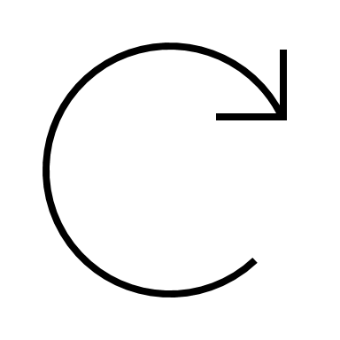
Collection UPGRADE 3.x.x
Operations Development
Prototyping
Operations Implementation
Archives Act 1983
Commission New Collection
Disposal Authority
Project Initiation
DEA Board
Endorsement
Records Managment
Decommission
Previous Collection
DEA Management Committee
Senior Responsible Official
Project Close
Upgrade Proposal
Upstream Collection Upgrade
Upgrade Champion
Innovation milestone within GA
Notes:
This diagram represents the decision making process that takes place for Collection upgrades within Geoscience Australia's EO Collections – starting at the dotted line and moving clockwise.
We use a semantic number approach as used in software versioning. With the first digit at left indicating Major, then Minor, then Patch at right. Upgrades constitute a Major version change for a dataset.

Slide 11
Collection UPDATE x.1.0
Operations Development
Change Implementation
Version update
Approval
Operational Deployment
DEA Change Control Board
Monitoring
Issue Closed
Change Control Board Proposal
Update Proponent
Issue identified
Remedy evaluation
Notes:
This diagram represents the Collection Update process. The Update process is a much lighter process, with the aim being to ensure consistency is maintained within the Collection by limiting unncesesary changes.

Slide 12
Policies Summary
Updates to source datasets are staged and not automatic
e.g. USGS Landsat 9 reprocessing does not automatically trigger updates in GA Collection
Changes to data or systems with a potential to impact the consistency of the Collection must be approved by the Change Control Board
Upgrades to Collections are approved via the DEA Management Committee
Collection Disposal is conducted in line with Archive Act responsibilities through consultation with Records Management and National Archives of Australia
Notes:
I'd like to highlight a few of the more important policies used in the management of GA's Collections:
Not all upstream changes are automatic. Due to management considerations / resourcing and impacts to users, not all upstream changes are automatically transferred to our users. These may be held back in order to ensure a well managed / orderly implementation.
Maintaining consistency is imperative. Users rely on consistency for timeseries analysis and the ability to generate results that they can depend on.
Legal requirements must be adhered to – though at times the technology outstrips the applicability of legal instruments (eg. Archives Act written in 1983).

Slide 13
Policies Summary
All changes likely to impact users must be communicated
Only a single instantiation of a dataset (nrt, interim or final) is available to a user at any given instant.
Dataset maturity may be specified in API calls.
Notes:
Communication is a key aspect of effective Collection management – when done well, users can anticipate and be well prepared for changes when they are released – helps build trust an confidence in our users.
And at a more granular level, we have processes that ensure that only one instantiation of a dataset is available to our users at any given moment. We do this through our implementation of our maturity concept, which automatically replaced superseded data (i.e. when data transitions from NRT with non-final auxiliaries, to the final product.

Slide 14
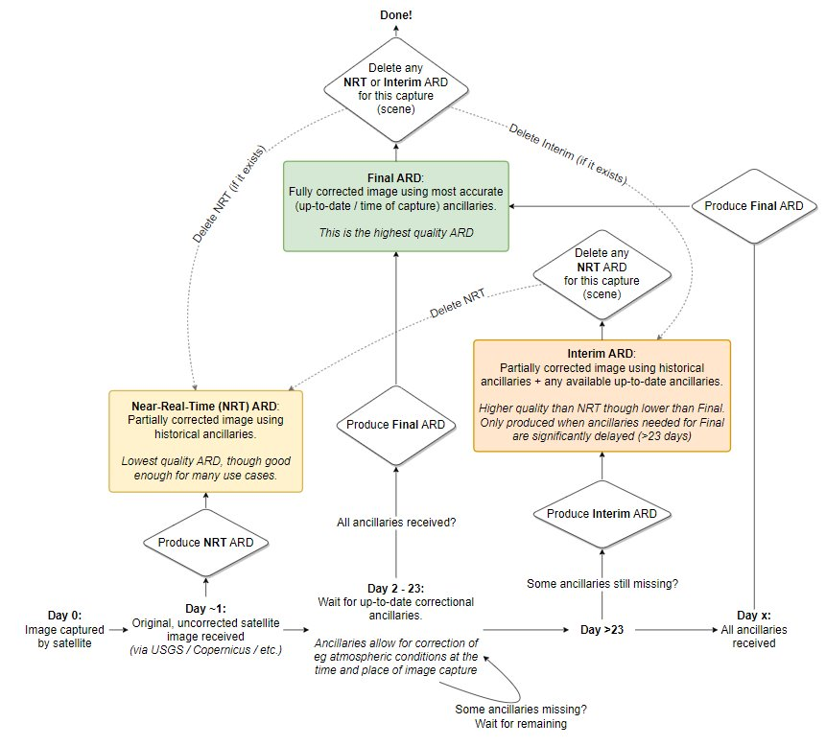
Dataset Maturity Implementation
Notes:
Further detail on the maturity concept is represented here. I won't go into detail on that .

Slide 15
Current State Practices
Collections Past
How are obsolete collections best handled?
GA Records Management
GA/DEA
Reproduceable Science
Code and Ancillary Repository Management
Decommissioning processes
Preservation responsibilities
PB-scale Special Interest Group in Australian Government
National Archives Act 1983
Disposal Authorities
User impact / communications
Collections Present - Updates
How is potential change in a current collection best handled?
External impacts (data supply)
Team lead proposal
Evaluation of change impact
Change Control Board
Assessment and approval of change proposal.
Traceability of changes in dataset versioning and related code repository and product metadata
User impact / communications
Collections Future - Upgrades
How is the development of a future collection best handled?
External influence / Collection Upgrades.
Integrating stakeholder feedback
Project Planning
DEA Management Committee
SATO-esque processes
PMP and BRD
Initiation
Validation
Operations Development
Operations Handover
Decommissioning.
User impact / communications
Notes:
We've considered the

Slide 16
Collection Lifecycle
Examples...
Collection Concept Stage
Principle 1: Products should be consistent within Collections
Principle 2: Collection Upgrades should be deliberate, meaningful and well considered
Notes:
In some work that Geoscience Australia and USGS have initiated, we've started to distill a set of common principles that could contribute to a common guidance or best practice reference for optimal Collection Lifecycle Management. We're hoping that such a reference will lead to more predictable and commonly communicated Collection management across CEOS agencies.
Our work revealed a number of consistencies in practice, but also a number of differences in terminology. The importance of developing a common language in our discussions became quite important.

Slide 17
Term | Definition
Product | A categorical term applied to describe the output from a process. Typically, a product has an associated product definition which contains the product description and specification.
Dataset | A related set of files composed of separate elements that can be manipulated as a unit. It is an instantiation of a product.
Collection | All products downstream of the rawest form of the main input data to a system, produced sequentially and processed with consistent algorithm/code/inputs/outputs. (DEA Content Management Interface).
Collection Governance | A management concept concerning the capability that enables an organization to ensure that high data quality exists throughout the complete lifecycle of the collection, and data controls are implemented that support business objectives.
Collection Upgrade | Reproduction of the Collection, including all downstream products, with the initial input being the rawest form of the data within the Collection system. *for GA Collections reflects as an increment in the Major number in the Collection's semantic number.
Collection Update | Minor modification to an aspect of the Collections data, metadata or supporting production systems or software. *for GA Collections reflects as an increment in the Minor or Patch number in the Collection's semantic number.
Provisional Product | Denote products that are in the process of being developed but have not yet been released.

Slide 18
Toward Common Principles
WGISS as a vehicle to promote a common set of Collection Principles
Consistent / predictable approaches
Improved outcomes for users
GA and USGS Collaboration as a starting point
Notes:
We're hoping that such a reference will lead to more predictable and commonly communicated Collection management across CEOS agencies.
While still a work in progress, there may be scope within WGISS to take this on as a collective effort.

Slide 19
Next Steps
Establish a working group within WGISS
Rework and confirm relevant existing definitions
Develop set of agreed principles
Promote within our organisations
Notes:
If WGISS does decide to take on the challenge of developing a set of Collection lifecycle principles, the steps could be as follows:
Establish working group
Revisit and agree relevant definitions to form a Collections vocabulary
Develop the principles
Promote and use within our organisations to improve practice and the experience of our users.

