Slide 1
EOSDIS and collections
WGISS-57, March 5-7, 2024
Doug Newman
NASA ESDIS Project, Goddard Space Flight Center
douglas.j.newman@nasa.gov

Slide 2
Our definition of ‘collection’

Slide 3
A collection is…
As per the Data Product Development Guide for Data Producers*
Data Collection - A major release of a data product, or of a set of closely related data products, which can be followed by minor releases within the same collection.
Data Product - A set of data files that can contain multiple parameters, and that compose a logically meaningful group of related data.
Dataset - A broadly used term that can be used to describe any set of data. The official term “HDF5 dataset” describes a data array in an HDF5 file (equivalent to a NetCDF-4 variable in a NetCDF-4 file or an HDF-EOS field in an HDF-EOS file). At the opposite extreme, an entire data collection can also be referred to as a dataset
*Ramapriyan, H. K., and P. J. T. Leonard. 2021. Data Product Development Guide (DPDG) for Data
Producers version1.1. NASA Earth Science Data and Information System Standards Office, 21
October 2021. https://doi.org/10.5067/DOC/ESO/RFC-041VERSION1
Notes:
NetCDF - network Common Data Form
HDF - Hierarchical data format
HDF-EOS - Hierarchical Data Format - Earth Observing System

Slide 4
‘Logically meaningful group of related data’
We can infer properties from the mandatory elements of NASA Earthdata’s UMM-C schema*.
A set of data that exhibit some common characteristics, usually
instrument, sensor
measurement(s)
processing level
Elements of the set may differ in the realm of
temporal extent
spatial extent
*https://git.earthdata.nasa.gov/projects/EMFD/repos/unified-metadata-model/browse/collection
Notes:
UMM-C - Universal Metadata Model for Collections

Slide 5
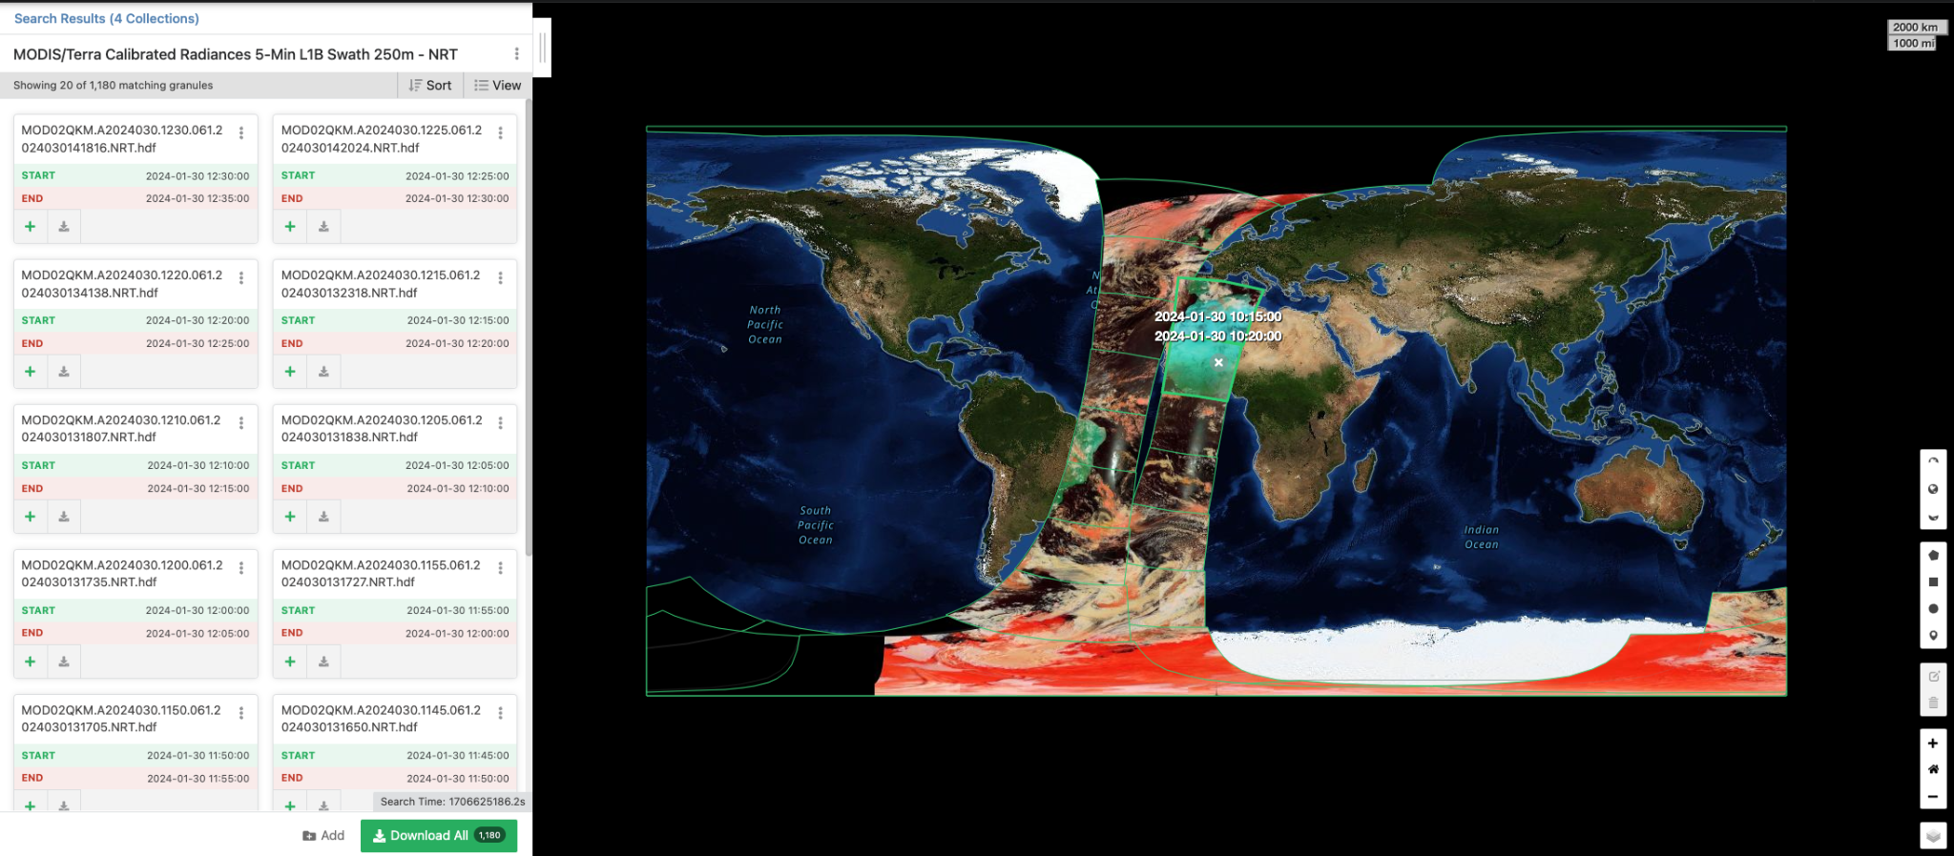
Notes:
https://search.earthdata.nasa.gov/search/granules?p=C1426416980-LANCEMODIS&pg[0][v]=f&pg[0][gsk]=-start_date&q=mod02qkm&tl=1706732400.089!3!!

Slide 6
Collection governance

Slide 7
Everything we do to ensure data collections are
secure
accurate
available
usable
A data governance board creates working groups to develop standards and guidelines for NASA’s Earth Science Data System (ESDS) and Earth Science Division (ESD). One such group is the Data Producers Working Group who are responsible for the Data Product Development Guide*
Approved standards are developed and endorsed through the ESDIS Standards Coordination Office (ESCO)
*Ramapriyan, H. K., and P. J. T. Leonard. 2021. Data Product Development Guide (DPDG) for Data
Producers version1.1. NASA Earth Science Data and Information System Standards Office, 21
October 2021. https://doi.org/10.5067/DOC/ESO/RFC-041VERSION1

Slide 8
Security
While all data in NASA Earthdata is public by design the integrity of that data is vital.
All data in transit will be encrypted using full end-to-end TLS encryption by September 15 2024
All non-science data at rest will be encrypted by September 6 2024
Data Management is controlled by NASA Launchpad
Only users with established NASA identities
Multi-factor authentication (MFA)
But we do recognise the need to allow other users the ability to manage the data they provided (CEOS data managers for example). Other forms of MFA are being investigated to facilitate this
Notes:
TLS - Transport Layer Security
CEOS - committee on earth observation satellites
WGISS - Working Group on information systems and services

Slide 9
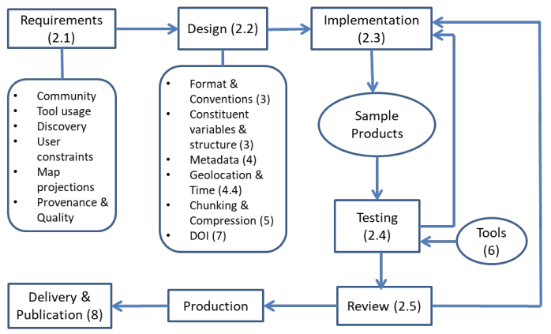
Accuracy
The accuracy of data is controlled by interface control documents for mission-level data products and Earthdata Pub for smaller products.
Calibration and validation of data products is performed by SIPS prior to archival at a NASA DAAC.
Quality assurance is executed by our data stewards at NASA DAACs, providing discipline-specific expertise.
NASA provide tools to improve quality
Analysis and Review of CMR (ARC)
CMR Metadata curation dashboard
*Ramapriyan, H. K., and P. J. T. Leonard. 2021.
Data Product Development Guide (DPDG) for Data Producers version1.1.
NASA Earth Science Data and Information System Standards Office,
21 October 2021.
https://doi.org/10.5067/DOC/ESO/RFC-041VERSION1
Notes:
CMR - Common Metadata Repository
DAAC - Distributed Active Archive Center

Slide 10
Availability
We define data availability as the ability to discover and access our data.
Our discovery service API, the Common Metadata Repository (CMR) has a 99.8% availability.
Our discovery user interface, Earthdata Search has a 99.8% availability.
Our access capability through HTTPS and S3 distribution has an availability of 99.9%
Notes:
API - application programming interface
HTTPS - Hypertext Transfer Protocol Secure
S3 - Amazon Web Services Simple Storage Service

Slide 11
Usability
Data formats
Multi-dimensional: netCDF-4/HDF5
Raster: GeoTIFF
Cloud: Cloud-optimized GeoTIFF and Zarr.
Metadata
CF compliant metadata for data usage
UMM-C and UMM-G with conversion capabilities to ISO-19115 via CMR for data discovery
Value-added services - see later section
The cloud
All science data located in Amazon Web Services ‘us-west-2’ region enabling equitable, high performance compute adjacent to the data.
DOIs
All NASA Earthdata collections will have a DOI to facilitate a permanent reference point for users.
Extensions to our DOI representations of collections include
Versioning
Hierarchy: parents, siblings, children.
Notes:
GeoTIFF - spatially tagged Tag Image File Format
CF - Climate forecast compliance
UMM-G - Unified Metadata Model for granules
DOI - Digital Object Identifier

Slide 12
Collection archival

Slide 13
Three copies model
Public, accessible copy of all data in AWS S3
Non-public, back up copy of all data in AWS S3 (separated by AWS account) - NASA Earthdata ORCA
Non-public, tape copy of all level zero* data on-premises - NASA Earthdata LZARDS
Studies are in progress for deploying ORCA to other commercial cloud providers to further reduce risk.
*All data that cannot be reconstituted from lower level data products.
Notes:
LZARDS - Level Zero and Repositories Data Store
ORCA - Operational Recovery Cloud Archive

Slide 14
As represented in metadata
Archive and distribution information
Format, file size, number of files, size of collection
Direct distribution information
Cloud provider, region, bucket location, prefix, credential endpoint
Collection progress
Enumeration of state of data, for example: PLANNED, ACTIVE, COMPLETE, DEPRECATED
Proposed: Data Maturity
Enumeration of maturity levels, for example: Beta, Provisional, Validated

Slide 15
As represented in the cloud
In Amazon web services, we migrate data through different storage tiers depending on their maturity.
‘Archived’ datasets can go into storage tiers with less stringent latency requirements at cheaper cost: S3 glacier.
‘Active’ datasets stay in the higher latency tiers: S3 standard, S3 infrequent access.

Slide 16
Collection services

Slide 17
Value-added data services
Harmony for
Reprojection
Reformatting
Spatial and temporal subsetting and stitching
Discipline-specific services
HyP3 for SAR processing
AppEEARS
Notes:
HyP3 - Hybrid Pluggable Processing Pipeline
AppEEARS - Application for Extracting and Exploring Analysis Ready Samples

Slide 18
Value-added visualization services
Worldview for browsing global, full-resolution satellite imagery layers
Downloading data associated with visualized layers with smart handoffs to Earthdata Search
GIBS for standards-based imagery APIs
Web Map Tile Service (WMTS)
Tiled Web Map Service (TWMS)
Web Map Service (WMS)
Geospatial Data Abstraction Library (GDAL)
Earthdata GIS for distributing cloud-native, GIS-ready, data, services, and resources
ArcGIS services
Open Geospatial Consortium (OGC)-compliant raster and feature geospatial services
VEDA for combining visualization, analysis and modelling on a collaborative platform
Notes:
GIBS - Global Imagery Browse Services
GIS - Geospatial Information System
VEDA - Visualization, Exploration, and Data Analysis

Slide 19
And finally…

Slide 20
New use cases for governance
Data governance as a gate between steps in the data lifecycle.
Getting data ‘fit for purpose’ in the following ecosystems:
Service readiness - data that is easily consumable by services
Cloud - cloud-optimized data formats - Zarr, COG
ML/AI - machine learning-optimized formats
Visualization - Zarr, COGs, MCRF
Notes:
ML - Machine Learning
AI - Artificial Intelligence
COG - Cloud-optimized Geotiff
MCRF - Cloud Raster Format

Slide 21
General pros
Data
Large community of experts for evaluation
Overlaying FAIR, O’FAIR practices over governance
Services
Associated with collections in CMR to ease discovery of services
UMM-S, UMM-T and UMM-VAR can be mapped to UMM-C
There is potential for consolidation of services across multiple collections
Notes:
UMM-S - unified metadata model for service
UMM-T - unified metadata model for tools
FAIR - Findable, Accessible, Interoperable, Reusable.
OFAIR - Open plus above

Slide 22
General problems
Data
Consensus takes time
The explosion and contention of cloud-optimized data formats
The trade off between speed and storage costs of intermediary formats
Services
As services become more sophisticated so does their metadata
Planning and direction is needed to avoid a ‘one service/tool per collection’ model

Slide 23
Questions
Email Address:
douglas.j.newman@nasa.gov
Website:
earthdata.nasa.gov
Social Media:
@NASAEarthData

