Slide 1
USGS Collection Management Practices
Tom Maiersperger, USGS
Agenda Item 9.3
WGISS-57
4-7 March 2023
Sydney, Australia

Slide 2
USGS Collections Governance Overview
National Land Imaging
Program Decision Board
EROS Product Control Board
Community
Community
R&D
PROD

Slide 3
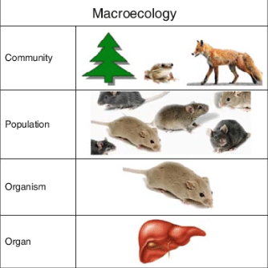
Collection Terms and Levels of Organization
Landsat Levels of Organization
Collection | Landsat Collection 2
Dataset | Collection 2 Level-1 Landsat 8-9 OLI/TIRS
Product | LC09_L1TP_042026_20220809_20230403_02_T1
File | LC09_L1TP_042026_20220809_20230403_02_T1_B1.TIF
Excerpted from Panikov, N.S. (2010). Microbial Ecology. In: Wang, L., Ivanov, V., Tay, JH. (eds) Environmental Biotechnology. Handbook of Environmental Engineering, vol 10. Humana Press, Totowa, NJ. https://doi.org/10.1007/978-1-60327-140-0_4

Slide 4
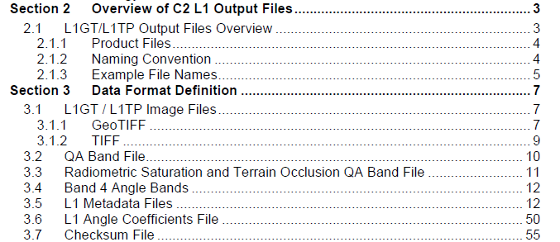
Importance of the Dataset Level
Landsat Data Groupings
Collection | Landsat Collection 2
Dataset | Landsat 8-9 OLI/TIRS Collection 2 Level-1
Product | LC09_L1TP_042026_20220809_20230403_02_T1
File | LC09_L1TP_042026_20220809_20230403_02_T1_B1.TIF
Datasets have Digital Object Identifiers, e.g., doi.org/10.5066/P975CC9B
Datasets Have Data Format Control Books, e.g., https://www.usgs.gov/media/files/landsat-8-9-olitirs-collection-2-level-1-data-format-control-book

Slide 5
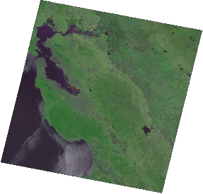
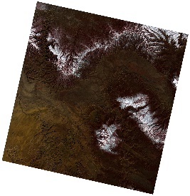
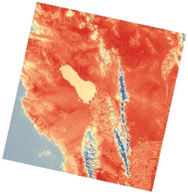
High Level Content & Structure of Collection 2 Core
Level | Spatial Format | Dataset Granularity
1 | Global Scenes (UTM, PS) | MSS (1-5) | TM (4-5) | ETM+ (7) | OLI/TIRS (8-9)
2 | Global Scenes (UTM, PS) |  | TM (4-5) | ETM+ (7) | OLI/TIRS (8-9)
1, 2 | CONUS, AK, HI Tiles (EA) |  | US ARD (4-9)

Slide 6
Selected Collection Management Practices
Minor revisions to products in a collection can be expected, but are infrequent and small in magnitude
To maintain the highest quality and consistency within the collection specification
Typically, in the event of errors or anomalies
Revised products supersede lower quality products and are identifiable by processing date
Changes to lower-level products propagate to higher-level products in the processing lineage
The nature and magnitude of minor reprocessing events are communicated to end users
https://www.usgs.gov/landsat-missions/landsat-collection-2-reprocessing-events

Slide 7
Selected Collection Management Practices
Unavoidable changes in forward production are allowed
e.g., cutting away from deprecated external auxiliary datasets to a new source used for Level-2 processing
The nature and magnitude of such changes are communicated to end users
https://www.usgs.gov/landsat-missions/news/atmospheric-auxiliary-data-changes-affect-landsat-8-9-level-2-surface
Dataset-appending changes are allowed
e.g., newly generated products sourced from the LGAC effort may be processed into the existing spec
Collection-appending changes are allowed
e.g., once sufficient maturity is achieved, provisional products may be processed as new dataset(s) into the collection spec

Slide 8
Selected Collection Management Practices
Major changes to collection specifications are saved for a full reprocessing of the historic record in the next collection, e.g.:
Improvements to radiometric and geometric calibration / quality at Level-1
Improvements to algorithms for deriving products at Level-2
Changes in the per pixel QA content
Other structural changes, e.g., spatial format, dataset granularity, file format, file naming conventions, bit packing design

Slide 9
Selected Collection Management Practices
Once a new collection is processed and released, the prior collection is superseded
Deprecation and User Transition
Cease forward processing of new data acquisitions into the superseded collection after ~ 1 year in parallel with new collection, then retain accessibility of the superseded collection for an additional ~ 1 year to allow user transition to improved data
Inform users: https://www.usgs.gov/landsat-missions/news/landsat-collection-1-datasets-be-removed-end-2022
Decommissioning
Make the superseded collection inaccessible
Retain access to tombstone digital object identifier pages and documentation related to datasets (DFCBs, ADDs)
Inform users: https://www.usgs.gov/landsat-missions/news/ring-new-year-landsat-collection-2
Publish a legacy sample of superseded products for future data forensics and intercomparisons
Preservation
Retain and back up lowest level of raw instrument data or other baseline data in perpetuity
Superseded collections may be deleted

