Slide 1
ESA collection management practices
Ferran Gascon, ESA
Agenda Item 10.2
WGISS-57
4-7 March 2023
Sydney, Australia

Slide 2
Overview
Introduction
ESA Collections
Recent activities:
Copernicus Sentinel-2
Envisat AATSR
ERS and Envisat Altimetry
Conclusions and Outlook

Slide 3
Introduction
Collections management enables collections (including metadata) to be properly handled and documented, and to become a resource for the user community.
Collections ensure a consistent data accessibility, usability, and long-term preservation.
Collections contribute to FAIR (Findable, Accessible, Interoperable, and Reproducible) scientific practices.
Collections facilitate the reanalysis of satellite measurements.
Collections are often generated through the reprocessing of the archive and therefore also referred as “reprocessed datasets”

Slide 4
Reprocessing on-going
Reprocessing completed
ESA UNCLASSIFIED – For Official Use
European Space Agency
Notes:
D/EOP has three main lines of activities: Earth Science, Copernicus and Meteorology

Slide 5
ESA Collections
ERS: https://earth.esa.int/eogateway/missions/ers/data
Envisat: https://earth.esa.int/eogateway/missions/envisat/data
Proba-1: https://earth.esa.int/eogateway/missions/proba-1/data
GOCE: https://earth.esa.int/eogateway/missions/goce/data
SMOS: https://earth.esa.int/eogateway/missions/smos/data
CryoSat: https://earth.esa.int/eogateway/missions/cryosat/data
Proba-V: https://earth.esa.int/eogateway/missions/proba-v/data
Aeolus: https://earth.esa.int/eogateway/missions/aeolus/data
Copernicus Sentinel-2: https://sentinels.copernicus.eu/web/sentinel/technical-guides/sentinel-2-msi/copernicus-sentinel-2-collection-1-availability-status
Copernicus Sentinel-5P: https://sentinels.copernicus.eu/web/sentinel/-/copernicus-sentinel-5-precursor-full-mission-reprocessed-datasets-further-products-release

Slide 6
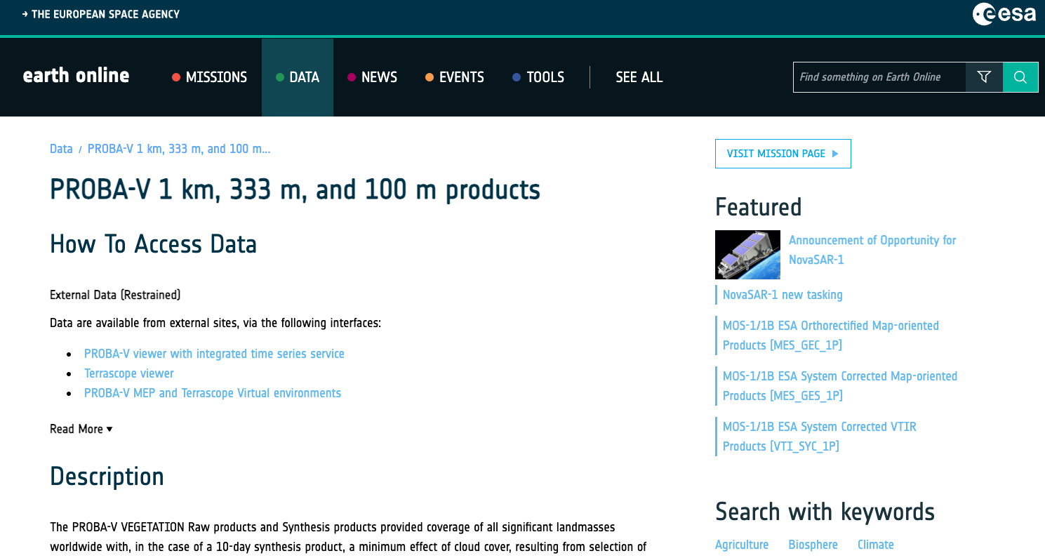
Proba-V Collections
https://earth.esa.int/eogateway/missions/proba-v/data

Slide 7
Copernicus Sentinel-2
Copernicus Sentinel-2 Collection-1 provides consistent time series with a uniform processing baseline.
Improved data radiometry (consistent across satellite units) and geometry (using Copernicus DEM and database of ground control points).
Both Level-1C (top-of-atmosphere) and Level-2A (bottom-of-atmosphere) products.
The Sentinel-2 Collection 1 (reprocessed data) featuring processing baseline $≥$5.0 is gradually ingested in the Copernicus Data Space Ecosystem.
Ingestion will be completed in Q2 2024.
Older data will be removed 6 month later(Q4 2024).
https://dataspace.copernicus.eu
https://sentinels.copernicus.eu/web/sentinel/technical-guides/sentinel-2-msi/copernicus-sentinel-2-collection-1-availability-status

Slide 8
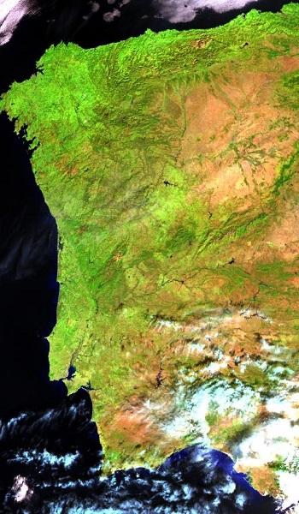
Envisat AATSR
The 4th Reprocessing of the AATSR instrument L1B data has been released to users.
Full mission archive from May 2002 to April 2012.
Level 1B products in a Sentinel-SAFE/NetCDF format with XML manifest file holding extensive metadata (e.g per-pixel uncertainty estimates).
Improved data quality, e.g. nadir and oblique view colocation, geolocation improvement via orthogeolocation to a DEM, improved surface classification via use of the Sentinel-3 Land Water Masks.
AATSR Full Resolution image of the Iberian Peninsula from 28 October 2006.
https://earth.esa.int/eogateway/news/envisat-aatsr-4th-reprocessing-data-now-available

Slide 9
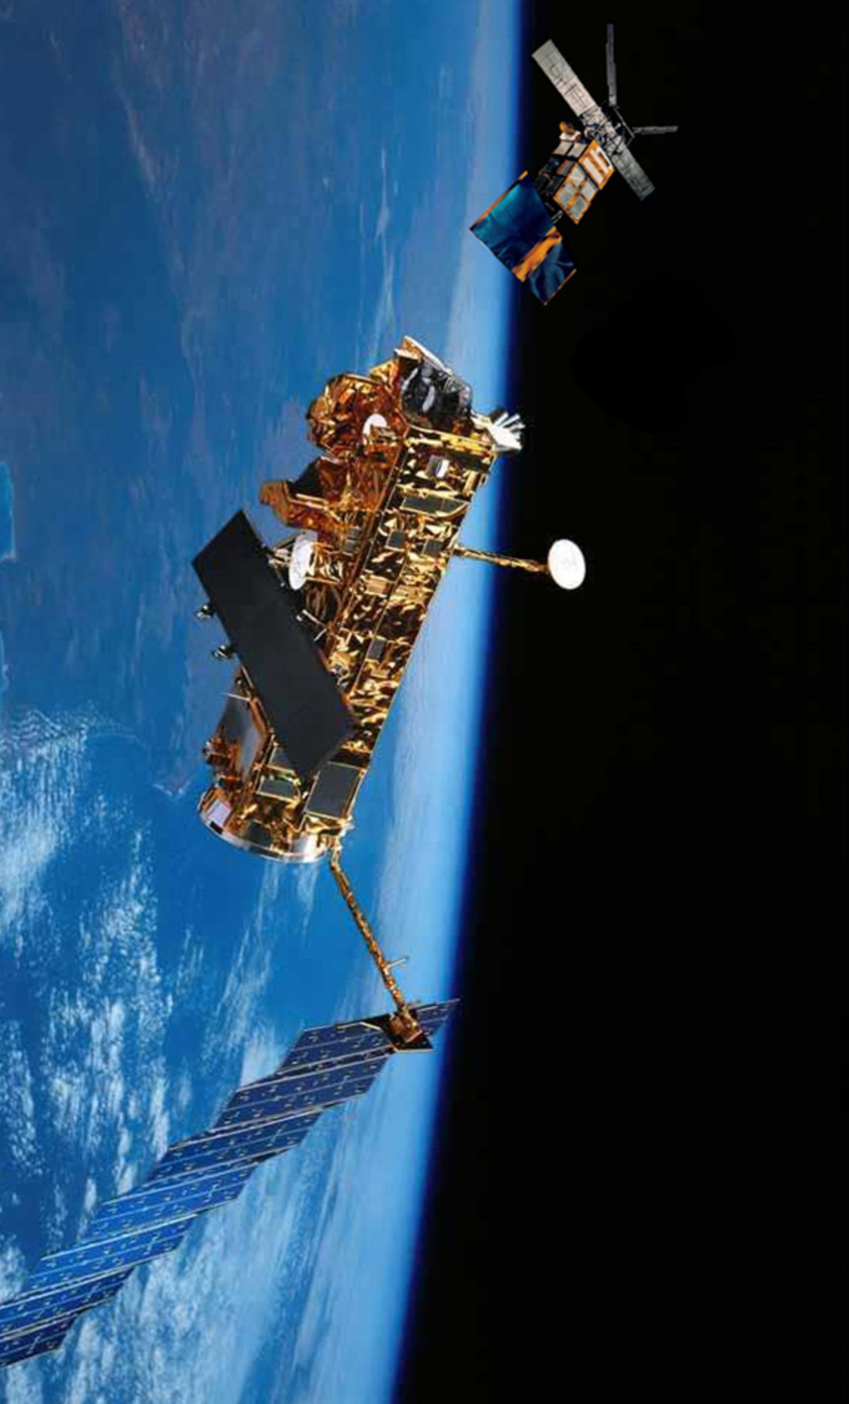
ERS and Envisat Altimetry
Fundamental Data Records for Altimetry (FDR4ALT) [www.fdr4alt.org] is an ESA project aiming at generating innovative Earth system data records:
The goal is to serve the different communities involved in long term data exploitation over the different Earth surfaces: ocean, coastal, inland water, ice sheets, sea ice and atmosphere.
Fundamental Data Records
L1B products containing all ancilliary and instrumental data used for calibrations
Thematic Data Products Level-2P, easy to use, validated products with uncertainties included
serving different communities involved in long term data exploitation
FDR ALT
FDR MWR
Ocean & Coastal
Topography
Inland waters
Land-Ice
Greenland Antarctica
SeaIce
Atmosphere
Ocean Waves

Slide 10
Conclusions and Outlook
ESA is providing collections for most of its past and present missions.
Additional collections are being prepared, e.g. Proba-1
Scientific applications, such as for climate change, have underlined the importance of collections management.
The development of new “down-stream” applications and services using space-borne data have increased the need for collections management.
Heterogeneous approaches for collections management (within ESA and across Agencies).
Need of further coordination between space agencies for defining harmonized and improved collection management practices ?

