Slide 1
On the way to generate a Fundamental Data Record (FDR) based on 40 years of AVHRR data
Stefan Wunderle, Christoph Neuhaus (UniBe); Martin Raspaud (SMHI); Jonathan Mittaz (NPL); Marin Tudoroiu, Mirko Albani (ESA)

Slide 2
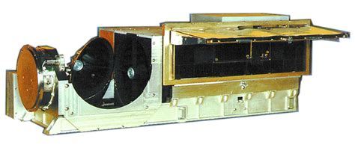
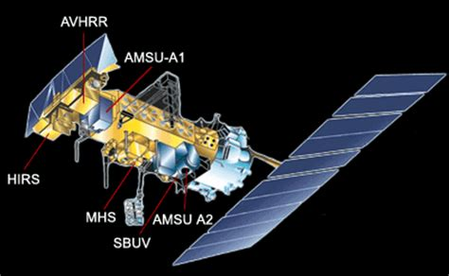
Advanced Very High Resolution Radiometer (AVHRR) 1978 – 2023 (2028)

Slide 3
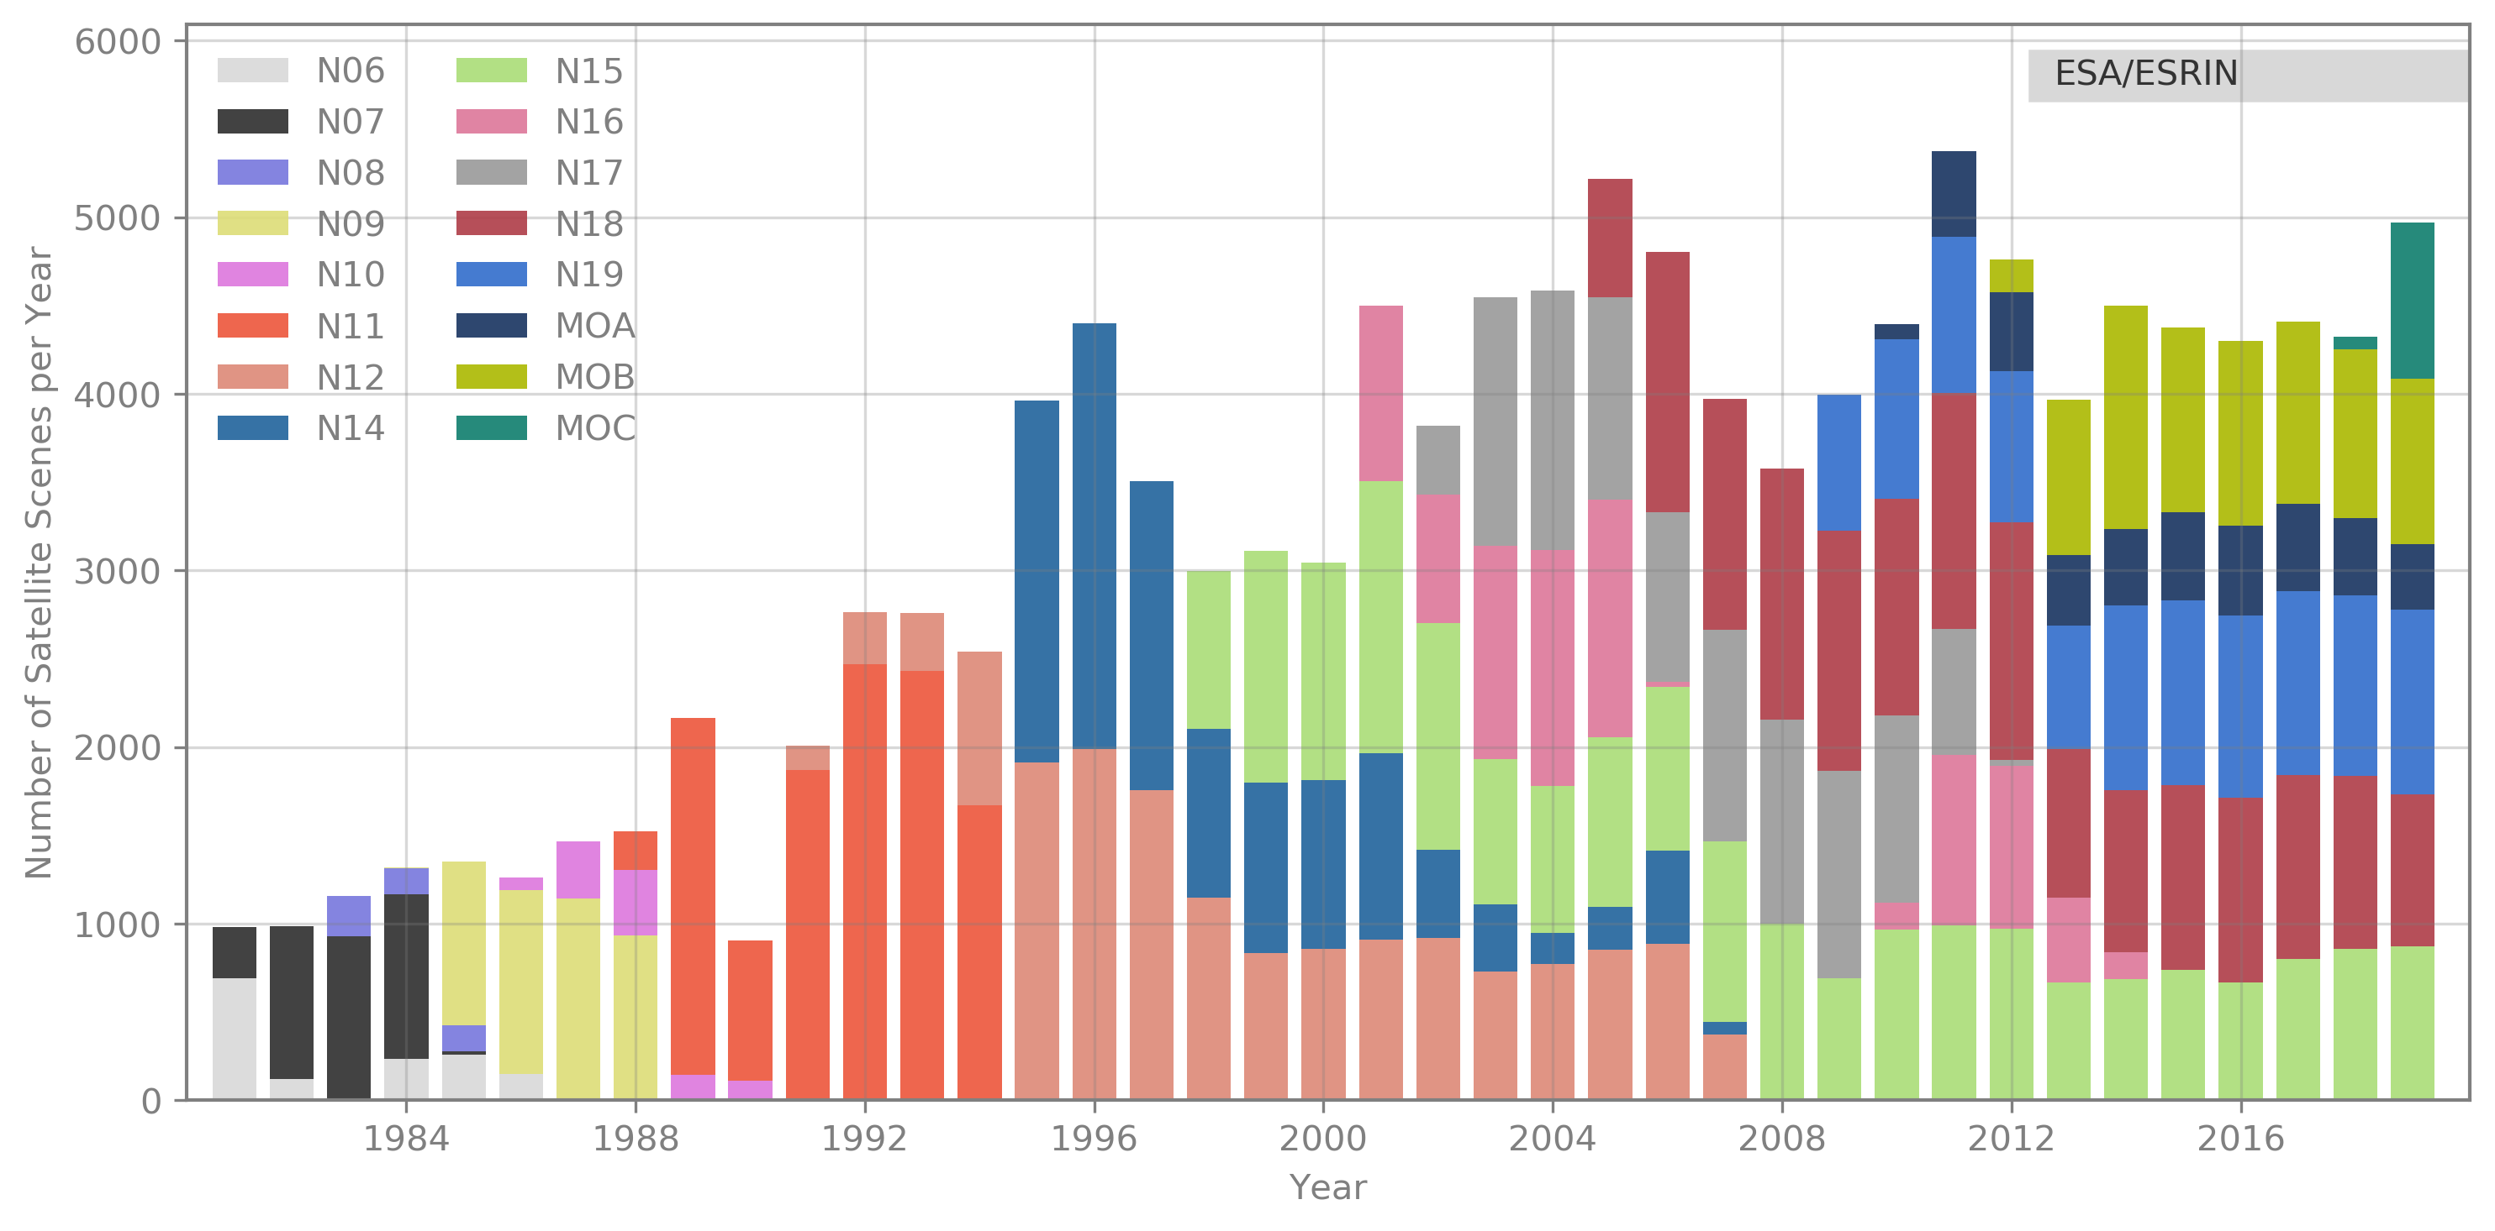
ESA Heritage Programme and University of Bern experience in AVHRR processing
UniBern – long tradition of AVHRR reception, processing and retrieval of ECVs
We see the need to make historical data accessible to the public and keep the data alive for an unlimited time.
Metop-B 2024-02-21 08:25:37.237 - 08:39:14.070 UTC; received at UniBe

Slide 4
AVHRR Curation Program (ESA – UniBe): finalized Dec. 2023 - generation of level1b data sets (consolidated EO-SIPs) - generation of level1c data sets (consolidated EO-SIPs) - data rescue of CEOS-Sharp files
Two-ten overpasses per day.
Dataset consists of more than 260.000 data products harmonized and consolidated through a dedicated ESA project (Heritage Space Programme).
All accessible free of charge via ESA dissemination services.
Archived for unlimited time by ESA.
Processing to Level-1b and Level-1c.
https://earth.esa.int/eogateway/catalog/avhrr-level-1b-local-area-coverage-imagery

Slide 5
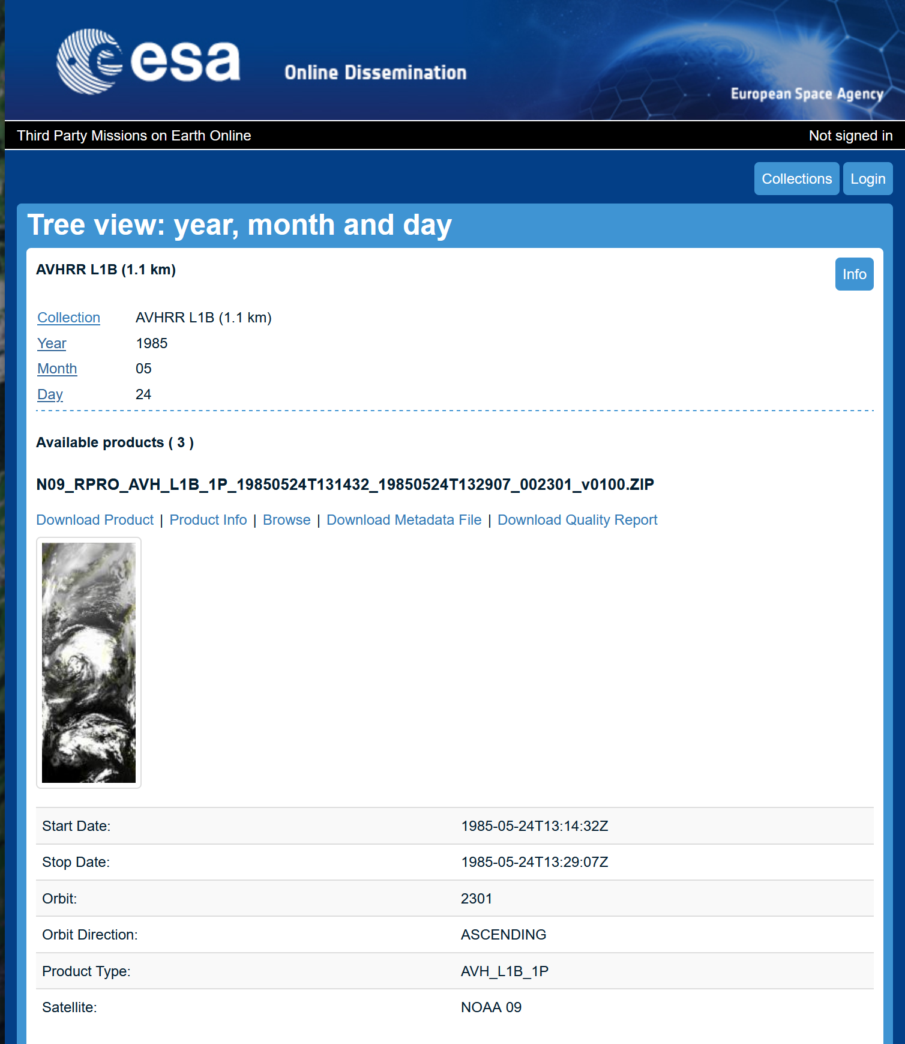
ESA Online Dissemination – AVHRR L1B data
https://tpm-ds.eo.esa.int/oads/access/collection/NOAA_AVHRR_L1B_LAC
https://doi.org/10.5270/AVH-f1i8784

Slide 6
FDR4AVHRR – Curation Project
KO: 26 January 2024 (duration: 23 months)
Consortium: UniBe (PI), NPL, SMHI
Objective: generation of a FDR based on AVHRR data and to make all data accessible via ESA dissemination service
Tasks:
Extend the European data set with additional data from UniBe (2021 – 2024)
Integrate global data from South Africa, Argentina, etc. and from the 1km Land Project (1992 – 1999)
Develop a module “uncertainty” to be added to open source software PyGAC
Develop a module “orthorectification” to be added to open source software PyGAC
Improve the inter-satellite calibration for all channels
Reprocessing of all data (Europe, global) to level1c
Validation and quality assessment
Transfer all data to ESA for archiving and dissemination
Co-operation with EUMETSAT MetOp-reprocessing team has started

Slide 7
Project Logic: Overview and Tasks

Slide 8
Task 1: Extend the AVHRR archive (Europe; global) AVHRR (1km) to be included in the FDR4AVHRR project
Europe
Bern (BRN), Switzerland
1980 – 2024
250.000 data sets;
incl. Berlin, ESA and DDE (1981-1988)
Dundee (DDE), Scotland
1979 – 2019
235.540 data sets

Slide 9
AVHRR (1km) to be included in the FDR4AVHRR project
Globe
Buenos Aires (BAA), Argentina
Data transfer ongoing.
N. products: 25504
Volume: 1.02TB
Coverage: 1995-2017
Hartebeesthoek (HBK), South Africa
Download completed.
N. products: 7684
Volume: 465GB
Coverage: 1985-2009
Malindi, Kenya (operated by ESA)
All DLT tapes transcribed.
N. products: 8452
Volume: 614GB
Coverage: 2001-2009

Slide 10
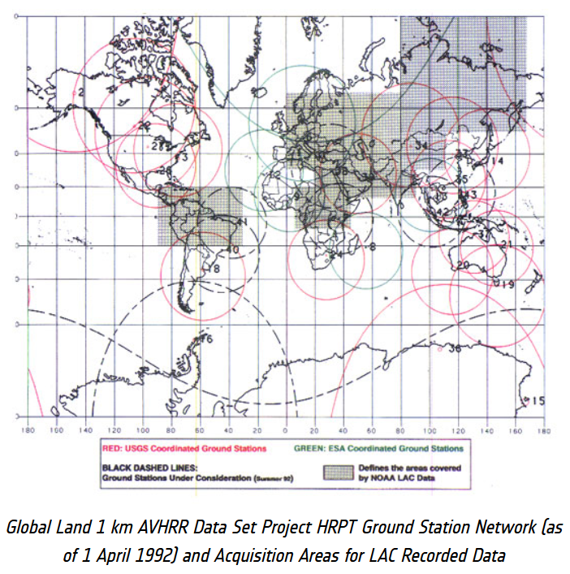
AVHRR (1km) to be included in the FDR4AVHRR project
Globe: from 1km-AVHRR Land Project (USGS, ESA, NOAA, CSIRO, and many more)
Stitched data from stations under USGS responsibility are available at ESA but not suitable for reprocessing and alignment to the global European Master Dataset.
Coordination ongoing with NOAA and USGS to retrieve the 31597 original (non-stitched) data.
To get access to the original data would be highly acknowledged.
1992 – 1999
31.597 data sets

Slide 11
Summary End of FDR4AVHRR Project (Nov.2025): approx. 500.000 1-km AVHRR level1c data (access ready data) will be available via ESA dissemination service.
The new FDR4AVHRR project will be a major contribution for ESA CCI’s and all
studies related to Essential Climate Variables.
Due to
Improved calibration
Improved geocoding
Validation
Included uncertainty
Improved open-source software PyGAC
Extended 1km-AVHRR data set (Europe, global)

