Slide 1
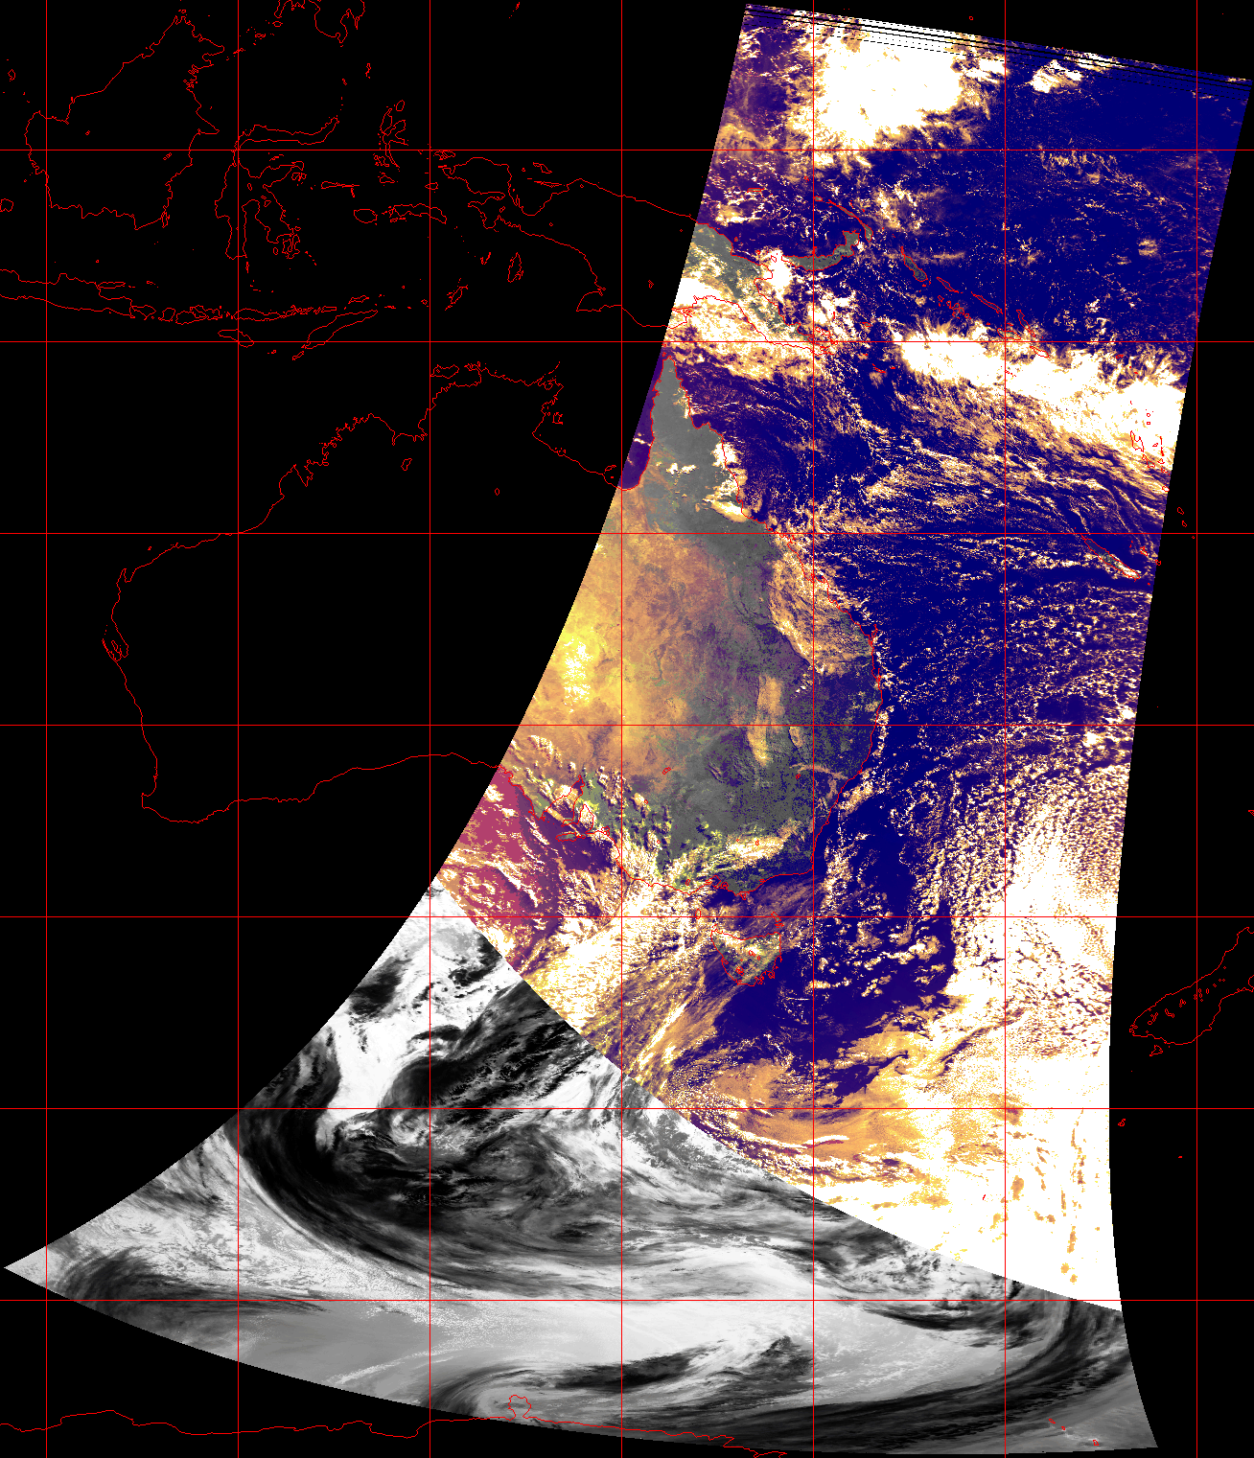
Australian AVHRR
TOA online collection and atmospheric correction processing
WGISS-57, Sydney | 6 March 2024
Matt Paget, Edward King, Aarond Dino
Rob Bridgart, Andrew Prata, Matt Stenson
Notes:
Update and follow-on from Edward King's presentation for WGISS-56, https://ceos.org/meetings/wgiss-56/.
In that presentation, Edward showed
History of AVHRR acquisition and collection management in Australia
Stitching of overpass scenes acquired from multiple receiving stations
Geometric and radiometric processing to TOA
This presentation summarises our work since last year.

Slide 2
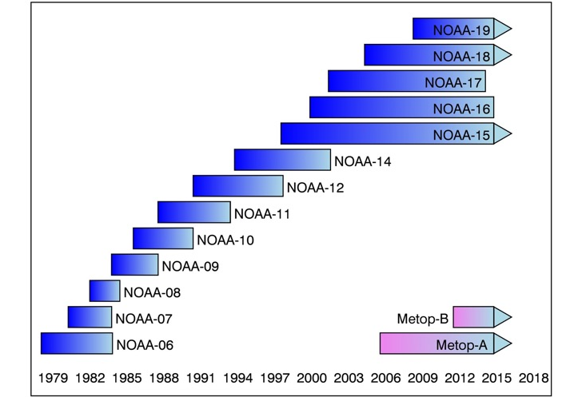
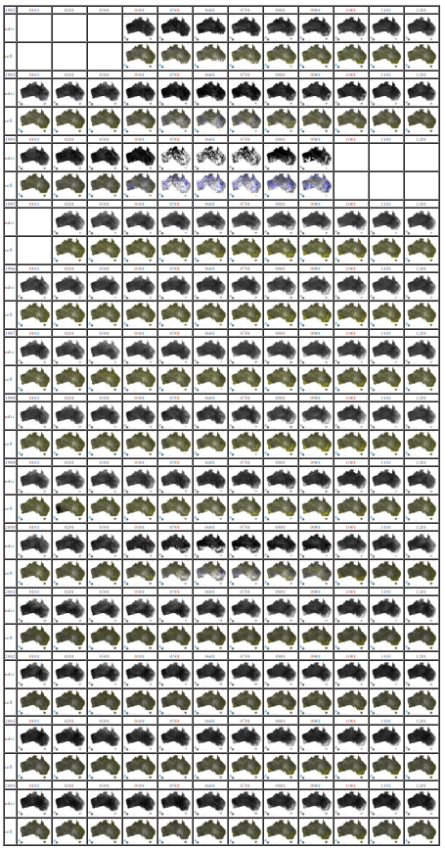
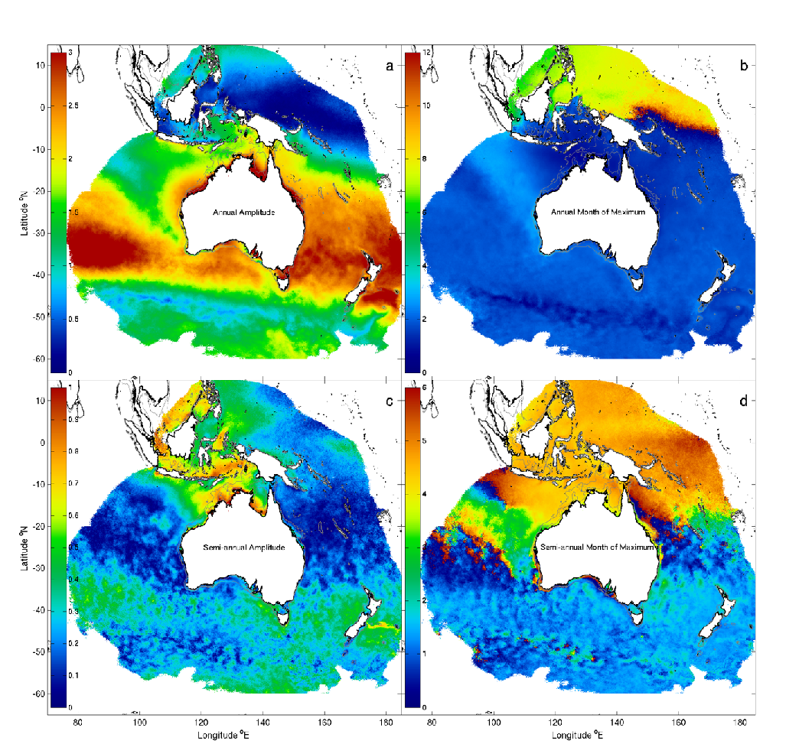
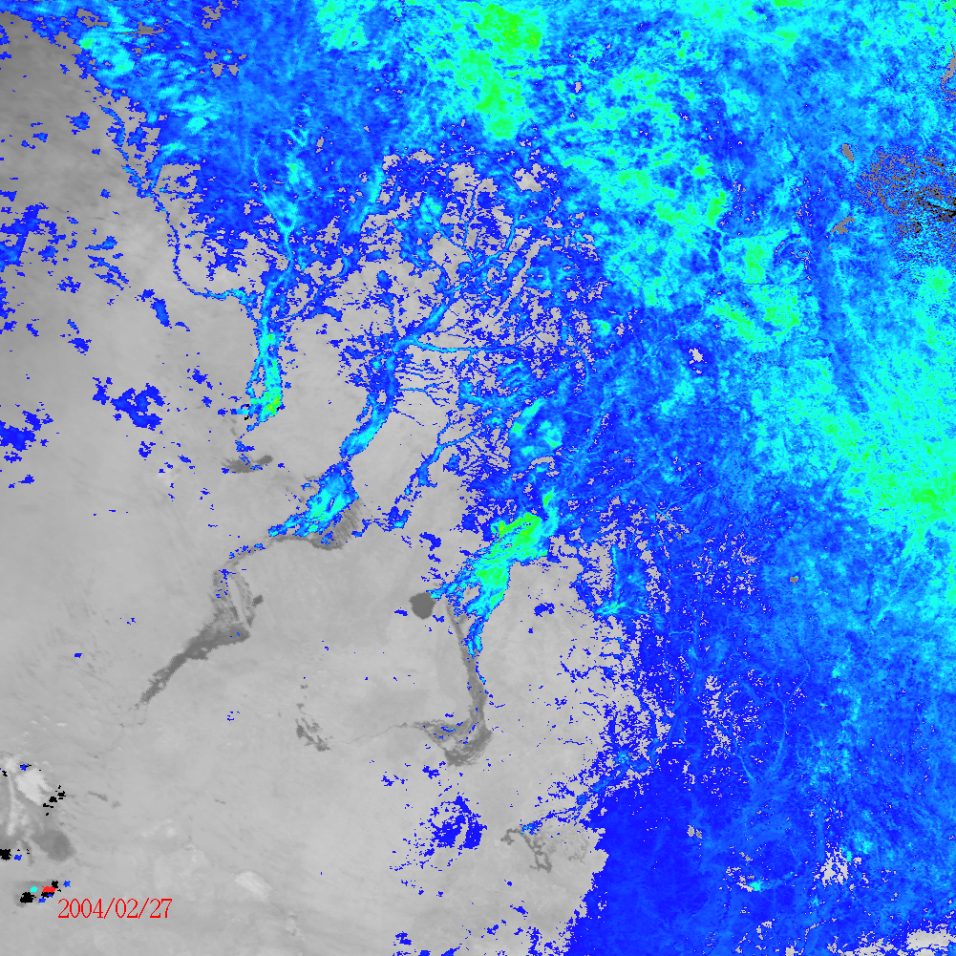
AVHRR is a long record with high temporal resolution
198?-1992
1992+
Long term change
  NDVI
  SST
Unique record of short timescale events and responses pre-2000
  Fire scars, floods
IR + NDVI (Channel Country, 2004)
SST Atlas of Australian Regional Seas (Wijffels et al 2018)
NDVI Monthly Time Series
Notes:
First a quick review of the applications we aim to support.
The Australian AVHRR record from 1992 is in good order. This is from around NOAA-11 onwards
Pre-1992 data is being worked on and is likely to be recoverable back to 1984/5
Our primary use cases include
Long term trend analysis; eg NDVI and also SST atlas of regional seas
Flood image is composite of Thermal IR (greyscale) showing surface water coming down channels into the desert to the SW, with thresholded NDVI in colour, indicating greening up ecosystem responds to flooding ingress

Slide 3
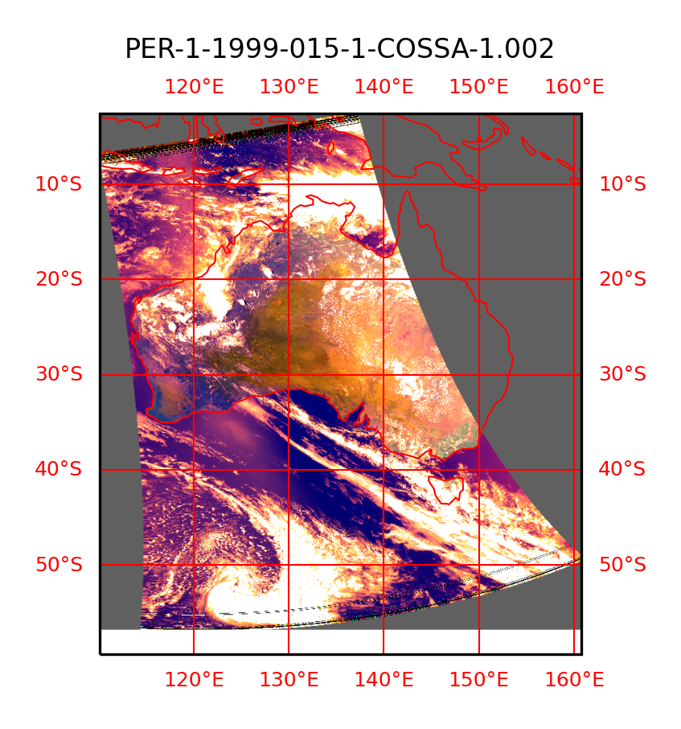
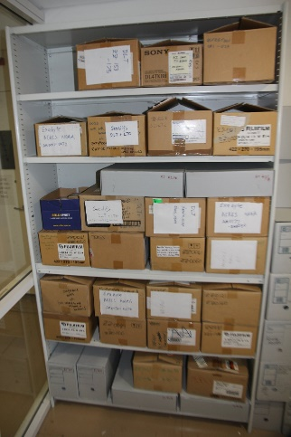
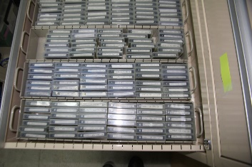
Activity Focus over last 6 months (since WGISS-56)
Trial L1 Processing of Existing (stitched) Archive
  Test of newly developed processing package
  61022 stitched passes from 1992/04/01 – 2023/12/31
  Daytime NOAA-11/14/16/18/19
  Top of Atmosphere radiances and reflectances
    using PATMOS calibration code from PyGAC
  Geolocation using Australian state vector method
  ~2500 CPU hours on National Supercomputing Infrastructure
  CLAVR-1-based cloud mask
  netCDF swath archive
  Remap -> COGS -> EASI Datacube for subsequent assessment
Recovery of pre-1992 Archive
  Continue sorting through data (on disk) read back from 10,000+ tapes
  Have identified pre-1992 data from Tasmania, Queensland and Western Australia
  Working on reverse engineering data file formats (station specific)
  Plan to extend basic processing to 1980’s
Data Availability
  Working to make data (L0 + L1) publicly accessible
  CSIRO research data portal https://dap.csiro.au
  CSIRO ”EASI” cloud, https://map.csiro.easi-eo.solutions
  TERN Data Portal, https://portal.tern.org.au
Notes:
Testing the upgraded TOA processing and preparation pipeline
Ran the processing for 60k passes from 1992 to present
Added CLAVR cloud mask
Reviewed included metadata
Convert TOA netcdfs to WGS84 COGS for distribution via CSIRO's EASI cloud platform and Australia's Terrestrial Ecosystem Research infrastructure
Work has also begin on the pre-1992 data.

Slide 4
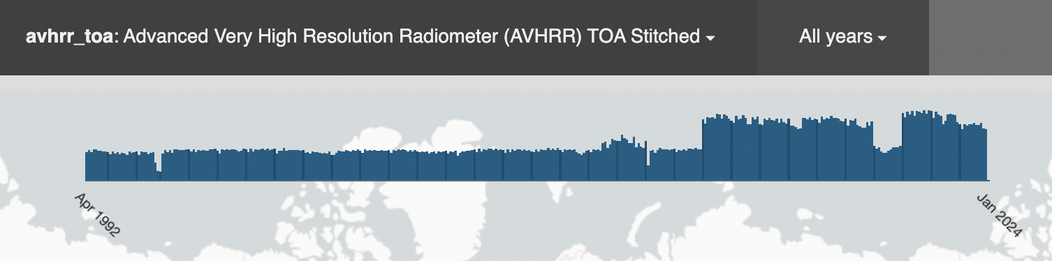
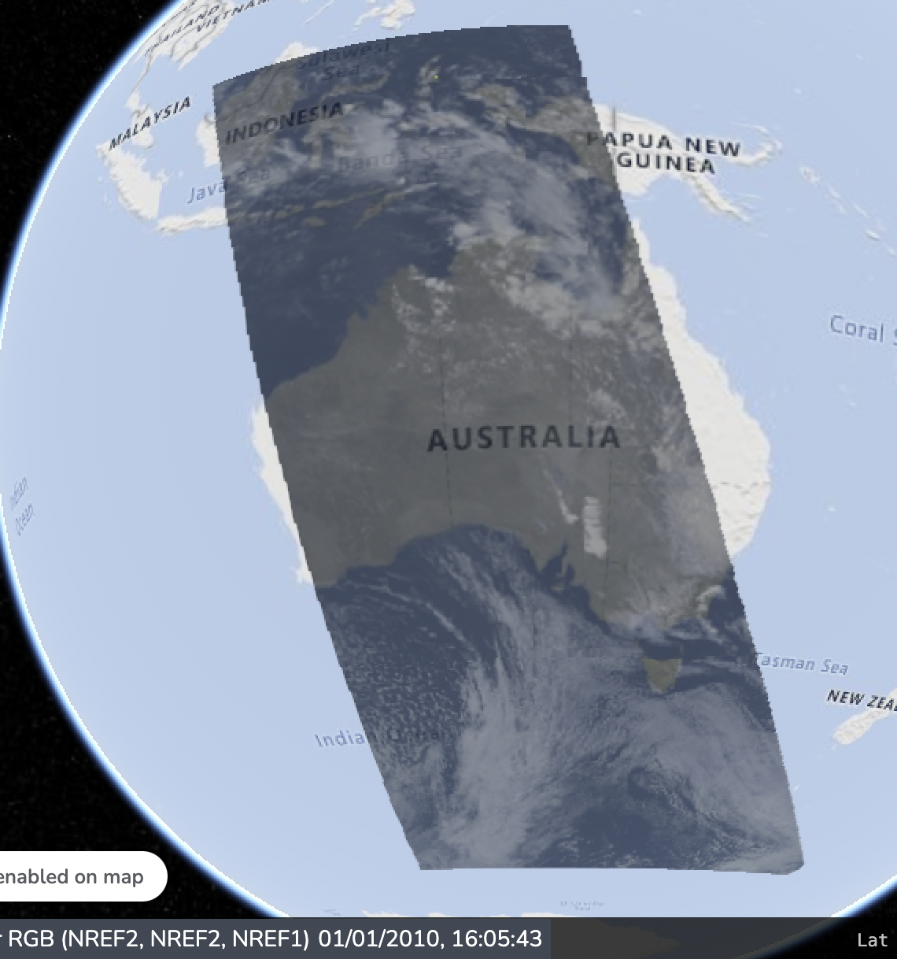
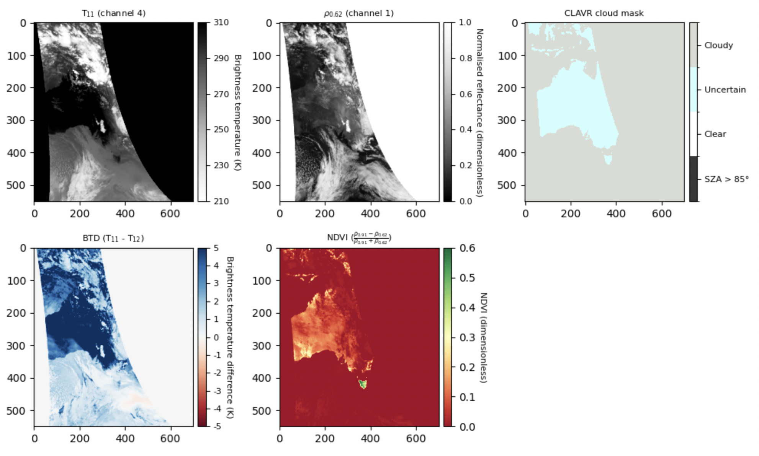
Online access to Australian TOA
Public access:
"EASI" cloud - Scene metadata and WMS
TERN Landscapes (forthcoming) - download
Data and analytics:
Remapped to WGS84 COG
"EASI" cloud – CSIRO partner login
Coverage & metadata, https://explorer.csiro.easi-eo.solutions/products/avhrr_toa
Pseudo-RGB WMS, https://map.csiro.easi-eo.solutions
Notebooks:
Verify the data layers
Composites and products
Notes:
Here are early examples of the online access to the Australian TOA data
We are using this to review the integrity and completeness of the 1992 to present data
For example we see that the cloud-mask has not converted or computed properly

Slide 5
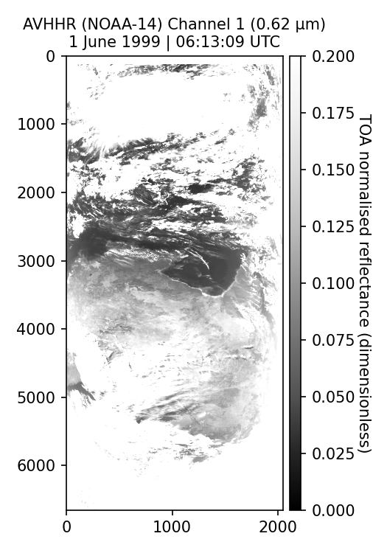
Atmospheric correction of AVHRR TOA
Account for scattering and absorption effects of the atmosphere
For shortwave AVHRR channels the primary atmospheric effects to consider include:
  Rayleigh scattering (single- and multi-scattering effects)
  Aerosol scattering (single- and multi-scattering effects)
  Water vapour absorption
  Ozone absorption
Observed TOA
Notes:
We have also started work on atmospheric correction and BRDF correction
Taking into account scattering, aerosols, water vapour etc
We're very happy to hear from the community on recommended common and compatible approaches that we can test and adopt

Slide 6
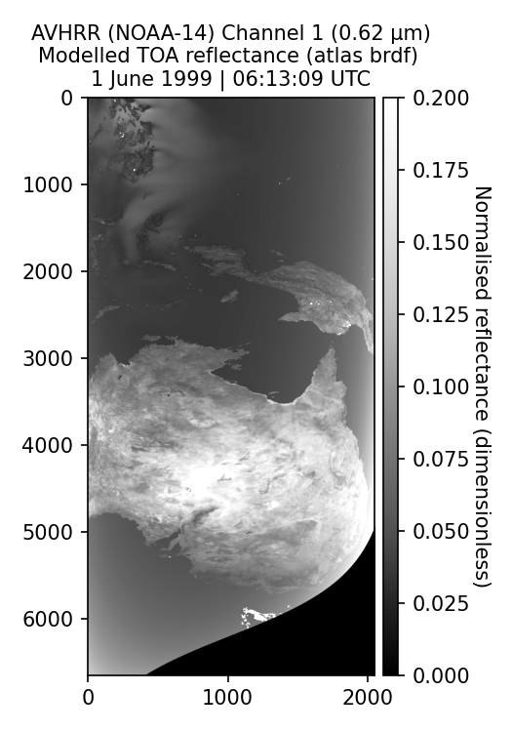
Radiative transfer modelling
We are evaluating the suitability of RTTOV for atmospheric correction
Other RTMs being considered include 6SV, libRadtran and MODTRAN6
Advantages of RTTOV include:
  It is ‘fast’ RT code
  Allows for atcorr in the thermal IR (e.g. to retrieve surface temperature)
  Integration with ERA5 and CAMS (aerosol) datasets
  Enabled with all AVHRR instrument spectral response functions
Simulated TOA with RTTOV
Notes:
We expect to start with the RRTOV software, as our colleague Andrew Prata has extensive experience with this
But we will also likely explore other common radiative transform modelling software
Considerations may include correctness, convenience, ancillary datasets, and application domains (e.g., land, shallow water etc)

Slide 7
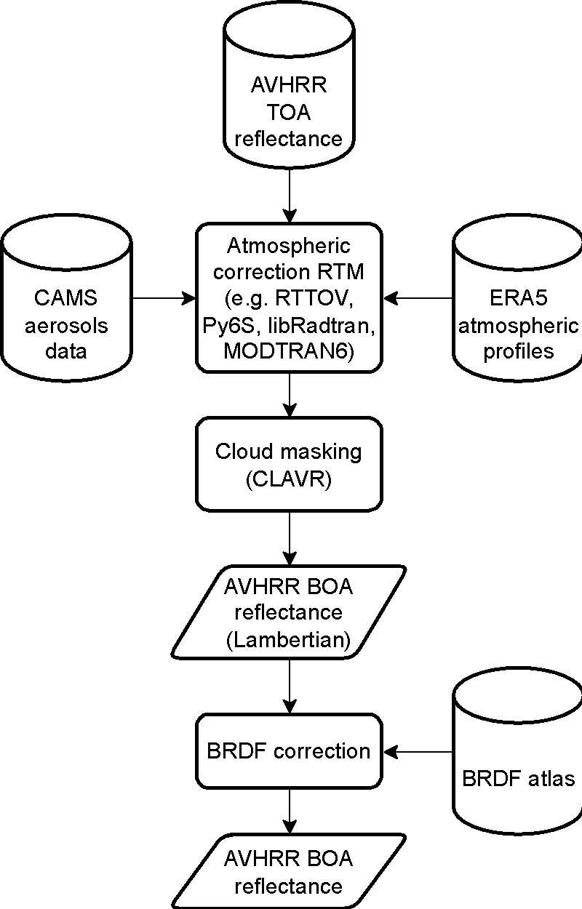
Proposed workflow for bottom of atmosphere (BOA) reflectance retrieval
Now have this (plus some reprocessing)
Update and improvement
At.corr. for a Lambertian surface (no aerosols)
BRDF correction (no aerosols)
BRDF with tropospheric aerosols
BRDF with tropo- and stratospheric aerosols
Trialing RT software and input datasets
Have this but may explore other options
Implement Li, Jupp et al
Validation / verification (MODIS, Aeronet etc)
Notes:
Here is our proposed surface correction workflow
We now have the TOA collection at the top of the graphic
We are presently building the workflows for the RT software options
We have implemented a CLAVR cloud mask but may revisit this
The BRDF correction method, by Li, Jupp et al, is consistent with the Landsat and Sentinel-2 surface correction adopted by Geoscience Australia
We have a staged approach where we expect to add more complexity as its developed, tested and versioned.

Slide 8









Acknowledgements
Present Effort
Australian National Collaborative Research Infrastructure
  Terrestrial Ecosystem Research Network (TERN)
  Integrated Marine Observing System (IMOS)
CSIRO Environment Business Unit
Honorary mention: Simon Pinnock (ESA)
40 years of data collection (ongoing)
CSIRO (several Divisions/Units)
Australian Bureau of Meteorology
Geoscience Australia
Australian Institute of Marine Science
Landgate (Western Australia)
Australian Universities (several)
Many colleagues – mostly retired
Notes:
That’s it. Of course being a long time series we acknowledge and value many contributions from Australian and international organisations.

Slide 9
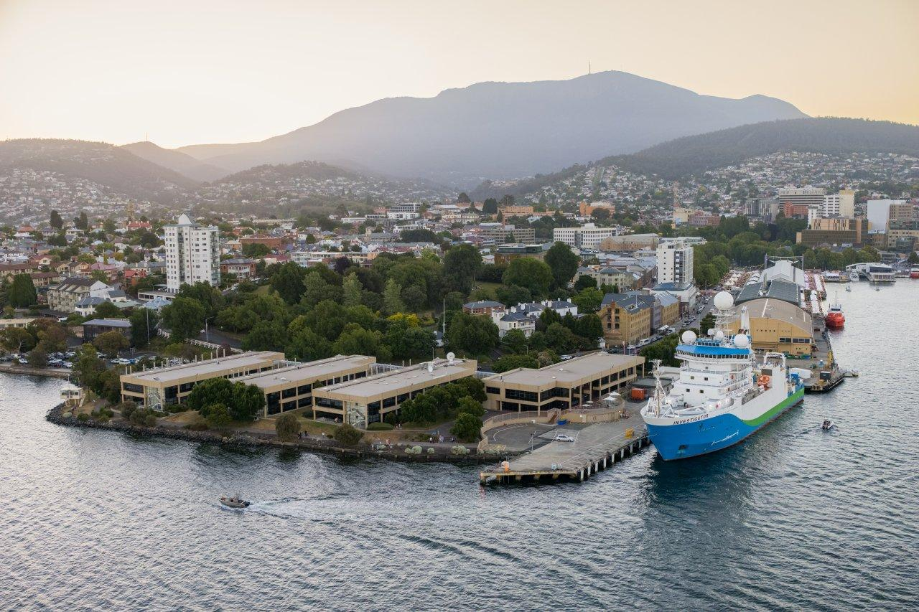
Thank you
CSIRO Environment
  Edward King
  Research Group Leader
    +61 3 6232 5334
    edward.king@csiro.au
    https://people.csiro.au/K/E/Edward-King
With
  Matt Paget
  Aarond Dino
  Rob Bridgart
  Andrew Prata
  Matt Stenson

