Slide 1
WGISS-57 AVHRR Data Recovery Project Updates
M.Albani, ESA
Agenda Item 8.6
WGISS-57
4-7 March 2024
Sydney, Australia

Slide 2
AVHRR a unique long term data series
AVHRR data available as GAC (4 km) or LAC (1km). 1-km AVHRR LAC data gives new insights on structural changes on land in comparison of coarse resolution AVHRR GAC data.
GAC DATASETS
NOAA POES AVHRR GAC global archive: 1978 onwards
LAC DATASETS
EUMETSAT MetOp AVHRR 1km FRAC global archive: March 2008 onwards
Global Land 1-km AVHRR data set covering the period 1992-99
Many national / regional data archives of LAC data covering a longer period with high value for the retrieval of ECVs. Some of them accessible for users, others not due to unknown accessibility, responsibility, data format and structure.

Slide 3
AVHRR 1 Km digital data archives (excerpt)
Europe: ESA & University of Bern (Switzerland), STFC CEDA (UK, including Dundee Satellite Receiving Station), MeteoFrance (France), DLR (Germany), METoffice (UK), IGiK (Poland);
Americas: NOAA and USGS (USA), NRCan/CCMEO (Canada), GiDyC-Servicio Meteorológico Nacional (Argentina), INPE (Brazil);
Africa: SANSA (South Africa), ASI / University of Rome (Kenya);
Asia: CMA (China), IRIM (Mongolia), GITSDA (Thailand), Jaxa (Japan);
Australia: CSIRO.
Datasets from Meteorological Institutes, Universities and other organizations all over the globe
Fundamental to ensure accessibility of 1-km LAC data from all available sources (in particular in the period before 2008)

Slide 4
Cooperation Activities on AVHRR
Objective: Build a worldwide coverage AVHRR LAC data series from 1979 onwards
Unfolding and making accessible 1km AVHRR data from regional archives (possibly open and free);
Transcribing unique data from heritage media;
Identifying a common format for AVHRR Level-1b and Level-1c data and pursuing (re)processing from AVHRR data owners/holders and data accessibility;
Facilitating data discovery through the WGISS Connected Data Assets Infrastructure.

Slide 5
WGISS
Committee on Earth Observation Satellites
AVHRR Global Land 1km Dataset

Slide 6
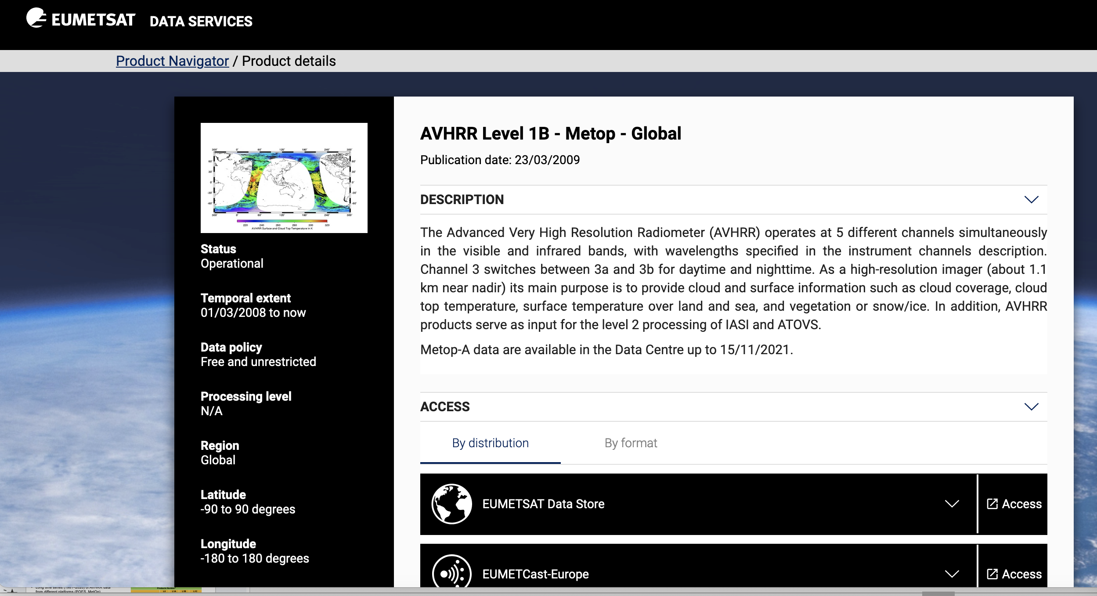
Global 1km AVHRR dataset 2008 - today
Metop satellites operated by EUMETSAT
Temporal extent: 01/03/2008 to today
Open and Free

Slide 7
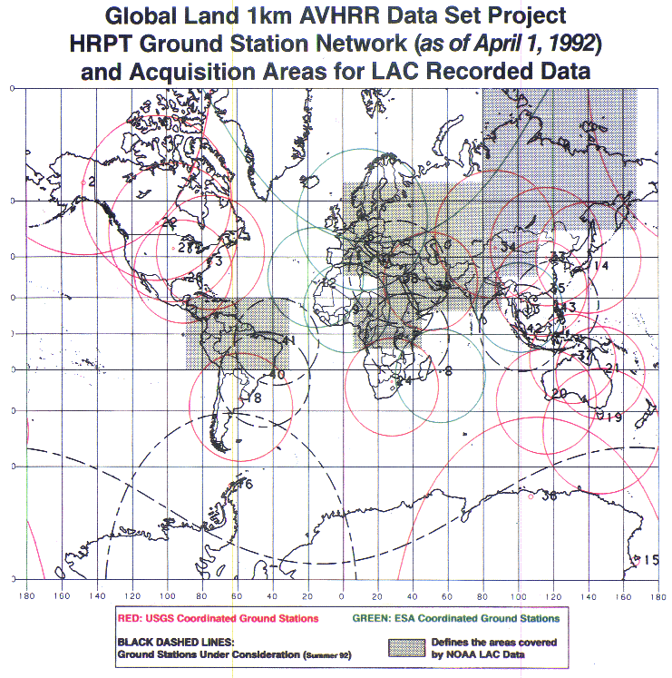
Global 1km AVHRR dataset 1992-1999
Two different global Land 1-km AVHRR datasets covering the period 1992-1999 are available at ESA :
Data acquired at ESA network stations (Terranova, Nairobi, Manila, etc..) were processed up to L1C and published in the ESA web page as dataset Out-of-Europe.
Data in stitched format (.arch files) from USGS not processable at ESA (and so not accessible to users) as data is not congruent with the expected one (ex. the calibration data is stitched partially from each acquisition pass, the L1B file does not contain the missing scanlines, the merged data header don’t provide the receiving stations references and header metadata is not compliant with data).
ESA looking for documentation on stitched product format 🡪 USGS? CSIRO?
ESA looking for a tool able to convert the stitched product (.arch files) to e.g. HRPT files or a well documented L1A format 🡪 USGS? CSIRO?
AVHRR receiving stations contributing to global land 1km AVHRR data set. (https://lta.cr.usgs.gov/1km/hrpt_image)
Products Number*
 | L0 | L1A | L1B | L1C
1Km-Project (out of Europe) |  | 3901 | 3901 | 2991
* No L0 available.

Slide 8
WGISS
Committee on Earth Observation Satellites
AVHRR Regional LAC Archives

Slide 9
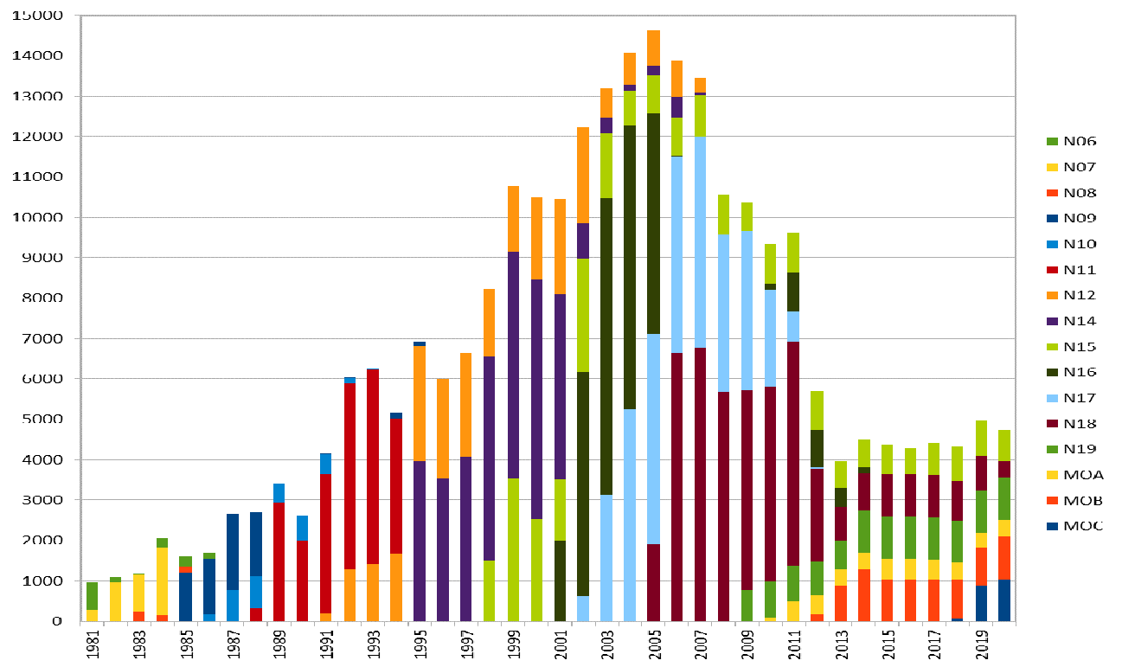
Europe – ESA & University of Bern
Long time series (1981–2020) of AVHRR data from different platforms (POES, MetOp)
Unique source to retrieve Essential Climate Variables (ECV) to investigate climate change over last 40 years.
Products Number*
 | L0 | L1A | L1B | L1C
Europe | 145231 | 259747 | 260060 | 259164
*The L0, L1A and L1B input data are scattered.
European dataset includes data from University of Bern, Dundee Station and ESA holdings: 260.000 products. harmonized and consolidated through a dedicated ESA project (Heritage Space Programme). All products are packed in the EO-SIP package format.
All data accessible free of charge via ESA dissemination services and safely archived at ESA.
Processing to Level-1c completed, data will be opened to users soon.
Presentation at WGISS#56

Slide 10
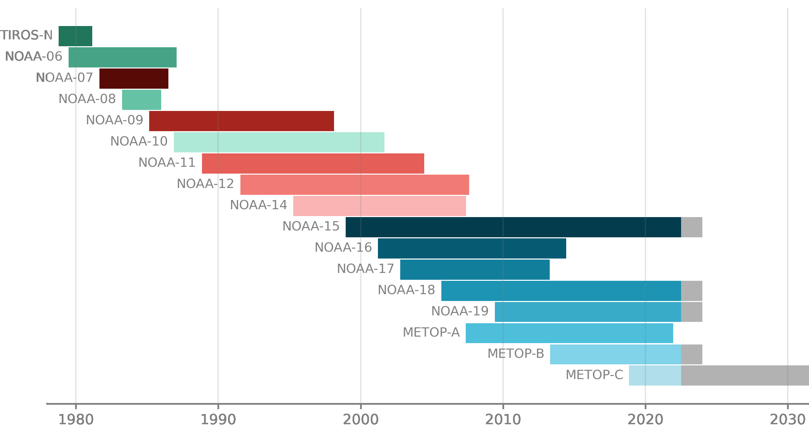
Europe - ESA Data temporal coverage
1980
1990
2000
2010
2020
D
A
Y
of
M
O
N
T
h
31
1
Missing data
Metadata extracted from ESA L1C products to build a heat chart on data acquisition frequency per day:
min value: 1
max value: 50
Missing data: white
Data gap will be closed getting missing products from other sources

Slide 11
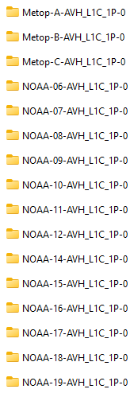
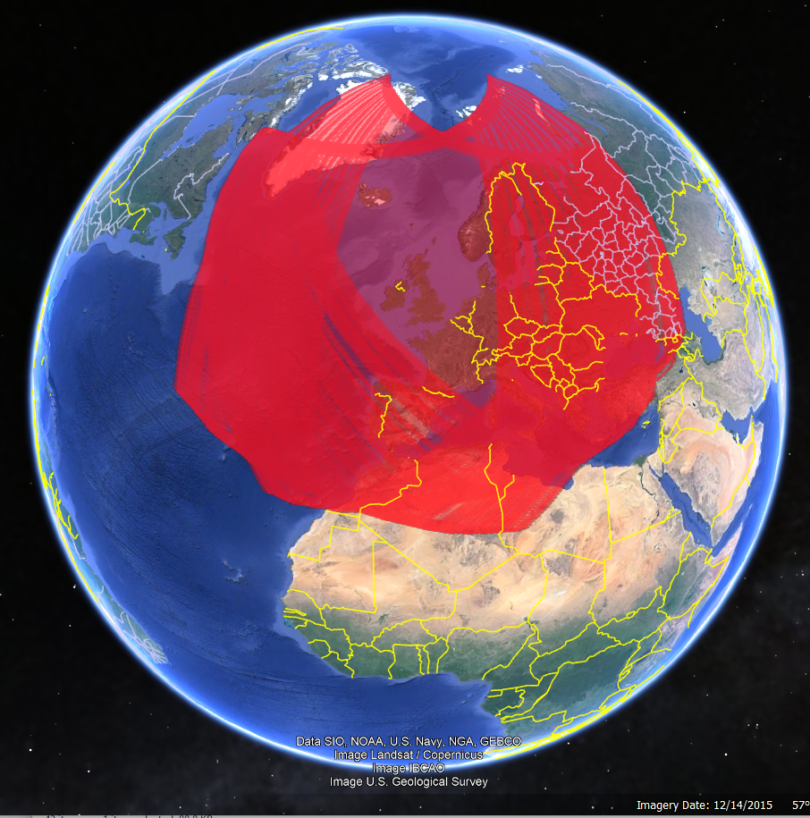
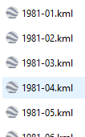
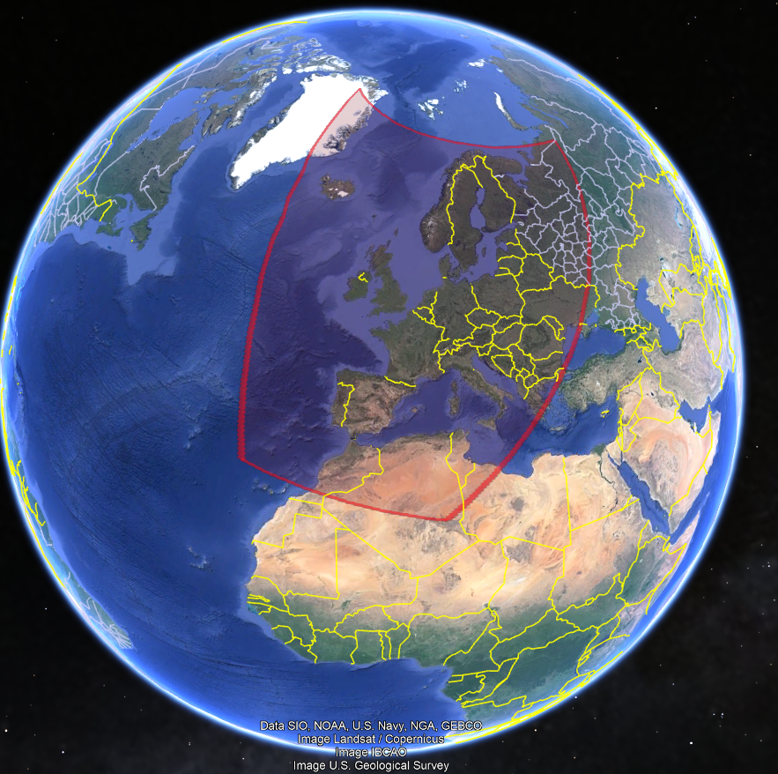
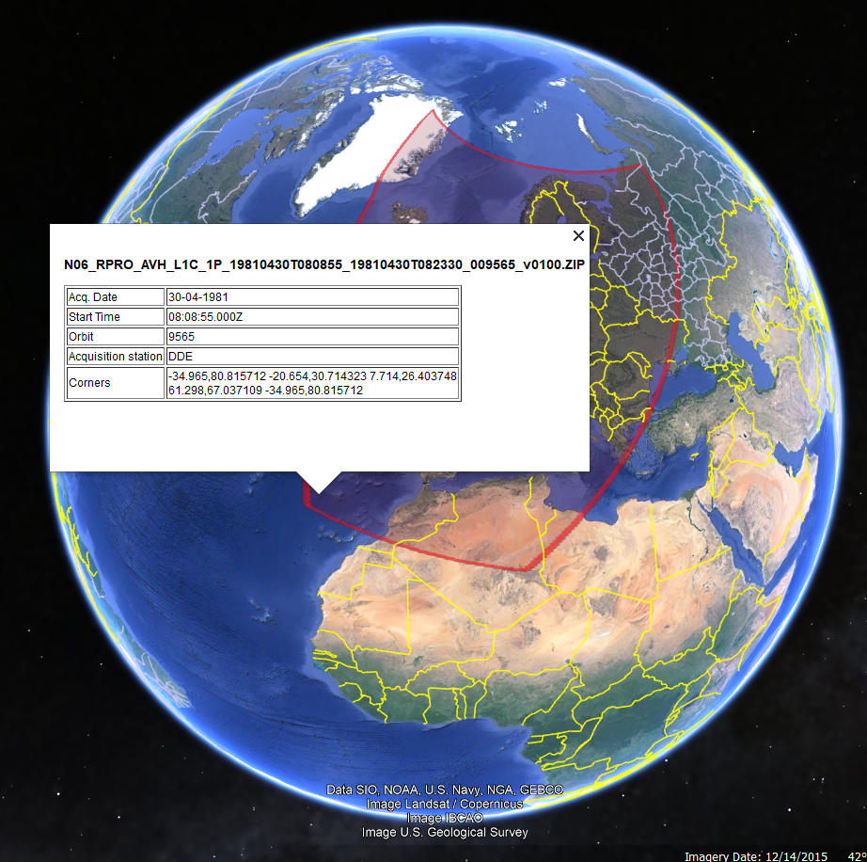
Metadata extracted from ESA L1C products
Built a KML file for each mission, year and month;
Each pass can be selected with metadata

Slide 12
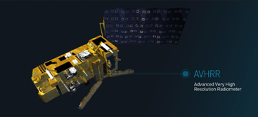
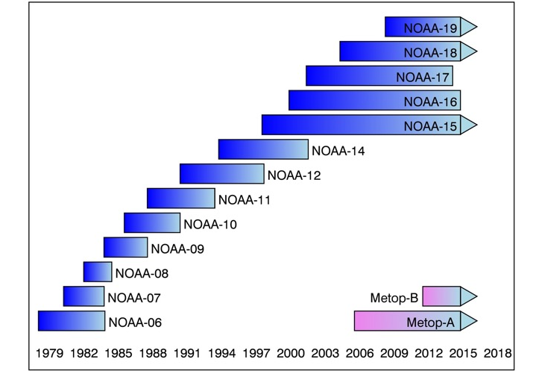
FDR for Advanced Very-High-Resolution Radiometer instrument (FDR4AVHRR)
Project started in Q1/2024 (following a series of AVHRR activities);
Reprocessing AVHRR series LAC products (NOAA & MetOp missions) 40+ years of length 🡪 climate record;
Generating innovative Earth system data records;
FDRs for TIR and VNIR channels mainly over Europe +
Cross-mission calibrated AVHRR FDR dataset at 1km spatial resolution for all channels;
Generation dataset including new modules for improved geocoding / orthorectification, error propagation and accurate uncertainty estimates in the calibration module with related documentation;
Extending ESA 2020 AVHRR European Data Set Version 1.0 with data beyond 2020 not only over Europe but also for selected regions across the world (Argentina, Kenya, South Africa, etc…)
FDR4AVHRR
Presentation at WGISS#57

Slide 13
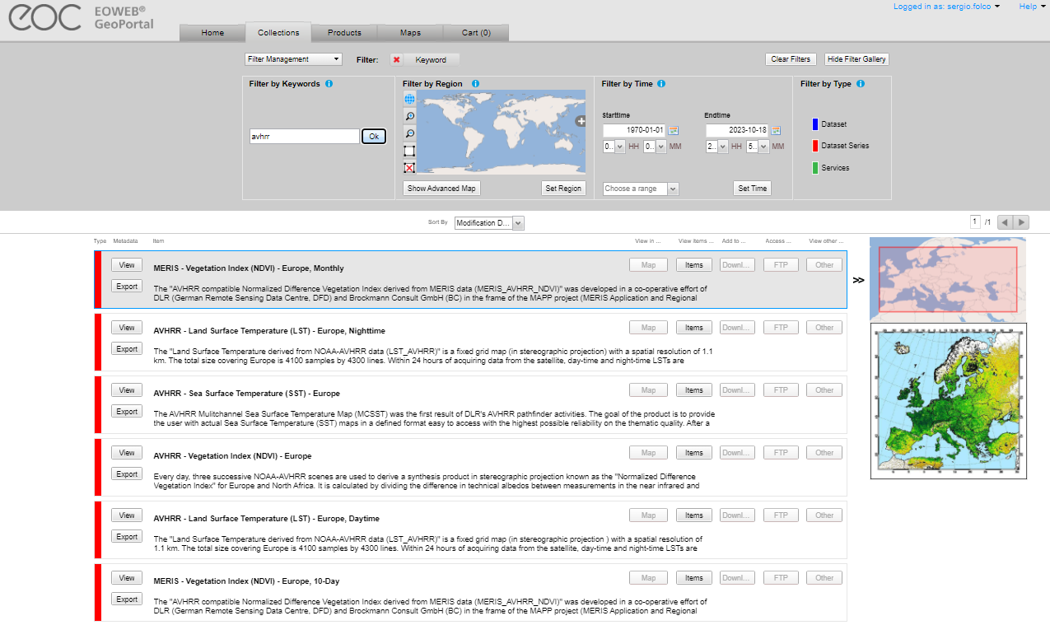
Europe – DLR
Four AVHRR datasets over Europe (N14,N16,N17,N18,N19) available in the DLR catalogue:
AVHRR - Land Surface Temperature (LST) - Europe, Nighttime;
AVHRR - Sea Surface Temperature (SST) - Europe;
AVHRR - Vegetation Index (NDVI) - Europe;
AVHRR - Land Surface Temperature (LST) - Europe, Daytime.
High redundancy with ESA dataset; not clear if L0 data available at DLR.
Presentation at WGISS#57

Slide 14
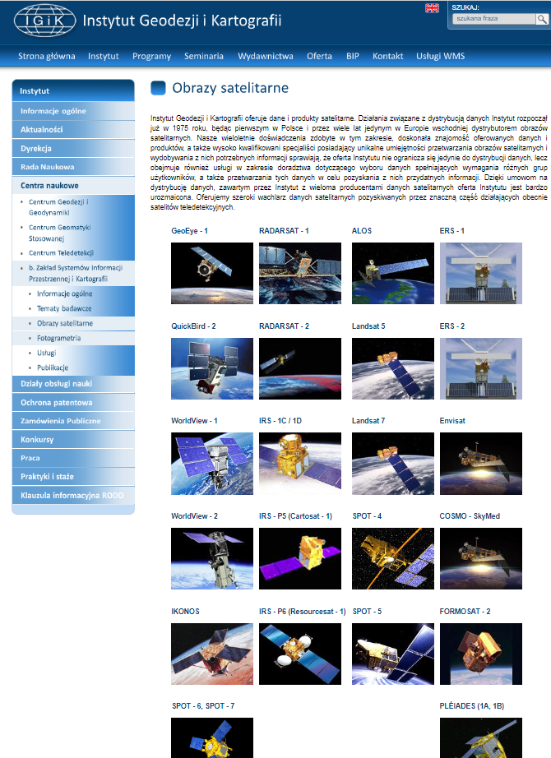
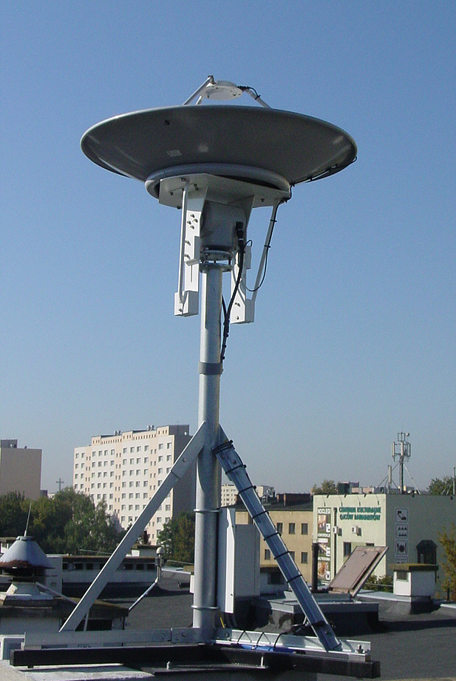
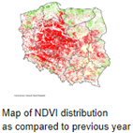
Europe – IGIK (Poland)
Polish Institute of Geodesy and Cartography.
Department of Remote Sensing maintains a database of satellite images and products derived from NOAA satellites since 1996 and used for agriculture studies
The receiving station recorded data in HRPT, SeaWiFS (and other formats) from NOAA, Seastar, Metop and NPOESS polar-orbiting satellites.
AVHRR products are not accessible from the web site.
Point of contact:
Dr. Dariusz Dukaczewski (dariusz.dukaczewski@igik.edu.pl)
Dr. Jan Musial (jan.musial@igik.edu.pl)
ESA contacted the IGIK point of contact. Waiting for feedback.
Will expand slide or have a dedicated presentation at next WGISS to better understand data volume and status of accessibility

Slide 15
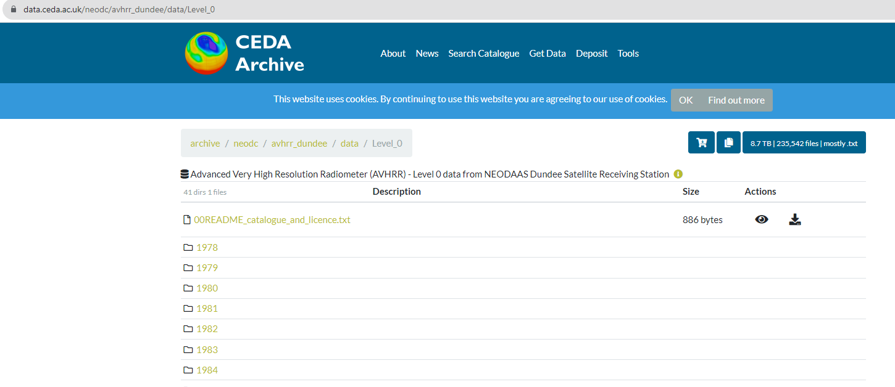
Europe – Dundee Station data at CEDA
1978 – 2018 AVHRR L0 data available with free and open access.
ESA has downloaded the full Dundee NOAA L0 products (8.9TB and 235541 L0 products). ESA partially reprocessed this level 0 dataset (AVHRR Data Curation Project) to extend the European Master Dataset geographical coverage over Greenland and the time coverage back to 1978. 🡪 Credits already provided to Dundee
Other data will be integrated to further extend geographical coverage towards Greenland
Presentation at WGISS#56

Slide 16
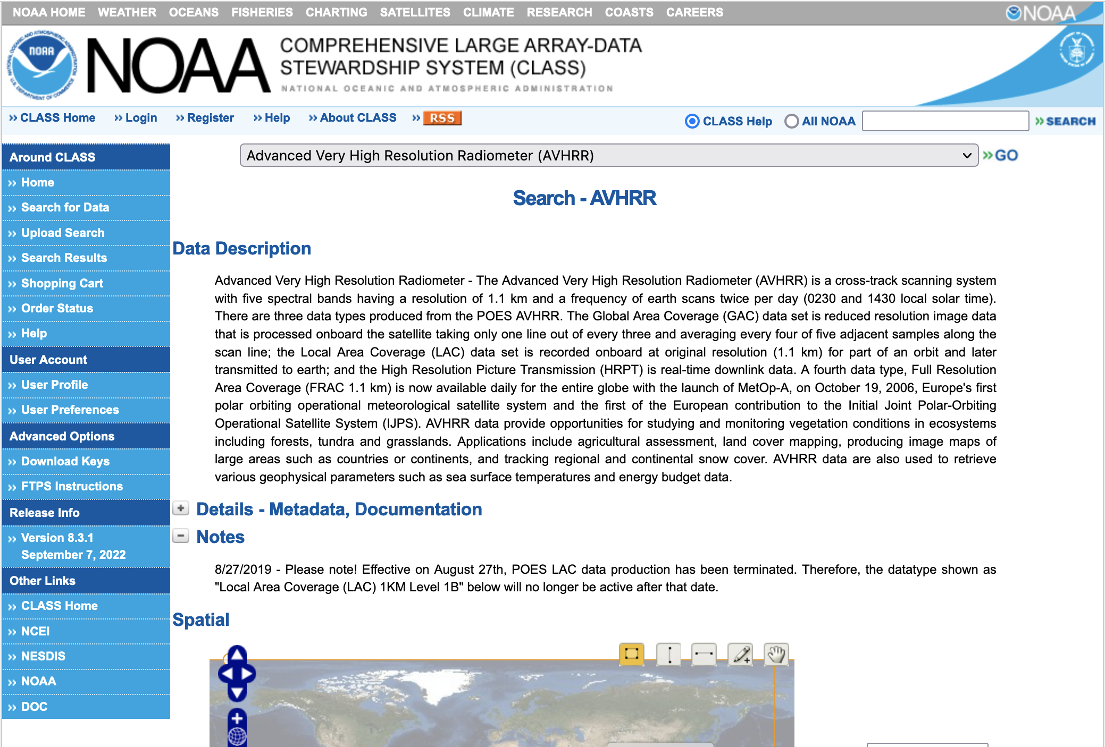
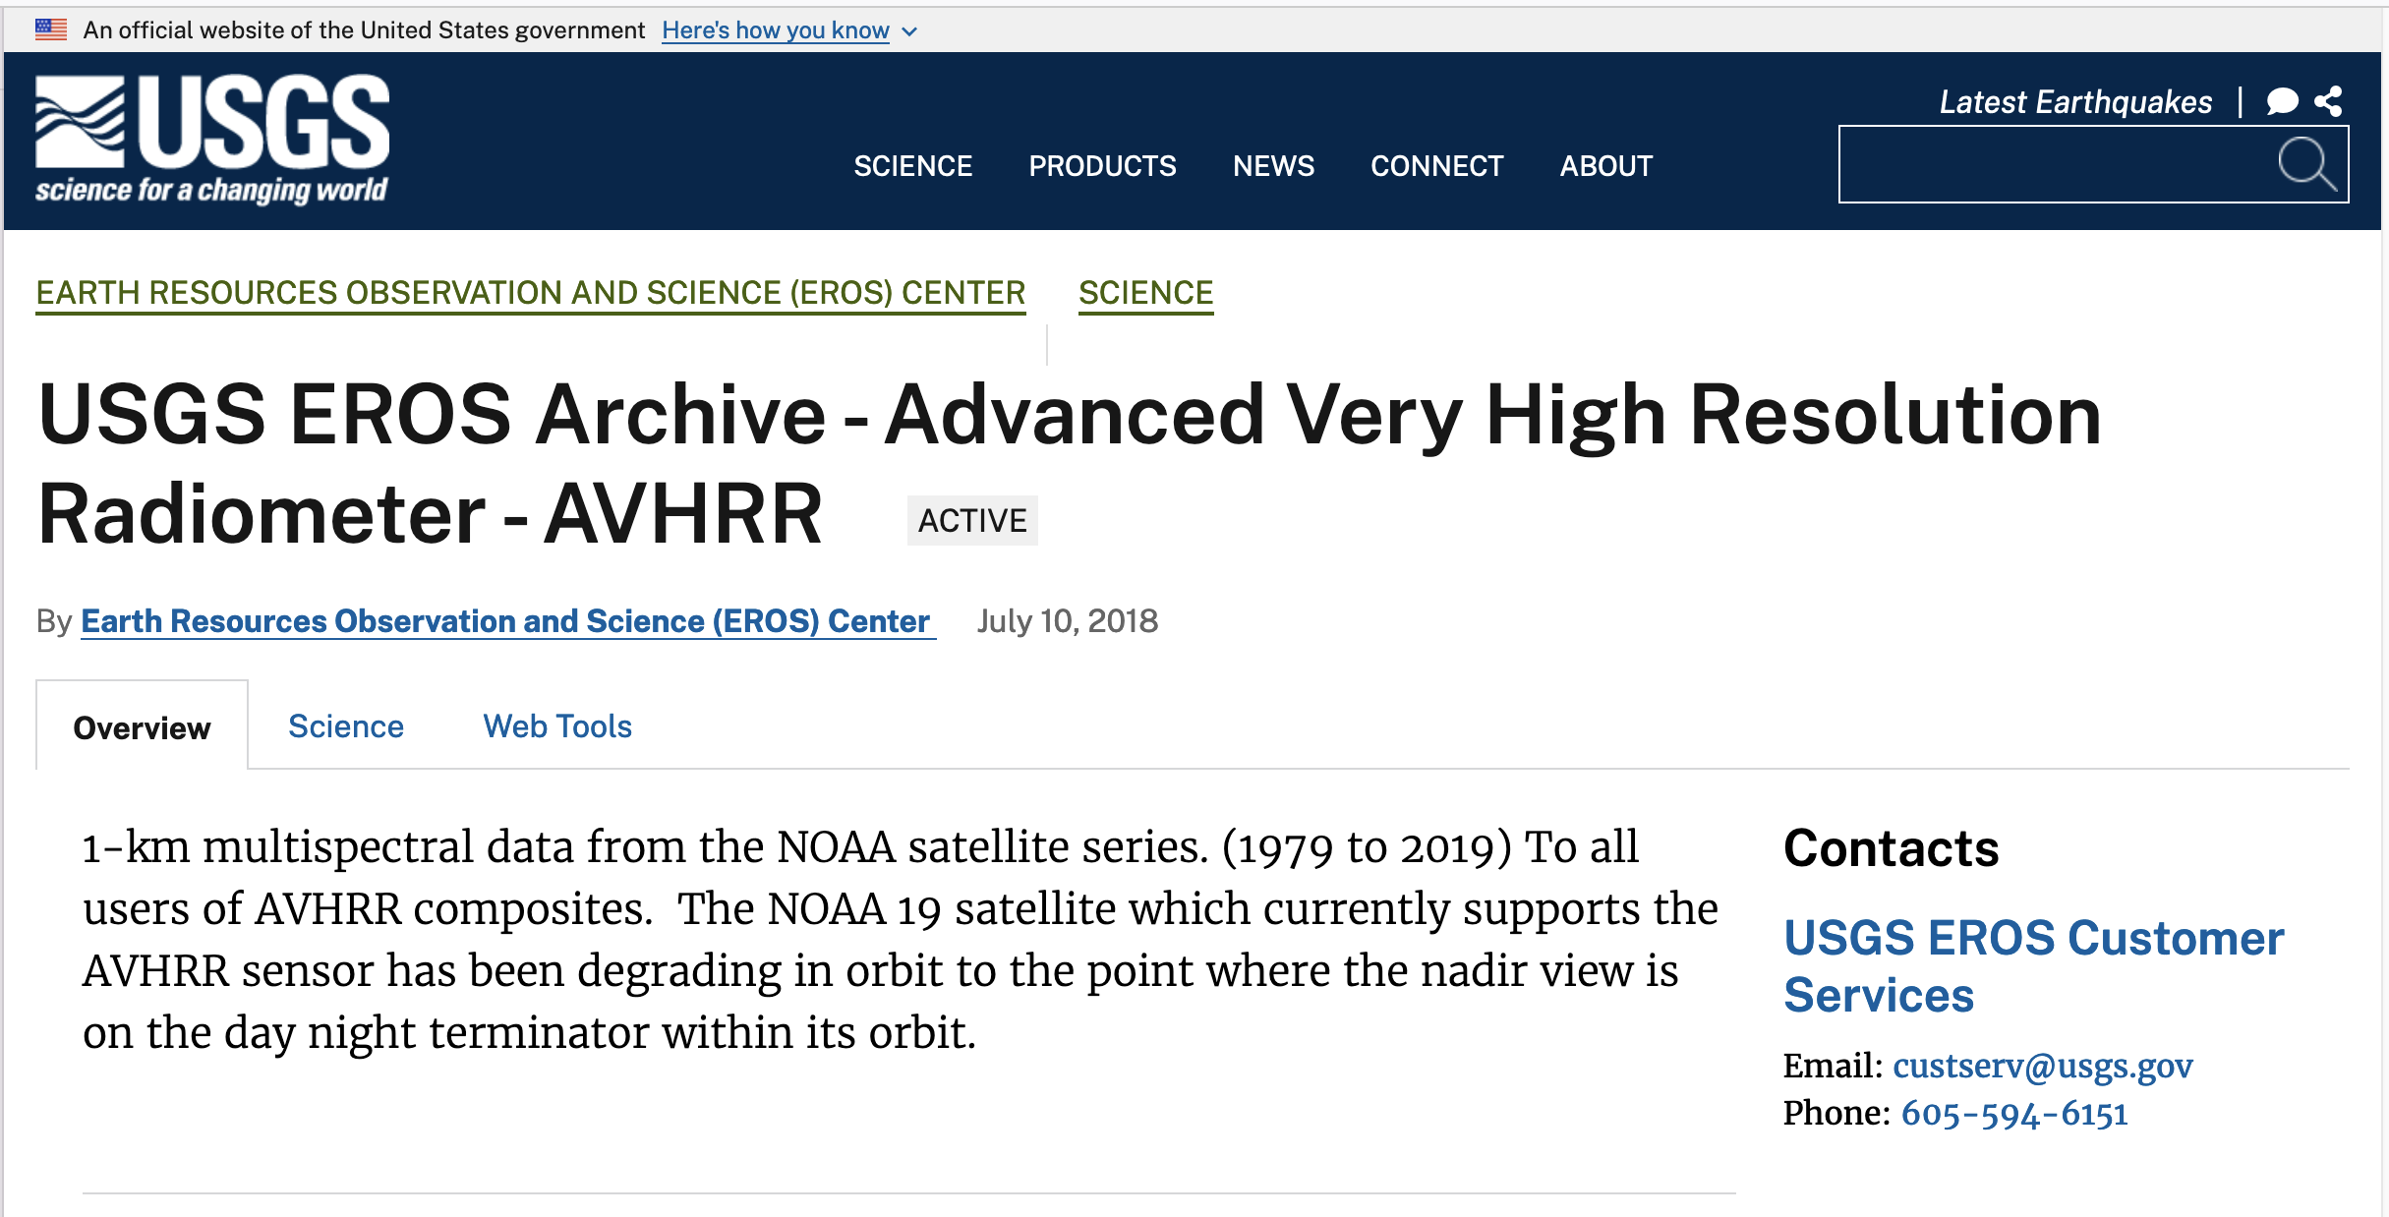
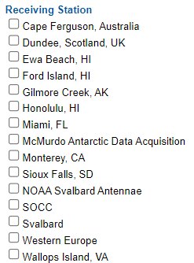
North America – NOAA & USGS
NOAA presentation at WGISS#55
USGS will be invited to make a presentation at WGISS#58

Slide 17
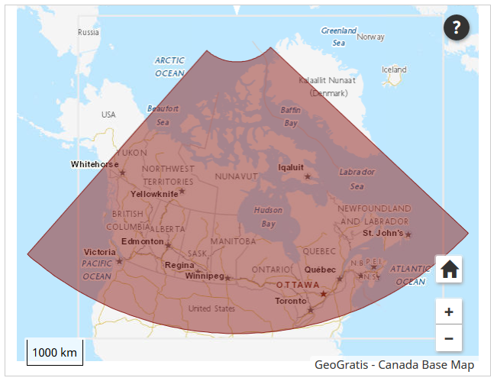
Canada – NRCan/CCMEO (1/2)
1981 – 2013 (+ AVHRR L1B LAC/HRPT received after that date); L1C at CCMEO
These are open source data covered by WMO CGMS data distribution policy, they can be shared freely and without charge
The Canadian sector is of high value to analyze changes of the environment.
The former developed pre-processing and retrieval of ECVs by A. Trishchenko and K.Klopenkov was of high quality and the standard for many other AVHRR processing chains.
Further development and processing was stopped some years ago but raw AVHRR data are available by NRCan.
https://open.canada.ca/data/en/dataset/9045136a-d6e7-a825-491d-ee5dc77a2620
.

Slide 18
CCRS/CCMEO will be invited to make a presentation at WGISS#58

Slide 19
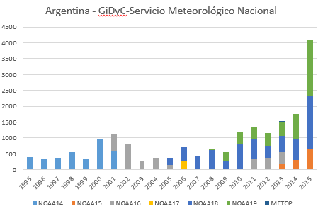
Argentina - GiDyC-Servicio Meteorológico Nacional
Initial products Metadata
Source: Jefa Departamento Teledetección Y Aplicaciones Ambientales, GiDyC-Servicio Meteorológico Nacional, Buenos Aires, Argentina
Number of products: 19360
Volume size: 740GB
Satellites: N14, N15, N16, N17, N18, MetopA/B
Time Period: 1995 – 2015
Extent: roughly Lat=[-30,15] Lon=[-60,-15]
Format: QUO (HRPT)
Exchange of letters finalized between ESA and SMN.
Data transferring to ESA is on-going for further processing, harmonization with the European dataset (processing and format) and dissemination to users.
Downloaded products metadata:
Number of products: 25504
Volume size: 1.02 TB
Time Period: 1995-2017
Format: .rar, .quo, .WI

Slide 20
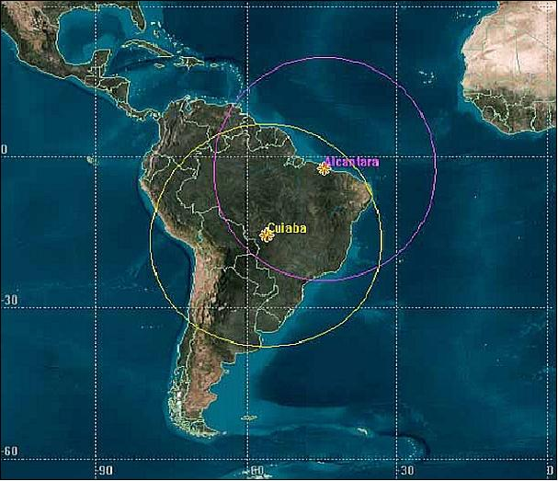
Brazil - INPE
Number of Scenes: 13.329
Satellites: N12, N14, N15, N16, N17, N18, N19
Number of products: 218647
Volume size: 10TB
Time Period: 1998 - 2022
Extent: Brazil
Format: HRPT
NO12 | Aug 1998-Aug 2007 | HRPT | 16335 products
NO14 | Aug 1998-Jun 2007 | HRPT | 10972 products
NO15 | Jul 2001-Aug 2019 | HRPT | 40877 products
NO16 | Jul 2001-Dec 2014 | HRPT | 26067 products
NO17 | Jn 2003 - Mar 2013 | HRPT | 27744 products
NO18 | May 2005 - Dec 2022 | HRPT | 54974 products
NO19 | Jan 2012 - Dec 2022 | HRPT | 41678 products
Exchange of letters being finalized between ESA and INPE

Slide 21
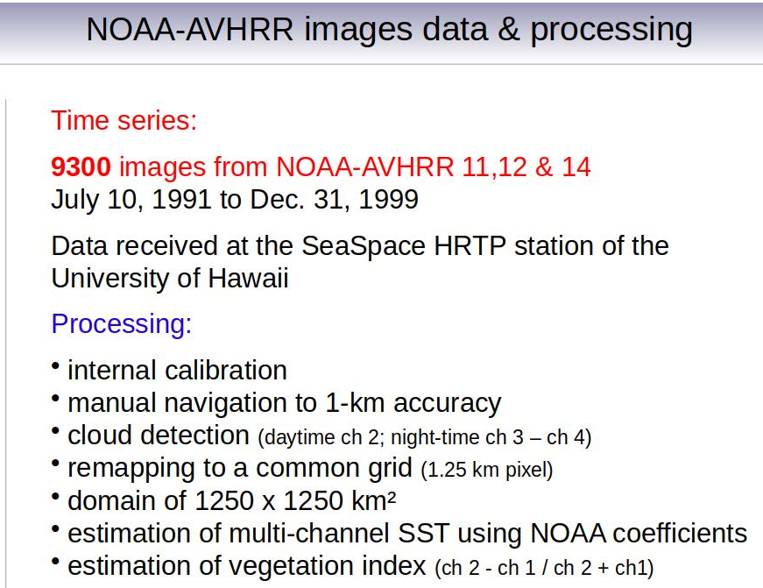
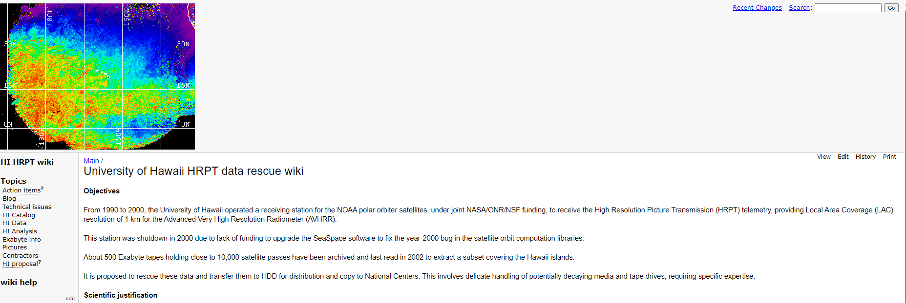
Hawaii – University of Hawaii
An AVHRR dataset was acquired at the Hawaii University between 1990 and 2000. Data are still on tapes, some were extracted covering the islands but accessibility not clear.
Hawaii University looking for support to extract data from tapes.
ESA offer to transcribe the exabyte tapes accepted, tapes and drives on their way to ESRIN.
Metadata from the website

Slide 22
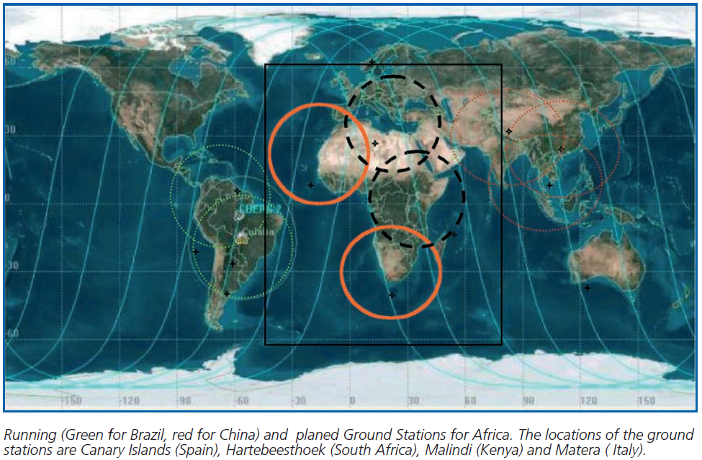
African Coverage
The combination of AVHRR data acquired in Maspalomas (Spain), Matera (Italy), Cairo (Egypt), Niamey (Niger), Hartebeesthoek (South Africa) and Malindi/Nairobi (Kenya) can provide full coverage of Africa;

Slide 23
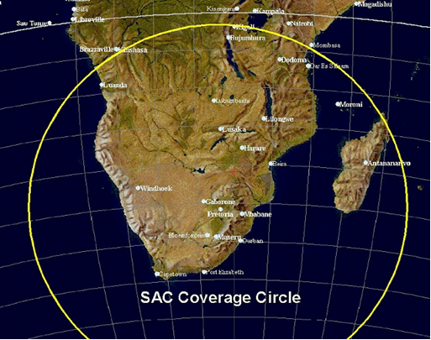
South Africa - SANSA
1km NOAA AVHRR data received at Hartebeesthoek, South Africa (25°53' S 027°42’ E) and maintained by SAC/SANSA – South African National Space Agency
NOAA 9 | 1985-1987
NOAA 11 | 1989-1993
NOAA 14 | 1995-2001
NOAA 16 | 2001-2005
NOAA 17 | 2005-2010
NOAA 18 | 2005-2009
Number of products: 7684
Volume size: 464GB
Exchange of letters finalized between ESA and SANSA and Data transferring to ESA completed.
Further processing, harmonization with the European dataset and dissemination to users planned in FDR4AVHRR.

Slide 24
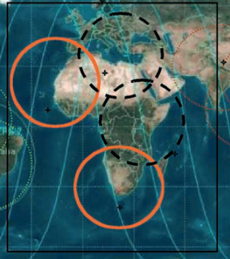
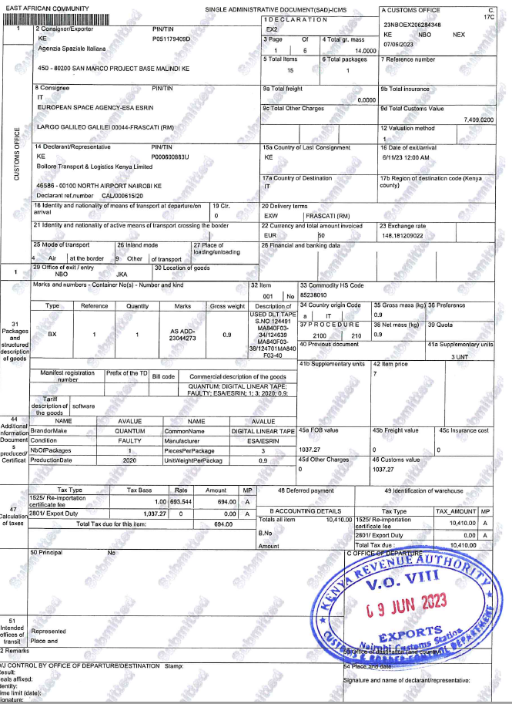
Central Africa (Kenya) - ASI/UniRoma
Data acquired at the Malindi station in Kenya from 2001 to 2009 and currently stored on 44 DLT tapes.
8452 products in L1B sharp format.
Volume: 614 GB
ESA transcribed the DLTs content successfully.
Further processing, harmonization with the European dataset and dissemination to users planned in FDR4AVHRR.

Slide 25
China – CMA/NSMC
AVHRR-receiving stations for global 1km land product (coordinated by USGS): Beijing, Urumqi, Guanzhou
AVHRR 1-km data covering Himalaya-Hindukush of the period 1981 – 1992 would be of exceptional value
http://satellite.nsmc.org.cn/PortalSite/Data/Satellite.aspx
CMA will be contacted and invited to make a presentation at WGISS-58.
Unable to register
NO-15 AVHRR data not found

Slide 26
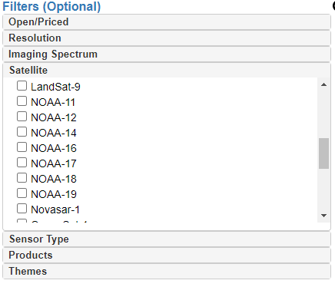
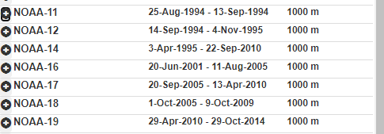
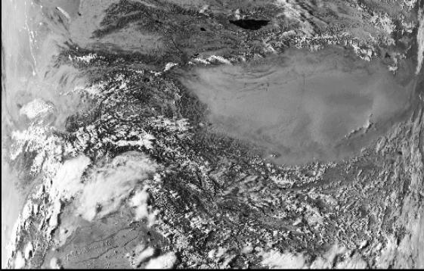
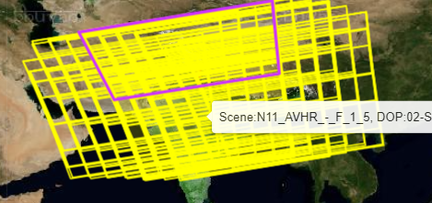
India - ISRO
https://bhoonidhi.nrsc.gov.in/bhoonidhi/index.html
Presentation at WGISS#57
Example over Hymalaya region
NOAA products are open-data and, after user registration, the products are downloadable.
No products number or volume can be extracted from the web site.

Slide 27
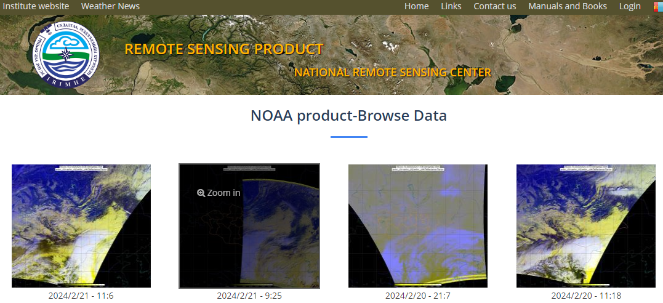
Mongolia - Remote Sensing Department, Information and Research Institute of Meteorology, Hydrology and Environment
From UniBern
AVHRR UBM data
Source: Remote Sensing Department, Information and Research Institute of Meteorology, Hydrology and Environment, Ulaanbatar, Mongolia
Number of Scenes: 5.016
Satellites: N09, N11, N12, N14, N15
Time Period: 1993 – 1999
Extent: roughly Lat=[20,70] Lon=[80,120]
Format: hmf (origin: dat, grid, lut)
Further info:- UBMx station data were included in the Global Land 1km AVHRR Data Project
Browsing the NOAA data, the acquisitions are from 01/01/2017 up to now.
Available data (raw,L1b,L1c) to download from 10/12/2023 (http://119.40.97.75:8080/thredds/catalog.html)
The institute will be contacted to get full data volume and status of accessibility

Slide 28
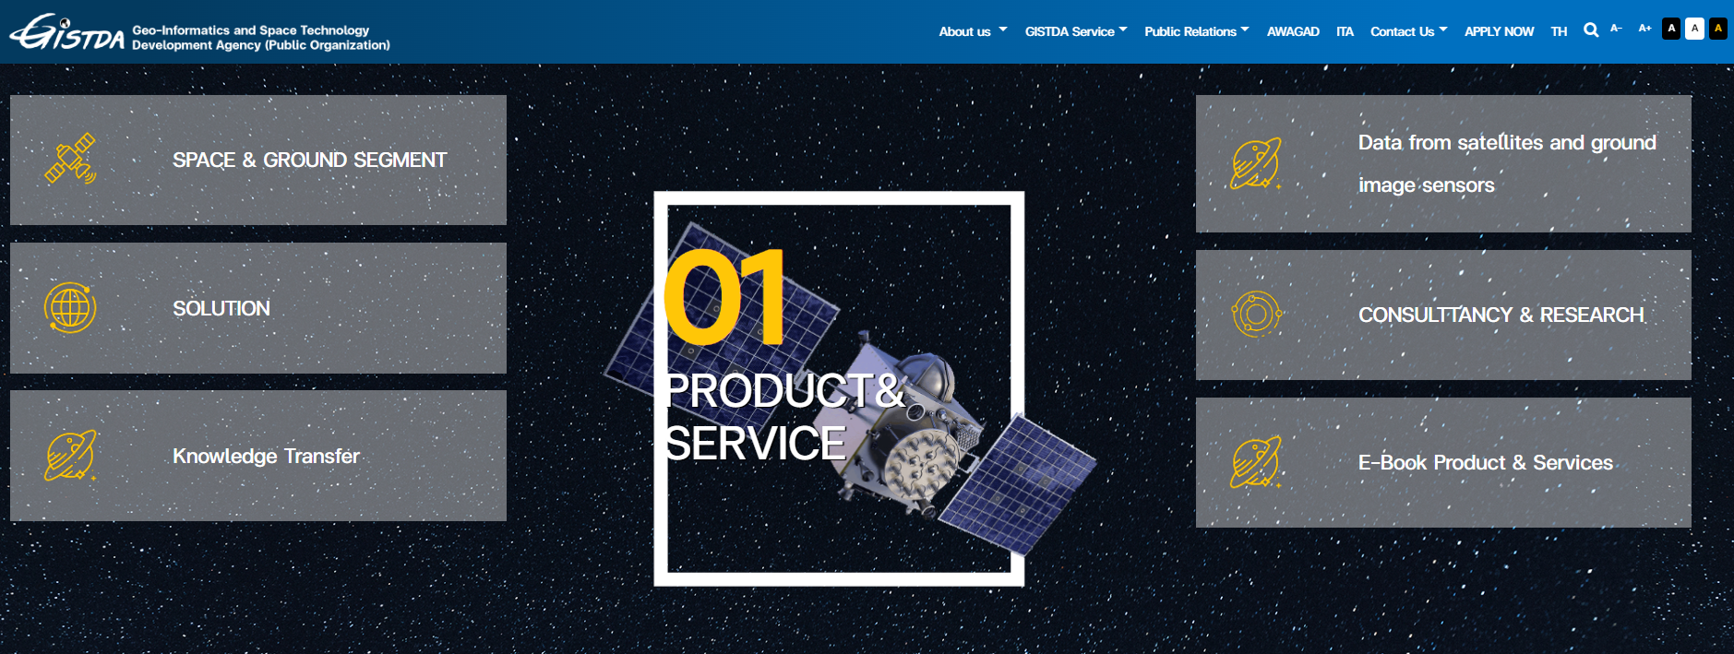
Thailand - GITSDA
GITSDA has been contacted and confirms they keep data from last six months. No further action.

Slide 29
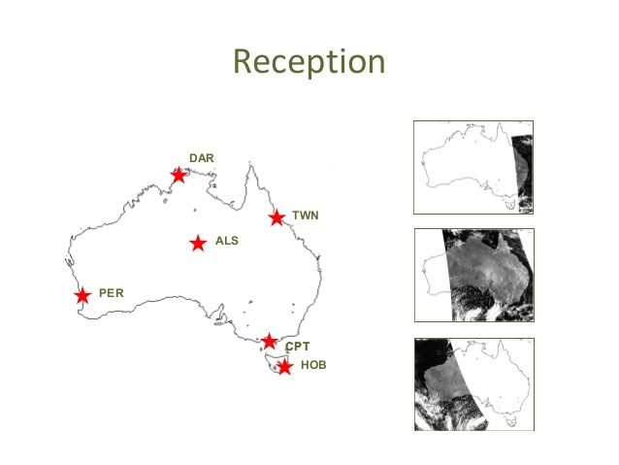
Australia – CSIRO (1/2)
AVHRR reception based on 6 stations for continuous 1-km data set.
Multiple state and federal agencies have been acquiring the data in this manner with reception stations in Hobart, Melbourne, Perth, Alice Springs, Darwin and Townsville.
Since the early 1990s CSIRO has been merging these separate local data sets to produce a stitched archive which makes use of the redundancy arising from overlap between reception stations to produce a higher quality and consistently formatted data set with national coverage.
The assembly of this data set continues within CSIRO today, though it is likely to come to an end sometime this decade as the last of the AVHRR sensors has now been launched.
Data availability: 1981 (NOAA-7) onwards.
Ian Grant, Bureau of Meteorology, Australia
https://link.fsdf.org.au/dataset/advanced-very-high-resolution-radiometer-avhrr
Presentation at WGISS#56 and #57

Slide 30
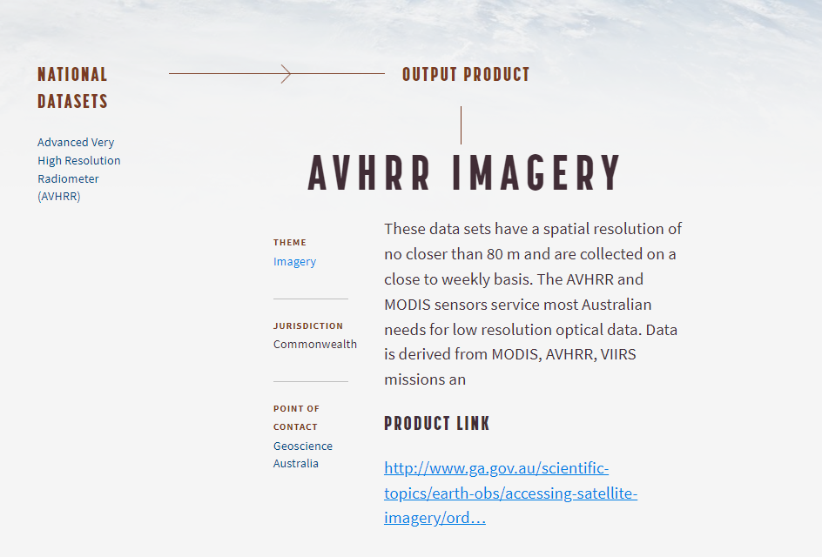
https://link.fsdf.org.au/dataset/avhrr-imagery
ESA and CSIRO will continue to exchange information
ESA will investigate with CSIRO approaches to un-stitch the “1km project products” (as CSIRO worked on stitched products from 1992 and perhaps format is the same).

Slide 31
Inventory of existing national/regional HRPT and LAC data archives Version 3 has been produced in Q1 2024.
List of Met offices and other organizations around the world who might have AVHRR LAC data being compiled at ESA
ESA will perform a worldwide AVHRR LAC data gap analysis extending the one done for Europe
ESA will contact additional organizations who might have AVHRR LAC data to investigate possibility to fill identified gaps

Slide 32
WGISS
Committee on Earth Observation Satellites
AVHRR Media Transcription

Slide 33
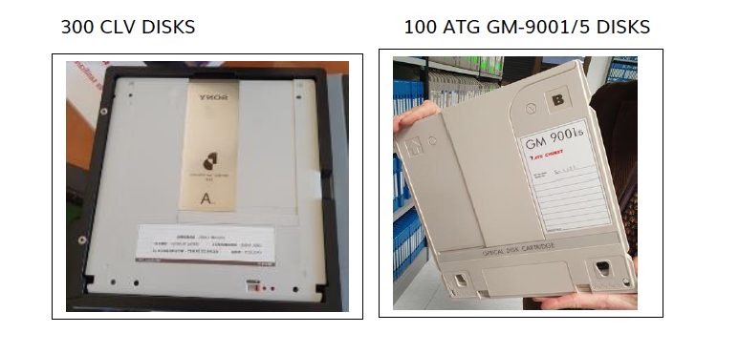
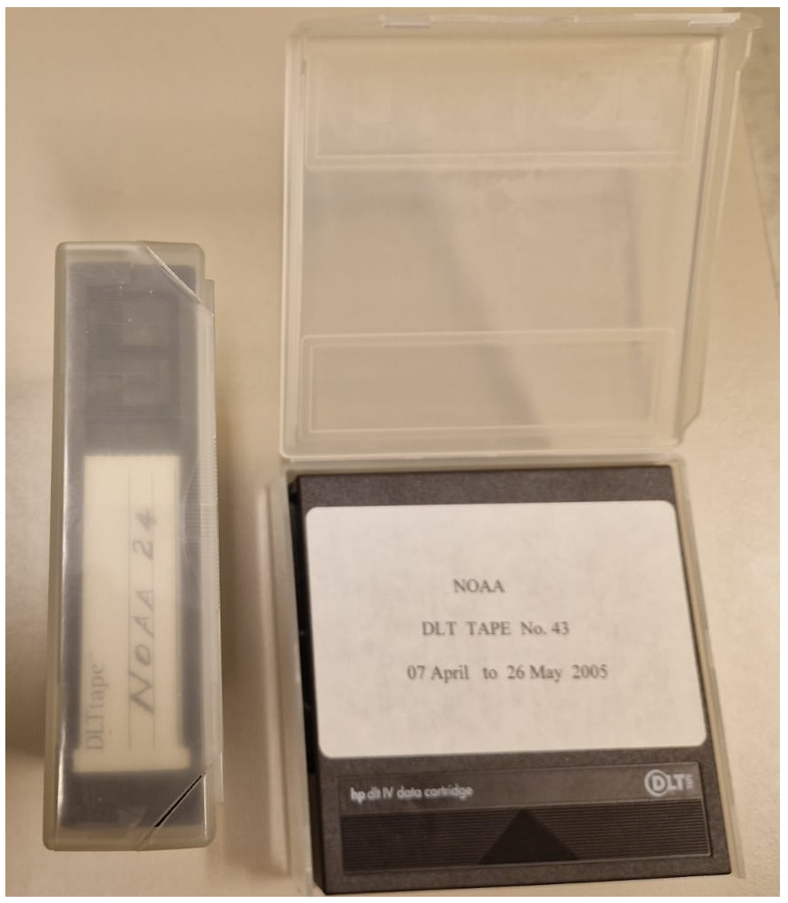
AVHRR 1 Km data on media
Several hundred heritage media (optical disks, DLTs, Exabytes) with potentially unique AVHRR LAC data identified:
ESA (Optical Disks)
University of Reading (Optical Disks)
University of Rome / ASI (DLTs)
University of Hawaii (Exabytes)
LM 1200 optical Disk 2.4GB
DLT cassettes

Slide 34
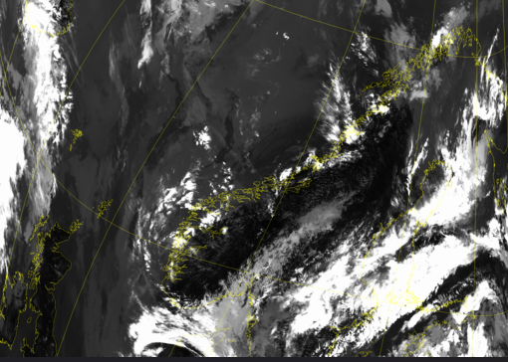
Optical Disks
ESA pilot activity completed with successful transcription of 2 different brands of optical disks originally held at ESA and University of Reading.
Transcription of the full batch of available optical disks (around 522) contracted to a commercial company.
In Oct23, ESA received the content of 15 transcribed optical disks. L1B products successfully processed using the ESA processor.
In Feb ’24, 50 media were successfully transcribed and data inventory under finalization (media containing both AVHRR and Nimbus CZCS data).

Slide 35
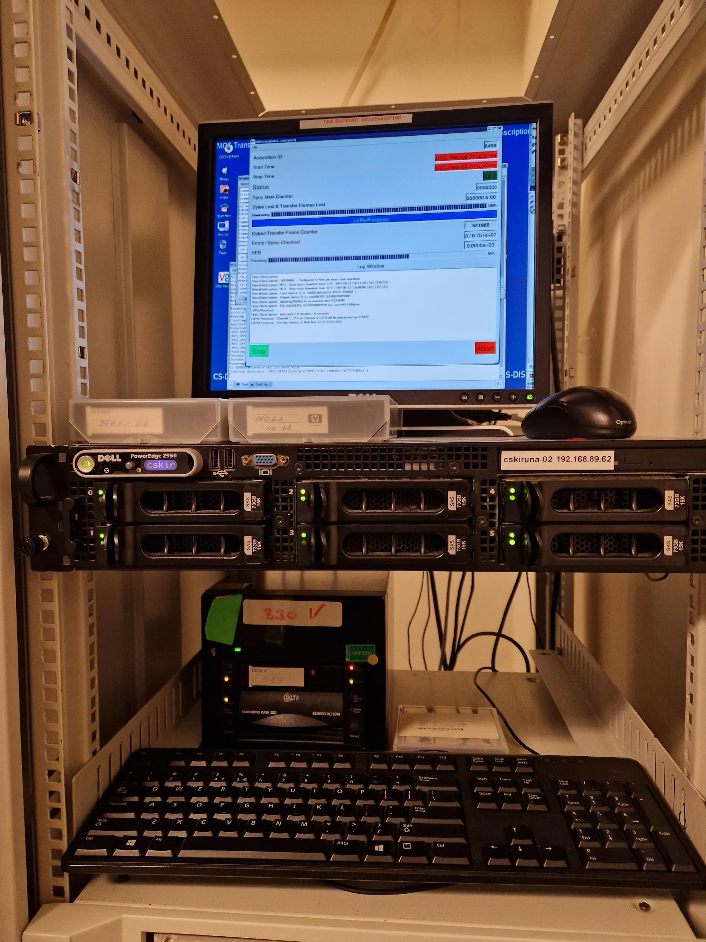
DLT Tapes
DLT transcription chain set-up at ESA/ESRIN to transcribe tapes containing unique AVHRR / SPOT and ERS data.
Tapes received from ASI / University of Rome successfully transcribed and 8452 AVHRR products acquired in Malindi (Kenya) from 2001-2009 now safely archived on disks at ESA. Data will be processed in the frame of the FDR4AVHRR project.

Slide 36
WGISS
Committee on Earth Observation Satellites
AVHRR Data Processing and Access

Slide 37
Next Steps
Continue ongoing transcription activities, coordination and projects and contact additional organizations with potentially unique AVHRR LAC data
Provide AVHRR points of contact and stakeholders with the AVHRR Dataset Consolidation Procedure and Processing Format used in the European consolidation project run at ESA. Collect feedback and discuss possibility to have a common/harmonised format (Q4 2024)
Check status of Discoverability of AVHRR datasets worldwide and pursue common entry point through WGISS CDA infrastructure (Q4 2024)
AVHRR Session follow-on will be held at WGISS#58

