Slide 1
WGISS-57 Data Stewardship and Maturity: overview and verification between maturity assessment approaches
I.Maggio, Rhea GROUP for ESA
Agenda ID: 2024.03.06_14.50
WGISS-54
Tokyo, Japan (JAXA)
3-7 October 2022

Slide 2
Executive Summary
Main concepts of the WGISS Data Management & Stewardship Maturity Matrix
Comparison between maturity assessment approaches
Way forward

Slide 3
Main Concepts

Slide 4
Data Management and Stewardship Maturity Matrix (DMSMM): Main concepts
DMSMM defines all activities needed to preserve and improve the information content, quality, accessibility, and usability of data and metadata.
Data stewardship “encompasses all activities that preserve and improve the information content, accessibility, and usability of data and metadata” (National Research Council 2007).
Data management includes all activities for “planning, execution and oversight of policies, practices and projects that acquire, control, protect, deliver and enhance the value of data and information assets.” (Mosely et al. 2009).

Slide 5
Capability Maturity Model Integration (CMMI)
Levels of Maturity of Digital Repositories
Climate Data Record Maturity Matrix (CDRMM)
TECHNOLOGY READINESS LEVELS (TRLs)
Scientific Readiness Levels (SRL)
Maturity Matrix for Long-Term Scientific Data Stewardship
2015, Ge Peng and Jeffrey L. Privette
Notes:
Capability Maturity Model Integration (CMMI) is a process improvement training and appraisal program and service administered and marketed by Carnegie Mellon University (CMU) and required by many DoD and U.S. Government contracts, especially in software development. CMU claims CMMI can be used to guide process improvement across a project, division, or an entire organization. CMMI defines the following maturity levels for processes: Initial, Managed and Defined.
CMMI currently addresses three areas of interest:
Product and service development — CMMI for Development (CMMI-DEV),
Service establishment, management, — CMMI for Services (CMMI-SVC), and
Product and service acquisition — CMMI for Acquisition (CMMI-ACQ).
Climate Data Record Maturity Matrix (CDRMM): Bates and Privette, 2012
TECHNOLOGY READINESS LEVELS (TRLs): Standard which measures the maturity of new technologies
Scientific Readiness Levels (SRL): FOR SPACE APPLICATIONS

Slide 6
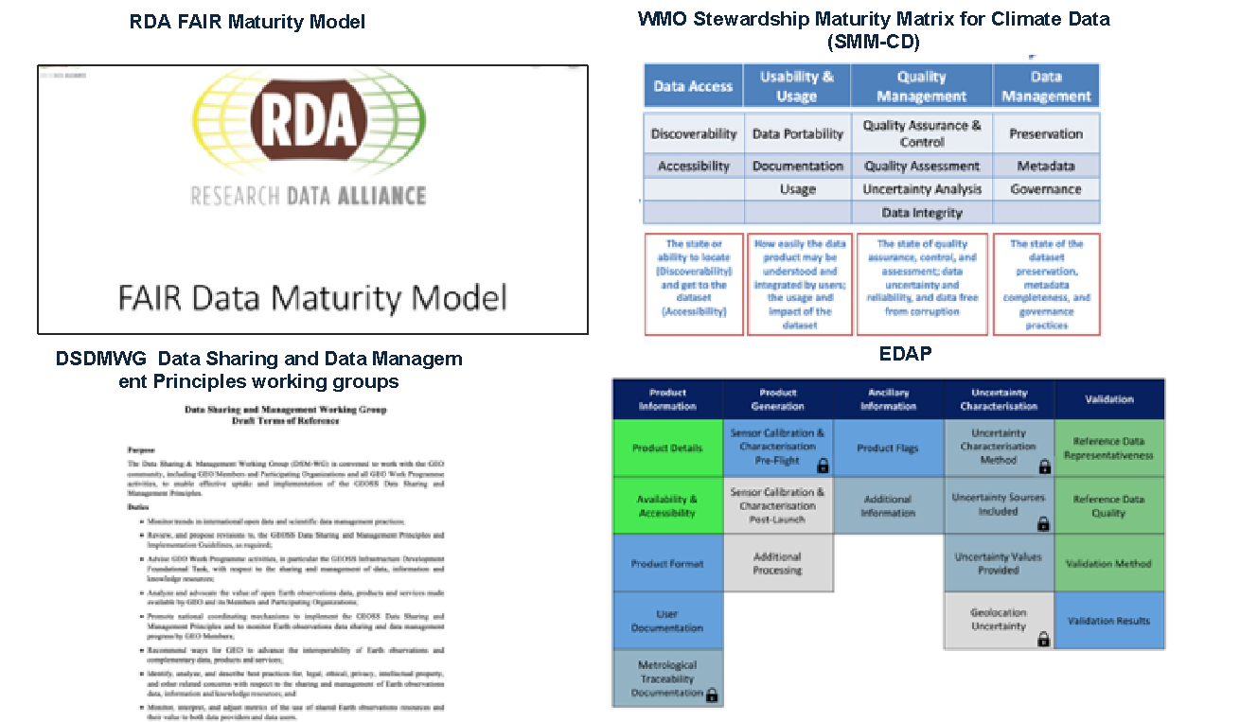

Slide 7
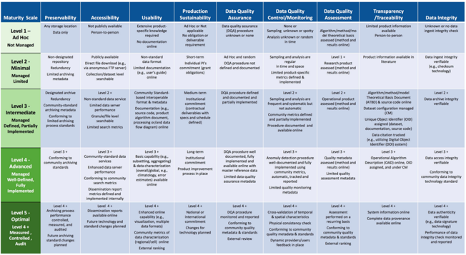
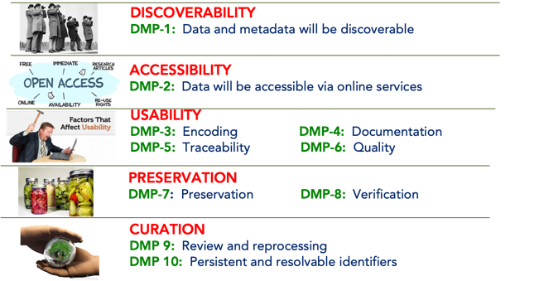
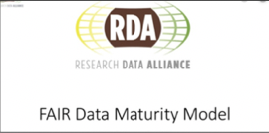
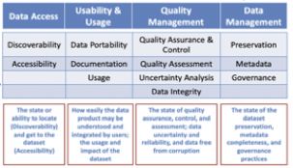
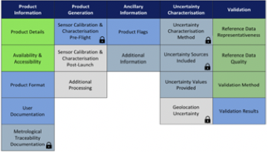
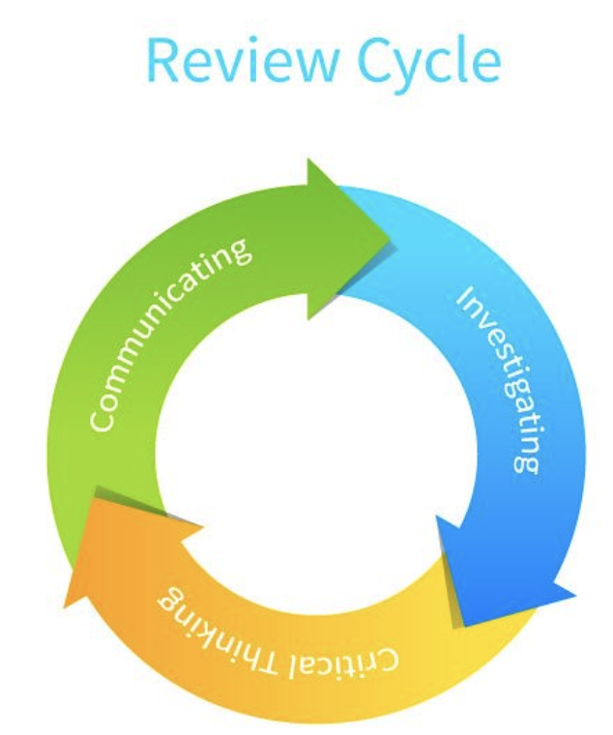
Starting Points
CEOS WGISS DMSMM: Generation process
MM for Long-Term Scientific Data Stewardship
GEOSS Data Management Principles
RDA FAIR Data Maturity Model
WMO Stewardship MM for Climate Data
ESA Earthnet Quality Data Assessment Pilot

Slide 8
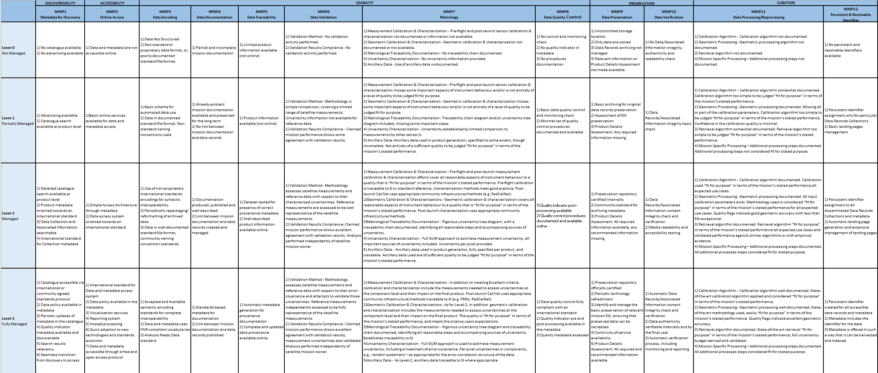
CEOS WGISS Data Management & Stewardship Maturity Matrix
https://ceos.org/document_management/Working_Groups/WGISS/Interest_Groups/Data_Stewardship/White_Papers/WGISS%20Data%20Management%20and%20Stewardship%20Maturity%20Matrix.pdf

Slide 9
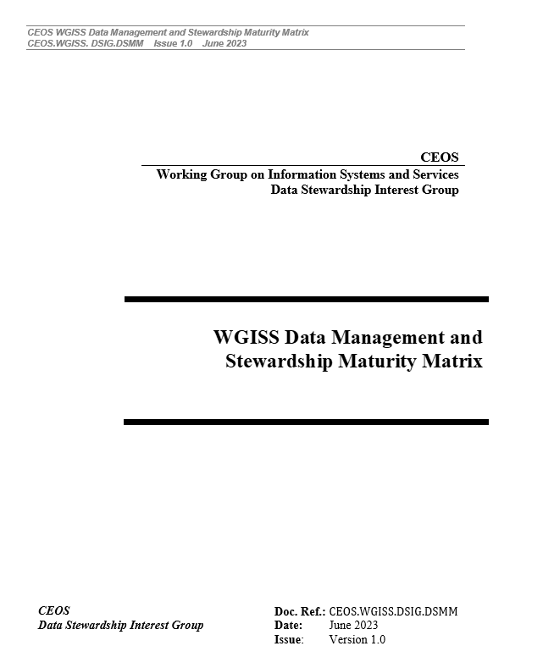
WGISS DMSMM pillars
5 Areas
Discoverability
Accessibility
Usability
Preservation
Curation
4 Level of Maturity
L0 Not Managed
L1 Partially Managed
L2 Managed
L3 Fully Managed
12 Components
Metadata for Discovery
Online Access
Data encoding
Data Documentation
Data Traceability
Data Validation
Data Metrology (e.g. Uncertainty)
Data Quality Control
Product Details
Data Preservation
Data Verification
Data Processing/Reprocessing
Persistent & Resolvable Identifier

Slide 10
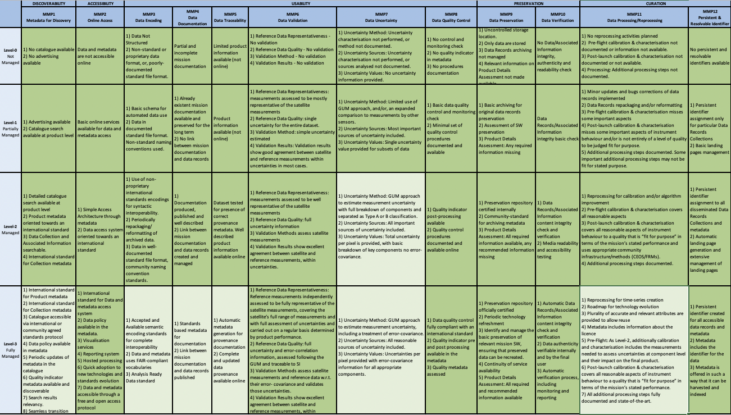
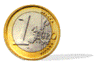
Data Management & Stewardship Maturity Matrix - Scope
A way to measure the status of the Agency Data Stewardship processes in place
A way to plan goals of Data Stewardship processes and projects

Slide 11
Comparison between maturity assessment approaches

Slide 12
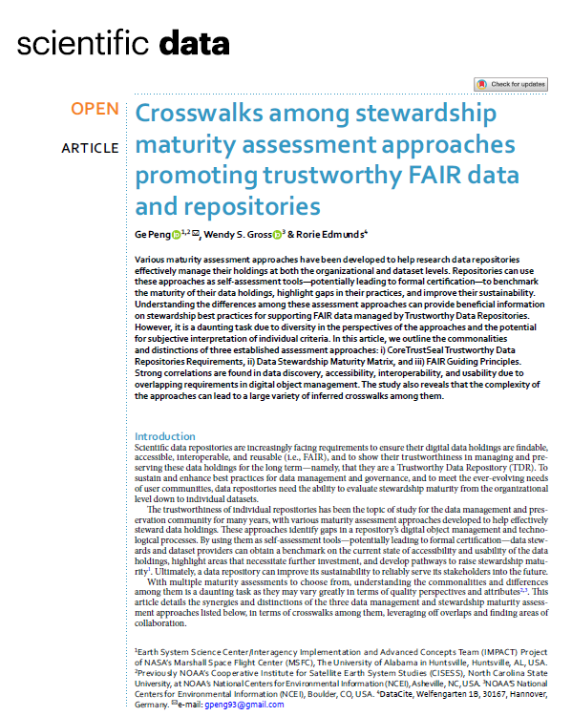
ARTICLE of NCEI and WMO
Various maturity assessment approaches have been developed to help research data repositories effectively manage their holdings;
Repositories can use these approaches as self-assessment tools to benchmark the maturity of their data holdings, highlight gaps in their practices, and improve their sustainability;
Understanding the differences among these assessment approaches can provide beneficial information on stewardship best practices for supporting FAIR data managed by Trustworthy Data Repositories.
In this article, we outline the commonalities and distinctions of three established assessment approaches: i) CoreTrustSeal Trustworthy Data Repositories Requirements, ii) Data Stewardship Maturity Matrix, and iii) FAIR Guiding Principles.
Strong correlations are found in data discovery, accessibility, interoperability, and usability due to overlapping requirements in digital object management.
The study also reveals that the complexity of the approaches can lead to a large variety of inferred crosswalks among them.

Slide 13
CoreTrustSeal Trustworthy Data Repositories Requirements (CTDRR)
The most well-established evaluation method is ISO 16363, which is based on the Open Archival Information System (OAIS) Reference Model, and establishes comprehensive audit metrics for what a repository must do to be certified as a TDR;
However, while it is desirable to be ISO 16363 certified, the time and financial burden tends to keep many organizations from pursuing it;
The World Data System of the International Science Council, in collaboration with the Data Seal of Approval and the Research Data Alliance, developed a set of 16 core CoreTrustSeal Trustworthy Data Repositories Requirements (CTDRR) for certification of repositories at the core level as a solid step towards meeting the ISO 16363 standard;
Currently, 183 institutional or disciplinary repositories have been accredited as core certified repositories (Latest statistics can be found at: https://www.coretrustseal.org/why-certification/certified-repositories/). ESA is starting now the process.

Slide 14
Data Stewardship Maturity Matrix (DSMM)
The scientific data stewardship maturity matrix is within the scope of the OAIS Reference Model, but it is instead focused on the individual dataset level.
DSMM was developed jointly by the National Centers for Environmental Information (NCEI), the official archive of the U.S. National Oceanic and Atmospheric Administration (NOAA), and the Cooperative Institute for Climate and Satellites–North Carolina.
NCEI is an authoritative source for environmental data and information, including climate data records that have been utilized in national and international climate monitoring and assessment activities.
DSMM assesses the maturity of stewardship practices in nine Key Components (KCs) to help ensure that individual digital datasets are of assured scientific quality; adequately preserved and
documented; and that they remain accessible, usable, and current to end users.
In particular, the Stewardship Maturity Matrix for Climate Data (SMM-CD) is now one of the three building blocks of the World Meteorological Organization (WMO)’s high-quality framework for managing global
climate data.

Slide 15
FAIR guiding principles
The FAIR Guiding Principles were initiated at the 2014 Lorentz Workshop ‘Jointly Designing a Data FAIRport’ (https://www.openaire.eu/how-to-make-your-data-fair) and formally defined by stakeholders from academia, industry, funding agencies, and scholarly publishers to encourage data sharing across systems, disciplines, and regional boundaries;
They were developed after both CTDRR and DSMM. Like the latter, fifteen principles target individual datasets, but primarily concern individual practices or capabilities on quality attributes of findability, accessibility, interoperability, and reusability for enhanced data sharing in machine-friendly environments;
These quality attributes are only a subset of what CTDRR and DSMM cover;
The FAIR Principles have quickly gained popularity in the global data management and stewardship community, have been endorsed by many international organizations and countries, and have had a major impact in prompting data sharing and reuse worldwide;
Moreover, based on the FAIR Principles, an increasing number of tools and frameworks have been developed to assess the FAIRness of digital objects. For example, the Research Data Alliance (RDA) FAIR Data Maturity Model Working Group18 has developed a set of core assessment criteria for FAIRness;
Known as RDA FAIR Data Maturity Indicators (DMIs), they aim to enable direct comparison of assessment results.

Slide 16
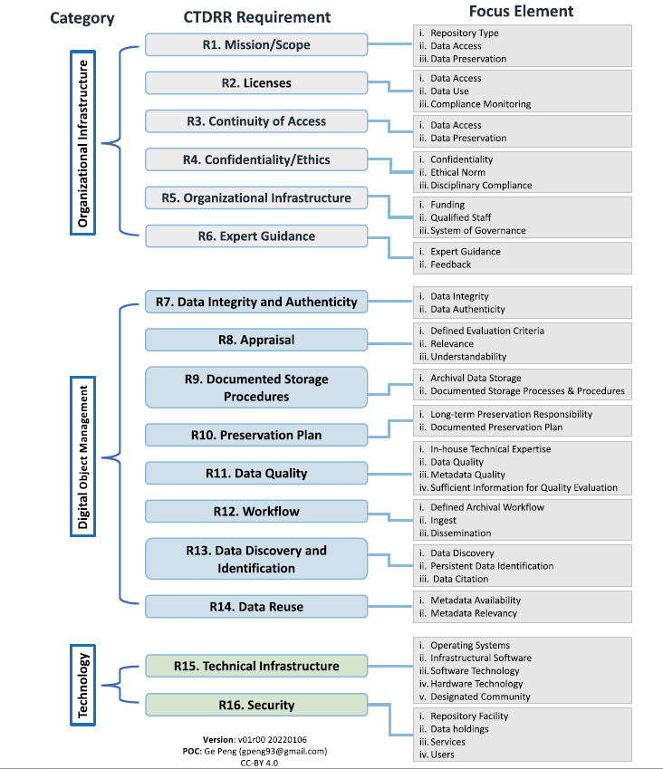
Focus elements associated with the CoreTrustSeal Trustworthy Data Repositories
Requirements (CTDRR)

Slide 17
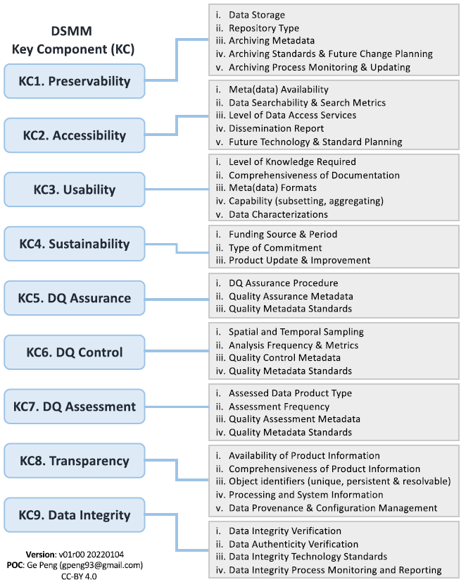
Focus elements associated with the DSMM

Slide 18
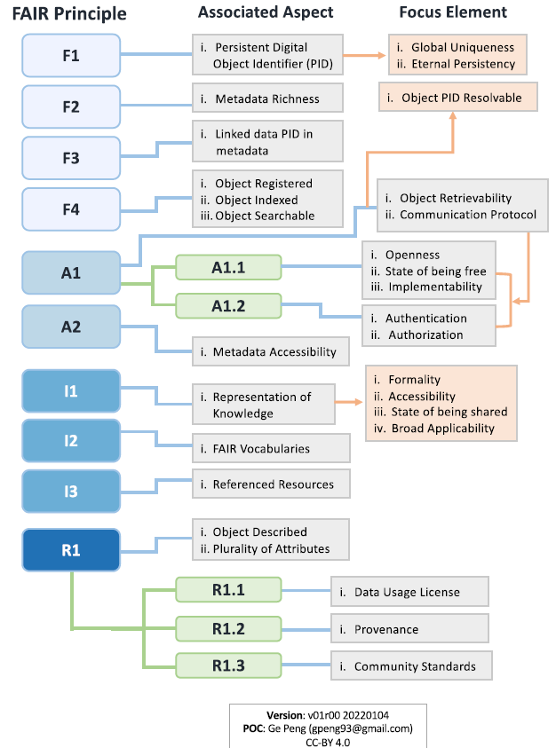
Focus elements associated with the FAIR principles

Slide 19
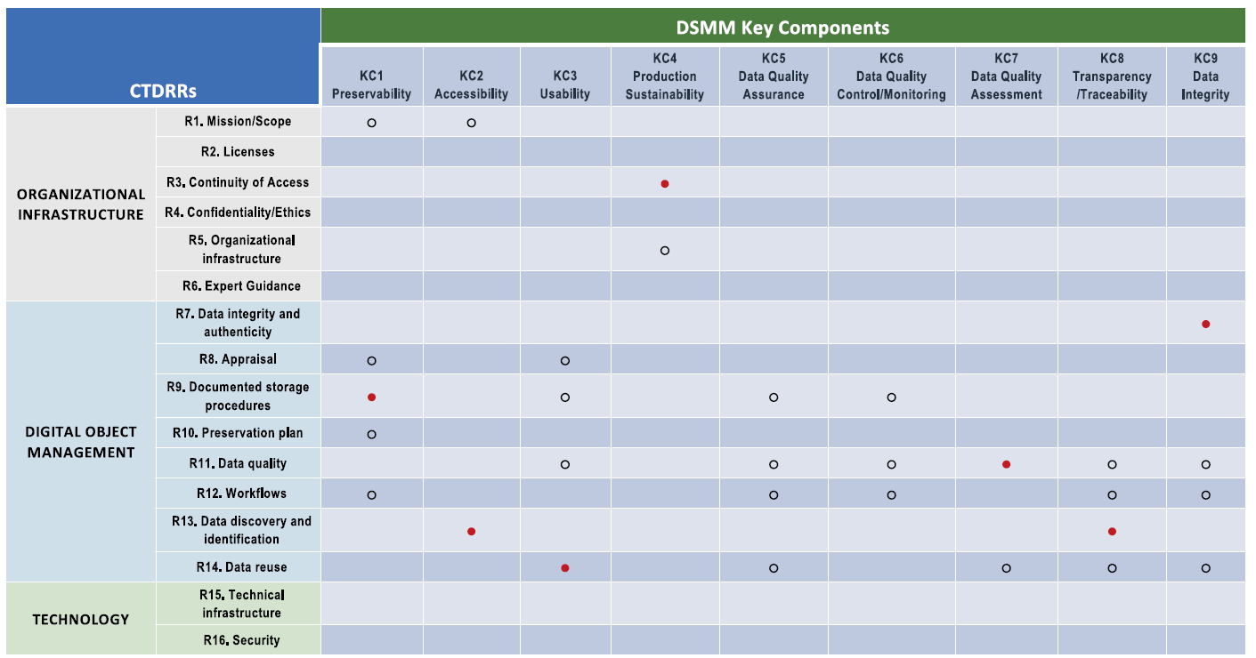
Crosswalk between CTDRR and DSMM
Both based on OAIS reference model
DSMM addresses the stewardship at Dataset level
CTDRR addresses the stewardship, preservation and service capabilities at an organizational level
The stewardship best practices captured in DSMM are beneficial in helping fulfill relevant requirements in CTDRR

Slide 20
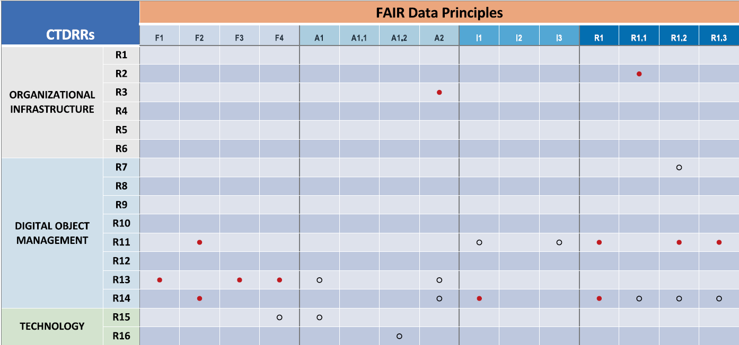
Crosswalk between CTDRR and FAIR
Both approaches are concerned with different level of data management
FAIR Principles is focused on the collection of digital objects
CTDRR is focused on a repository’s processes, capability, and infrastructure
FAIRness of digital object can be measured only at a specific moment
A Trustworthy Data Repository has the ability to maintain or even enhance the FAIRness of a digital object over time.
A repository may ‘enable’ FAIR.

Slide 21
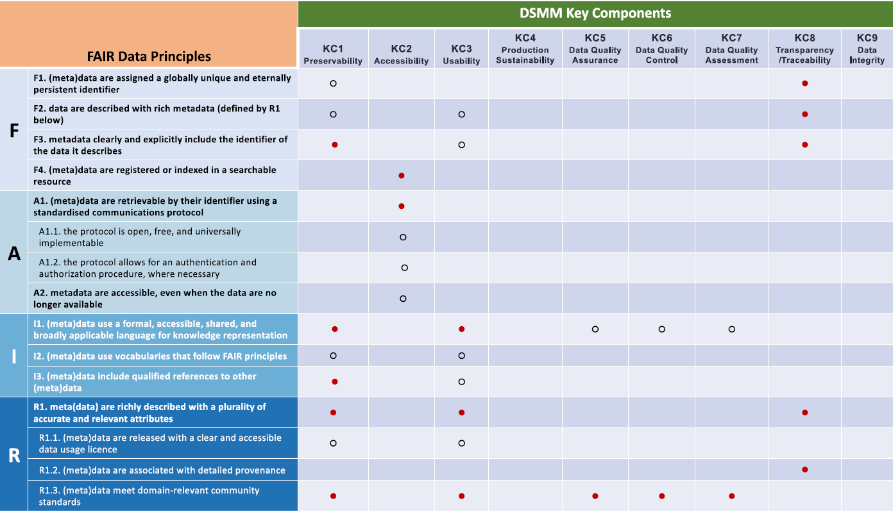
Crosswalk between FAIR Principles and DSMM
Strong synthesis was found between DSMM and the FAIR Principles, with stewardship practices captured in DSMM helping support the FAIRness of individual datasets

Slide 22
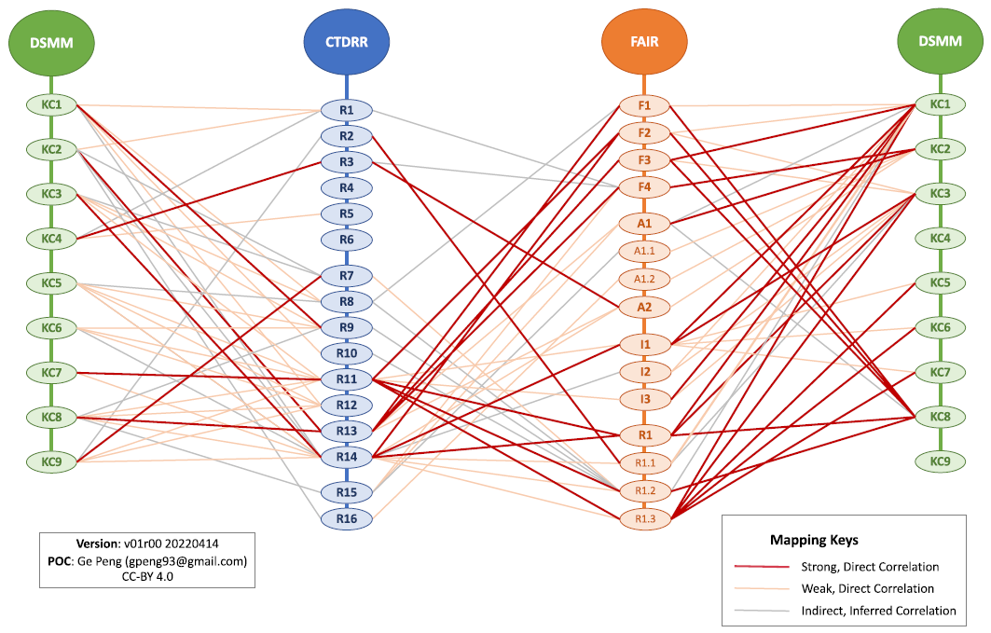
Mappings between each pair of CTDRR, FAIR and DSMM

Slide 23
KEY FINDINGS
CTDRR and DSMM are two of a handful of data stewardship maturity models used to ensure that best practices are followed for the acquisition, preservation, discovery, accessibility, interoperability, and reusability of data for the long-term. Both are based on the OAIS Reference Model. The main differences between these two approaches stem from their different perspectives.
In contrast, the FAIR Principles provide high-level guidance for enabling that (meta)data are findable, accessible, interoperable, and reusable, and prompting data sharing in a machine-friendly environment. They have the most limited scope of the three approaches and tend to measure whether a Principle is satisfied or not.
Unlike CTDRR and DSMM, they do not include maturity levels for measurement of individual FAIR Principles nor do they evaluate data quality practices explicitly.
Strong correlations among these three assessment approaches are found in terms of data discovery, accessibility, interoperability, and usability as a result of their overlapping requirements for the stewardship of data objects.
From an institutional perspective, a prime objective of TDRs is to meet certification requirements—such as CTDRR—as well as codify organizational governance and management plans for stewarding data for the long term.
In tandem with the data object perspective, creation and stewardship lifecycle management best practices can be guided by all three stewardship approaches.

Slide 24
CONCLUSION AND WAY FORWARD
DMSMM
CTDRR
DSMM
FAIR Principles
WGIS DMSMM is now mature and used at ESA
🡪 Esa provided the AVHRR application during last session on Maturity Matrix;
WGISS DMSMM could be presented in a webinar organized jointly with WGCapD;

Slide 25
