Slide 1
WGISS
Documents and Past activities pages periodic review: proposal for discussion
I.Maggio, RHEA for ESA
Agenda Item 9.4
WGISS-57
4-7 March 2024
Sydney, Australia

Slide 2
During the WGISS#56 meeting few actions were addressed to DSIG.
WGISS-56-14 | DSIG to draft a process for periodic review of the documents page and create an ongoing WGISS action to review the page at every WGISS Plenary meeting. | DSIG | In Progress | Possible presentation on this topic at WGISS#57 meeting
WGISS-56-16 | DSIG to draft a process for periodic review of the 'Past Activities' page and create a periodic activity to review this. Consider redesigning and rebranding how this is displayed (Collaborations?) | DSIG | In Progress | Possible presentation on this topic at WGISS#57 meeting
WGISS-56-18 | WGISS to ensure AVHRR recovery efforts are noted in WGISS website (and perhaps in the CEOS Work Plan activity). | DSIG | Open | Possible presentation on this topic at WGISS#57 meeting

Slide 3
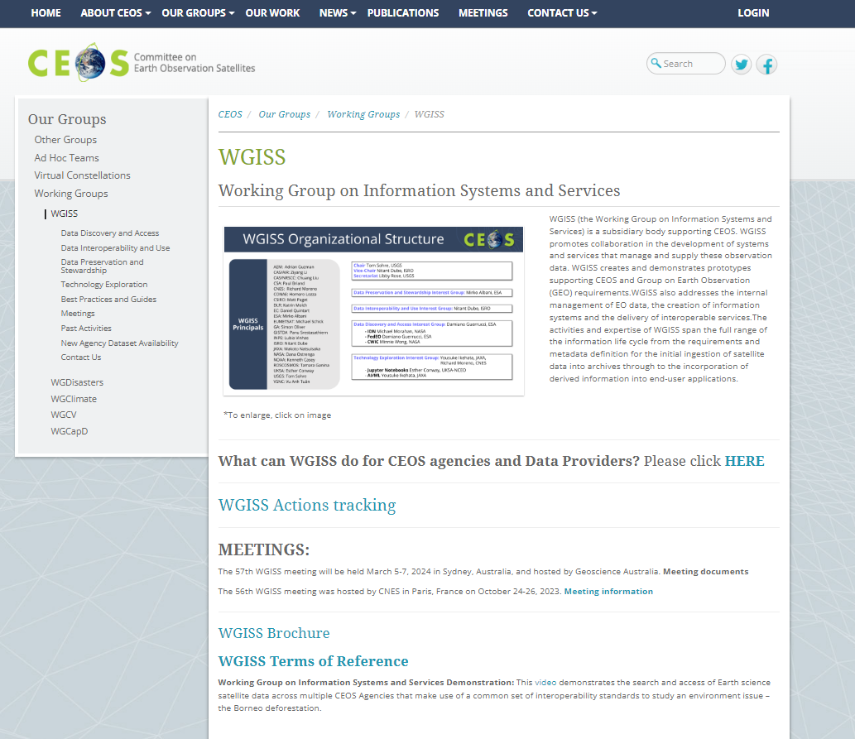

REVIEW of WGISS Webpages should be performed every 2 years (e.g. when new chair takes lead):
Organisation
Terms of Reference
Interest Groups definitions
Collaborations projects
…

Slide 4
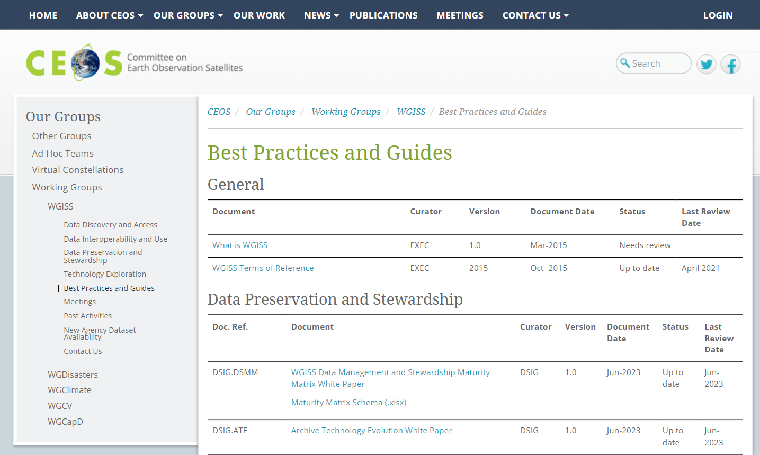

Slide 5
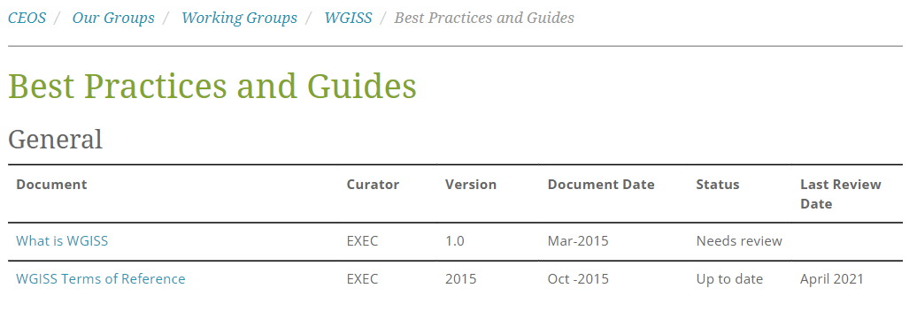
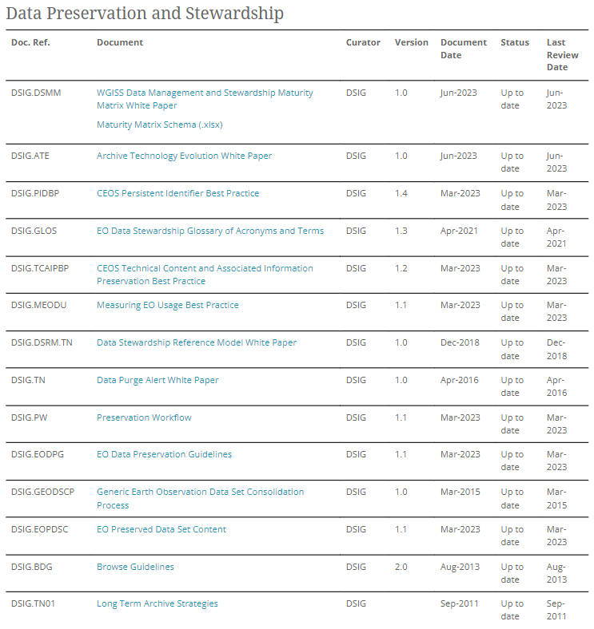
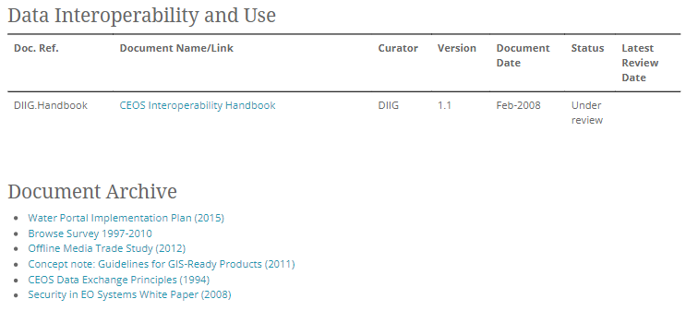
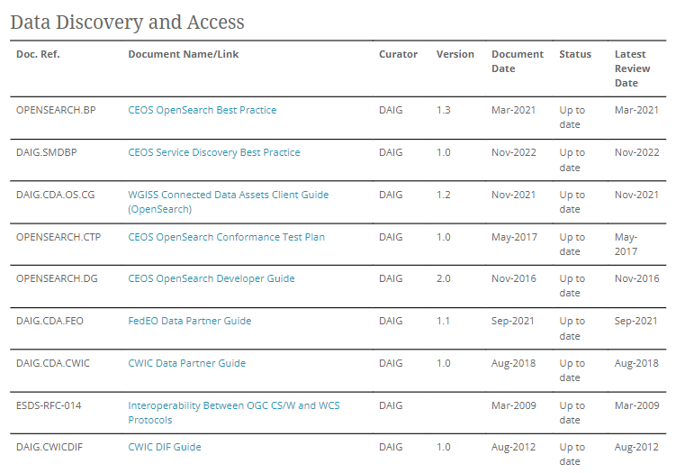
Best Practice and Guides web page to be presented in the IG overview at every WGISS meeting

Slide 6
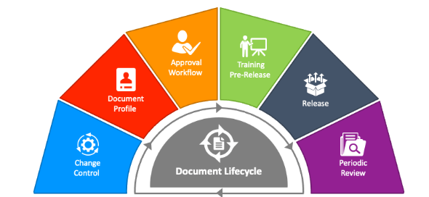
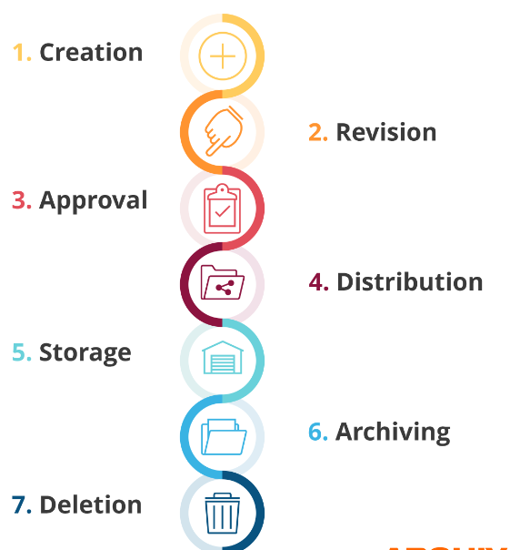
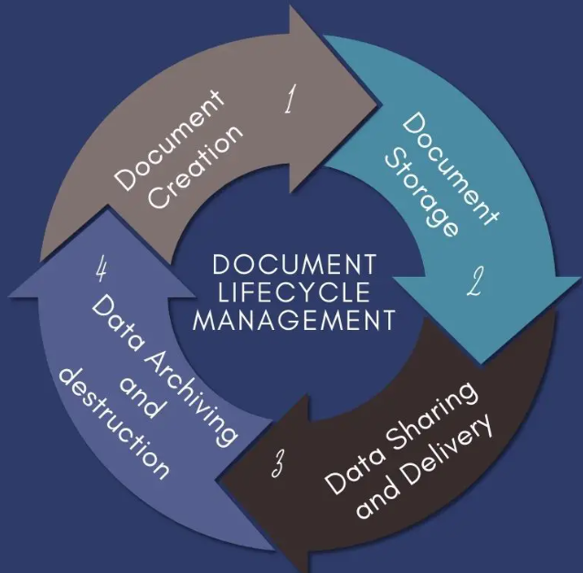
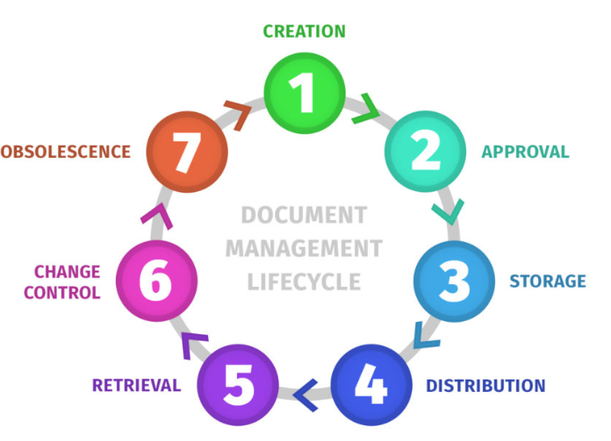
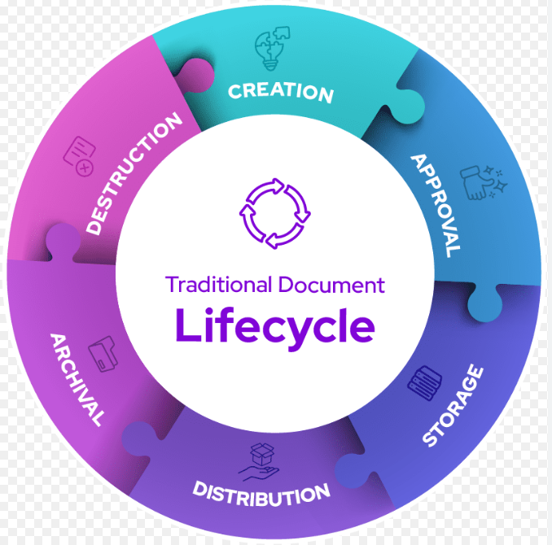
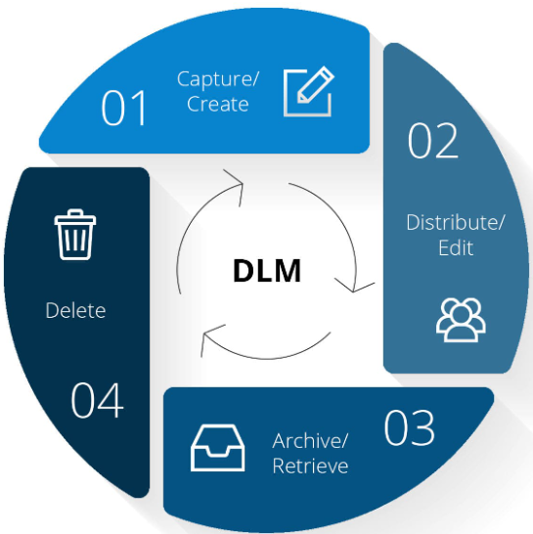
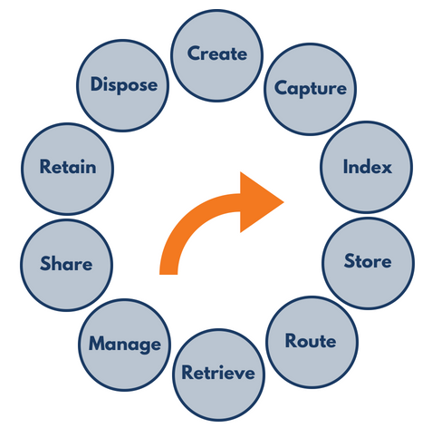

Slide 7
Internal or external request
  Confirm need of a new document
  Selection of the relevant IG as owner
  Action EXEC
  New document circulated for review to all IGs
  Final issue and formal approval
  Action Owner IG
Document creation
Document review and formal approval
Refreshment for Technology changes, verification of links and references and/or adding more details, etc.
Document periodic review and (if needed) disposal
Document storage and discovery
  Review cycle every 2 years or on-demand
  Action Owner IG
  Approved document distribution to WGISS_ALL and storage on WGISS website (discoverable and accessible)
  Action WGISS Secretariat

Slide 8
Internal or external request
  Identification of existing document
  Selection of the relevant IG as reviewer
  Action EXEC
  Document circulated for review to all IGs
  Document acceptance
  Action Owner IG
Document creation
Document review and formal approval
Refreshment for Technology changes, verification of links and references and/or adding more details, etc.
Document periodic review and (if needed) disposal
Document storage and discovery
  Review cycle every 2 years or on-demand
  Action Owner IG
  Document distribution to WGISS_ALL and pointed from WGISS website (discoverable and accessible)
  Action WGISS Secretariat

Slide 9
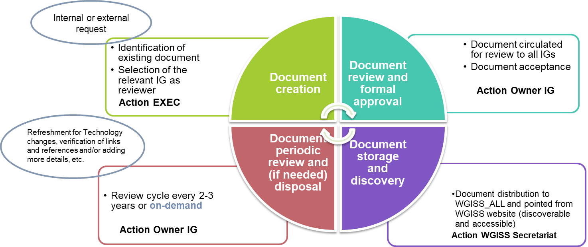
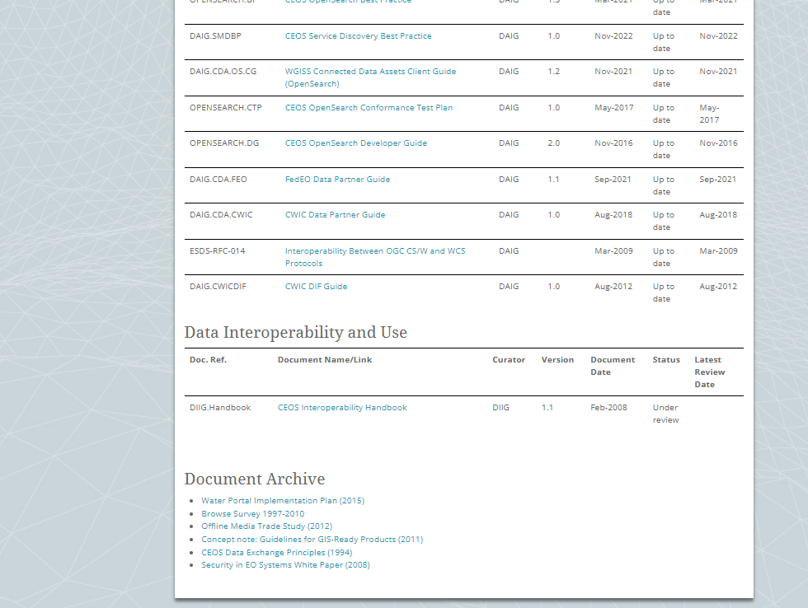
Documents from other sources
Existing documents from other sources (CEOS agencies, CGMS, etc.) might be of interest for WGISS
Additional section in Best Practices and Guides web page might be added to point to the relevant documents
Document from other sources

Slide 10
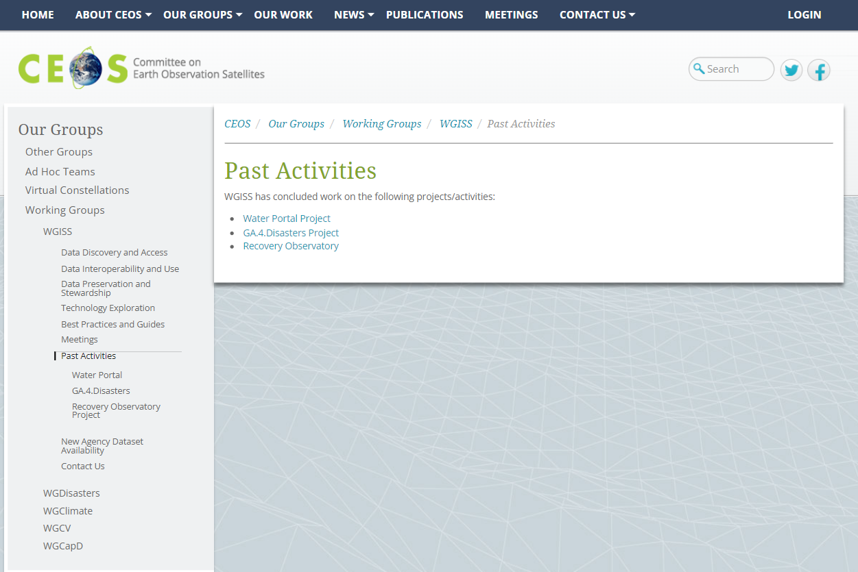
Proposed way forward:
- Rename Past Activities into
Collaboration differentiating ongoing
from completed activities
https://ceos.org/ourwork/workinggroups/wgiss/past-activities/

Slide 11
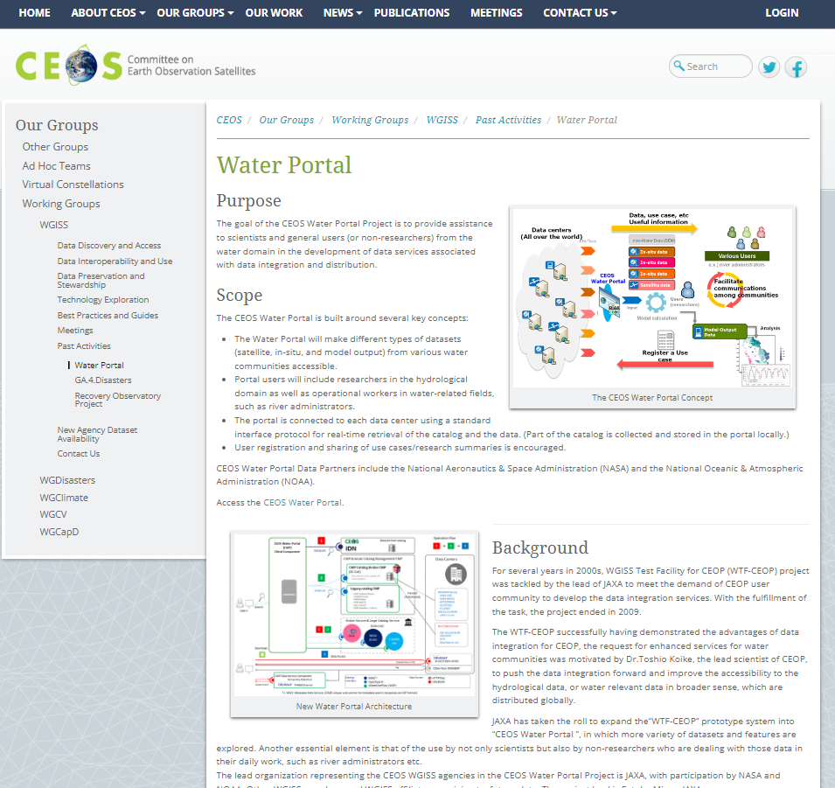
Purpose: The goal of the CEOS Water Portal Project is to provide assistance to scientists and general users (or non-researchers) from the water domain in the development of data services associated with data integration and distribution.
Background: For several years in 2000s, WGISS Test Facility for CEOP (WTF-CEOP) project was tackled by the lead of JAXA to meet the demand of CEOP user community to develop the data integration services. With the fulfillment of the task, the project ended in 2009.
http://waterportal.ceos.org/ not working
Partners: CEOS Water Portal Data Partners include the National Aeronautics & Space Administration (NASA) and the National Oceanic & Atmospheric Administration (NOAA).
Contact Point: For more information, feel free to contact Satoko Miura (Japan Aerospace Exploration Agency, JAXA).
Interesting to maintain in the WGISS website

Slide 12
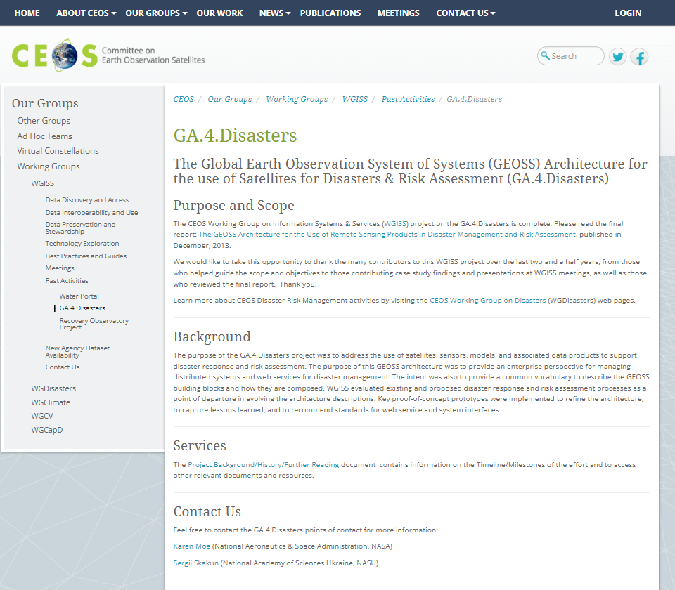
The Global Earth Observation System of Systems (GEOSS) Architecture for the use of Satellites for Disasters & Risk Assessment (GA.4.Disasters)
Purpose: The CEOS Working Group on Information Systems & Services (WGISS) project on the GA.4.Disasters is complete. Please read the final report: The GEOSS Architecture for the Use of Remote Sensing Products in Disaster Management and Risk Assessment, published in December 2013.
Background: The purpose of the GA.4.Disasters project was to address the use of satellites, sensors, models, and associated data products to support disaster response and risk assessment.
All documents can be downloaded
Joint with WGDisasters.
Contact Point: Feel free to contact the GA.4.Disasters points of contact for more information: Karen Moe (National Aeronautics & Space Administration, NASA); Sergii Skakun (National Academy of Sciences Ukraine, NASU)
Interesting to maintain in the WGISS website

Slide 13
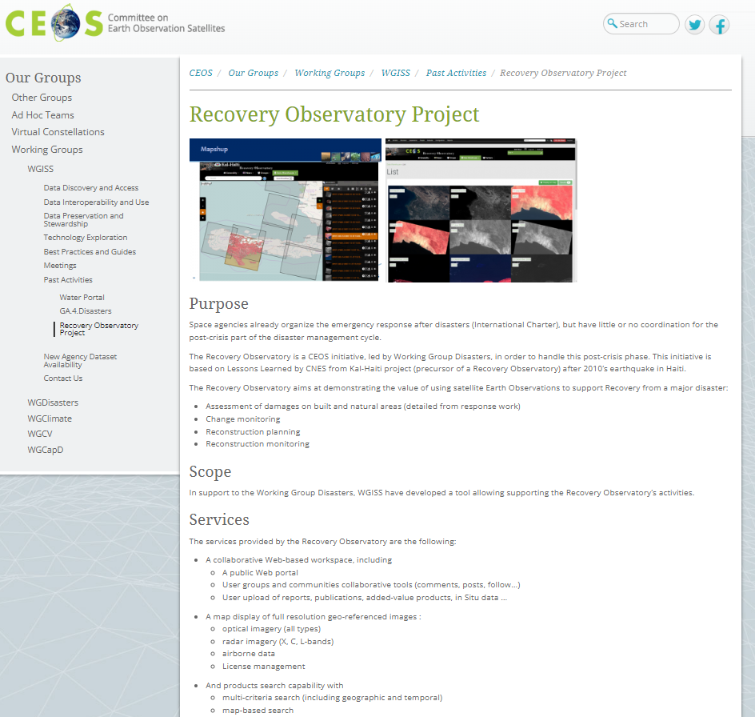
Purpose: Space agencies already organize the emergency response after disasters (International Charter) but have little or no coordination for the post-crisis part of the disaster management cycle. The Recovery Observatory aims at demonstrating the value of using satellite Earth Observations to support Recovery from a major disaster:
- Assessment of damages on built and natural areas (detailed
from response work)
              - Change monitoring
              - Reconstruction planning
              - Reconstruction monitoring
Background: The Recovery Observatory is a CEOS initiative, led by Working Group Disasters, in order to handle this post-crisis phase. This initiative is based on Lessons Learned by CNES from Kal-Haiti project (precursor of a Recovery Observatory) after 2010’s earthquake in Haiti.
Joint with WGDisasters
Contact Point: Please feel free to contact this Interest Group for more information: Richard Moreno – French Space Agency (CNES)
Interesting to maintain in the WGISS website

Slide 14
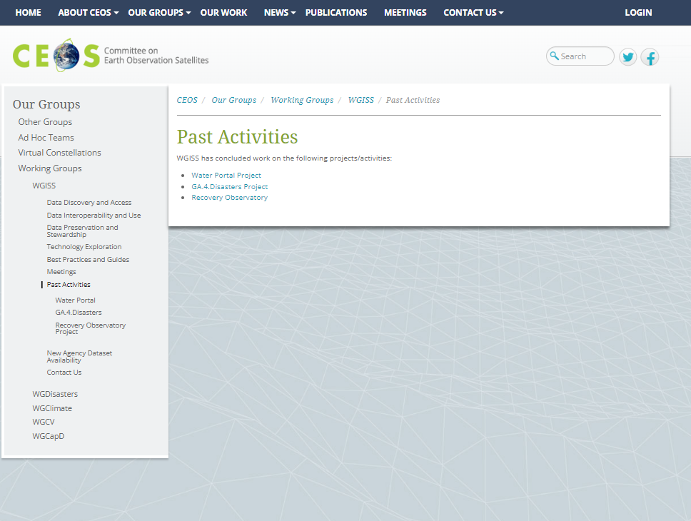

Collaboration Projects
The page includes joint projects in collaboration with other external Entities, Working Groups and Agencies.
WGCapD
WGCV
WGDisaster
How to organize the new web page:
- Ordering by Working groups or Agencies?
- Ordering by Projects name?

Slide 15
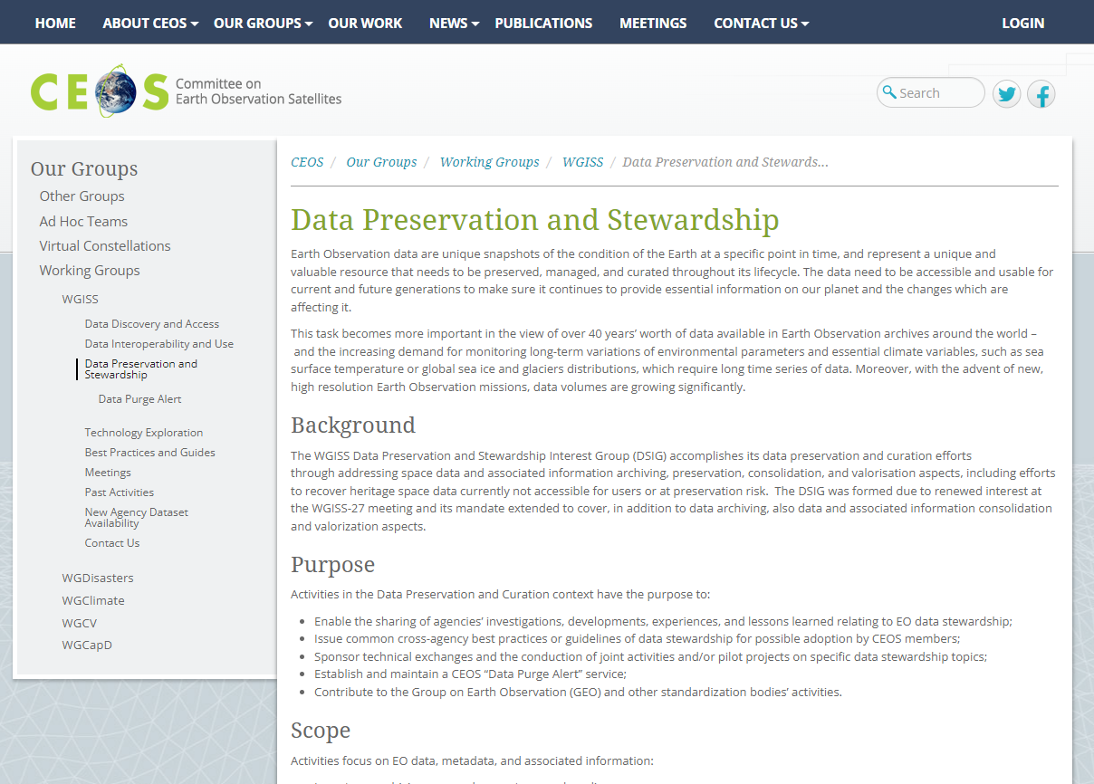
Sub-section on Heritage Data Recovery
will be added in DSIG area
Objectives
Ongoing projects (e.g. AVHRR)
…
Heritage Data Recovery

Slide 16
Climate related applications are requiring more and more to extend critical long-term science observations back in time through recovery and use of heritage (historical) datasets. Objective of the sessions is to identify historical/heritage datasets currently not accessible to users (e.g. because on old media, not kept online, etc.) and trigger potential joint recovery actions.
Need: identify historical/heritage datasets currently not accessible to users (e.g. because on old media, not kept online, etc.) and trigger potential joint recovery actions. The sessions are consisting of WGISS members presentations with information on heritage datasets to be recovered in terms of:
    Dataset description and scientific relevance
    Dataset location and status of accessibility
    Dataset format, volume, etc.
    Availability of dataset related documentation, software, information
    Indication of priority based on uniqueness, applications, needs, impact
SUB-SECTION
AVHRR cooperation objectives (clickable in another webpage or in this page)
Unfold and make accessible 1km AVHRR data from regional archives (possibly open and free)
Transcribe unique AVHRR data from heritage media
Identify a common format for AVHRR Level-1b and Level-1c data and pursue (re)processing from AVHRR data owners/holders and data accessibility
Facilitate data discovery through the WGISS Connected Data Assets Infrastructure

Slide 17


