Slide 1
WGISS-57
Archive Technologies Evolution White Paper
Summary and Recommendations

Slide 2
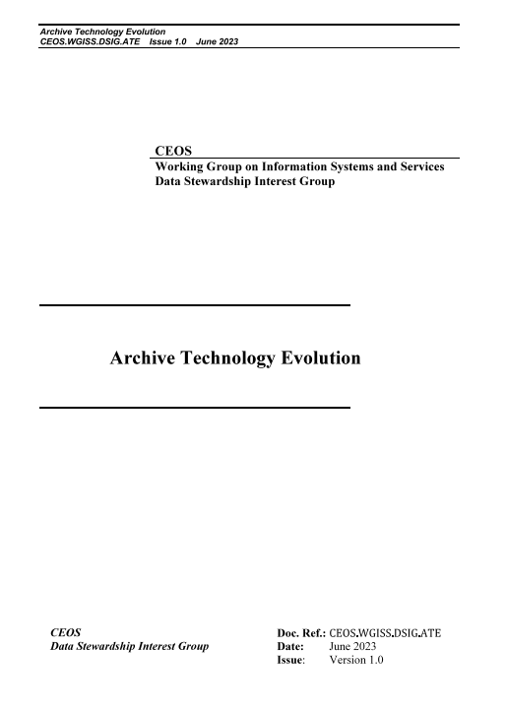
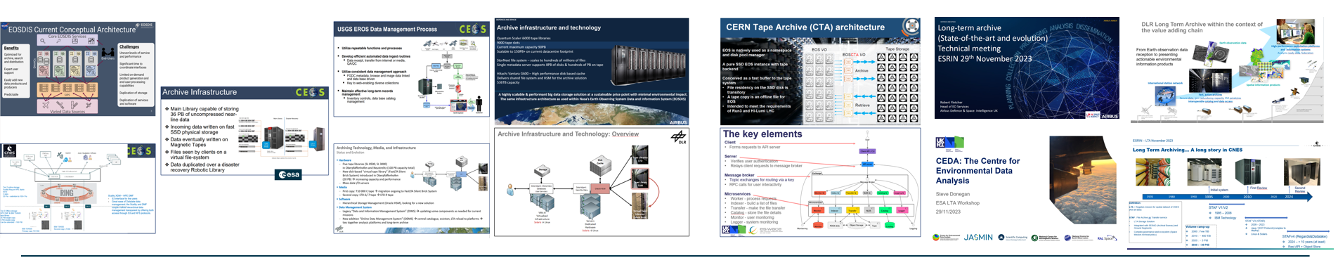
Archived data volume at space agencies is growing exponentially. At the same time archiving technology is changing very rapidly.
Surveys, workshops and dedicated sessions were held at WGISS to present the status of CEOS agencies archives in terms of content, technology and future evolutions/trends. A dedicated study on the evolution of the ESRIN archive was also performed at ESA.
These activities were summarized in a CEOS Archive Technology Evolution White Paper.
Issues and solutions in data archiving and future challenge of “Preserving long-term data at the Exa-scale”

Slide 3
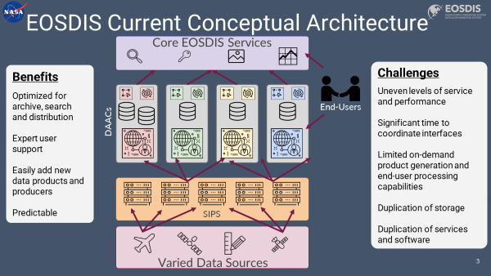
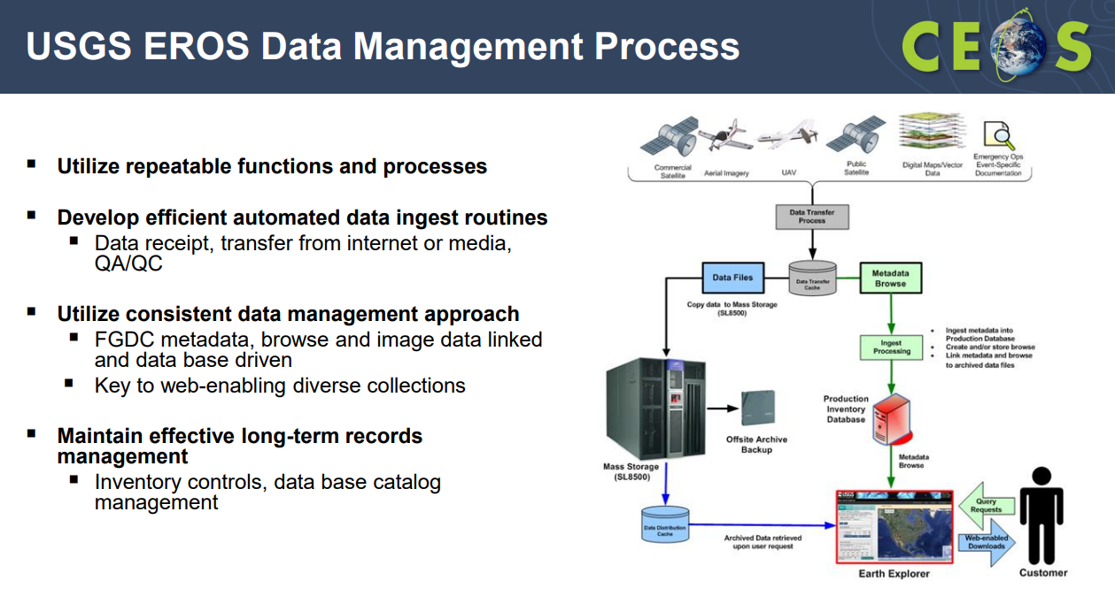
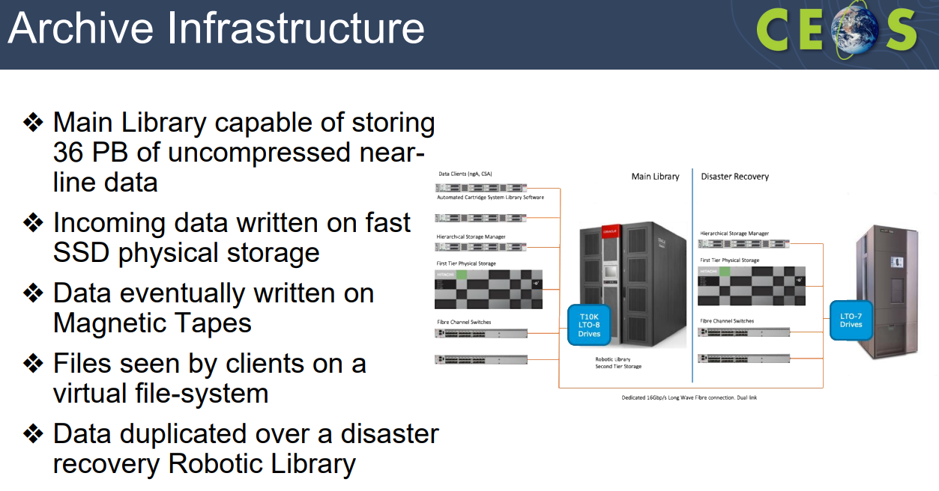
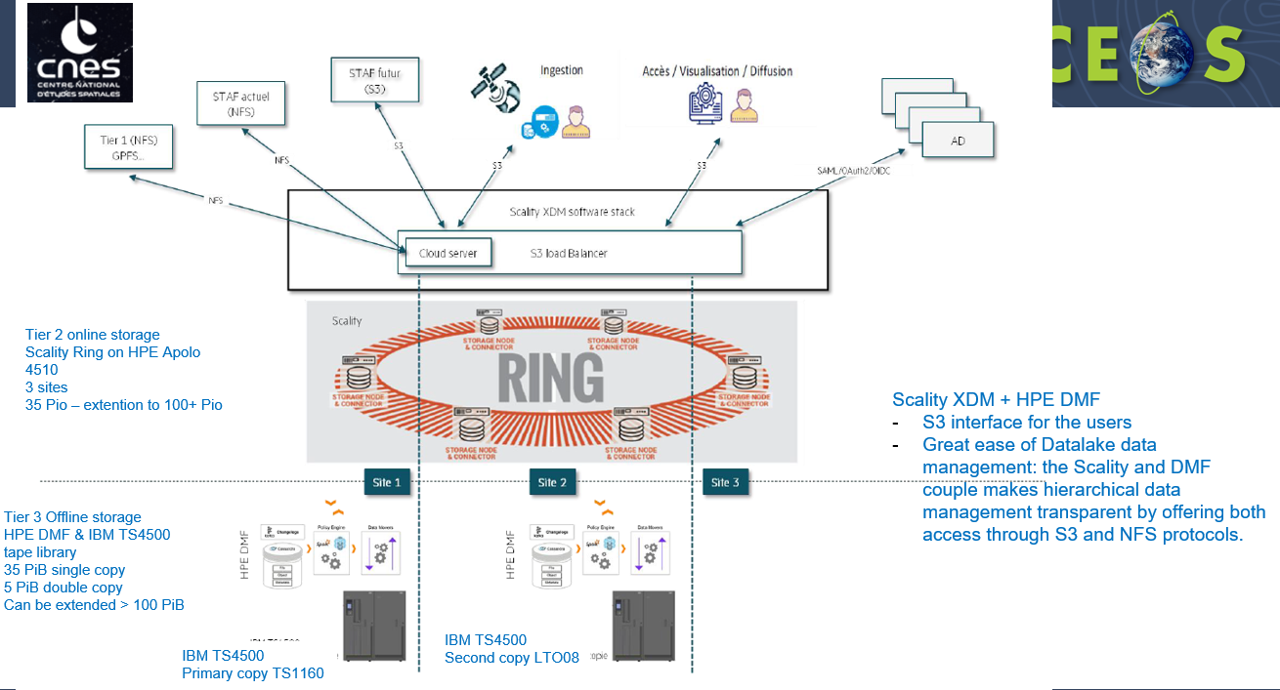
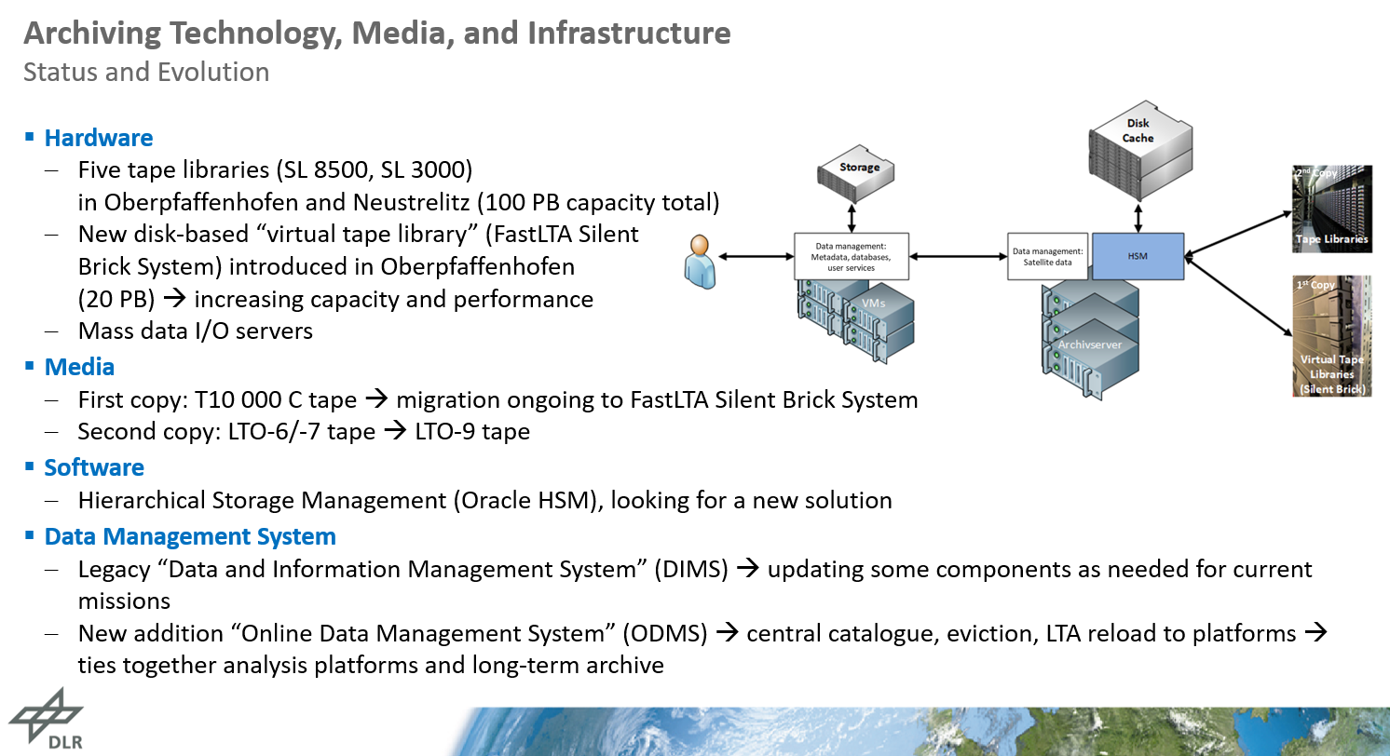

Archive Technology Surveys – WGISS#54

Slide 4
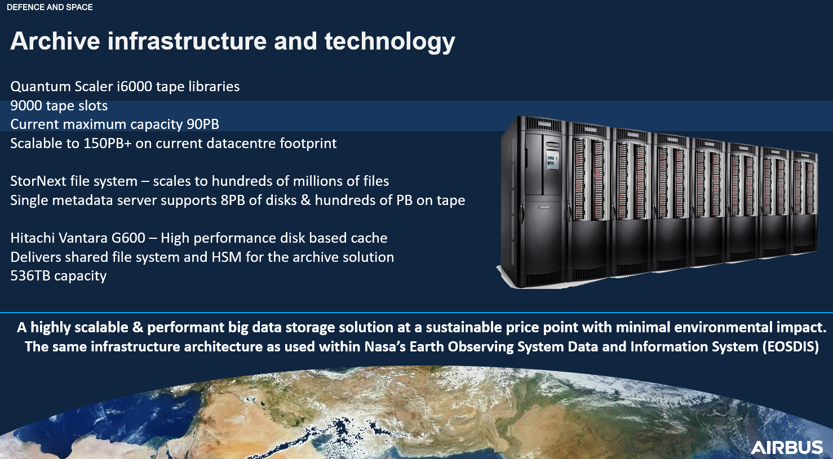
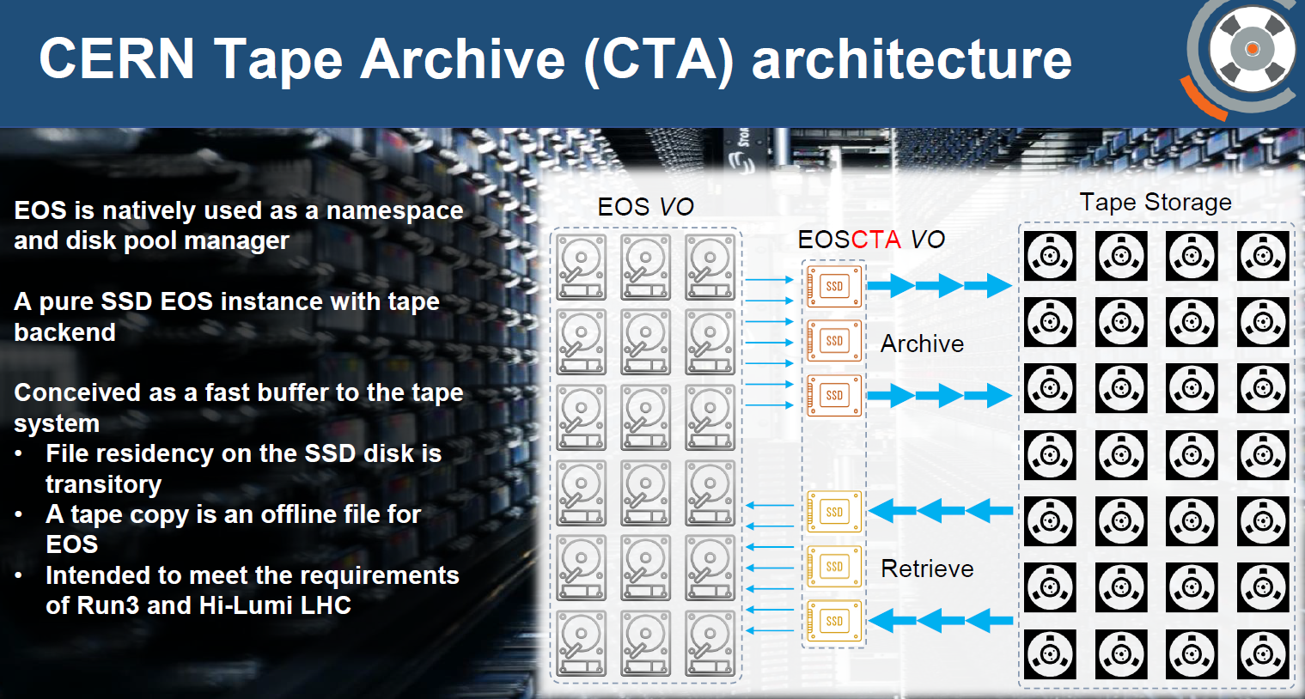
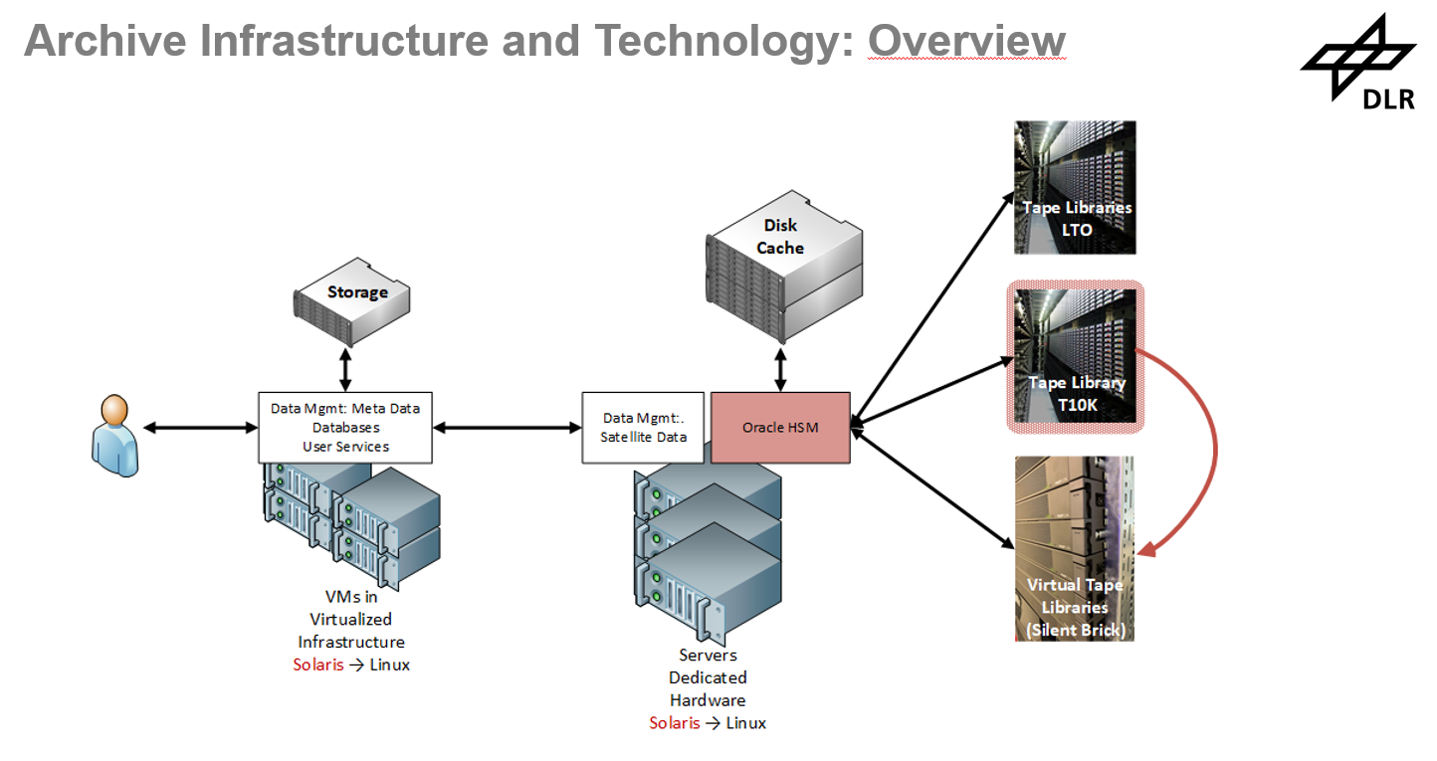
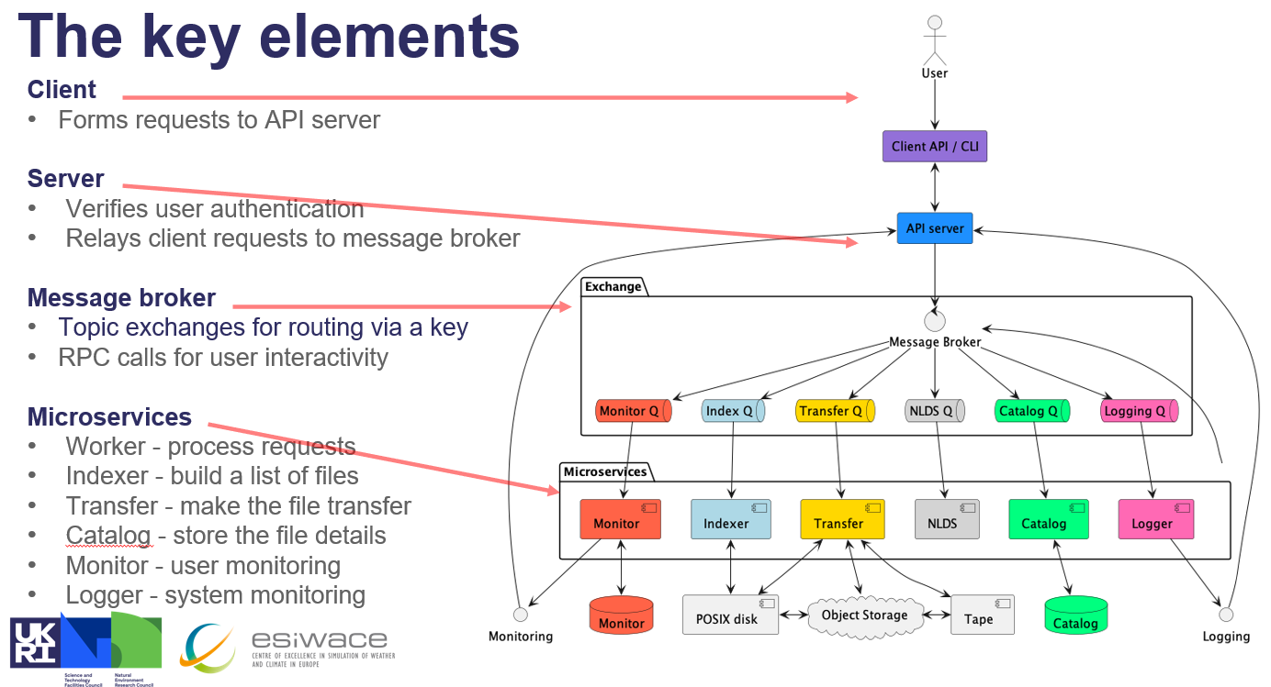
Archive Technology Surveys
LTA Technical Meeting (ESRIN)

Slide 5
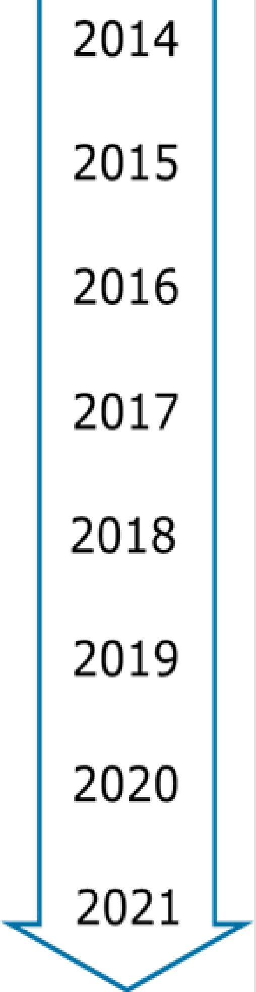
Archive Upgrade at ESA
To keep up with the always growing amount and variety of data produced, the archive is constantly enhanced to facilitate the archival process.
Over the course of the last 15 years, several HW upgrade have been performed to the core of the Archive, the Robotic Library.
Future upgrades shall take into account technological innovation and practices.
A study was awarded to industry for a technology survey and to help drawing a roadmap for the archive upgrade with the goal to achieve:
Better ingestion and extraction performances
Reduce overall power consumption
Use of state-of-the-art technologies
Ensure maintainability of the archive HW and SW
Archive Kick-off
Migrated technology and data from T10KB to T10KD
Increased number of drives
Implemented 10GB Network
Upgraded fiber channels environment from 8gbp/s to 16gbp/s
Upgraded 1rst tier from mechanical HDD to SSD Disks
Optimized 1st tier – dedicated LUN for iNodes
Implemented Disaster Recovery
Introduction of 2nd tier
Migration to LTO-8 (increased number of drive to 12)

Slide 6
ESA/ESRIN Archive Evolution Study
The study, aimed at drawing a roadmap for the update of the ESA Heritage Space Data Archive, has been used as an input for the white paper and covered the following topics:
Archiving market
  Hardware (Tapes, Folio, Glass Drives, Disk Storage, OS Orchestrators etc.)
  Software ( Alluxio, Atempo, Versity, MinIO, LABDRIVE, nageruHive etc.)
Cloud Providers (on prem, public offers, etc.)
Standards
Existing ESA technologies and Archives solutions (Copernicus LTA, Planetary Science Archive, etc.)
Other organizations technologies and archives solutions (NASA, CERN, NOAA – NCEI, EUMETSAT etc.)
Sustainability (Energy consumption, Cooling Requirements etc)
Costs (HW, SW, Maintenance etc.)

Slide 7
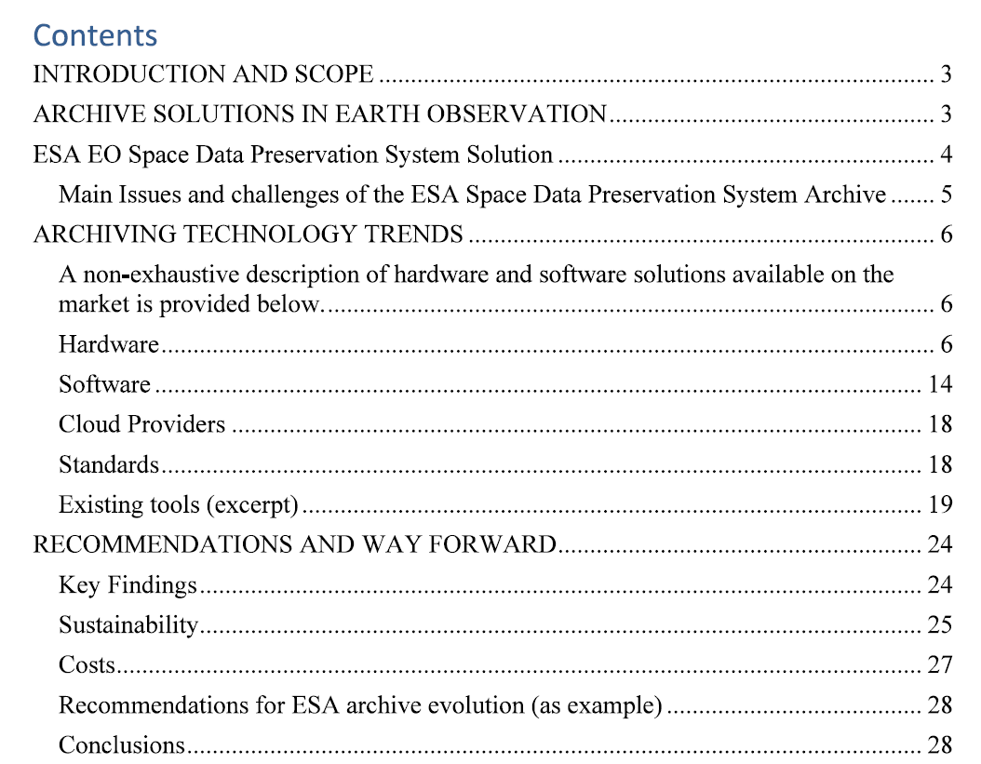
The white paper takes as reference and describes the functionalities and architecture of the ESRIN archive, which is similar to most of other solutions implemented at WGISS Agencies.
It collects some of the main challenges faced today by EO data archives and provides information about archiving and preservation solutions available on the market.
It finally provides recommendations for archives evolution taking into account environmental friendly aspects (power consumption).

Slide 8
Main challenges (excerpt)
The evolution of the archive should not only ensure seamless archival of the always increasing amount of data produces; It should also take into account some challenges which are common in Tape Based Archives:
Lots of I/O affects performances
Media failures recovery takes time and uses resources
Some Archive software forces the archive of being vendor (and OS) locked
Support tickets requires lots of data collection (even for obvious failures)
Support tickets often result in requests to update firmware
Firmware updates are complicated time consuming

Slide 9
Main challenges (2)
Data migrations is complicated, time consuming, expensive
Longevity of technology has side-effects (maintenance costs, obsolescence of HW)
Tape prices are not predictable. While this doesn’t seem the case recently, it has been an issue in the past
With the end of some tape families and HSM archive managers, it is feared that the main vendors are moving away from tape archive solutions
Archives ready for lots of data, less ready for billions of small files
Extracting data from tapes is slow and complicated

Slide 10
Main challenges (3)
Tape based archives are often seen by external clients as a network file-system. Due to lots of I/O necessary to update the file-system metadata, performances when archiving small files is scarce. The archive at ESA has been used for benchmarking performances with a copious number of small files.
The Archive had ~20 PB of data for a total of 220 Millions of files before the benchmark. A dataset with ~200 TB and over 1 Billion of files was used to test archiving capabilities:
Consequences of such high number of files:
Degraded file listing/queries
File-system Metadata reaching ~1TB GB of size (was 200GB)
Increased time to backup the File-system Metadata (could not be done daily)
Huge time required to copy the benchmark dataset into Archive
  300,000 files per day using a single tape drive
  ~4 years to complete the activity and copy the data into the current archive with 2 drives in parallel

Slide 11
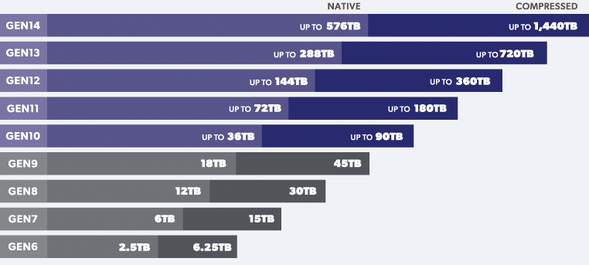
Advantages of Tape Archive
There are however lots of advantages of using Tape Based Archive
Easy to expand
Power efficient
Tapes are cheaper and cheaper
Tapes evolution are on par with disk evolution
Malicious encryption of data is just not possible
Malicious deletion of data is not achievable
LTO Tape family roadmap, LTO-9 available on the market

Slide 12
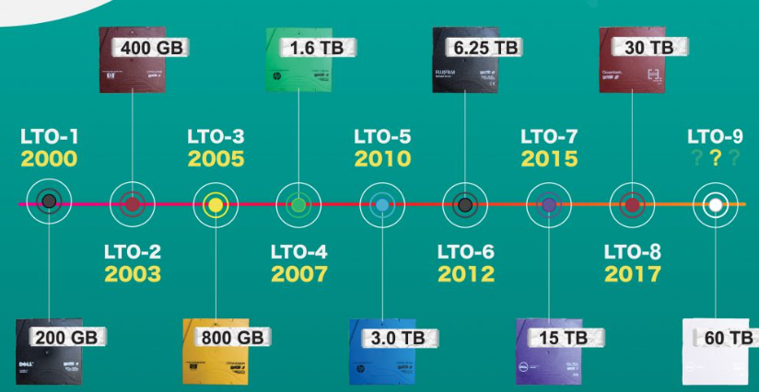
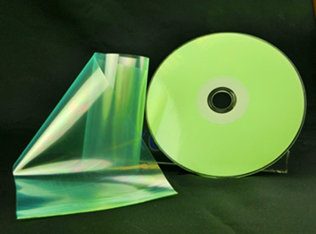
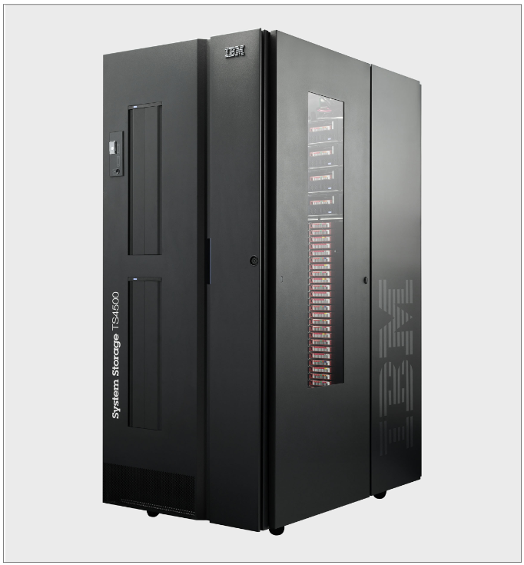

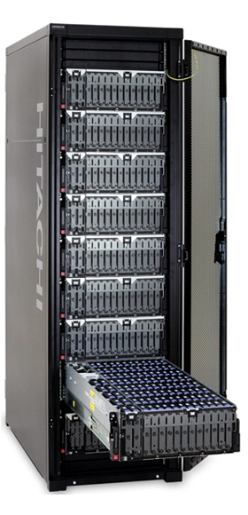
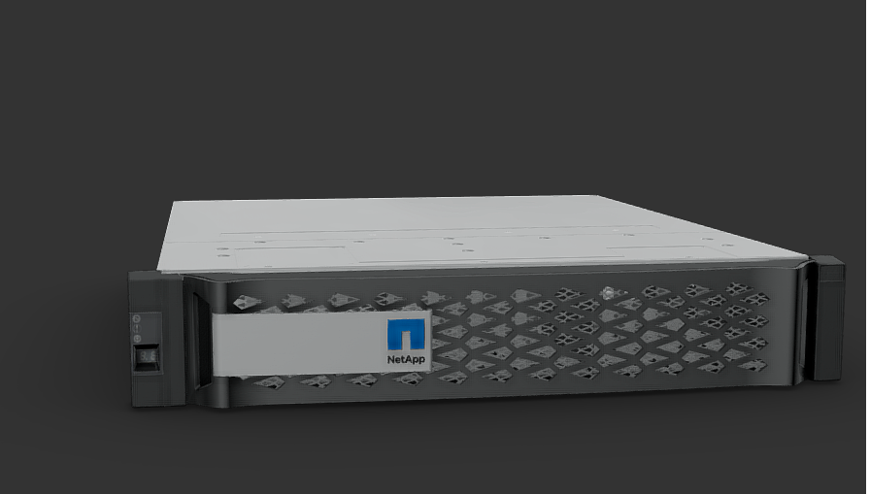
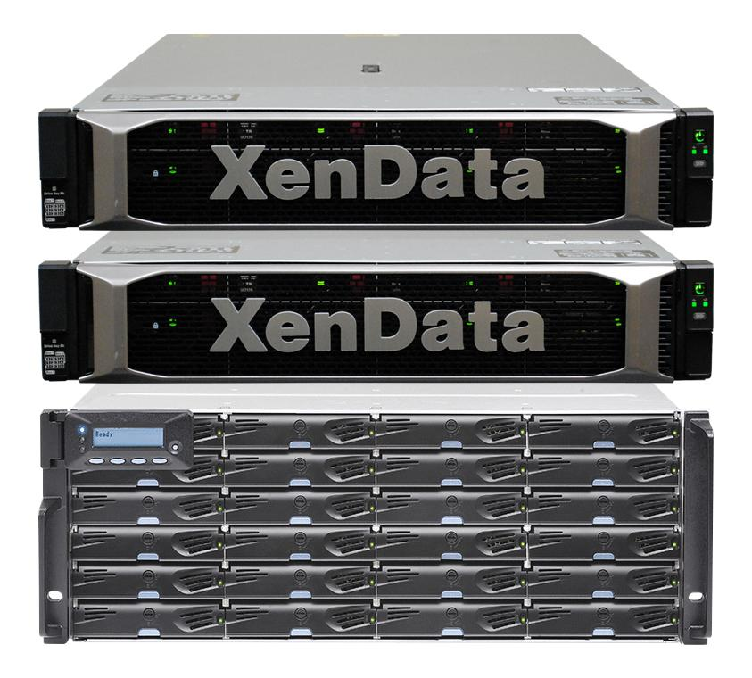
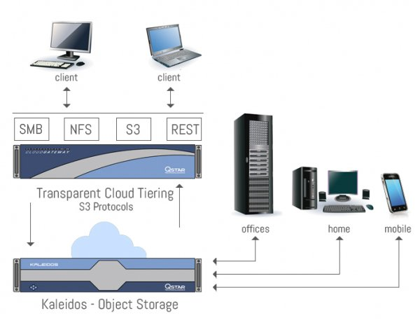
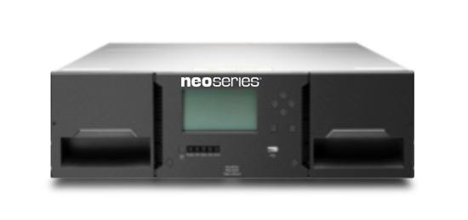
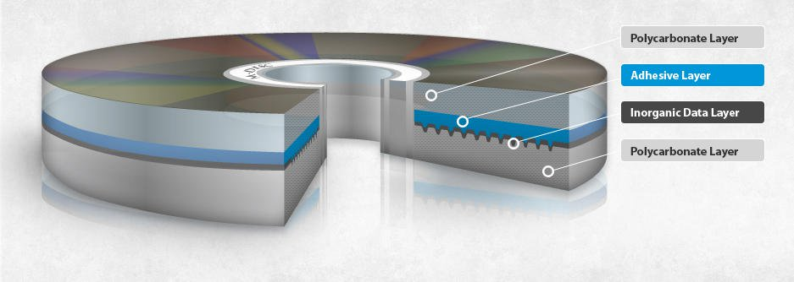


ARCHIVING TECHNOLOGY TRENDS
Hardware
LTO technology
Folio Photonics
IBM Storage
Microsoft Glass Drive
Hitachi Vantara
Quantum
NetApp
XenData
Qstar Kaleidos
Overland Tandberg Libraries
M-Disk
Spectra Logic
Oracle Storage
Piql Film
Hewlett-Packard

Slide 13







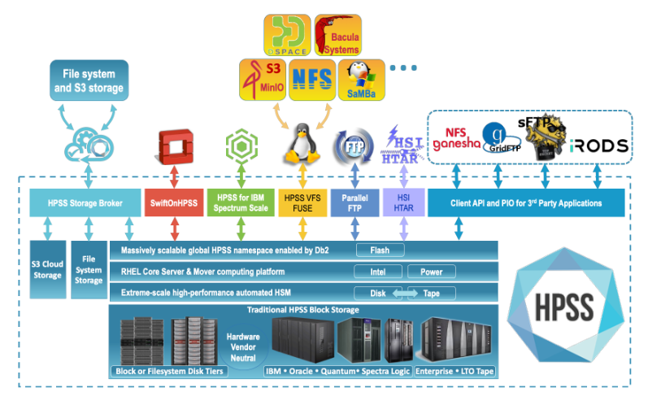
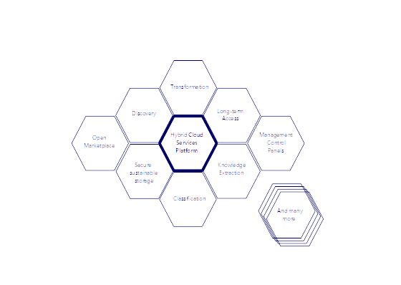

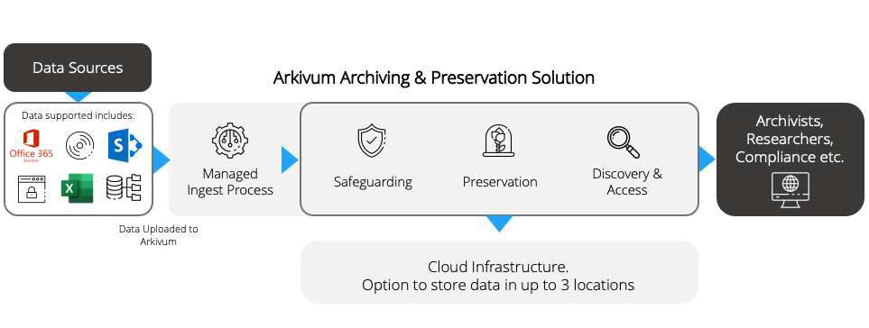
ARCHIVING TECHNOLOGY TRENDS
Software
Atempo
Alluxio
Preservica
Seagate Lyve
Piql
Versity
MinIO
Qstar Archive Storage
IBM
LABDRIVE
nageruHive
Arkivum

Slide 14







ARCHIVING TECHNOLOGY TRENDS
Cloud Providers
Amazon Web Services AWS
Google Cloud
OVH
Cloudferro
Safespring
Microsoft Azure
Oracle

Slide 15
Key Findings
There are solutions to keep using currently owned storage technologies. You don't need to change the entire infrastructure
Hardware providers are developing hot, warm and cold storage solutions that can complement the current infrastructure
Some WORM storage options are already available or being developed that are based on nonmagnetic media, like optical disks or crystal based
More and more, organizations are moving to cloud-based services because of their flexibility and cost effectiveness in the short-term. However, the step to cloud migration needs to be planned because long-term costs and vendor locking could be an issue in the future

Slide 16
Key findings (2)
Complementary to pure cloud solutions, the hybrid-cloud approach suggestable. A mix between public access on the cloud plus cold on-premise storage would benefit in the long-term
The preservation software market is very active and growing. In addition to the classic providers in this area, some new players are showing interesting solutions also with a very open-minded approach to avoid extra costs or cloud locking
SaaS is a trend on this market
Many providers are showing some environmentally friendly messages, it is however not clear how much of the figures are greenwashing
OAIS is the standard for preservation and needs to be followed. In addition, other standards could improve archives operations in different directions
Big cloud providers are charging for requests or operations which makes it almost impossible to make a budget in advance

Slide 17
Archive Technology Evolution White Paper - Recommendations
To ease data migration, vendor lock for both the Hardware and Software is to be avoided when possible.
To ensure an environmentally friendly evolution, tape based solutions must be taken into account.
Many Cloud providers are showing some environmentally friendly messages but it is not clear how much are they real or just green-washing. Complementary to pure cloud solutions, the hybrid-cloud approach is suggestable.
OAIS is the standard for preservation and needs to be followed.
Big cloud providers are charging for requests or operations what make almost impossible to make a budget in advance.
Some European cloud providers are not charging for the recovery.

