Slide 1
DLR AVHRR LAC data curation and reprocessing
THE TIMELINE PROJECT
Katrin Molch
German Aerospace Center DLR
CEOS-WGISS #57, Sydney, Australia & online
6 March 2024

Slide 2
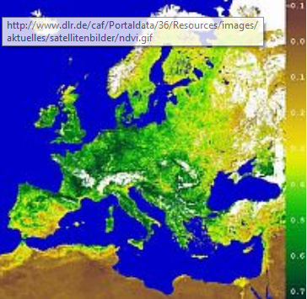
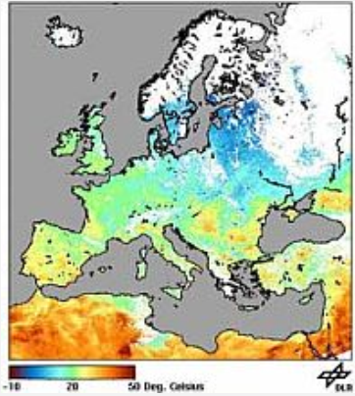
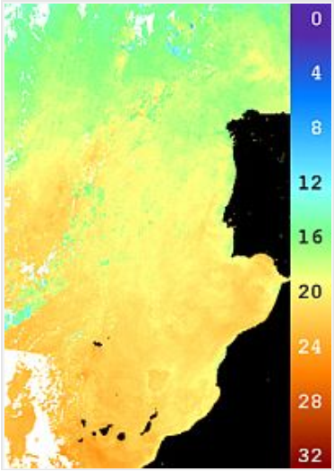
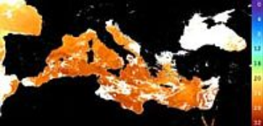
Towards AVHRR LAC data consolidation at DLR
NDVI
LST day/night
Back in 2013
Over 30 years worth of AVHRR LAC (1 km) HRPT data in DLR LTA – new data added daily
Processing chain for daily AVHRR products since early 1990s – old code and hardware
? Dismantle or modernize ?
SST Baltic
SST Atlantic
SST Mediterranean
The result
TIMELINE project initiated 2013, funded internally, for AVHRR LAC data consolidation, harmonization, and geospatial product generation

Slide 3
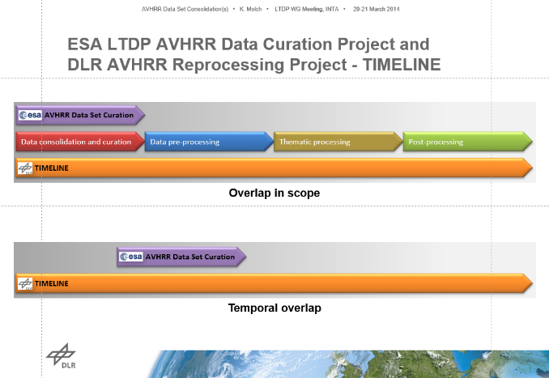
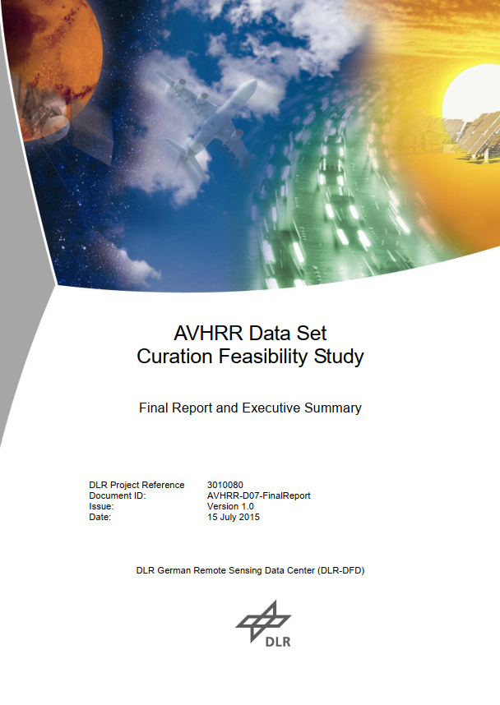
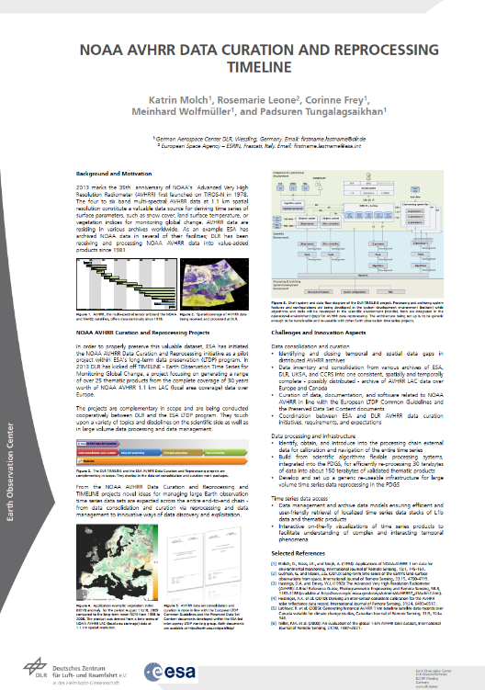
Joint ESA-DLR activities related to AVHRR consolidation
Discussion of AVHRR activities (ESA, DLR) in ESA Long-Term Data Preservation Working group since 2012
AVHRR curation feasibility study 2013-2015
Joint publication @ Big Data in Space conference (BiDS) in 2013
Two-day expert consultation workshop @ DLR 04/2015

Slide 4
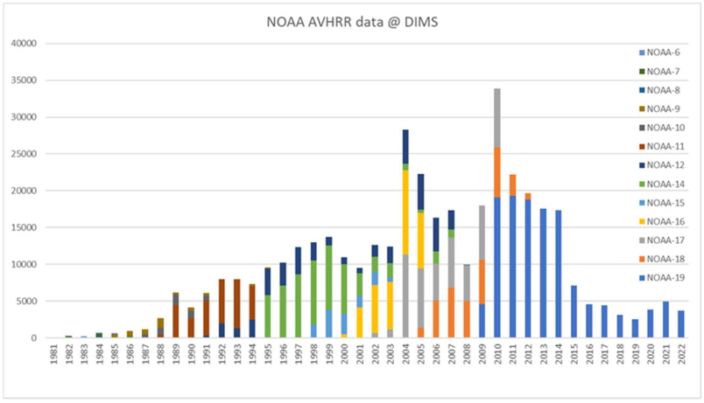
AVHRR input data
Number of L0 AVHRR LAC scenes per NOAA sensor used in TIMELINE
… to be continued with MetOp-A/-B/-C AVHRR data
Source: Wolfmüller EtAl, Optimized Data Access from and to a Long-term Archive for the Processing of Time Series, Proceedings Preservation and Value Adding Conference (PV2023), Geneva, 2-4 May 2023. (link).

Slide 5
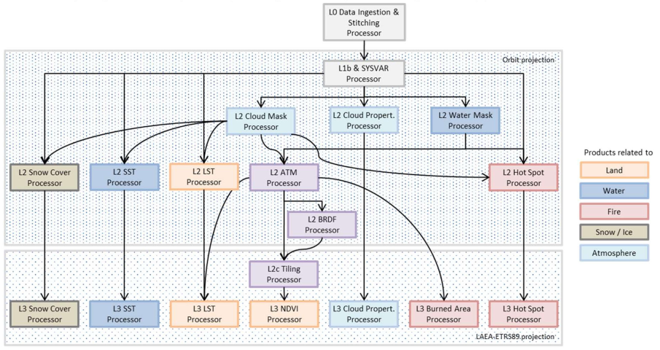
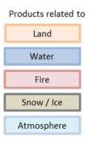
Workflow and products
Source: Wolfmüller EtAl, Optimized Data Access from and to a Long-term Archive for the Processing of Time Series, Proceedings Preservation and Value Adding Conference (PV2023), Geneva, 2-4 May 2023. (link).

Slide 6
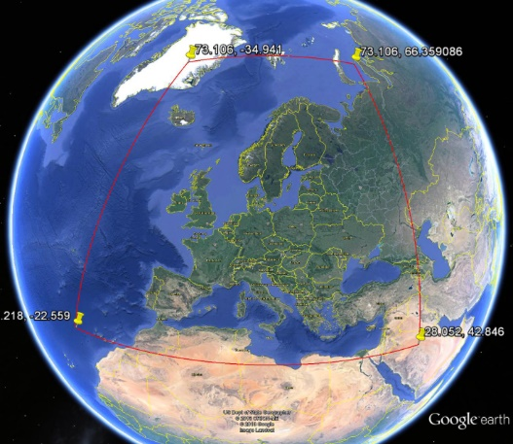
TIMELINE product suite
SST
CP
LST
SC
NDVI
BA
Daily, 10-day, monthly composites
Including quality and uncertainty layers
Available in orbit geometry (L2) and projected to LAEA, ETRS89, EPSG 3035 (L3)
18 output product types, 1.5M products, >500TB
Product format: netCDF
Temporal coverage 1981 – 2022
In general 1 km spatial resolution
Spatial coverage of
TIMELINE products
NDVI Normalized Difference Vegetation Index
LST Land Surface Temperature
SST Sea Surface Temperature
CP Cloud Properties
SC Snow Cover
BA Burnt Area
Source: Dech EtAl, Potential and Challenges of Harmonizing 40 Years of AVHRRData: The TIMELINE Experience (link)
Notes:
Monthly NDVI composite for May 2007 Snow cover L2c product derived from NOAA-17 AVHRR/3 scene acquired on 1 January 2009
Example for the TIMELINE LST L3 product: Mean LST in August 2007.
Example for the TIMELINE SST L3 product: Mean SST in July 2007
Cloud properties contained in the L3b monthly- / hourly-resolved APOLLO_NG 10 km product (July 2001, 14:00-15:00 )

Slide 7
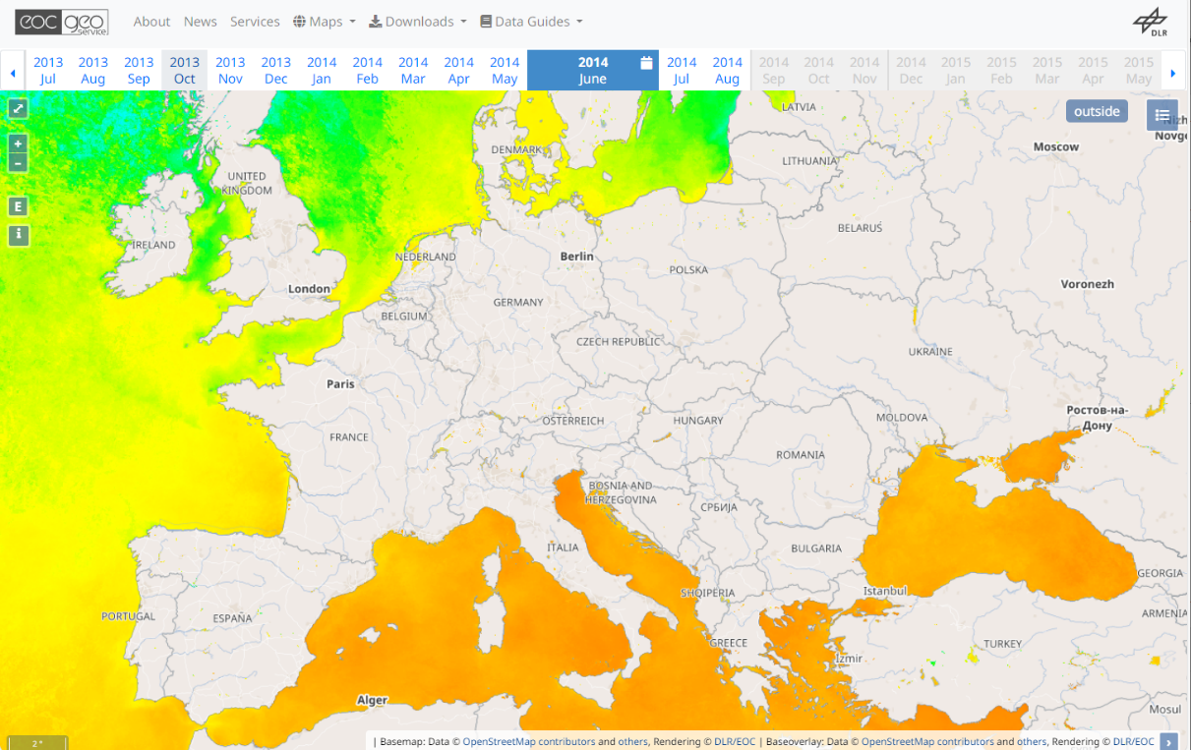
Data policy and access
L0, L1b, L2 data for internal use
L3 projected composites will become free & open
Currently used for internal studies / theses → to be released step-by-step
STAC metadata being generated for L3 products
CEOS CARD-4L self assessment ongoing for selected data (LST L3, others tbd.)
Future access to TIMELINE L3 products via EOC-Geoservice (https://geoservice.dlr.de) for visualization & download

Slide 8
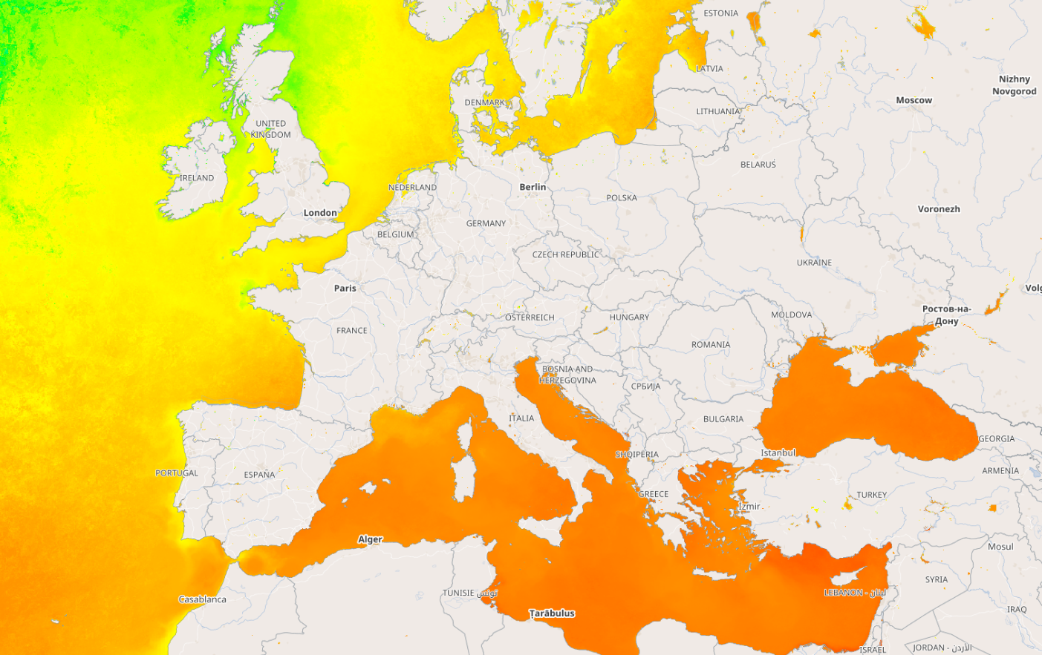
Edit Master text styles
Thank you!
Questions?
Katrin Molch
German Aerospace Center DLR
Earth Observation Center
Katrin.molch@dlr.de
Notes:
Comparison of European L1 data sets would be interesting
Interested in contributing to the international effort

