Slide 1
WGISS-57 CEOS Data Access Website
Filippo Marchesi
Solenix for ESA
Agenda Item 7.9
WGISS-57
4-7 March 2024
Sydney, Australia

Slide 2
Data Discovery & Access
Objectives & Achievements:
SLT to DAIG
Improve the overview of group’s activities & achievements
Reorganization of side tiles
Updated content, related links and status of available services & documents
Updated contact and procedure to be involved into DAIG
https://ceos.org/ourwork/workinggroups/wgiss/access/

Slide 3
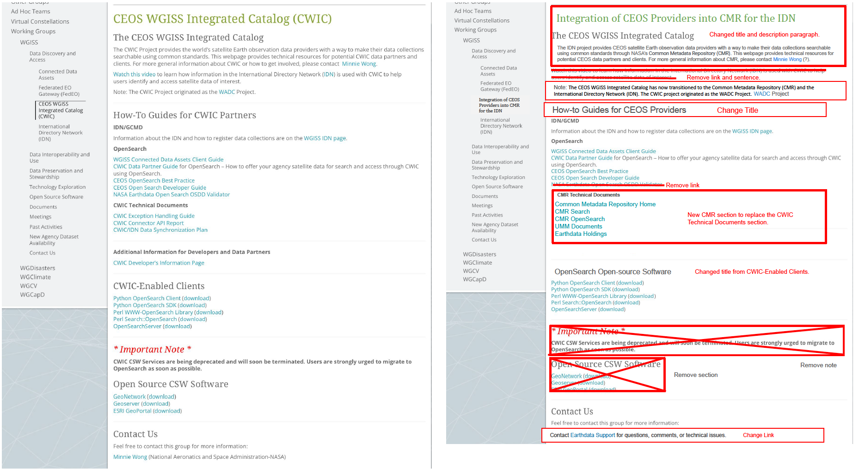
CWIC & CMR

Slide 4
Thanks
Data Discovery Access Interest Group - DAIG
Access-SysTeam-Help@wgiss.ceos.org
Damiano Guerrucci
damiano.guerrucci@esa.int
Filippo Marchesi
filippo.marchesi@solenix.ch

