Slide 1
FedEO Report
Yves Coene (Spacebel for ESA), Mattia Stipa (ESA)
CEOS WGISS #57, Sydney (Australia)
Session 7: Discovery and Access, 06/03/2024

Slide 2
Outline
FedEO in CEOS domain
FedEO current metrics and DIF-10 export status
FedEO evolution activities

Slide 3
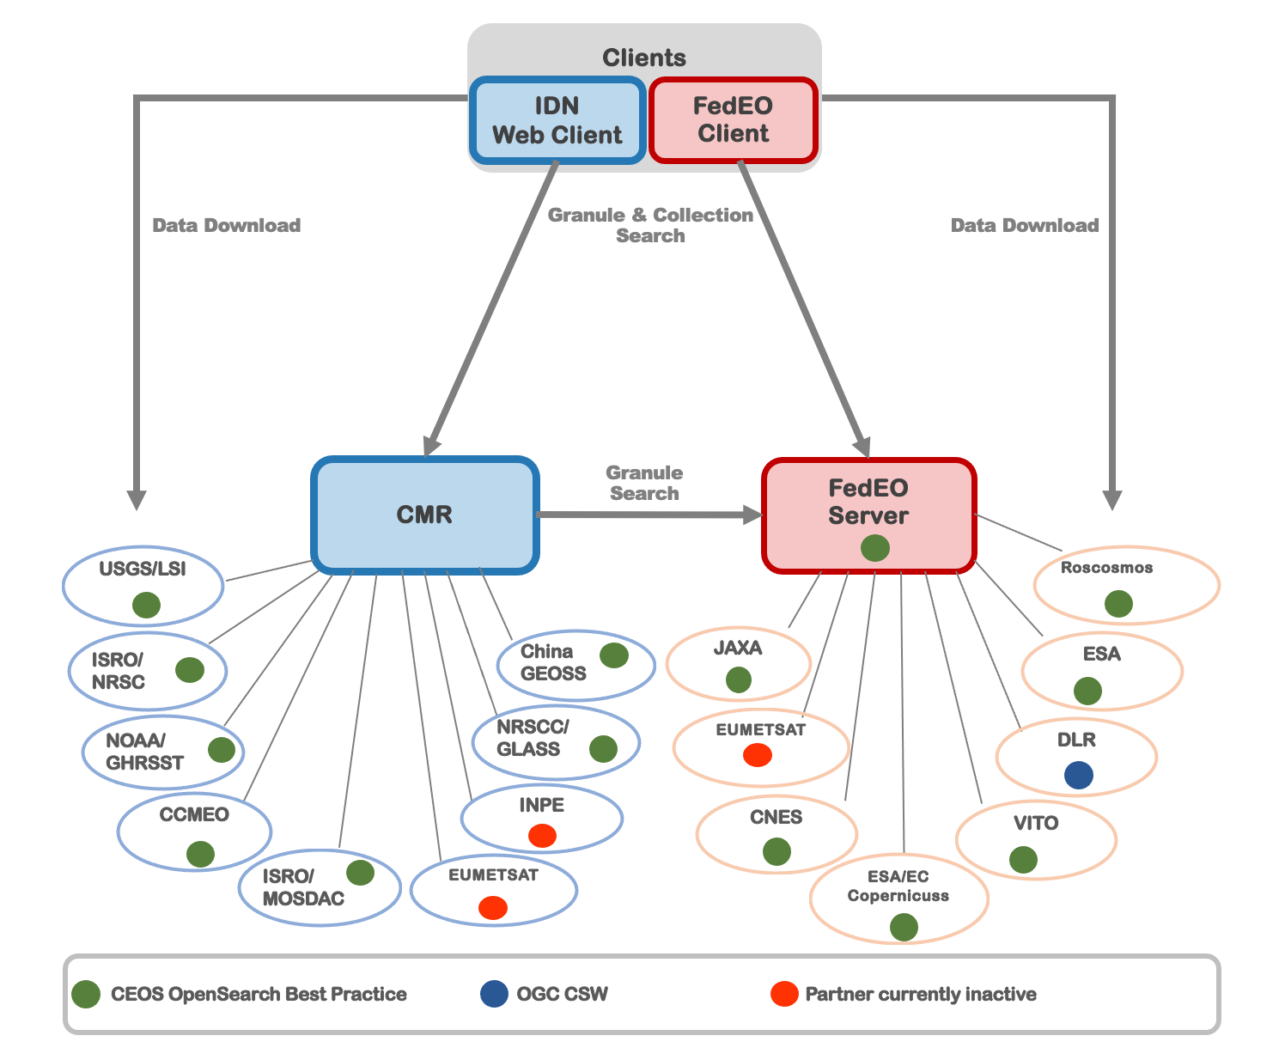
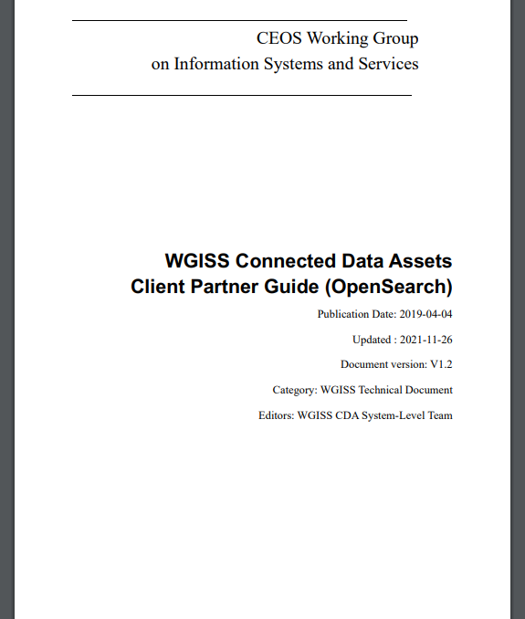
WGISS Connected Data Assets
FedEO: Federated Earth Observation missions access

Slide 4
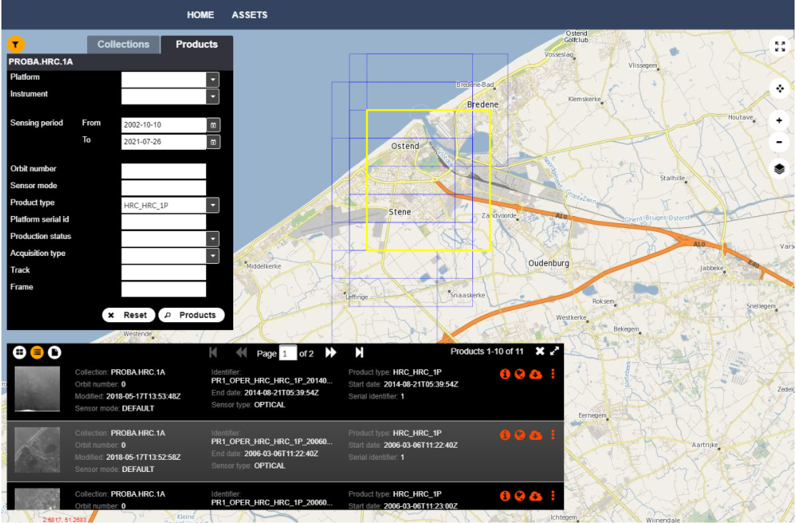
FedEO in CEOS Domain
FedEO Client available at https://fedeo-client.ceos.org
FedEO Server (API) available at https://fedeo.ceos.org/readme.html
Validation server (API) available at https://geo.spacebel.be/readme.html
Notes:
https://earth.esa.int/eogateway/news/new-version-of-the-fedeo-client

Slide 5
New FedEO release
Resource discovery:
Collections, granules
Services/tools (new)
RESTful API offering multiple interfaces:
OpenSearch
OGC API – Features (incl. Part 3 Filtering, CQL2, OpenAPI)
STAC API (incl. Filtering and Collection Search)
Content negotiation
Atom, GeoJSON, JSON-LD, RDF/XML, Turtle
ISO (various), OGC (various)
STAC, Schema.org, GeoDCAT-AP, DIF10

Slide 6
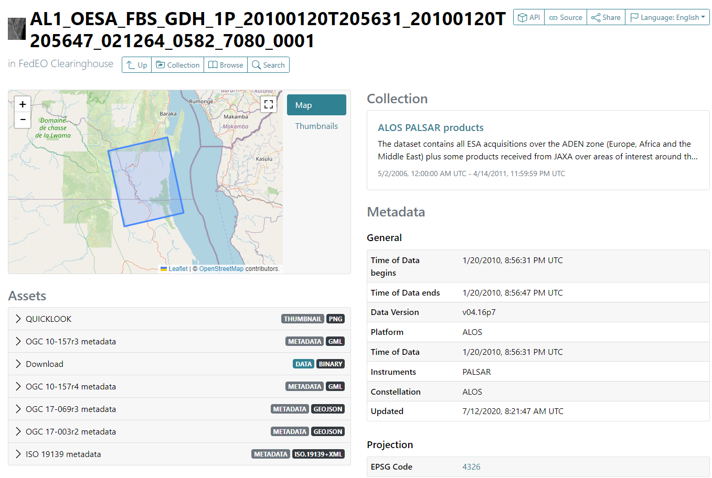
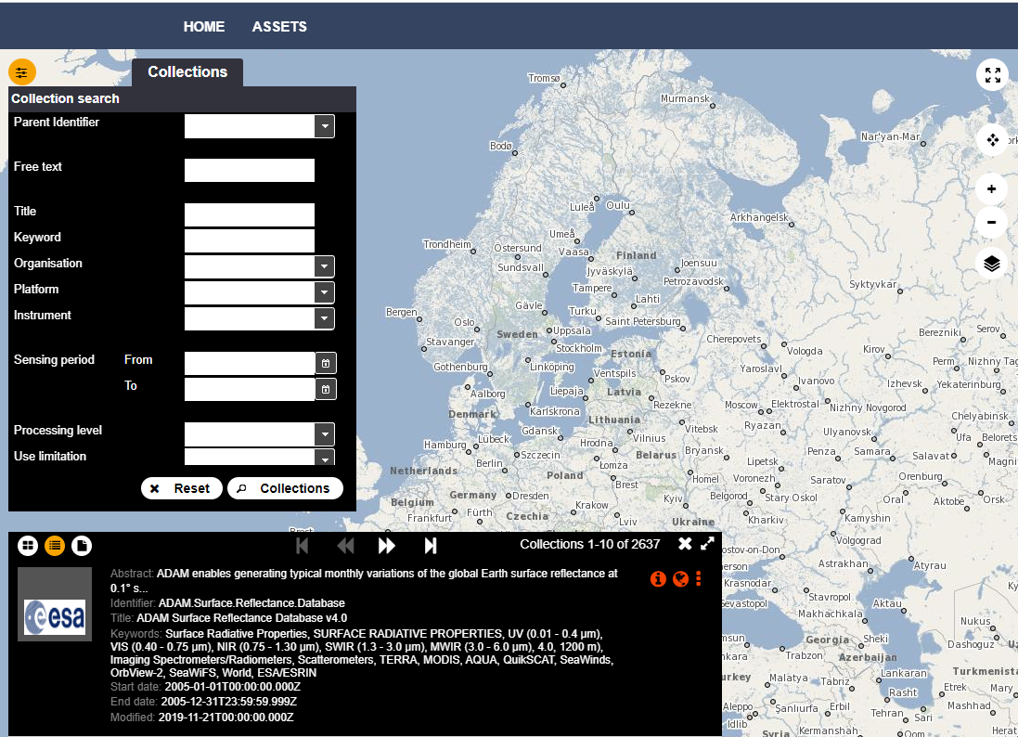
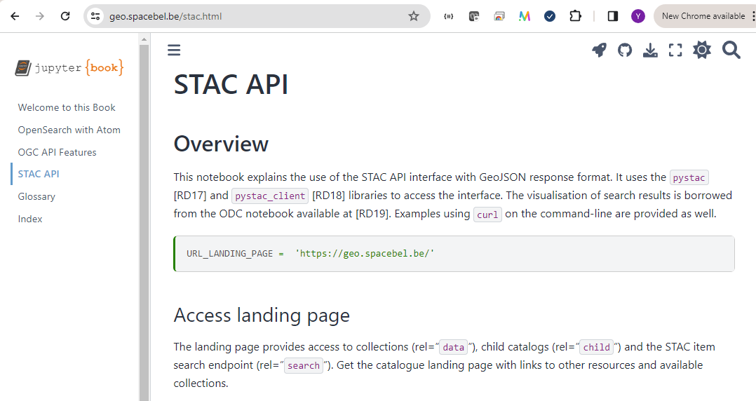
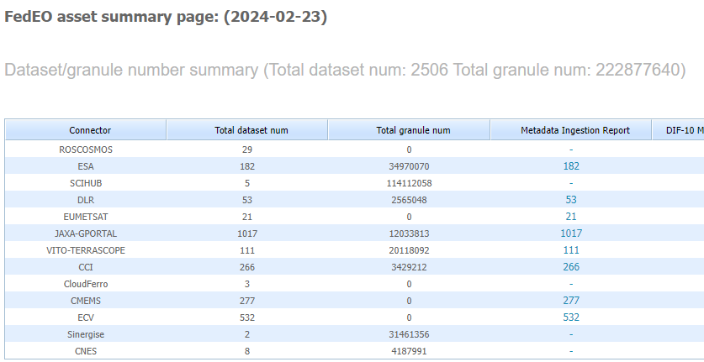
New FedEO release
https://fedeo.ceos.org/readme.html

Slide 7
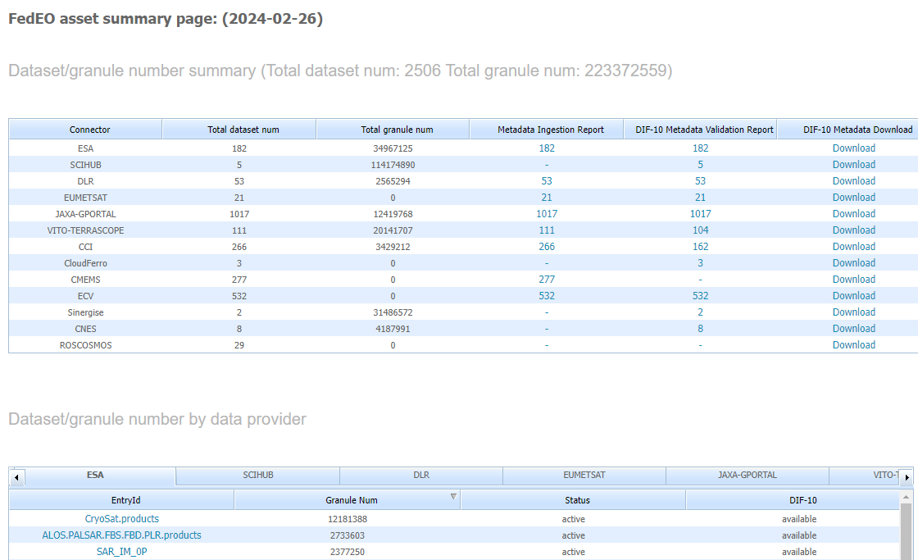
DIF-10 Metadata Export
https://fedeo.ceos.org/asset/index.html
Collections being harvested automatically by IDN, e.g. ESA, DLR, VITO, ESA CCI, JAXA.
See:
https://cmr.earthdata.nasa.gov/search/collections.umm_json?provider_id=FedEO&data_center=DE/DLR&pretty=true
https://cmr.earthdata.nasa.gov/search/collections.umm_json?provider_id=FedEO&data_center=VITO&pretty=true
https://cmr.earthdata.nasa.gov/search/collections.umm_json?provider_id=ESA&data_center=ESA/ESRIN&pretty=true
DIF-10 collections are available for being ingested into IDN, from
https://fedeo.ceos.org/asset/index.html
Notes:
https://cmr.earthdata.nasa.gov/search/collections.umm_json?provider_id=FedEO&data_center=DE/DLR&pretty=true
https://cmr.earthdata.nasa.gov/search/collections.umm_json?provider_id=FedEO&data_center=VITO&pretty=true
https://cmr.earthdata.nasa.gov/search/collections.umm_json?provider_id=ESA&data_center=ESA/ESRIN&pretty=true
https://access.earthdata.nasa.gov/holdings

Slide 8
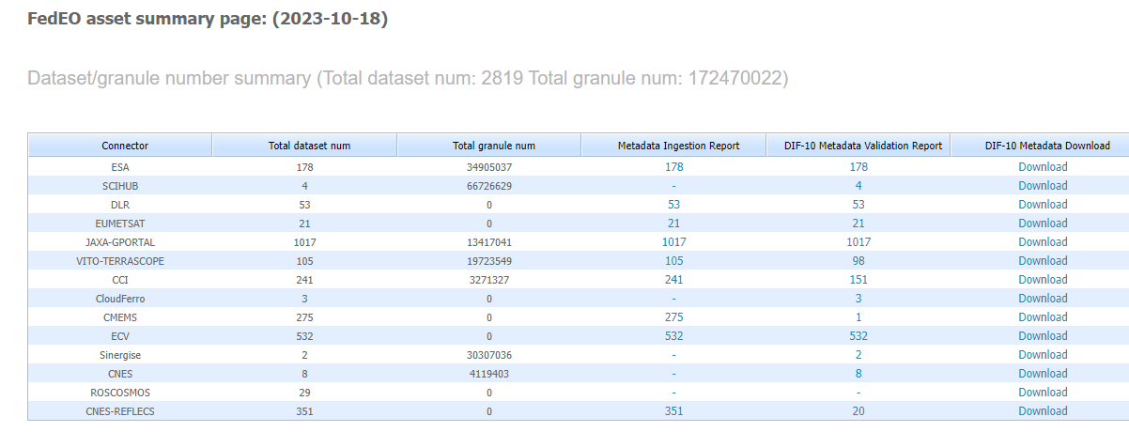
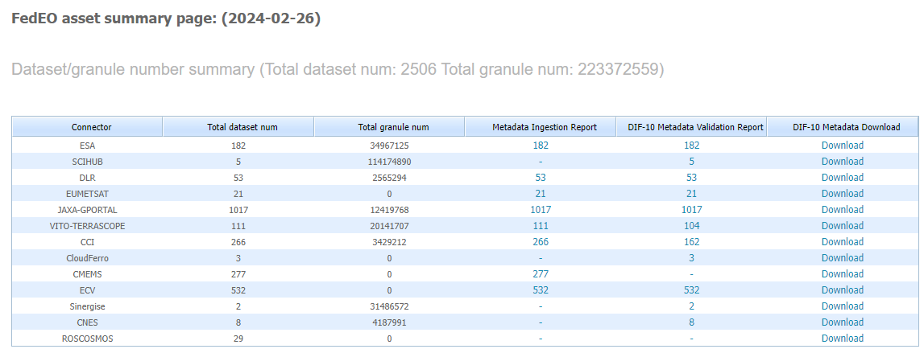
Metrics evolution
FedEO: 172 to 223 million granules (+29%) since WGISS-56 (Oct 2023)
ESA (EOCAT): 182 collections with 34.9 million granules.

Slide 9
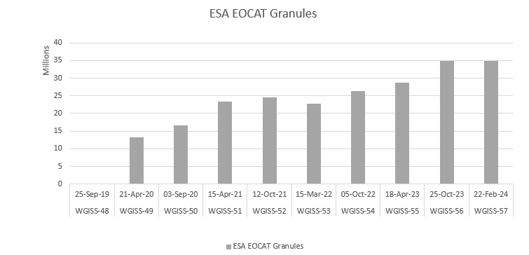
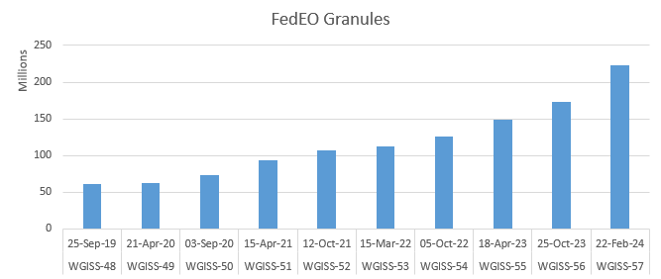
Metrics evolution

Slide 10
Additional Collections
VITO Terrascope
108 collections (additional UAV collections encoded in DIF10), was 104.
ESA CCI
162 valid DIF10 collections (was 151).
Sentinel collections
Migrated interface to https://dataspace.copernicus.eu
5 collections (was 4).
Granule count via "{resto:exactCount}" shown on Asset page.
Additional work required to restore CNES-REFLECS collection metadata (identifiers used as path parameters).

Slide 11
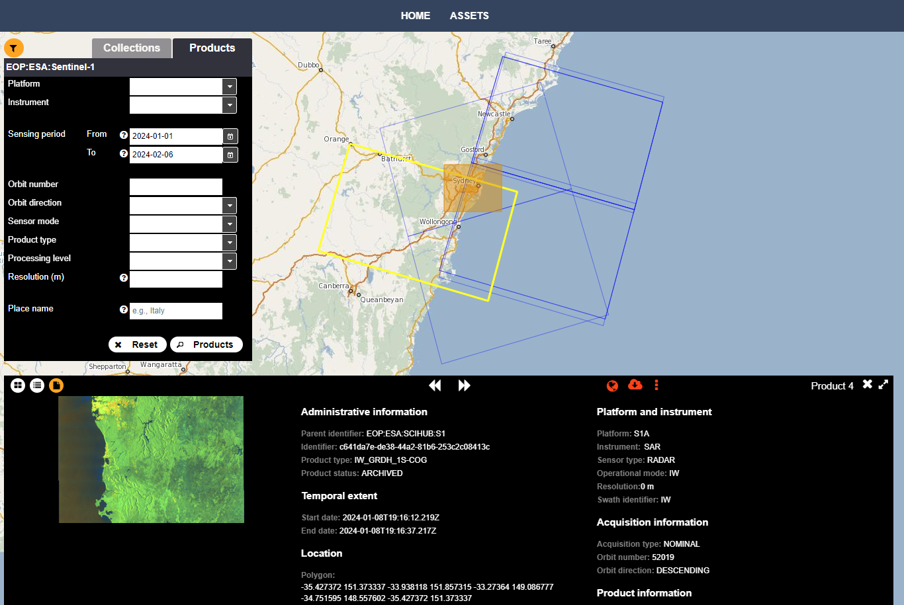
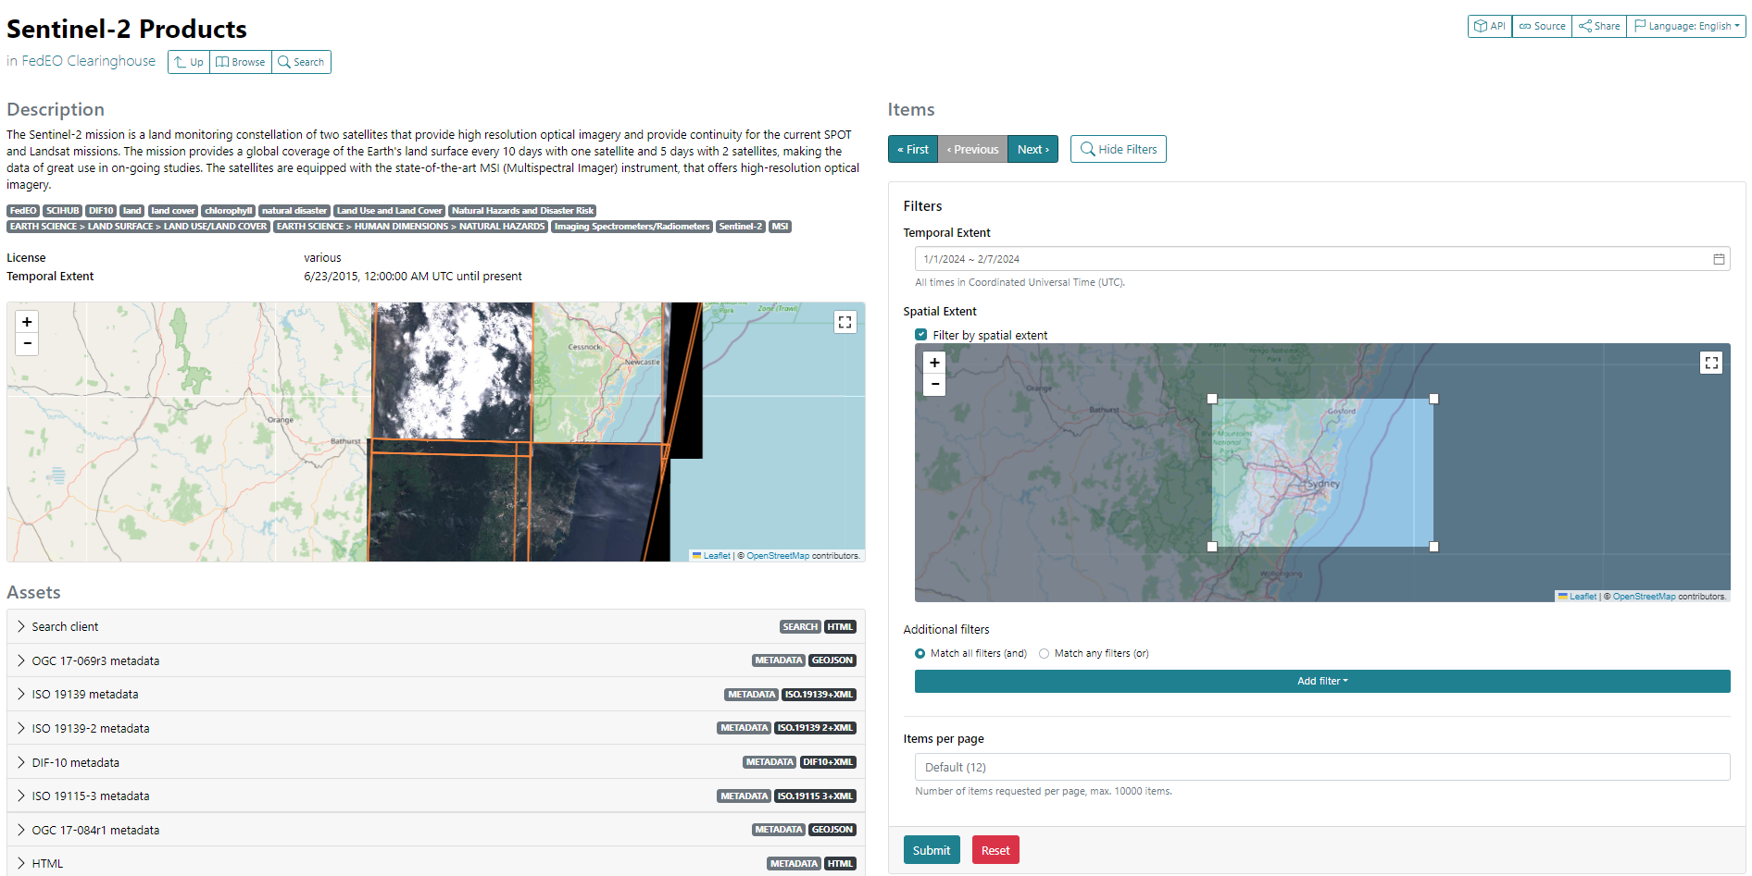
Sentinel collections
Sentinel backend interface migrated to https://dataspace.copernicus.eu
5 Sentinel collections available in FedEO API via two-step search
No authentication for metadata/quicklooks required.

Slide 12
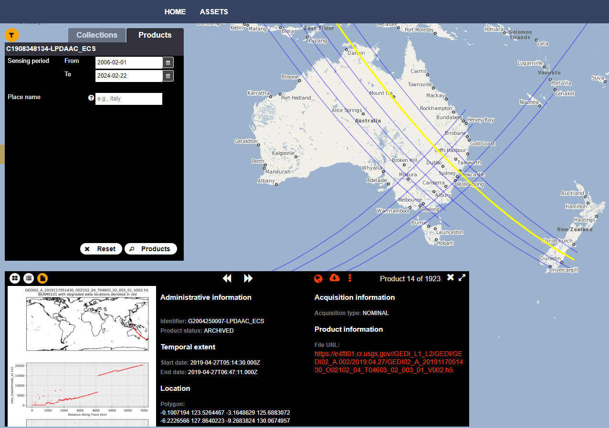
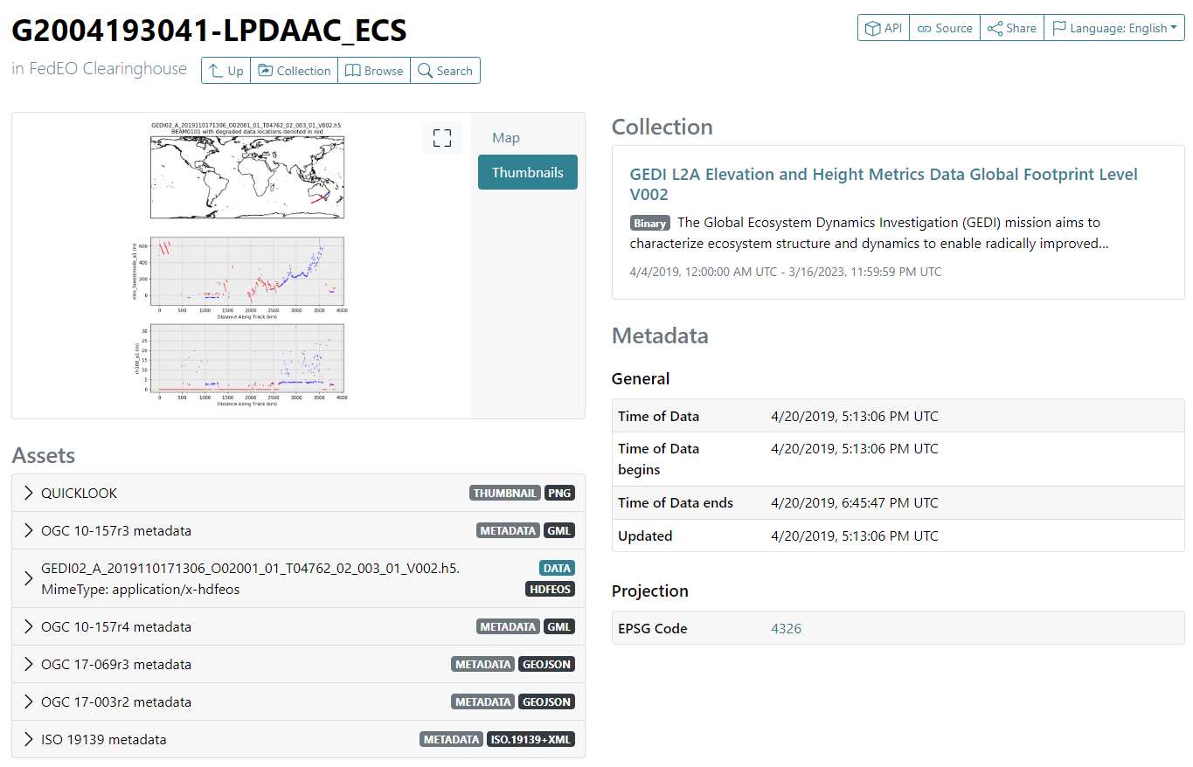
CMR collections
NASA CMR collections available via CMR OpenSearch backend I/F
52753 collections available via FedEO API
Not ingested and not included in FedEO metrics.

Slide 13
Evolution – Notebook Discovery
Periodic Notebook metadata record harvester:
Uses GitHub/GitLab API to find all notebooks
Extracts embedded EUMETSAT-like metadata
Accesses DataCite to obtain citation
Applied to 4 GitLab/GitHub repositories
EUMETSAT Notebooks (approx. 200)
ESA AI4EO
Metadata available via all supported protocols:
OpenSearch
OGC API Features
STAC API

Slide 14
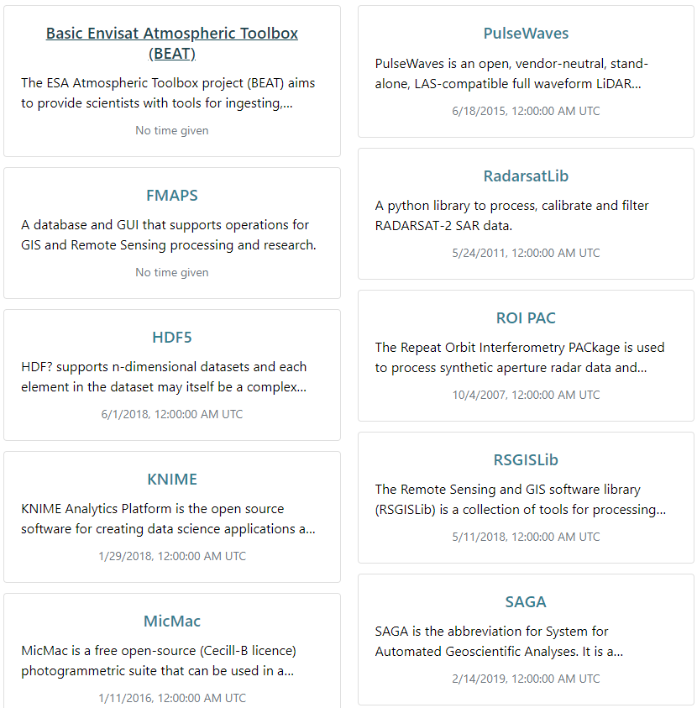
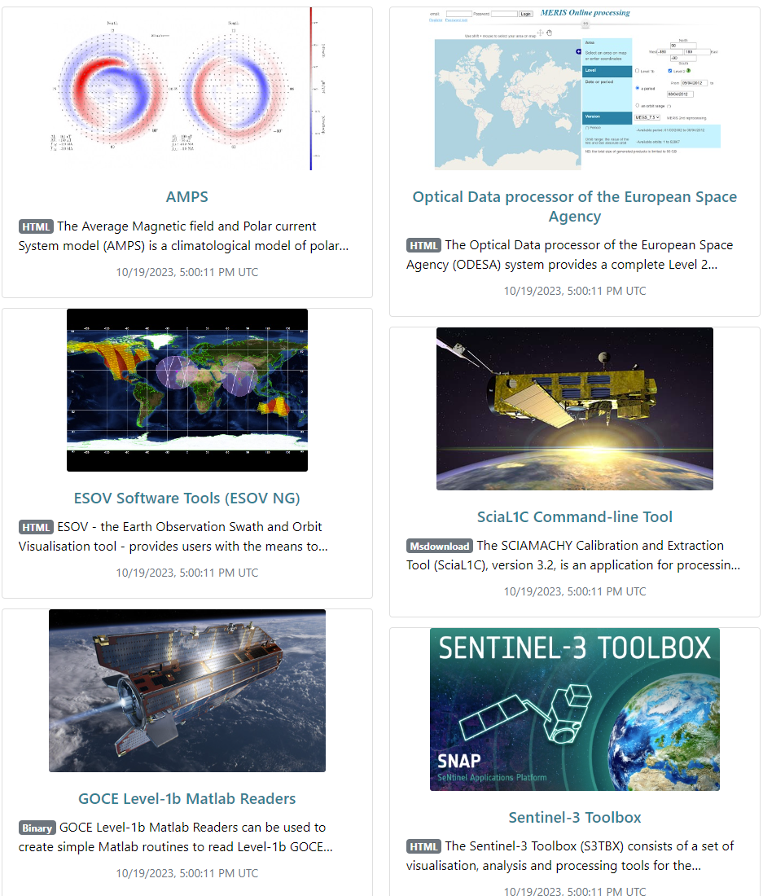
Service/Tool Metadata
New FedEO API supports service discovery.
Following tool/service metadata records are available via fedeo.ceos.org API:
CEOS SW and Tools Survey v1.0 (Excel)
ESA Earth Online
Open-source tools referenced on static WGISS Data Access Web pages: resto, GeoServer, GeoNetwork, ….
Find “by organization”, “by platform”, or search API.
Currently on Validation Server only:
EUMETSAT, AI4EO, EOVOC Notebooks

Slide 15
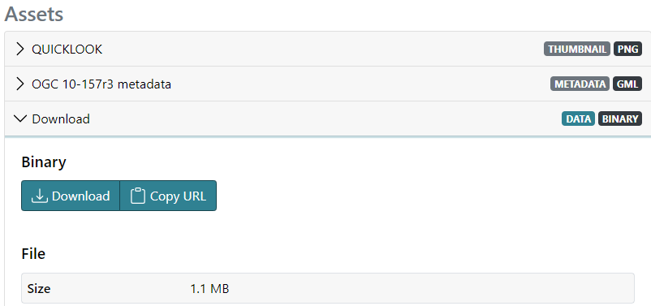
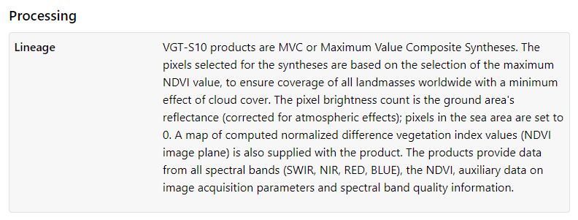
Evolution – STAC encoding improvements
License information
Download file size (STAC “File extension” ).
Provenance/lineage information as provided by DLR, VITO, ESA CCI (STAC “Processing extension”).
Notes:
Provenance: https://emc.spacebel.be/browser/external/emc.spacebel.be/collections/b673f41b-d934-49e4-af6b-44bbdf164367?.language=en
https://emc.spacebel.be/browser/external/emc.spacebel.be/collections/urn:ogc:def:EOP:VITO:VGT_S10?.language=en
https://emc.spacebel.be/browser/external/emc.spacebel.be/series/eo:organisationName/CEDA/8b63d36f6f1e4efa8aea302b924bc46b

Slide 16
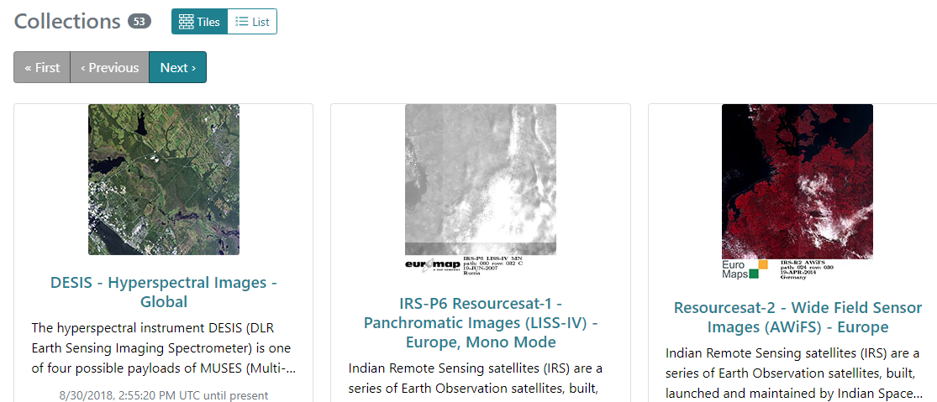
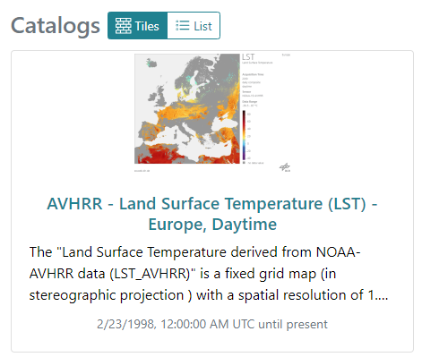
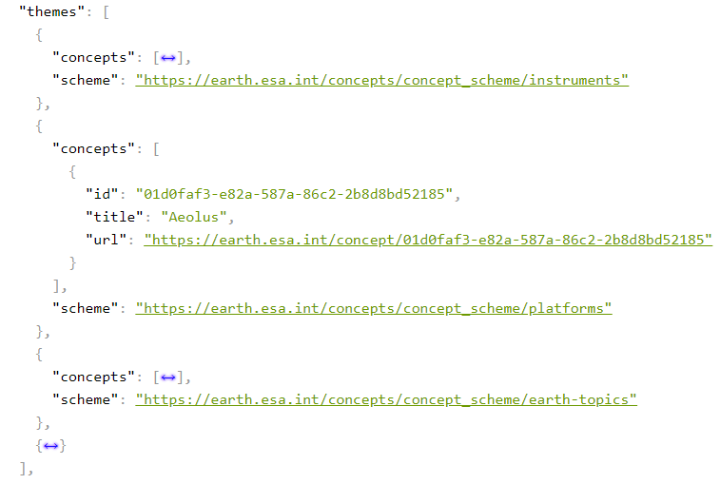
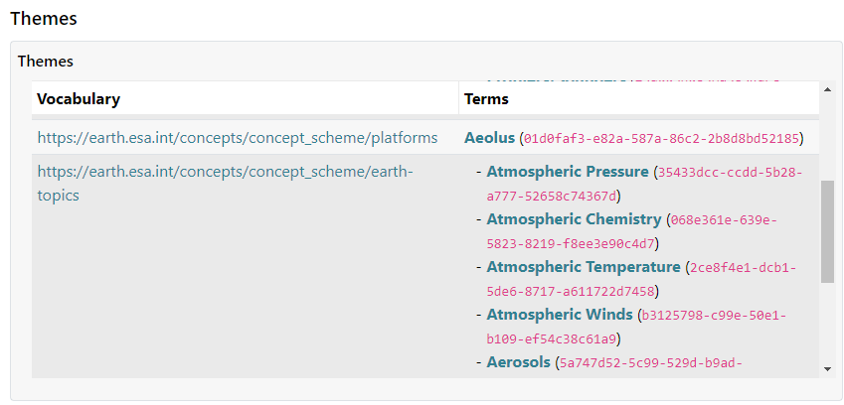
Evolution – STAC encoding improvements
Collection & Catalog quicklooks extracted from ISO metadata (gmd:graphicOverview).
STAC “Themes extension” (https://github.com/stac-extensions/themes) to encode controlled keywords in service metadata (applies to collection metadata as well).
Notes:
https://emc.spacebel.be/browser/external/emc.spacebel.be/collections/services/items/eoli-aeolus-vre?httpAccept=application%2Fgeo%2Bjson%3Bprofile%3Dhttps%3A%2F%2Fstacspec.org

Slide 17
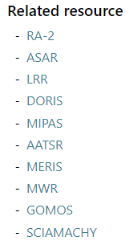
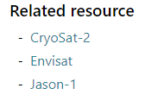
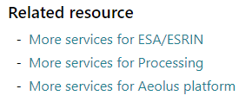
Evolution – STAC encoding improvements
STAC Collection cross-linking rel=“related”
Collection
Organisation Science Keyword Platform Instrument
Service/Tool
ToolType

Slide 18
Conclusion
CEOS FedEO interfaces updated significantly (Feb. 2024)
CEOS OpenSearch (backward compatible)
OGC API-Features
STAC API
Etc.
Sentinel catalogue interfaces migrated.
More convenient, metadata and quicklooks accessible without credentials.
Ongoing updates on validation server (service discovery, notebook discovery, UMM-JSON, ..)
Finalizing UMM-JSON generation/exchange does require synchronization with NASA.
STACBrowser can be used to browse/search fedeo.ceos.org.

