Slide 1
STAC Best Practices Roadmap
Yves Coene (Spacebel for ESA)
CEOS WGISS #57, Sydney (Australia)
Session 7: Discovery and Access, 06/03/2024

Slide 2
Outline
Context
Approach
Current status Best Practices
Action Plan

Slide 3
Context
CEOS OpenSearch Best Practices successfully used to federate and discover agency resources via IDN, CMR and FedEO.
  Reduces interoperability risks
“STAC” as successor of “OpenSearch” for resource discovery (JSON, OpenAPI) ?
  Similar capabilities ?
  Similar Best Practices ?
Multiple options for “STAC” implementation
  Multiple options lead providers and open-source tools developers to implement arbitrary (different) subsets, causing interoperability risks.
  Implementing all options is unnecessary and increases costs
Need for “STAC Best Practices” identified: Adherence to Best Practices should reduce cost and interoperability risks for both client and server implementations

Slide 4


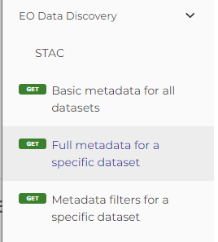
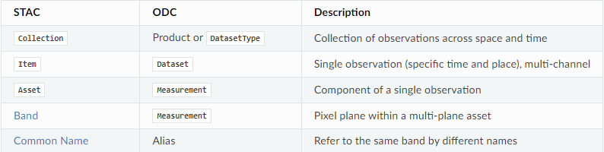

Context
STAC is currently proposed for multiple use cases :
  Collection and Granule discovery ( STAC Collection / Item )
  DataCube-related (STAC Item / Asset / Band)
  OpenEO - cloud-based Earth Observation data processing
Scope of STAC Best Practice
from DAIG (as replacement of OpenSearch Best Practice)
(*) e.g. https://odc-stac.readthedocs.io/en/latest/stac-vs-odc.html
Notes:
https://api.openeo.org/1.2.0/#tag/EO-Data-Discovery/operation/describe-collection

Slide 5
Approach (WGISS-55, 2023)
STEP 1 (WHAT): Propose applicable list of uses cases to narrow scope of STAC Best Practices:
  Get DAIG group feedback/confirmation and/or priorities for proposed use cases (or additional/other use cases)
STEP 2 (HOW): Prepare draft STAC Best Practices addressing selected use cases by solving issue in one of three ways:
  Recommend or mandate one method over another in the Best Practices
  Raise issue with appropriate STAC standards body to consolidate on single solution
  Create extensions for missing/needed areas (unlikely).
STEP 3 (MEASURE): Obtain DAIG feedback on STEP 2 and iterate…

Slide 6
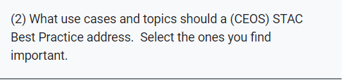

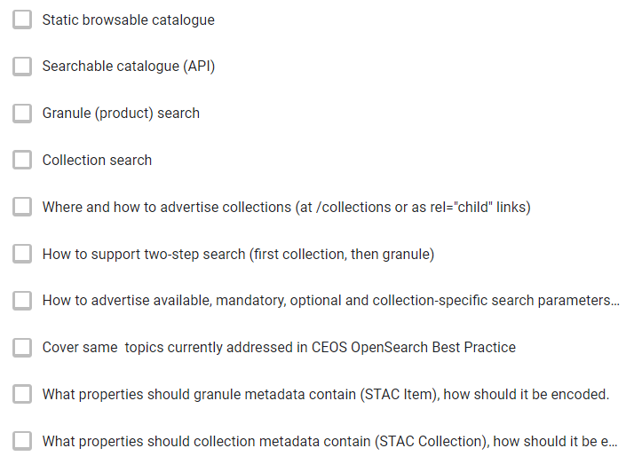
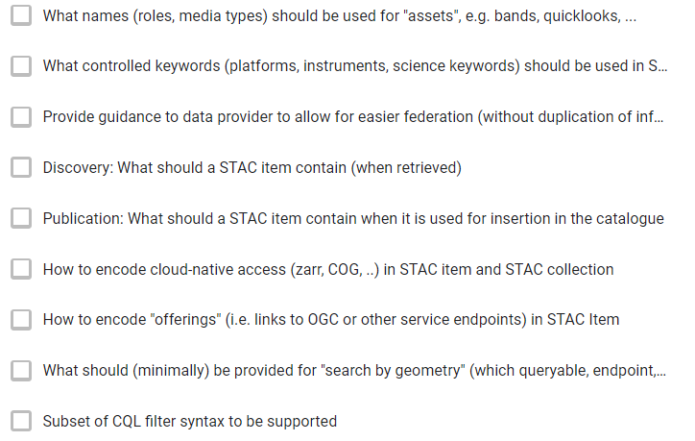
STEP 1 “define scope” - survey

Slide 7
STEP 1 “define scope” – survey results expected scope
Most requested topics :
  STAC API (75%)
  Granule search (70%)
  Guidance to allow federation (70%)
  Advertise available queryables (65%)
  Encode granule metadata (65%)
  Collection metadata (60%)
  Controlled keywords, media types, roles (60%)
  Cloud-native assets (60%)
  Collection search (55%)
  “other topics” proposed:
    e.g. asset-level search, highly recommended extensions, ..

Slide 8
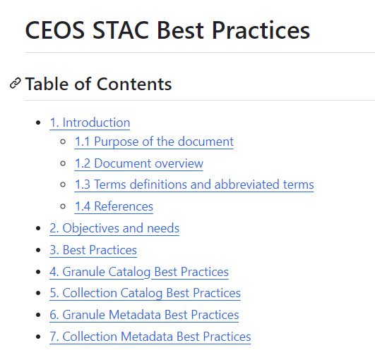
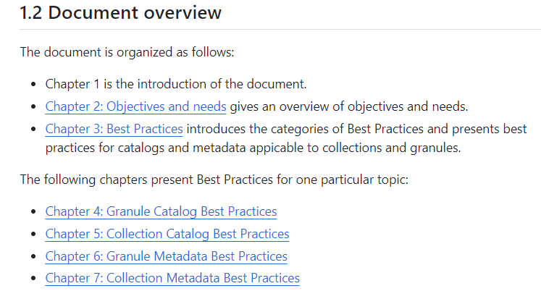
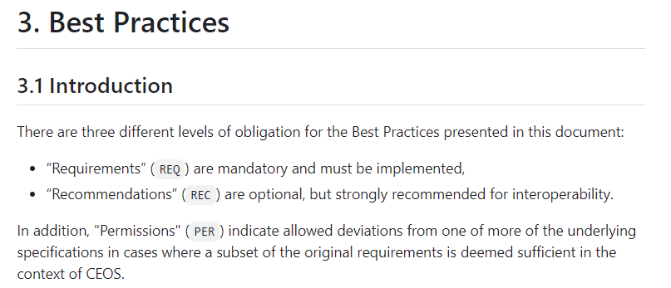
STEP 2 “Best Practices” – current status
  Draft Best Practices at https://github.com/ceos-wgiss/stac-best-practices

Slide 9
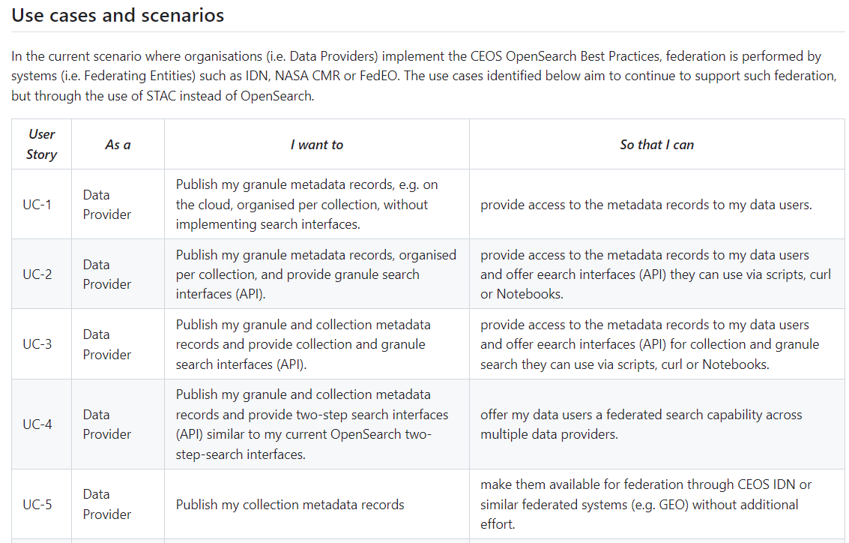
STEP 2 “Best Practices” – current status

Slide 10
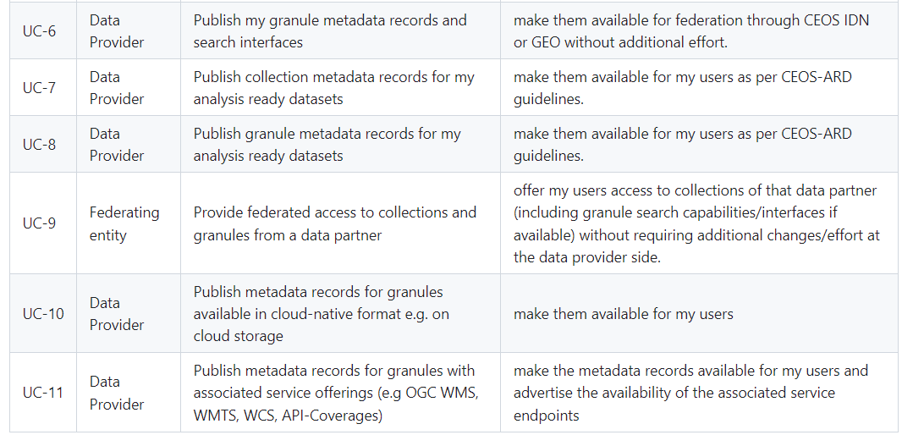
STEP 2 “Best Practices” – current status

Slide 11

STEP 2 “Best Practices” – current status v survey priorities
Most demanded topics to be ad
  STAC API (75%) §3.2, §4.3, §5.3
  Granule search (70%) §4 Granule Catalog
  Guidance to allow federation (70%) §*
  Advertise available queryables (65%) §3.2 Catalog
  Encode granule metadata (65%) §6 Granule Metadata
  Collection metadata (60%) §7 Collection Metadata
  Controlled keywords, media types, roles (60%) §3.3, §7.2 Metadata
  Cloud-native assets (60%) §6.3 Granule Metadata
  Collection search (55%) §5.3 Collection Catalog
  “other topics” proposed:
    e.g. asset-level search, highly recommended extensions, ..

Slide 12
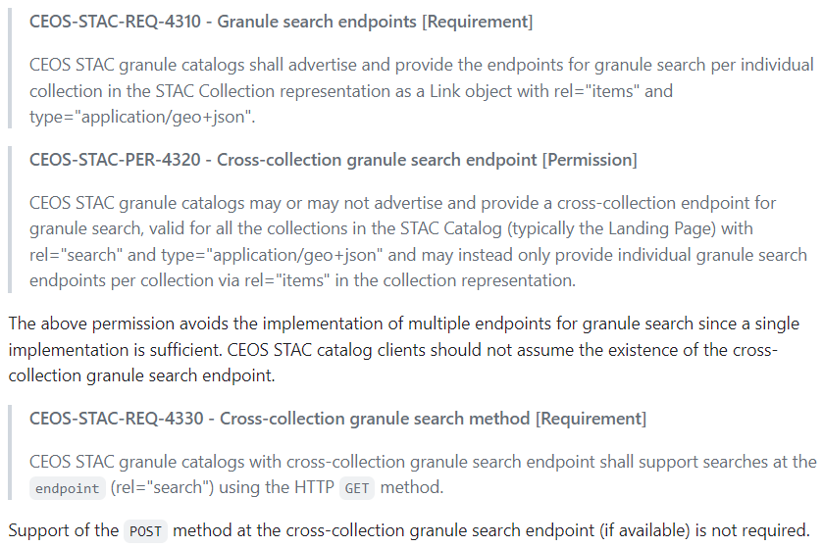
Best Practices – Example requirements
Requirement presentation

Slide 13
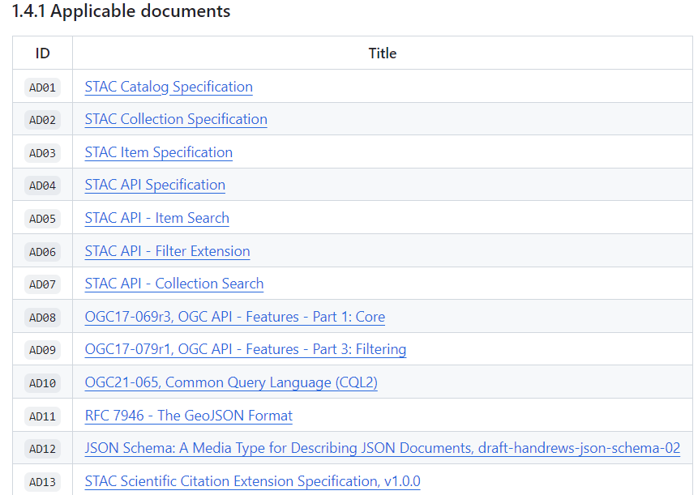
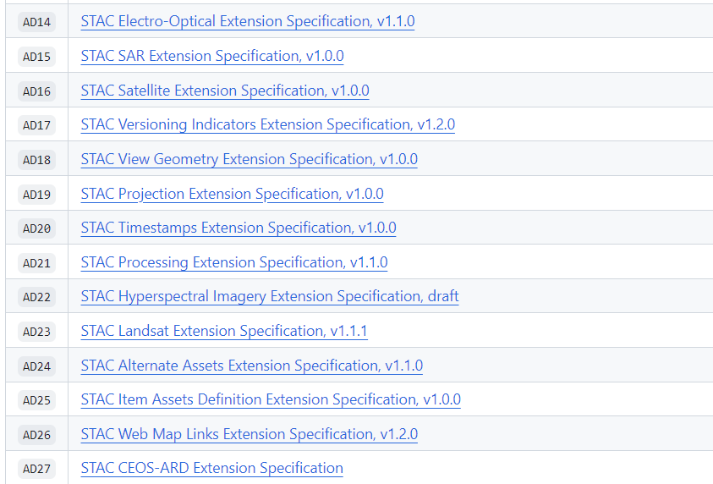
Best Practices – Underlying “STAC” specifications
Proposed Practices rely on parts of STAC/STAC API, underlying OGC specifications and parts of (available) “extensions” of STAC and STAC API
Expected scope “OGC STAC/
STAC API” Community Standard
CEOS STAC ARD Extension

Slide 14
Action Plan
Collect contributions, questions and feedback from interested parties in next period on draft Best Practices available at https://github.com/ceos-wgiss/stac-best-practices
  Email
  GitHub Pull requests
  GitHub issues
  Ad-hoc telcos
Discuss/agree contributions/feedback received before or at planned dedicated teleconferences
  April ‘24 virtual meeting
  May ‘24 virtual meeting
Consolidate initial version of Best Practices in June and finalize by end of July 2024
Present finalized Best Practices (First release) at WGISS-58 (October ‘24)

Slide 15

Conclusion
Your feedback and inputs are important.
https://github.com/ceos-wgiss/stac-best-practices/tree/main

Slide 16

Context - STAC
“STAC” is a generic name for a family of specifications…
  covering file formats and APIs,
  some at v1.0, some still release-candidate,
  referencing external OGC API specifications
  extensible, with large set of
    STAC extensions
    STAC API extensions
  at different levels of maturity.
The ecosystem of the above (draft) specifications allow many use cases to be realized in multiple ways, while some are not yet possible.
Notes:
https://github.com/stac-api-extensions

Slide 17
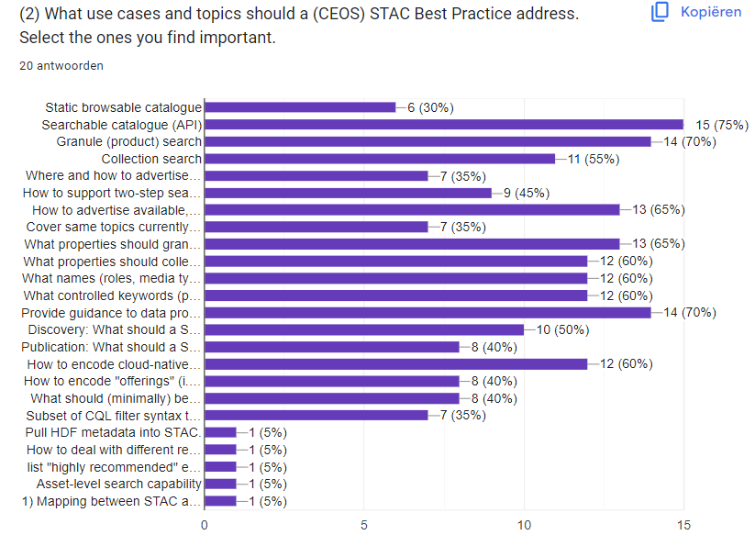
STEP 1 “define scope” – survey results expected scope

