Slide 1
OpenEO as community standard and other related OGC standards (e.g. OGC GeoDataCubes)
Alexander Jacob
Eurac Research
Matthias Mohr
Agenda Item 7.3
WGISS-57
4-7 March 2023
Sydney, Australia

Slide 2
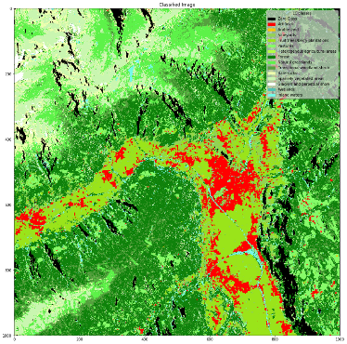
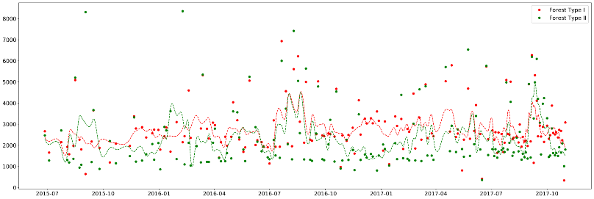

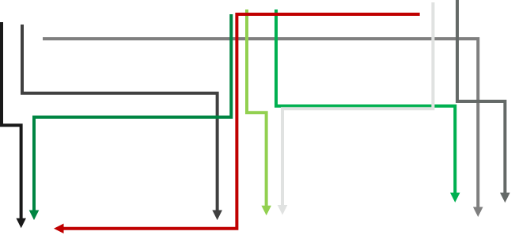

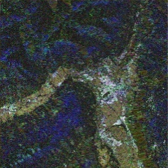
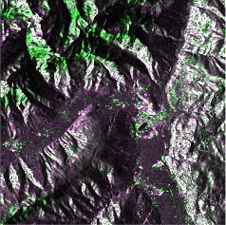
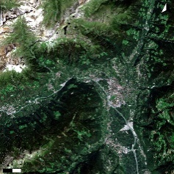
Why openEO?
Standardization Gap

Slide 3


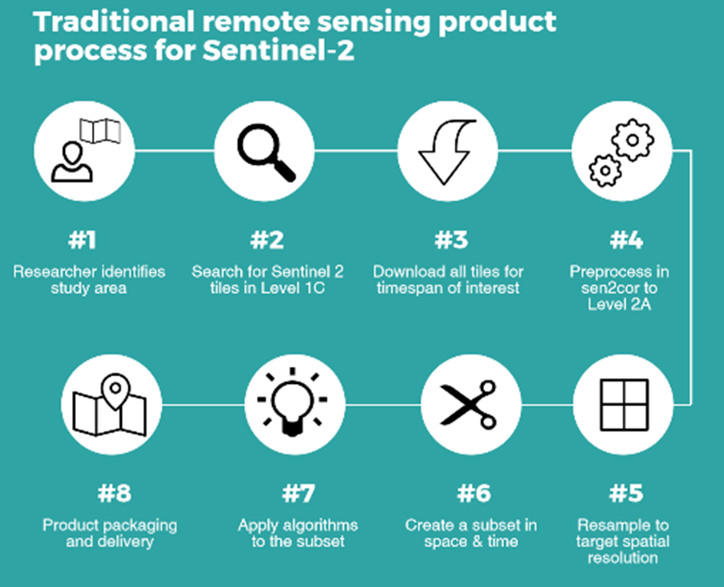
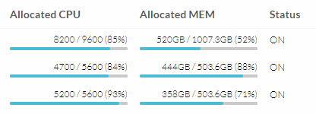
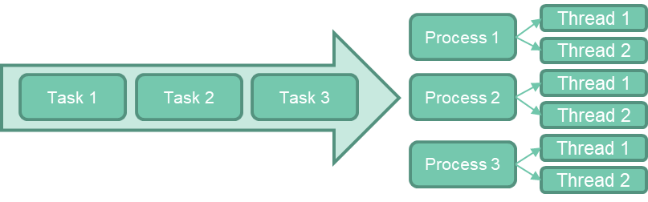
Why openEO?
Data & Infrastructure Management Burden

Slide 4
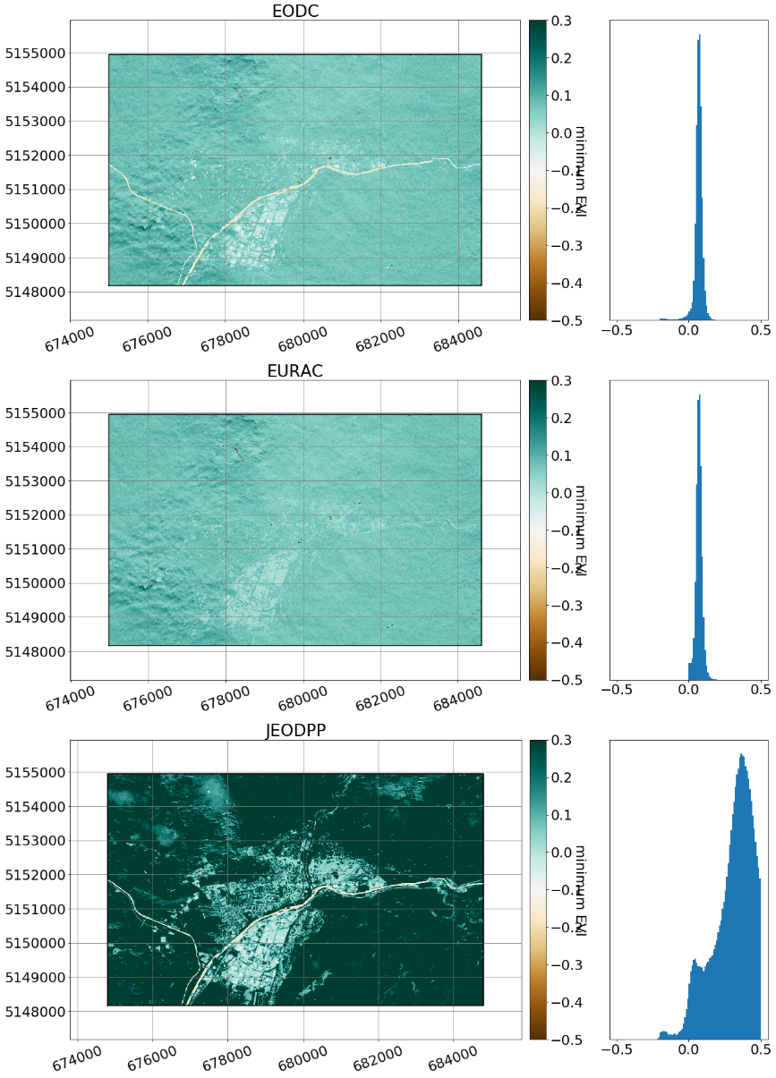
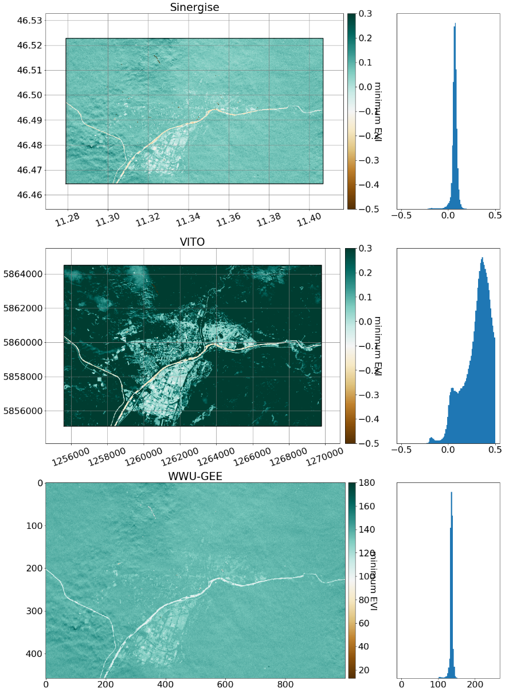
Why openEO?
Data Disparity & Provenance GAP

Slide 5
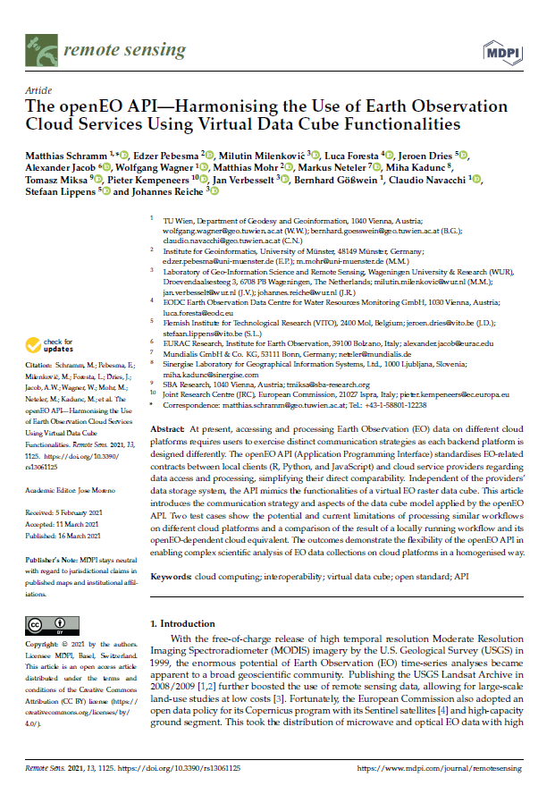
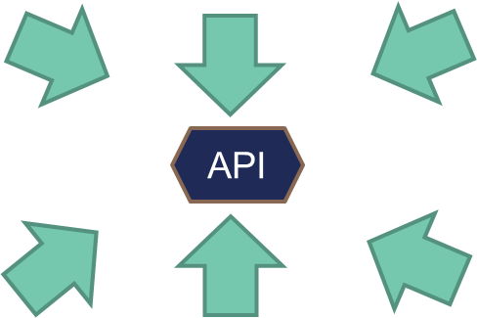
openEO API
https://doi.org/10.3390/rs13061125
Defined in OpenAPI
    api.openeo.org
HTTPS & JSON
Functionality
    Capabilities
    Data Discovery
    Authentication
    File management
    Data Processing / Workflow management
    Data Export / Web Services
    Extensions

Slide 6
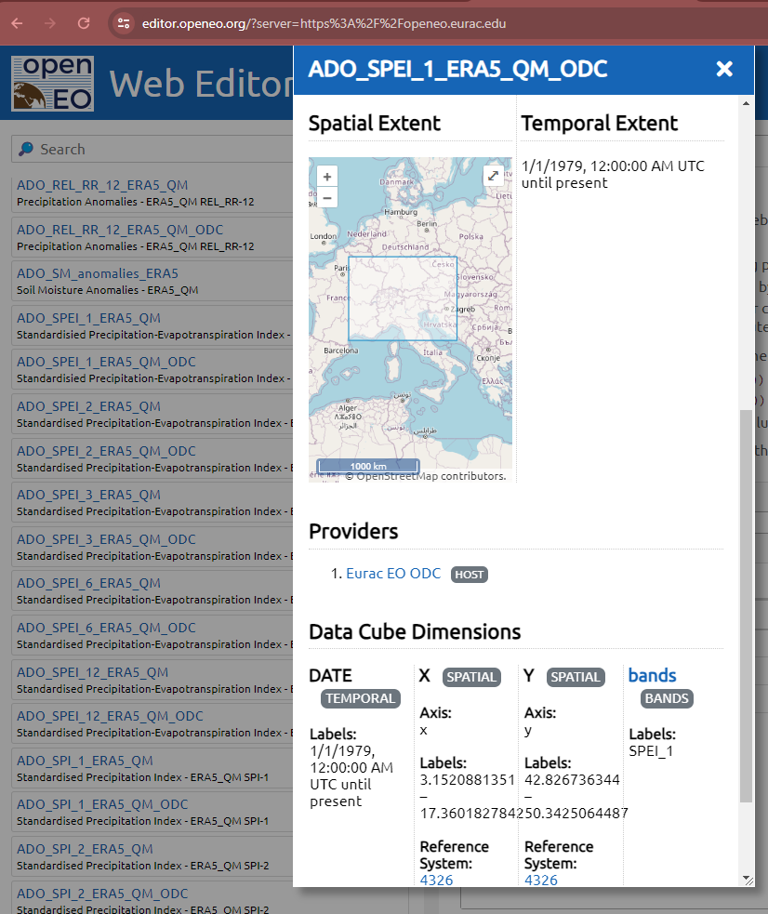
Discovery
Data Discovery via STAC
  only Collections by default
  can be extended to include Items
  Commercial Data support (extension)
File Formats (In & Out)
Auth
  Clients can „self-configure“
  OpenID Connect (various flows/grants)
  HTTP Basic
Federation (extension)

Slide 7
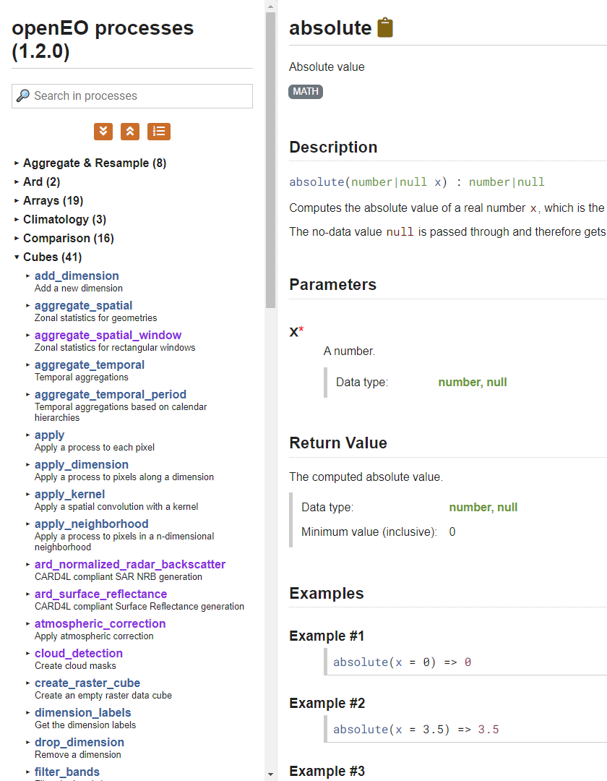
Processes
Pre-defined processes
  processes.openeo.org (150+)
  Can be customized (e.g. remove a parameter)
  JSON Schema
User-defined processes
  Combine processes to a new process (like functions in programming)
  Parameters
  Metadata
User-defined Functions
  Run custom code (e.g. in Python, R)
  Runtimes (e.g. Python 3.10 with xarray and geopandas)
  Docker Images

Slide 8
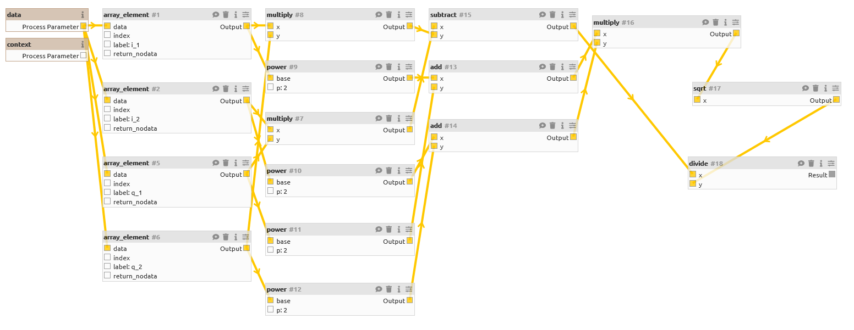
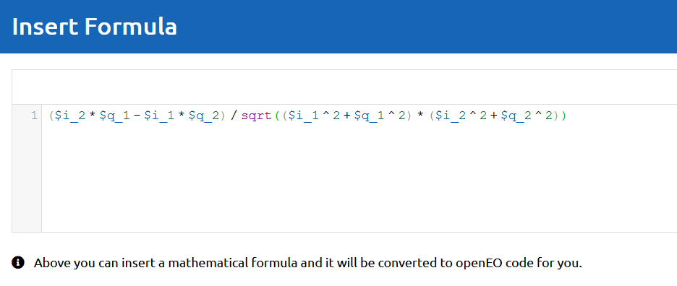
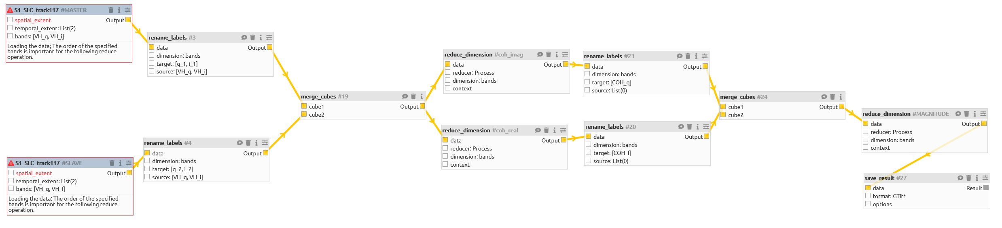
Process: Process Graphs
STAC

Slide 9
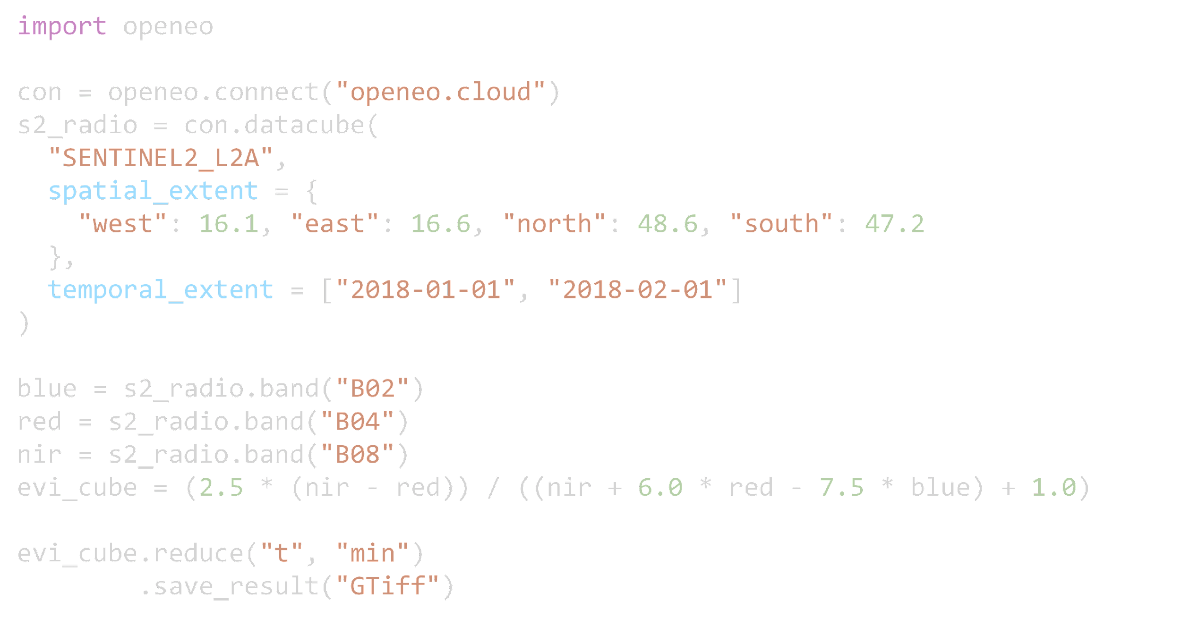
Python Client

Slide 10
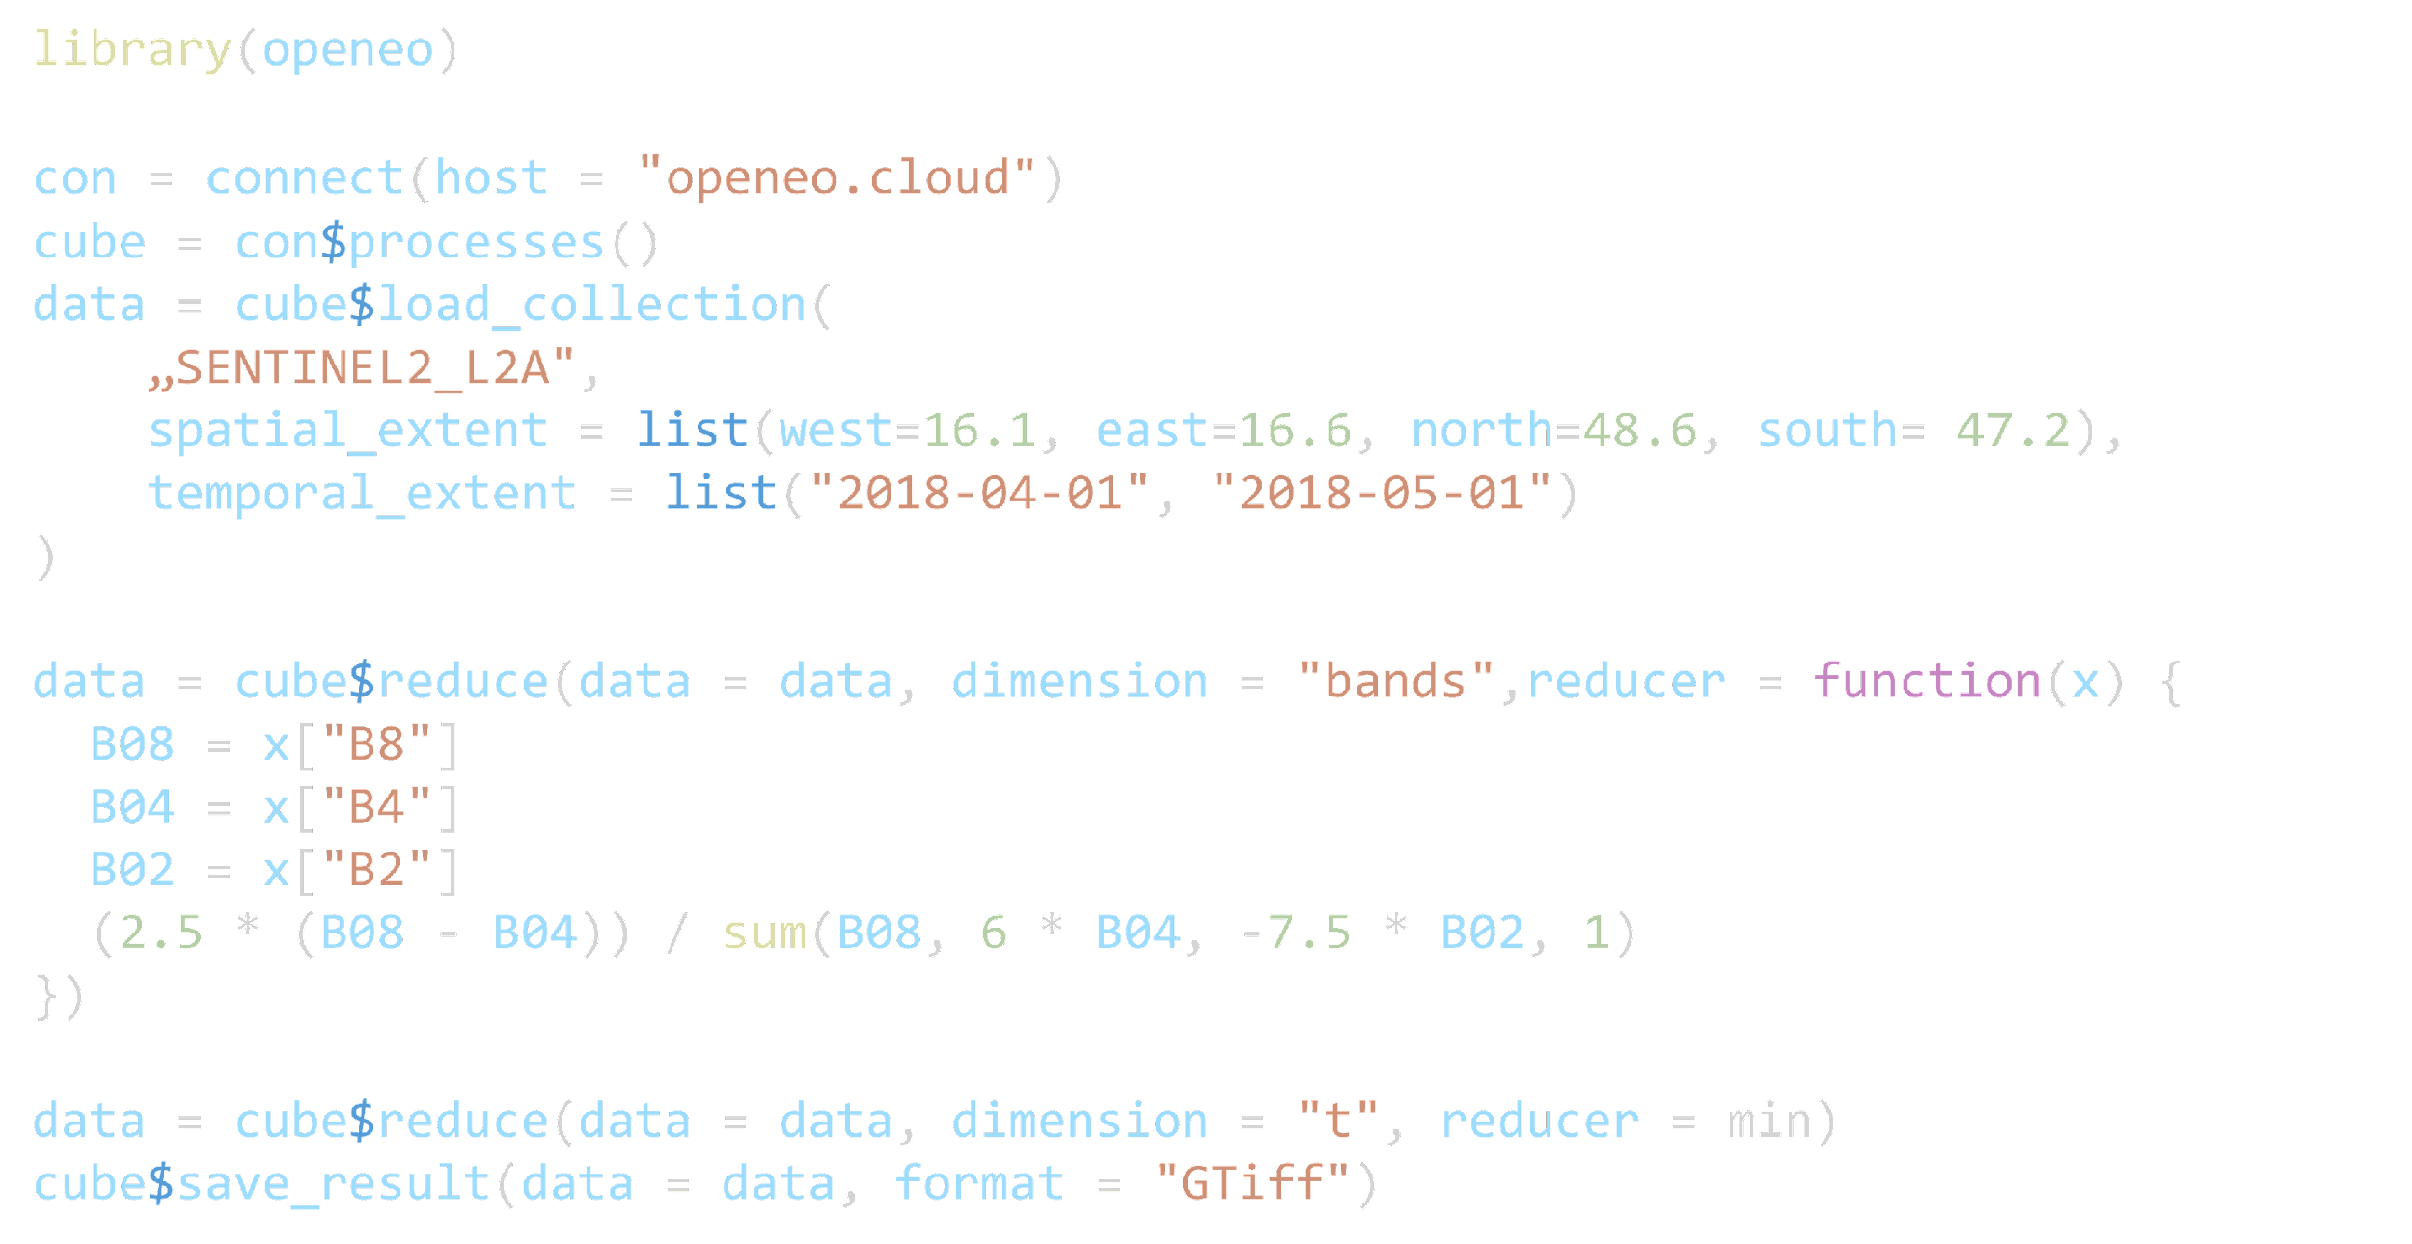
R Client

Slide 11
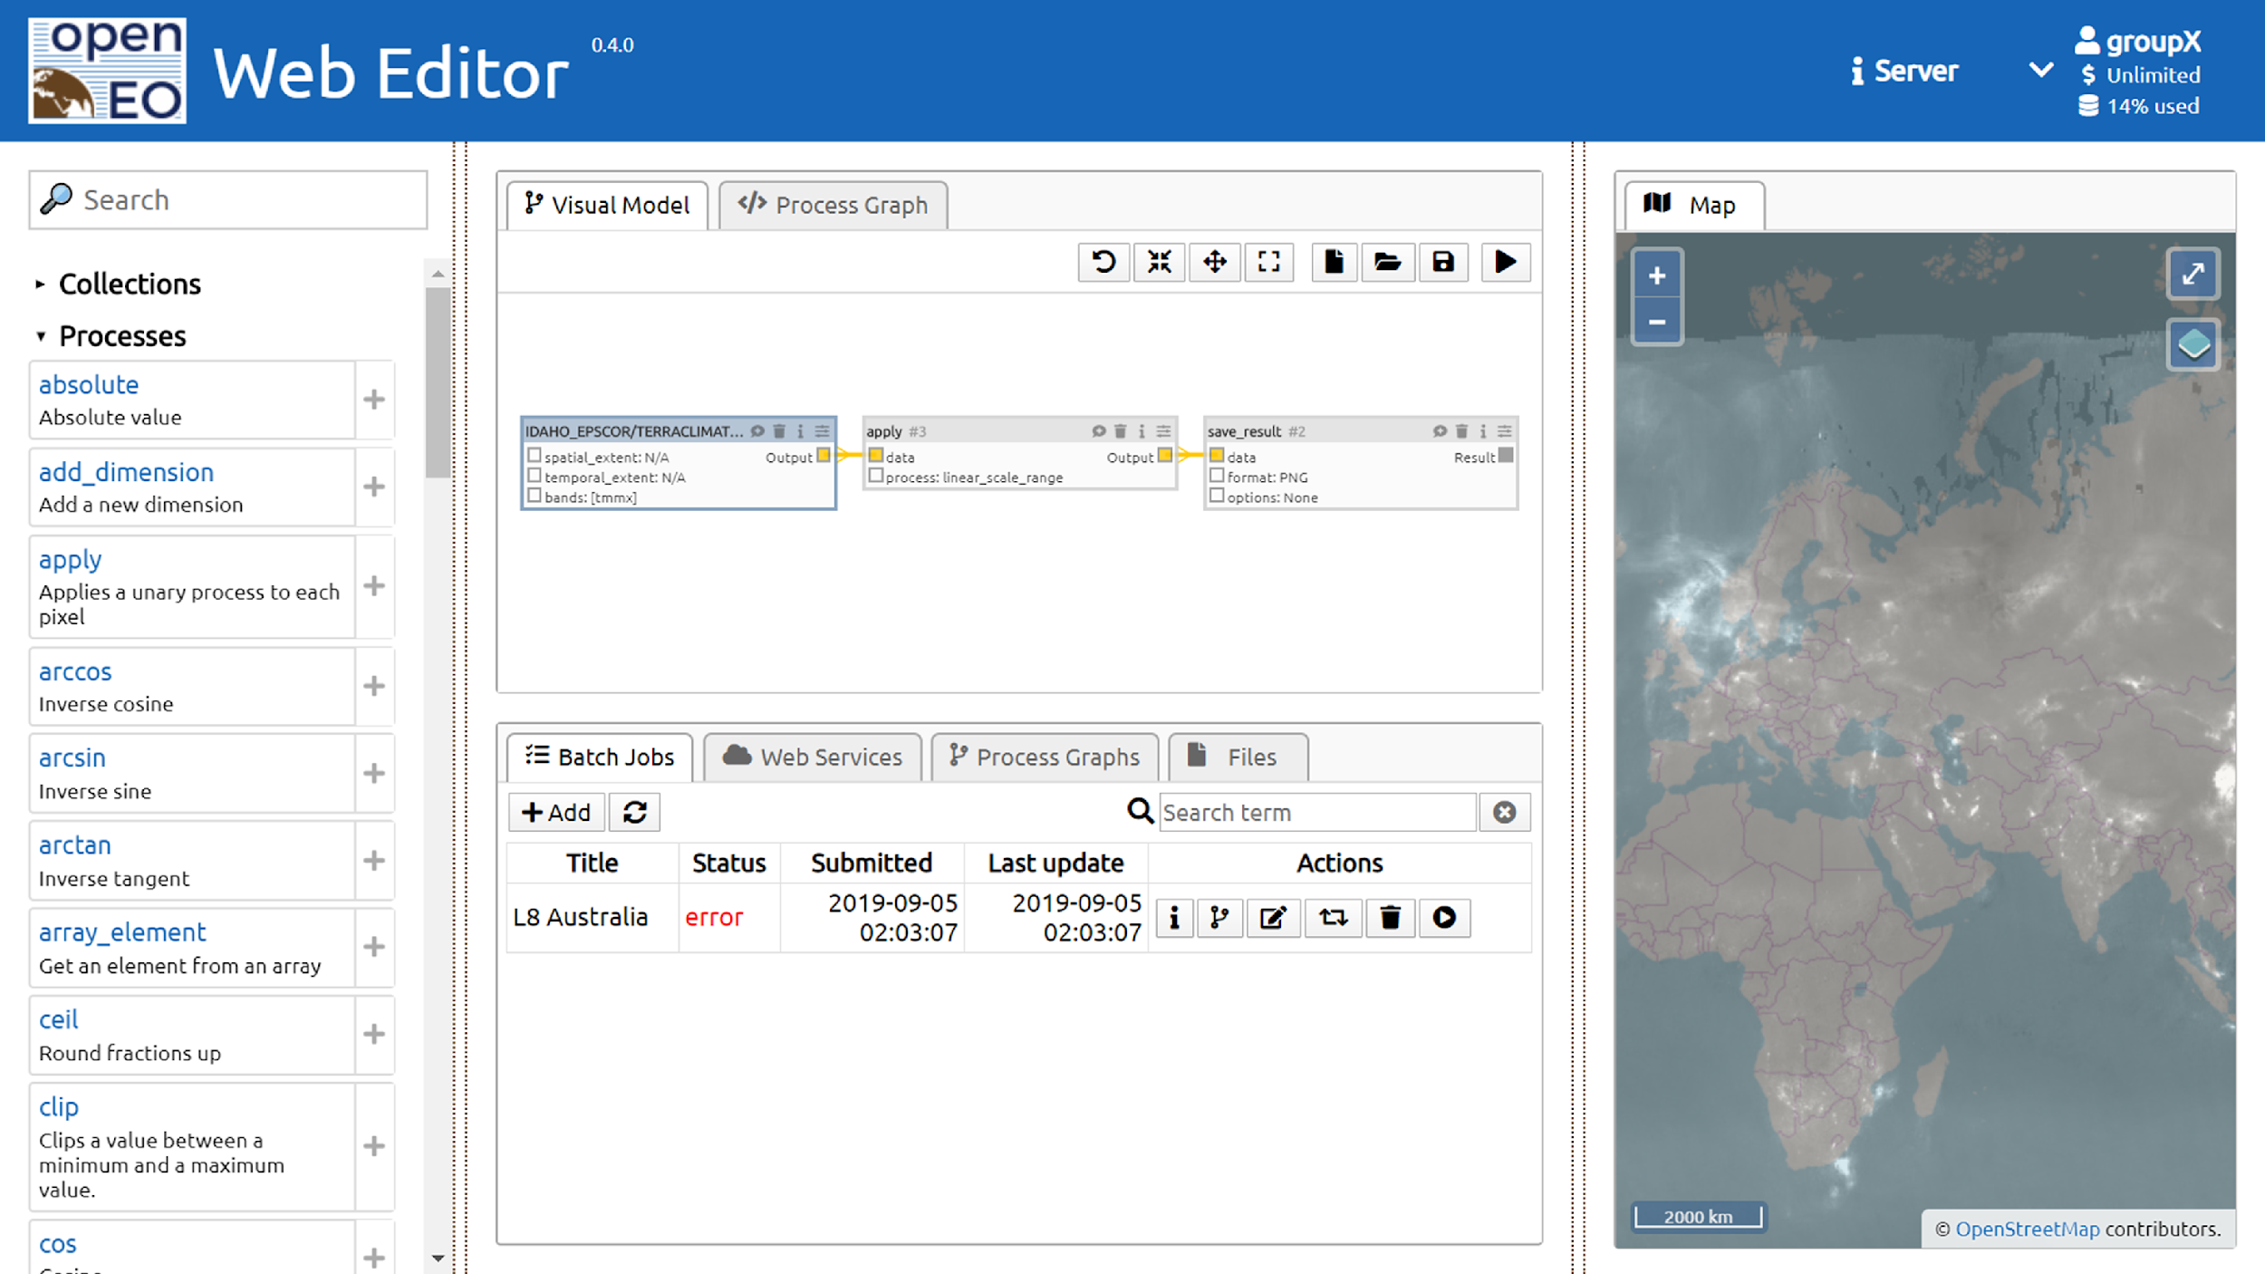

Slide 12
Implementations
GeoPyspark / Geotrellis (VITO, CDSE)
Xarray / Dask (EODC, EURAC, local processing, …)
Google Earth Engine
WCPS / rasdaman (EURAC)
GRASSGIS / actinia (mundialis)
Sentinel Hub (Sinergise)
… (RISE, IBM, WASDI)
Python
  opinionated, pythonic implementation
  Jupyter integration
R
  Rstudio integration
  Rmarkdown
  Jupyter integration
JavaScript (TypeScript)
  Web Apps
  Mobile Apps
Julia
Web Editor: editor.openeo.org
  Simple UI for the browser
  Model Builder

Slide 13
openEO community standard
Submitted to OGC
  Scope: API and Processes
  Type: Community Standard
  Submitter: openEO PSC
RFC started Feb 6th ; ended Feb 27th 2024
Justification document
Presentation at OGC MM in Delft 26th & 28th of March 2024

Slide 14
openEO + OGC API - Processes
Crosswalk
Similar APIs, but different scope
openEO has process specifications
Minor conflicts which require new versions
OGC API - Processes - Part 3 may run openEO UDP
openEO may run Application Packages (OGC API - Processes - Part 2)

Slide 15

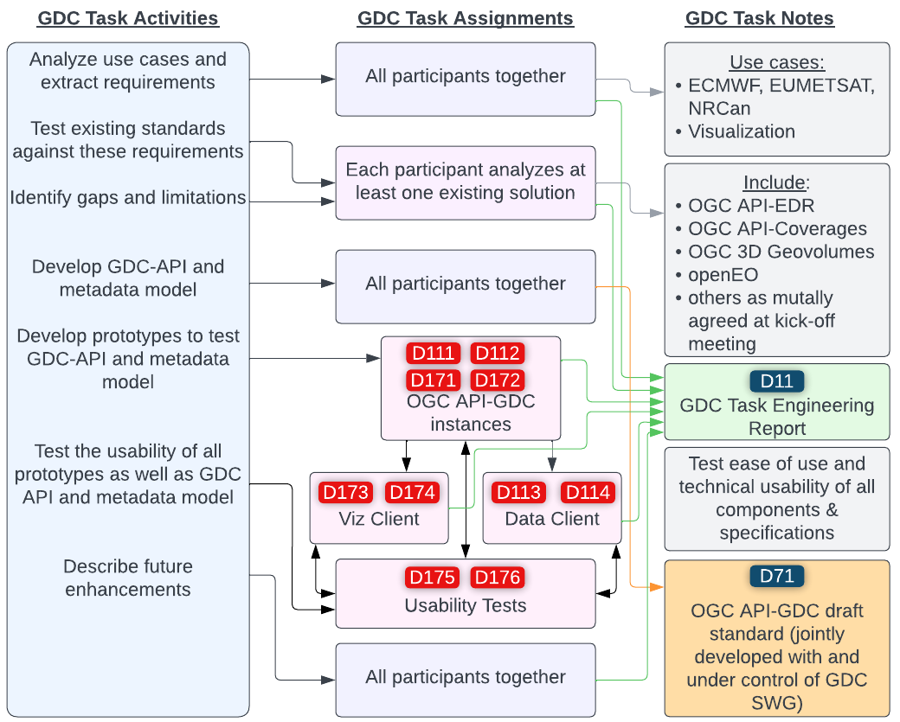
OGC GeoDataCube API
INITIAL IDEAS
General “mostly” consensus GDC API is an implementation profile for existing OGC APIs
Could also be expressed as best practice or implementation guideline
openEO is already in many cases an implementation of OGC API

Slide 16
OGC GeoDataCube API
Testbed 19: Draft API specification
  OGC API - Common (Part 1 and 2)
  Coverages (Part 1)
  Processes (Part 1)
  openEO (discovery, auth, batch jobs)
Draft for OGC GDC SWG

Slide 17
OGC GeoDataCube API
Capabilities
(Service Discovery)
Data Discovery
Process Discovery
Authentication
Discovery Layer. Gives information about everything you can do with the service.
/
/conformance
/collections
/processes
/file_formats
/credentials/basic
/credentials/oidc
OGC API Commons Part 1
and openEO API
OGC API Commons Part 2
and openEO API
OGC API Processes Part 1 or openEO API
openEO API
Data Access
Processing openEO
Processing
OGC API
Data processing Layer. Allows simple data modification during data access or complex processing scenarios using openEO or OGC API including workflows.
/collections/{id}/ …coverages
…items
/result
/jobs/{job_id}
/processe/{id}/
…execute
/jobs/{job_id}
OGC API Coverages
or STAC API
openEO API
OGC API Processes Part 1
Visualization
Result Access
Result Access Layer. Download results or access them through a web service.
/service_types
.../maps
.../tiles
/jobs/{job_id}/
…result
OGC API Maps , OGC API Tiles or openEO API
OGC API Processes Part 1 or openEO API

Slide 18
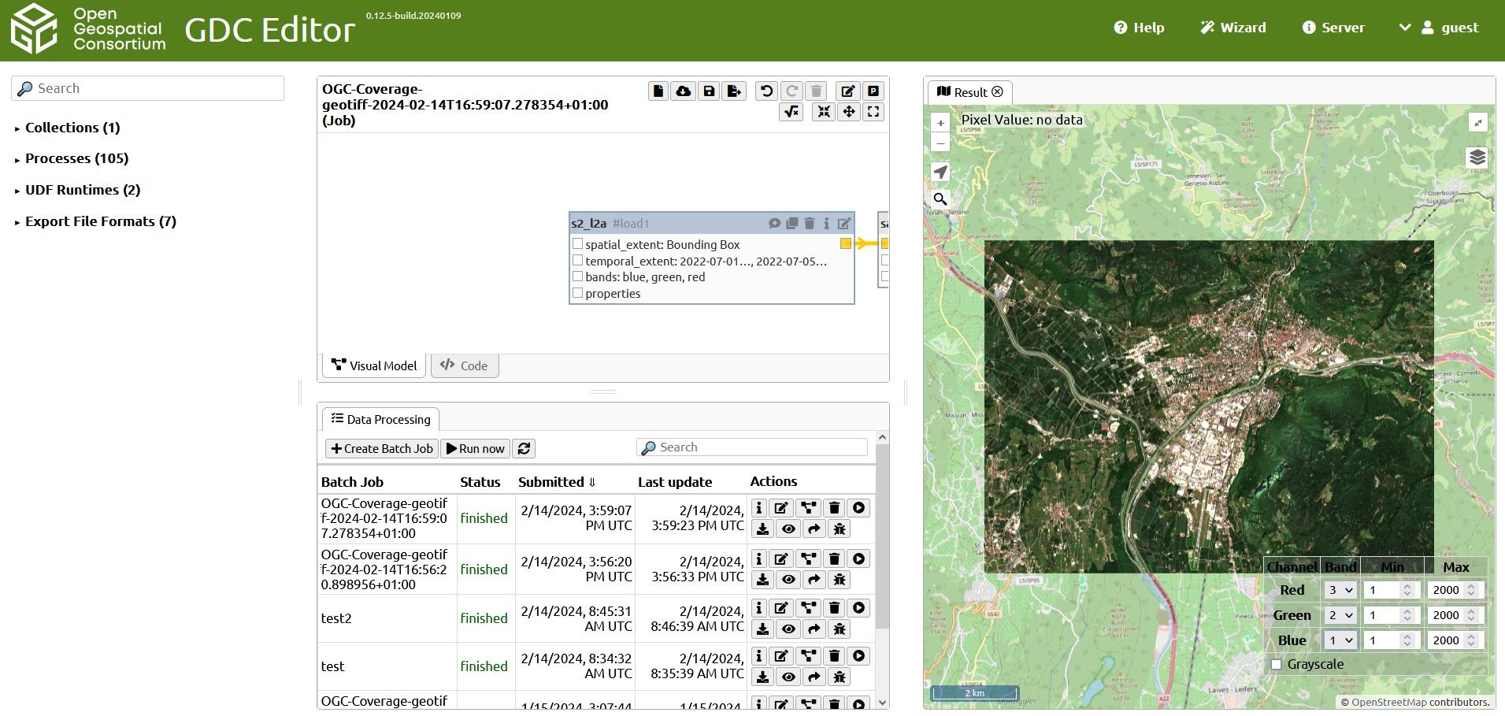
GDC Editor

Slide 19


OGC GeoDataCube API
Engineering Report
Draft Specification

Slide 20
Thank you!
Alexander Jacob - alexander.Jacob@eurac.edu
Matthias Mohr - matthias@mohr.ws
https://openeo.org/

