Slide 1
Sandbox Notebooks
Simon Oliver
Geoscience Australia
Agenda Item 7.6
WGISS-57
4-7 March 2023
Sydney, Australia

Slide 2
Overview
History of notebooks Digital Earth Australia
Notebook walkthrough
Thoughts on best practice
DEA Sandbox
Future work

Slide 3
History of notebooks in DEA
DEA scientists were working independently on code with limited focus on reuse and findability
DEA-notebooks GitHub repository was created as a single development location so code could be easily shared and built upon
Evolved into a curated, mature community of practice within DEA that develops and shares notebook material

Slide 4
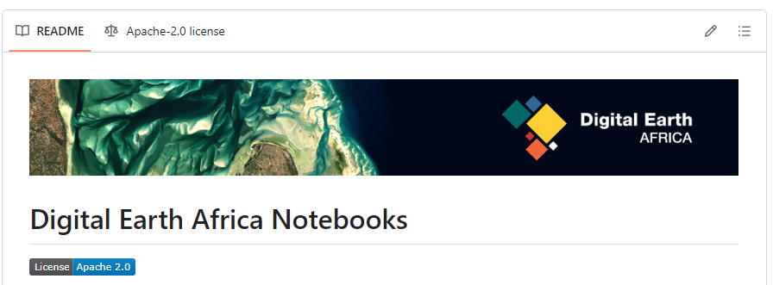
History of notebooks in DEA
Validation tool during development of OpenDataCube (Australian Geoscience Data Cube)
Additional to automated code verification
A way for users to communicate to developers and test approaches
Concept has been adopted by
other ODC programs, including
DE Africa

Slide 5
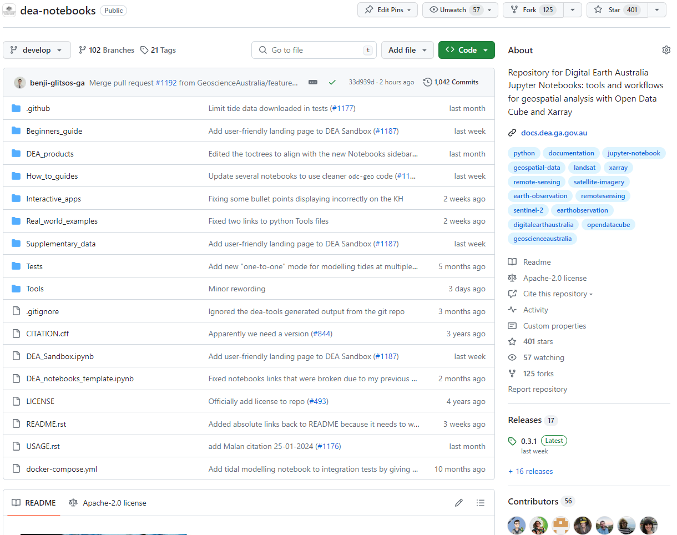
Current State of Notebooks
Beginners guide
DEA products
How to guides
Interactive apps
Real world examples
Tools
Notes:
The structure of the notebooks repository is built to follow a tutorial structure. The folders are intentionally alphabetical, with a beginner's guide at the top, building to more complex material as you move through the folder structure.
Beginners guide – introduces the user to the concept of jupyter notebooks, simple data structures and python commands and the very basics of loading and interacting with Earth Observation data.
DEA products – provides an introduction to each DEA data product, how to use and load the data and how to perform analysis and plotting.
How to guides – this folder is a collection of "recipe-style" code snippets, demonstrating simple functionality such as exporting geotiffs, through to generating animations, or performing simple EO analyses like calculating band indices or reprojecting data.
Interactive apps – these are interactive point-and-click, low code applications that have been developed to allow users to perform analysis or generate outputs, without needing to have a knowledge of python code.
Real world example – more complex workflows that tie everything together to solve real-world scientific/management questions such as change detection, or analysis of vegetation phenology.
Tools – DEA Notebooks is accompanied by an open source Python package dea-tools, which provides access to custom tools for loading and analysing EO data. Combining these two sources (notebooks and Python package) allows users to have easy access to the tools they need to run Notebooks, while also enabling external users to import our tools into their own larger-scale EO workflows.

Slide 6
Measures of impact
401 GitHub stars, 125 code forks
Top 44 of all remote sensing repositories on GitHub (out of 1612)
Top 14 of all earth observation repositories on GitHub (out of 391)
56 unique contributors
82 Jupyter Notebooks
Used in 8 university training courses, referenced in 19 scientific papers
Notes:
GitHub's "topics" search return dea-notebooks in the top 44 repositories for "remote sensing", and the top 14 for "earth observation".
Repository has a file where users can self-report their usage of the repo. Using this method, we have collated 19 known scientific papers, 3 conference papers, 8 university training courses and two creating artworks that make use of code in the dea-notebooks repository.

Slide 7
Notebook best practice thoughts
Aligns with and represent current state of underlying data collection i.e. keep pace with Collection upgrades
Managed by a Community of Practice within DEA
Represents current Python libraries
Infrastructure agnostic where possible (Desktop/Supercomputer/Commercial Cloud)
Add a preferred citation to make it easy for people to reference the resource, and to track its uptake
Consistent look and feel
Notes:
A community of practice is used to identify and manage maintenance and new works in the repository. The CoP meets regularly and includes representatives from across the GA DE programs which has resulted in wide participation and contribution to the project from across the program. Regular and dedicated time is supported by senior management to enable undertaking of repository works which helps keep them up-to-date and aligned with current DE processes under the hood.
To ensure up-to-date code, Notebooks are run automatically via integration tests at every code change. Getting full test coverage has always been a challenge, but these tests have already been incredibly valuable for catching issues before our users do, and reducing overall maintenance load
Use of a consistent Notebooks template format and pull request template checklists has produced a consistent look and feel throughout the repo, which simplifies the user experience and results in high-quality content throughout the repository

Slide 8
Challenges
CEOS Jupyter Notebook Best Practice
GA follows most of the best practice recommendations in the current CEOS Best Practices draft
consistent/discoverable notebook names/abstracts/headers including products used etc. as well as templating and PEP8
GA also uses tags aid discovery - a challenge has been the lack of a controlled vocabulary which makes the tags less useful than they could be.

Slide 9
Digital Earth Australia Sandbox
DEA Sandbox is a learning and analysis environment for getting started with DEA data and our Open Data Cube.
Great feedback from use in University EO courses
Includes sample data and Jupyter Notebooks that allow users to experiment with DEA's Earth Observation datasets and explore proof-of-concept applications.
Notebooks provided are those from the dea-notebooks repository

Slide 10
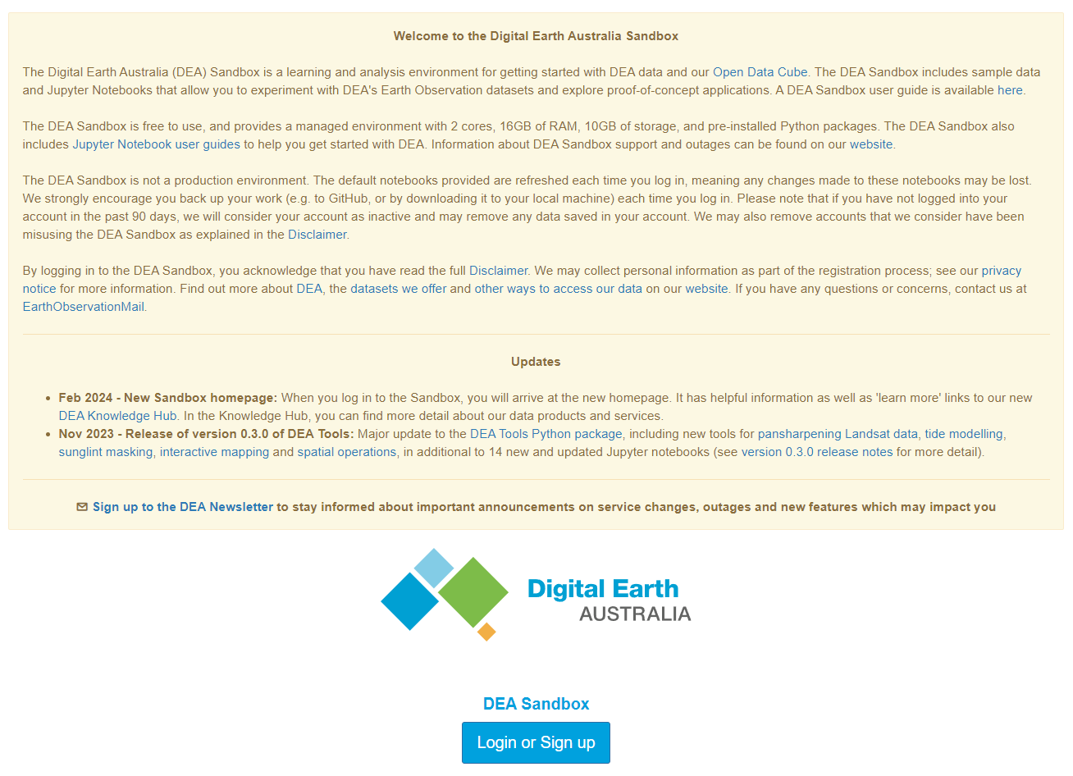
Digital Earth Australia Sandbox
The DEA Sandbox is free to use, and provides a managed environment with 2 cores, 16GB of RAM, 10GB of storage, and pre-installed Python packages.
Not a production environment.
The default notebooks provided are refreshed after each log in.

Slide 11
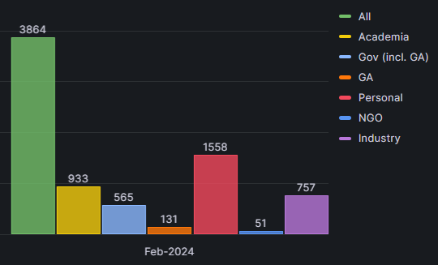
Measures of impact
In the last 6 months, the Sandbox has been logged into 5728 times
Average 30 unique users per day
Notes:
By the time of this presentation, we will have hit 25,000 all time log ins to Sandbox.
Graph shows Sandbox account holders, broken down by their email type provided when they signed up. So someone from @edu.au would be an academia user for example. The graph does not show the "other" category where we couldn't determine the industry.

Slide 12
Future work
Where are we headed with Notebooks?
Focus on sustainability and uptake of DEA notebooks and DEA Sandbox
Develop a consistent guide to accessibility, e.g., color blind friendly data visualisation
Improve testing coverage of DEA notebooks to reduce manual maintenance load

Slide 13
Future work
How do we see DEA Sandbox evolving?
Develop a viable scaling up mechanism - the DEA Sandbox provides just a "taster" of what you can do with DEA + ODC, which can be confusing for many of our users who come from more scalable platforms like GEE

Slide 14
Thanks!
Presented by Simon Oliver simon.oliver@ga.gov.au
With contributions from
Dr Claire Krause
Dr Robbi Bishop-Taylor
Dr Claire Phillips
Bex Dunn

