Slide 1
Multi‐mission Algorithm and Analysis Platform (MAAP)
WGISS (Working Group on Information Systems and Services)
57th meeting
March 5-7, 2024 in Sydney, Australia
Gerald Guala¹, Doug Newman², Hook Hua⁴, Laura Duncanson⁶, Sam Niemoeller⁴, Neha Hunka⁶, Alex Mandel³, Brian Freitag⁷, George Chang⁴, David Moroni⁴.
1 NASA Headquarters, Washington DC, USA
2 NASA Goddard Space Science Center, Greenbelt, MD, USA
3 Development Seed, Washington DC, USA
4 NASA Jet Propulsion Laboratory, Pasadena, CA, USA
6 Geographical Sciences, University of Maryland, College Park, MD, USA
7 Marshall Space Flight Center, Huntsville, AL, USA
Copyright 2024. ALL RIGHTS RESERVED. United States Government Sponsorship acknowledged. Reference herein to any specific commercial product, process, or service by trade name, trademark, manufacturer, or otherwise, does not constitute or imply its endorsement by the United States Government
Notes:
MAAP is
A joint venture between NASA and ESA
A cloud-based scalable, integrated platform for algorithm development, scalable science processing, analysis and visualization
Using biomass and biomass harmonization as their initial use cases

Slide 2
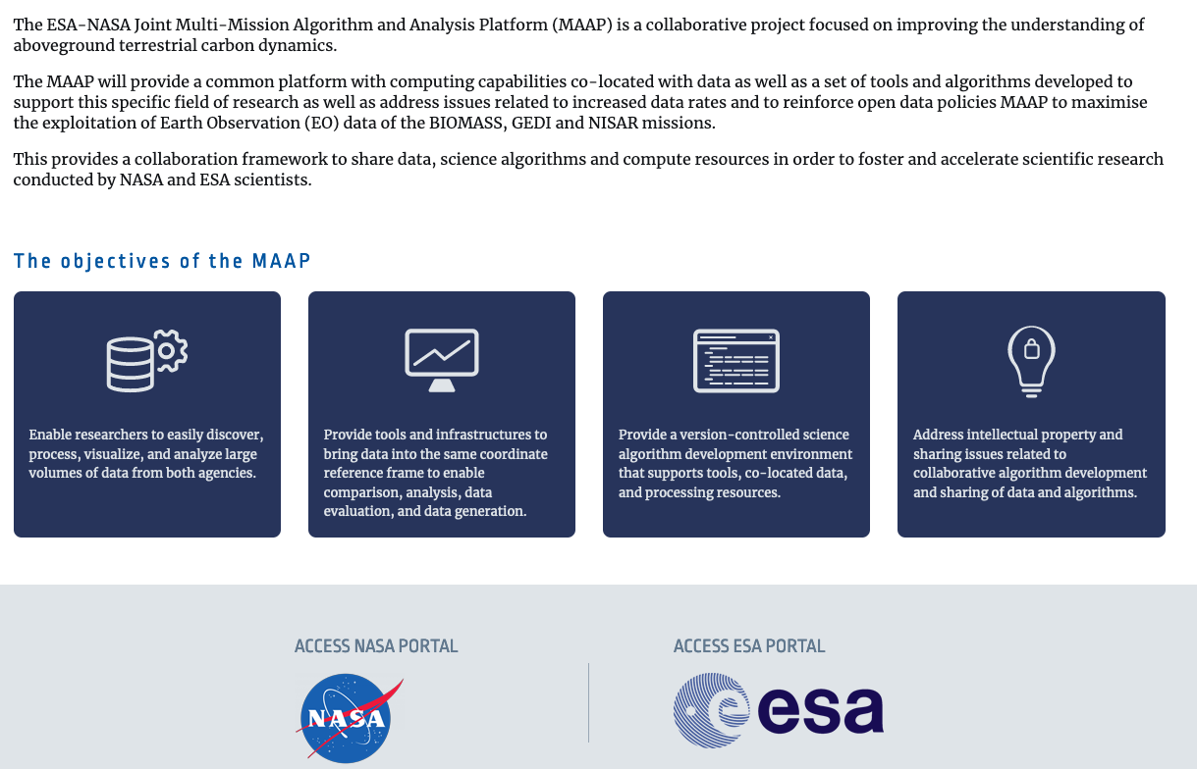
Multi‐mission Algorithm and Analysis Platform (MAAP)
https://scimaap.net/
Notes:
Discover, process and visualize data at scale
Facilitate the co-location of different datasets
Full-blooded development environment for collaborative algorithm development
Provide solutions for intellectual property rights in a collaborative development environment

Slide 3
MAAP Architecture

Slide 4
MAAP High-Level Architecture
Legend
ESA MAAP
API access
UI access
NASA ESDIS CMR
Data Flow
NASA Datasets (collection & granules)
ESA-NASA Joint Code Repository
Platform Team (JPL)
NASA MAAP
Data Team (MSFC)
Joint JPL/MSFC
MAAP API Endpoint
Algorithm Development Environment
EOSDIS
Docker Images of Notebook Runtimes
Container Registry
Algorithm Developers
Common Services
CI/CD
Data Processing Service
OGC WPS
SSO
Authentication
Runs on
HySDS: same software used by SWOT, NISAR, SWODLR, SNWG/OPERA, SMAP with HySDS (SWH), OCO-2 in AWS, Unity, GRFN
Runs large-scale processing in lower-cost AWS spot market compute
Metadata
Orchestration Production Rules
Authorization
On-demand Processing
Logging
Jupyter notebooks
Resource Management
Metrics
Eclipse Che
Kubernetes
Dataset Index for Processing
MCE Compliance
Data Analysts
Deployment
Metrics
Containers in Auto-Scaling Preemptable Fleets
Accounting/Billing
In-Situ Data
Generated Data Products
Data Management Services
Data Access for Analysis
Cumulus: Same software used by NASA ESDIS DAACs
Supports cataloging collections and granules across all NASA DAACs
ETL-ingest
Ingest
Campaign Data
Cumulus
Input Data
Metadata
MAAP STAC Catalog
Dataset Index (collection & granules)
Subsetting Services
Data Store
VEDA: Same software used by joint ESA, JAXA, NASA Covid-19 dashboard
WCS
EDSC
Object Storage
Features
Data Search Catalog
COG, mosaicJSON
OGC WMTS
Visualization Services
http/https/s3
Access
EPT
TiTiler Service
Fast Browse
Data Explorers
3D Tiles
CMC
Notes:
NASA MAAP is deployed to AWS in us-west-2.
Spot instances for cheaper processing. Surprisingly low risk.
HySDS - proven services used by SWOT, SMAP and NISAR
Cumulus + CMR?
VEDA used by earth.gov

Slide 5
Joint Interoperability across ESA and NASA
OGC Interfaces for Open Science Interoperability
ESA-NASA Joint Code Repository
Checks out code
Checks out code
Checks out code
ADE
Build algorithm runtimes
Build algorithm runtimes
ADE
Application Package
CI/CD
CI/CD
Registers Executable Algorithms
On-demand jobs
On-demand jobs
Loads Executable Algorithms
Joint Algorithm Catalog
Loads Executable Algorithms
WPS-T
WPS-T
NASA MDS
ADES
ADES
ESA MDS
DPS
DPS
Data
Data
STAC
Dataset Index (collection & granules)
Metadata
Metadata
Joint MAAP CMR
Notes:
ESA and NASA are standing up infrastructure based on common foundations providing IaC, algorithms and discovery services

Slide 6
MAAP Foundational Use Cases

Slide 7
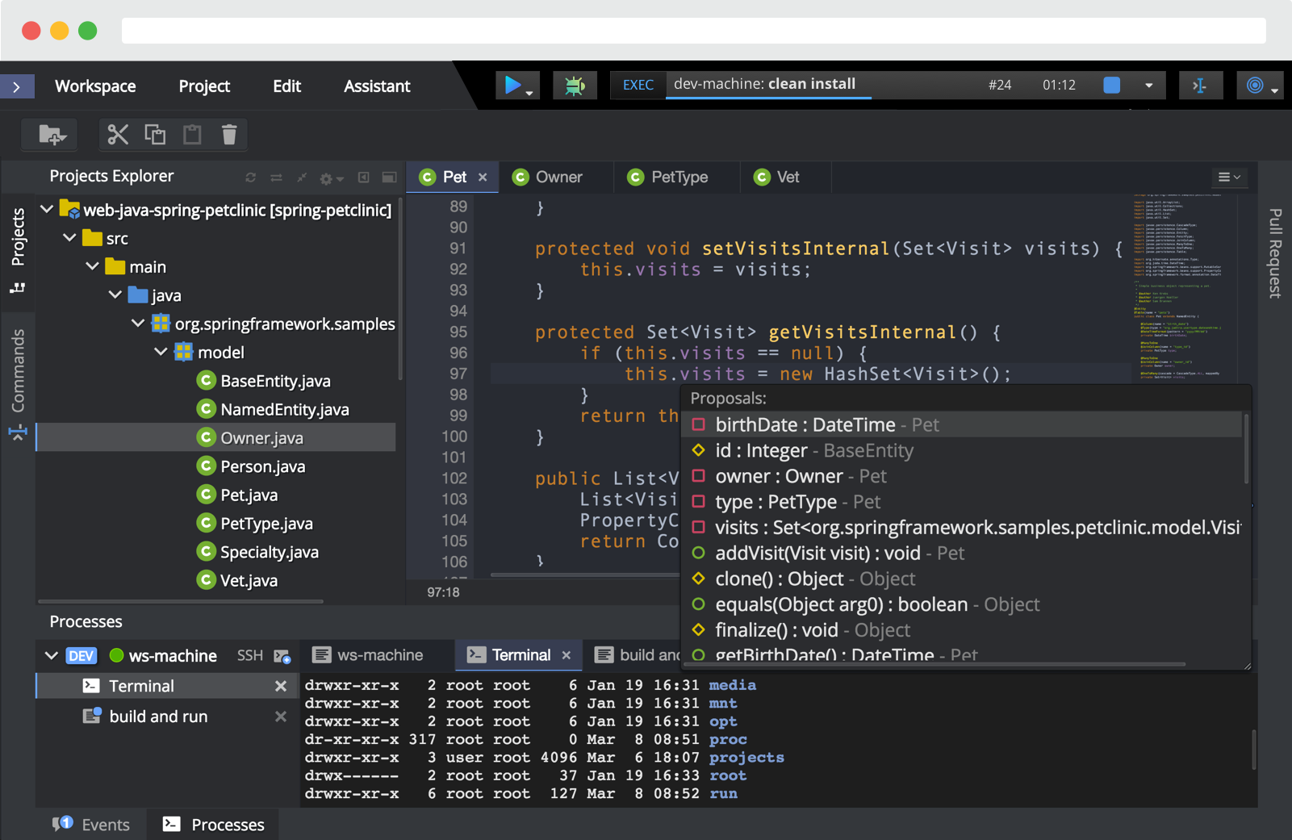
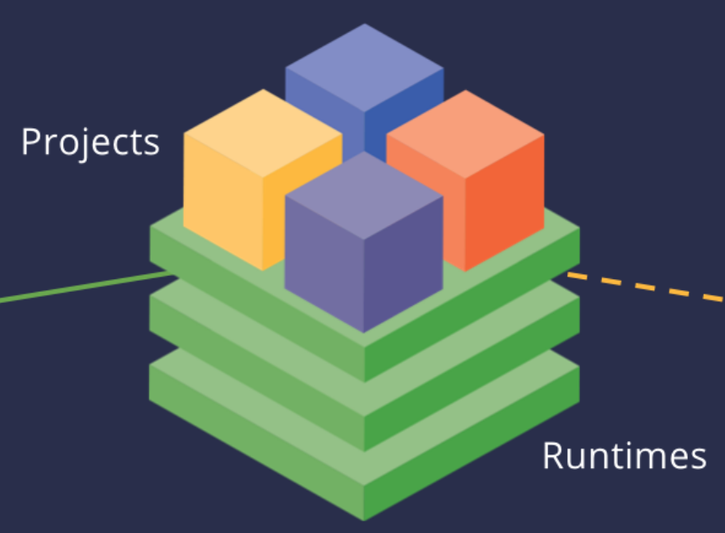
Foundational Use Case - Algorithm Development
1
Algorithm Developers, Science Teams
Algorithm Development Environment (ADE)
Data access (including ARDs) and use of analysis services
Versionized Algorithms
Notes:
Algorithm development
You notebook algorithms run inside workspaces on Eclipse Che / JupyterLab
Notebooks are collocated with data –in AWS us-west-2 facilitating data-adjacent compute.

Slide 8
Foundational Use Case - Data Product Generation
2
Algorithm Developers, Science Teams
Algorithm Development Environment (ADE)
Data access (including ARDs) and use of analysis services
Build Algorithms to run at large-scale
Accesses Input Data
Generates Data for Analysis
Science Data Processing Service
Backend DPS shares heritage with NISAR, SWOT, OPERA, SMAP with HySDS, OCO-2 L2 FP, Unity, etc.
Notes:
Once you have refined your algorithm in the small you can scale up to production levels in the same environment.
Your developed algorithms are built and deployed to the science data processing service to run at scale.
DPS is composed of proven services used by SWOT, SMAP and NISAR (HySDS)
Processing and data are also collocated in AWS Oregon region

Slide 9
Foundational Use Case - Analysis of Data Products
3
Algorithm Developers, Science Teams
Algorithm Development Environment (ADE)
Accesses Input Data
Generates Data for Analysis
Data Analysis Services
Notes:
Data Team focuses on enabling data analysis services (e.g. catalog/discovery, TiTiler and Foilium for fast browse tiling, dashboard, CMR-STAC, etc)
UI/UX can be in notebooks
Some of these services are leveraged from NASA VEDA (Visualization, Exploration and Data Analysis)

Slide 10
MAAP Platform and Services

Slide 11
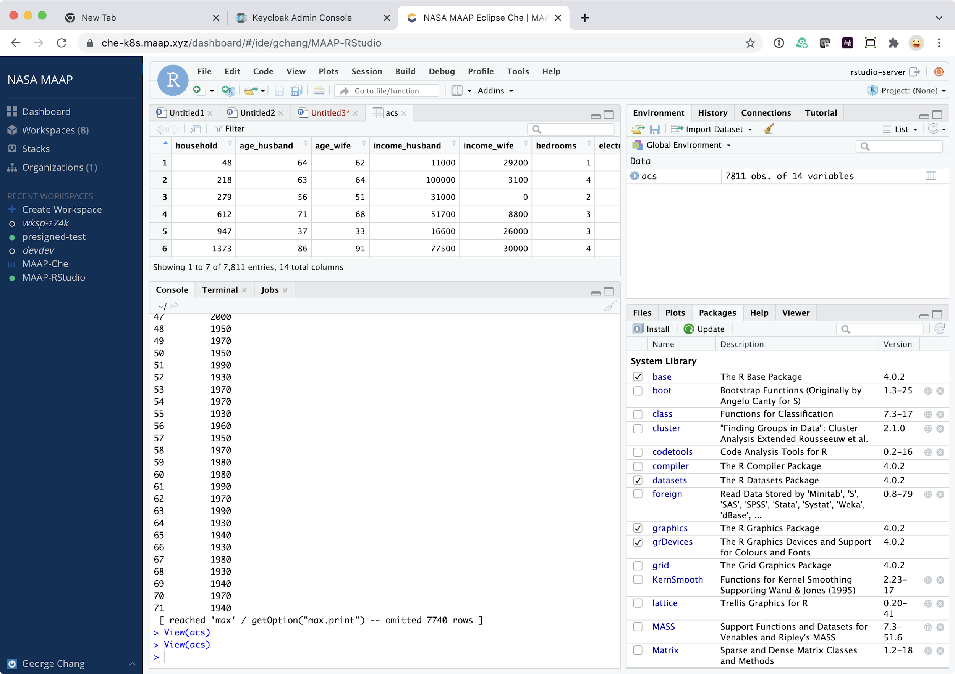
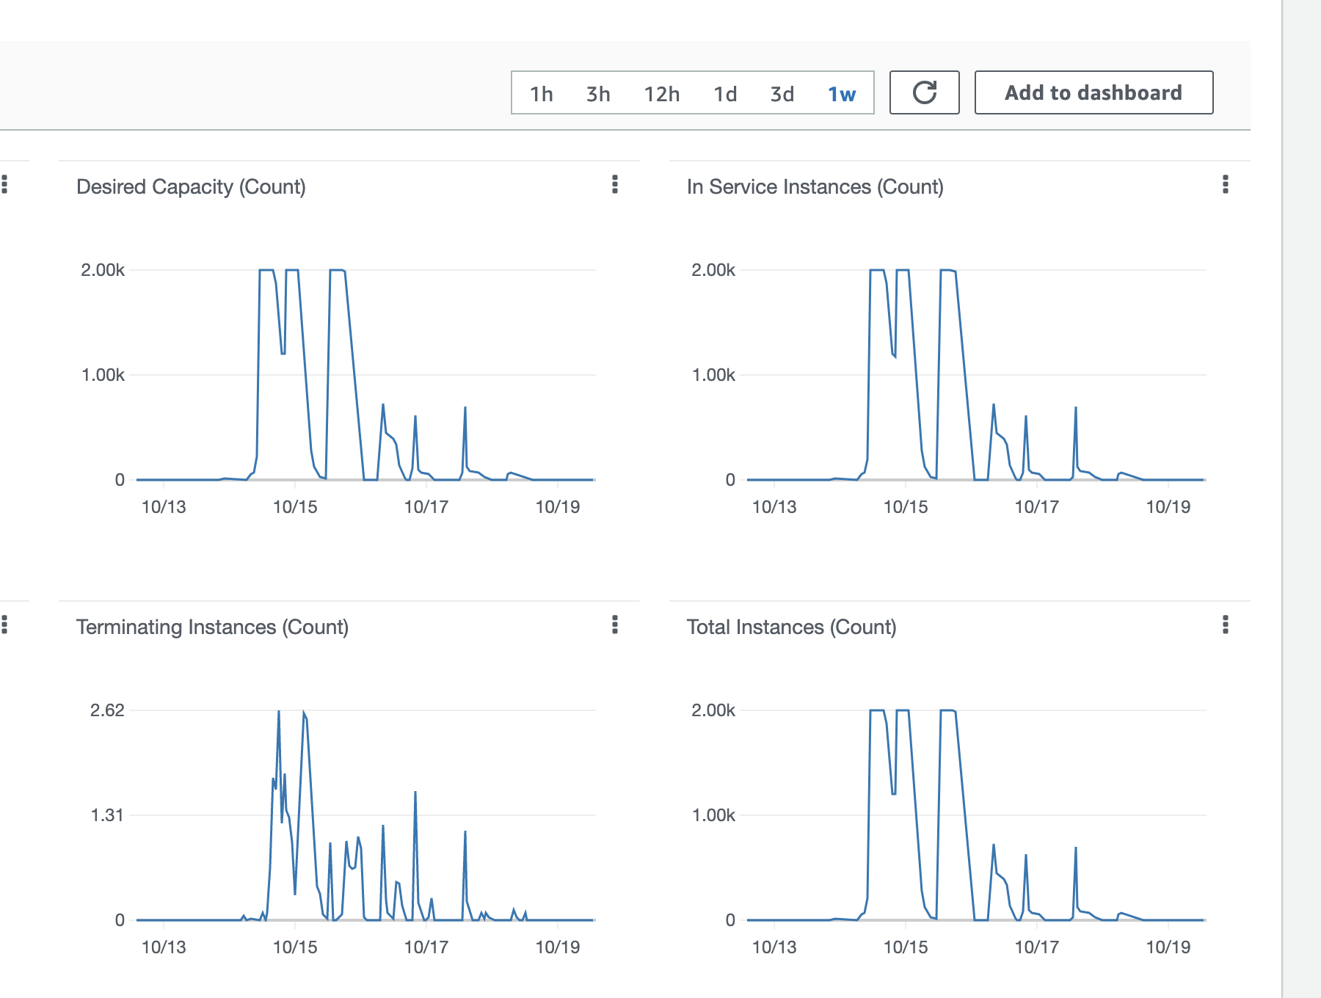
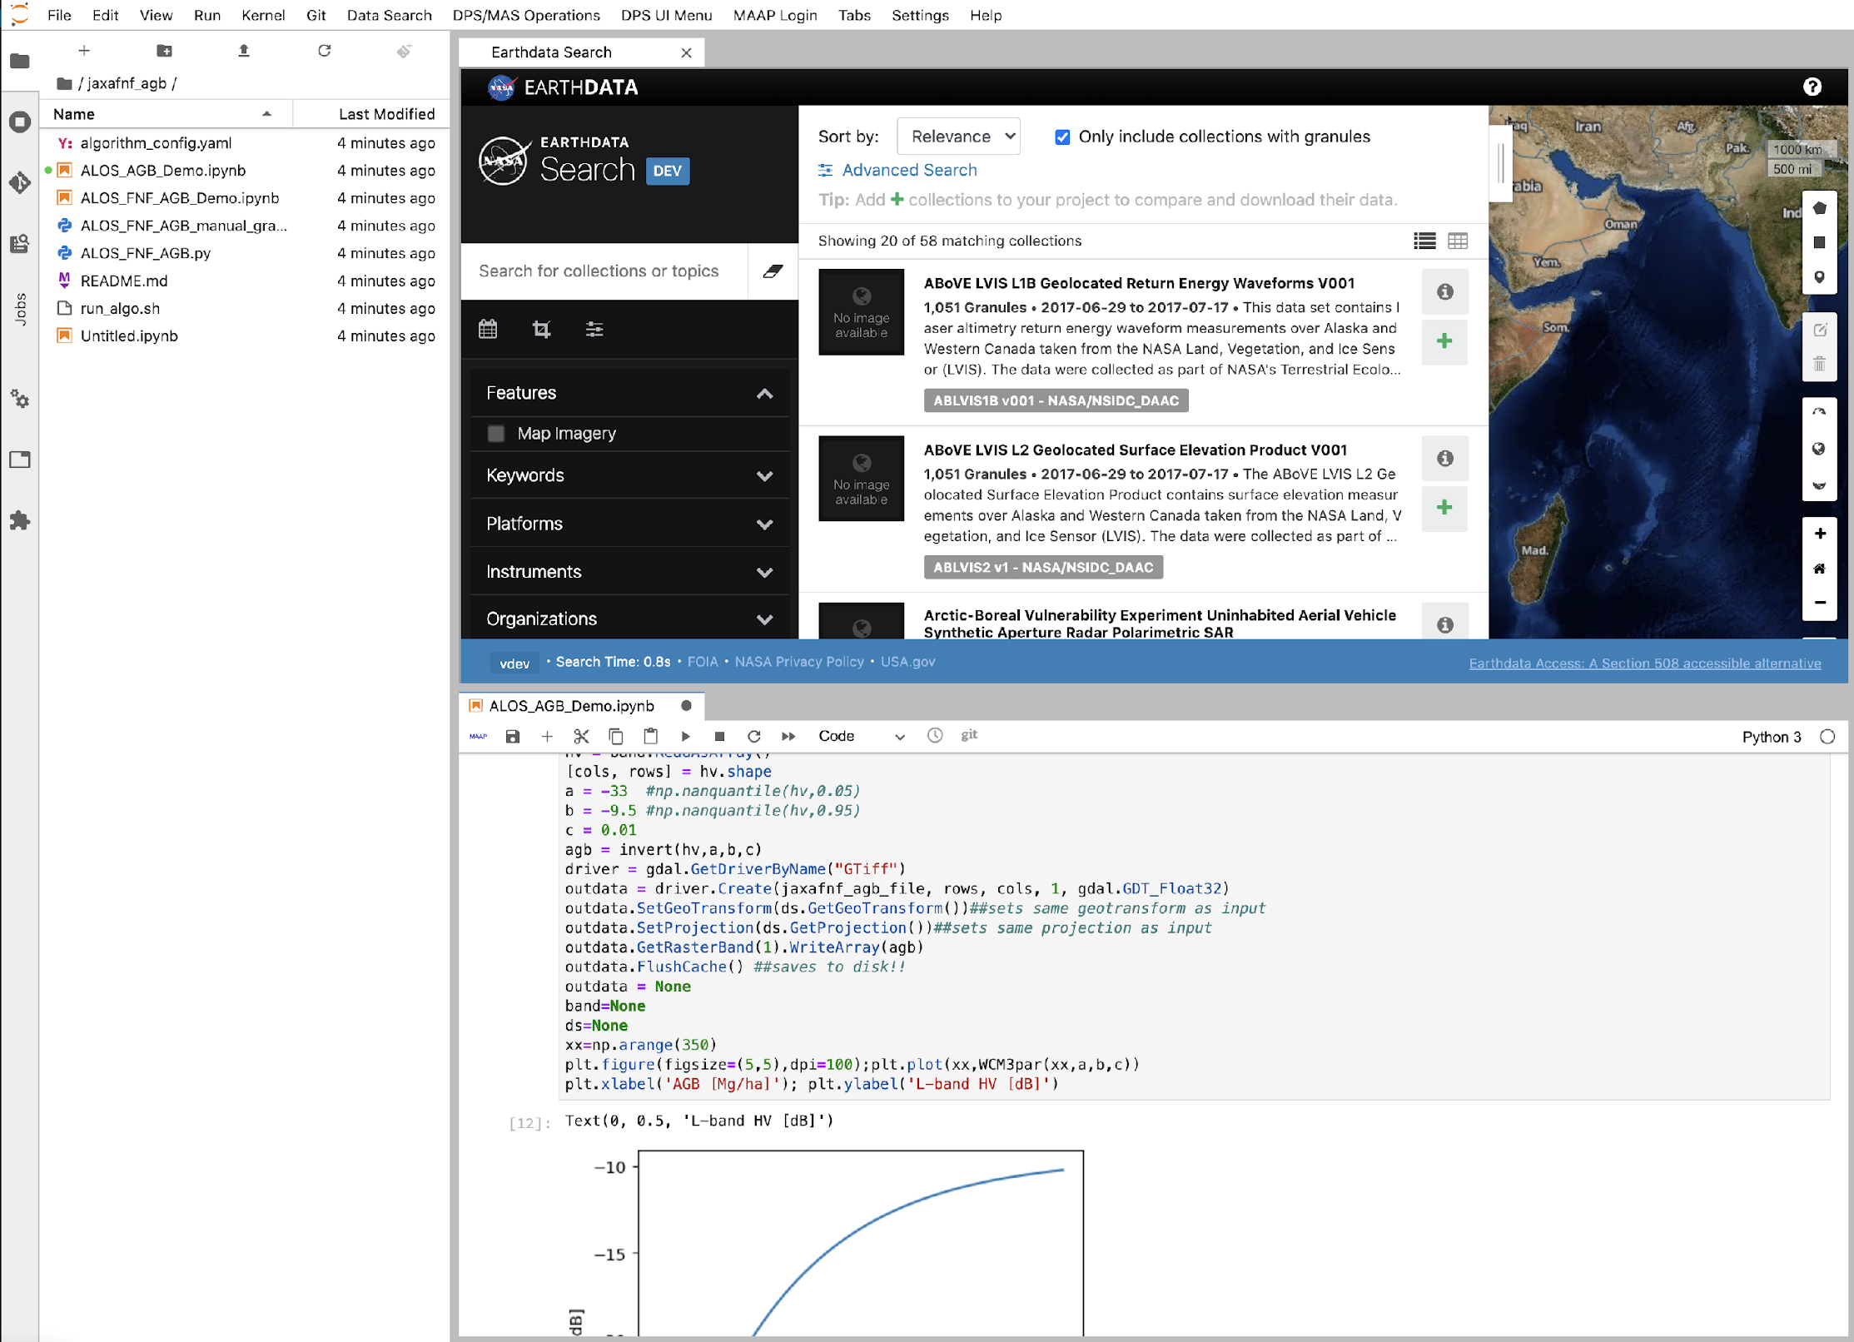
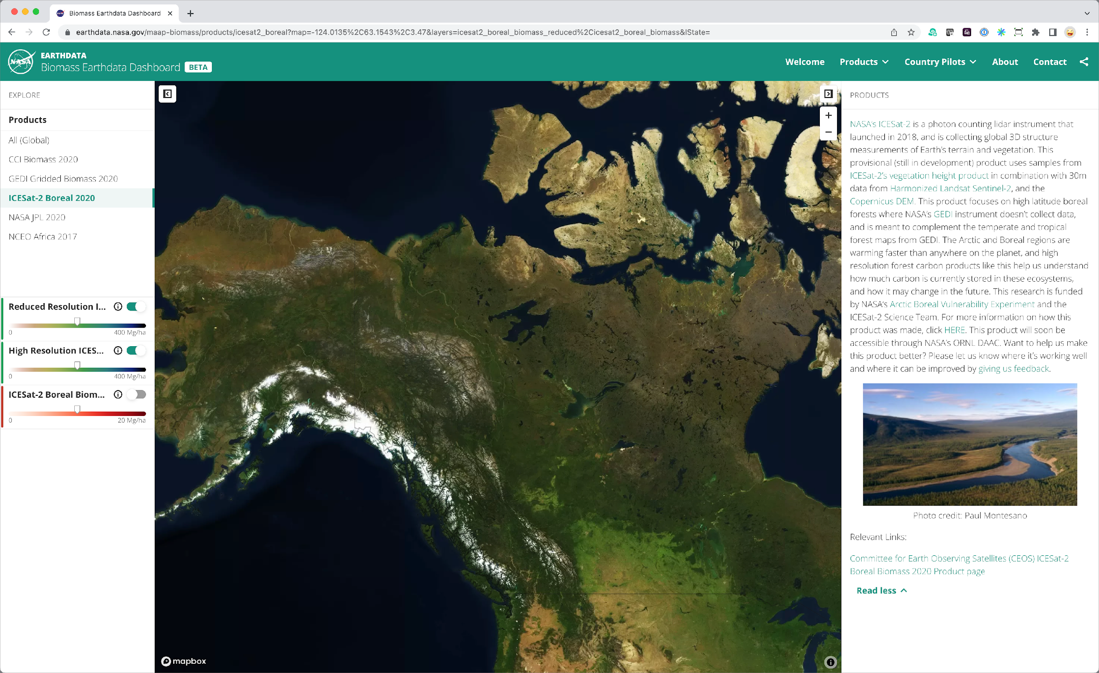
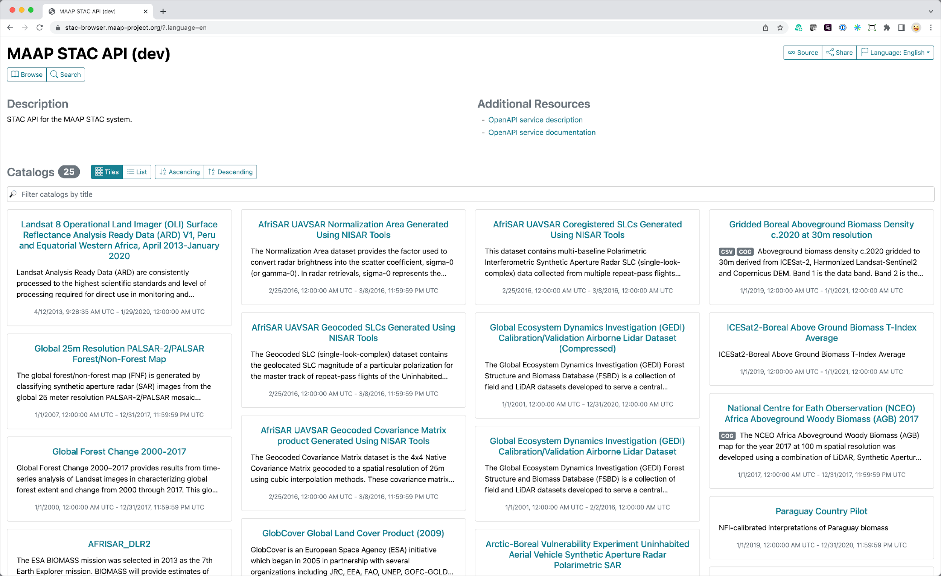
Algorithm Development
Data Processing
Open Standards APIs
Visualization and Analysis
Data Catalog
Notes:
MAAP allows for iterative, collaborative development of science processing algorithms in a single scalable environment. Dev -> test -> catalog -> visualize and analyze -> iterate. All facilitated by open standards-based APIs at the gates between these operations.

Slide 12
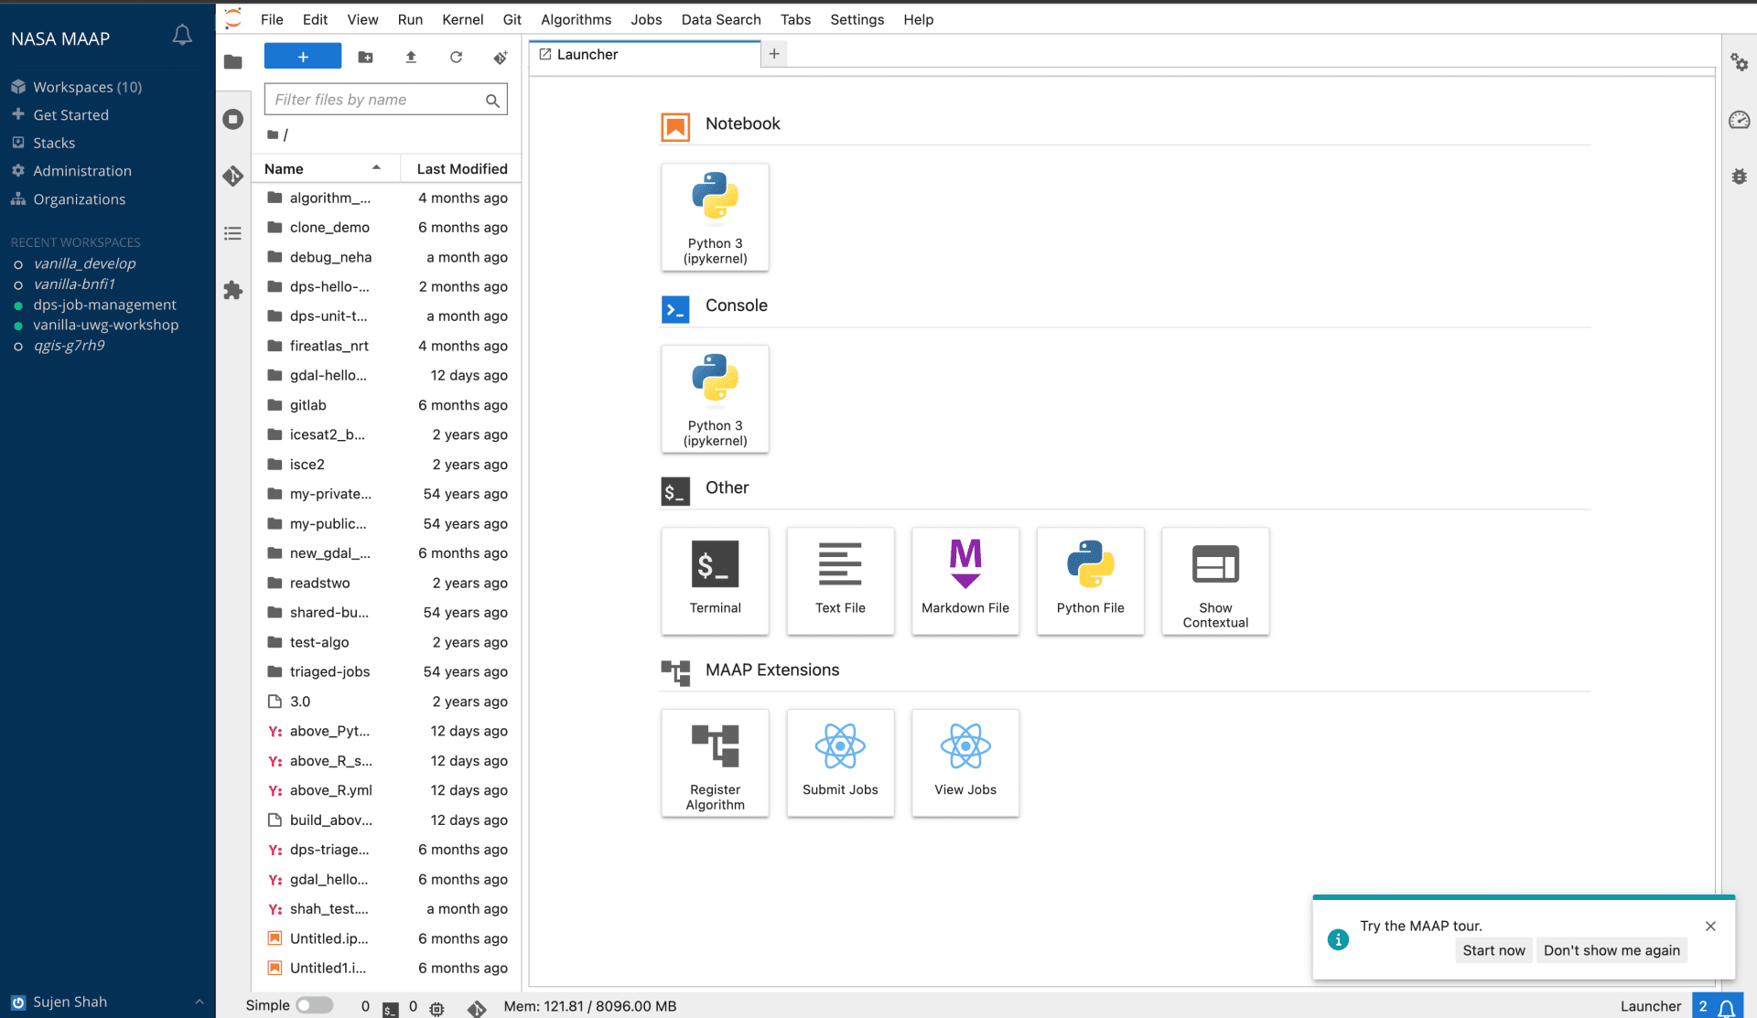
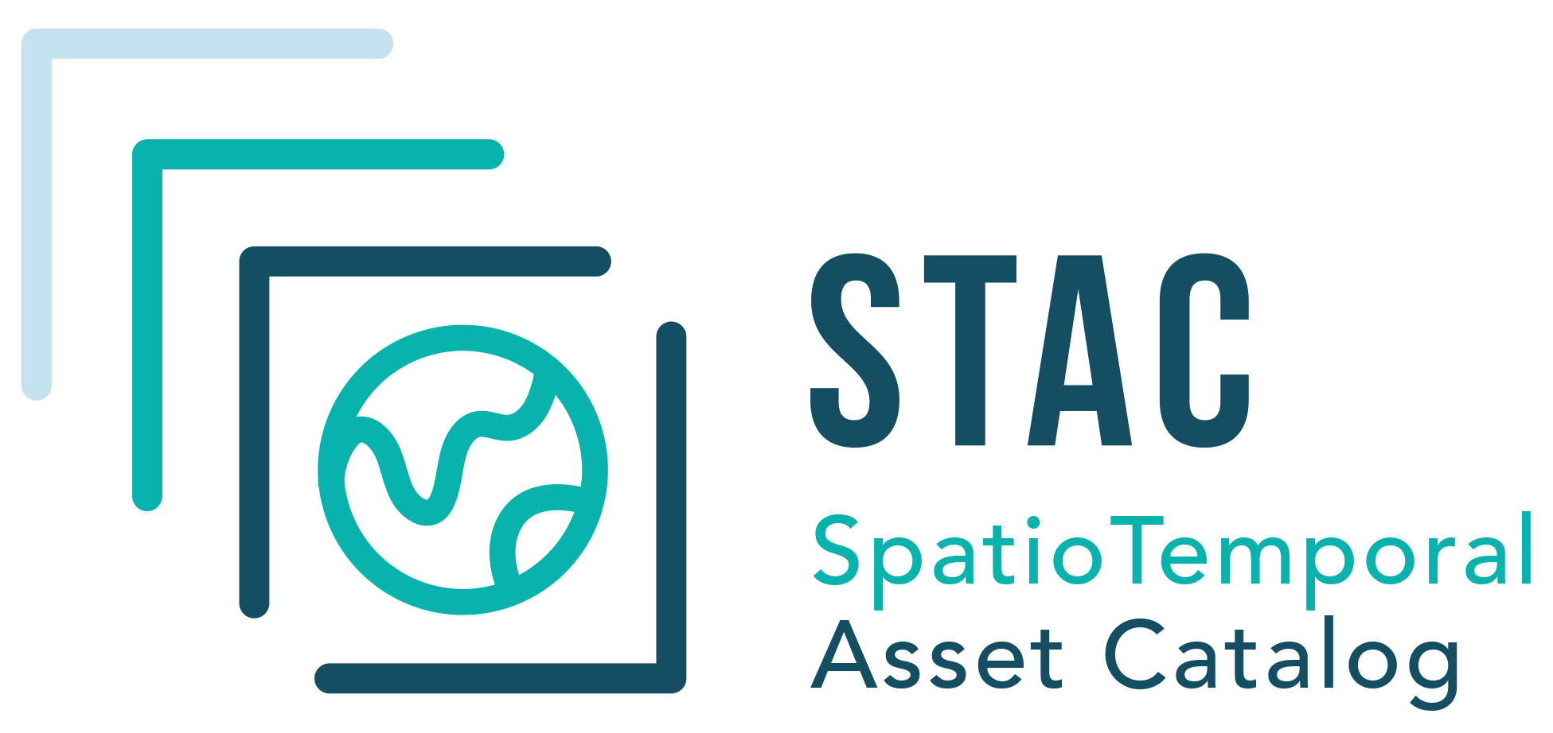
Rapid Algorithm Development
Ability to upscale user’s algorithms (Jupyter notebooks) from small regions of interest to global scale on the Data Processing Service.
Key technologies:
Notes:
Algorithm development is facilitated by standard, popular tools such as Jupyter notebooks, starting small but able to scale up to global datasets.

Slide 13
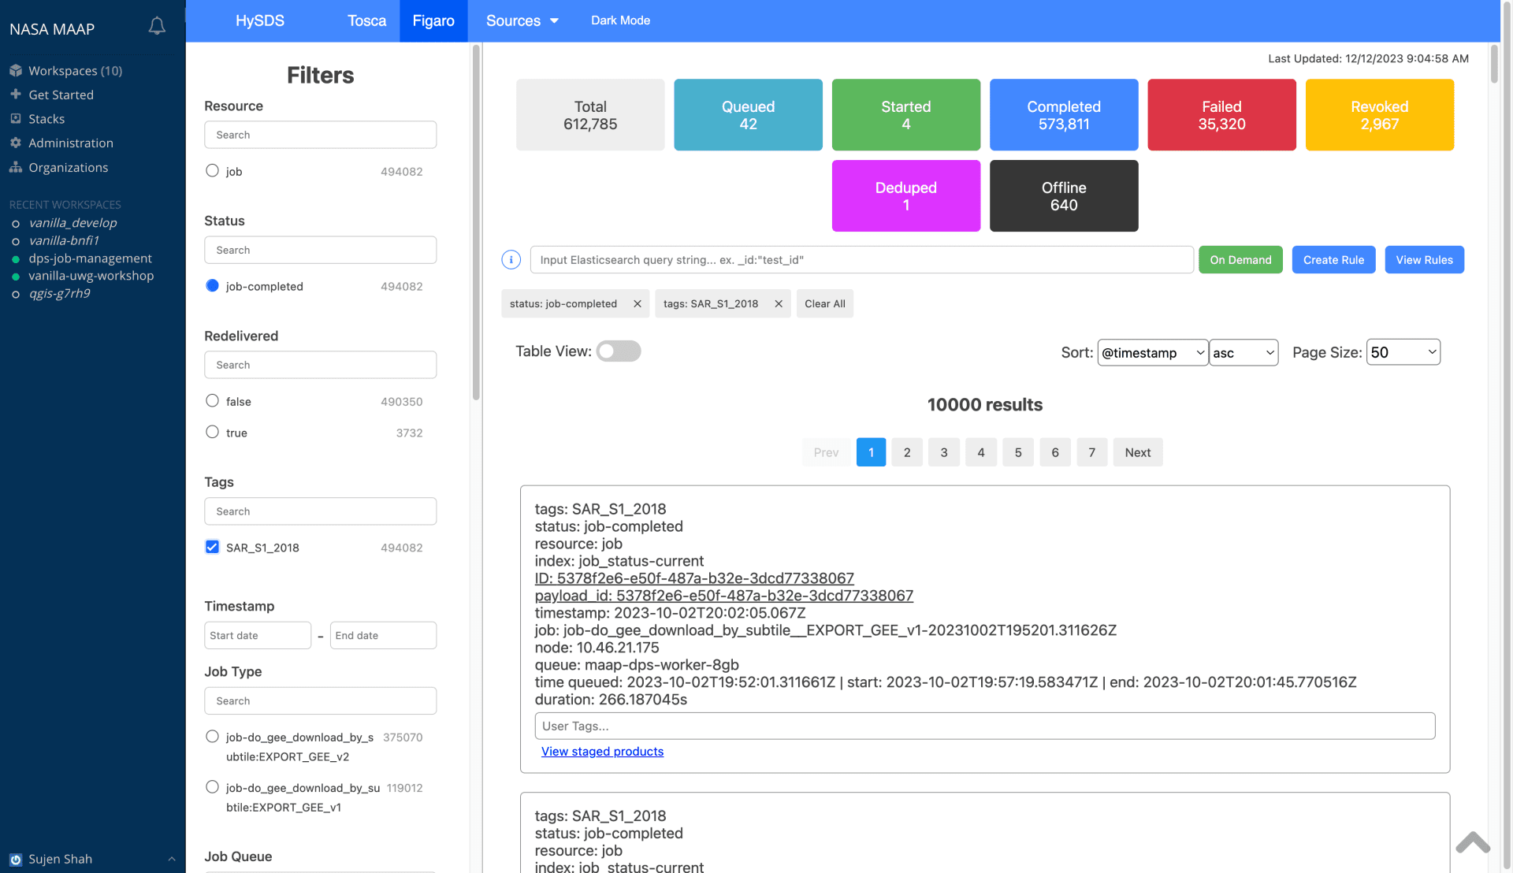
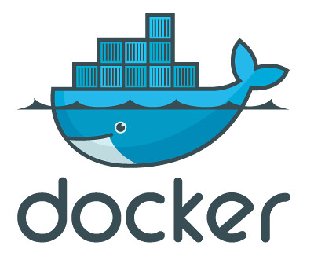
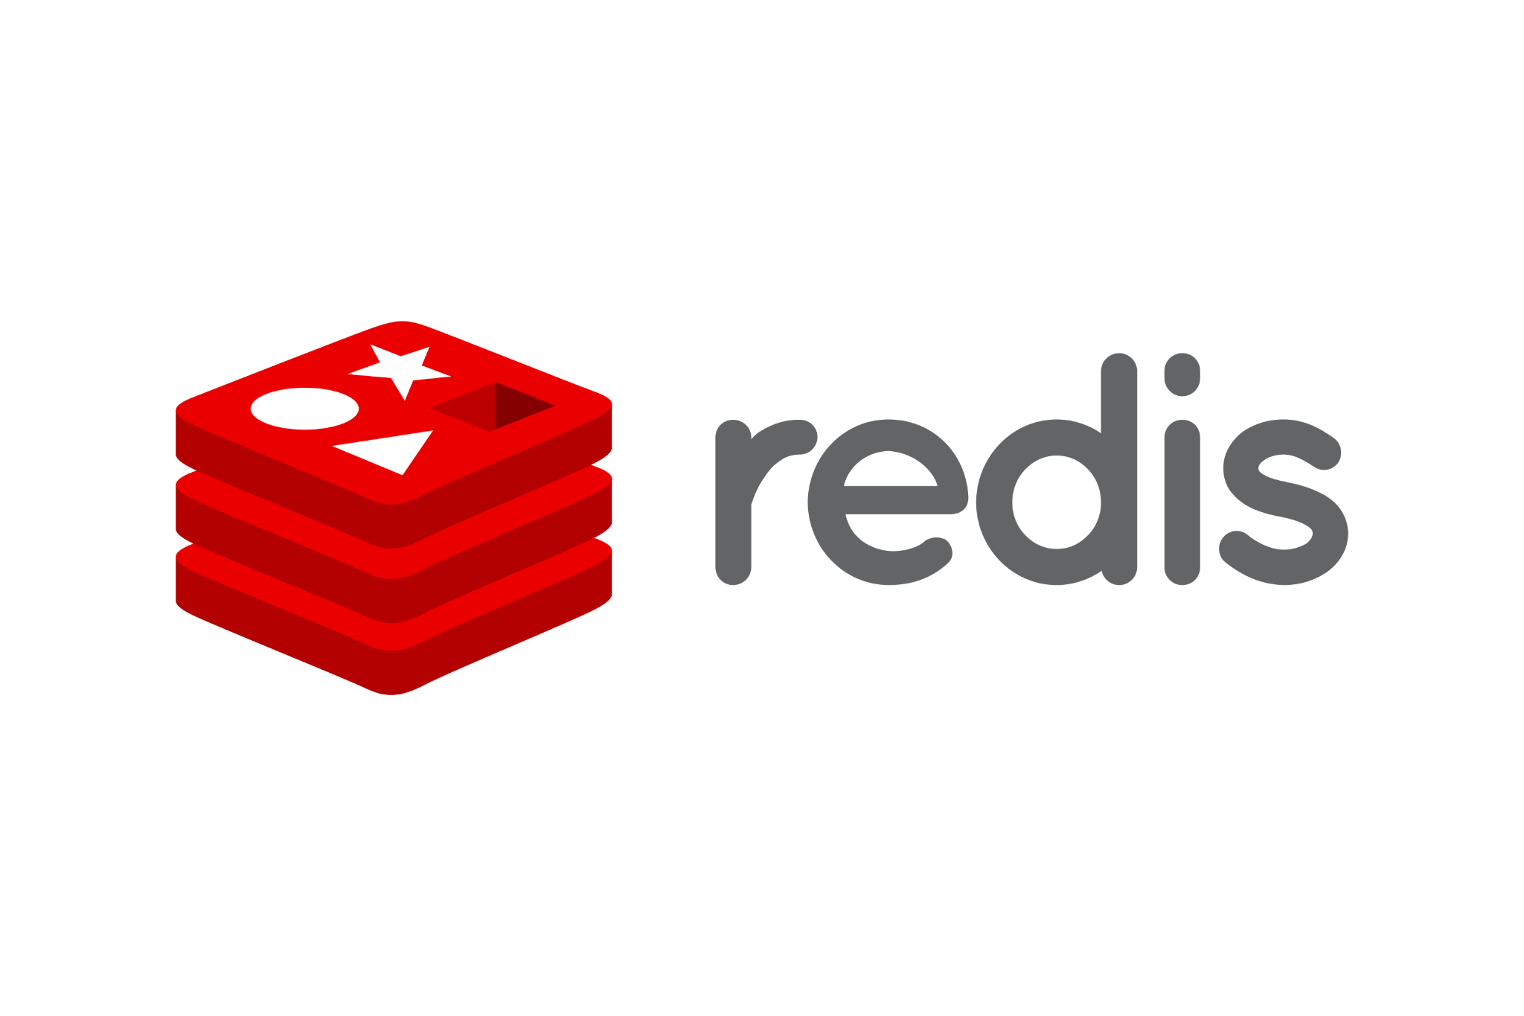
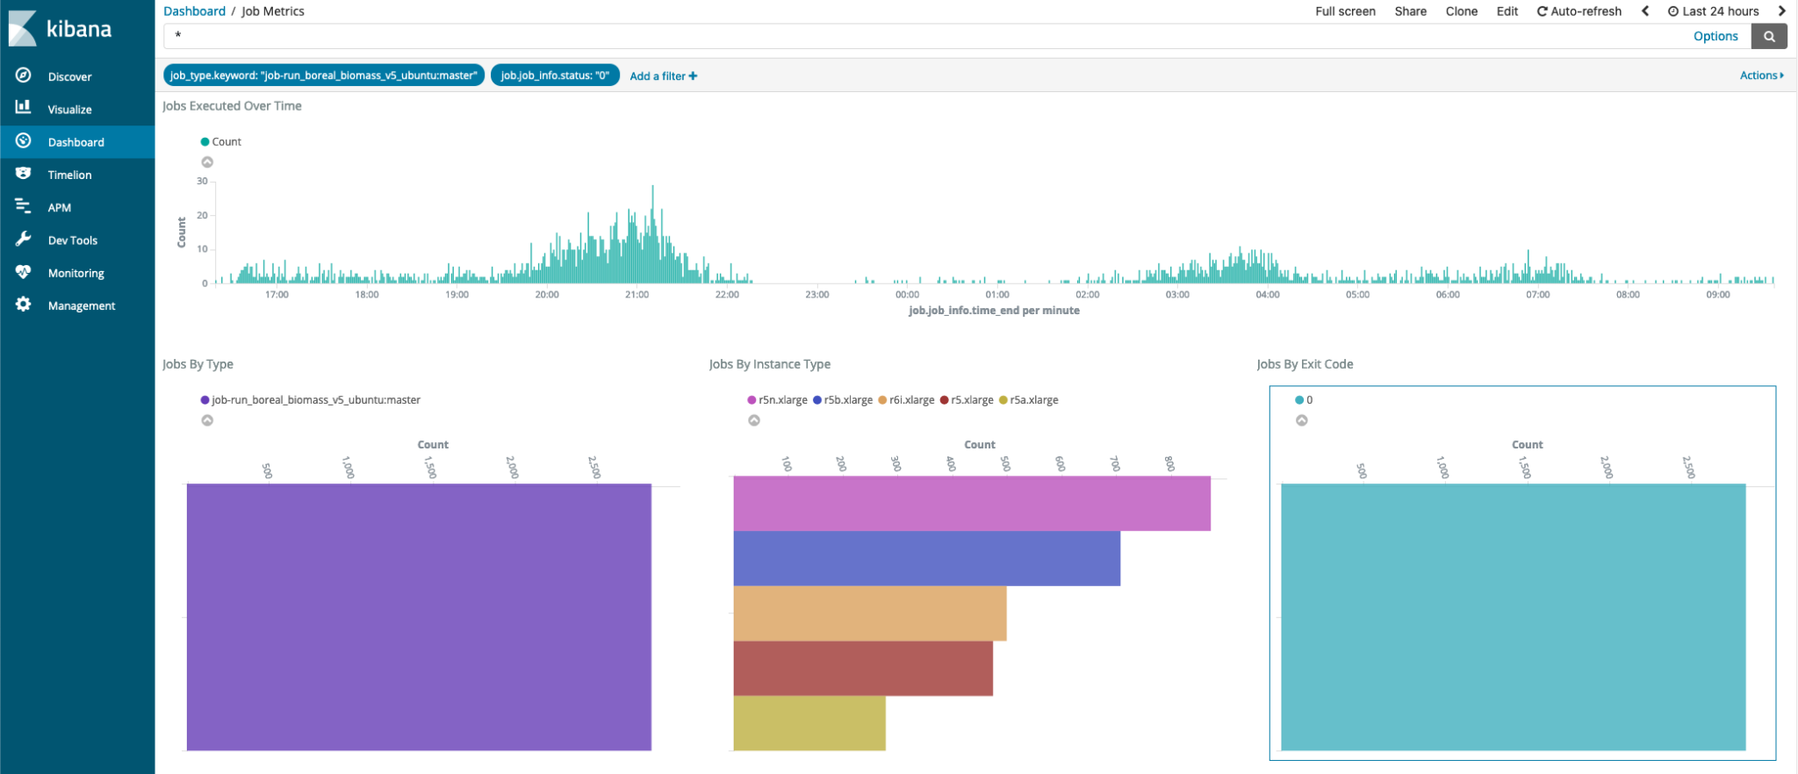
Enabling Large Scale Data Processing
Enable large scale analysis by leveraging the Data Processing Service (DPS) based on Hybrid-cloud Science Data System (HySDS) https://github.com/hysds
Key technologies:
Notes:
The Hybrid Cloud Science Data System, or HySDS is an open source science data system that can be used to process large amounts of science data products. It has been used across several NASA earth science missions to process large-scale data from L0 to L2/L3 science data products. Other missions using this same HySDS data processing service includes: NISAR, SWOT, OPERA, SMAP, and OCO-2 / OCO-3 reprocessing.

Slide 14
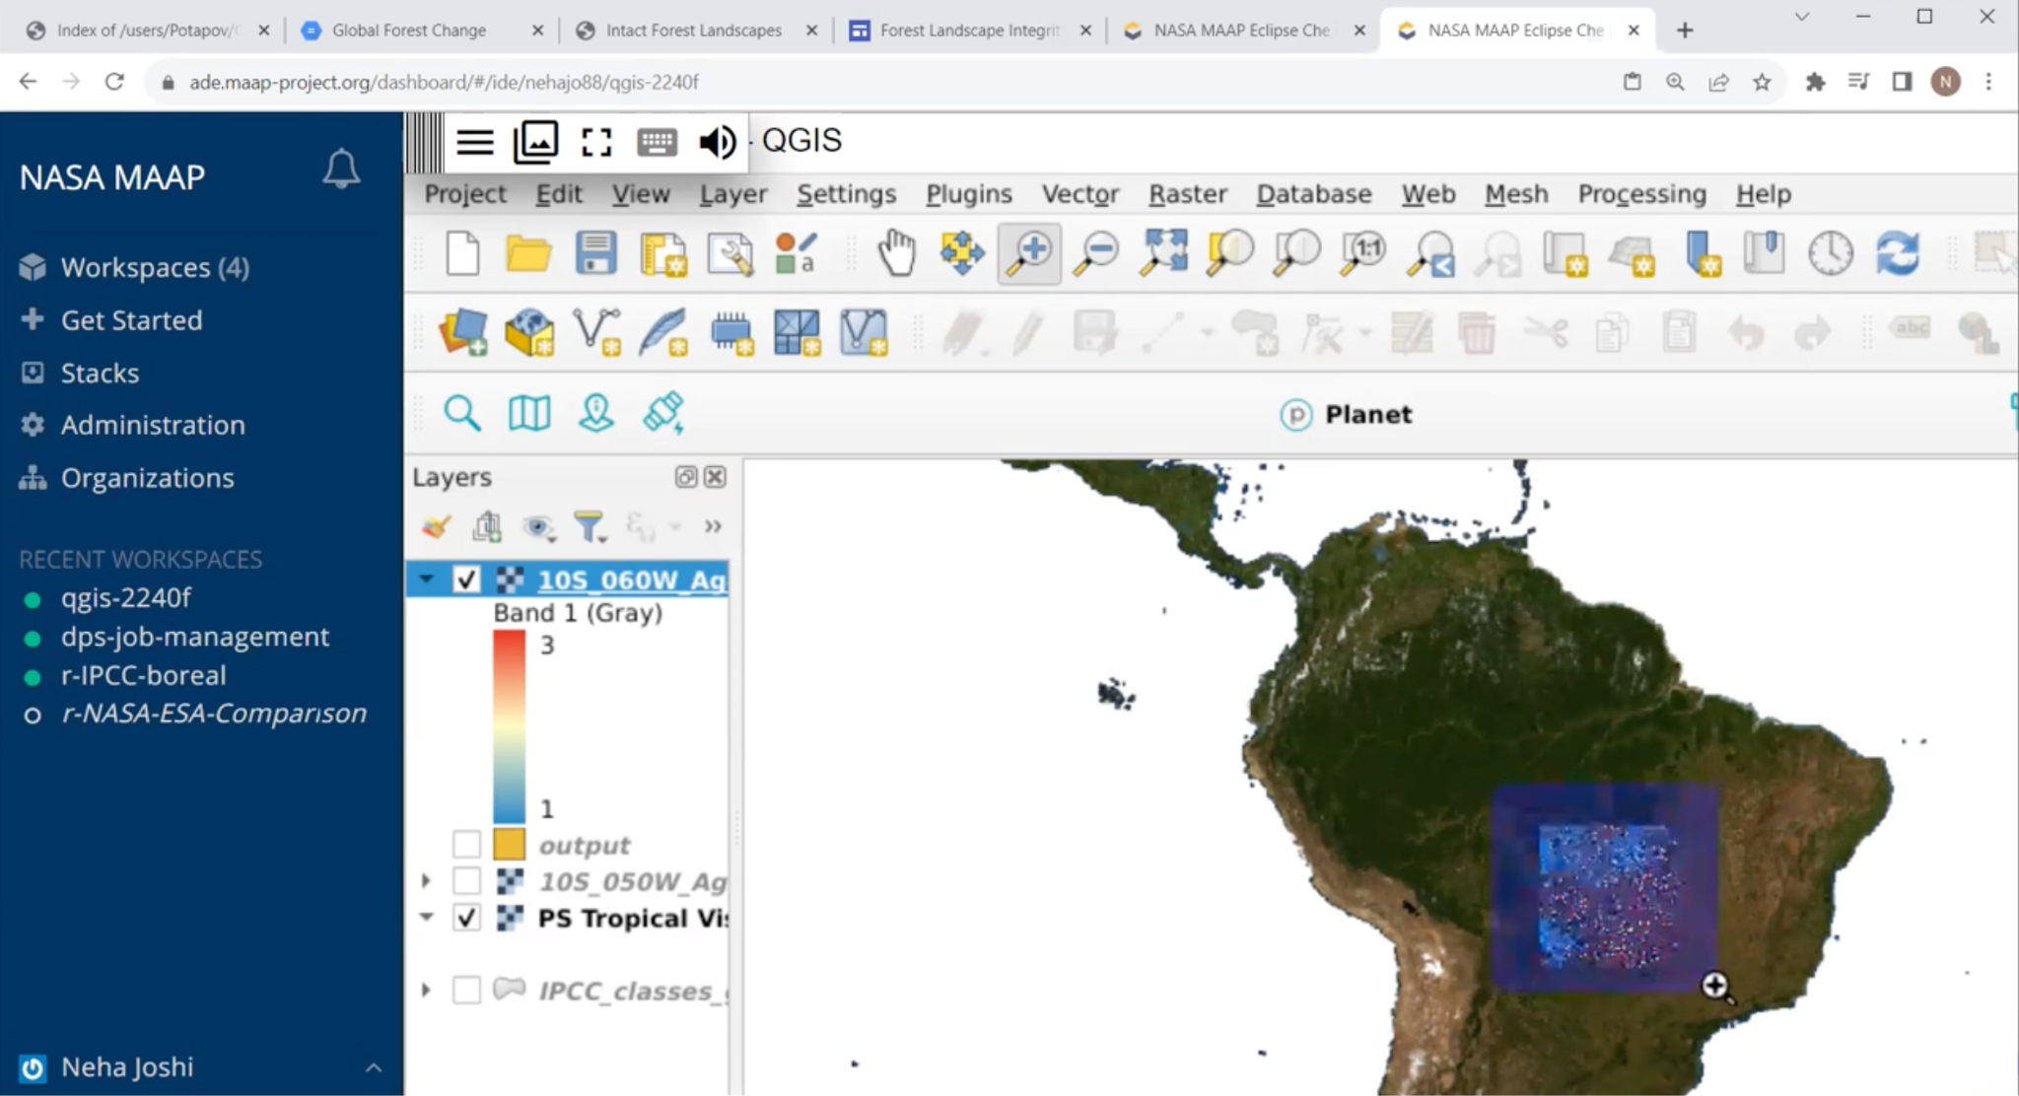
Large-Scale Processing Leads to Rapid Analysis
GIS integration
“It takes half a month to churn out their comparative performance on my laptop. On MAAP, it takes 2-3 hours - Fast science enables fast action.” – Neha Hunka
Notes:
This is the power of being able to bring equitable access to large scale compute adjacent to the data. We’ve seen this in other areas of NASA and it is something that individual scientists can leverage as well.
Compute improvements are half the story. Mt Edgecombe seismic storm - HyP3. Observed April 2022, paper published October 2022. Without the data adjacent compute removing the need to download? Still downloading in October 2022.

Slide 15
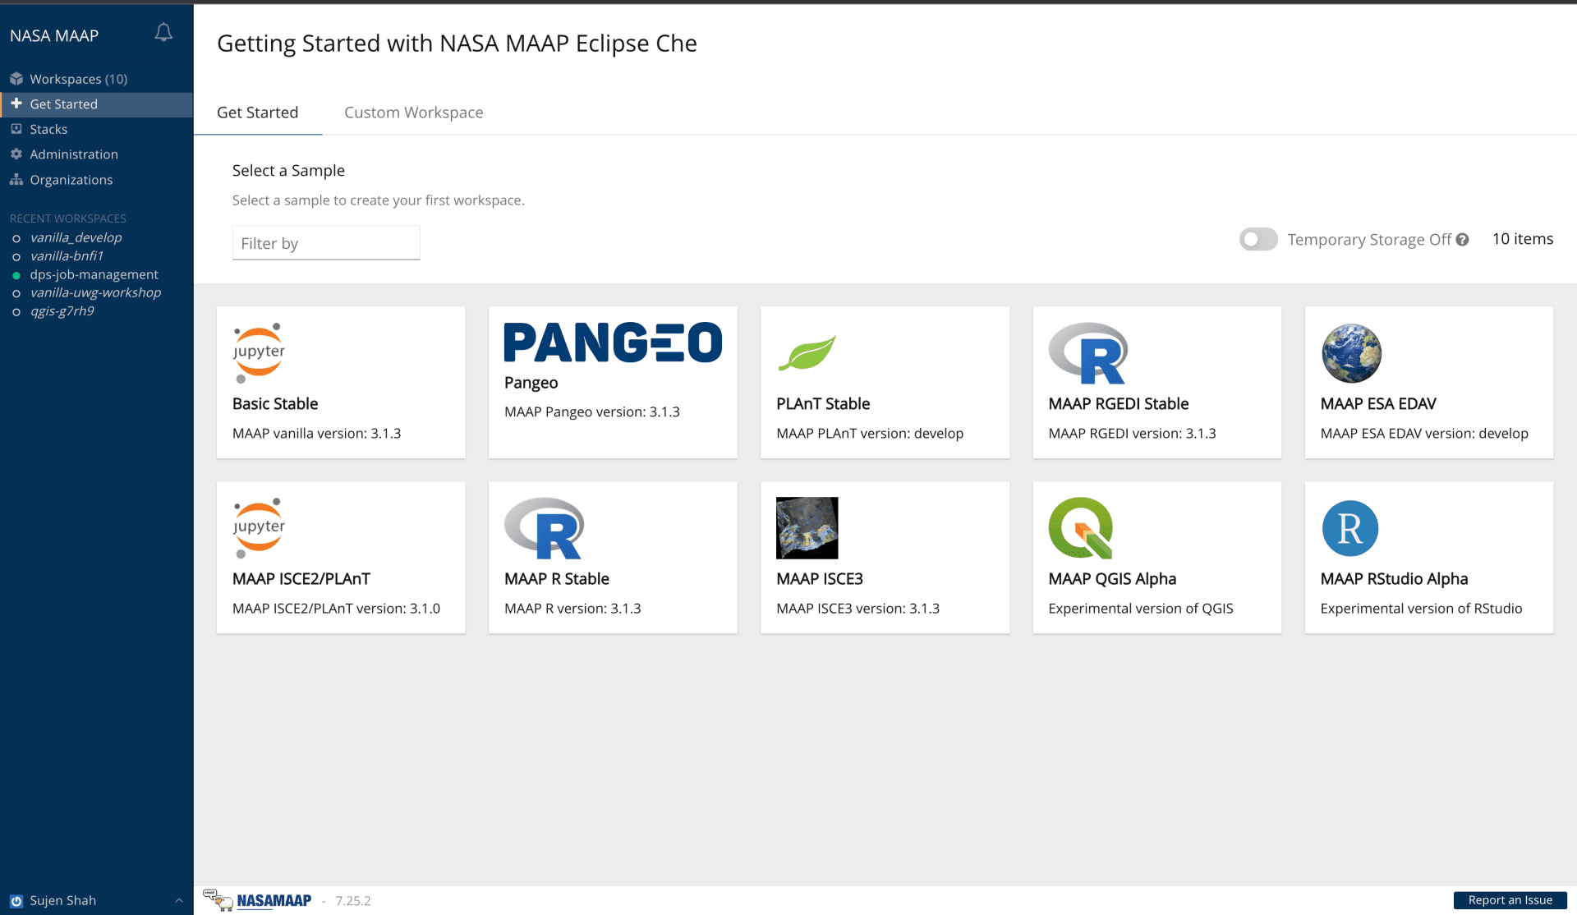
Collaboration
Collaborative work environments with interoperability and full access to the above.
Key technologies:
Notes:
Eclipse Che / Jupypter notebooks for collaborative development
Docker for portable algorithm deployment
Kubernetes for scalable execution of processing.
Open-source Kubernetes for broad platform for deployment (cloud, on-premises laptop)

Slide 16
Joint ESA-NASA MAAP Interoperability
Identity and Access Management
Data Access (S3/https)
Cloud-Optimized Data Format (COG)
Common metadata repository (CMR)
MAAP v0
Joint Code Repository
Process Invocation (OGC WPS)
Web Mapping (OGC WMTS & WMS)
Increasing Joint Interoperability
MAAP v1
Updated joint MAAP API
(focused more on expanding and maturing existing use cases, data collections, and services)
MAAP v2
Data Assets Metadata (STAC)
Interoperable Algorithm Runtime Format (OGC Application Packages)
Interoperable Algorithm Runtime Process Registration & Invocation (OGC WPS-T, ADES) → API Processes?
MAAP v3 + v4
Notes:
only on NASA MAAP v2
EPT support https://docs.google.com/presentation/d/1X16Ga7lzYJ52j_VTC-5J-PHd7Z1gjiiu8QNdjHKnoXg/edit#slide=id.g152c5422d81_0_1232
Features (not full OGC Features
GeoPackagre from GEDI Subsetting https://docs.google.com/presentation/d/1X16Ga7lzYJ52j_VTC-5J-PHd7Z1gjiiu8QNdjHKnoXg/edit#slide=id.g152c5422d81_0_1654

Slide 17
MAAP Science Products

Slide 18
Notes:
GEDI, deployed to the international space station, consequently leaves a large data gap in the northern forests. These forests are warming more than any others on the planet and research is needed to understand how climate change is affecting the northern carbon cycle. Using MAAP we are able to use ICESat2 data were used to fill this gap, creating the first lidar-based high resolution panboreal forest carbon map on three MAAP platform.

Slide 19
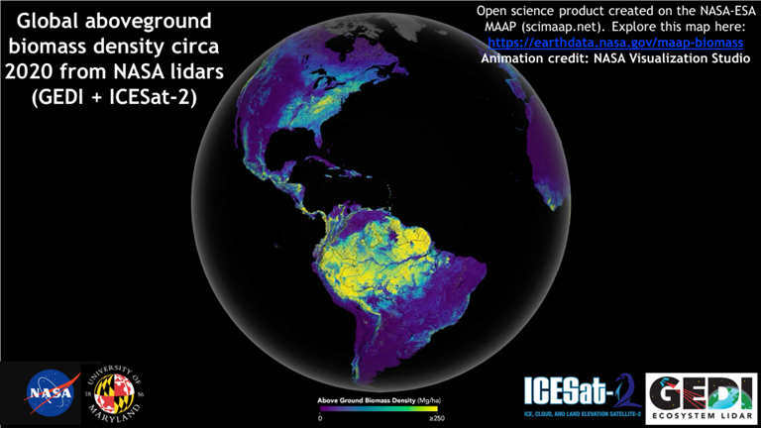
Notes:
This visualization shows global forest biomass for the year 2020 from a combination of the GEDI and ICESat2 missions. All of the code to create this product are freely available.

Slide 20
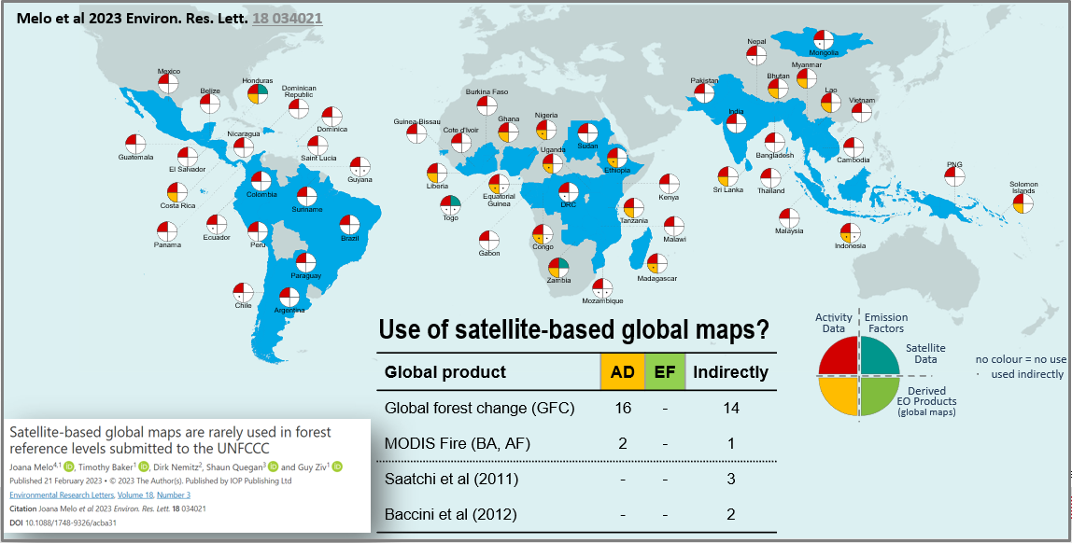
Example use case: Biomass Harmonization
Aiding UNFCCC processes by generating forest biomass estimates from space data directly for policy-level reporting. (Hunka et al. 2023)
Forest aboveground biomass maps are rarely being used in policy reports in the United Nations Framework Convention on Climate Change (UNFCCC)
Notes:
MAAP facilitates UNFCC processes by generating forest biomass estimates from space data. This can be used directly for policy-level reporting. Above ground biomass maps are rarely used in policy reports, the fulfillment of this use case will hopefully change that situation.

Slide 21
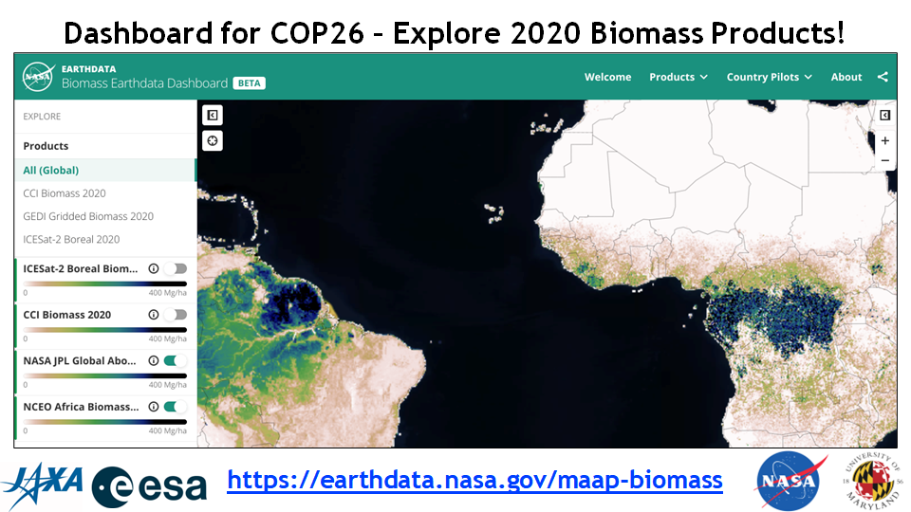
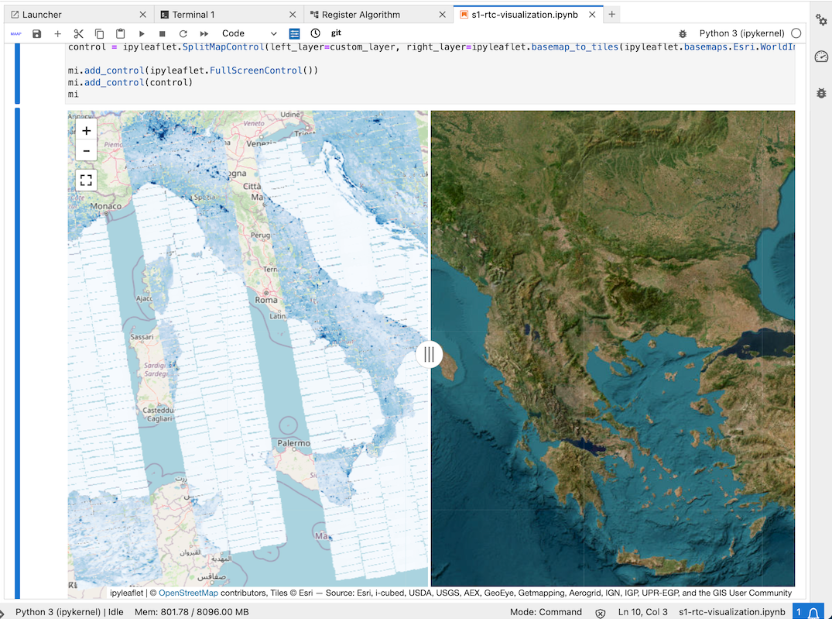
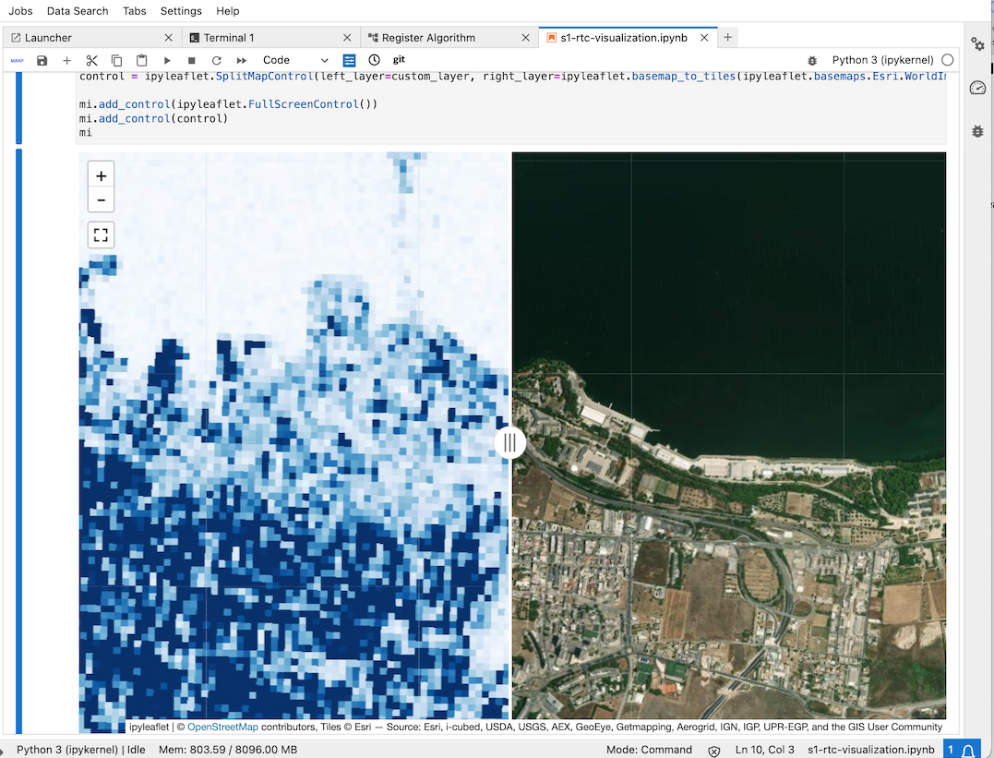
MAAP UWG: Rapid, On-Platform Visualization
961 Sentinel-1 SLC bursts processed via the ISCE3-GCOV workflow on MAAP.
Visualized on the MAAP platform within minutes, at full resolution.
Sentinel-1 datasets courtesy of ESA
Notes:
As part of the biomass harmonization activity, a dashboard was created for easy visualization of MAAP data products by both creators and users alike.

Slide 22
Notes:
The MAAP provides a platform for working with many different international users on science and communication; this is an example of comparing the ESA CCI and NASA GEDI biomass maps in Japan, where researchers from NASA, ESA and JAXA are collaborating to improve maps.

Slide 23
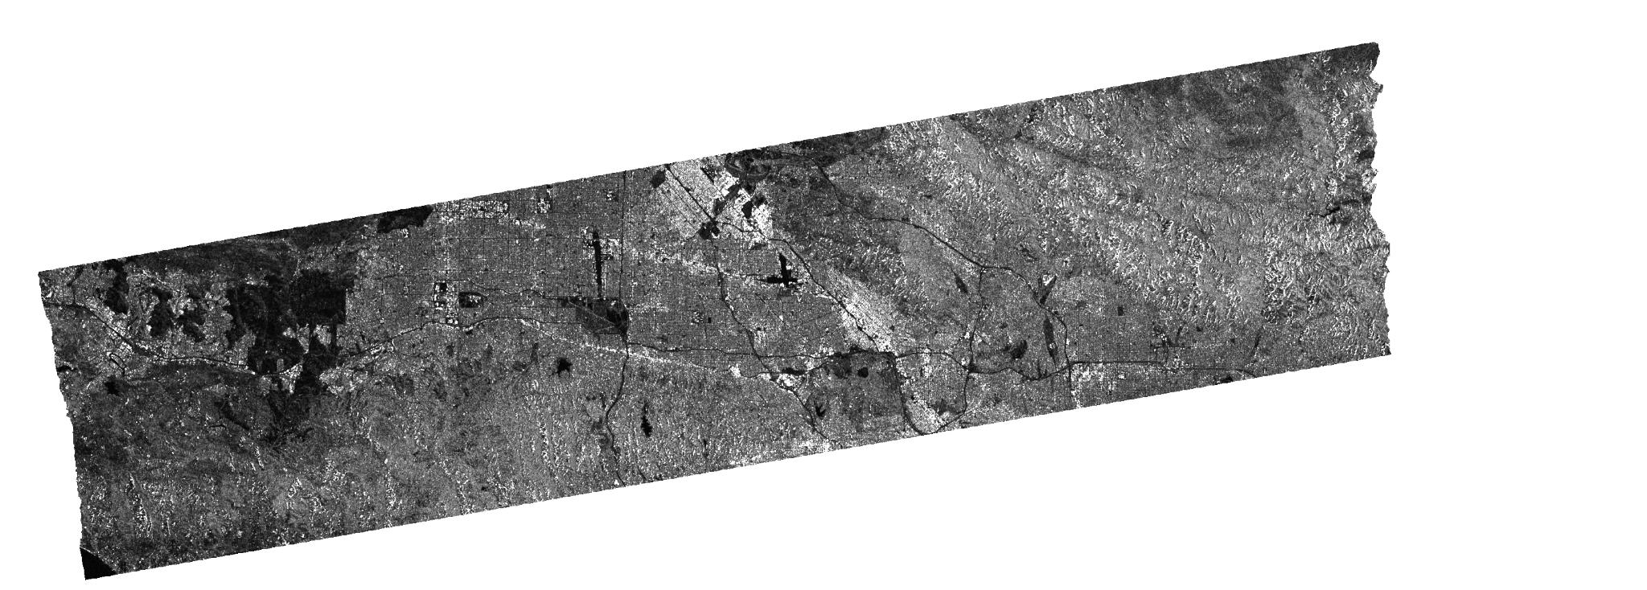
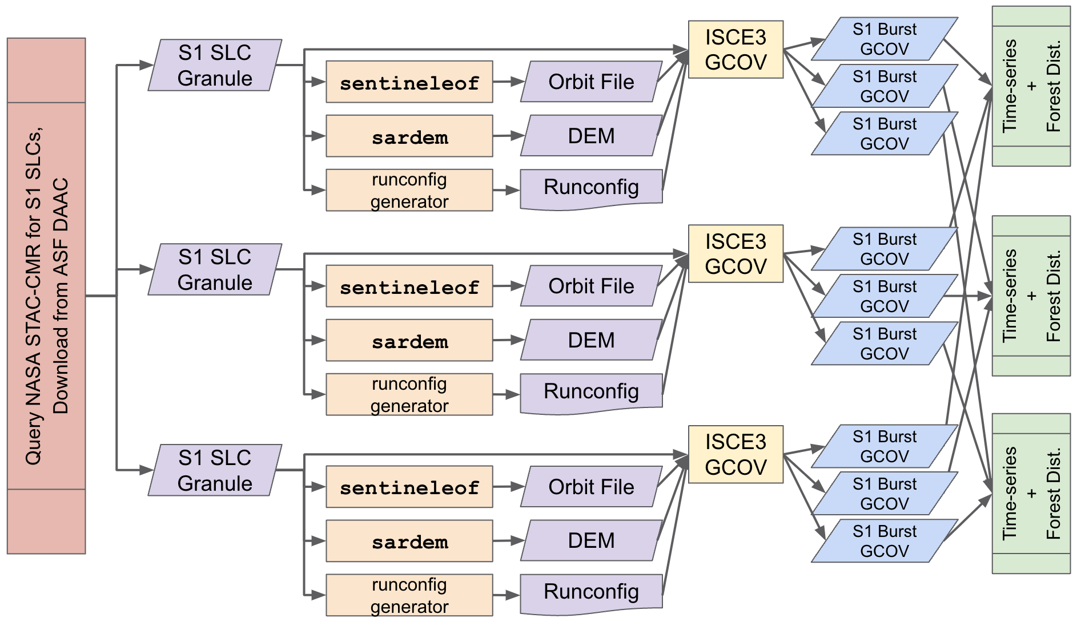
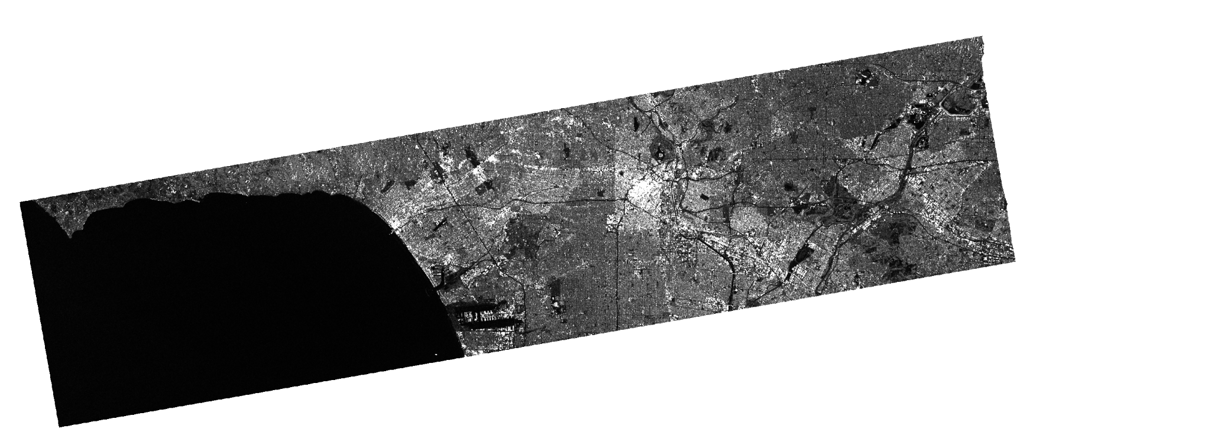
MAAP UWG: Sentinel-1 Disturbance Product
Example Image Processing Pipeline on MAAP
Sentinel-1 SLC bursts processed via the ISCE3-GCOV workflow on MAAP
With guidance from G. Shiroma and S. Staniewicz
Sentinel-1 datasets courtesy of ESA
Notes:
Here is an example of Sentinel-1 SLC bursts processed via the ISCE3-GCOV workflow on MAAP.

Slide 24
Conclusion

Slide 25
Key Takeaways
The MAAP platform provides a collaborative data-exploration and algorithm-development environment, paired with highly-scalable parallel-processing system.
MAAP started as a joint ESA-NASA collaboration, but has demonstrated novel approaches to interoperable and integrative algorithm development, to scalable processing, to analysis, and data exploration.
“The MAAP is enabling global collaboration for policy-relevant open-science” in biomass harmonization.
NASA Earth science missions, such as NISAR, require large-scale science analysis capabilities from L1-L3 data.
“Fast science enables fast action.” – Neha Hunka
Notes:
Discover, develop, process, visualize, analyze, iterate.
Interoperable at the agency level
Enabling global collaboration for policy-level open science (biomass harmonization)
It will become more vital with the advent of NISAR
Fast science…

Slide 26
Near-term
MAAP → Visualization, Exploration, and Data Analysis (VEDA)
includes Earthdata GIS
Increasing Joint Interoperability
STAC integration with algorithms, processing, and CMR-STAC
Getting ready for NISAR and BIOMASS mission data
Expanding beyond biomass
Looking Ahead
Integrative approaches for algorithm development to processing to analysis
Managed Services architectures
e.g. Mission Data Processing Services (MDPS)
Interests in hybrid approaches (on-premises and cloud) to lower costs
Notes:
Near term
Incorporating VEDA and Earthdata GIS for visualization and integration with ESRI ecosystem
STAC
NISAR
Biomass was our initial proof-of-concept. We can expand now that has been achieved.
Future
Is integrative a real word? Yes! ‘serving or intending to unify separate things.’
Managed services - the hidden bonus of cloud providers
Hybrid. Cloud doesn’t always translate to lower costs, our primary rationales are collaboration and equal access.

Slide 27
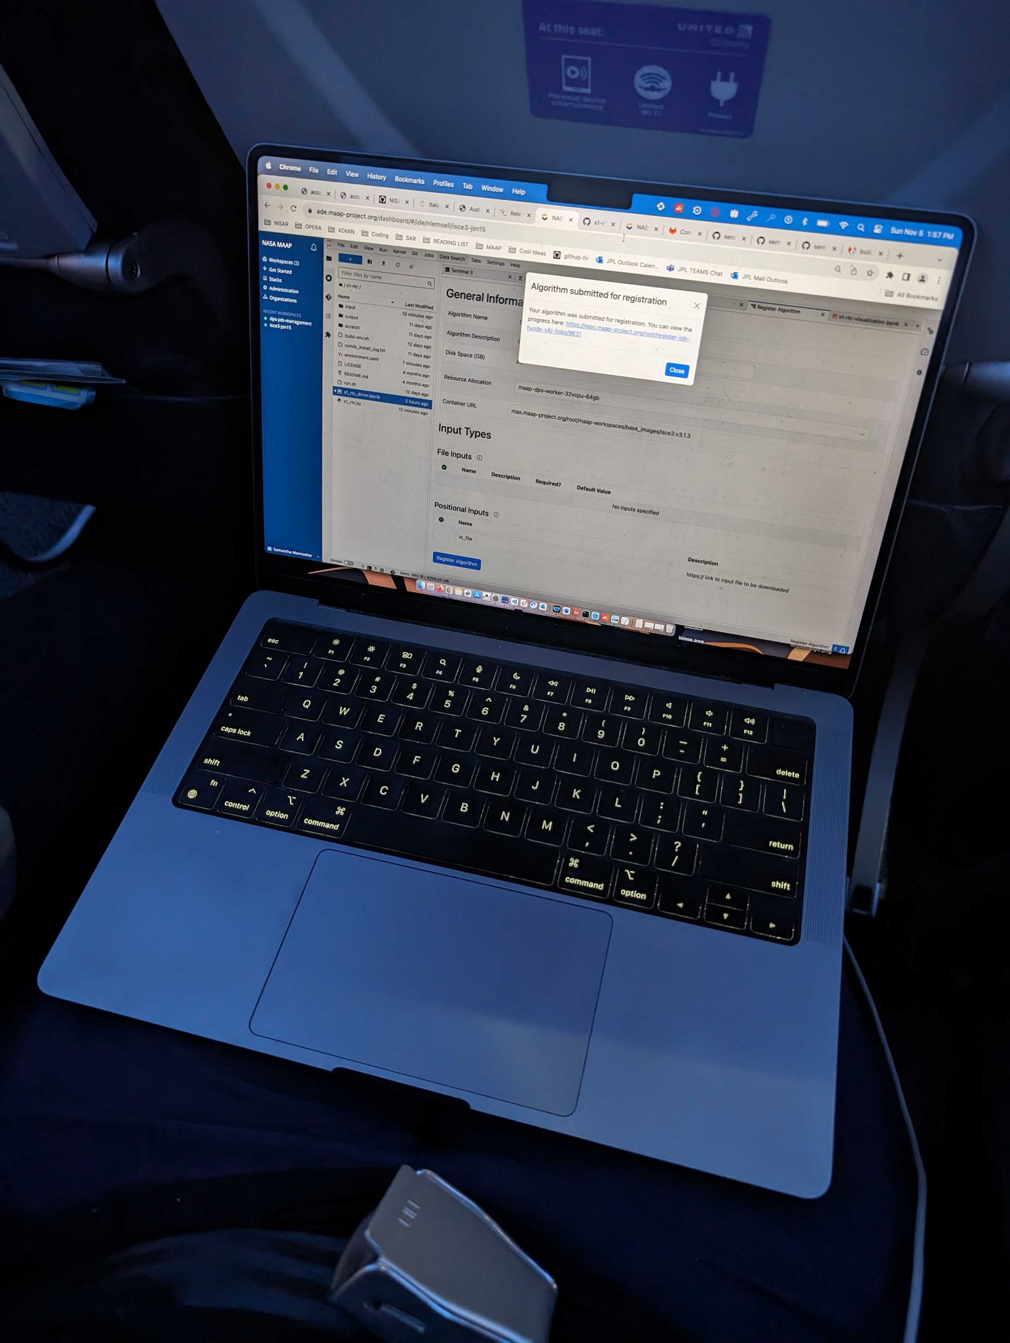
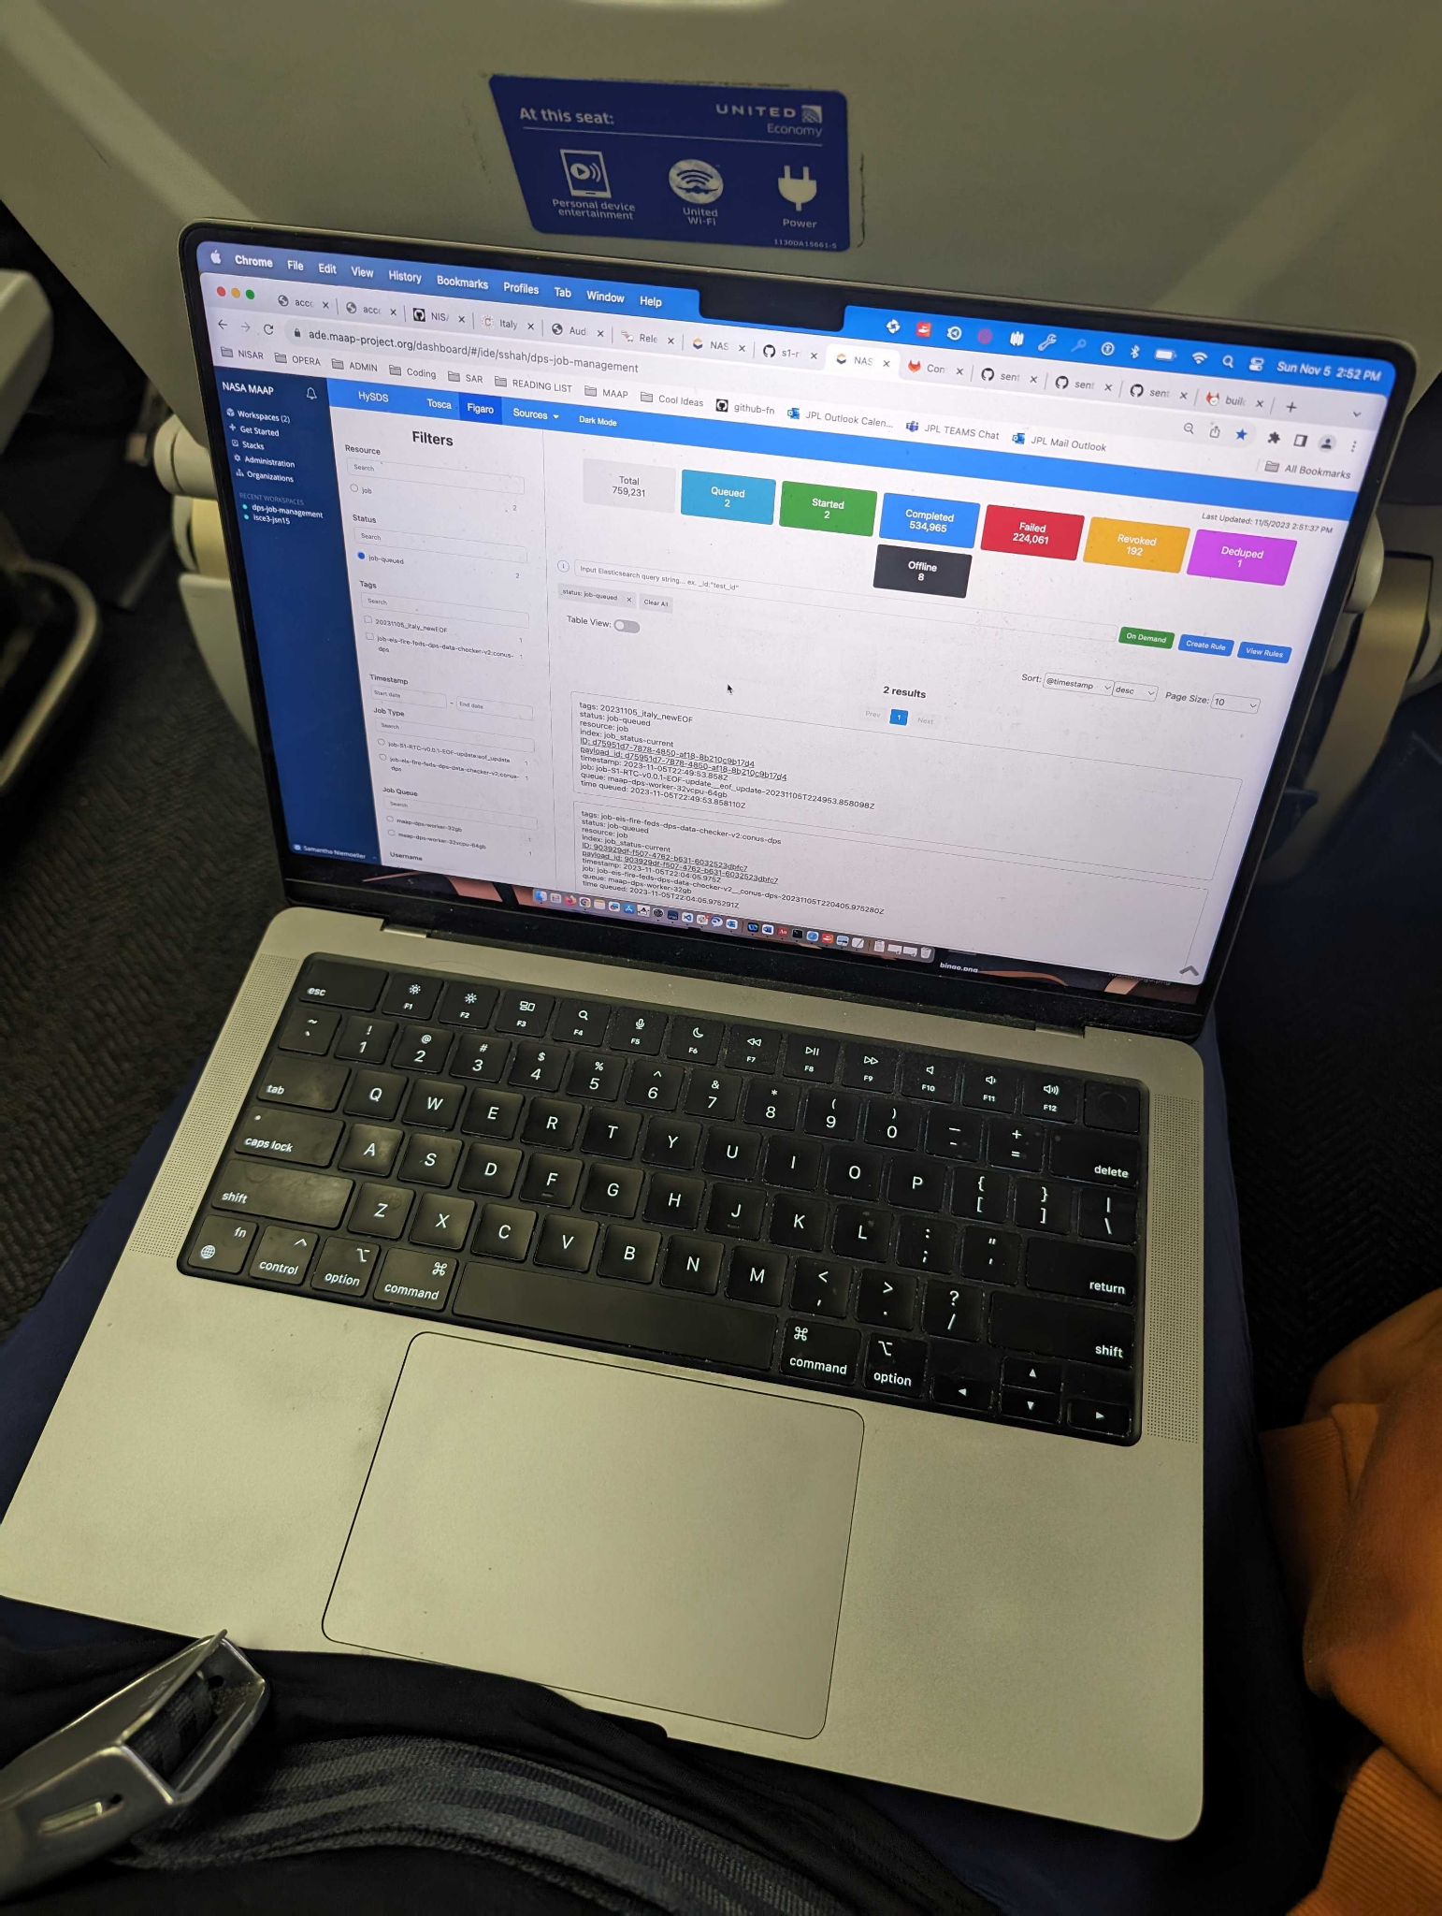
MAAP v3 in use in-flight at 39,000ft
Sentinel-1 Disturbance Algorithm Registration
Control of HySDS Data Processing Running in AWS Cloud
Source: Sam Niemoeller (JPL)
Notes:
Now we are just showing off!

