Slide 1
Knowledge Graphs and FedEO
Yves Coene (Spacebel for ESA), Mattia Stipa (ESA)
CEOS WGISS #57, Sydney (Australia)
Session 5: Interoperability, 05/03/2024

Slide 2
Outline
Introduction
RDF Knowledge Graphs
GraphQL

Slide 3
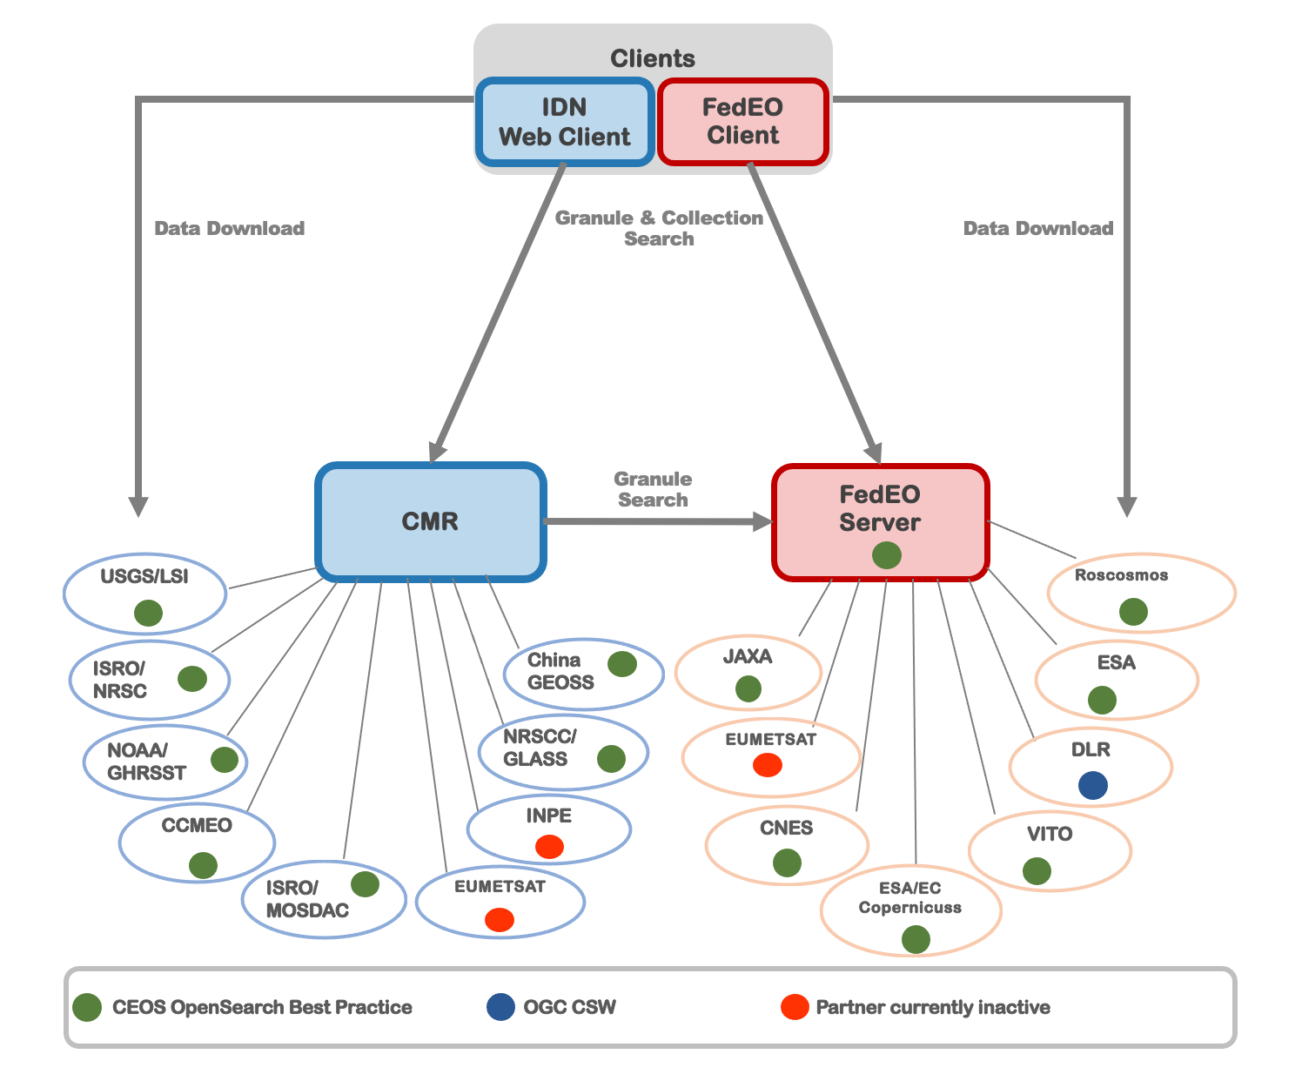
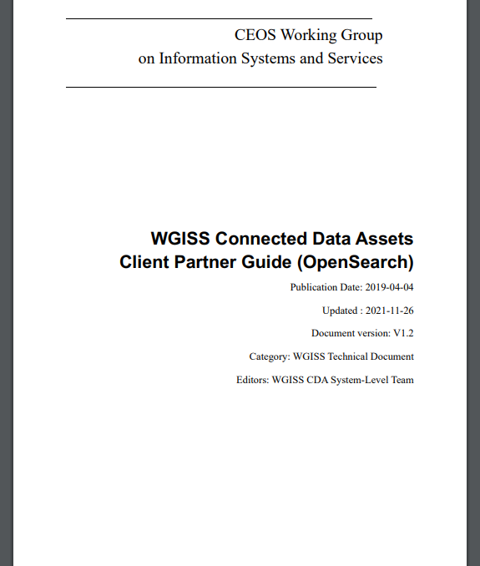
Introduction
FedEO: part of WGISS Connected Data Assets

Slide 4
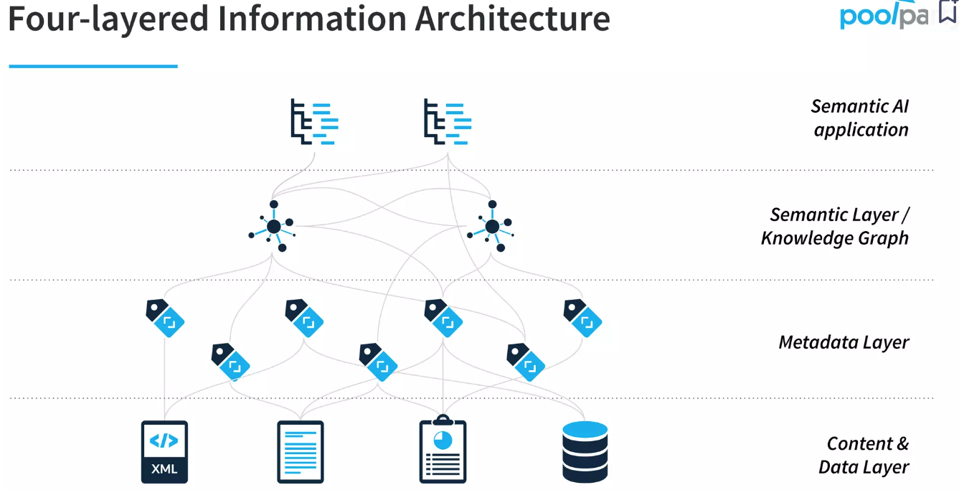
Introduction
Research projects related to Knowledge Graphs (KG) in the context of FedEO
Considered by some as rebranding of the Semantic Web**
EOVOC and E-MC projects supported by BELSPO: exploring RDF Graphs and GraphQL
Aim to provide Semantic Layer/Knowledge Graph on top of FedEO metadata layer as per below 4-layer model*.
Sources: * https://www.slideshare.net/semwebcompany/introduction-to-knowledge-graphs-and-semantic-ai, ** https://www.zdnet.com/article/rebooting-ai-deep-learning-meet-knowledge-graphs/

Slide 5
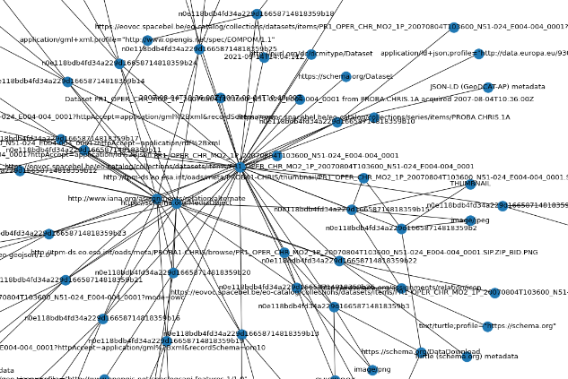
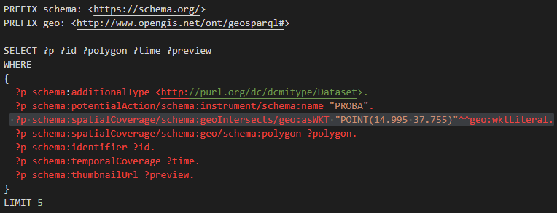
RDF Knowledge Graphs
FedEO supports RDF Knowledge Graph representations for its resources
Part of Linked Open Data cloud (triples)
All resources identified by URI
Linked Data (RDF/XML, Turtle, JSON-LD)
(Geo)SPARQL interface (subset), LDP
FedEO Knowledge Graph(s) use
GeoDCAT-AP vocabularies/properties
Schema.org vocabulary
External interconnections:
ESA Thesaurus (SKOS)
GCMD (SKOS)
DBpedia, Yago, INSPIRE, OGC, DOI, …

Slide 6
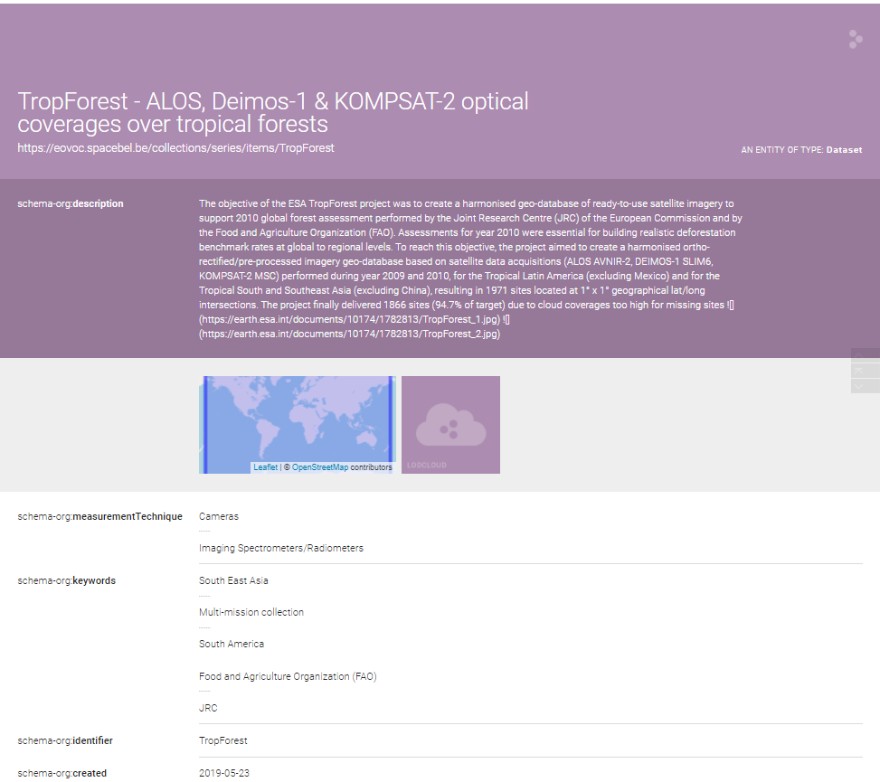
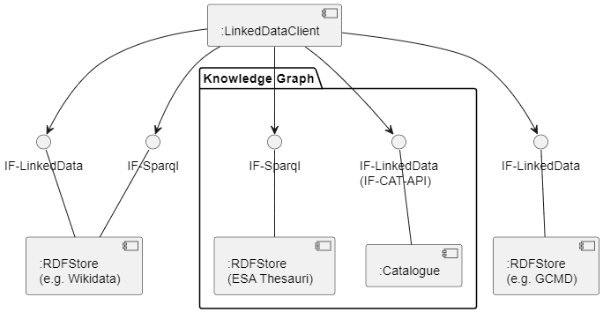
RDF Knowledge Graphs
Linked Data Clients (e.g. LodView) access FedEO as Linked Data (RDF/XML+Schema.org):
Collections, granules, services (interlinked)
ESA SKOS thesauri: platform, instrument, earth topics
Also URI for organisations, languages, …

Slide 7
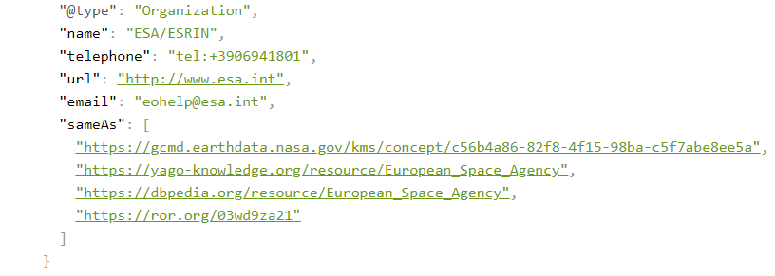
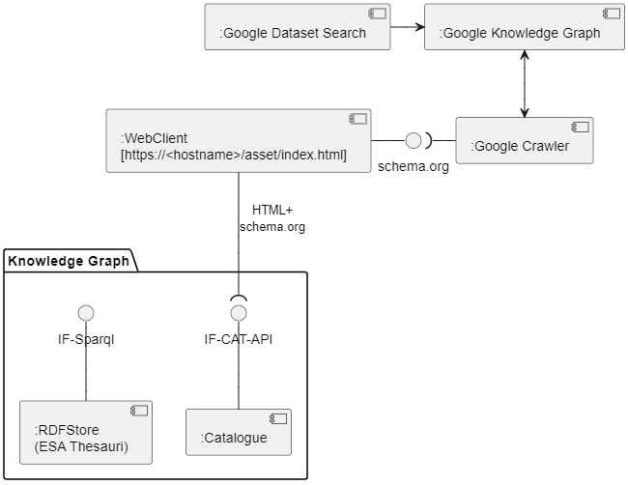
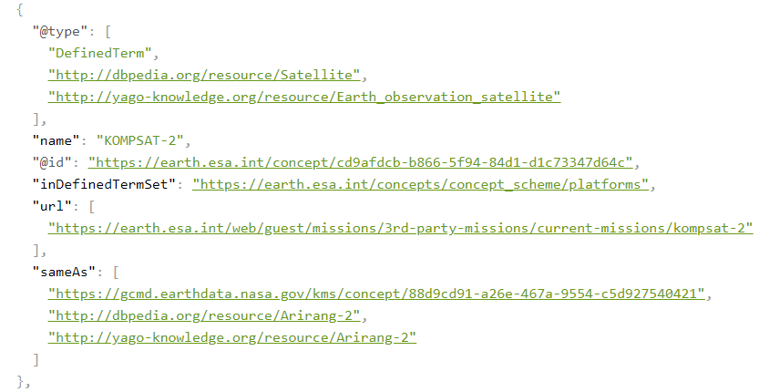
RDF Knowledge Graphs
FedEO “feeds” search engine’s (e.g. Google) Knowledge Graph
Via “Structured data”: JSON-LD representation of RDF (schema.org)
EO resource encoding with schema.org documented at https://github.com/eovoc/eo-on-schema.org
Notes:
https://fedeo.ceos.org/collections/series/items/TropForest?httpAccept=application/ld%2Bjson;profile=%22https://schema.org%22

Slide 8
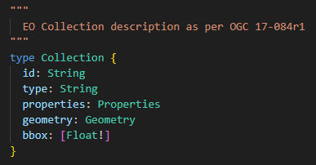
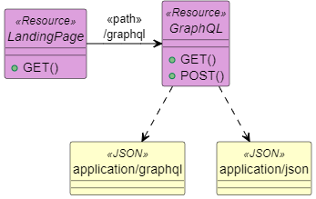
GraphQL
Originated @Facebook (2012)
Example APIs:
GitHub, DataCite
Schema Definition Language (SDL)
Defines request and response structures
GraphQL over HTTP
/graphql endpoint GET with application/json responses
/graphql POST application/graphql
Supports “introspection”, i.e. is self-describing.

Slide 9
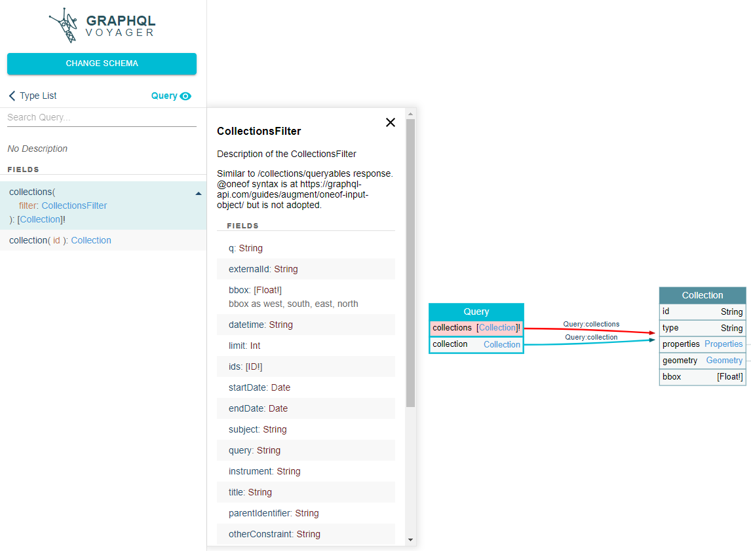
GraphQL
Only interoperable if same model is used for interface with Schema Definition Language (SDL)
E.g. Response model based on OGC 17-084r1, schema.org, STAC, …
E.g. Query model as per OpenSearch, STAC API, …
Example 1: OGC 17-084r1 as response model for GraphQL, Query based on OpenSearch / API Features interface

Slide 10
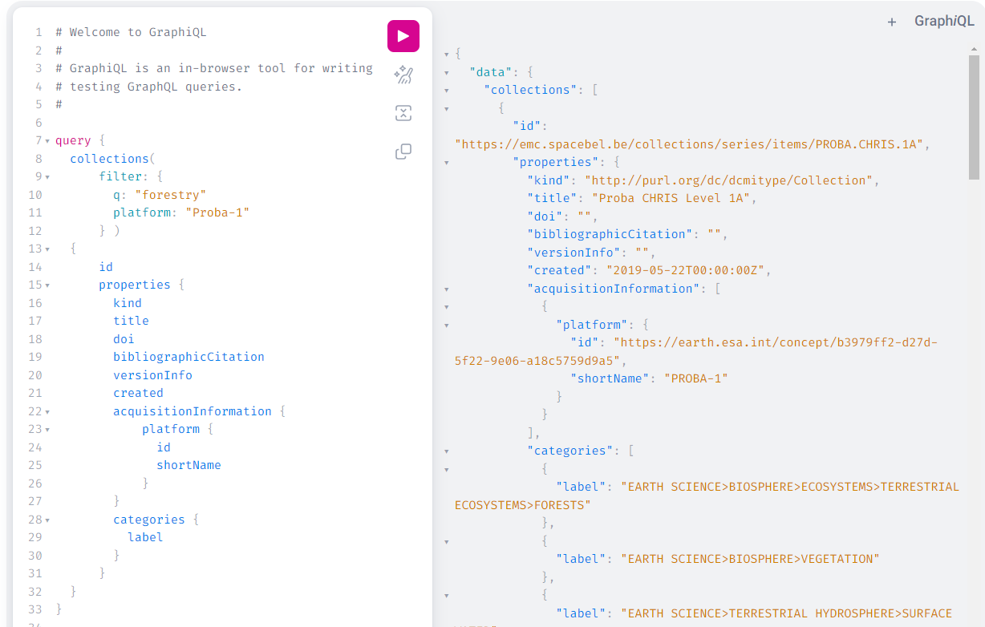
GraphQL
Example GraphQL response
Enter GraphQL query with context sensitive help
OGC 17-084r1 encoding requested limited to subset of fields
Response can be very compact: only what client needs

Slide 11
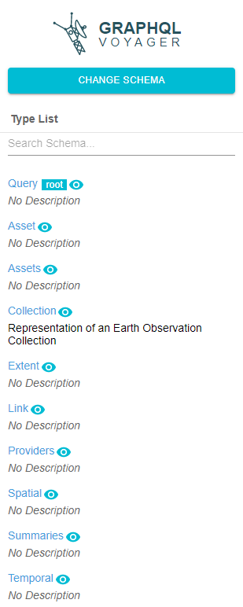
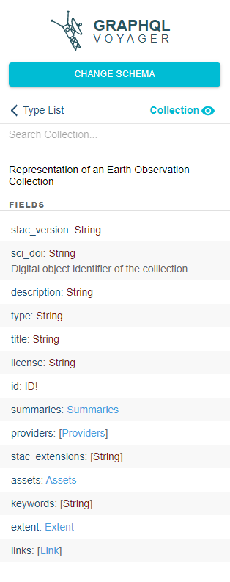
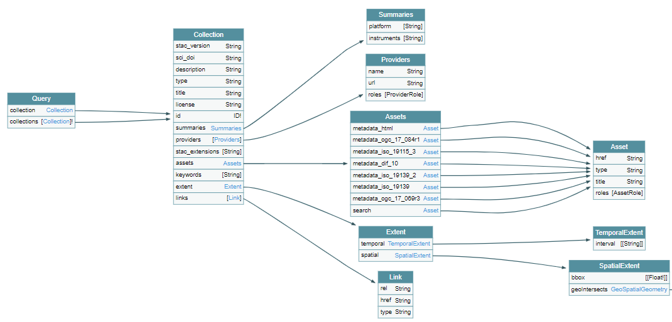
GraphQL
Example 2: STAC as response model for GraphQL

Slide 12
Conclusion
Knowledge Graph features being explored in FedEO-related activities
RDF (Semantic Web, Linked Data)
GraphQL
Implementations require further work.
RDF/SPARQL and GraphQL not sufficient to achieve interoperability
Same (RDF) vocabularies to be used to express relations/properties.
Same SDL schemas (GraphQL) to be used.

Slide 14
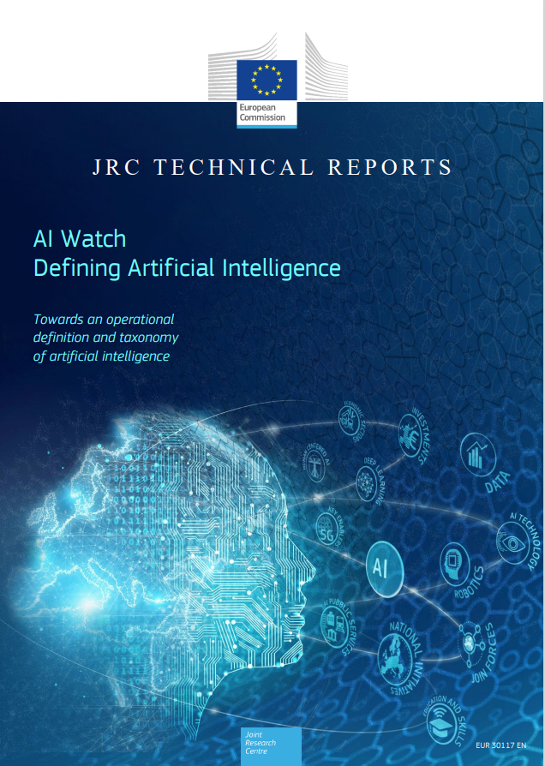
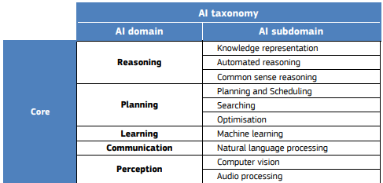
SPARE
Source: https://publications.jrc.ec.europa.eu/repository/bitstream/JRC118163/jrc118163_ai_watch._defining_artificial_intelligence_1.pdf

