Slide 1
WGISS-57
Cloud Native Geospatial and Interoperability
Alex Leith, Auspatious
Agenda Item 6.7
WGISS-57
4-7 March 2023
Sydney, Australia

Slide 2
What is the talk about
I’m Alex Leith and I have around 5 years experience in EO
My background is geospatial, but I have spent a lot of time supporting open source software and open data
I worked on the development of STAC specifications that are required to load data efficiently, which were adopted by E-84, MSPC, USGS and others
This talk is about how open standards and specifications enable interoperability with a focus on data consumption. (Architecture and Interface, from the framework)

Slide 3
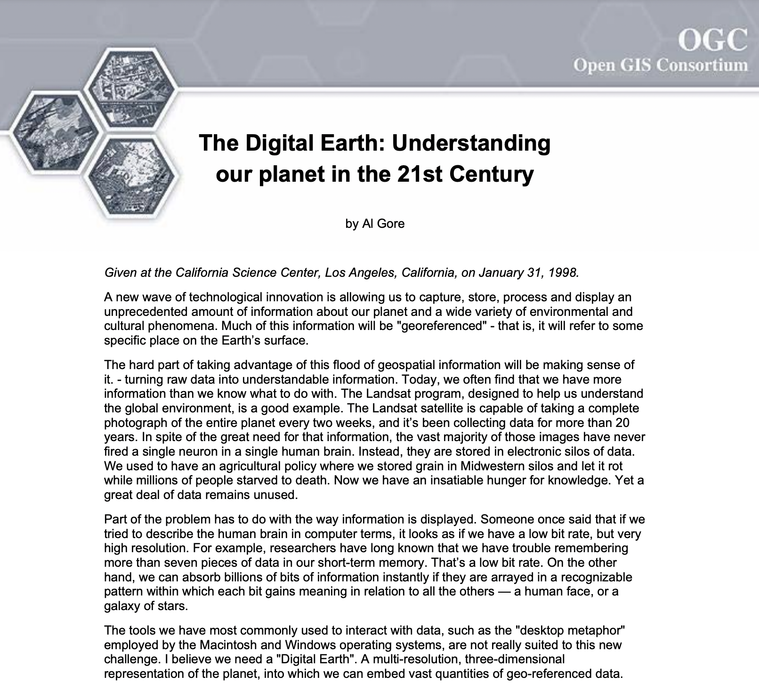
The Digital Earth
“We have an unparalleled opportunity to turn a flood of raw data into understandable information about our society and our planet.”
“In the first stage, we should focus on integrating the data from multiple sources that we already have.”
“In the long run, we should seek to put the full range of data about our planet and our history at our fingertips.”
- Al Gore, 1998

Slide 4
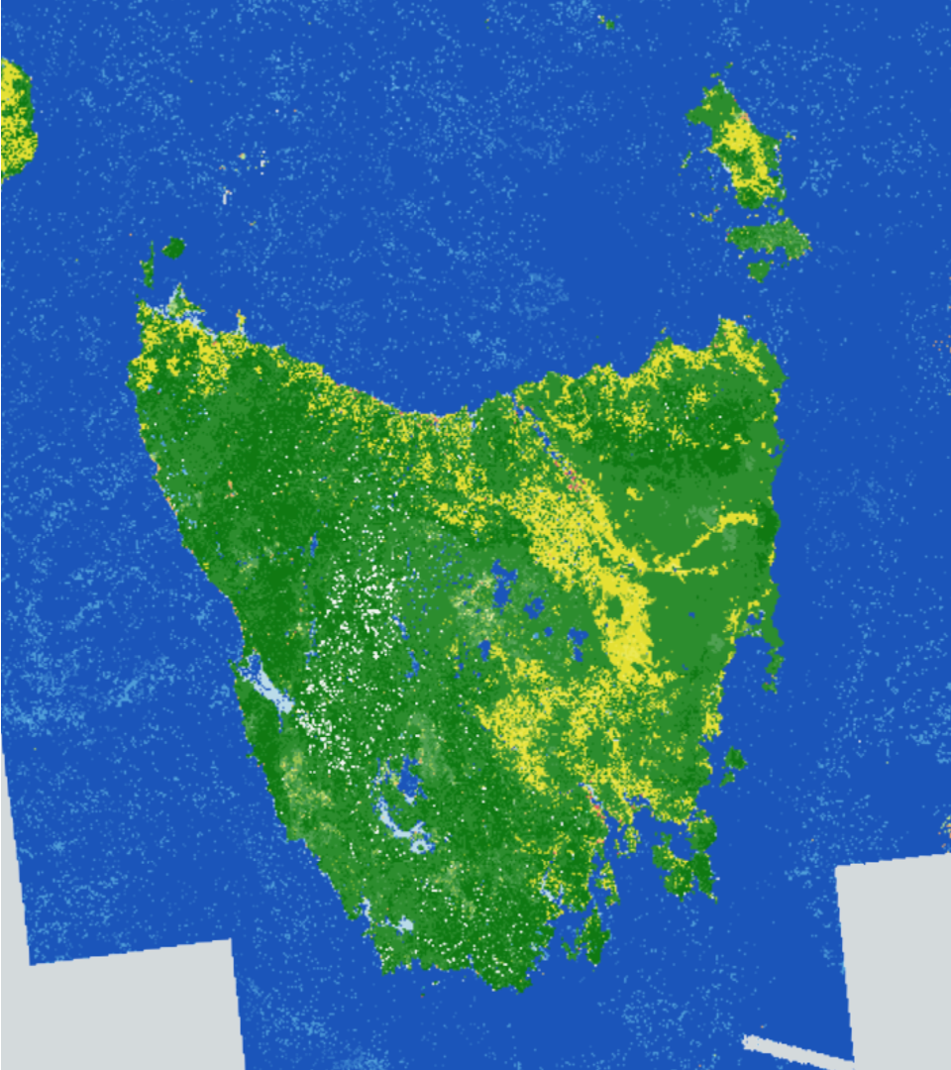
Digital Earth Australia (2010)
Funded by the Australian Government
Australia used to be a downlink for Landsat
Raw data was stored on tapes
Data eventually was digitized in Unlocking the Landsat Archive project
The Australian Geoscience Data Cube (AGDC) was developed
It was improved and renamed to “the Open Data Cube”
Today Digital Earth Australia supports government and industry by making EO data accessible

Slide 5
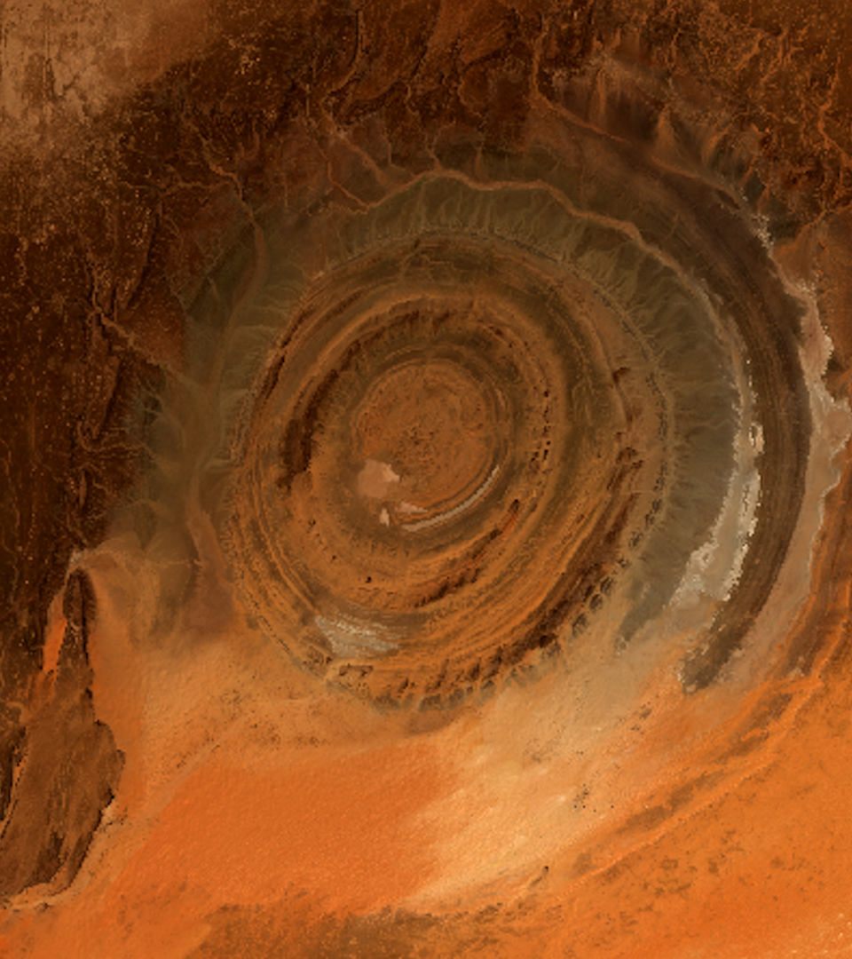
Digital Earth Africa (2020)
Funded by US-based Philanthropic organization and Australian Government
Broad goals around making data more easily accessible across the African continent
The mission
DE Africa will process openly accessible and freely available data to produce decision-ready products. Working closely with the AfriGEO community, DE Africa will be responsive to the information needs, challenges and priorities of the African continent. DE Africa will leverage and build on existing capacity to enable the use of Earth observations to address key challenges across the continent.

Slide 6
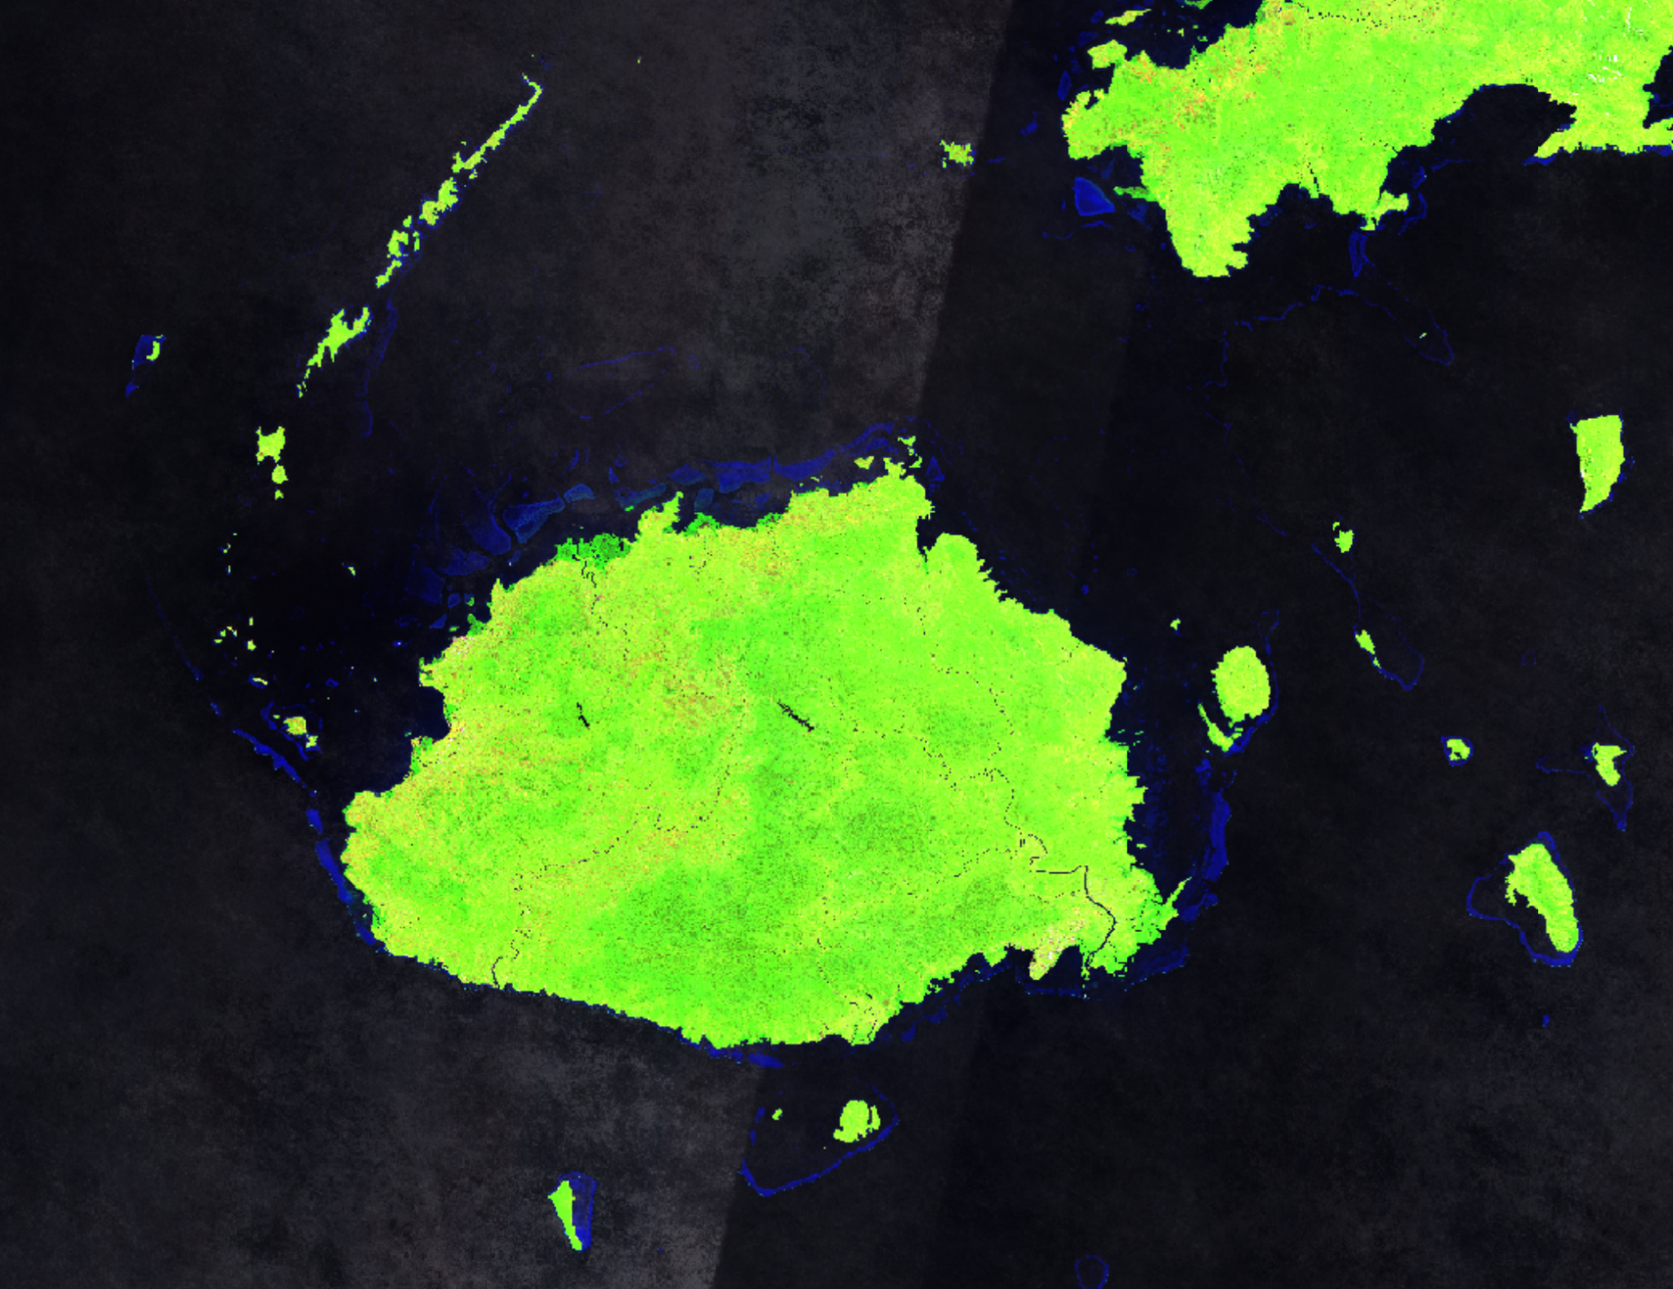
Digital Earth Pacific (2023)
Empower more people from the Pacific to access and analyse data. Chart a course towards a culture of scientific collaboration that is self-sustaining and meaningful.
Simplify access to Earth and Ocean Observation data. Deliver a technology infrastructure that enables people to access, visualise and analyse data.
Deliver new products specific to the needs of the Pacific. Research and develop new and adapt existing derived data products and deliver them routinely and reliably.

Slide 7
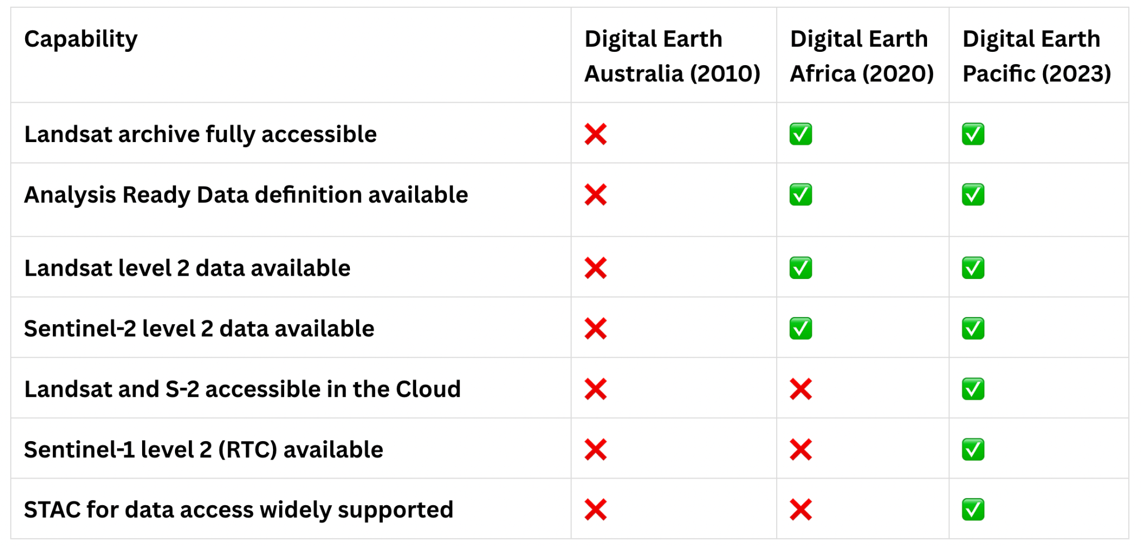
What capabilities were available

Slide 8
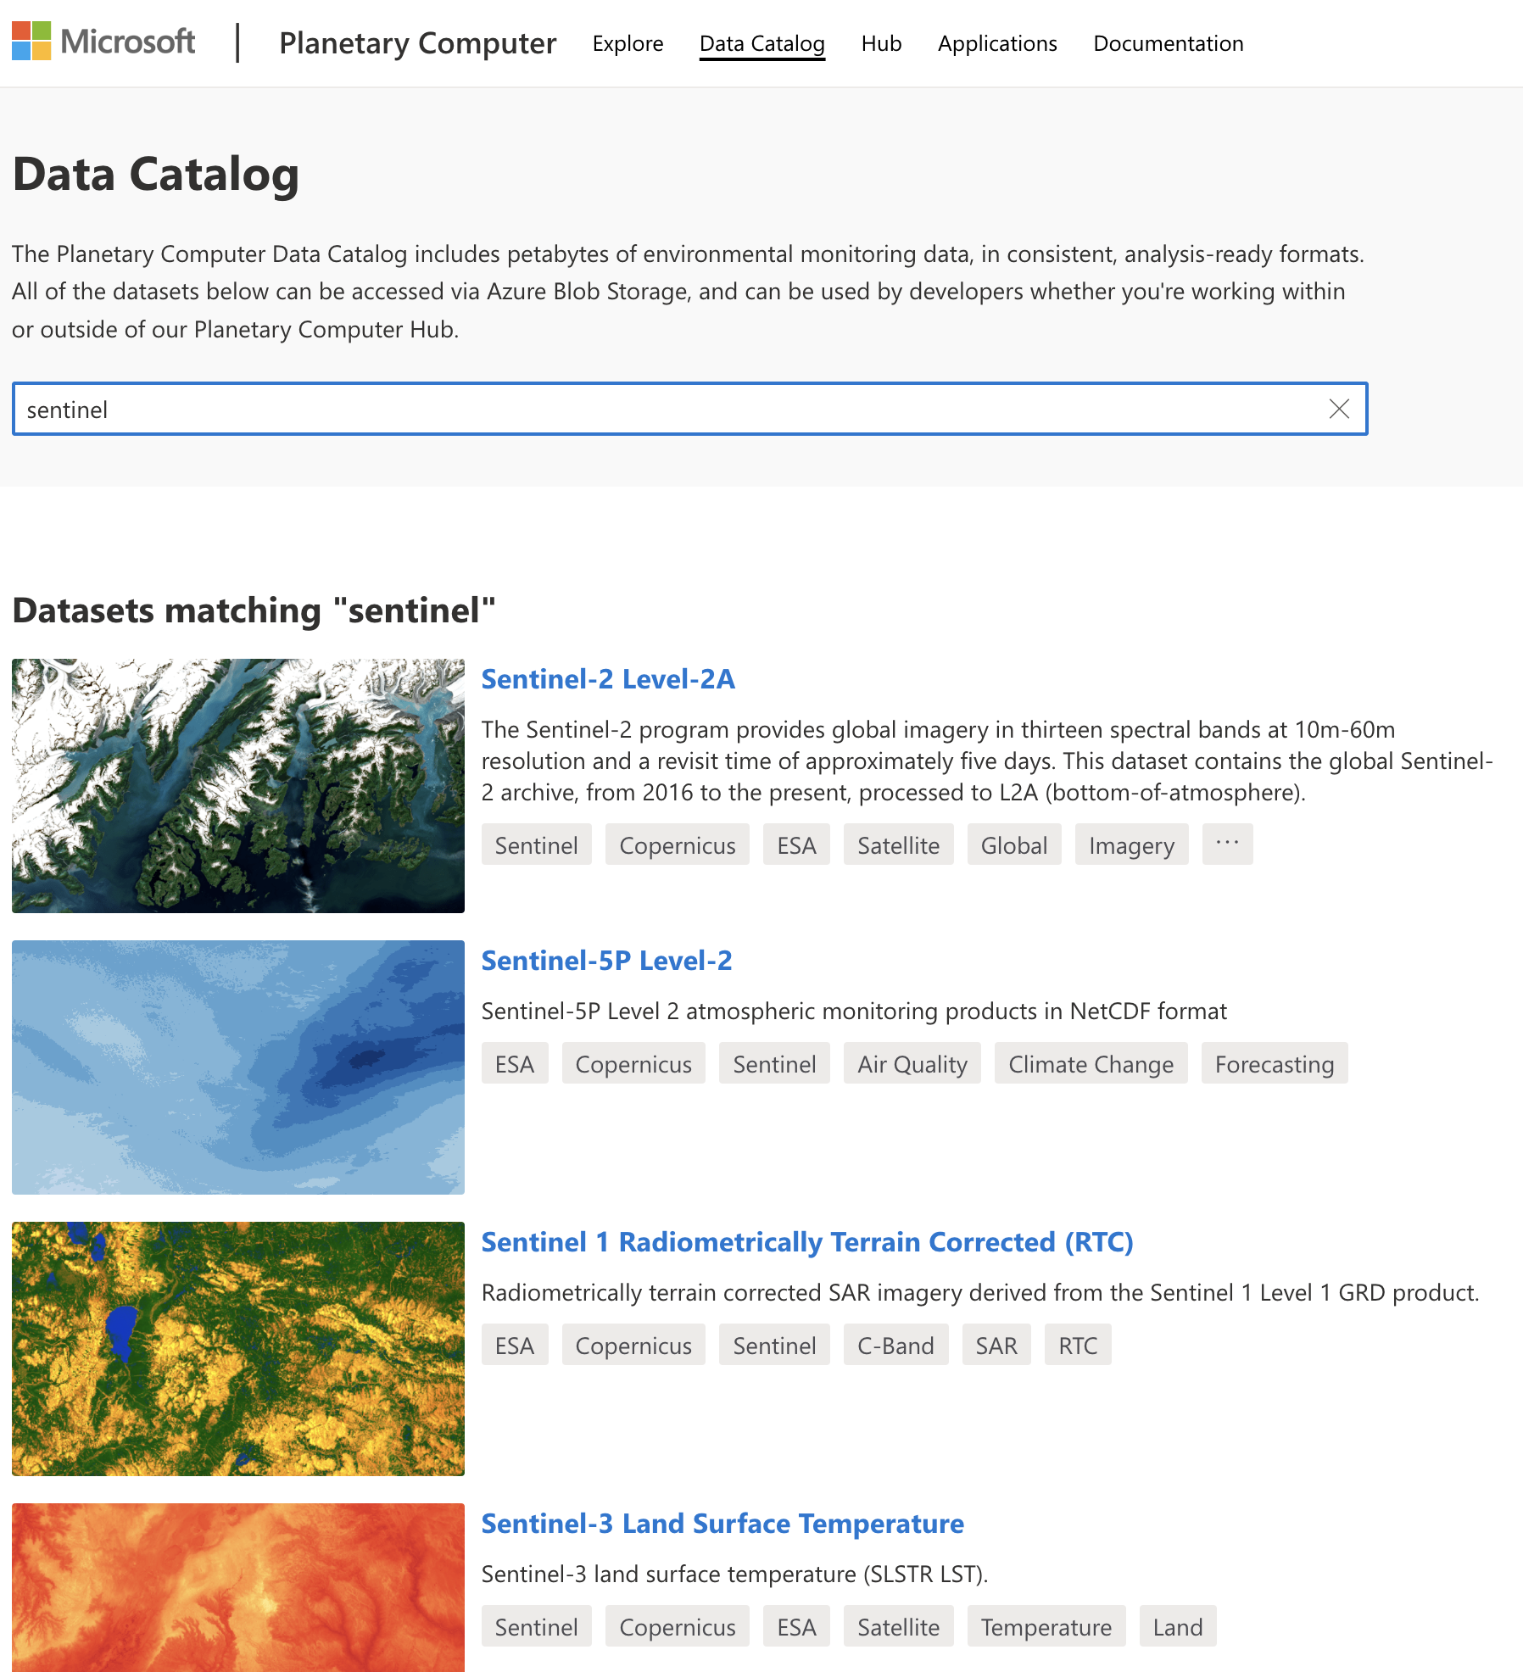
The Present Future of Digital Earth Platforms
Global analysis ready data is accessible with low to no barriers
Petabytes of open data, including:
Landsat 4, 5, 7, 8 and 9 from early 80s to yesterday
Sentinel-2 (A and B) from 2016 to yesterday
Sentinel-1 (A and not B any more) from 2014 to yesterday
New commercial satellites practically every week!

Slide 9
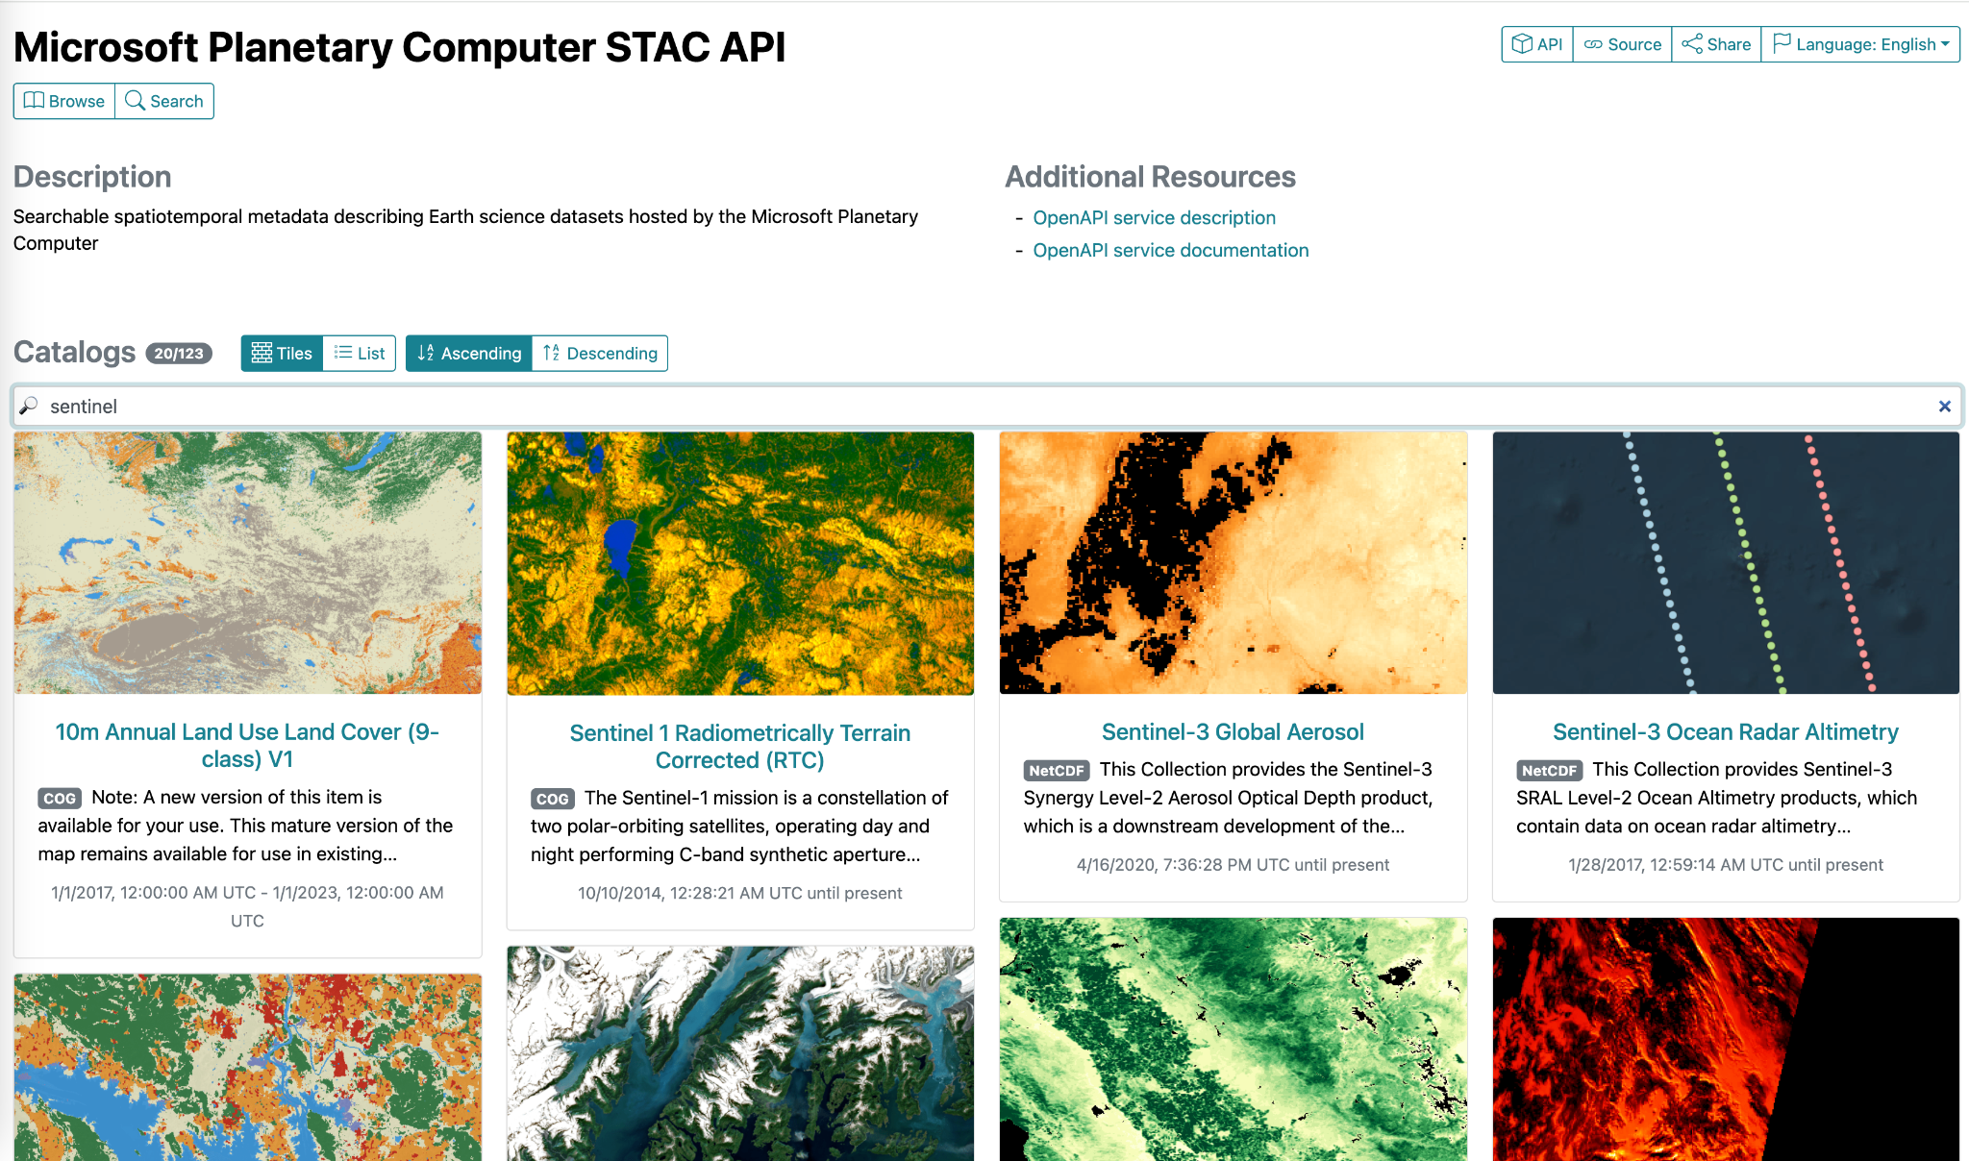
Radiant Earth’s STAC Browser

Slide 10
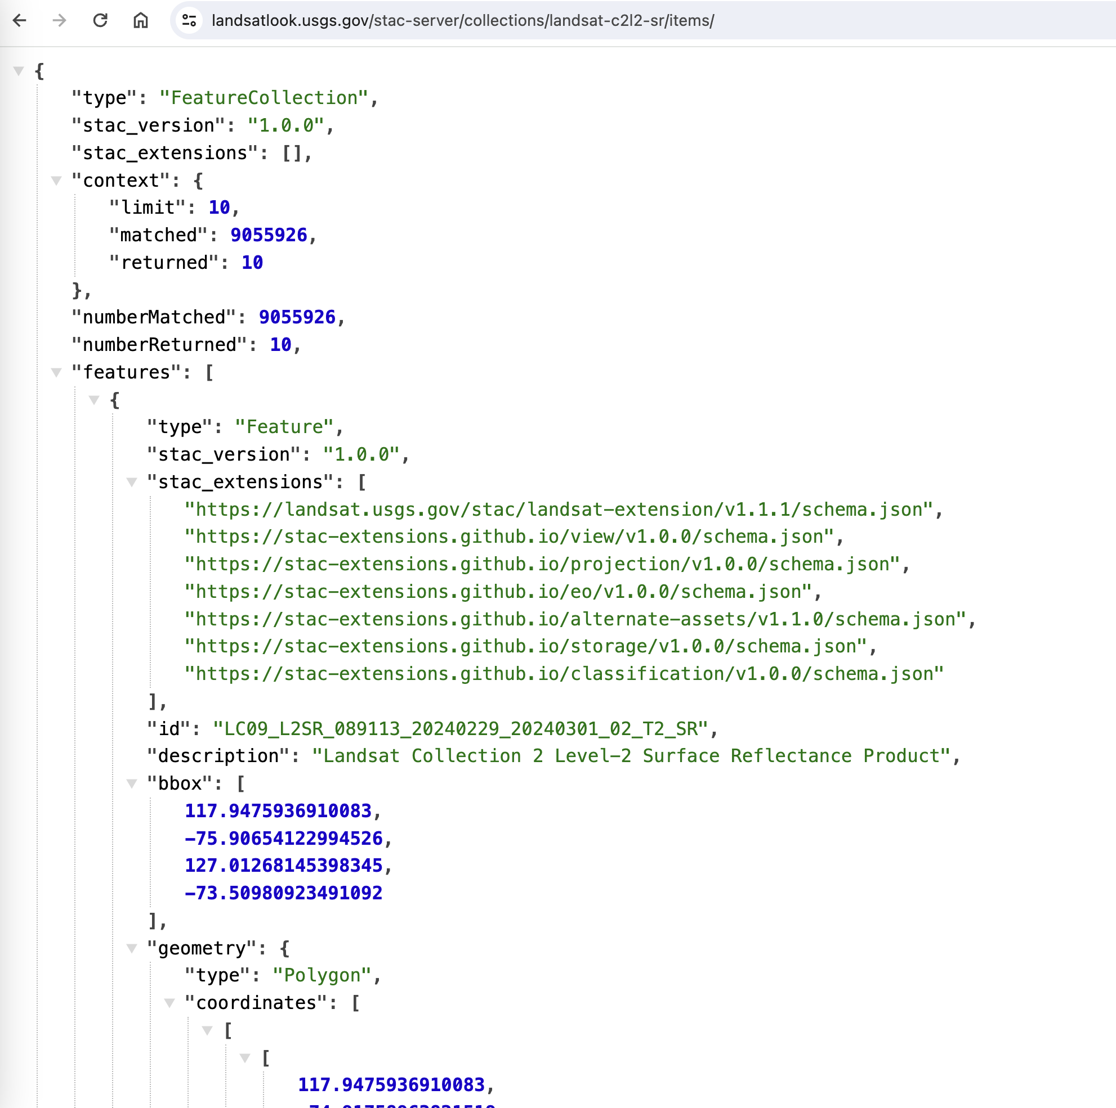
What is STAC?
STAC Catalog
A list of Catalogs or Collections
STAC Collection
A product, like Landsat C2 L2 SR
Contains Items
STAC Item
A single space/time/thing, like a single Landsat scene. Contains Assets, i.e., links to a .tif file
STAC Asset:
a link to a resource. Can be on a Collection or an Item
STAC API
A REST API that contains a searchable interface for Collections and Items

Slide 11
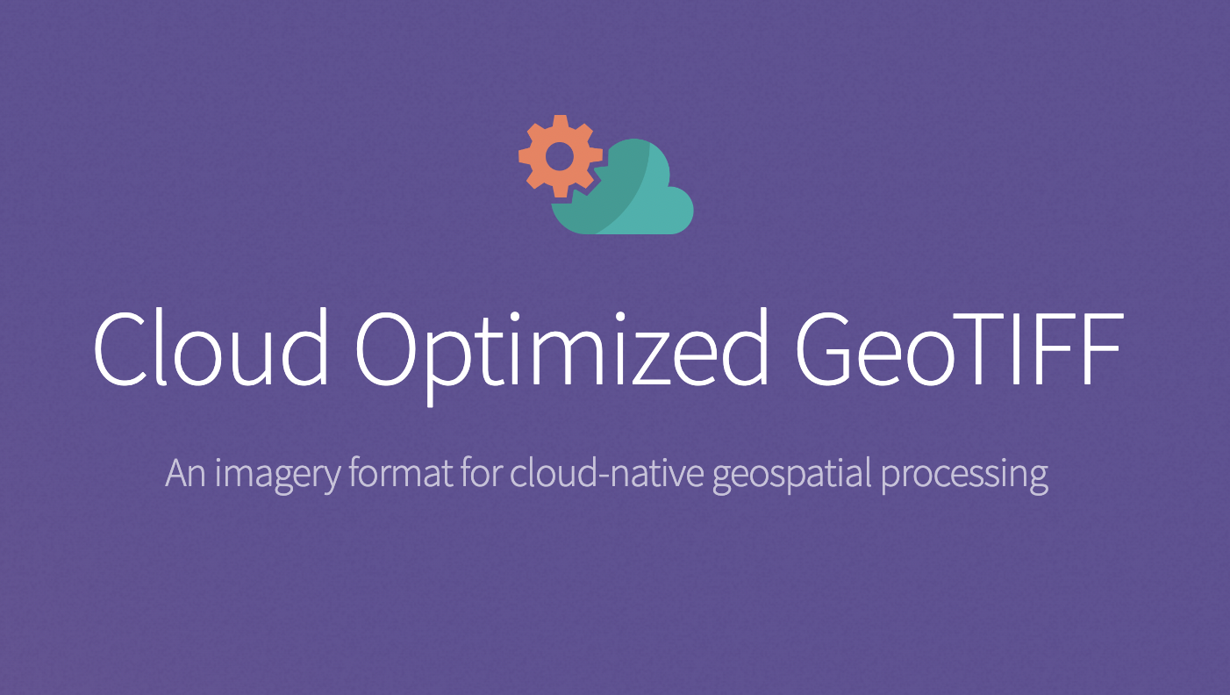
Cloud Optimised GeoTIFFs

Slide 12
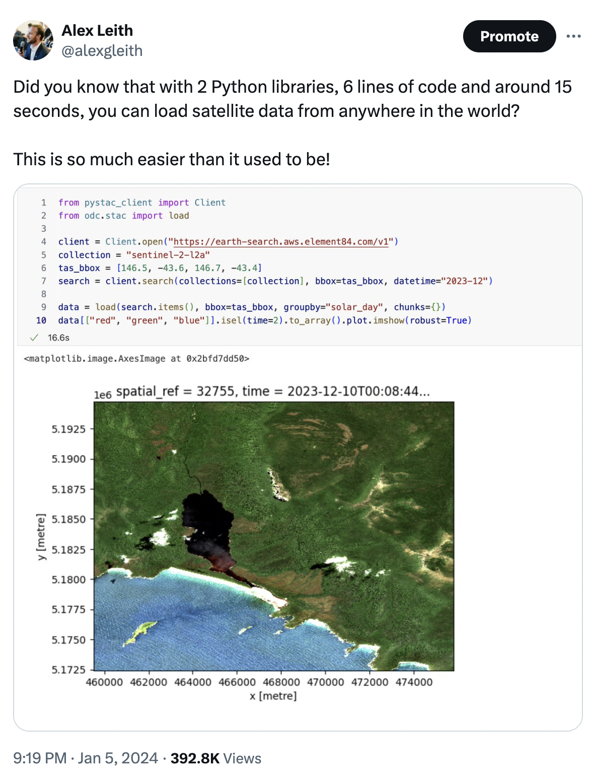
Python STAC Tools
PySTAC and PySTAC Client
ODC-STAC (and odc-geo)
Xarray
Pangeo, the Open Data Cube and Microsoft’s Planetary Computer are all interoperable
Code on the right finds and loads a single Sentinel-2 scene.

Slide 13
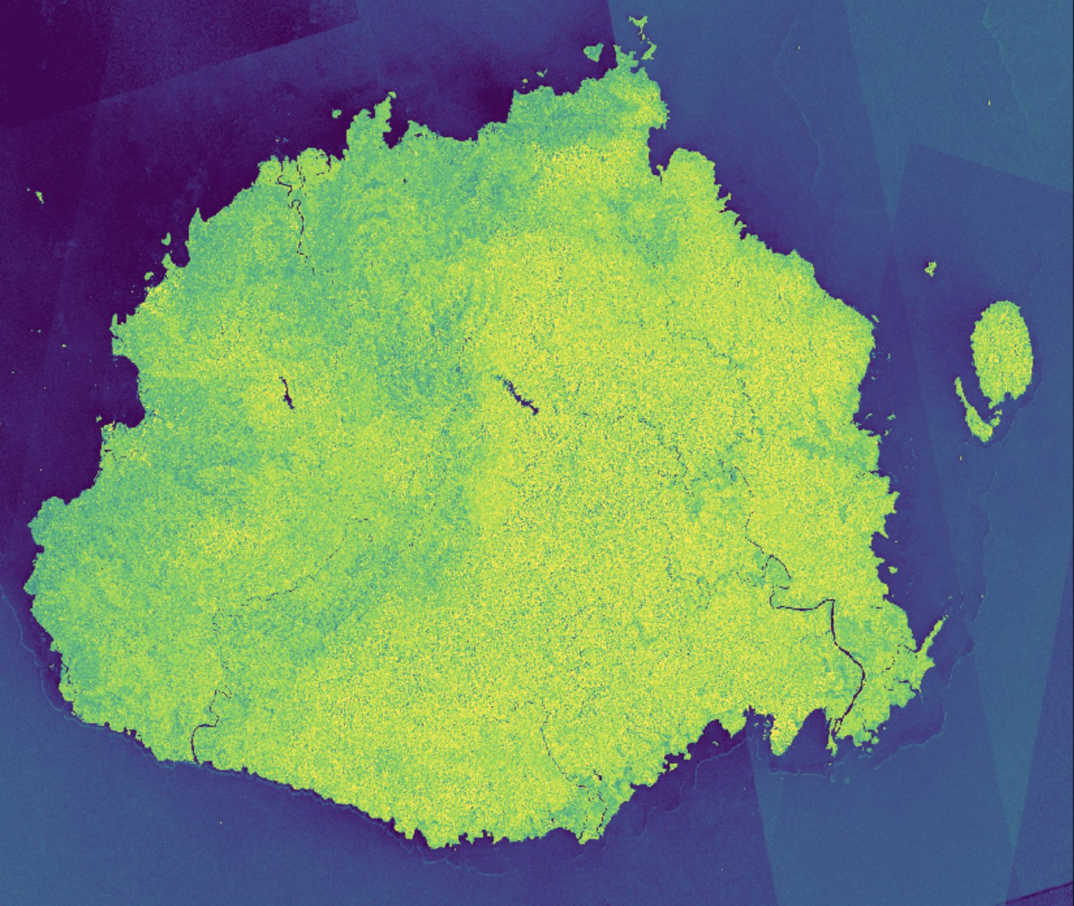
Case Study 1: Sentinel-1 Mosaics
The process is, for each tile:
Search the MSPC STAC API for Sentinel-1 descending scenes
Load, create medians and means of vv and vh and write those as well as a pixel count
This was easy because we didn’t need to build a radiometrically terrain corrected data process! (I.e., the ARD already existed.)

Slide 14
Case Study 2: Global Coastlines
The process is, for each tile:
Find and load Landsat scenes via the USGS STAC API
Mask clouds and filter extreme tide pixels using a tide model (FES 2014)
Find and load the Copernicus DEM via MSPC STAC API and use it to mask hillshaded pixels
Find and load the ESA WorldCover data via the MSPC STAC API and use that to identify ocean
Create annual mosaics that can be used to extract shorelines from 1985-2023

Slide 15
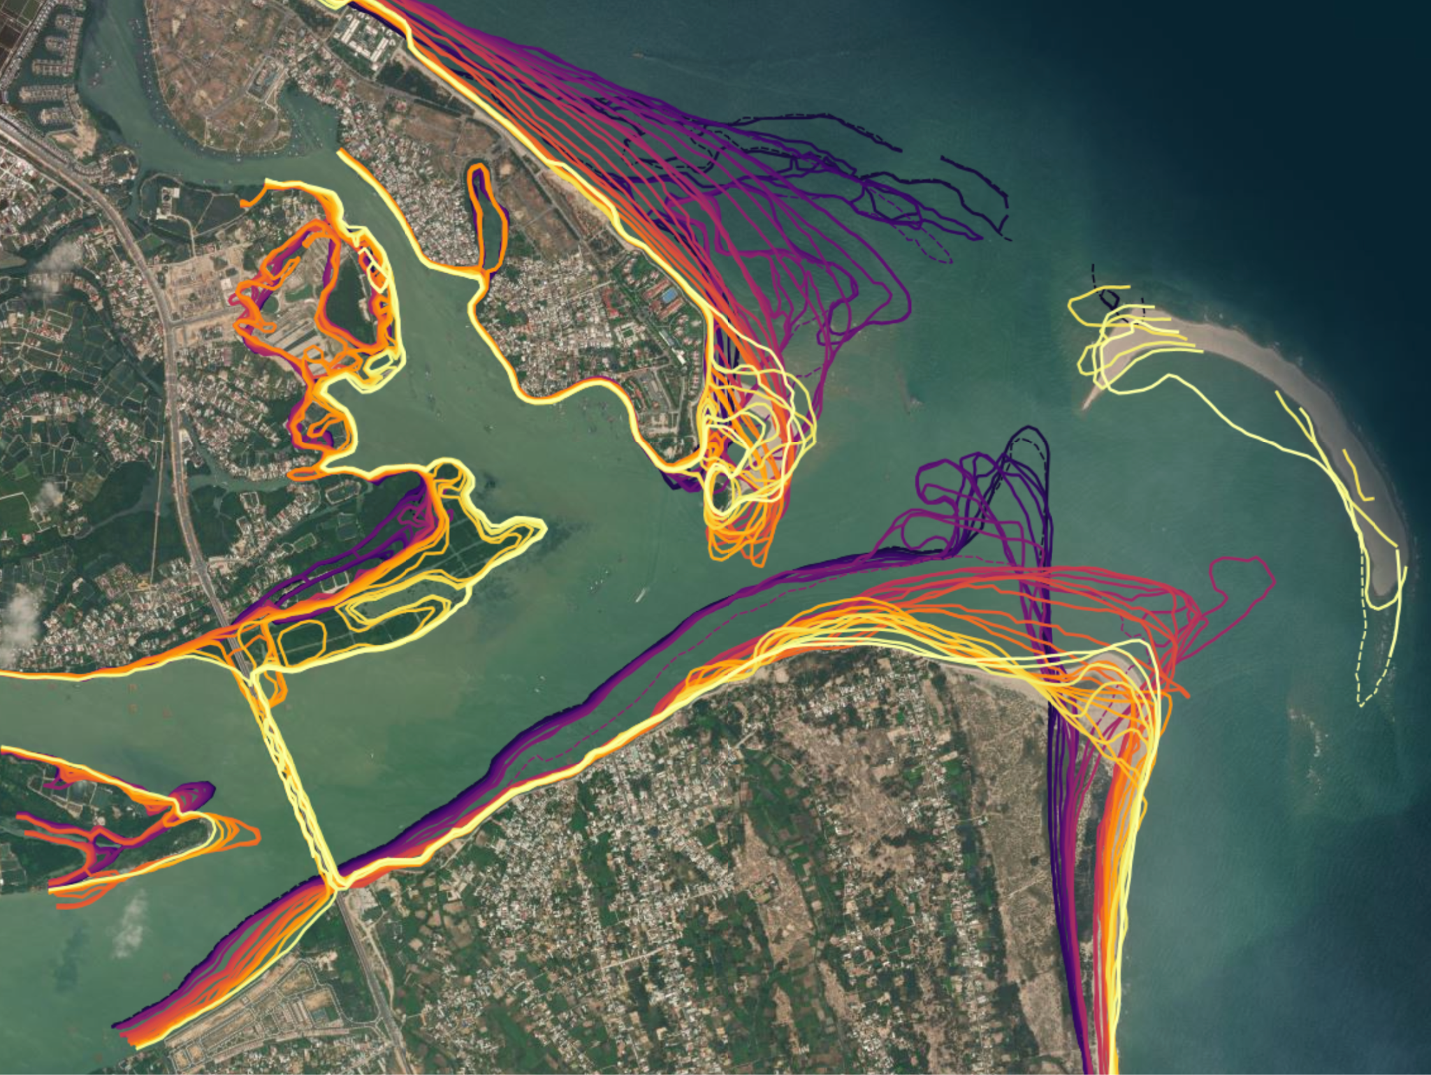
Example outcome

Slide 16
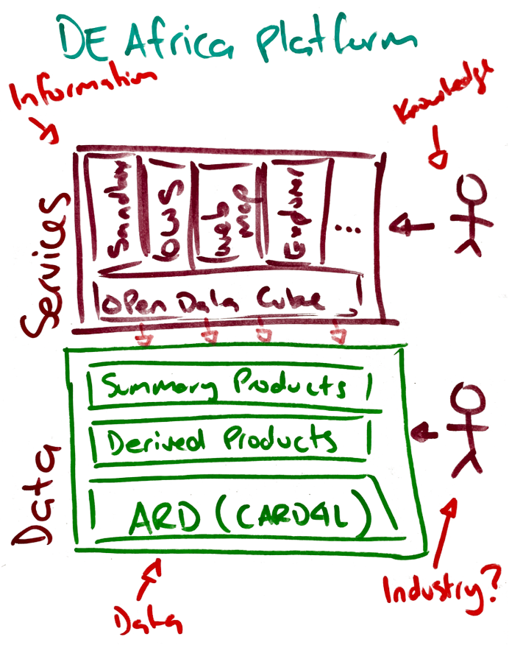
Platform Architecture
Host data on a system that allows direct, HTTP(S) access (COGs)
Host services that provide an index to that data (STAC)
Run internal applications that are publicly facing using the same data and index APIs
This process of consuming your own APIs is called dogfooding

Slide 17
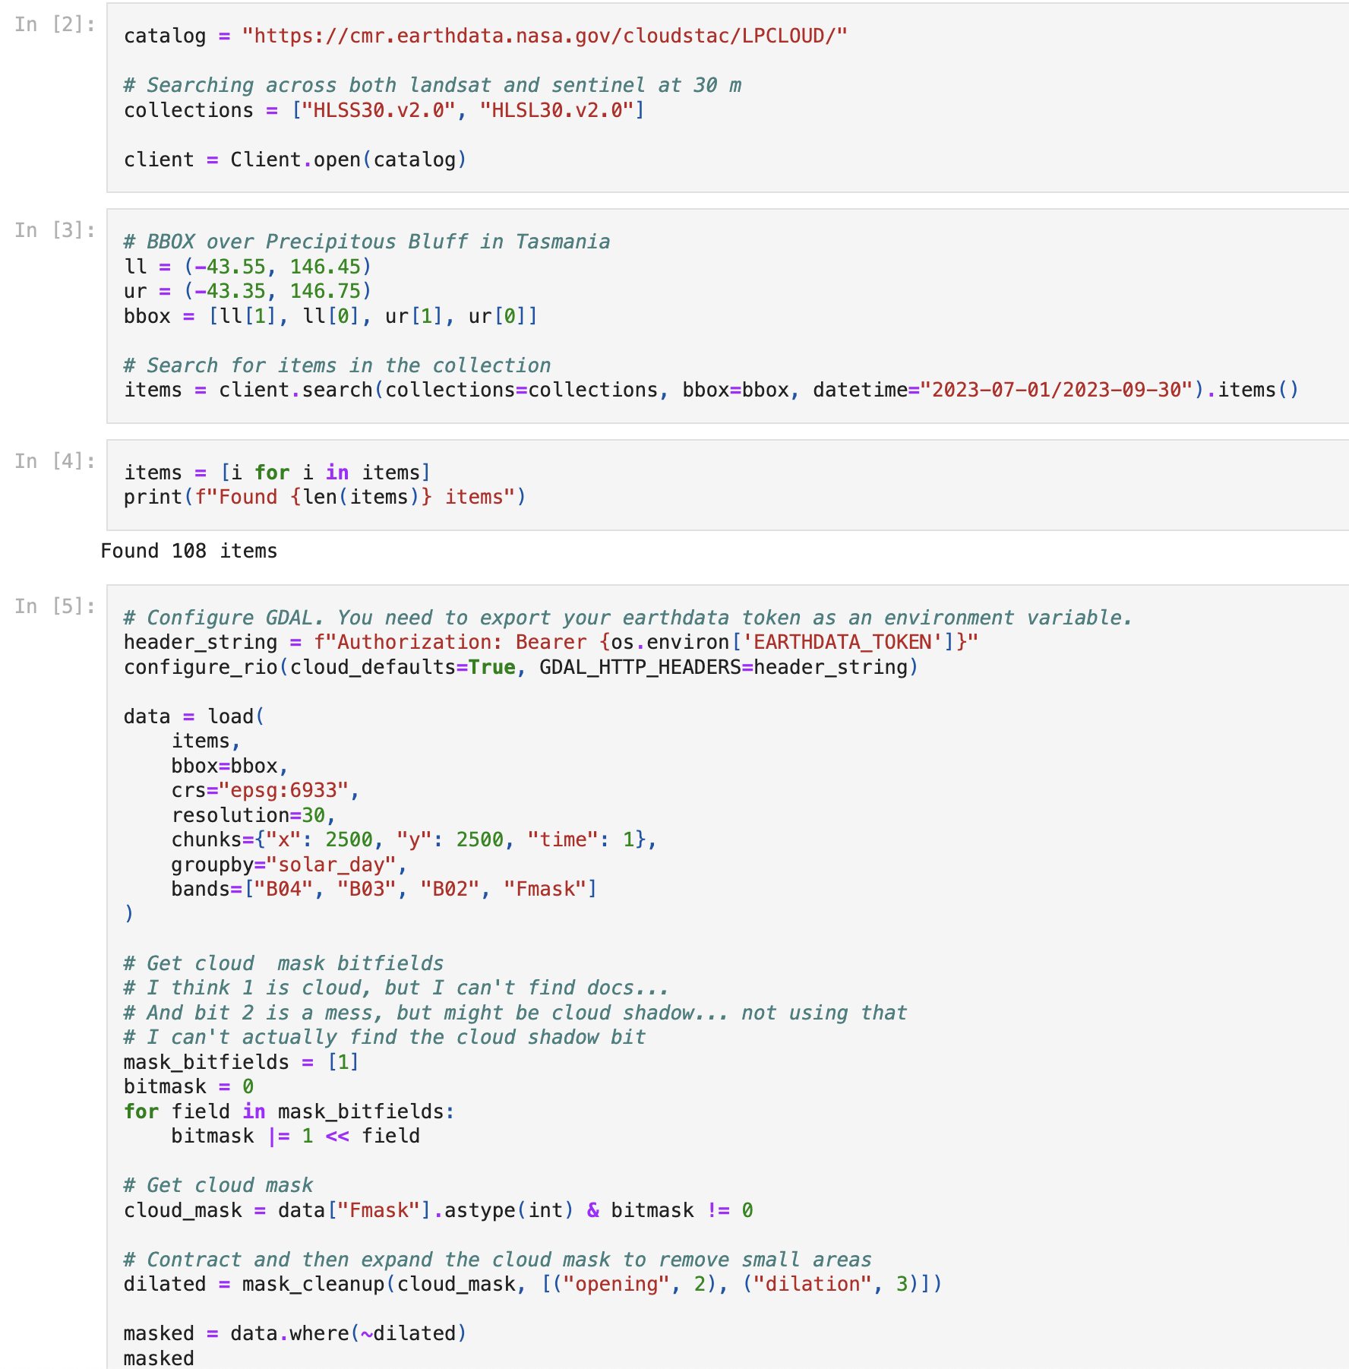
The future of interoperability…
The future is here, it’s just not evenly distributed.
William Gibson
The example on the right is almost all the code needed to find and load HLS data, mask it and create a temporal mosaic, direct from NASA.

Slide 18
Cloud Native Geospatial

