Slide 1
Geospatial Standards and their role in Interoperability
Liping Di, Liying Guo
George Mason University
Agenda Item 5.4
WGISS-57
4-7 March 2023
Sydney, Australia

Slide 2
Internet GIS Architecture
GIS Client
Simple web interface
Intelligent agent
Value-added service provider
Internet
Service provider
Data Provider
Data Provider
Data Provider

Slide 3
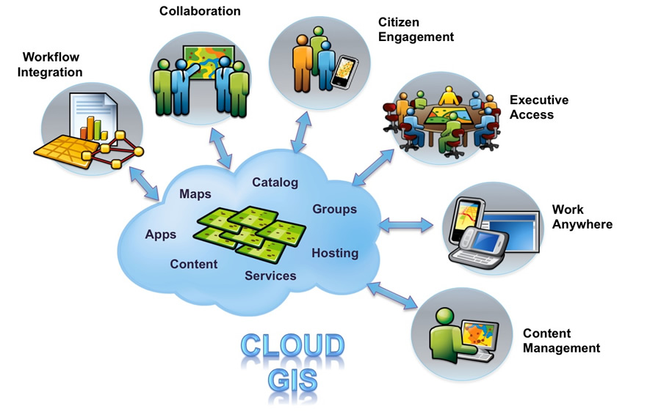
Cloud GIS Architecture

Slide 4
Sharing geospatial resources
Geospatial resources include
Hardware
Software (process)
Geospatial data and information
Geospatial knowledge (process modeling, workflow, ontology, etc)
Most of the resources are reusable by many different individuals and organizations
Sharing those resources is the best choice for maximizing the return of investments.
With the development and popularization of the Web technology, it is natural choice to select the Web as the media to share the resources.

Slide 5
Geospatial Interoperability
Interoperability: The ability of two or more systems from multiple vendors to communicate (i.e., exchange information and/or services) with each other meaningfully.
The geospatial interoperability means that geospatial systems from different vendors can communicate and collaborate to fulfill a geospatial analysis task.
Geospatial data/information interoperability
Geospatial process/service interoperability
Geospatial knowledge interoperability

Slide 6
D
Data Interoperability
Syntactic data interoperability: two or more systems capable of communicating and exchanging data.
Specified data formats (e.g., XML, SQL)
Communication protocols are fundamental to this type of interoperability.
Syntactical interoperability is a prerequisite for achieving any further interoperability.
Semantic data interoperability: the ability of two or more computer systems to automatically interpret information exchanged between them meaningfully and accurately in order to produce useful results as defined by the end users of both systems.
a common information exchange reference model.
The content of the information exchange requests are unambiguously defined: what is sent is the same as what is understood.

Slide 7
Service (process) Interoperability
Service Interoperability: The ability of systems to provide services to and accept services from other systems, and to use the services exchanged
Service function definition
Service interfaces
Service invocation

Slide 8
Knowledge Interoperability
The knowledge interoperability is the transfer of knowledge between heterogeneous environments
it is a powerful tool for the acquisition of new knowledge
Machine-understandable knowledge representation

Slide 9
How to Make GIS Interoperable
Interoperability means that diverse geospatial systems can talk to each other meaningfully.
In order to make them talking to each other meaningfully, individual parties involved should agree on the common methods for communication among them
The common methods that everybody agrees upon are the standards.
Therefore, standards are the key for geospatial Interoperability.

Slide 10
The Definition of Standards
Definition of Standards
Standards are statements of fact, quality, procedures, or content, to which applicable entities are compared for purposes of acceptance and/or use.
They are documented agreements that contain or specify technical or other specific criteria to ensure that processes, products, or services meet their intended purpose.
Standards can be designated as either voluntary or mandatory with respect to usage.
Using common standards increases the sharability, reliability, and effectiveness of geospatial data.
FAIR principle- findable, accessible, Interoperable, and reusable

Slide 11
Specifications
Standards vs. Specifications
Sometimes, specifications are also called standards. However, there are some small differences between them.
Specifications are statements prescribing particular content, inclusion, or usage requirements, or instructions for implementing standards.
Product specifications contain all the elements required to completely describe a geographic data product.

Slide 12
Classification of Geospatial Standards
According to the principle of information engineering, the geospatial standards can be classified into four general categories based on the subject a standard tries to address:
Data
Processes
Organizations
Technology
A geospatial standard may only address one category of the standards or may contain several categories of standards.

Slide 13
Data Standards
Data Classification - Data classification standards provide groups or categories of data that serve an application.
Data Content - Data content standards provide semantic definitions of a set of objects.
Data Symbology or Presentation - Data symbology or presentation standards define graphic symbols.
Data Transfer - Data transfer standards are independent of technology and applications and facilitate moving data among systems, without prior specification of the intended end use of the data.
Data Useability- Data Useability standards describe how to express the applicability or essence of a data set or data element and include data quality, assessment, accuracy, and reporting or documentation standards.

Slide 14
Process Standards
Processes or functions describe tasks and how information and technology are used to accomplish organizational goals.
Process standards may also be called service standards.
They describe how to do something, procedures to follow, methodologies to apply, procedures to present information, or business process rules to follow to implement other standards.
Most current standard efforts are concentrated on developing this type of standards.

Slide 15
Major type of process standards
General Data Transfer Procedures - the activities required to convert data to a general data format, such as SDTS, for general access.
Data access – standard for accessing data.
Data analysis procedure --methods for computing, comparing, contrasting, assembling, or evaluating a data set for an application or specified product.
Geospatial services – standards on service declaration, description, discovery, binding, and execution.
Data Integration - Data integration procedures are the methods for combining various data sets into a unified, geographically harmonious data set.
Quality Control and Quality Assurance - the methods followed to achieve a specified quality and the methods to check the quality of an existing data set.

Slide 16
Organization Standards
The organizational component of information engineering consists of the rules for assigning responsibilities and authorities for the people who perform tasks and use technology.
These include things like who does which tasks, what data do they need, and what are the attendant skill requirements.
Organizational standards are the specifications for communication among communities. These are the human and institutional interactions necessary to carry out data, activity, and technology standards. Ways to organize, communicate, identify responsible parties, and coordinate roles are examples of organizational standards.
ISO has done some preliminary study on developing the organization standards
certification of personnel, Information Community, etc.

Slide 17
Technology Standards
Technology includes things like software, hardware, and system protocols.
Technology standards relate to the tools, environment, and interfaces among systems, and are often called information technology specifications.
They are the tools to produce, manipulate, manage, organize, disseminate, or otherwise implement activity or data standards.
A lot of OGC standards belong to this category.

Slide 18
Who are the major players (U.S.)
Individual agencies—such as NASA, USGS, DOD etc.
The Federal Geographic Data Committee (FGDC)
The American National Standard Institute (ANSI)
The InterNational Committee on Information Technology Standards (INCITS) Technical Committee L1 (INCITS/L1)
The Open Geospatial Consortium (OGC)
The International Organization for Standards (ISO) Technical Committee 211 (ISO/TC 211).

Slide 19
Applicable scope of standards
Agency standards: e.g., NASA EOS data model, format, and metadata
Federal standards: e.g., FGDC standards
National standards: e.g., ANSI standards
International standards: e.g., ISO standards
Industry standards: e.g., OGC standards

Slide 20
Standards Approval Process
The standard approval process used by standard-setting organizations are very similar.
The purpose of the process is to build consensus among the stakeholder on a specific subject the standard is addressed.
The process normally involves the development, public comments, and approval stages.
The standard process normally takes long time to finish, e.g., 2-3 years and cost a lot of money.

