Slide 1
CEOS Common Online Dictionary
Peter Strobl, EC-JRC Emma Woolliams, NPL Katrin Molch, DLR
Agenda Item 5.3
WGISS-57
4-7 March 2023
Sydney, Australia

Slide 2
Executive summary
Completed work to explore a CEOS common online dictionary (CEOS WGCV Action Item 49-06, 06/2021)
Results summarized in a publication – currently in peer review
Main findings
Large interest in the topic; need, urgency, and effort are recognized
Many good but isolated dictionaries exist
Critical: Fundamental terms often defined inconsistently
Implementation needs a coordinated effort endorsed by all stakeholders
CEOS with its Interoperability Framework could be a suitable body to put this in place

Slide 3
Introduction & status
Recap of the problem:
Inconsistent use of terminology by different communities hampers communication in interdisciplinary research and other collaborations
Project-specific glossaries with altered/new definitions to overcome the issue make things worse
CEOS WGCV Action Item 49-06 (06/2021) “[…] to advance the idea of a CEOS common online dictionary, with a view to eventually reaching out to launch a broader community effort”
Work considered completed; publication submitted to Surveys in Geophysics in 12/2023 to report on the activity and to summarize results "Lost in translation: The need for common vocabularies and an interoperable thesaurus in Earth sciences"; in peer review, preprint available upon request
Propose to close Action Item 49-06 when paper has been accepted

Slide 4
Work performed
Reviewed 12 existing dictionaries
Assessment of useability​
Identification of circular definitions and inconsistencies​
Assessment of structure​
Reviewed ISO 25964:2011 guidelines on ‘information and documentation: thesauri and interoperability with other vocabularies’ ​
Presentations to CEOS, ESA and WMO meetings​
Studied in detail selected sample terms​ - observation, in-situ, interoperability​ - as examples of broader problems
Built a hierarchical set of base and core terms
Compiled and submitted draft paper for publication

Slide 5
“In-situ” - disambiguation
Location of sample
In-situ / Ex-situ
Observed in its original location vs brought back to laboratory for testing
In-situ / satellite
Observed e.g. ground-based, sea- or airborne vs from an orbiting platform
In-situ / remote
Observed close to the location of the sample vs from a (significant) distance
Various communities use the term 'in-situ' in different ways – in contrast to different alternatives.
It is very important to be clear about which notion of ‘in-situ’ is referred to. Sometimes it relates more to location and sometimes to fidelity.
vs
Location of sensor
vs
Distance sensor to sample
vs

Slide 6
Main findings I
Wide interest in the topic wherever we discussed it; the need and urgency are clearly recognized as is the huge dimension of the undertaking – if it is to be done well
Many individual, well-designed dictionaries exist
Examples: NASA GMCD, NOAA Data Management Lexicon, ISO Geolexica, NERC Vocabulary Server, OGC Rainbow, …
Mostly existing in isolation; not linked, no overarching effort or framework
Result of working in isolation:​
Inconsistent definitions​
Controversial definitions​
Superficial definitions

Slide 7
Main findings II
We propose criteria for a good dictionary; it should be consistent, hierarchical, understandable, educational and updateable
ISO 25964:2011 provides an excellent framework for building a consistent dictionary
Federation of existing dictionaries a possibility?
A Wiki-like system, moderated by expert groups, might be the most suitable implementation
Unique source, accessible, easy to reference, editable, moderated

Slide 8
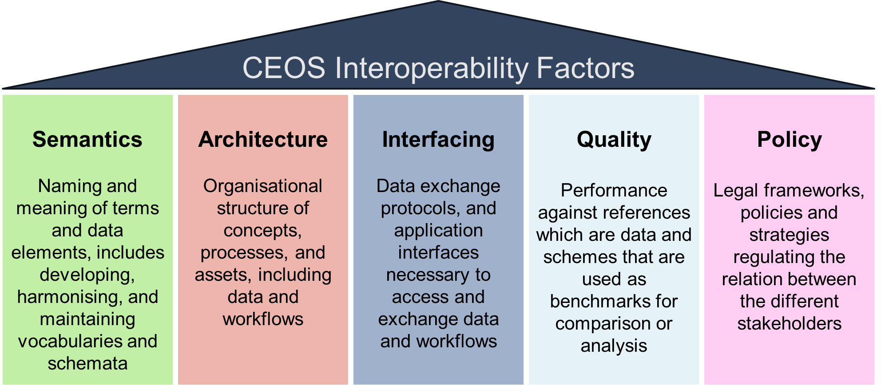
Possible way forward
Start discussions about formulating a properly funded project to establish an example of a public dictionary
CEOS with its Interoperability Framework could be a suitable body to coordinate such an effort 🡪 Semantics is a key factor in the framework
Update the CEOS Cal/Val portal definitions with
Hierarchical framework for the 30 core terms defined so far as an example
Highlighting and linking core and base terms within
Connect to CEOS interoperability framework
Illustration courtesy P. Strobl

Slide 9
Thank you!
any questions?

Slide 10
Additional material

Slide 11
Problems found
Simple lists of words are not used often – structure is important
Rare to have versioning (or keep older definitions) – and definitions change
Very large number of definitions for some terms – e.g. in ISO online browsing platform
Inconsistent definitions (e.g. in-situ, observation, sample, …)
Superficial definitions (e.g. interoperability) lacking full framework
Circular definitions – and poor use of the foundational ‘base terms’
Development process – isolated efforts – creates these problems

Slide 12
Observation
Process / result distinction
Observation: process of observing
Observation value : the result (including associated uncertainty)
Continuum from measurement to simulation
Bokulich 2020 (philosopher) defined increasing ‘model ladenness’ of data – as below
(but other splits possible!)
Distinction hard – but we disagree with ISO approach of considering simulation as a form of observation based only on an algorithm as observer
Measurement?
Observation?
Model?
Raw measurement
Data conversion / calibration
Data correction
Data scaling
Interpolation
Data scaling / regridding
Data fusion
Data assimilation
Simulation
Level 1
Level 2
Level 3/4

Slide 13
Suggested approach
Formal ‘thesaurus’ (controlled and structured vocabulary, with explicit relationship between terms)
Collaboration between standard-setting and good-practice setting organisations to develop a collective-effort wiki-style vocabulary
Long-term commitment to collaborative working
Oversight editorial teams
Terminology in documents linked to central reference (with version control at the individual definition level)
Conflicts handled through separate ‘branches’
More complete frameworks (e.g. CEOS interoperability / CEOS FRM etc) connected to the terminology alongside higher level definitions

Slide 14
Suggested structure
Hierarchical – with perhaps different types of hierarchy simultaneously available
Definitional (definition uses another word in thesaurus)
Contextual (hierarchical on subject)
Ontological (formal parent/child relationships, ‘is a’ and ‘has a’)
Structured around base and core terms (simple, easily agreed definitions)
With ‘controversial’ terms highlighted where there are disagreements
With ‘high impact’ terms highlighted where frameworks are more valuable than definitions

Slide 15
Categories of terms
 | Category of term | Examples
 | Base terms | Data, entity, phenomenon, property | Underpinning terms – small committee to create list
 | Core terms | Uncertainty, leaf area index, data centre, spectral resolution, accuracy, precision, measurement | Basic vocabulary for Earth sciences – small committee to create list and collate existing definitions
 | Controversial terms | Sampling, observation, in-situ, processing level, model, confidence | Terms different communities use differently. Facilitated discussions or disambiguation pages
 | High impact terms | Interoperability, analysis ready data, data assimilation, real-time, operational | Terms that need a framework document – developed in the right committee. Link to simple, high-level definition

Slide 16
A good thesaurus is:
Consistent
On a foundation of base terms. No ambiguity. No circular or overlapping definitions. Clear preferred terms. Alternative definitions explained clearly.
Hierarchical
Clearly shows relationships between terms – in a definitional, contextual and ontological way. Mutually exclusive parent / sibling / child relationships
Understandable
Clear definitions, with differentiation/disambiguation of controversial terms. Checked for understandability by multidisciplinary teams
Educational
Not just for computers! Promotes a conceptual framework, shows linkages, satisfies curiosity, helps communication of concepts. Links to detailed frameworks for high-impact terms.
Updateable
Unified thesaurus with version control at the level of individual terms, methods for providing disambiguation links, and adding new terms.

