Slide 1
WGISS-57
Interoperability Framework History
Tom Sohre, USGS
Agenda Item 5.2
WGISS-57
4-7 March 2024
Sydney, Australia

Slide 2
CEOS Interoperability Overview
At the 2022 CEOS Plenary, CEOS Principals confirmed that coordination of interoperability related work remains within the WGISS perimeter. WGISS was invited to propose an interoperability roadmap at SIT-38, considering the CEOS Interoperability Framework concept developed and presented by LSI-VC. (Decision 36-09).
WGISS coordinated across CEOS groups (ARD OG, LSI-VC, SEO, WGISS, WGCV, etc.) to develop a framework and mapping of CEOS activities / groups / people to each interoperability factor.

Slide 3
Framework Development
Meeting | Date | Topics
Kick off meeting | February 2023 | Discussed vision, teams, topics, membership and annual process. WGISS, LSI-VC, CEOS ARD OG, WGCV, SEO
#2 meeting | March 2023 | Discussed the components and the topics.
#3 meeting | March 2023 | Draft roadmap was proposed. Discussed the components and the topics based on the roadmap. Further discussions in each VC/WG were requested.
SIT-38 side meeting | March 2023 | Discussion on draft roadmap Initial identification of “Factors” critical for Interoperability
WGISS-55 | April 2023 | Reviewed SIT-38 recommendations Discussed history of WGISS Interoperability Handbook (2008)
#4 meeting | May 2023 | Reviewed current Framework concept (7 factors) Assigned action to WG Leads to identify Factor Champions Set up recurring Interoperability IG meeting (2nd Wed. of month)
WGCV, CGMS | June 2023 | Presented Status of Framework
#6 meeting | June 2023 | Reviewed Factors, Definitions, In/Out
#7 meeting | August 2023 | Roadmap Factors consensus Data Call to ALL CEOS WG Chairs re: Interoperability Supporting Activities
#8 meeting | September 2023 | Reviewed CEOS Work Plan initial mapping
LSI-VC | October 2023 | Present Status of Framework / Roadmap for Input
SIT-TW | October | Present Status of Framework / Roadmap
WGISS-56 | October | Discuss WGISS Interoperability Interest Group Goals
Plenary | November | Present Interoperability Framework / Roadmap for Endorsement

Slide 4
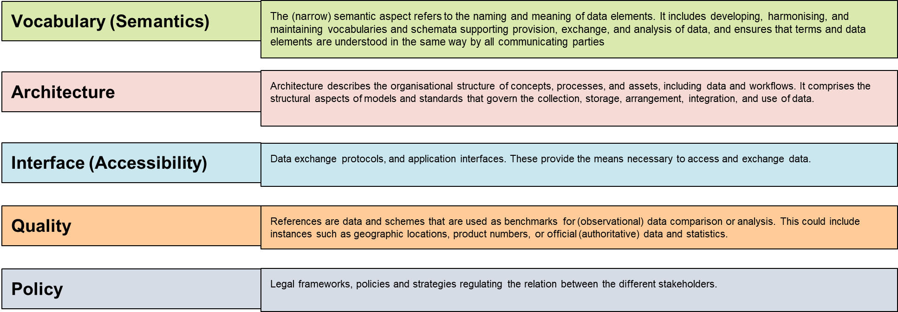
Proposed Interoperability Framework

Slide 5
Framework Roadmap

Slide 6
Handbook TOC brainstorming
CEOS Interoperability Handbook 1.1 (Feb. 2008):
Glossary
Foreword
Purpose
Abstract
Introduction
Data Archiving
Data Access
From Data to Information
Technologies Enabling Interoperability
CEOS Recommendations for Interoperability
Link to document
CEOS Interoperability Handbook 2.0 (2024):
Purpose
Introduction
Vocabulary (lead: tbd)
Overview
Included / Excluded
Best Practices
Steps toward Maturity
Architecture (lead: tbd)
Interface (lead: tbd)
Quality (lead: tbd)
Policy (lead: tbd)

