Slide 1
CEOS Communications
Overview
Libby Rose
SEO Comms Team
Agenda Item 4.2
WGISS-57
4-7 March 2024
Sydney, Australia

Slide 2




CEOS Communications
Twitter: @CEOSdotORG
Facebook: @socialceos
LinkedIn: @CEOSdotORG
YouTube: @CEOSdotORG

Slide 3

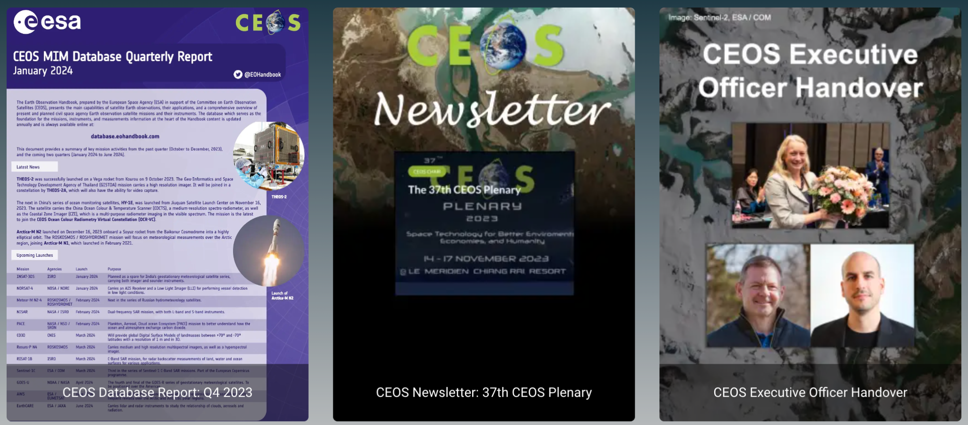
CEOS Blog
ceos.org/news
This is where we can promote WGISS activities!

Slide 4

Quarterly Revisit
Quarterly newsletter with updates on CEOS comms publications including:
  CEOS Newsletter
  Blog
  MIM Database Training Calendar
  Upcoming & Recent Meetings
Stay informed of what is happening across CEOS
Sign up!
http://eepurl.com/ij_2z1

Slide 5
Stakeholders
Internal CEOS Communications
External CEOS Communications
CEOS Principals
Working Teams
  Ensure cross-cutting work is shared broadly
Decision Makers
  Including local/regional, governments UN Agencies
EO Experts
  Academics, technicians and commercial EO industry
Candidate CEOS Members/Associates
  Organisations who meet the criteria to join CEOS
EO Allies
  E.g. biodiversity experts, urban planners

Slide 6

2024 Campaigns
40th Anniversary of CEOS Jan - Dec 2024
  Reflect on past 40 years, and look to the future
EO for Biodiversity Plenary 2023 - Plenary 2024
  Support CSA Chair Priority
  Promote EETT White Paper & EO for Ecosystems
Greenhouse Gas Observations from Space SIT TW 2024 - SIT-40
  Support JAXA SIT Chair Priority
  Promote related deliverables and activities

Slide 7
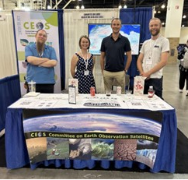
IGARSS
CEOS Booth at IGARSS in Athens, Greece, 7-12 July 2024
Opportunity to showcase WGISS activities
What should be showcased?
Some common questions:
  Where can I access data?
  How to use cloud native products?

Slide 8
WGISS Outreach Discussion

Slide 9
Questions to discuss
What are the goals of WGISS for outreach?
  How can we support this with outreach and communications?
What does WGISS want to promote to the broader EO community?
  What one thing should be put on a flyer?
  Are there different topics which should be targeted towards data providers vs data users?
How can we bring new people in to support WGISS work?
Do we need a generic “What is WGISS?” slide deck?

Slide 10
WGISS Training Events

Slide 11
Discussion
Actions on hold:
  WGISS-52-08: WGISS DMSMM: prepare a webinar for WGCapD and technology session describing the maturity matrix use case after WGISS-53.
  WGISS-56-02: Technology Exploration to explore the use of the AI/ML White Paper as a training topic in cooperation with WGCapD.
Can we to proceed without WGCapD cooperation?
Community feedback on Technical Papers - is there a quicker way to get comments? Are technical papers still the way we want to exchange information?
  Should we make more use of GitHub?

