Slide 1
WGISS Collaborations
Tom Sohre, USGS
Agenda Item 4.1
WGISS-57
4-7 March 2023
Sydney, Australia

Slide 2
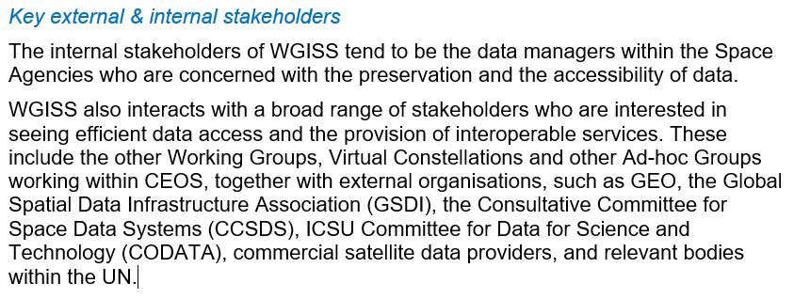
WGISS Stakeholders (ToR)

Slide 3
WGISS recent collaborations
SEO – ongoing collaboration re: Interoperability Lab and Open Data Cubes
LSI-VC – CARD4L, STAC
WGCapD – Jupyter notebook webinar
WGCV – joint meeting w/ WGISS-54 (and planned WGISS-58)
WGDisasters – joint meeting w/ WGISS-55
ARD OG – “consists of nominated representatives from … WGISS” (ARD OG website)
Non-CEOS:
CGMS – WGISS overview at CGMS WG IV (June 2023); cloud best practices overview @ WGISS-56
OGC

Slide 4
Discussion Topics
Should we identify a clear POC for each CEOS collaboration? (see prior WGISS POC table)
What is the overlap between WGISS and LSI-VC (STAC) and SEO (Interoperability Lab, Data Cubes)
How do we participate in standards body collaborations (OGC, ISO, STAC)?
How would WGISS like to collaborate with “New Space”?
How do we ensure info delivered to stakeholders in timely manner?
Should we have online “discussion groups” or similar?
How do we iterate on documents (best practices) and update published documents?
How do we collaborate with WGCapD to “deliver” (train) WGISS best practices or capabilities?
Should we provide reference information on WGISS website from CEOS Agencies (or collaboration groups)
Ex: CEOS Agency Cloud or AI/ML vision, lesson learned documents
Ex: non-CEOS documents / links (GEO, CGMS, OGC)

Slide 5
New Space in WGISS
Reference:
At the upcoming Land Surface Imaging Virtual Constellation (LSI-VC)
Satellite Earth Observation Commercial Engagement Workshop
For Discussion:
How might WGISS engage with New Space?
Commercial Engagement Workshop at WGISS-58 / WGCV on topics such as:
Cloud, STAC, OGC, AI/ML, Data Cubes, Federation, Data Access

Slide 6
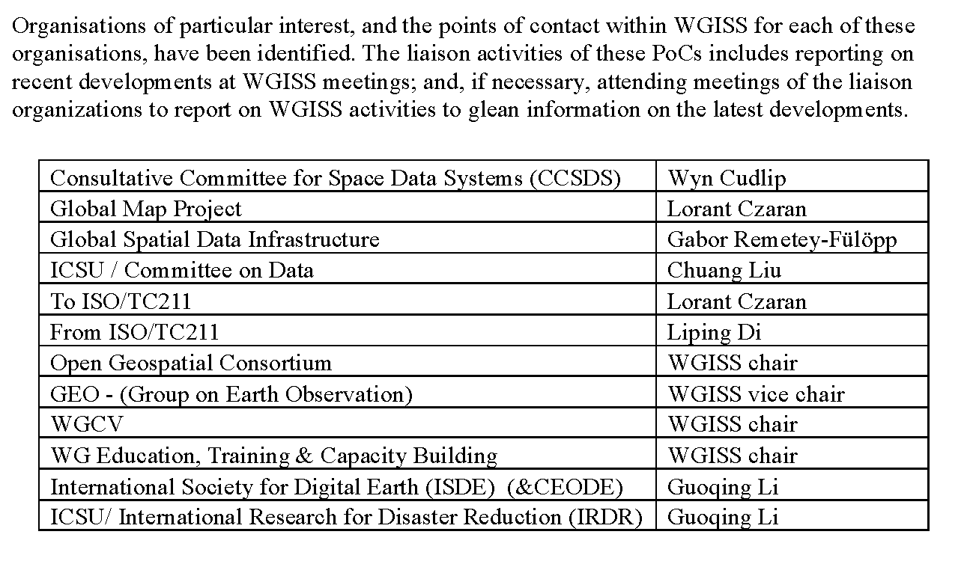
Example table in prior year workplan…

