Slide 1
USGS Overview The 2030 Vision
Steven Covington
USGS National Land Imaging Program
Principal Systems Engineer
The Aerospace Corporation

Slide 2
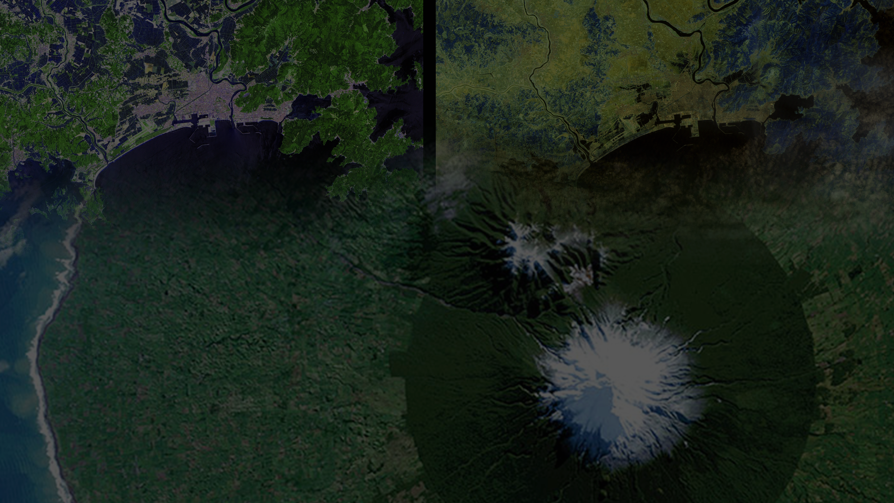
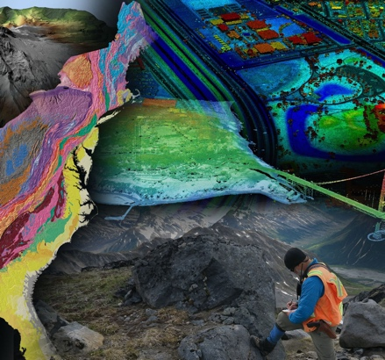
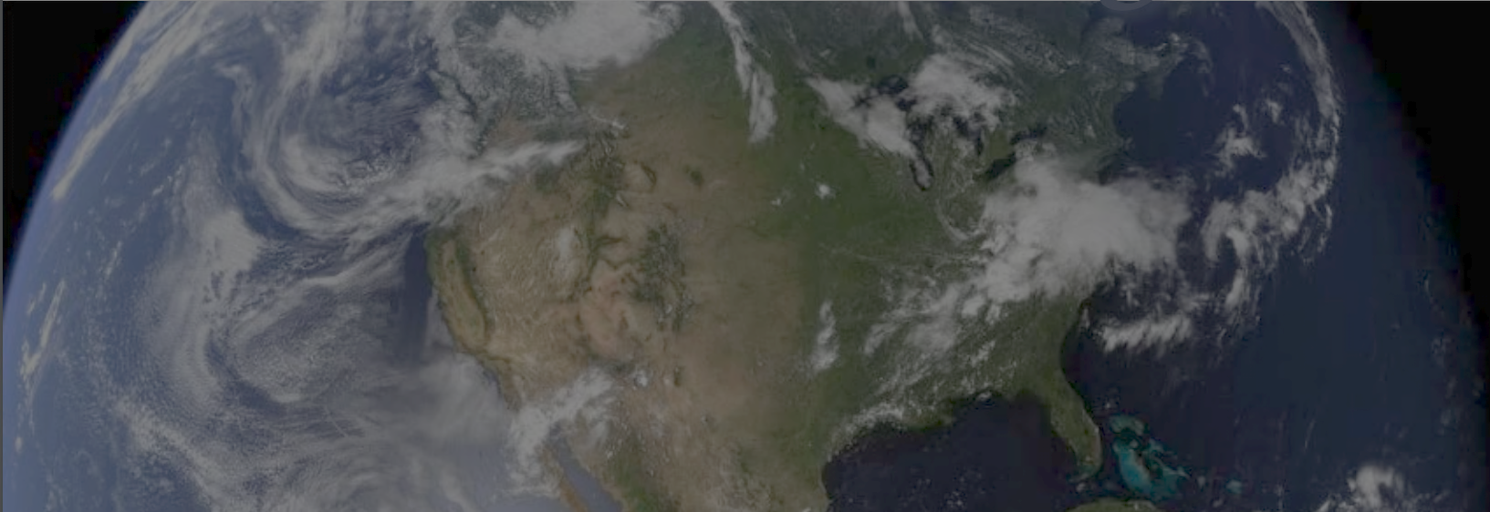
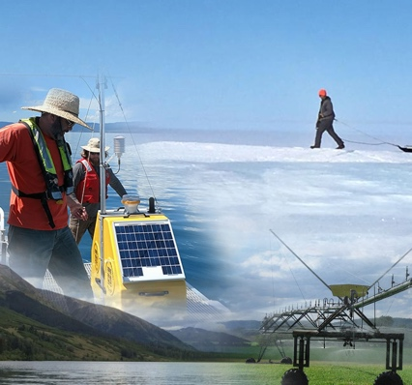
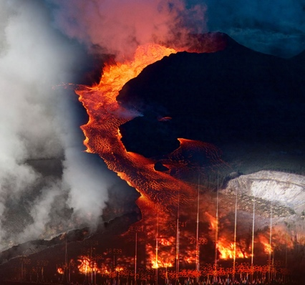
USGS Mission Areas
Water Resources
Natural Hazards
Core Science Systems
Ecosystems
Energy and Minerals
Vision
Lead the Nation in 21st-century integrated research, assessments, and prediction of natural resources and processes to meet society’s needs
Mission
Monitor, analyze and predict current and evolving dynamics of complex human and natural Earth system interactions
Deliver actionable intelligence at scales and timeframes relevant to decision makers

Slide 3
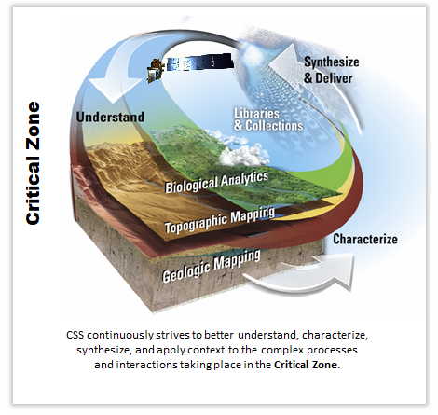
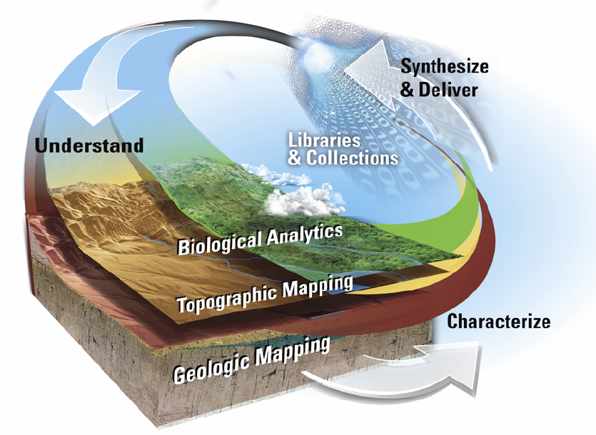
Core Science Systems – Mission Overview
America relies on our broad range of nationally-focused Earth system and observation science, geospatial research, and foundational data to remain informed, safe, and healthy.
Serve as the Nation’s Civilian Mapping Agency.
Provide remote sensing, topographic, geologic, and biogeographic data and maps to the Nation (Federal, State and Local governments, Tribes, the public) and the World.
Conduct surveys and research on the Nation’s surficial, geologic, and biologic resources.
Coordinate effective and economical use and management of geospatial data assets for Federal agencies and the Nation.
Operate Landsat Satellites and collect, archive, process and deliver science-quality data.
Architect and develop Landsat Satellite ground and flight systems in collaboration with NASA.
Provide land cover analyses and products using remote sensing imagery from satellites.
Provide multidisciplinary research and data to understand and anticipate the changing climate, environment, and land use.
Support data management, data synthesis and analysis across science disciplines.
Connect USGS scientists to published literature, data, and collections to support evidence-based practices.
Inventory and preserve geological and geophysical data collections to provide a framework for geoscience data and information sharing.
Improve Federal-State cooperation and collaboration by effectively leveraging partnerships.
Critical Zone
CSS continuously strives to better understand, characterize,
synthesize, and apply context to the complex processes
and interactions taking place in the Critical Zone.

Slide 4
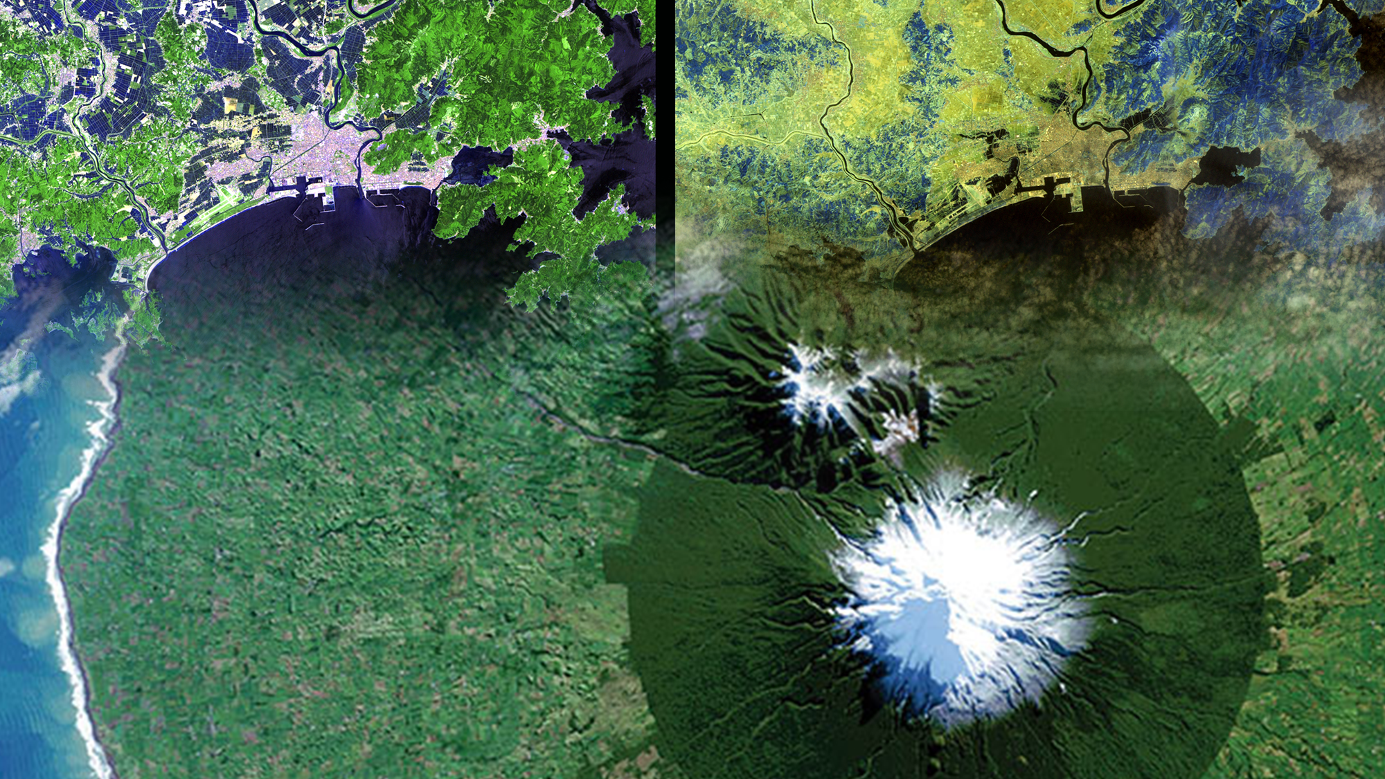
National Land Imaging Program Roles & Responsibilities
As defined by Public Law and National Space Policy, to carry out the Public Interest of the United States:
Operate and maintain a National Land Imaging Archive to house a Basic Data Set of global data – for historical, scientific, and technical purposes – includes data obtained from U.S. civil, commercial and foreign satellite systems
Operate and maintain the Landsat flight and ground systems
Collect, process, archive and distribute these data as Public Domain holdings of the United States
Determine U.S. civil operational requirements for global land surface data and to conduct a national program of civil-operational land imaging
Conduct research and development in the applications of remote sensing in order to enhance the ability of the U.S. to manage and utilize its renewable and nonrenewable resources
Develop civil applications and information tools using known standards and protocols and make them available to the general public; facilitate federal civil agency use of National Security Space system data via the Civil Applications Committee
Fundamental goal: Ensure public availability of a primary data record about the historical condition and current state of the Earth’s land surface and to predict its future condition

Slide 5
Multi-Decadal Sustainable Land Imaging Program
First Phase of SLI
Second Phase of SLI
Landsat Next
Landsat 9
Commercial/Interagency/
International Partnerships
SLI Technology Development and Infusion (NASA)
(USGS)
User Needs Development (USGS)
11/22/2017
JSG
04/01/2020
JSG
02/10/2022
JSG
SLI
Architecture
Study
2018-2019
SLI
Architecture
Study
2026-2027
2010 2020 2030
LANDSAT 8
SLI
Architecture
Study
2013-2014
LANDSAT 9
LANDSAT NEXT
LANDSAT BEYOND
JSG=Joint Steering Group Meeting

Slide 6
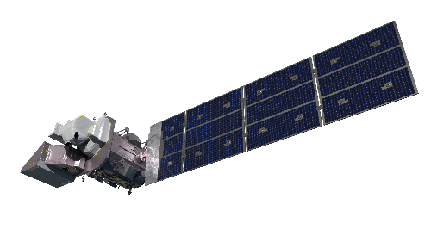
International Partnerships
Core Science Systems – National Land Imaging Program – Outreach and Collaboration Branch
NLI International Engagement Objectives
Enhance USGS land-imaging system capabilities and reduce overall costs
Increase quantity and quality of EO data available to USGS users
Engagement Mechanisms
Bilateral Partnerships
Geoscience Australia/Australian Space Agency, European Commission/European Space Agency, German Aerospace Center, Indian Space Research Organization, Japanese Aerospace Exploration Agency, others
Landsat International Cooperator Network and Landsat Ground Network
Multilateral Collaboration
Committee on Earth Observation Satellites (CEOS), Group on Earth Observations (GEO), International Charter for Space and Major Disasters, UN Committee on the Peaceful Uses of Outer Space, UN International Committee on Global Navigation Satellite Systems; Int’l Standards Organization Technical Committee 211 on Geographic Information and Geomatics, others
Support to U.S. National and International Earth Observation and S&T Policy
U.S. National Space Policy; U.S. National Plan for Civil EO; State Dept-led Civil Space Dialogues and international agreement reviews; EO support to USGS International Programs Office

Slide 7
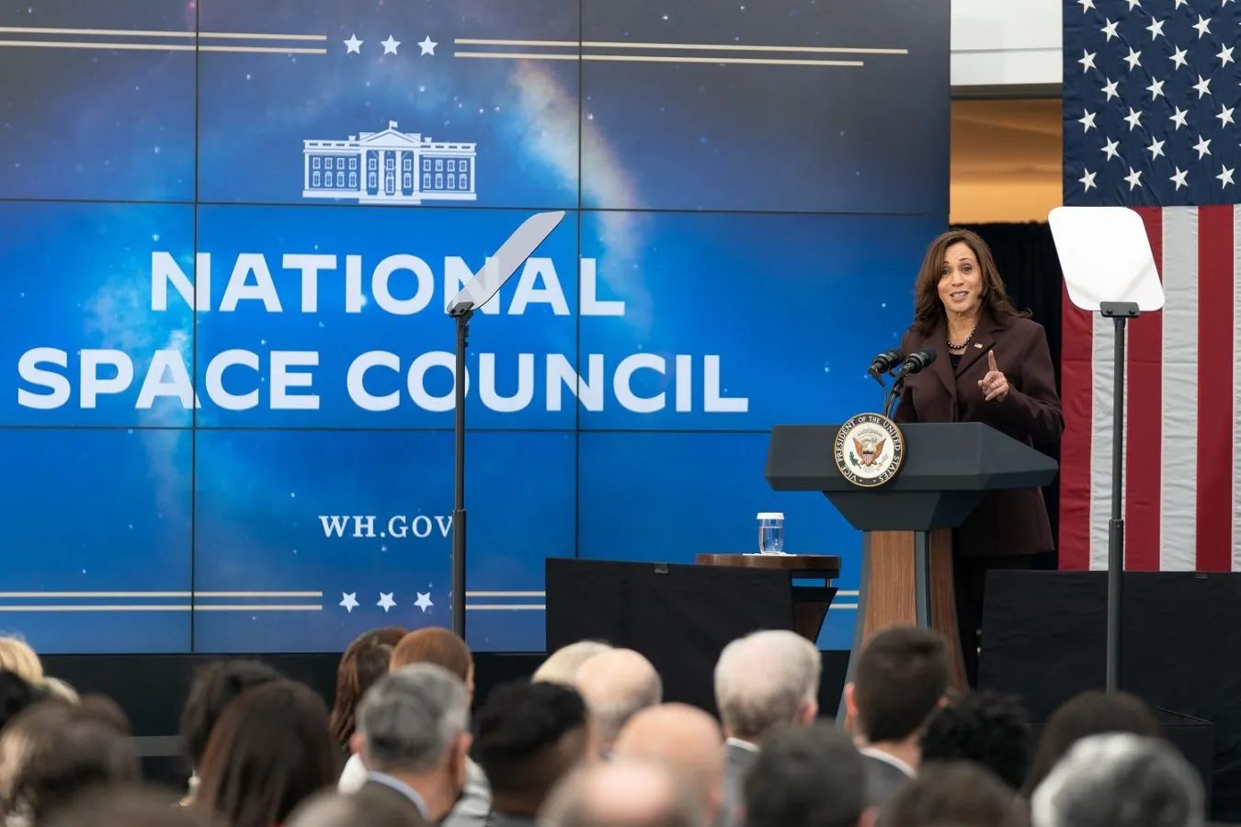
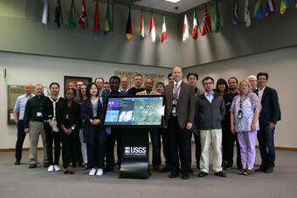
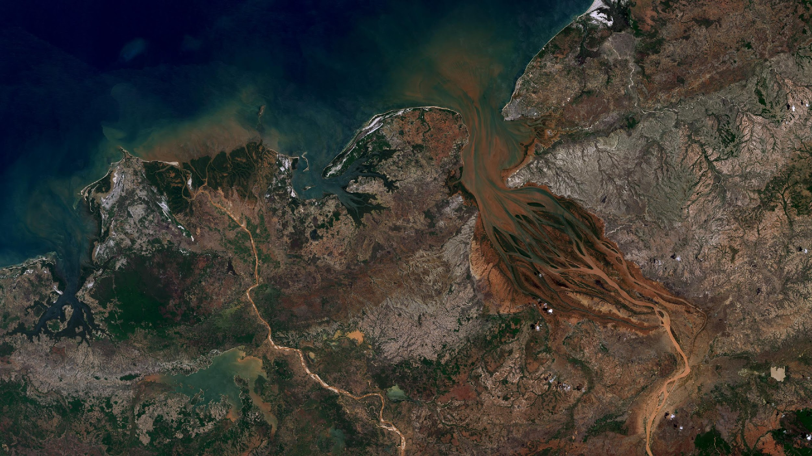
Landsat 2030 International Partnership Initiative
At the December 2023 U.S. National Space Council Meeting, the U.S. Department of the Interior announced the Initiative, which is opened to interested governments willing to commit to:
the global, open use of Landsat observations
supporting the use of Landsat data for public decision support, commercial value-added services, and scientific and global change research.
Substantial and positive response from USGS’s international partners
(Top) VP Kamala Harris, NSpC Chair, providing her remarks
(Bottom) Int’l Landsat Partners at the USGS EROS Center
Landsat 9 image of the Betsiboka River Basin, Madagascar
7 December 2021

Slide 8
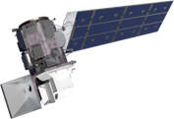
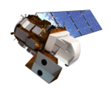
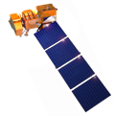
Operational Landsat Missions
Landsat 9 (L9)
Launched: 2021
Landsat 8 (L8)
Launched: 2013
Landsat 7 (L7)
Launched: 1999
Performing full Landsat science mission
Together provide 8-day revisit
Operated out of the Landsat multi-mission Mission Operations Center (LMOC)
Operating in a lower orbit for future NASA prototype refueling mission (OSAM-1)
Operated out of the Landsat 7 Mission Operations Center (MOC)
Science data acquisition suspended
‹#›

Slide 9
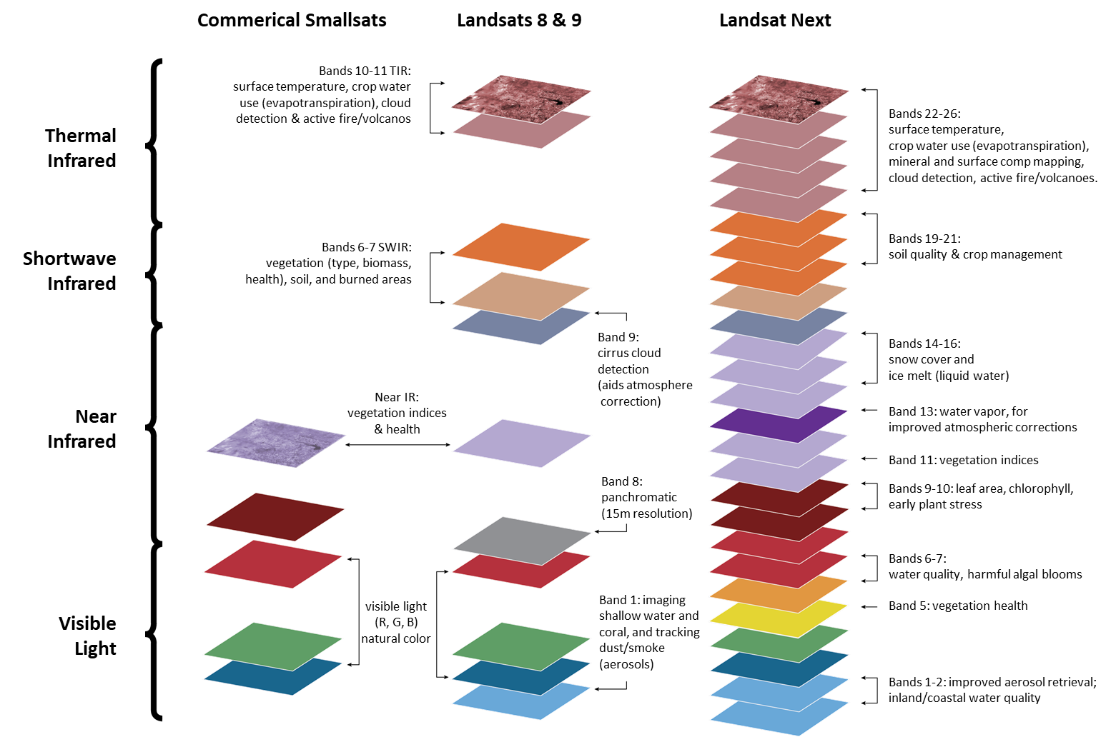
Landsat Next Comparison with Today
Landsat Next will have 26 bands versus Landsat 8 and 9, which have 11 bands
Landsat Next VNIR/SWIR bands will generally be 10m and 20m, versus Landsat 8 and 9, which is 30m Landsat Next scenes will be nearly 15-times larger than a Landsat 9 scene product Landsat Next will have a revisit period of 6-days, versus Landsat 8 and 9’s combined 8-day revisit
Landsat Next enhancements improve our understanding of global environmental change

Slide 10
2030 Vision
Unify US FedCiv offerings: A new collaborative framework of U.S. Civil Earth Observation could truly integrate remote sensing satellite activities and products, benefitting science and operational users of the data and potentially freeing up funding that could be used to provide additional Earth Observation missions and data products to meet the ever-increasing needs of the users.
Cooperative Global Access Standards: Beyond the U.S. architecture comes the need for common search/discovery access to disparate global archives; cloud agnostic interoperability to enable and encourage multi-source/ multi-modal access and exploitation of analysis ready data.
Start Now: An integrated U.S. architecture beginning in the 2030 timeframe would provide sufficient time for the agencies to plan for its implementation while not disrupting current missions and projects. Simultaneously, work with international organizations and collaborators to broaden implementation and acceptance.
Ubiquitous Cloud Access and Services Across the Global Archive of Earth Observations

Slide 11
USGS and US Civil Space Have a Big Data Challenge
Current 50+ year USGS Landsat archive is ~20PB
It is estimated that two year after LNext operations begin, the USGS Landsat archive will be close to 50PB
Other space agencies and commercial firms are projecting similar data growth trends
We may not have the infrastructure or services to cost-effectively utilize global EO holdings in the 2030s
1970s
1980s
1990s
2000s
2010s
2020s
2030s

Slide 12
Areas of Exploration to minimize risk
Encourage processing and analysis “next to the data” (in the cloud) vs. data downloads
Enable streamlined multi-source, multi-modal data access capabilities
Understand opportunities (and challenges) for data replication; ensure quality and integrity of replicas
Focus on Earth Observation (EO) Data & Service Interoperability

