Slide 1
ISO TC 211 Liaison Report to CEOS WGISS
Liping Di, Liying Guo
ISO TC 211/George Mason University
Agenda Item 3.3
WGISS-57
4-7 March 2023
Sydney, Australia

Slide 2
ISO TC 211
ISO Technical Committee 211 (TC 211) is responsible for setting international standards on geographic information/geomatics
96 standards (including update) published
22 standards under development
Currently TC 211 has 39 participating member countries and 34 observing member countries
ISO TC 211 has set up liaison relationship with many related external organizations, including CEOS WGISS
  CEOS WGISS is a class-A liaison of ISO TC 211
  ISO TC 211 appointed as its liaison to CEOS WGISS
  Currently, Dr. Liping Di as ISO TC 211 liaison to CEOS WGISS and also CEOS WGISS liaison to ISO TC 211

Slide 3
ISO 19124
ISO 19124 Geographic information — Calibration and validation of remote sensing data and derived products
Part 1: Fundamentals --- Published
Part 2: SAR --- In progress
Part 3: Optical --- To be started soon
Part 4: Calibration and validation sites --- To be started soon

Slide 4
ISO 19130-2
ISO 19130-2 Geographic information — Imagery sensor models for geopositioning — Part 2: SAR, InSAR, lidar and sonar
The previous version was published in 2014
This is the work to revise ISO 19130-2:2014

Slide 5
ISO 19176
ISO TC 211 and OGC, with the support of CEOS, has joined together to standardize Analysis Ready Data (ARD)
  Concept, terminology, architecture, framework, metadata, quality, and individual product specifications
ISO has designated the ARD standard to be ISO 19176

Slide 6
Multi-part ISO/OGC ARD standard
Envisioned that ARD standard will be a multi-part ISO & OGC standard
  Part 1 -- ARD framework and fundamentals
  Other parts will be defined in ISO 19176-1
Dividing ARD into more homogeneous parts on which an ARD specification can be set
Currently the joint project team of ISO TC 211 and OGC has been working on Part 1—ISO 19176-1
Slide ‹#›

Slide 7
ISO 19176-1 -- ARD framework
ISO 19176-1: Geographic information — Analysis Ready Data — Part 1: Framework and Fundamentals
Defining overall structure of ARD series, the common structure and metadata, common preprocess/format/etc requirements
  Allows other parts to plug in
Using CEOS Analysis Ready Data Governance Framework as the basis
Two-year development period
  Expected to be published as an ISO and OGC standard in June 2025
  Part 2 work will start when part 1 working draft is ready for review (expected one year after part-1 project starts-2024)
  Other parts of the standards can start simultaneously if resources allow.

Slide 8
CEOS ARD Definition
CEOS Analysis Ready Data (CEOS ARD) are satellite data that have been processed to a minimum set of requirements and organized into a form that allows immediate analysis with a minimum of additional user effort and interoperability both through time and with other datasets
Slide ‹#›

Slide 9
ISO 19176-1 Scope
This ISO 19176 series specify threshold and goal requirements on metadata and pre-processes applied to geospatial data, including those collected by a sensor on-board a platform in a mission, and products derived in part or whole from the data, in order for the data to be certified as analysis ready data (ARD). The ISO 19176 series will be based upon the concepts of other International Standards in the ISO 19100 family of standards. Analysis Ready Data means geospatial data that have been processed to a minimum set of requirements and organized into a form that allows immediate analysis with a minimum of additional user effort and interoperability both through time and with other datasets.
Part 1 addresses the overall framework, which defines the overall content requirements for ARD and division of geospatial data into more homogeneous subtypes, and common ARD requirements on metadata, pre-processes, and data organization.
Subsequent parts will define the specific ARD requirements for subtypes of geospatial data defined in Part 1.
This document is intended for use by data producers, data providers, service providers and potential users of data products.

Slide 10
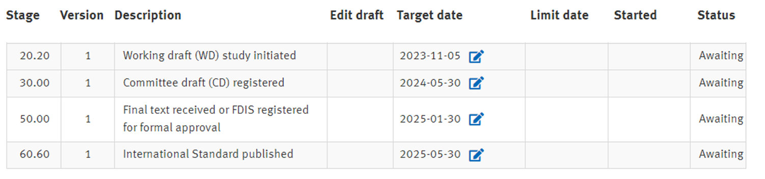
ISO 19176-1 development timeline

Slide 11
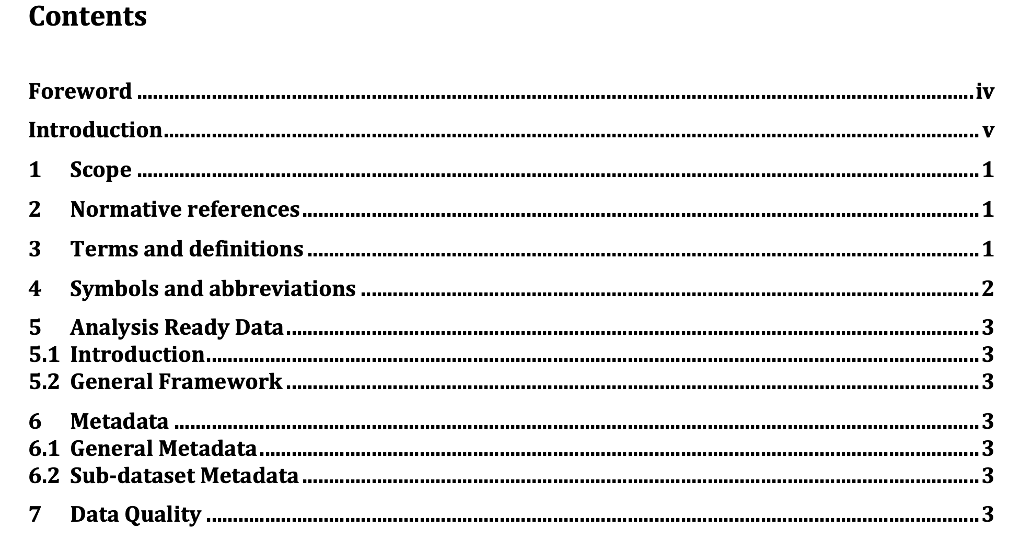
ISO 19176-1 Outline

Slide 12
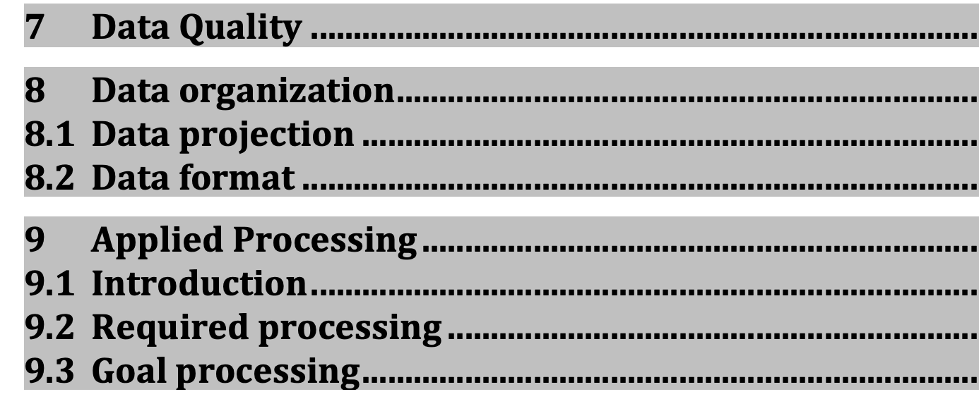

Slide 13
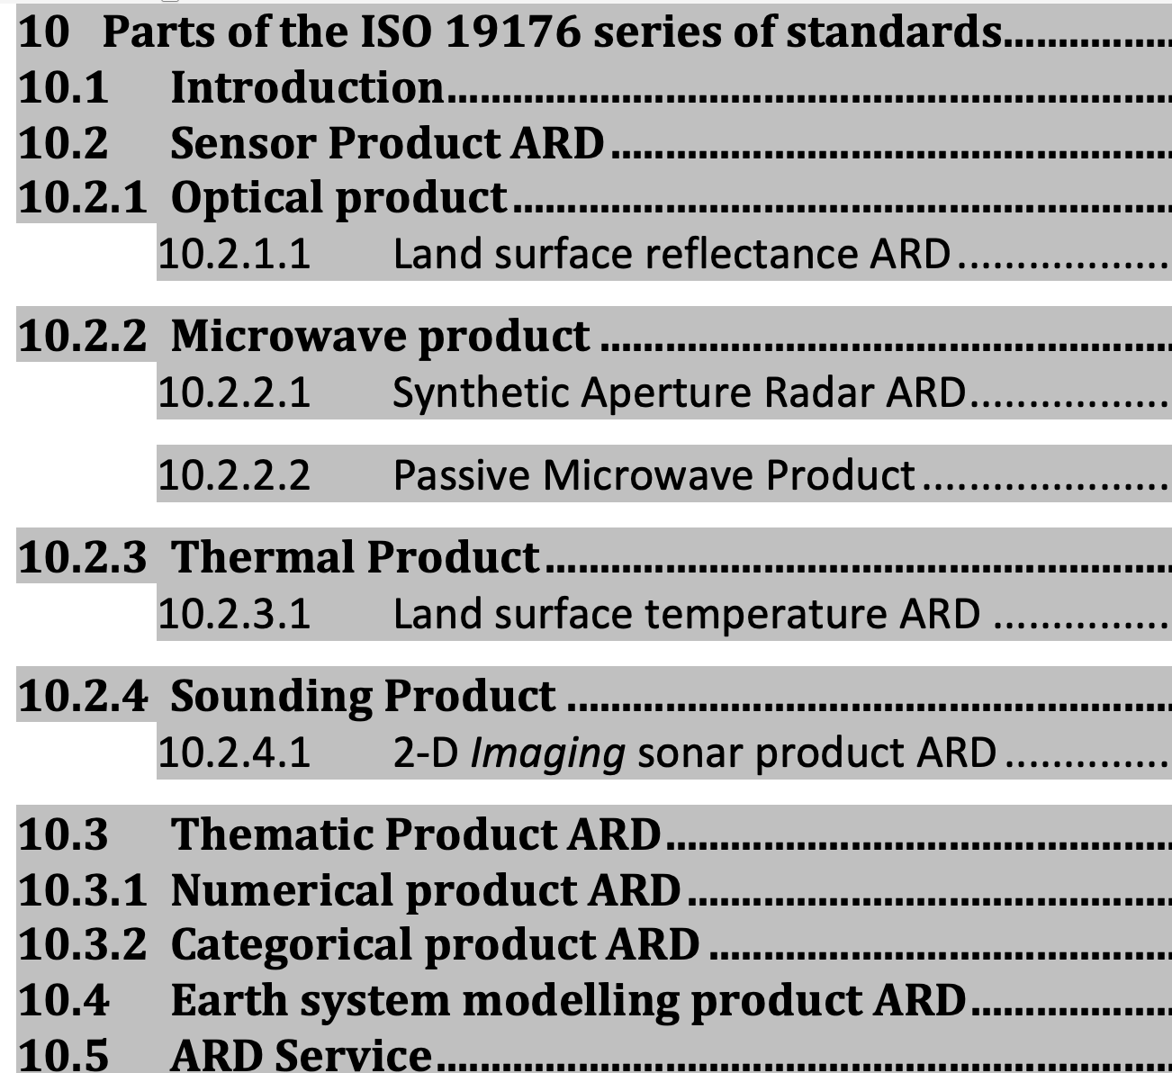

Slide 14
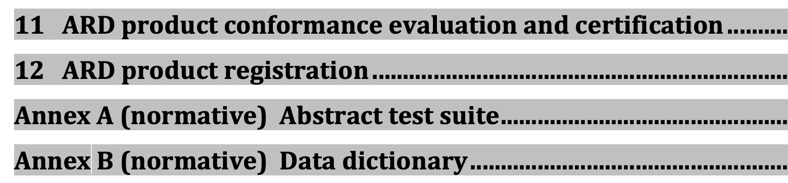

Slide 15
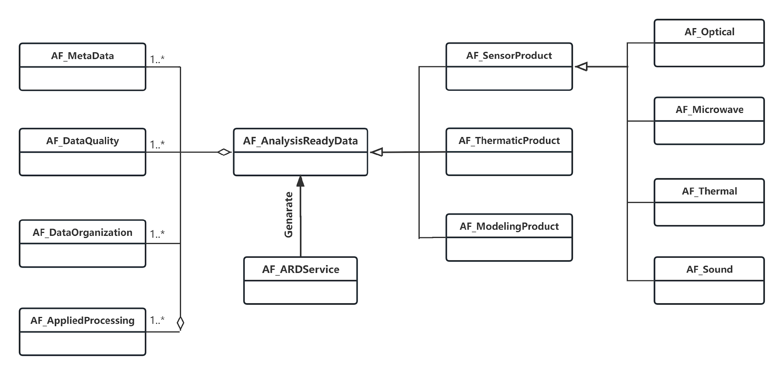
Overall UML model

Slide 16
Future work
Make the committee draft ready by end of May 2024
Community engagement/promotion
Welcome CEOS WGISS members to join the development

