Slide 1
NOAA Agency Report
Kenneth Casey, PhD, Nancy Ritchey, and Rich Baldwin
Deputy Chief, Data Stewardship Division
NOAA/NESDIS National Centers for Environmental Information (NCEI)
March 2024
WGISS-57
Sydney, Australia

Slide 2
One-Slide Summary
Some details provided on NOAA “new space” activities with industry/commercial partners
Update on NESDIS Common Cloud Framework (NCCF)
NCCF continues progress since last WGISS update, with new Secure Ingest capability. Direct cloud access still working through agency approval
Cloud archive service, Open Information Stewardship Service (OISS), preparing for Production deployment
Updates from NOAA/NESDIS/NCEI
OneStop NOAA Data Catalog has fully replaced old CKAN system
Heavy emphasis on preparing for cloud data migrations

Slide 3
Some “New Space” Activities at NOAA
NOAA Commercial Data Program
Engages with the commercial sector through pilots and acquisition of operational satellite data-as-a-service for commercial data to help improve weather forecasts and provide risk reduction to the overall observing system
Currently two lines of effort,
Commercial Purchase: Radio Occultation Data Buy
Commercial Weather Data Pilot (CWDP) Round 4: Ocean Surface Winds
Industry Proving Grounds (IPG) - not exactly “New Space”, but industry related
$85 million investment to promote the development and use of actionable climate information, led by NCEI
Focused on three industries (Finance and reinsurance, retail and architecture, and engineering) to inform sector-relevant data tools and user-friendly climate data

Slide 4
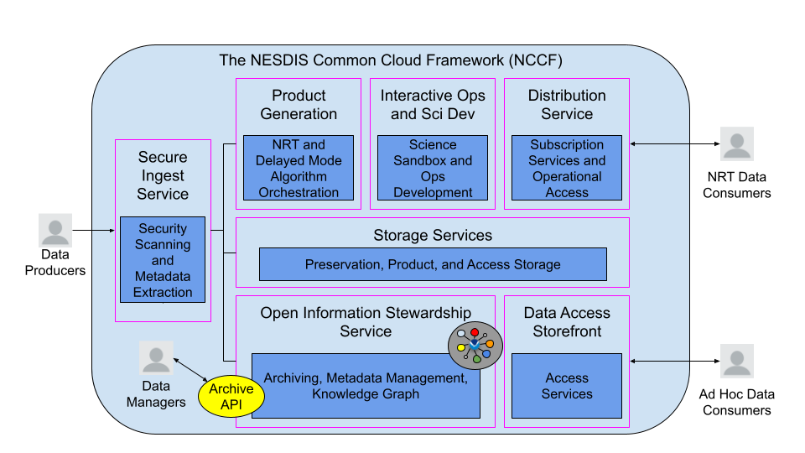
NESDIS Common Cloud Framework (NCCF)
Several operational pieces, including Product Generation and soon, new Secure Ingest Service
Enabling public access in agency approval process
Archive service, OISS, moving into User Acceptance and Test tier this Program Increment (PI)
To Production next PI
Notes:
This figure illustrates the high-level view of the NESDIS Common Cloud Framework (NCCF), a framework of reusable services providing data ingest, product generation, science development, data access, and long term data preservation and stewardship.

Slide 5
The New Cloud Archive Approach…
Leverage NCCF services and knowledge graphs (KG) in a semantically-enabled, linked open data interoperability framework to enable full provenance in a scalable, repeatable, and transparent platform
We are calling this new platform the Open Information Stewardship Service (OISS)
Notes:
Leveraging the cloud and knowledge graphs allows us to build an ambitious new platform:
Semantically-enabled
Linked open data
Full provenance
Scalable, repeatable, and transparent

Slide 6
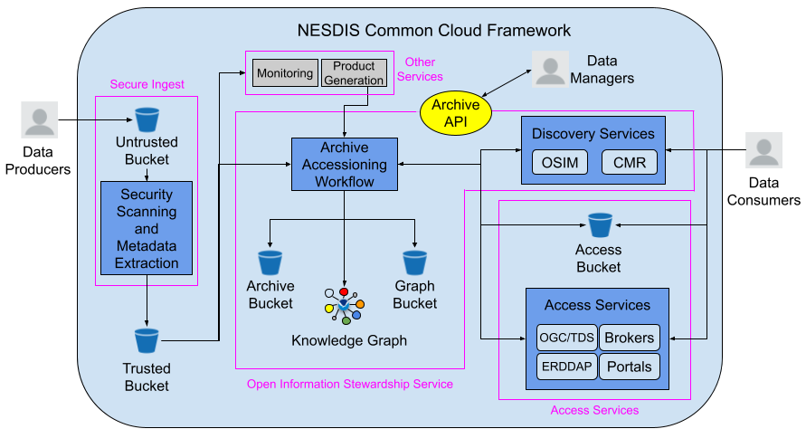
OISS: Broader NCCF Data Flow View
As data flow intro and through the NCCF, the data orchestration capability of OISS comes into play
Data enter via Secure Ingest, then are picked up and moved into archival storage and access services, documented in enterprise catalogs, and directed to other NCCF services as needed
Notes:
The NCCF Open Information Stewardship Service (OISS) - This figure illustrates the new NOAA Cloud Archive service, OISS, in the broader context of information flow through the NCCF.

Slide 7
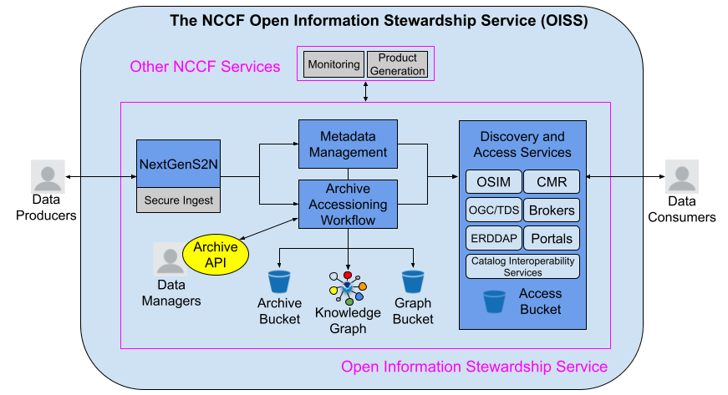
OISS: OAIS Reference Model View
From an Open Archival Information System (OAIS) Reference Model perspective, OISS connected to all OAIS Functional Entity areas (Ingest, Administration, Data Management, Archival Storage, Access, etc.)
Notes:
The NCCF Open Information Stewardship Service (OISS) - A slightly different view, more from an OAIS perspective.

Slide 8
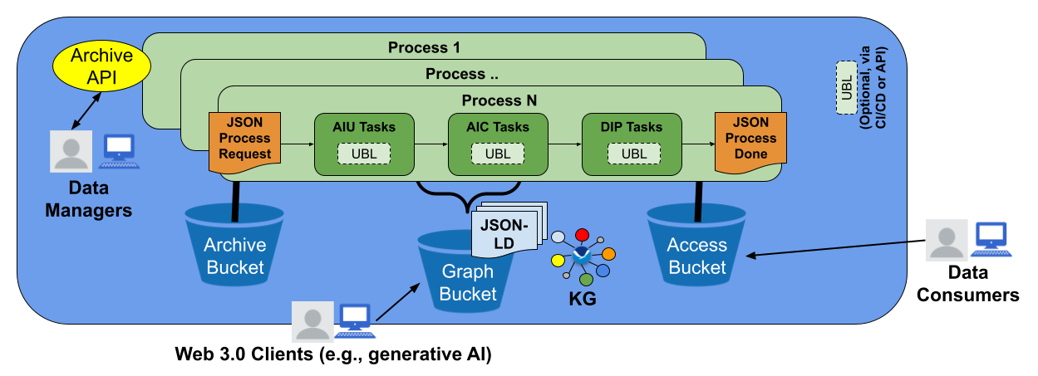
OISS Archive Accessioning Workflow
Processes in the event-driven framework execute AIU, AIC, and DIP tasks, move data to Archive and Access buckets, and write results to the Graph Bucket and the KG.
AIU = Archival Information Unit UBL = User Business Logic
AIC = Archival Information Collection DIP = Dissemination Information Package
Notes:
The OISS Archive Accessioning Workflow: This figure shows how processes in the event-driven framework execute AIU, AIC, and DIP tasks, move data to Archive and Access buckets, and write results to the Graph Bucket and the KG. Optional tasks containing User Business Logic (UBL) can be executed either internally via CI/CD or externally via API calls. Processes are defined by data managers and validated by the Archive API. Not only are the data exposed, but fully linked JSON-LD documents storing the patterns/processes/workflows are too, enabling transparent and accessible provenance.

Slide 9
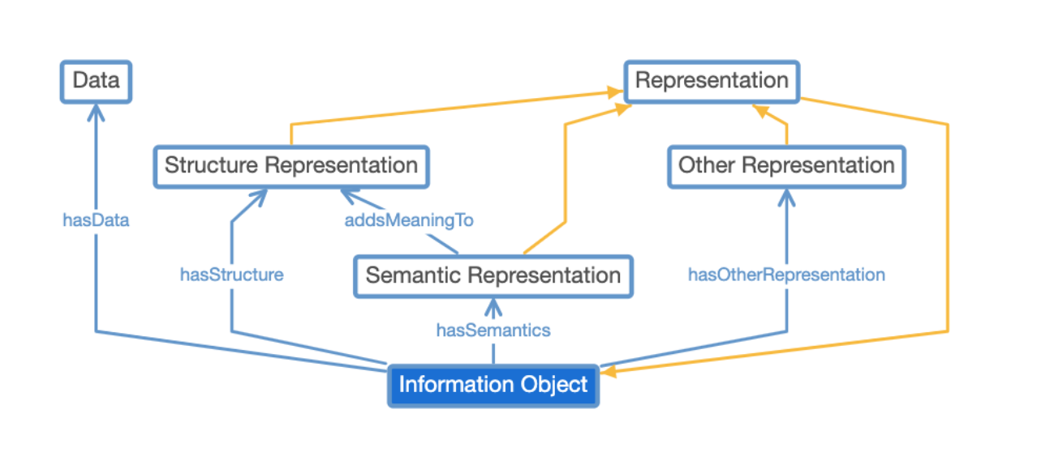
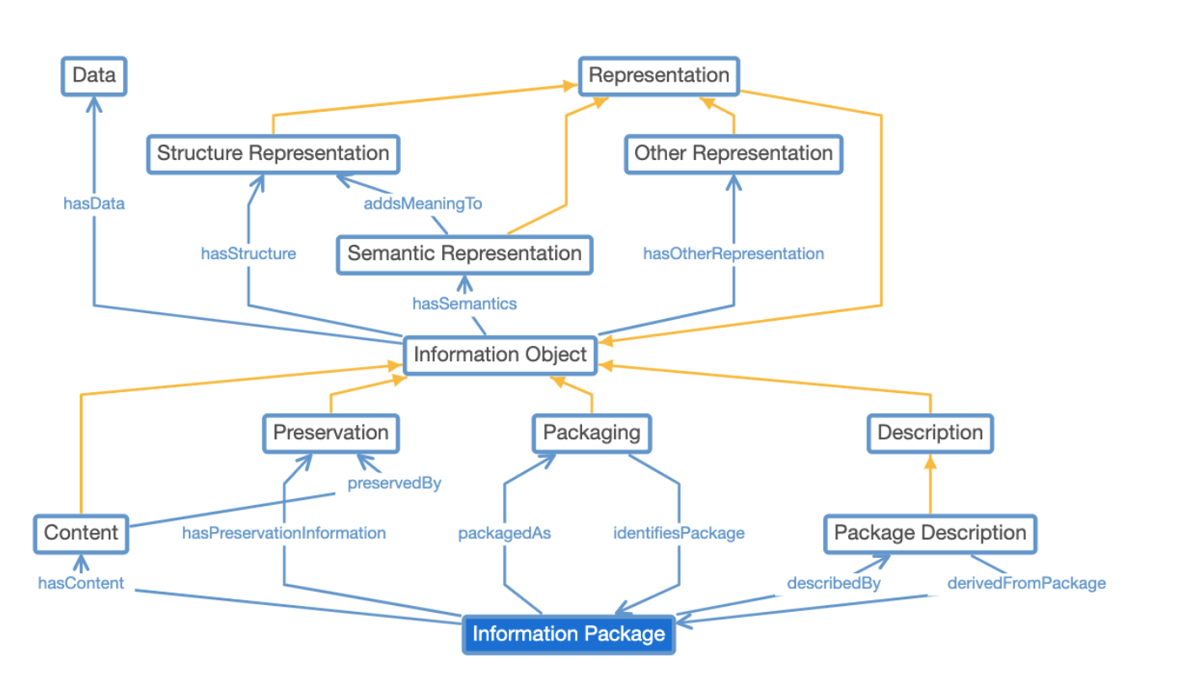
Semantic Interoperability in OISS
“Process as data” in the KG is big step forward, but alone cannot solve interoperability
Semantic interoperability within a shared reference model is required to allow data to be shared and reused by people and their applications across communities and domains
Information Objects are combined to create AIUs, which are instantiations of Information Packages
Using terms and patterns from existing ontologies (SSN, SOSO, Schema.org, SensorML, Dublin Core, GCMD, NIEM, SWEET, etc.) enables users of the cloud archive service to reap rich benefits of the semantic web
We also enable new, user-defined ontologies that are constructed and published automatically to the KG for discovery and reuse
Information Object: the primary building block, recursive and generic
Information Package: the secondary building block, a complete generic model
Notes:
But it is not enough that the process definitions themselves are encoded as data to solve the interoperability problem. We need semantic interoperability within a shared reference model as well. Grouping AIUs into AICs with context in this shared data model with semantics enables users to reap the benefits of the semantic web, allowing data to be shared and reused by people and their applications across communities and domains.

Slide 10
Power of a Fully-Integrated KG
Every archive workflow step is tracked and considered “data”, enabling scientific reproducibility and transparency
Semantic interoperability allows for the KG to be shared across people and apps
Linkages to other concepts in the KG (and to other KGs) can be explored via the “connective” power of the KG
Supports Large Language Models, AI, and Earth Digital Twin implementations

Slide 11
Current Status of the NOAA Cloud Archive
Gearing up for promotion of OISS to the NCCF Production tier
In Dev tier now, User Acceptance and Test (UAT) tier by April
Promotion to Production planned for our next Program Increment (Apr-Jul period)
Also gearing up for wide use and application of OISS to support both new archive requests and migration of existing holdings, including everything in CLASS
Cohort of ~10 staff being trained now, using Jupyter notebooks to configure the archive workflows

Slide 12
Activities at NCEI
OneStop-Inventory Manager operational
Sanctioned as the official NOAA Data Catalog, with metadata workflows refreshed across all NOAA Line Offices
CKAN decommissioned
NCEI staff focused on cloud migrations, including science applications and data streams
Starting with teams in our Boulder, Colorado facility, moving entire contents of Storenext system (~ 5 PB) over next 1.5 years
Initial focus on Passive Acoustic Data, Hydrographic Surveys, and Trackline Geophysics
CoMET = Collection Metadata Editing Tool

Slide 13
Questions?

