Slide 1
Geoscience Australia Agency Report
Simon Oliver
Geoscience Australia
Agenda Item 3.1
WGISS-57
4-7 March 2023
Sydney, Australia

Slide 2
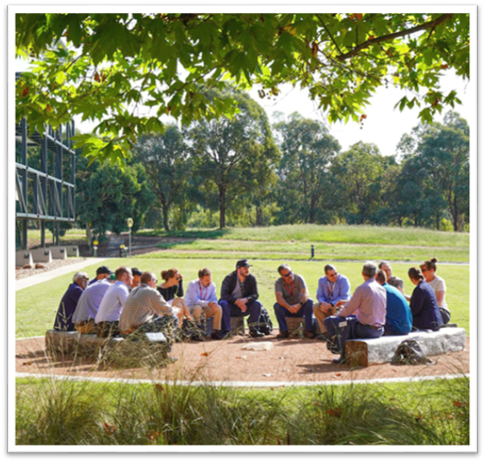
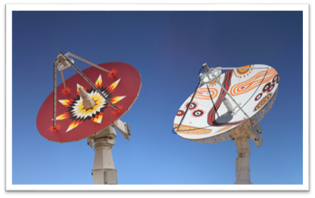
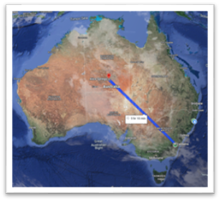
Geoscience Australia
Australia's national public-sector geoscience organisation.
Minerals, Energy, Groundwater, Positioning, Location Information, Oceans, Reefs, Antarctica, Community Safety and Earth observation.
Australian Landsat Station - 1979

Slide 3
Impact from Earth observation
Notes:
In terms of impact, DEA products and services are being used by Australian governments to:
map water availability, environmental watering and irrigated cropping in the Murray-Darling Basin;
measure the state of the environment to better understand changes in land use and inform land management practices nationally;
monitor wetlands, coastal change, shorelines and mangrove forest extents, and;
gain situational awareness of bushfires on a national scale.
Australia's State of the Environment Report, 2021 included over 20 references to DEA datasets across five sections:
Datasets referenced included Coastlines, Land Cover, Water Observations from Space, Mangroves, Fractional Cover and Surface Reflectance.
DEA was recognised as an underpinning platform for Earth observation data analytics. The report acknowledged DEA program objectives, as well as specific mentions of DEA Maps and Sandbox.
DEA Land Cover is used by the Department of Climate Change, Energy, the Environment and Water, and the Australian Bureau of Statistics as part of Australia’s national environmental-economic accounts report under the United Nations’ System of Environmental-Economic Accounting (SEEA).
DEA created a time series dataset that estimates how water volume in waterbodies changes over time, using LiDAR-derived Digital Elevation Models, DEA's Sentinel-2 Surface Reflectance imagery, and Water Observations data. DEA’s water volume estimates are being used to assess on-farm storage across the Northern Murray-Darling Basin bringing increased transparency and accountability to water management in the Basin and promoting water compliance and its enforcement.

Slide 4
Overview
Analysis Ready Data
Collection Management
Copernicus Hub
DEA Knowledge Hub
DEA Sandbox
DEA Notebooks
STAC implementation
DEA Explorer
OpenDataCube

Slide 5
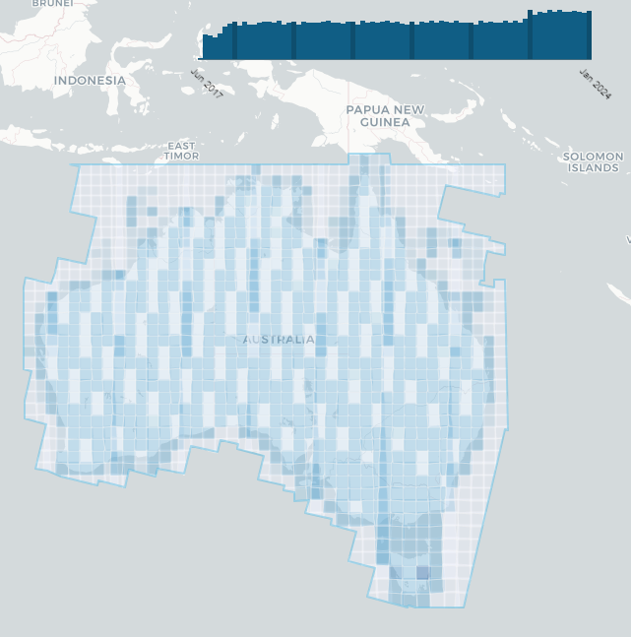
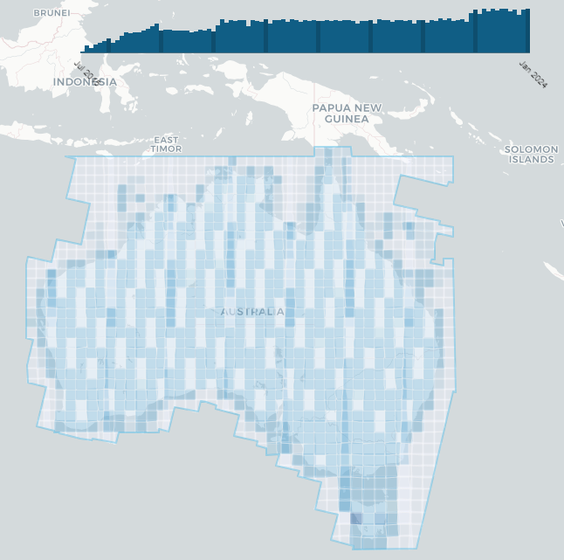
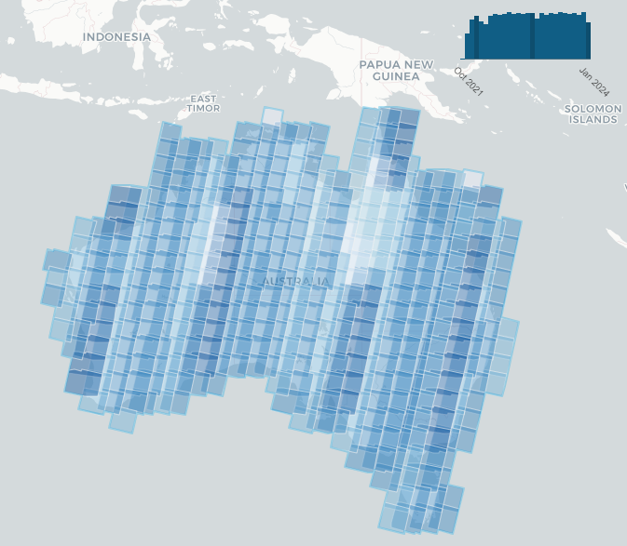
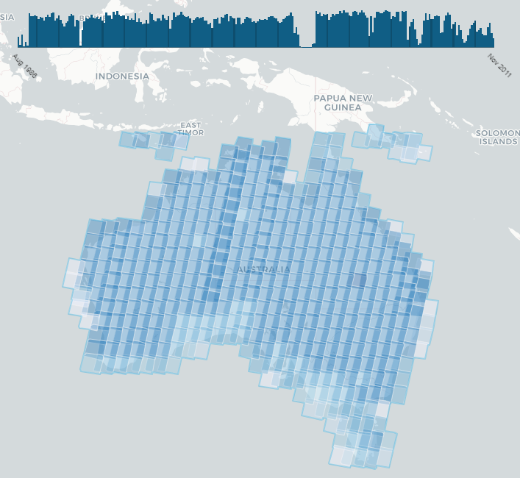
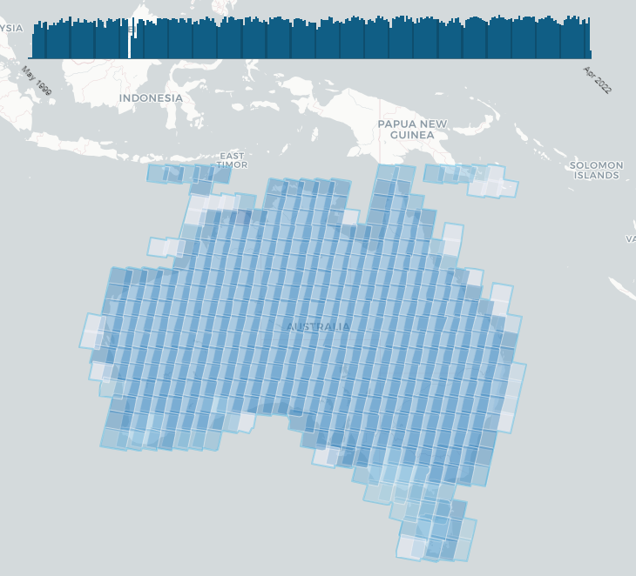
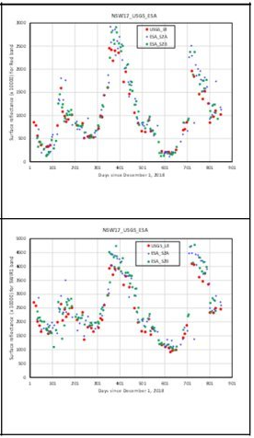
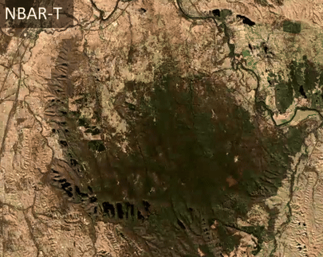
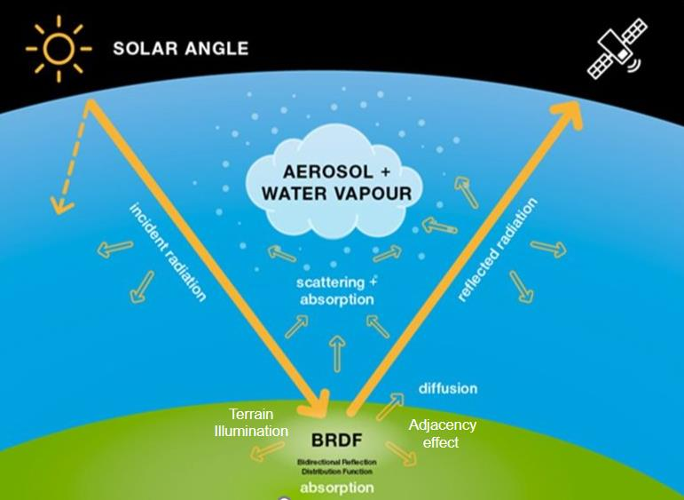
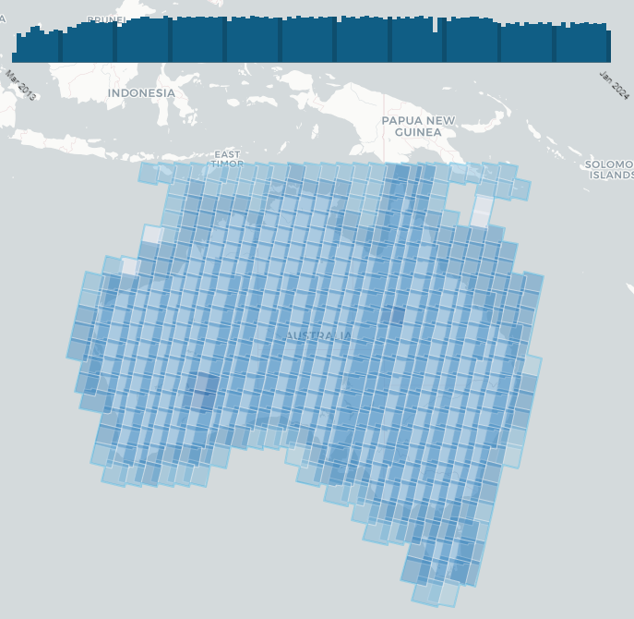
Analysis Ready Data
Sentinel-2A&B and Landsat 5-9 (Geoscience Australia NBART)
Seeking to influence next generation of harmonizable surface reflectance
Notes:
Geoscience Australia developed it's own surface reflectance approach many years ago based around an Nadir, Bi-directional Reflectance Distribution Function Adjusted Reflectance with Terrain Illumination correction (NBART). In recent years we've moved entirely to NBART products and used to produce and make available non-terrain corrected products.
Our Landsat and Sentinel-2 products basically run on the same algorithm using a common workflow with common auxiliary inputs. This means that our surface reflectance for like bands between Landsat and Sentinel-2 are highly comparable and in many ways equivalent and harmonizable.
Something we're pursuing in other areas of CEOS including Working Group on Calibration and Validation (WGCV) and the Land Surface Imaging Virtual Constellation (LSI-VC) in the idea of encouraging ARD providers to produce equivalent measures of surface reflectance. Currently there is a wide interpretation in terms of how surface reflectance may be defined, which results in harmonization approaches like those from Sen2Lke from ESA and NASA's Harmonized Landsat and Sentinel-2 needing to reprocess the data to achieve that equivalence.

Slide 6
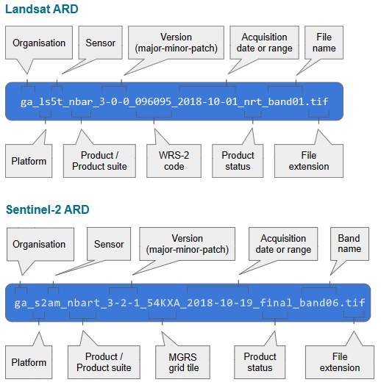
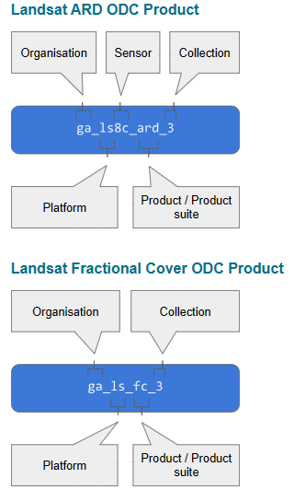
Collection Management
Maturity Concept
Aims to produce the best available product
NRT, Interim and Final maturity (lower levels superseded as data becomes available)
Same product – maturity noted in metadata and supported by OpenDataCube API.
Versioning of products and datasets
Interim
Interim
Final
Final
Supercomputer
NRT
NRT
Interim
Interim
Final
Final
Notes:
We produce rapid versions of these products for Landsat and Sentinel-2 as soon a practicable after acquisition and download. Once final versions of the Level 1 and auxiliary data used in the correction arrive we reprocess to obtain a final version of the data.
A little over a year ago Geoscience Australia implemented a dataset maturity concept which enables transition from NRT to final versions of a dataset, without users having to switch products. Through our OpenDataCube implementation, only one version of a dataset is available at a given point in time.

Slide 7
Digital Earth Australia Products
Baseline satellite data
ga_ls5t_ard_3 | Geoscience Australia Landsat 5 Thematic Mapper Analysis Ready Data Collection 3
ga_ls5t_nbart_gm_cyear_3 | Geoscience Australia Landsat Nadir BRDF Adjusted Reflectance Terrain, Landsat 5 Geomedian Calendar Year Collection 3
ga_ls7e_ard_3 | Geoscience Australia Landsat 7 Enhanced Thematic Mapper Plus Analysis Ready Data Collection 3
ga_ls7e_nbart_gm_cyear_3 | Geoscience Australia Landsat Nadir BRDF Adjusted Reflectance Terrain, Landsat 7 Geomedian Calendar Year Collection 3
ga_ls8c_ard_3 | Geoscience Australia Landsat 8 Operational Land Imager and Thermal Infra-Red Scanner Analysis Ready Data Collection 3
ga_ls8c_nbart_gm_cyear_3 | Geoscience Australia Landsat Nadir BRDF Adjusted Reflectance Terrain, Landsat 8 Geomedian Calendar Year Collection 3
ga_ls9c_ard_3 | Geoscience Australia Landsat 9 Operational Land Imager and Thermal Infra-Red Scanner Analysis Ready Data Collection 3
ga_s2am_ard_3 | Geoscience Australia Sentinel 2A MSI Analysis Ready Data Collection 3
ga_s2bm_ard_3 | Geoscience Australia Sentinel 2B MSI Analysis Ready Data Collection 3
Notes:
Geoscience Australia has iterated to Collection 3 with consistent processing across Sentinel-2 and Landsat product suites.

Slide 8
Digital Earth Australia Products
Inland water
ga_ls_tc_pc_cyear_3 | Geoscience Australia Landsat Tasseled Cap Percentile Calendar Year Collection 3
ga_ls_wo_3 | Geoscience Australia Landsat Water Observations Collection 3
ga_ls_wo_fq_apr_oct_3 | Geoscience Australia Landsat Water Observations Frequency April to October Collection 3
ga_ls_wo_fq_cyear_3 | Geoscience Australia Landsat Water Observations Frequency Calendar Year Collection 3
ga_ls_wo_fq_myear_3 | Geoscience Australia Landsat Water Observations Frequency Multi Year Collection 3
ga_ls_wo_fq_nov_mar_3 | Geoscience Australia Landsat Water Observations Frequency November to March Collection 3
Land and vegetation
ga_ls_fc_3 | Geoscience Australia Landsat Fractional Cover Collection 3
ga_ls_fc_pc_cyear_3 | Geoscience Australia Landsat Fractional Cover Percentile Calendar Year Collection 3
ga_ls_mangrove_cover_cyear_3 | Geoscience Australia Landsat Mangrove Cover Calendar Year Collection 3

Slide 9
Collection UPGRADE 3.x.x
Operations Development
Prototyping
Operations Implementation
Archives Act 1983
Commission New Collection
Disposal Authority
Project Initiation
DEA Board
Endorsement
Records Management
Decommission
Previous Collection
DEA Management Committee
Senior Responsible Official
Project Close
Upgrade Proposal
Upstream Collection Upgrade
Upgrade Champion
Innovation milestone within GA

Slide 10
Collection UPDATE x.1.0
Operations Development
Change Implementation
Version update
Approval
Operational Deployment
DEA Change Control Board
Monitoring
Issue Closed
Change Control Board Proposal
Update Proponent
Issue identified
Remedy evaluation

Slide 11
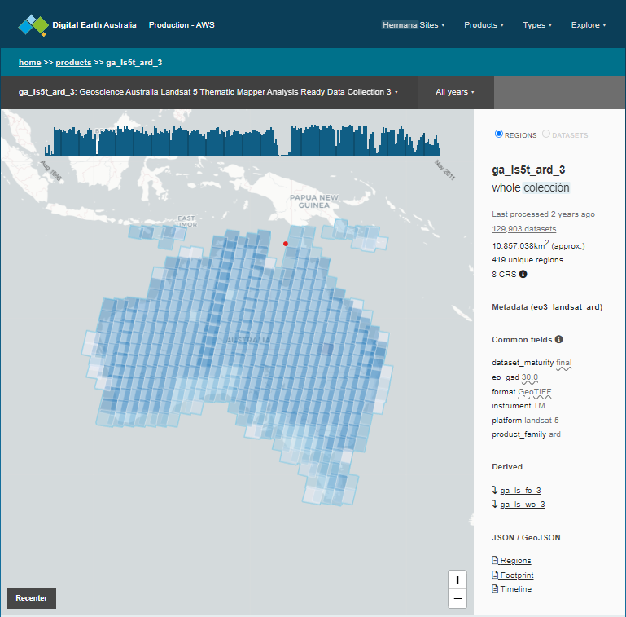
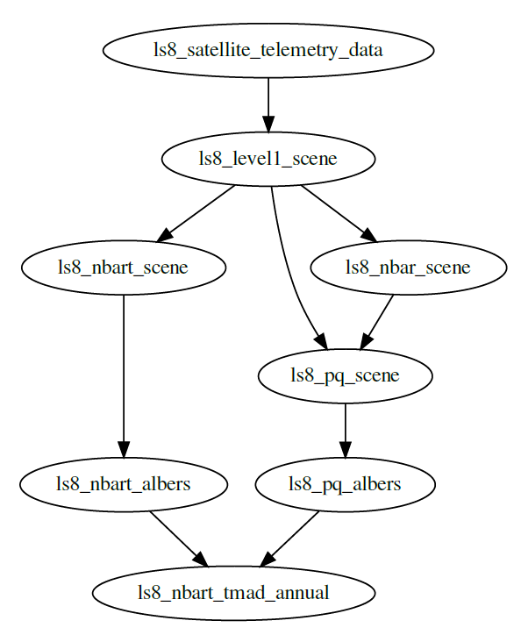
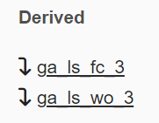
Linked metadata
Linked Metadata Enables Collection Management and simplifies updates
Automatically create provenance graphs through ODC API

Slide 12
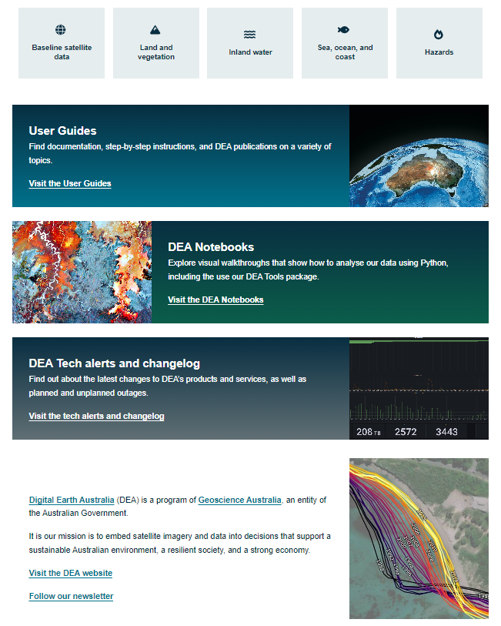
DEA Knowledge Hub
Everything users need to know about DEA products and services
User Guides and Notebooks
Tech alerts / changelogs
Benefits
Consistent version controlled repository
On-brand look and feel
Easy for collaborators to edit
Static website with low-cost hosting
Notes:
A very recent activity has been to consolidate our product information and transition away from Drupal based document management
The knowledge hub brings together information about Digital Earth Australia’s products and services, allowing users to utilise our free and open-source satellite imagery archive.
The Knowledge Hub provides a one stop shop for information about DEA products and services. Each of DEA's published data products has a dedicated metadata page, full of information about how to use, access and cite the product, as well as detailed information on how the product was developed, information on quality and accuracy and a history and product changelog.
The User Guides section provides information on how to use and interact with DEA products and services, and acts as a helpful starting point for new users to DEA.
DEA Notebooks provide step-by-step, interactive code examples that demonstrate how to utilise python and the open data cube to access and analyse DEA data. These Notebooks are written as a tutorial, and start with a beginners guide that introduces basic python code concepts. Examples increase in complexity and end with examples of real world applications of DEA data.
A tech alerts and changelog is provided on the site for users to monitor to be notified of updates to DEA products and services, new releases and planned and unplanned outages.
The Knowledge Hub site has a public GitHub repository and is built using Sphinx. The site design has been templated to create a consistent look and feel, and to make the site easy to maintain and update. Hosting on github means that users within DEA with a github account can contribute content easily, removing a previous barrier to content maintenance created by the previous Drupal system. Migration of DEA's content to this platform has reduced the barrier for maintenance and upkeep, improved the flexibility of the site and reduced overall costs and resources required to maintain our public knowledge base.

Slide 13
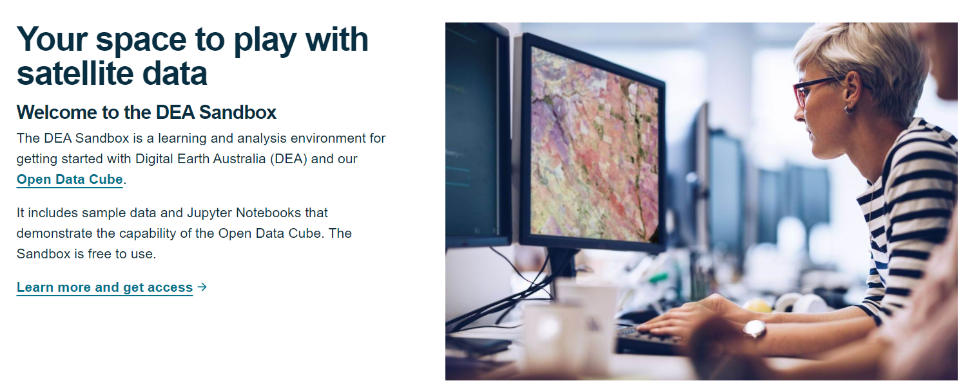
Digital Earth Australia Sandbox
Notes:
Geoscience Australia maintains and continues to develop our free Jupyter sandbox environment which allows users run small scale process on our infrastructure and data. We also maintain a rich set of Jupyter notebooks and work hard to keep it up to date and relevant / reflective of our current product offerings.

Slide 14
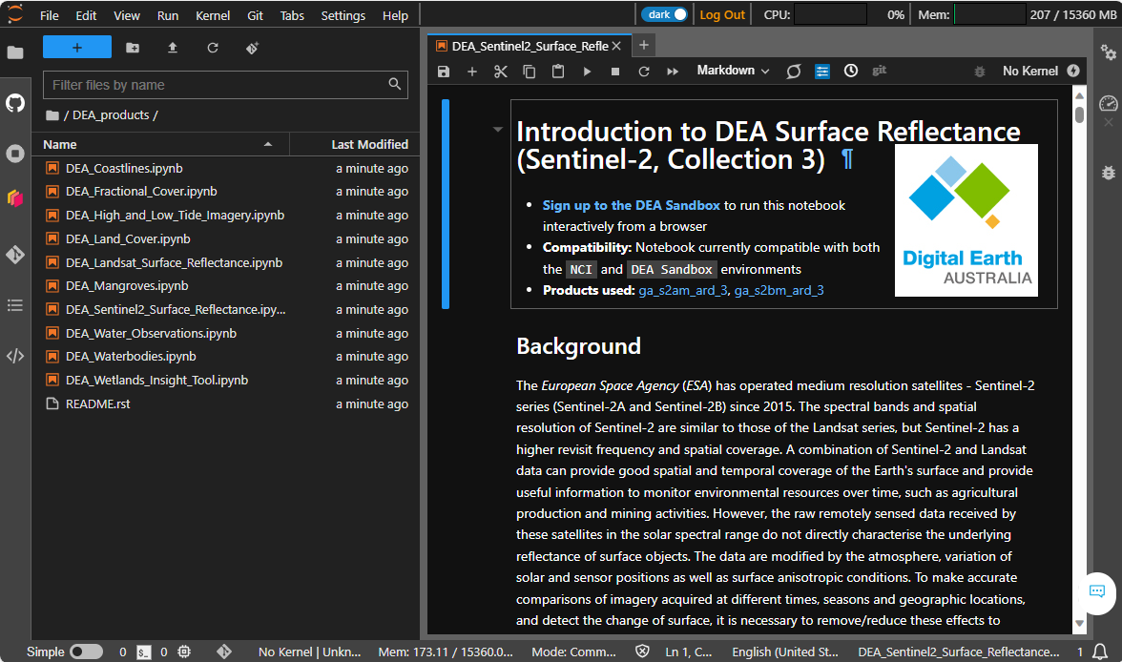

Slide 15
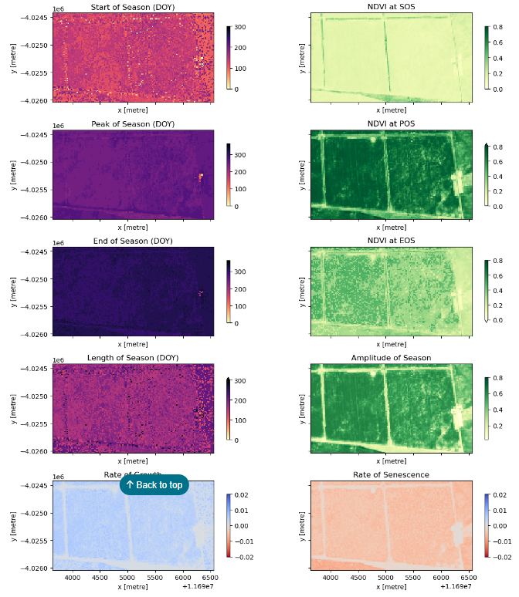
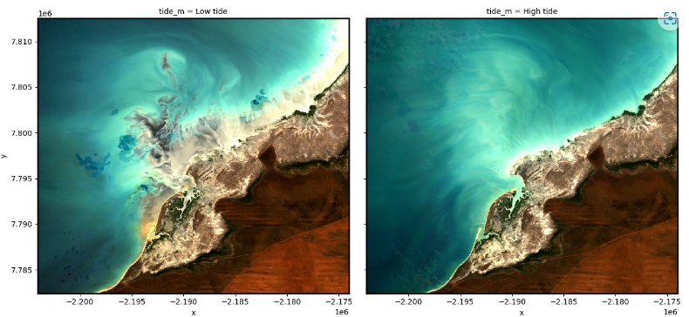
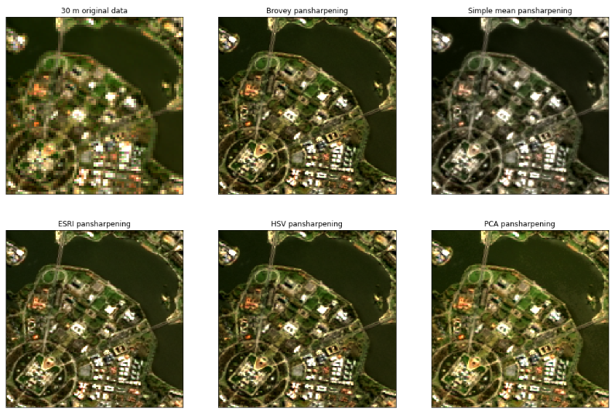
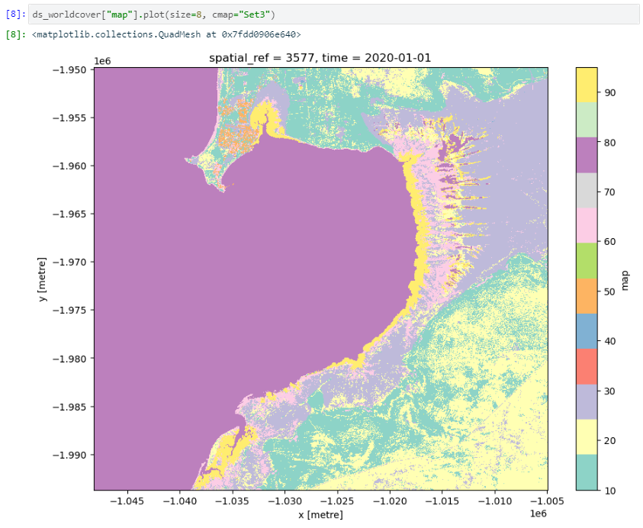
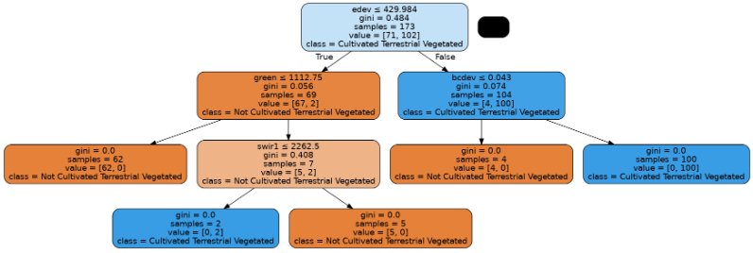
Digital Earth Australia Notebooks
Available in DEA Sandbox
Maintains alignment with product evolution
Open to contributions
Extensive how-to guides
Phenological studies
Combining tidal and image data
Pan-sharpening Landsat
Combining DEA and Planetary Computer
Machine Learning routines
Notes:
The Digital Earth Australia notebooks and tools repository (dea-notebooks) hosts Jupyter Notebooks, Python scripts and workflows for analysing Digital Earth Australia (DEA) satellite data and derived products. This documentation is designed to provide a guide to getting started with DEA, and to showcase the wide range of geospatial analyses that can be achieved using DEA data and open-source software including Open Data Cube and xarray.

Slide 16
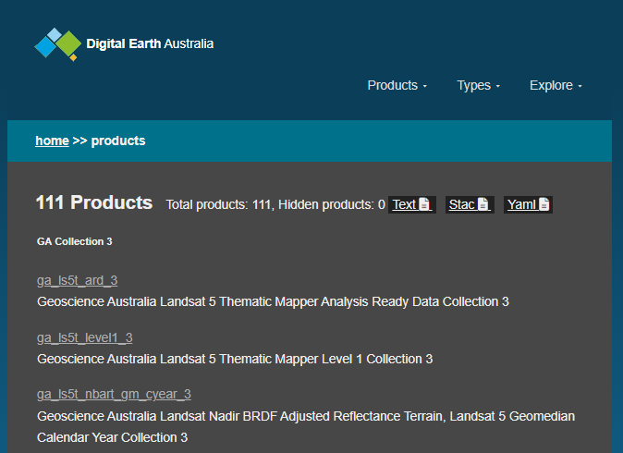
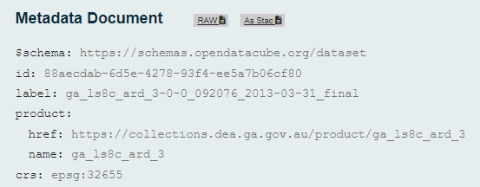
STAC Implementation
explorer-aws.dea.ga.gov.au/stac
All data and collections available as STAC v1.0.0 Items, Catalogs and Collections
Stored in ODC's index, but converted to STAC automatically and transparently on request
This has allowed us to upgrade our STAC baseline in the past without rewriting old collections.
Collections can be searched using STAC API 1.0.0rc1
Uses PostGIS underneath for spatial queries
This is slightly behind the stable 1.0.0 release of STAC API (though differences are small)
We don't support many extensions yet, such as allowing search by arbitrary fields (although ODC underneath does).
Dynamic catalogs, such as the most recently-added data across all collections ("arrivals" catalog)

Slide 17
OpenDataCube (ODC)
Open Source, managed by an independent multi-org Steering Council. Much development still funded by Geoscience Australia
Working on major new releases (v2.0 via transitional v1.9 series)
Addressing accumulated technical debt: simplifying and cleaning up architecture and APIs, removing unused features and preparing for expected future challenges.
Dropping support for legacy ODC metadata formats, facilitating better alignment between ODC metadata (EO3) and STAC standard.
Managed migration pathway (deprecate old features in 1.9, remove in 2.0, data migration tools, support for v1.8.x to continue until 1.9.x is feature complete.)
New PostGIS-based database backend, with native CRS spatial indexes (e.g. performant spatial searches across the anti-meridian and in polar regions)
Reintegration with the odc-geo package.
Support for multi-dimensional loading, e.g. for hyperspectral datasets (being contributed by CSIRO)

Slide 18
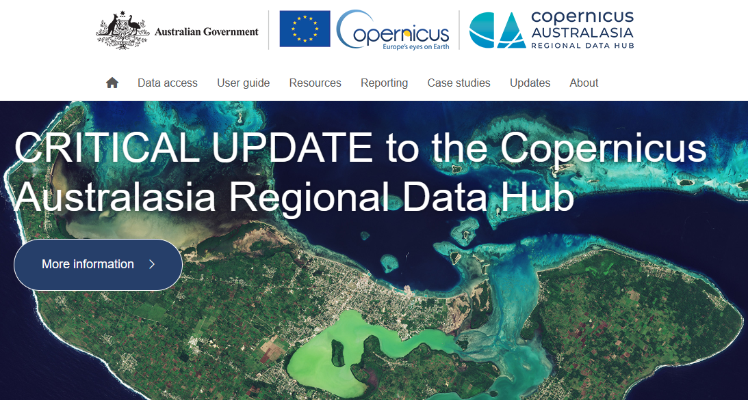
Notes:
The Hub has been operating since 2016 and provides a local copy of Sentinel data in our region – hosted on The National Computational Infrastructure's supercomputer at the Australian National University.
The Hub holds more than 6PB of Sentinel-1, 2, 3 and 5P satellite data, and is growing by 1PB/year.
Current membership of the Hub includes Geoscience Australia (management), CSIRO, Queensland, New South Wales and the Western Australia government.
From October 2023 until mid-2024, we will be undertaking major upgrades to migrate the Hub to the Copernicus Data Space Ecosystem platform in Europe.
Integration of the Hub with the EUMETSAT Data Store has already been completed, providing optimal access to Sentinel Marine products.
***
With our Steering Committee agreeing to continue the Copernicus Australasia Regional Data Hub (the Hub) beyond June 2024 when the current agreement ends, our focus has been to prepare for another five years of operation, particularly in light of the European Commission’s Copernicus Programme transitioning to the new Data Space Ecosystem platform (CDSE) this year. The CDSE will replace the current EU public access (Open/Sci/API) hubs due to be decommissioned during October 2023.
Over the next 6-12 months, the Copernicus Australasia Regional Data Hub will be making significant upgrades to its systems to ensure it remains compatible with the changes occurring in Europe. The upgrades will also improve system robustness and reliability, provide faster and more guaranteed access to new data, while remaining compatible with other services. The system will provide for more flexible data management and allow the Hub to utilise the latest storage and network technologies.
The major component will be transitioning our infrastructure to the new GAEL Store Service (GSS) platform that has been developed by GAEL Systems. As part of this transition, our data acquisition processes will migrate to the CDSE (as well as maintaining data acquisition from EUMETSAT’s Datastore), and a new user portal will be deployed.
The GSS platform will change how the Hub’s data is stored at the National Computational Infrastructure (NCI). This means the APIs used to connect to the Hub’s data will change to align with the CDSE APIs: https://dataspace.copernicus.eu/analyse/apis
Our new Hub is due to go live during October 2023 in line with the decommissioning of the legacy EU Hubs, and ESA’s transition to the CDSE. Initially, the GSS system will only contain data that is collected from October 2023 onwards. However, over a period of 3-6 months, it will be updated to hold all historic data. During this transition period, the current Hub portal will still be accessible, but will only contain pre-October 2023 historic data that has not yet been migrated to the new system. Once all the historic products have been migrated, we expect to decommission Sentinel Australasia Regional Access (SARA) and our legacy Hub. At this stage, we anticipate this will take place in early to mid-2024. Once the data migrations commence, we will provide a table to allow you to track data locations on this webpage.

Slide 19
Thank you!
Simon Oliver simon.oliver@ga.gov.au
Special Advisor, Digital Earth
earth.observation@ga.gov.au

