Slide 1
WGISS Action Review
Libby Rose
WGISS Secretariat
Agenda Item 2.2
WGISS-57
4-7 March 2023
Sydney, Australia

Slide 2
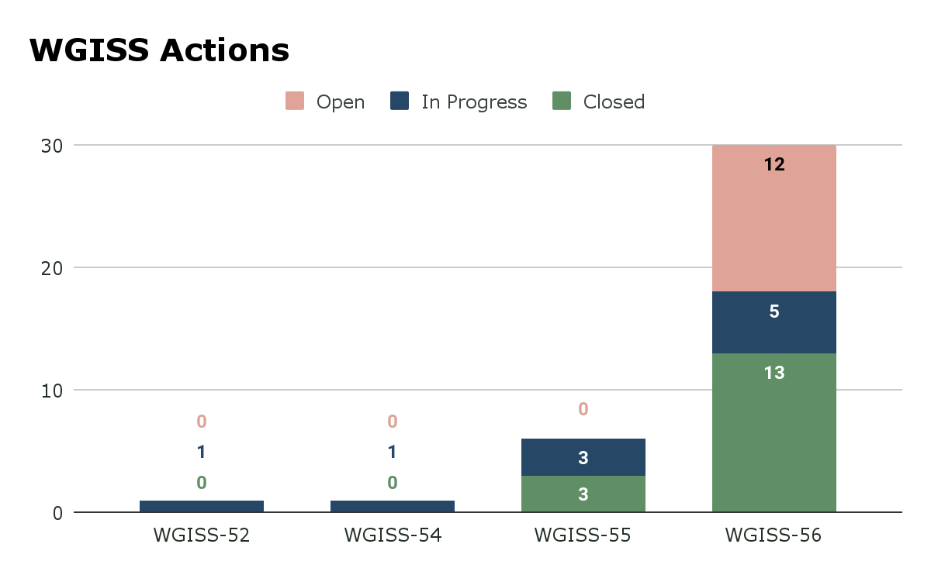
Summary

Slide 3
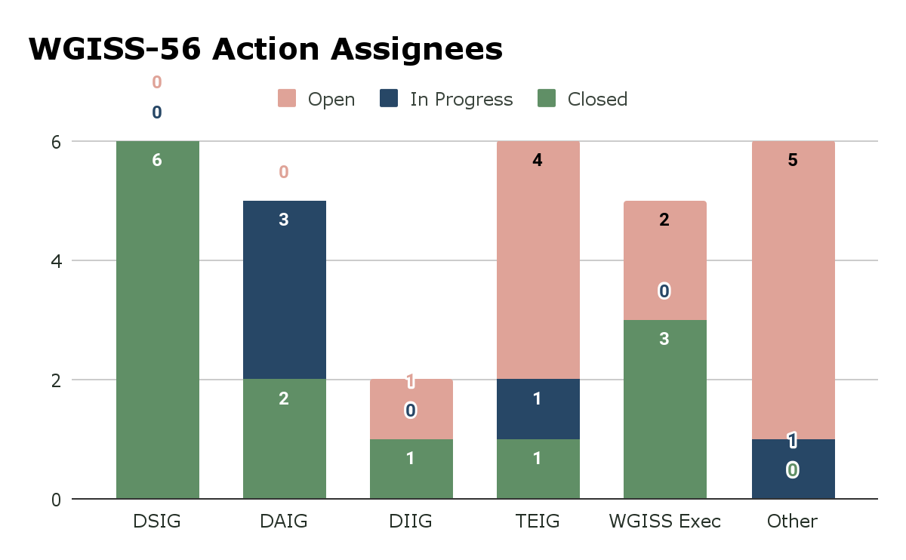
Summary

Slide 4
For Discussion: WGISS-56-01
WGISS to document cloud-enabled dataset recommendations including how data providers avoid data replication.
No assignee
Anyone willing to take this on?

Slide 5
For Discussion: WGISS-56-10
WGISS to review the GEO Data Policy to understand how that might impact CEOS.
Assigned to WGISS Exec
Anyone willing to take this on?

Slide 6
For Discussion: WGISS-56-25
WGISS to review CGMS Cloud Best practices document and evaluate whether WGISS should promote it and/or develop a CEOS Cloud Best Practices document.
No assignee
Anyone willing to take this on?

Slide 7
For Discussion
WGISS-56-01: WGISS to document cloud-enabled dataset recommendations including how data providers avoid data replication.
WGISS-56-10: WGISS to review the GEO Data Policy to understand how that might impact CEOS.
WGISS-56-25: WGISS to review CGMS Cloud Best practices document and evaluate whether WGISS should promote it and/or develop a CEOS Cloud Best Practices document.

