Slide 1
WGISS Work Planning
Tom Sohre, USGS
Agenda Item 2.2
WGISS-57
4-7 March 2023
Sydney, Australia

Slide 2
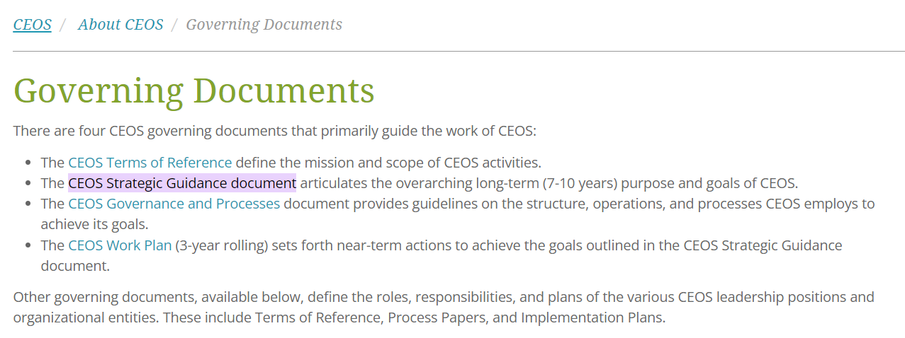
CEOS Governance

Slide 3
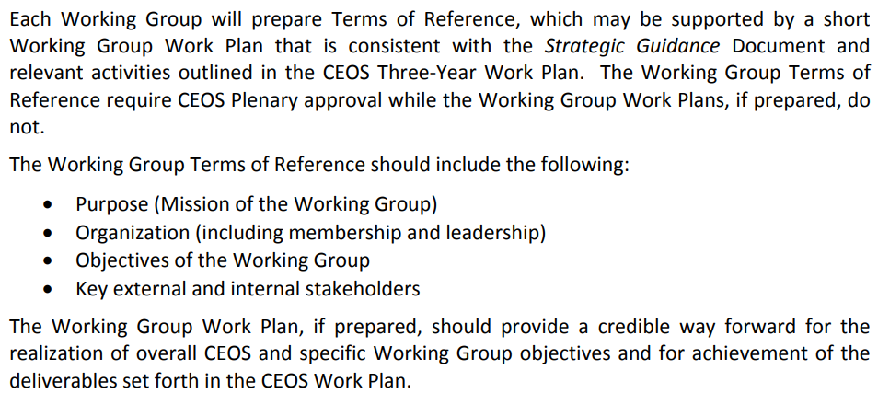
Working Group Governance
ToR last updated 2015
WGISS previously created Working Group Work Plans … but have not since ~2018
Notes:
Add links to ToR
Note here that “may be supported by WG work plan” … was done up until 2018 … but has not been done in recent years to my knowledge

Slide 4
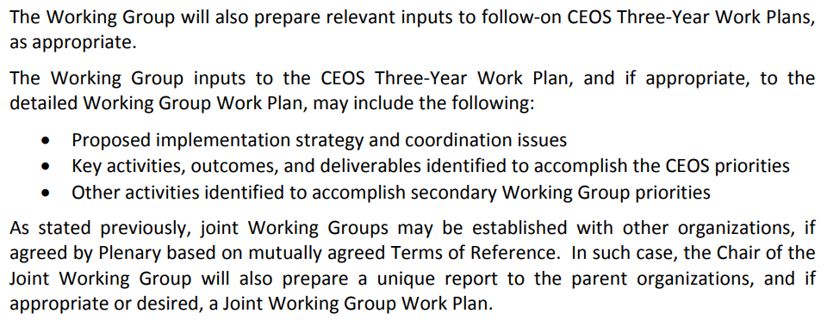
Governance cont.
2024-2026 Work Plan in development by CEO
(CEO presentation later)

Slide 5
WGISS Vision (ToR)
Purpose: To facilitate (CEOS) data and information management, and to support the provision of services for both data providers and data users
Goals:
To enable Earth observation data and information to be more accessible and usable to both data providers and data users world-wide through international coordination.
To foster easier exchange of Earth observation and related data and information to meet the requirements of users and data providers.
To foster the development of best practices and encourage the development of interoperable services that exploit space-borne Earth observation data.
To enhance the complementarity, interoperability and standardization of Earth observation data and information management and services with other types of geospatial data such as in situ data.

Slide 6
WGISS Objectives (ToR)
WGISS receives strategic direction and specific requests for work from CEOS Plenary and CEOS SIT.
WGISS provides reports on progress in achieving its objectives and also provides recommendations to the CEOS Plenary and CEOS SIT to help guide them in their strategic decision-making
WGISS Activities Fall into three main areas:
Support for CEOS.
… takes strategic direction from the CEOS Plenary and from the CEOS Strategic Implementation Team (SIT) …
Addressing issues related to data management, access and use.
… producing recommendations, guidelines, and best practices …
Knowledge Exchange.
… WGISS activities are coordinated across CEOS agencies and adequately promoted …

Slide 7
WGISS Workplan Deliverable History
Title | Status | Creation year | Completion date
CEOS OpenSearch Best Practices Guideline Document | closed | 2014 | 2014 Q4
CEOS Data Stewardship Best PracticesGuideline documents | closed | 2015 | 2015 Q4
Assessment of Technical Architectures for Supporting Operational Programs | closed | 2015 | 2015 Q4
Development of the Recovery Observatory Infrastructure | closed | 2015 | 2015 Q2
CEOS Data Stewardship Best PracticesGuideline documents | closed | 2015 | 2015 Q4
Study on future data architectures | closed | 2016 | 2016 Q4
CEOS data holdings reported in GEO | closed | 2017 | 2018 Q3
ECVs/CDRs Discovery and Access through WGISS Systems | closed | 2017 | 2020 Q2
Reference model for data stewardship planning and implementation | closed | 2017 | 2017 Q4
Improve WGISS Interoperability Standards Architecture | closed | 2017 | 2018 Q4
Technology Exploration webinars and workshops | closed | 2017 | 2021 Q4
CEOS data holdings reported and accessible in GEO and other international relevant contexts | closed | 2018 | 2022 Q4
Develop a White Paper on Single Sign-On (SSO) authentication. | closed | 2018 | 2019 Q4
Mekong Data Cube | closed | 2019 | 2021 Q4
Explore emerging trends and disrupting technologies (e.g. Artificial Intelligence);evaluate... | closed | 2019 | 2021 Q4
CEOS Glossary of Terms Related to Analysis Ready Data;Future Data Architectures;and Interoperability | closed | 2020 | 2020 Q4
Opensearch Best Practices to include Service Discovery | closed | 2022 | 2022 Q4
Archive Technologies White Paper | closed | 2022 | 2023 Q2
Discovery and Access for Data Analytics and Processing Tools and Services | closed | 2022 | 2024 Q1
Feasibility Study for Common Guidlines for the STAC Implementations | open | 2022 | 2024 Q3
Data Management and Stewardship Maturity Matrix | closed | 2022 | 2023 Q1
Jupyter Notebook Best Practice | open | 2022 | 2024 Q2
CEOS Interoperability Framework Roadmap | closed | 2023 | 2023 Q4
AI/ML White Paper | open | 2023 | 2024 Q4
CEOS Interoperability Handbook 2.0 | open | 2024 | 2025 Q1
White Paper on EO Data collections management and governance | open | 2024 | 2025 Q1
White paper on Software preservation | open | 2024 | 2025 Q3
CEOS Deliverable Tracking Tool
WGISS Best Practices and Guides
CEOS Publications

Slide 8
Topics for Consideration this Week…
Collaborate with SEO on “Interoperability Lab” (further discussion in Session 5.5 w/ David Borges)
Progress on implementation of Interoperability Framework … Handbook, Demonstrators, Maturity (discussion on Session 5)
Support for Biodiversity (and Ecosystem Extent Task Team) … Data Cubes, AI/ML, Interoperability
Review of past “Info Sharing” (i.e. Open Science, Open Data Cubes, Digital Twins) -> relevant topics for WGISS?
New Space Task Team … How to Incorporate into WGISS?
Resourcing our work (Recruiting)
Update WGISS Outreach Info (further discussion in Session 4.3)
Identify ways to improve feedback for Best Practices (and increase visibility to CEOS members)
Identify process improvements for “knowledge sharing” (info from CEOS members and/or collaborators)
Develop multi-year WGISS Work Plan (WGISS Priorities, more granular than CEOS Workplan “Deliverables”)
Notes:
WGISS Outreach Plan
WGISS Brochure (“What is WGISS”?)
Standard Slide Deck for presentations to collaborators
Further Discussion in Session 4.3

Slide 9
Backup

Slide 10
2024-2026 WGISS Proposed Deliverables
Number | Status | Title | Completion Date | Description
DATA-22-05 | OPEN | Feasibility Study for Common Guidlines for the STAC Implementations | 09/30/2024 (Q3 2024) | Evaluate the possibility of defining a guideline/best practice for the STAC at CEOS level, By that act for an alignment in implementing STAC (in all forms API, static search or metadata modelling)&nbsp;
DATA-22-01 | OPEN | Jupyter Notebook Best Practice | 06/30/2024 (Q2 2024) | Knowledge sharing with Jupyter Notebook will be investigated and the best practice will be issued.
DATA-23-01 | OPEN | AI/ML White Paper | 12/31/2024 (Q4 2024) | Use cases of AI/ML technologies for the Earth Observations will be collected, categorized and summarized as a white paper.
 | NEW | White Paper on EO Data collections management and governance | 03/31/2025 (Q1 2025) | This white paper would address topics including management of data collections in the Cloud, Preservation of "MASTER" collections, reproducibility of previous collections versions (algorithm availability), cross-collection validation, and general Interoperability and Governance approaches.
 | NEW | White paper on Software preservation | 09/30/2025 (Q3 2025) | This white paper would address and recommend techniques to ensure preservation and reusability of software tools related to EO missions (e.g. processors, exploitation and visualization tools).
 | NEW | CEOS Interoperability Handbook 2.0 | 03/31/2025 (Q1 2025) | This Interoperability Handbook would be revised version of the handbook originally published by WGISS in 2008 and provided guidance toward the implementation of the recently endorsed CEOS Interoperability Framework (2023).

