Slide 1
WGISS-57
Closing
Tom Sohre, USGS
Agenda Item 11.2
WGISS-57
4-7 March 2023
Sydney, Australia

Slide 2
Final Thoughts
Actions and Decisions Review (Libby)
  Next Steps (Minutes, next Chair Team meeting)
WGISS-58 (Tom)
Closing Remarks (Tom)
Notes:
Next chair team meeting 3/26 (prior to SIT; during LSI-VC) …. WGISS-57 lessons learned and WGISS-58 notional plans

Slide 3
Future Meetings
WGISS-58 (October 15-18, 2024), EROS, Sioux Falls, SD
  Joint meeting w/ WGCV
  Tentative Satellite Earth Observation Commercial Engagement Workshop
Looking for host for WGISS-59 (~April/May 2025) and WGISS-60 (~Sept/Oct 2025)
Meeting Themes:
  Fall: Work Planning for following year
  Spring: Work Plan status

Slide 4
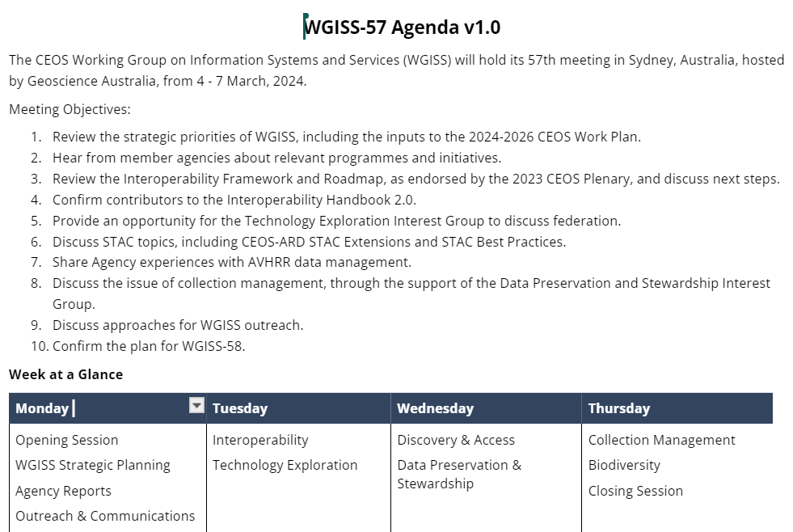
WGISS-57 Objectives

Slide 5
WGISS Vision
WGISS Vision (Terms of Reference):
  To enable Earth observation data and information to be more accessible and usable to both data providers and data users world-wide through international coordination.
  To foster easier exchange of Earth observation and related data and information to meet the requirements of users and data providers.
  To foster the development of best practices and encourage the development of interoperable services that exploit space-borne Earth observation data.
  To enhance the complementarity, interoperability and standardization of Earth observation data and information management and services with other types of geospatial data such as in situ data
YOUR support this week has advanced the vision for CEOS WGISS!
Notes:
Refresher … or intro for newer WGISS partcipants

Slide 6
WGISS-57 Topic Summary
Over 55 participants during the week, in-person and virtual
  12 WGISS Principles represented, CEOS SEO and CEO participation
Specific sessions (and great discussion) on topics including:
  WGISS Work Plans (and updates to Terms of Reference, website, outreach/communications)
  Agency Status (GA, NOAA, ISRO, USGS) and ISO TC 211 status
  Interoperability Plans … including Input and Demonstrators
  AI/ML status within Technology Exploration and Demonstrators
  Discovery and Access utilizing STAC
  CEOS EO Data Access via CEOS Connected Data Assets
  AVHRR Data Recovery Project
  Archive Technologies, Data Stewardship and Maturity Matrix
  Collection Management
  Biodiversity (CEOS Chair Team Priority for 2024)

Slide 7
How to get involved in WGISS…
Become involved in an Interest Group(s)
  Data Preservation and Stewardship (mirko.albani@esa.int)
  Interoperability and Use (nitant@sac.isro.gov.in)
  Discovery and Access (damiano.guerrucci@esa.int)
  Technology Exploration (ikehata.yousuke@jaxa.jp)
Self-Nominate for Vice Chair, Nov. 2025-Nov. 2027 (tsohre@usgs.gov)
  Transitions to Chair from November 2027 - 2029
Notes:
IG participation-> reach out to Libby or the IG chair
V.Chair nominations -> reach out to myself or Nitant
Hosting -> reach out to myself or Nitant

Slide 8
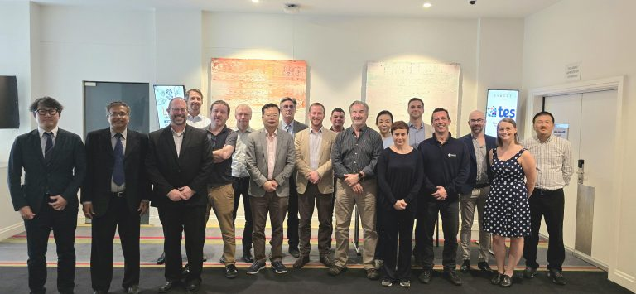



Thank you
Thank you to the WGISS Exec Team
Thank you to Libby
Thank you to ALL participants and broader CEOS organizations supporting WGISS
Thank you to GA and CSIRO

