Slide 1
WGISS-57 WGISS and Mapping Ecosystem Extent
Roger Sayre
U.S. Geological Survey
Agenda Item 10.2
WGISS-57
4-7 March 2023
Sydney, Australia

Slide 2
Ecosystem Extent – Potential WGISS Focus Areas
OUTLINE
Ecosystem Extent – An Application Area
Mapping Approaches
Open Data/Data Formats
Imagery Availability and Data Services
Product Exposure
Standards
Interoperability
AI/ML
Challenges

Slide 3
Ecosystem Extent – An Application Area within Biodiversity
The Three Fundamental Elements of Biodiversity
Genes
Not remote sensing detectable at this time
Species (Populations)
Fauna - Not practically remote sensing detectable at this time (e.g. whales from space)
Flora – Increasingly detectable with hyperspectral imagery
Ecosystems
Ecosystems occupy space in three kinds of spatial configurations (small patch, large patch, and matrix-forming)
Many terrestrial, freshwater, and coastal (e.g. shallow benthics) ecosystems are detectable in imagery
Mapping Ecosystem Extent is an application area within Biodiversity

Slide 4
Mapping Approaches
The Three Fundamental Dimensions of Ecosystems
Ecosystem Structure
Practical approach to mapping ecosystem extent. Map ecosystems by mapping and combining their structural components (vegetation assemblages, climate settings, terrain setting). Image-based approach with modeling.
Ecosystem Function (Processes)
Some aspects of ecosystem function are mappable (e.g. productivity, flux of water) but many are not (nutrient cycling, competition and predation, etc.) Image-based approach when doable.
Ecosystem Composition
Addresses biotic composition, largely biogeographic in nature, captures differences in species distributions, based on field/expert knowledge, not an image-based approach.

Slide 5
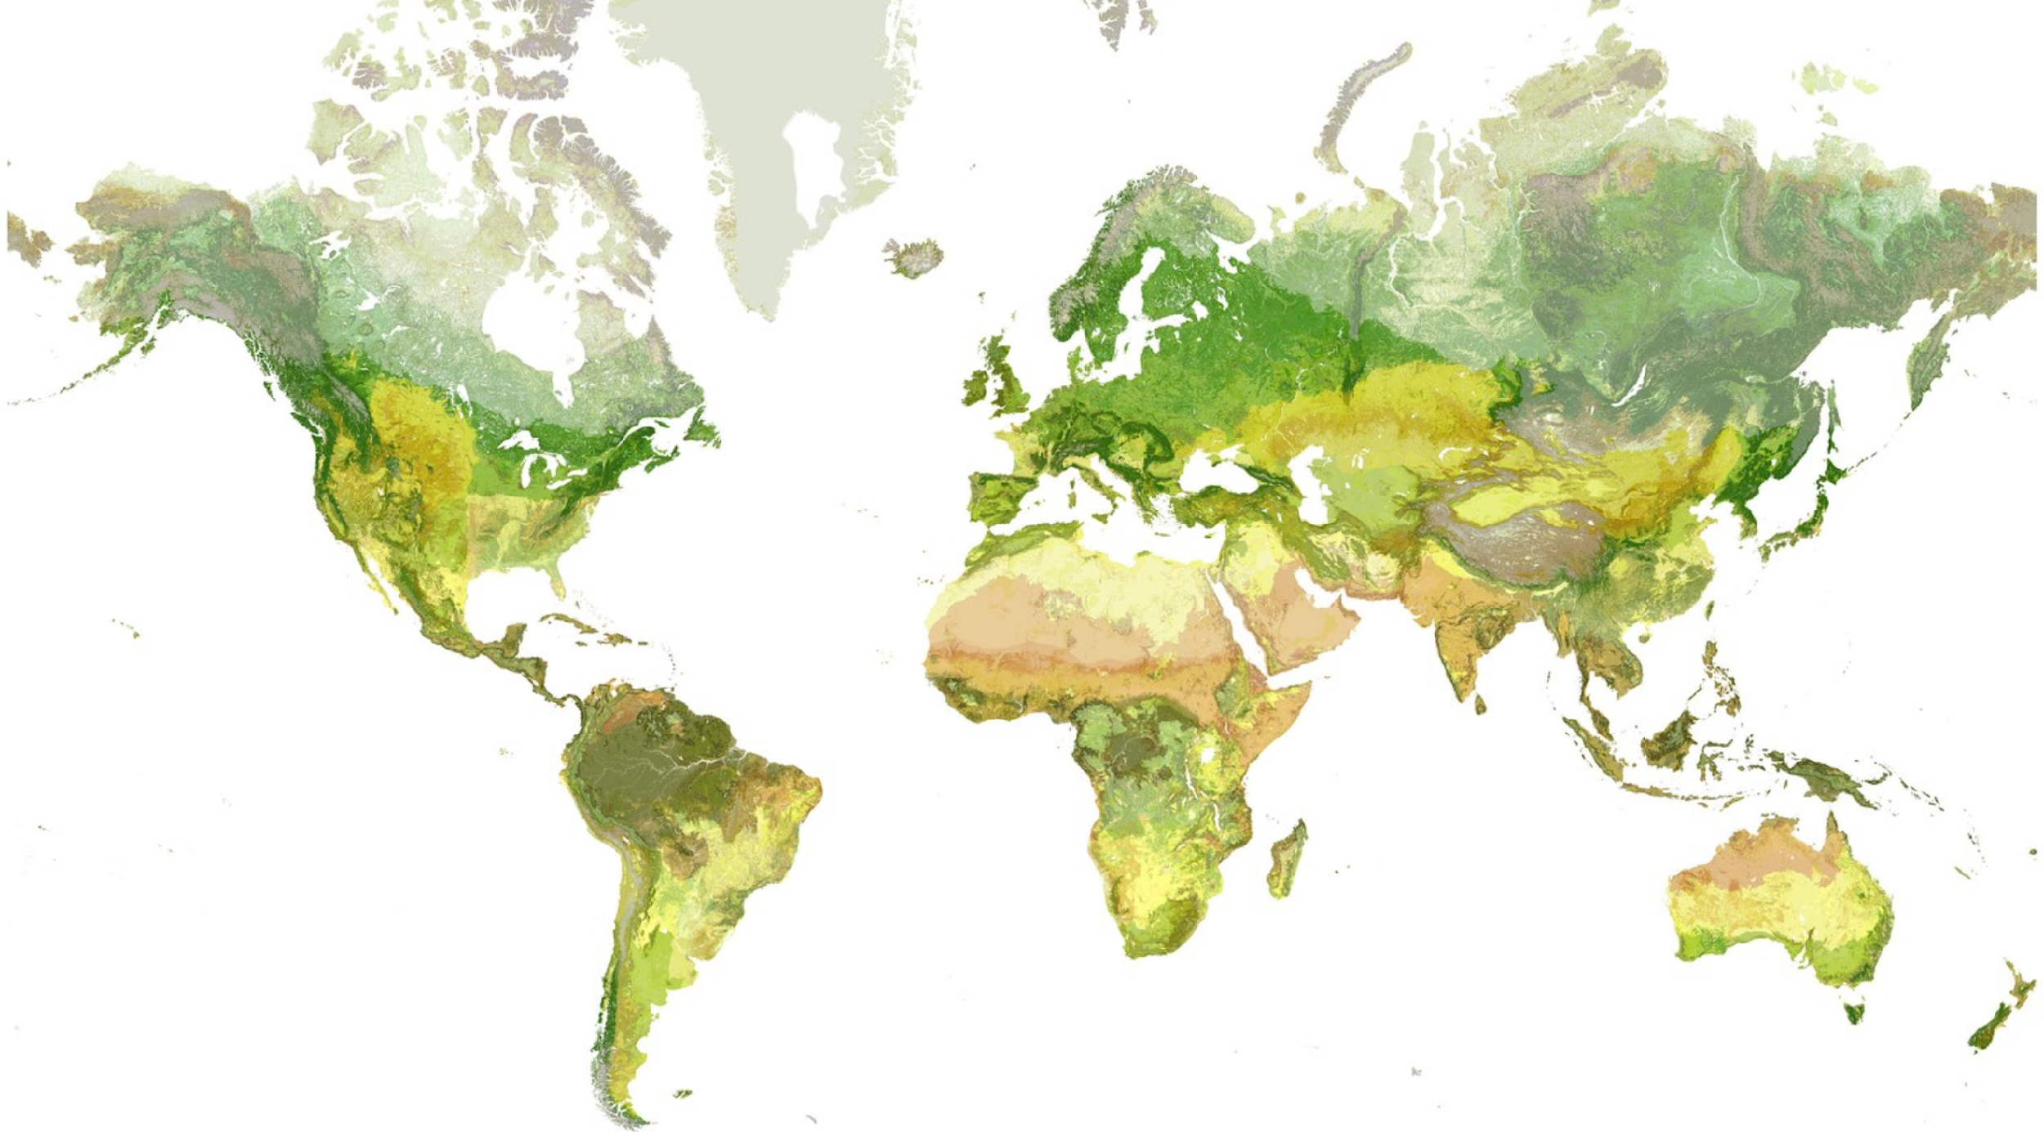
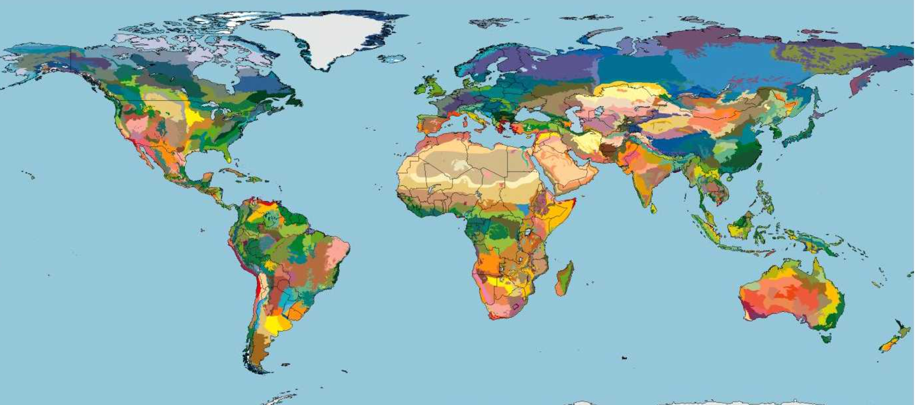
Mapping Approaches
USGS/Esri/TNC
World Terrestrial Ecosystems
WWF
Terrestrial Ecoregions
IUCN
Global Ecosystem Typology
Structure-based approach
Climate Setting
Terrain Setting
Vegetation Cover
Composition-based approach
Biogeography
Unmapped
Mixed approach

Slide 6
Mapping Approaches
USGS/Esri/TNC
World Terrestrial Ecosystems
WWF
Terrestrial Ecoregions
IUCN
Global Ecosystem Typology
Structure-based approach
Climate Setting
Terrain Setting
Vegetation Cover
Composition-based approach
Biogeogeography
Unmapped
Mixed approach
New Reporting Standard for CBD and UN SEEA

Slide 7
Open Data/Data Formats
Data Cubes
Multiple data cubes with values for x, y, z, where z = vertical dimension, or, x, y, t where t = time
Imagery very conducive for data cube development
Data Cubes work when data structure is raster. When original data structure is vector, polygons must be rasterized.
Vector data: shapefiles, GeoJSON, kml/kmz
Raster data: netCDF, GeoTiff
Tabular and point data: CSV

Slide 8
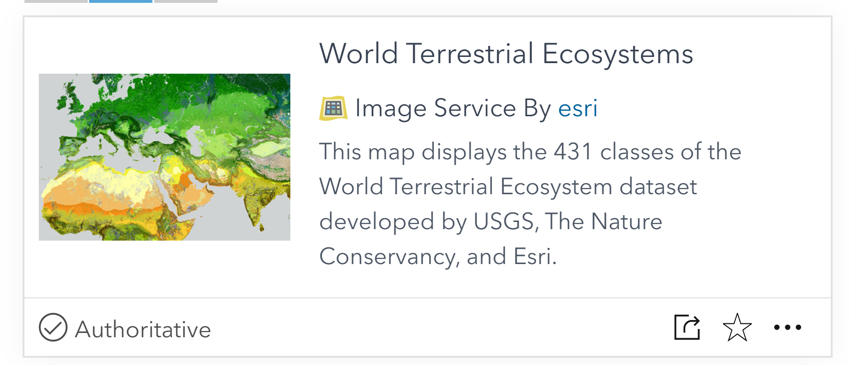
Imagery Availability and Data Services
Imagery: Pipes vs. Local
Data Services: WMS, WFS
Example: WTE data

Slide 9
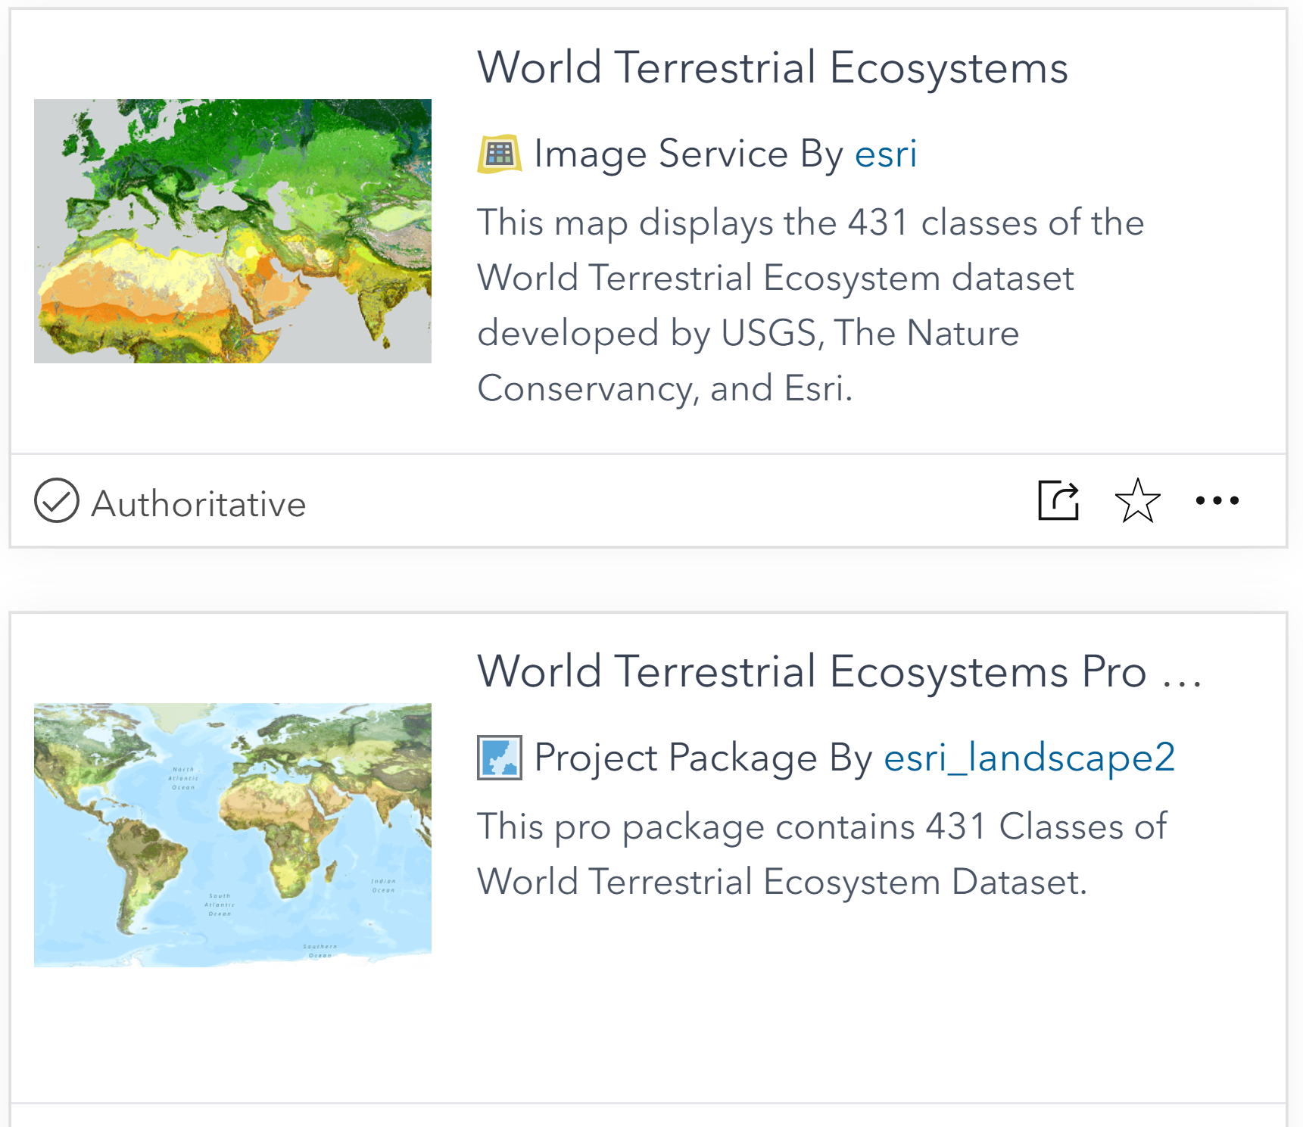
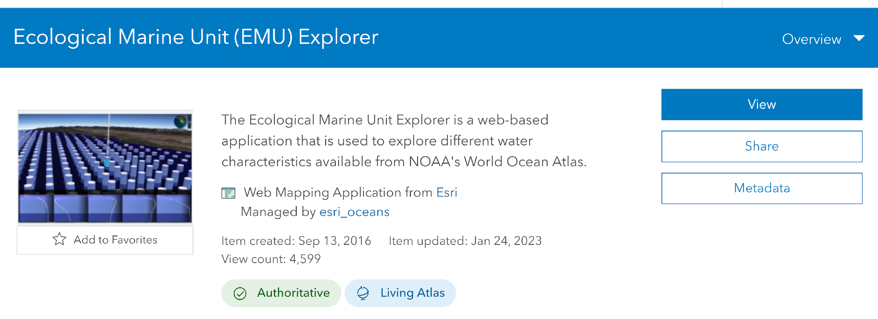
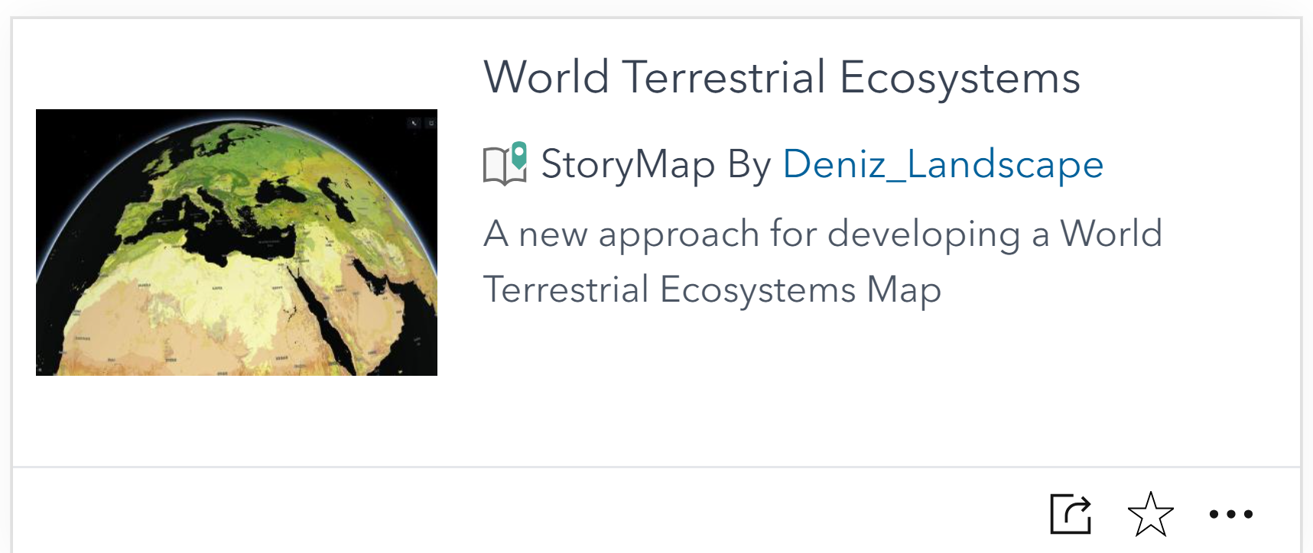
Product Exposure
Data, Pubs, Maps (StoryMaps), Explorers
World Terrestrial Ecosystems Explorer
Ecological Land Units Explorer
Ecological Marine Units Explorer
Global Mountains Explorer
Global Island Explorer
Global Coastlines Explorer

Slide 10
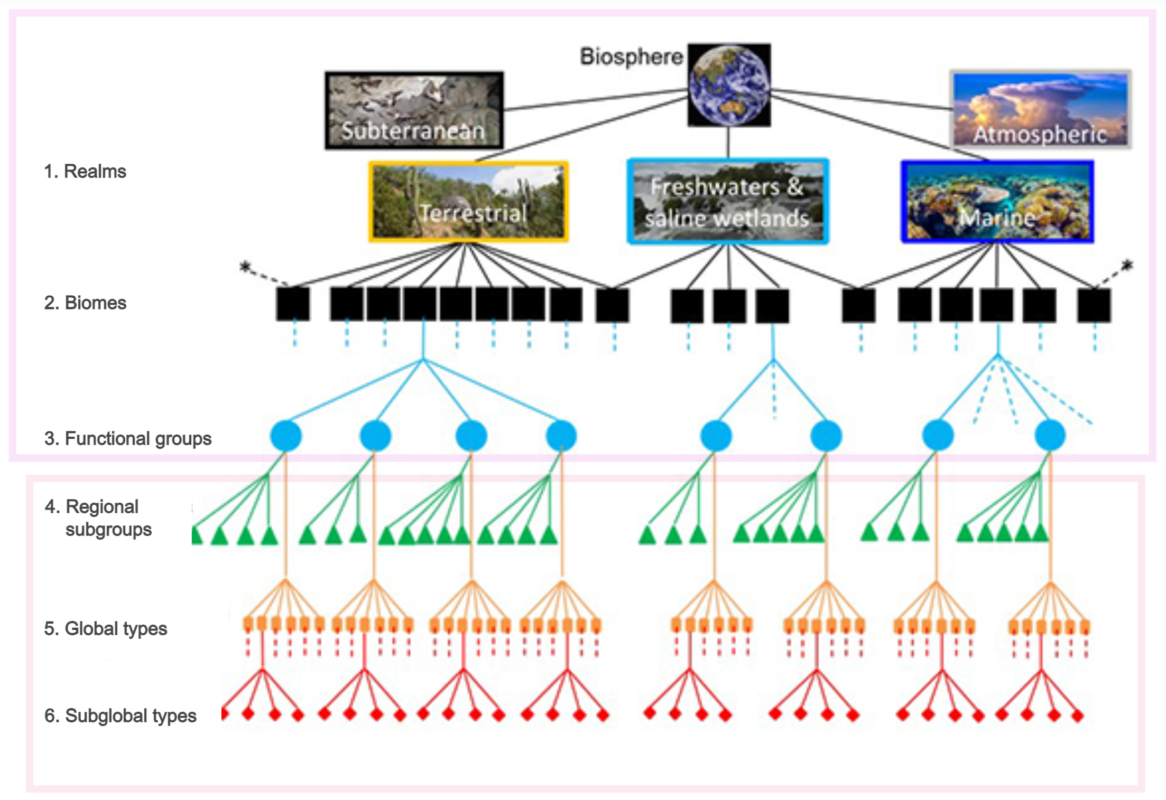
Standards
The IUCN GET (Global Ecosystem Typology)
Hierarchical
Standard Reporting Unit for CBD (Headline Indicator A.2 Extent of natural ecosystems)
CEOS EETT Whitepaper Recommendation:
2a. For each ecosystem class in the IUCN GET and Ramsar’s classification scheme, identify the key EO data sources and mapping approaches needed for its delineation.

Slide 11
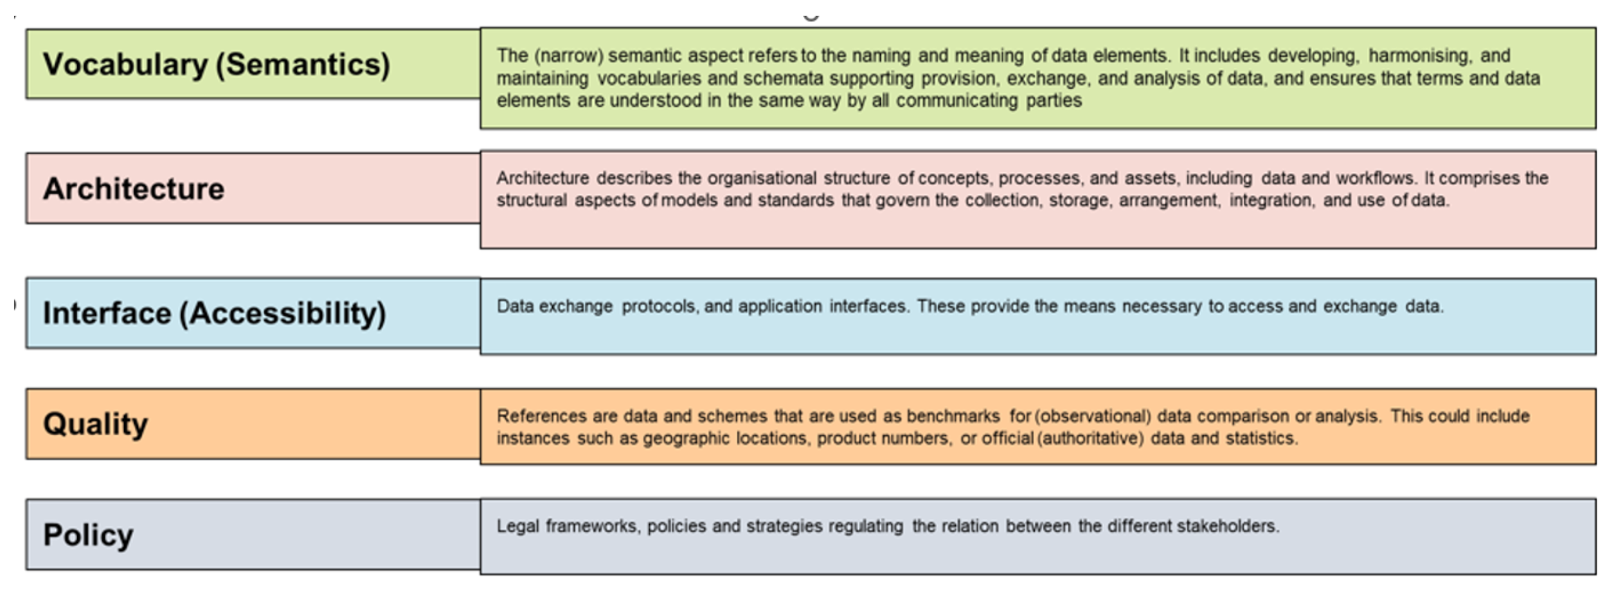
Interoperability

Slide 12
AI/ML
For wall-to-wall ecosystem mapping by image classification AI/ML is ‘old news’
‘New’ AI (Geo AI) has at least two potentially powerful applications:
Object-based feature extraction (mangroves, burned structures, roads/trails, etc.)
Crosswalking between existing maps to the IUCN GET using labels, attributes, etc.

Slide 13
Challenges (Ecosystem Extent White Paper +1)
Limited availability of value-added products
Combining data from different types of sensors
EO data accessibility, usability and technical capacity of users
Ecosystem condition
Reference data for training and validation
Scale
‘Metadata Aversion Syndrome’

