Slide 1
Biodiversity
Importance and role in CEOS
Gary Geller, NASA
Agenda Item 10.1
WGISS-57
4-7 March 2024
Sydney, Australia
(c) 2024 California Institute of Technology. Government sponsorship acknowledged.

Slide 2

Introduction
Biodiversity: The variety of life on Earth
  Genes
  Species
  Ecosystem
Important to humans
  Food, fiber, regulation of water resources, pollination, recreation…
  Close, inter-dependent ties to climate
Key organizations: UN CBD, IPBES, GEO BON
Wikimedia Avoini

Slide 3

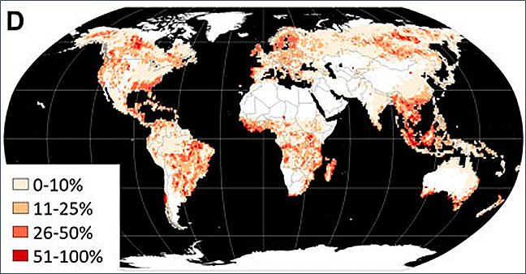
Global biodiversity crisis
Global forest change
Forest loss, disturbance, and degradation 2000–2020, Potapov 2022, Front. Remote Sens.

Slide 4
CEOS biodiversity timeline
2011: Biodiversity Activity
2021/SIT-36: one slide intro
2022/Tech Workshop: Ecosystem Extent TT proposed
2022/Plenary: Ecosystem Extent TT approved
2023/Plenary: White Paper endorsed
2024/Plenary: deliver Demonstrator
Overarching goal: Sustained CEOS engagement with biodiversity

Slide 5
What can we measure with RS?
Environmental characteristics (T, precipitation, topography…)
Optical characteristics of vegetation
  Greenness
  + in situ data => Species distributions
  Leaf & canopy “traits” (water content, structural compounds…)
Radar and lidar
  Ecosystem structural characteristics (height, profiles)
Complementarity: Combine sources

Slide 6
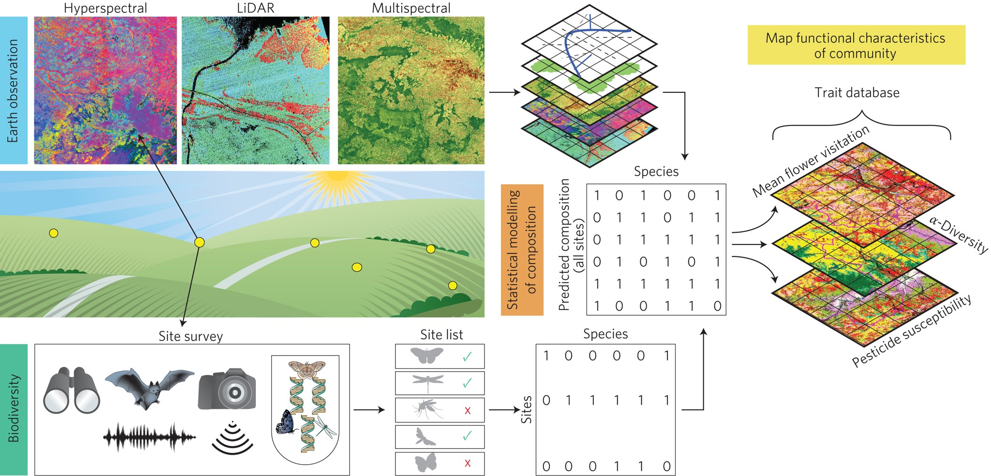
Ongoing revolution in monitoring capabilities
Bush et al. (2017) Nature Ecology & Evolution

Slide 7
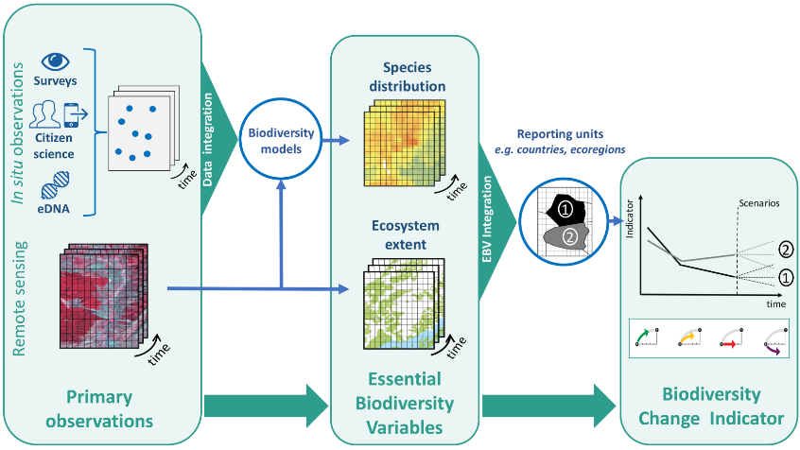



Workflow: raw observations to users
Users
National Governments
Navarro et al. 2017 COES
Notes:
This is the overall workflow from observations to EBVs, indicators, and users…but, this is not commonly operationalized. GBiOS would facilitate that process.

Slide 8
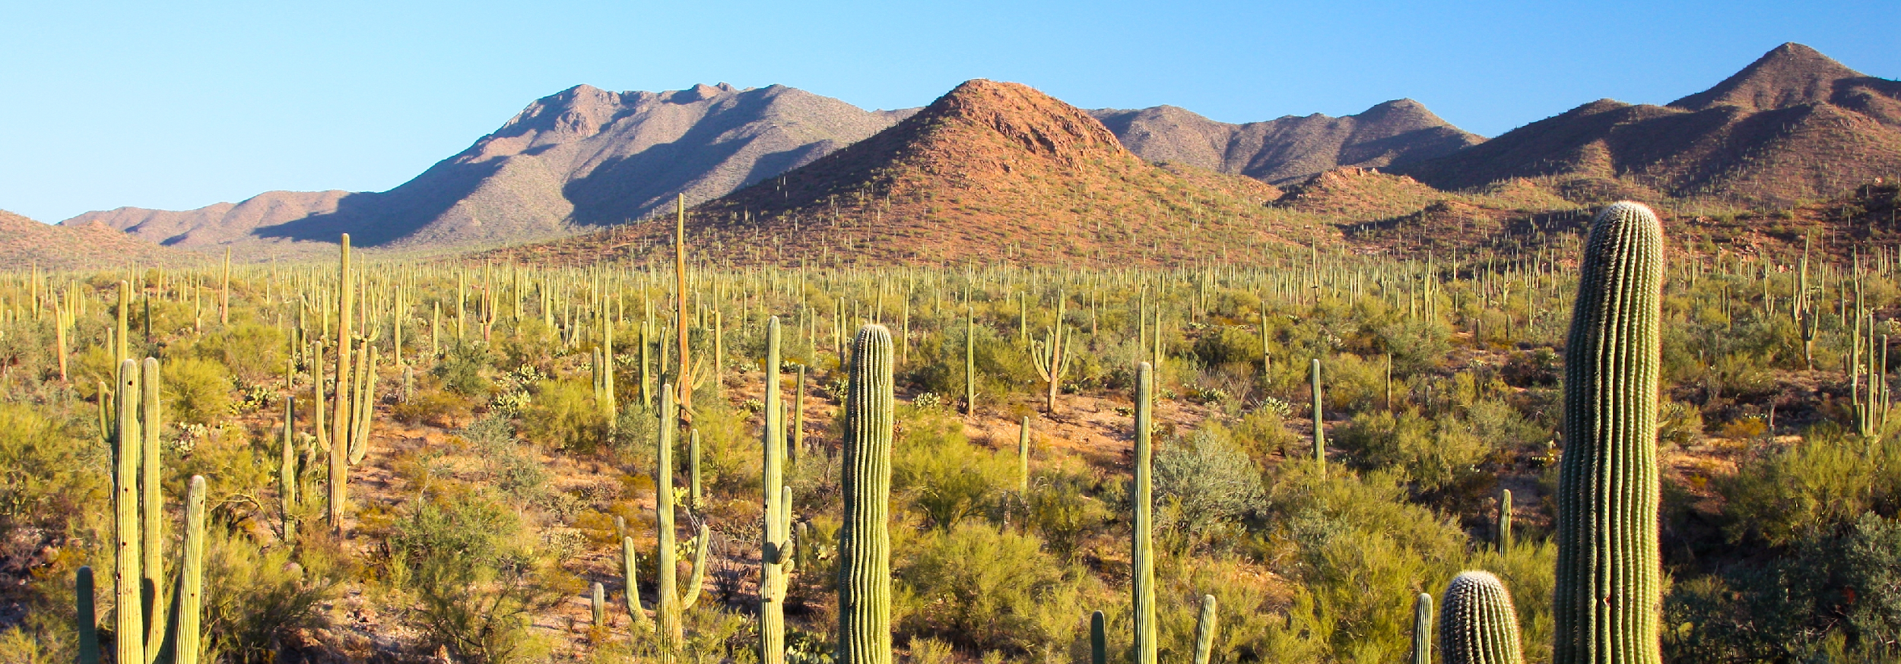
Opportunities
Combining data from different types of sensors
Use of hyperspectral data
Artificial intelligence and machine learning
Data cubes
Global monitoring…
Joe Parks, Wikimedia

Slide 9
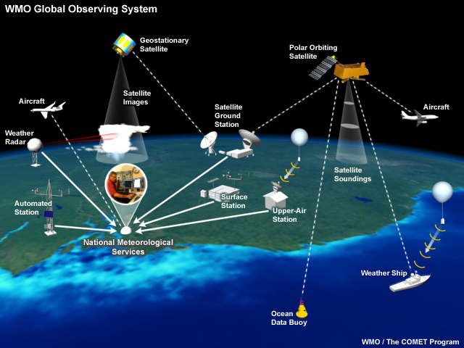
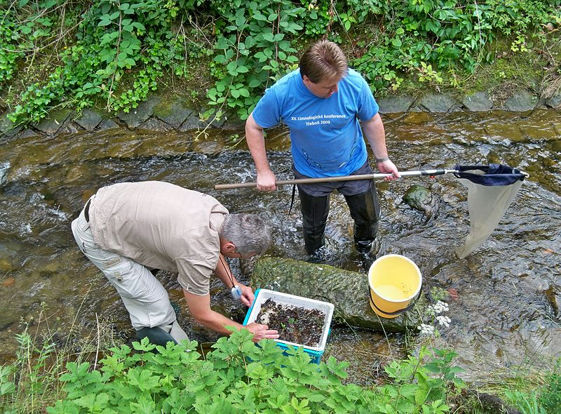
Global Monitoring
Weather
Biodiversity
Notes:
WMO Global Observing System:
Globally integrated system with many components
Many partners
Developed and grown over time
Acquires data, processes it, shares it with others in the network, delivers it to users

Slide 10
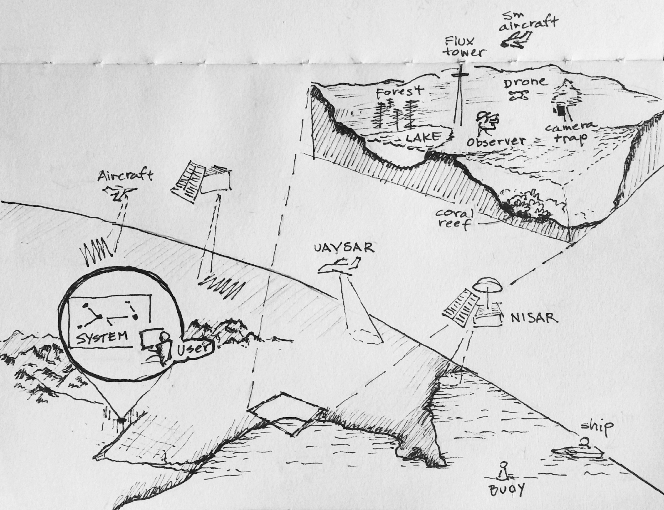
Global Monitoring
Global Biodiversity Observing System (GBiOS)
Weather
Notes:
WMO Global Observing System:
Globally integrated system with many components
Many partners
Developed and grown over time
Acquires data, processes it, shares it with others in the network, delivers it to users

Slide 11
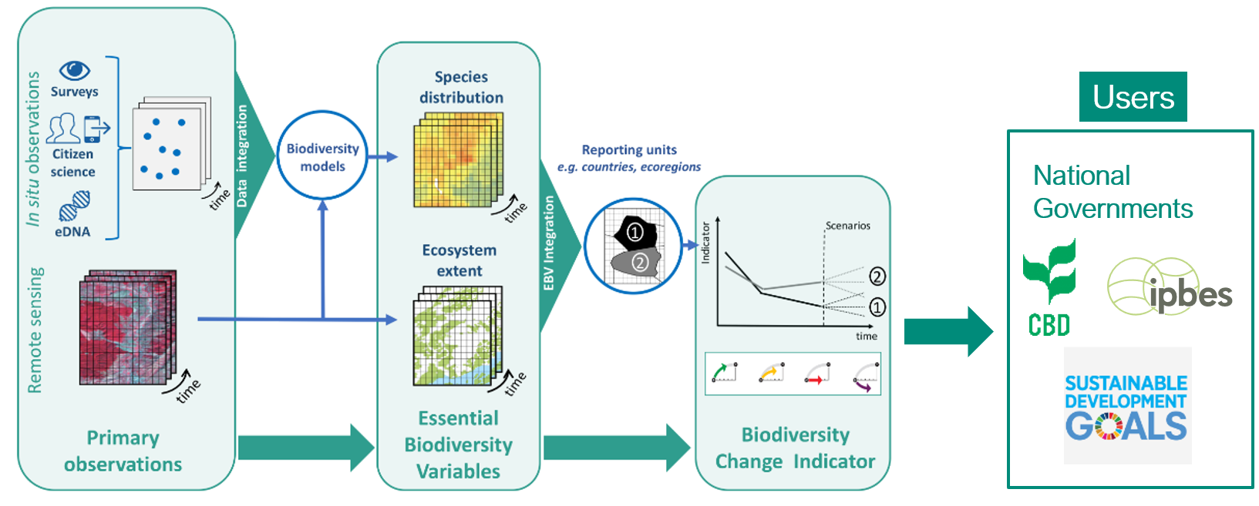

Challenges
Combining data from different types of sensors
Operationalizing workflows (=> value-added products)
EO data usability & technical capacity of users
Standards…. Interoperability & comparability
Global monitoring
US National Park Service

Slide 12
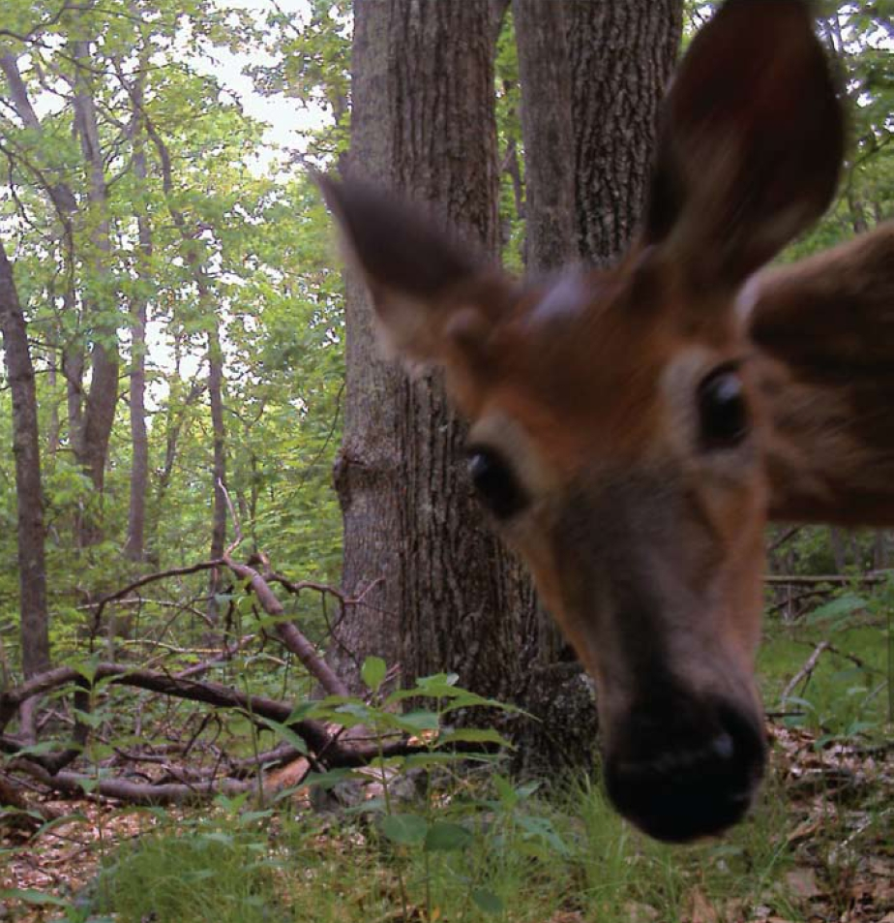
Thank you
US FWS

Slide 13
Backup

Slide 14
Global Monitoring: GBiOS concept
CBD & IPBES have indicated the need
Many pieces already exist
Space-based EO is essential
  Global, periodic
Highly collaborative
Federated approach
Standards, interoperability, comparability
Notes:
Thinking broadly a Global Biodiversity Monitoring System would have two basic thrust areas: Observations and Processing (the latter including storage and delivery).

Slide 15
Recommendation Area 1
Thematic Recommendation
Specific Recommendations
1. User Engagement
Increase biodiversity community engagement with EO and CEOS through workshop(s) and other activities to improve ecosystem extent mapping.
Key organizations:
Convention on Biological Diversity
UN System of Environmental Economic Accounting
GEO Global Ecosystems Atlas initiative
Ramsar Convention on Wetlands
1a. Identify specific user requirements to guide EOs & identify products needed for ecosystem extent.
1b. Establish a sustainable communication channel between CEOS and user communities for continued interaction.
1c. Improve CEOS understanding of technological, socio-political, and cultural constraints for the biodiversity community to use EO data.

Slide 16
Recommendation Area 2
Thematic Recommendation
Specific Recommendations
2. Technical advances
Support development of technical advances to improve utilization of EO for ecosystem mapping.
2a. For each ecosystem, identify the key EOs and processing methods needed for its delineation.
2b. Facilitate combining data from different types of sensors to take advantage of their complementarity.
2c. Facilitate time series analysis and its application to ecosystem extent mapping.
2d. Explore ways to utilize EO to characterize ecosystem condition and its relationship to ecosystem extent.

Slide 17
Recommendation Area 3
Thematic Recommendation
Specific Recommendations
3. Capacity
Work to increase capacity of biodiversity users to utilize EO for ecosystem mapping and monitoring.
3. Identify opportunities for capacity development resources, e.g., a training or a Massive Open Online Course (MOOC) focused on the use of EO for ecosystem mapping and monitoring.

Slide 18
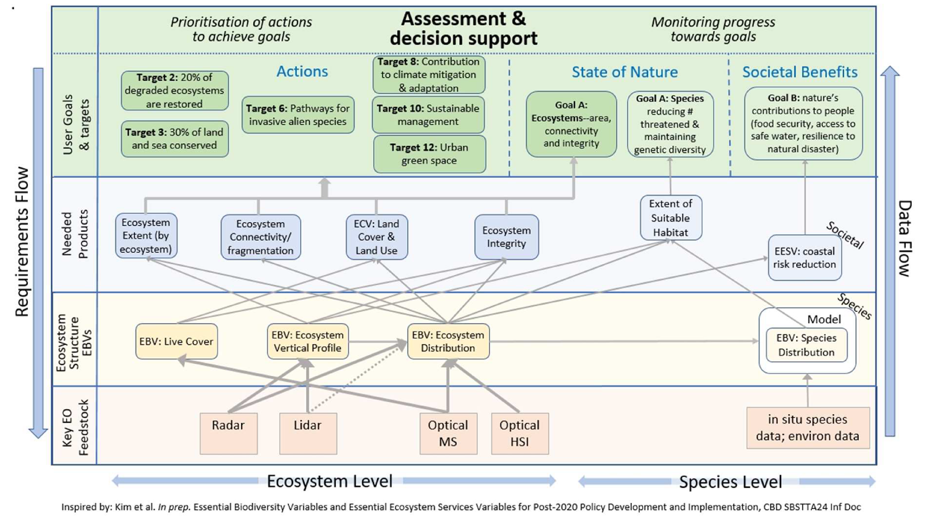
Connecting User Needs to Observations
Notes:
This figure shows how Agency data flows into Essential Biodiversity Variables and products needed by Conventions and other entities for managing biodiversity.
(Updated version from SIT-37)

Slide 19
Essential Biodiversity Variables
Set of measurements to capture the major dimensions
of biodiversity and how it is changing
Criteria:
Biological
State variables
Sensitive to change
Scalable
Feasible
Ecosystem agnostic
Genetic Composition
Species Populations
EO: Important data source
Species Traits
Community Composition
Ecosystem Structure
EO: Core data source
Ecosystem Functions
Notes:
There are six classes of EBVs (middle of the figure) each of which has several variables in it. Space-based EO is an important input for all of them (even Genetics) but is the key input for some of them. For example Ecosystem Extent, within the Ecosystem Structure class, is mostly a space-based EO-derived variable.
Ecosystem Structure class
Ecosystem Extent
Ecosystem Vertical Profile
Live cover fraction
Ecosystem Function class
Primary productivity
Ecosystem phenology
Ecosystem disturbance

Slide 20
Additional Resources
GEO BON website, and overview (slides and video)
Ecosystem Extent and Integrity (slides and video): key variables for which satellite EO is essential
UN SEEA: ecosystem accounting variables (extent, condition, services…)
Workshop linking EO and in situ for a global system
Example dashboard highlighting products ASEAN Biodiversity Dashboard
World Economic Forum Global Risks Report 2021
IUCN position paper for UNFCCC COP26

