Slide 1
Training* at EUMETSAT with Jupyter Notebooks

Slide 2
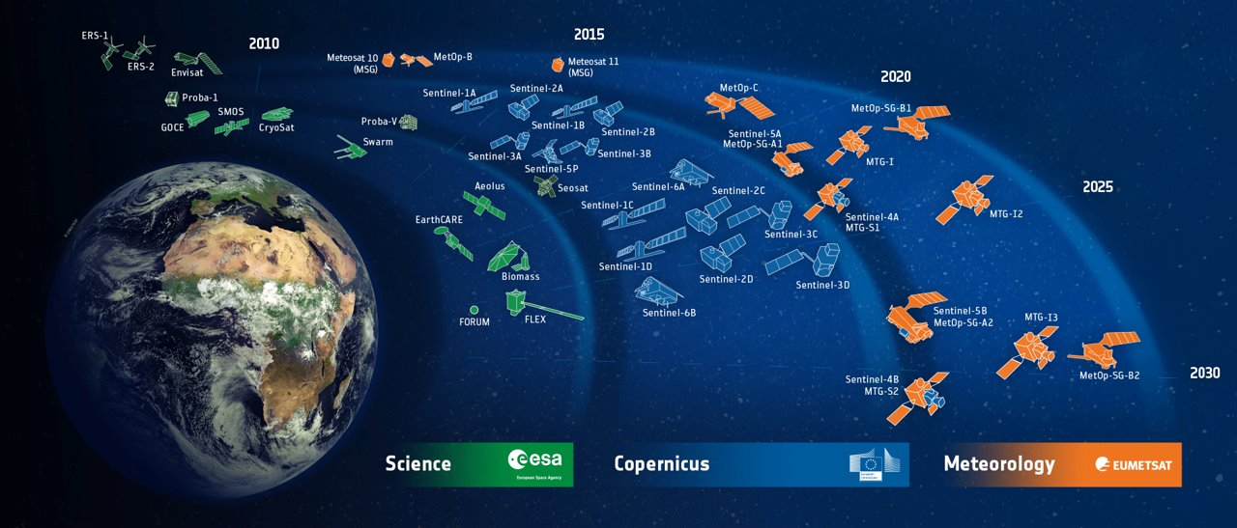
Unprecedented amounts of satellite data....
… new generation satellites, value-added products, model forecasts and analyses

Slide 3




Difference application domains & diverse users....
ATMOSPHERE
MARINE
CLIMATE
WEATHER

Slide 4



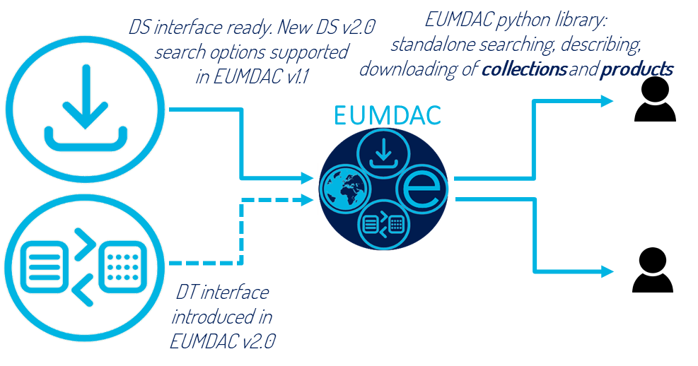


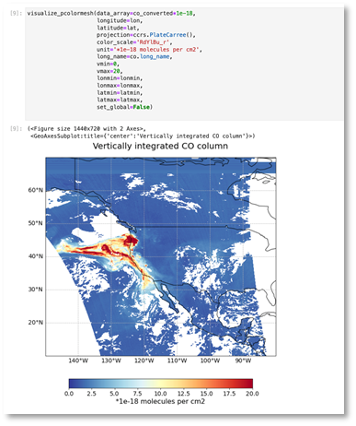
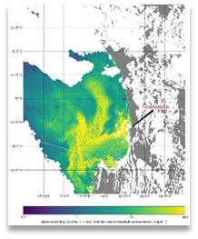




Python and Jupyter for user engagement
Webinars, courses & MOOCS,
self-paced learning
Training
EUMETSAT Data Access Client
Prototype processors
Data access
User guidance
Case Studies
Communication
Jupyter Notebook competition
Community toolkits
Community

Slide 5







Notebooks for training
> 100
notebooks on different application domains, such atmosphere, marine, weather and climate
> 100
notebooks from different domains, incl. Machine Learning MOOC and JN competition
Public
https://gitlab.eumetsat.int/eumetlab/
https://github.com/wekeo
Internal
Mirror
Mirror
Internal development GitLab instance

Slide 6
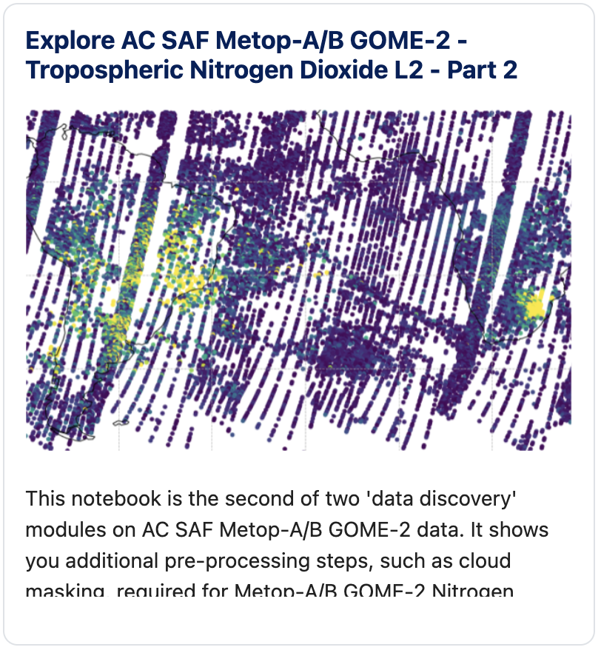
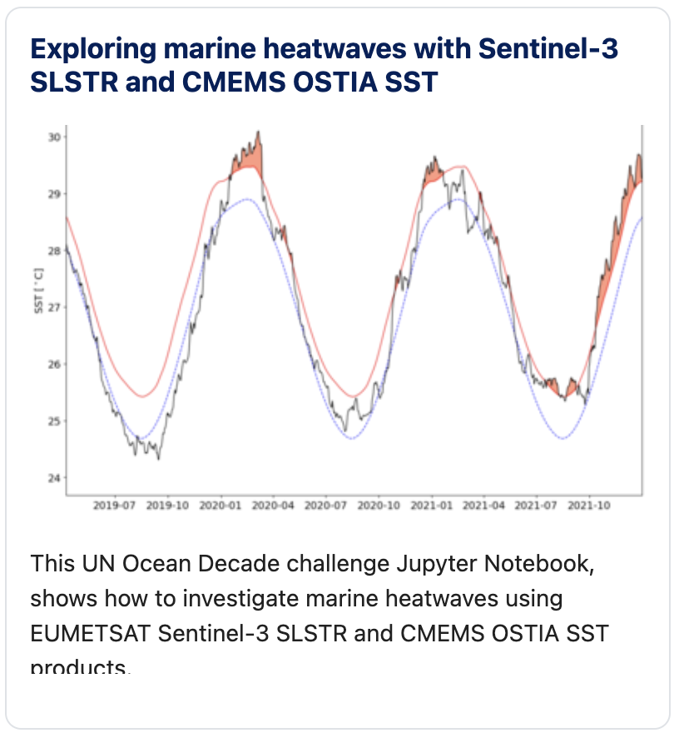
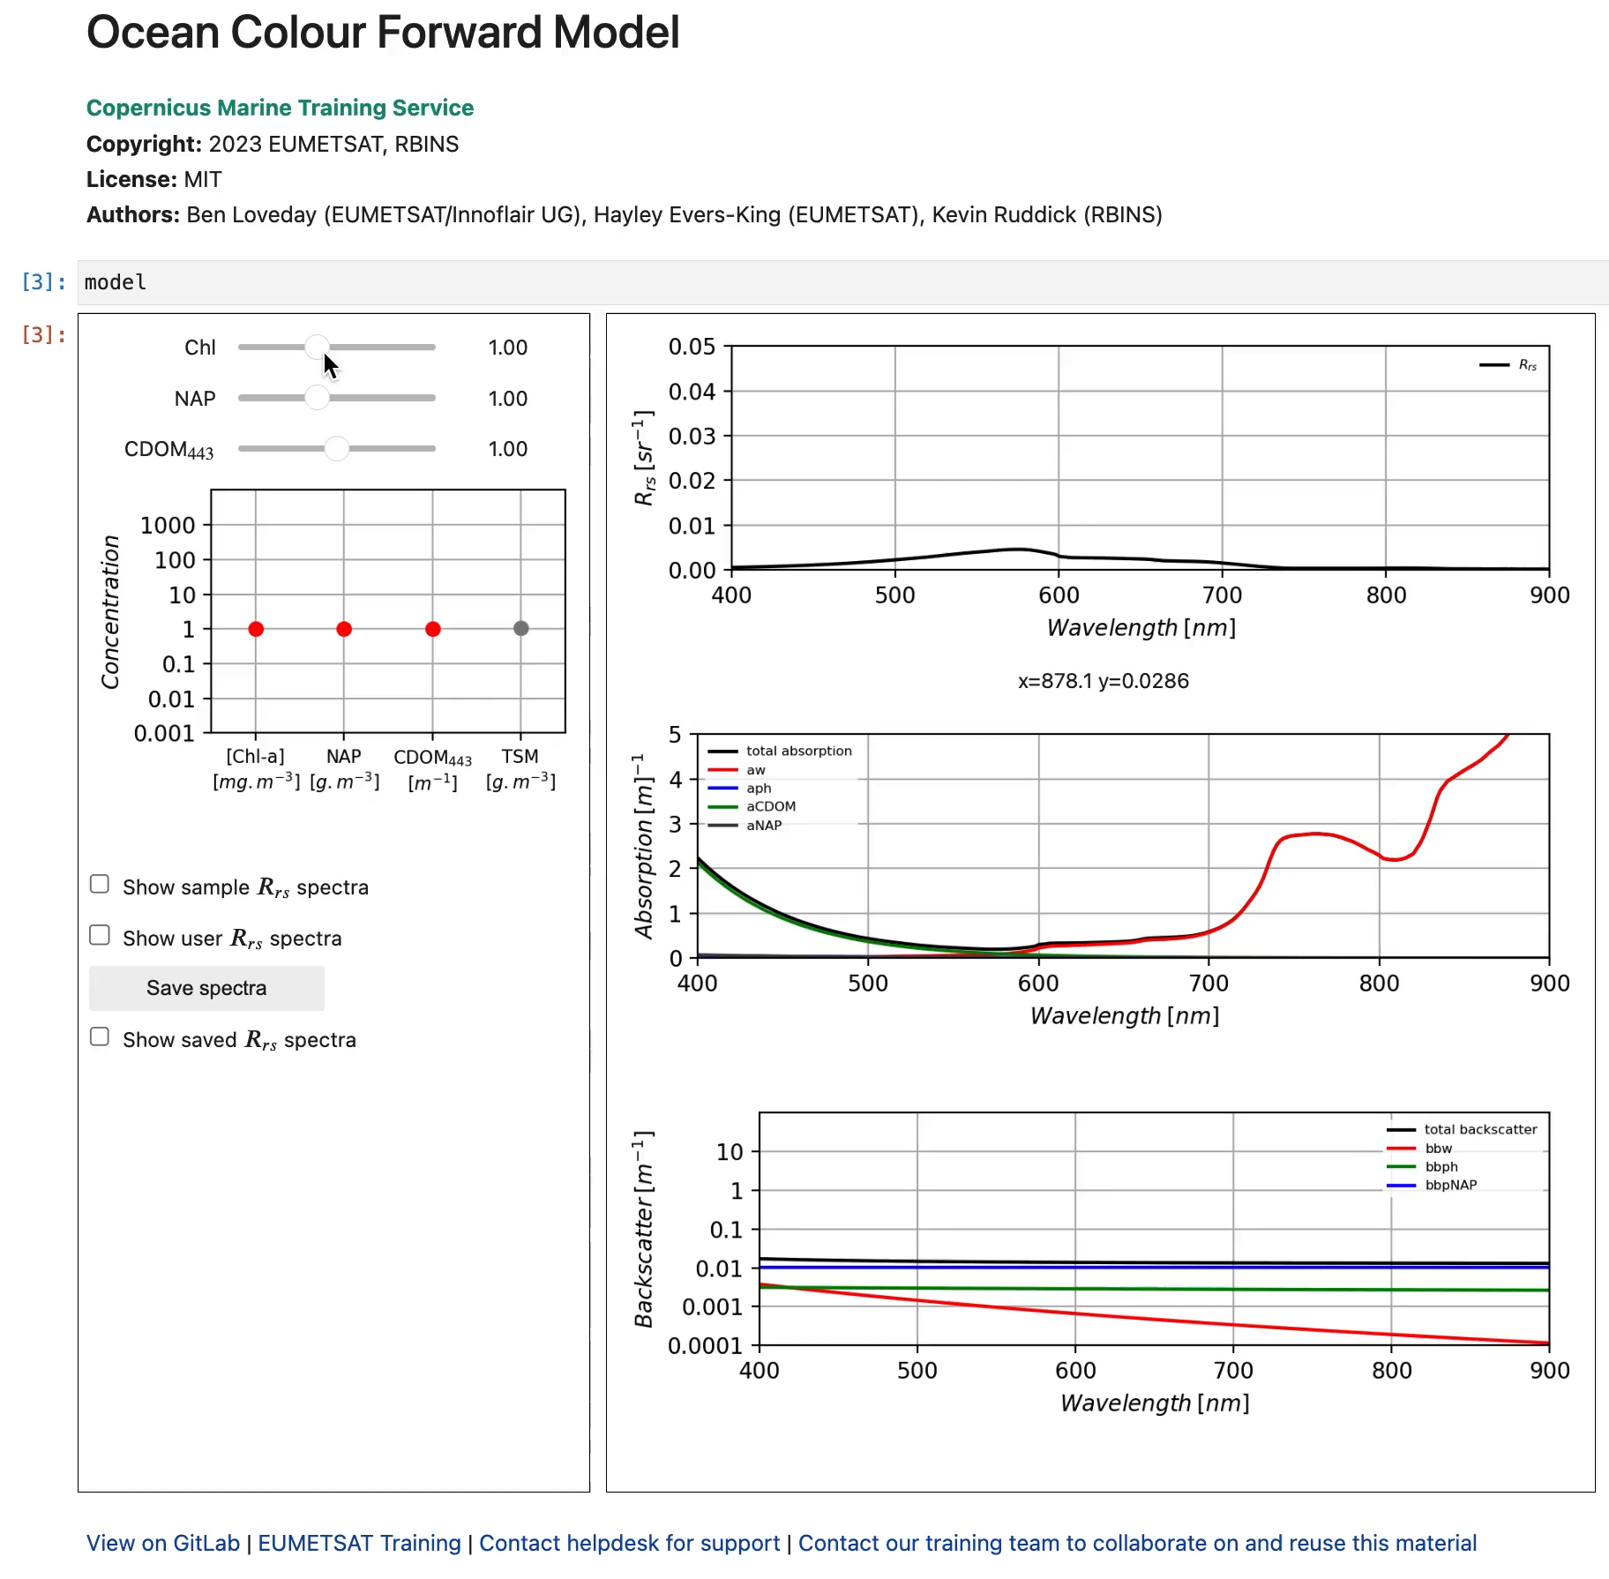
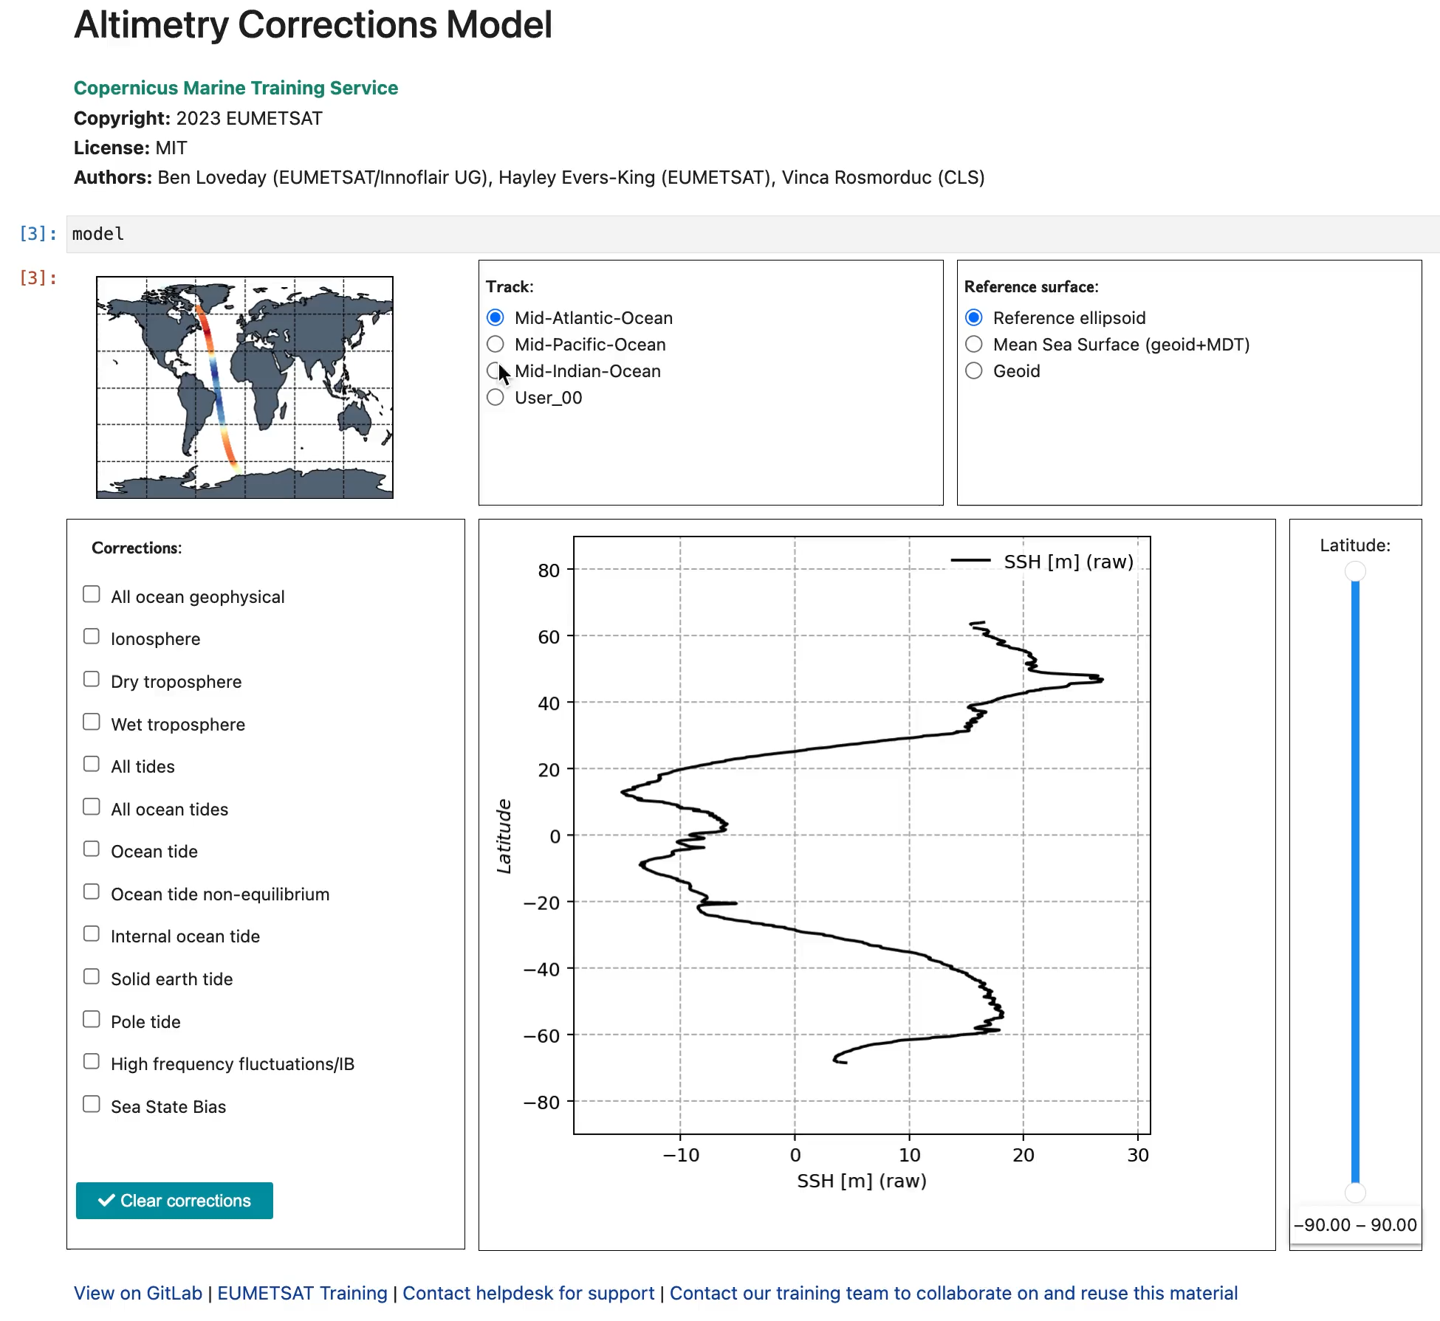
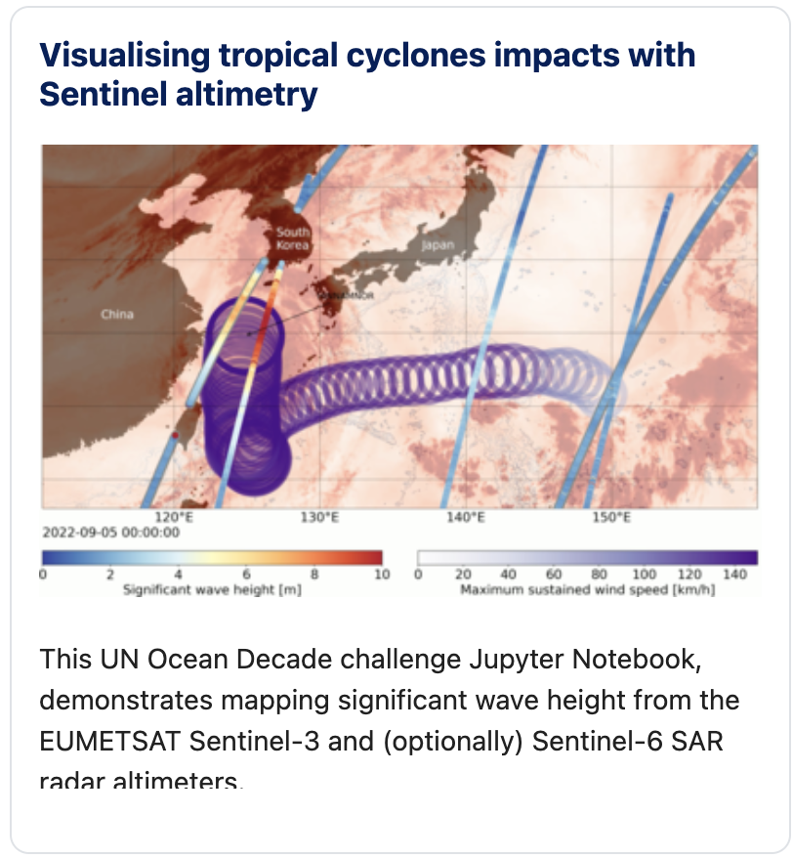
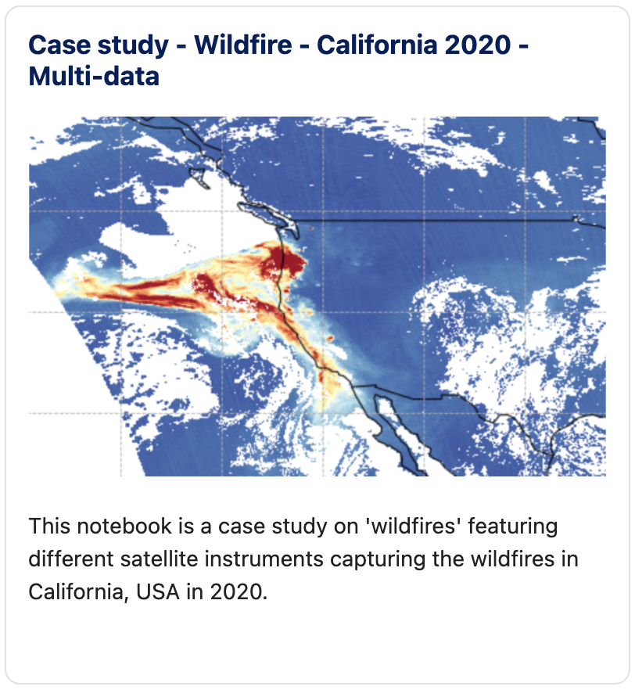
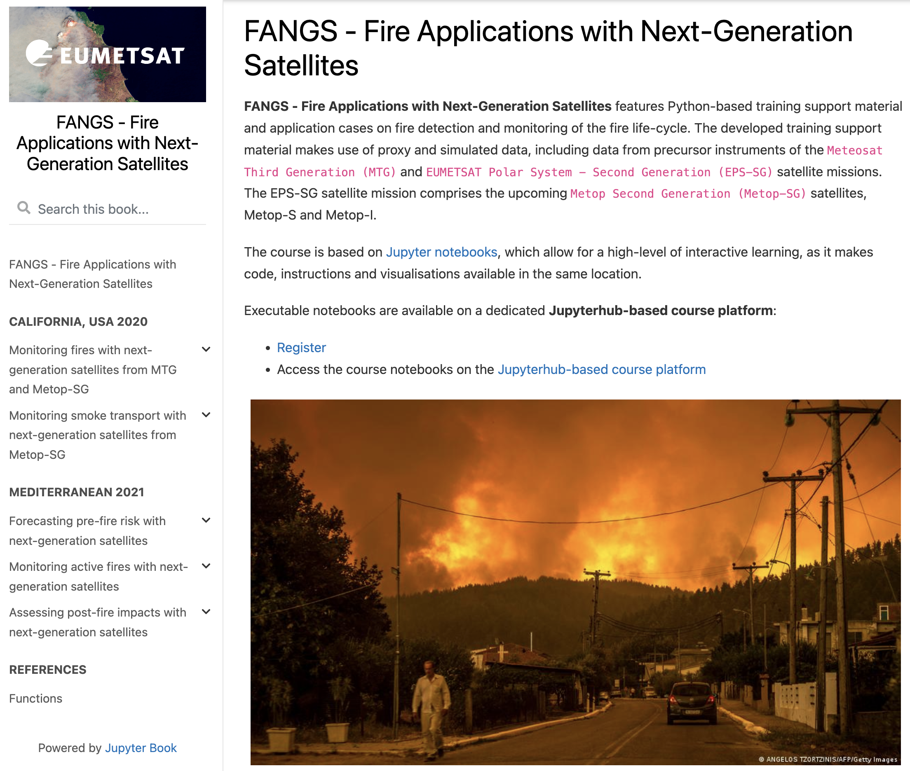
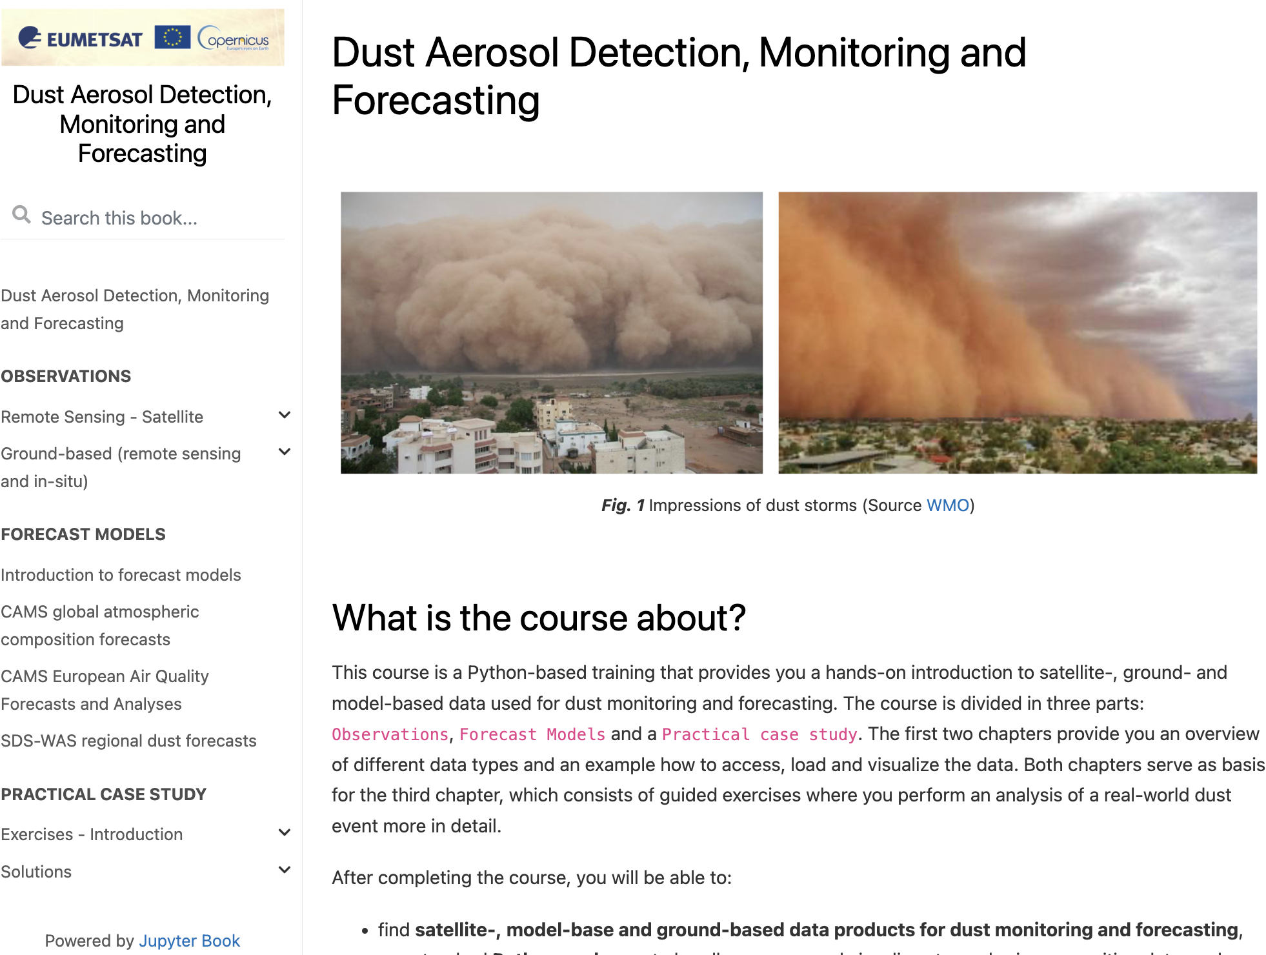
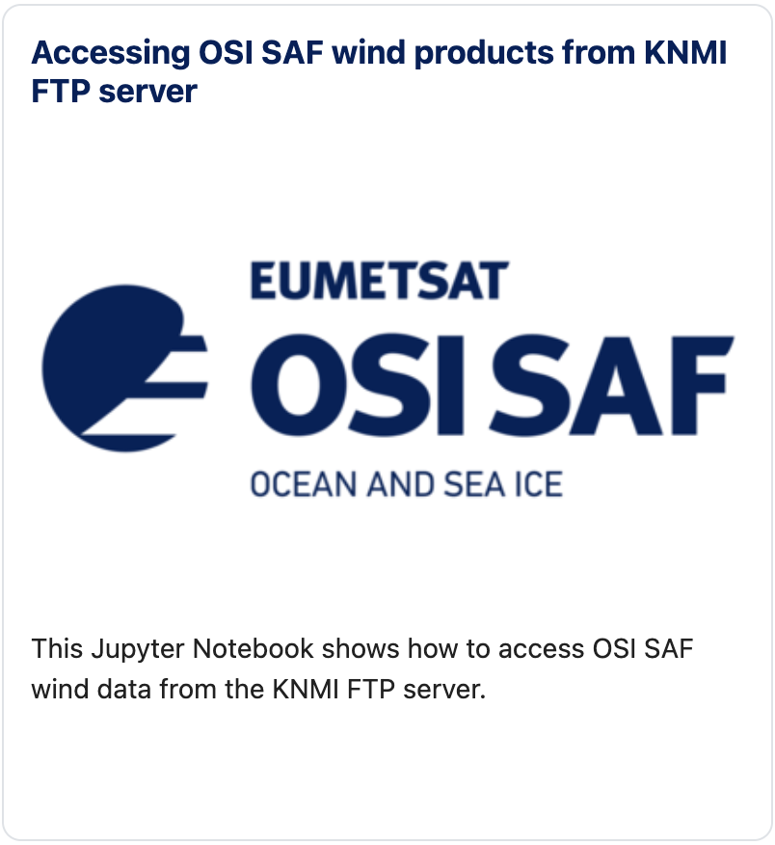
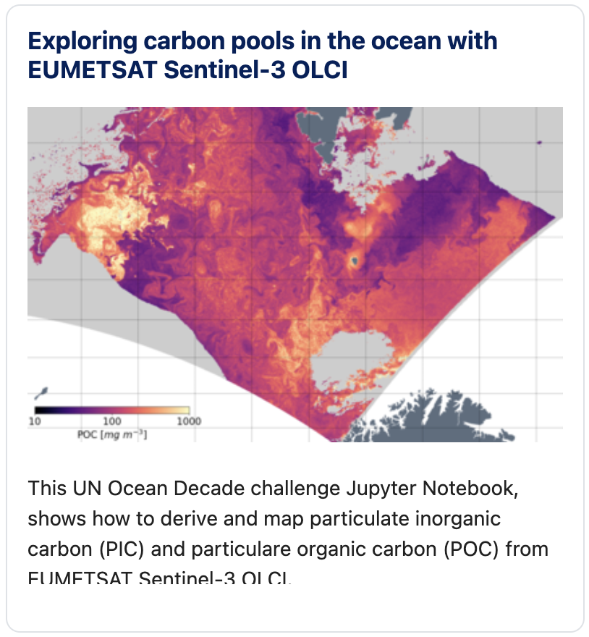
Notebooks for training; examples
Product access
Data exploration & visualisation
Methodological approaches
Applications
Courses
Case studies
Conceptual models

Slide 7
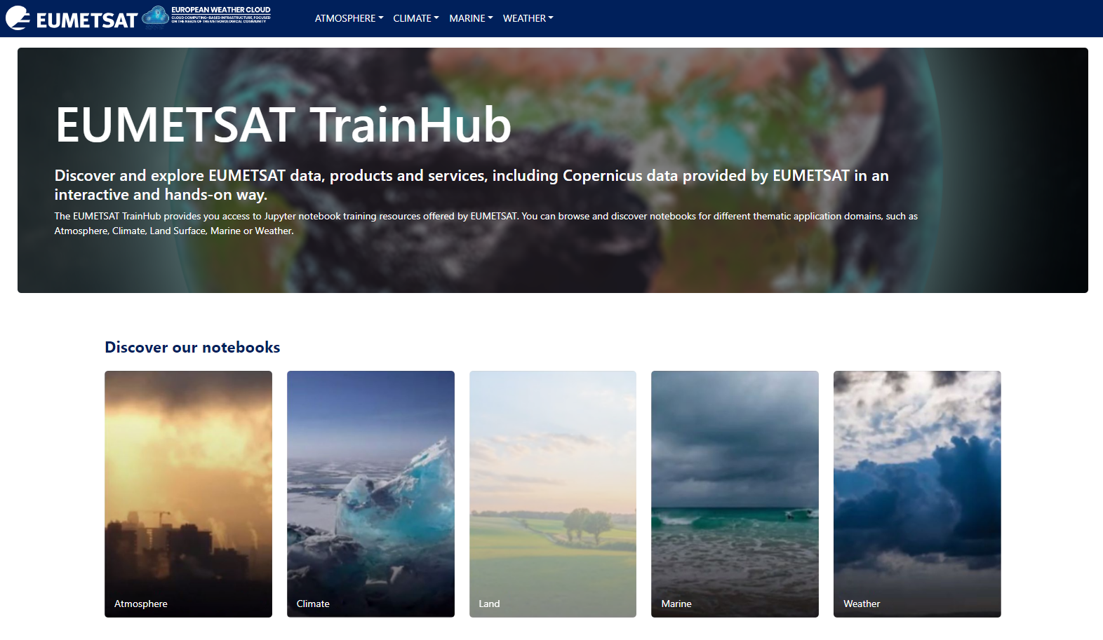
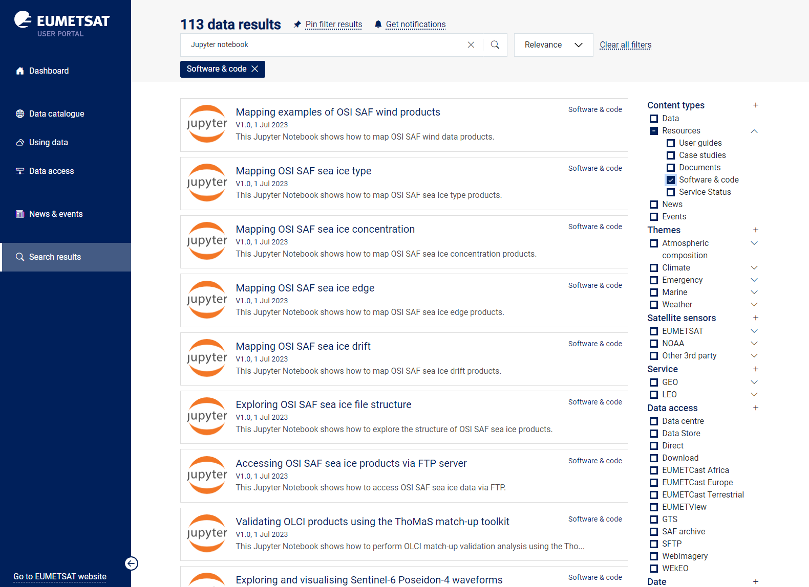

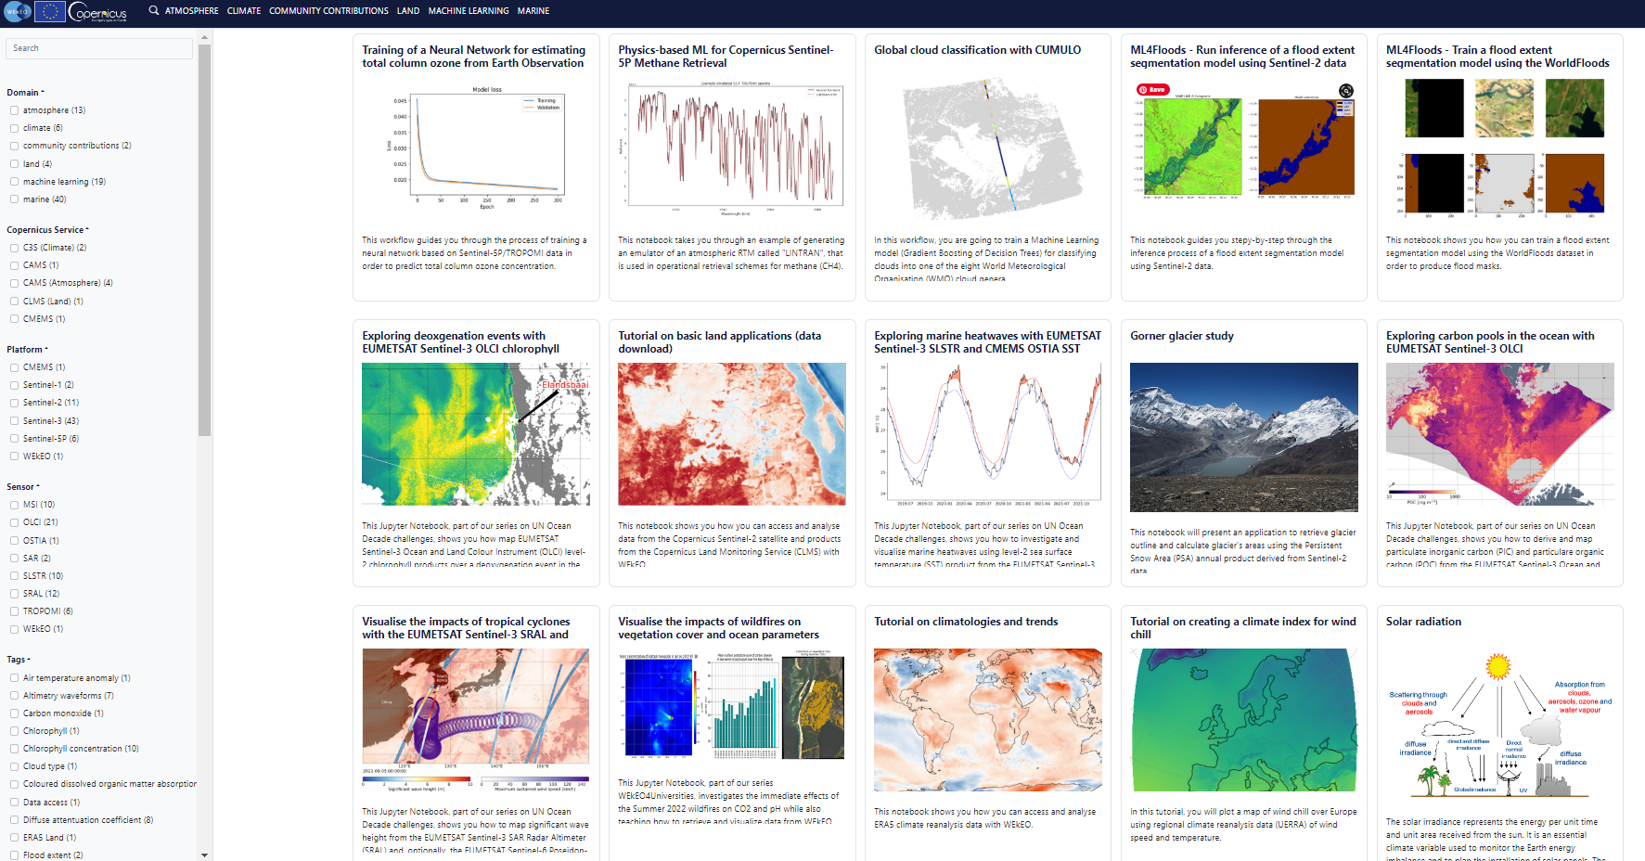


Notebook catalogues
EUMETSAT user portal, TrainHub and WEkEO catalogue.
More interactive ways to search and explore notebooks
Can be connected to own allocated resources (JupyterHub)
Use notebook embedded metadata
Connections to executable environments:

Slide 8

Good practice contributions...
1
Leverage the ‘Literate Programming Paradigm’
Use of instructional design elements
2
3
Follow best practices for scientific computing
Take advantage of the full Jupyter Ecosystem
4
5
Aim for Reproducibility
  Wagemann, J., Fierli, F., Mantovani, S., Siemen, S., Seeger, B. and J. Bendix (2022): Five Guiding Principles to Make Jupyter Notebooks Fit For Earth Observation Data Education. Remote Sensing 2022, 14(14), 3359.

Slide 9
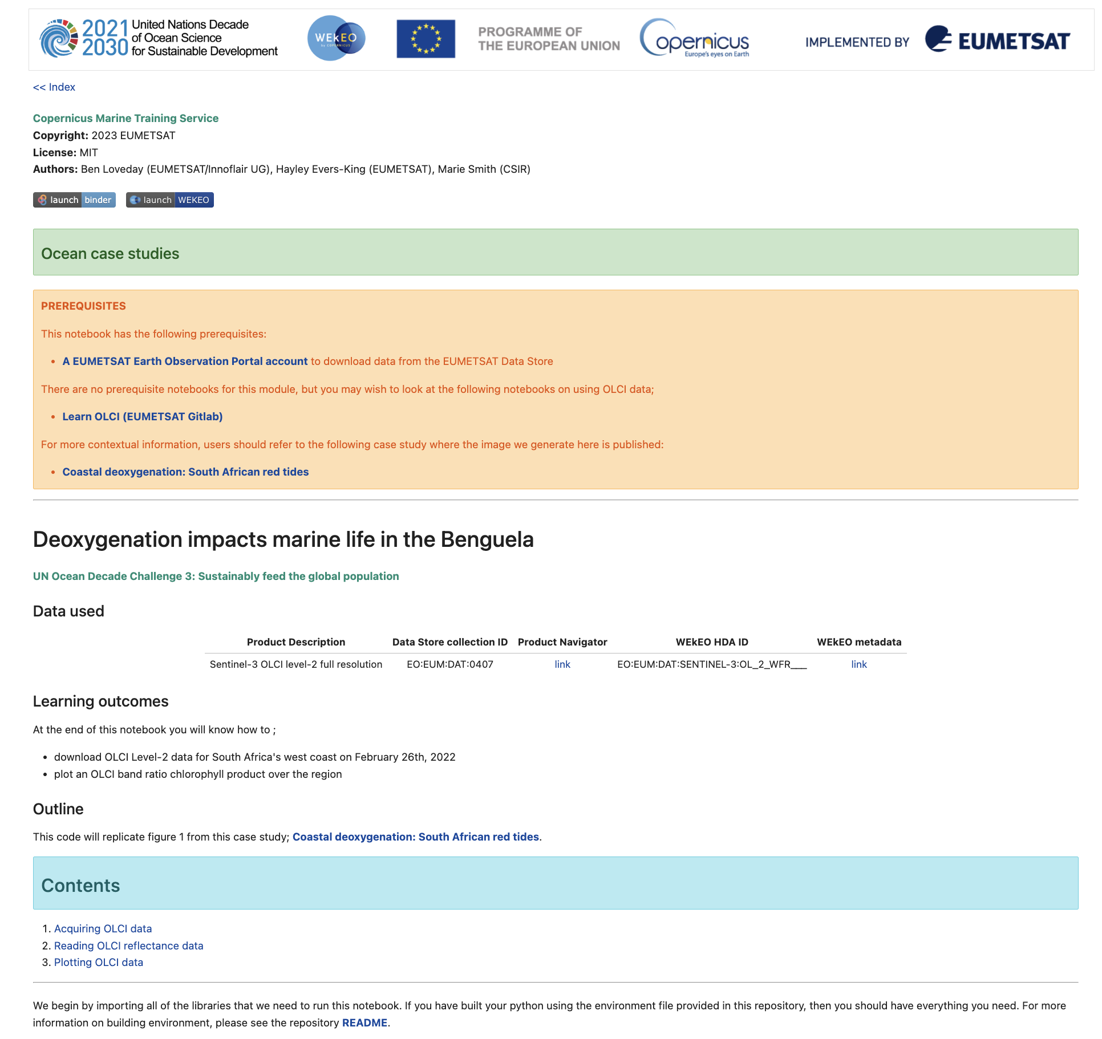
Good practice contributions...
Notebook style guide
  Developed for consistency and to allow users to navigate notebooks.
  Includes:
    Header with logos for attribution
    Navigation between index and series of notebooks
    Prerequisites – other notebooks, links that will provide prior/supporting knowledge
    Narrative introduction to provide context
    Outline with sections for navigation
    Data used with catalogue links
    Learning outcomes
    Contact points for support

Slide 10
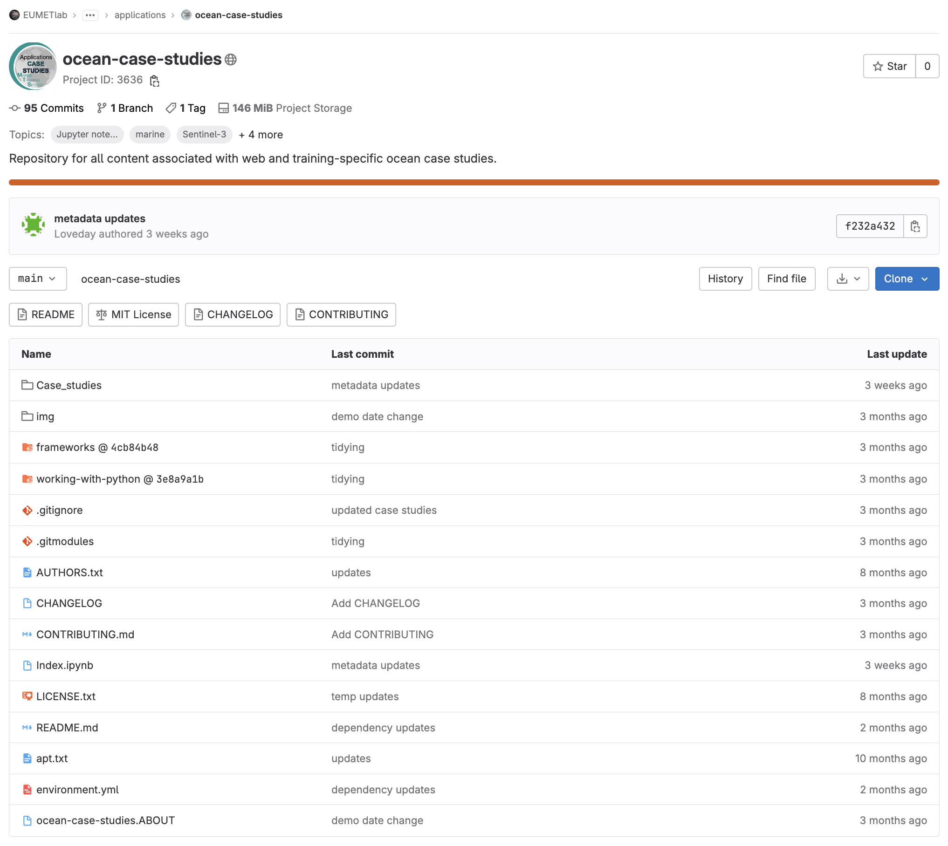
Good practice contributions...
Technical aspects and review:
  All repositories include:
    Code license information (usually MIT)
    Authorship and contact information
    Full README with installation guide
    Environment (YAML) file so notebooks can be run anywhere
  Use of mirroring and sub-moduling to prevent code duplication
  Quality review covering licensing and dependency analysis
  Index notebook connecting related content
  Metadata added to all

Slide 11
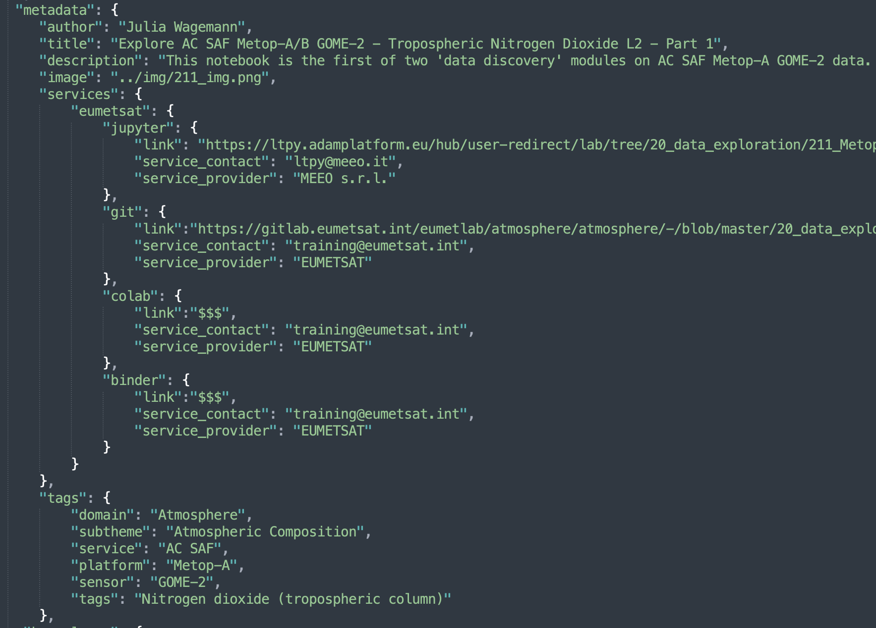
Metadata at the notebook level
Title
Author
Description
Thumbnail
Hosting services, e.g. Jupyterhub, Github/Gitlab, Colab, Binder
Tags:
  Application domain
  Data service
  Satellite
  Sensor
  Variableles

Slide 12


Good practice contributions...
Compromise between having a pre-installed Python environment setup vs. learning how to setup the environment
Compromise between downloading data vs. making data already available on the training platform (fragmentation of data landscape a barrier)
Maintenance of notebooks – especially with many contributors and frequent changes of data access systems.
Advantages
Notebooks remove elements of fear – users are more familiar with a browser than a command line
The wider ecosystem, including sharing and hosting notebooks, make notebooks well suited as a teaching tool
Useful for user engagement in different settings
Challenges

