Slide 1
Jupyter Notebooks CEDA Exemplars
Esther Conway, UKSA-NCEO
Agenda ID: 2023.10.26_13.45
WGISS-56
Paris, France (CNES)
24-26 October 2023

Slide 2
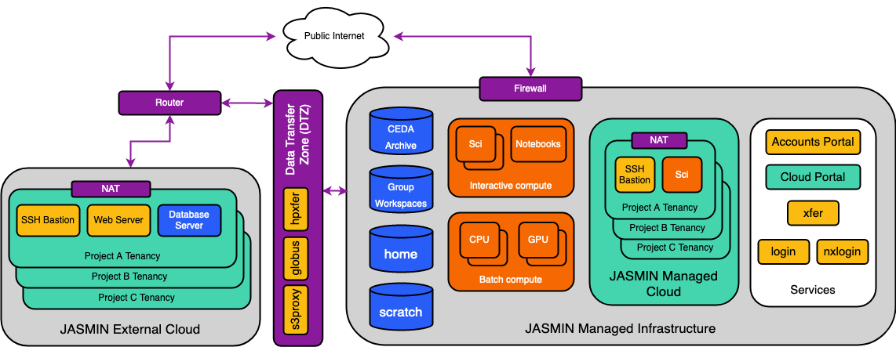
JASMIN Architecture

Slide 3
What Notebooks do we care about ?
Training Notebooks for JASMIN and Environmental Data Science
Project training for datasets held on CEDA
Provenance (notebooks that have created data held on CEDA)
Demonstrators
Potentially - scientific output from NCEO
Notebooks for our systems in development (EODataHub which will include Data cube services and sandpit)
Hackathon ouput

Slide 4



Technology Stacks and Dependencies
Jupyter on Jasmin – easiest solution but only if you have Jasmin access. Common dependencies, Jasmin Jupyter Service, Data Access, JASPY version
Download to personal computer suitable for small files. Common dependencies, Binder, Data Access, environment .yml
Access via OpenDap using Binder suitable for accessing relatively small file where they can be scattered through a large data set. Common dependencies, Binder, Data Access, environment .yml and OpenDap service availability
Colabs – great for access to range of google earth data via the python API and AI capabilities.
Platform Restrictions
Data Restrictions

Slide 5
Common Depedencies
Platform and Service Dependencies: All notebooks will run on something whether it is a personal laptop or integrated into a service
Language versions :Jupyter notebooks support Python, Java, R, Julia, Matlab, Octave, Scheme, Processing, Scala, and many other languages. It essential to note not only the language but also the version employed in the notebooks
Libraries: Libraries used by the notebook should be clearly identified in the header. Notebooks are being run on standard machines on data analysis platforms, sometimes libraries need to be installed on the fly using for example using conda. When this happened the first cell should be used for that purpose. The installation mechanism should be clearly noted and explained.
Additional scripts and files: Frequently notebooks utilize external scripts, shapefiles and other types of file. The header should contain clear information on their name, location and purpose. Ideally these should be kept in the same repository directory as the notebook rather than linked to.

Slide 6
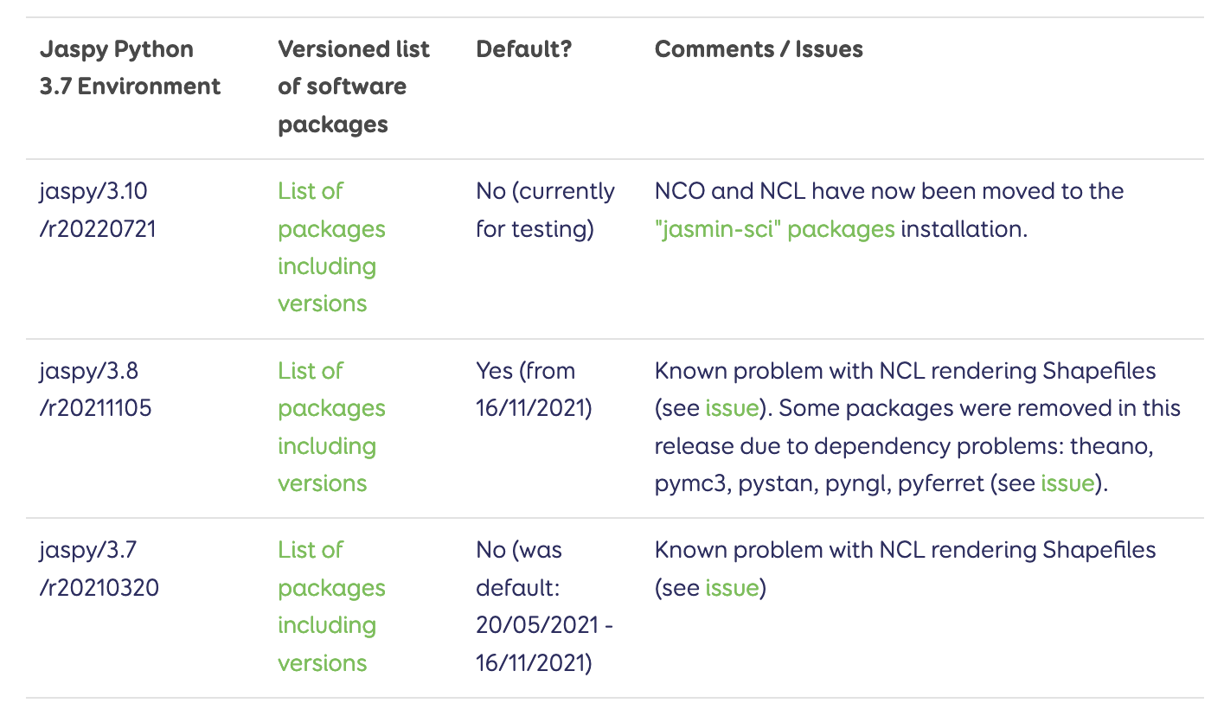
Technical dependencies and Virtual Environments
JupyterHub deployed on Data Analysis Platform: Many CEOS Agencies have deployed JupyterHub on their data analysis platforms.Very often this is deployed on specific analysis machine whose environments can be published and version information added to the notebook header for example: https://help.jasmin.ac.uk/article/4729-jaspy-envs
OpenDap and http Services: In addition to running on a platform notebooks may also rely upon data transfer services run by an archive or platform. Frequently these services require users to hold accounts or use specific code within cells to enable access. Platforms/archives should publish up to date information on their services and access requirements. The notebook should explain the access pathway and link to such information. For example https://help.ceda.ac.uk/article/4442-ceda-opendap-scripted-interactions
import numpy as np import netCDF4 as nc
import seaborn as sns
from scipy import stats import pandas as pd
import os
import matplotlib.pyplot as plt
%matplotlib inline
import warnings warnings.filterwarnings('ignore') warnings.simplefilter('ignore')
https://help.jasmin.ac.uk/article/4729-jaspy-envs#jaspy-envs

Slide 7



On the Horizon
Sometimes its more important to preserve the process than the data

Slide 8


The challenge
Overheads and difficulties of maintaining notebooks. Repository of broken thinks or not enough notebooks reach the required standard
Its OK to say this isn't feasible
Benefits and needs of the EO community

Slide 9
4.1 Notebook description, purpose and discoverability 9
4.2 Structure, workflow, code and documentation 10
4.3 Technical dependencies and Virtual Environments 11
Platform/Service Specific Dependencies 11
4.4 Citation, access to and navigation of input data 13
4.5 Association with archived data 14
4.6 Archival, Preservation and Retirement 15
Review of notebooks 15
4.7 Open source software licensing 17
4.8 Publishing, Versioning and DOI

Slide 10

Contact
Best Practice Draft Document: https://docs.google.com/document/d/1b9HMAz1SewUjP7OTc6Hgez62Vn3BLj0Q-mPyhpZvQ18/edit
Contact: esther.conway@stfc.ac.uk
Slide 10

