Slide 1
Service Metadata & Discovery Best Practice and Registry Tools
Yves Coene (Spacebel for ESA), Mattia Stipa (ESA)
CEOS WGISS #56, Paris (France)
Jupyter Notebooks Workshop, 26/10/2023

Slide 2
Outline
Introduction
Discovery scenarios for Tool and Service Registries
Registries
ESA AI4EO Registry
FedEO Tool and Service Registry
CMR/IDN Registry
Conclusion

Slide 3
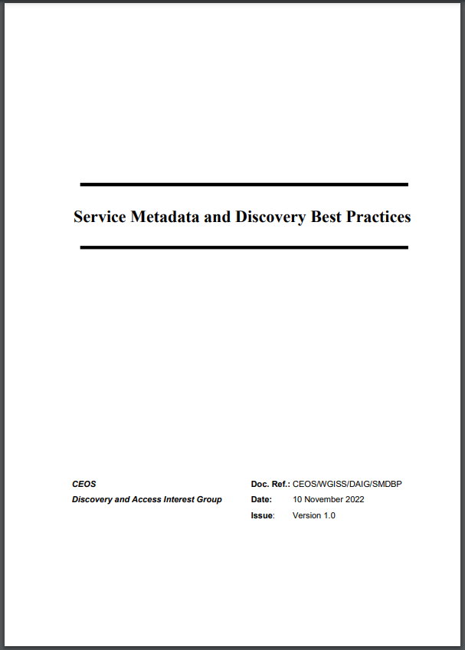
Introduction – Best Practices
“CEOS Best Practices for Service Metadata and Discovery”
Version 1.0 approved and published in November ’22.
Extends Best Practices for collection and granule discovery (CEOS OpenSearch Best Practices) to “services” (incl. tools, applications, service endpoints) with intention to “share”.
Defines core set of metadata properties without imposing single metadata format.
First step towards sharing tools and applications metadata via regional registries and CEOS IDN.

Slide 4
Introduction - Discovery Scenarios
Best practices document describes several discovery scenarios that can be applied to (Jupyter Notebook) tool registries)):
Scenario 2: Downloadable tools
Source code, binaries, Jupyter Notebooks, Docker images, …
Download from repository (GitHub, Zenodo, ..) or registry (e.g. DockerHub, …)
Scenario 3: Web GUI tools
Software as a Service (SaaS)
E.g. Jupyter Notebook on Google Colaboratory, Binder
Scenario 5: Coupled Services
Associate tools and services (e.g. Notebook) to EO collections

Slide 5
ESA AI4EO Registry
https://ai4eo.esa.int/
Web Portal providing access to Notebooks
5 thematic areas:
Climate and forecast
Land Use
Fire monitoring
Health risk
AI Techniques
No standard-based metadata / API
Access to ESA GitLab

Slide 6
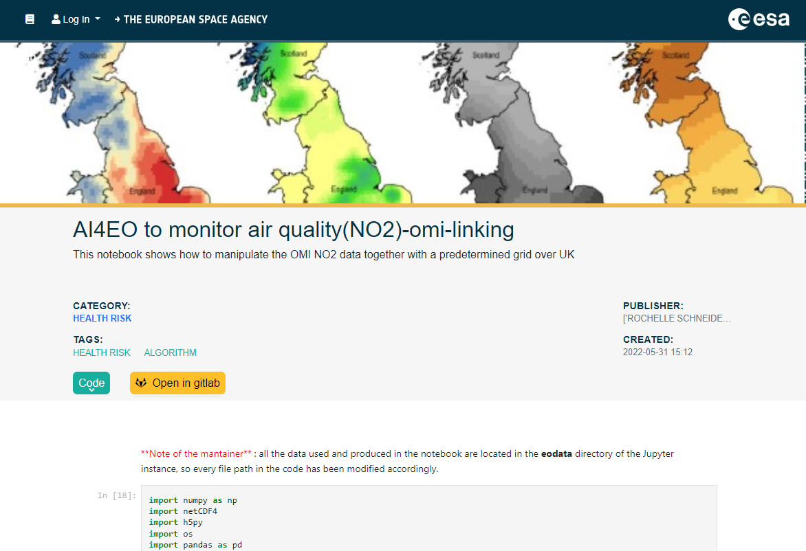
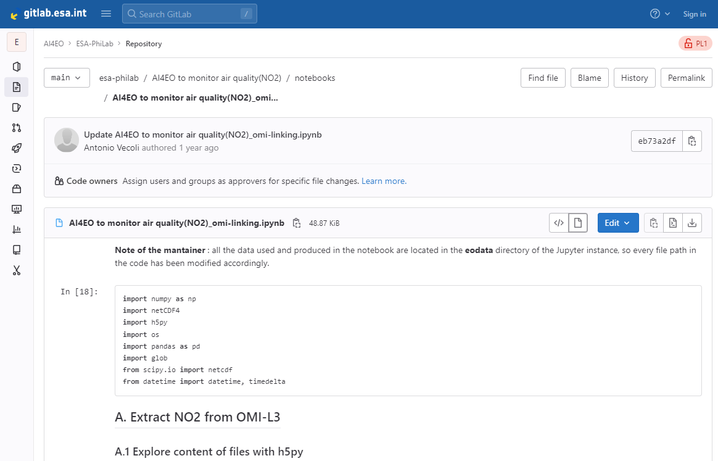
ESA AI4EO Registry
Access to ESA GitLab

Slide 7
FedEO Tool and Service Registry
FedEO Evolution service discovery presented at WGISS-55
Support for multiple discovery interfaces:
OpenSearch
OGC API Features (incl. Part 3 Filtering)
STAC API (incl. Filtering and Collection Search)
OGC API Records
Main (service) metadata input formats:
OGC 19-020r1 (GeoJSON)
ISO19139
Large number of response and metadata output formats:
ISO19139 and OGC 19-020r1
GeoDCAT-AP and schema.org (JSON-LD, RDF, Turtle)
STAC, UMM JSON, ISO19115-3 (In progress)
Resource coupling in selected formats (ISO, OGC and GeoDCAT-AP)

Slide 8
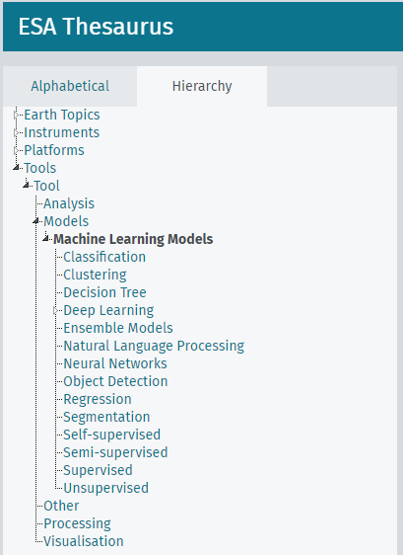
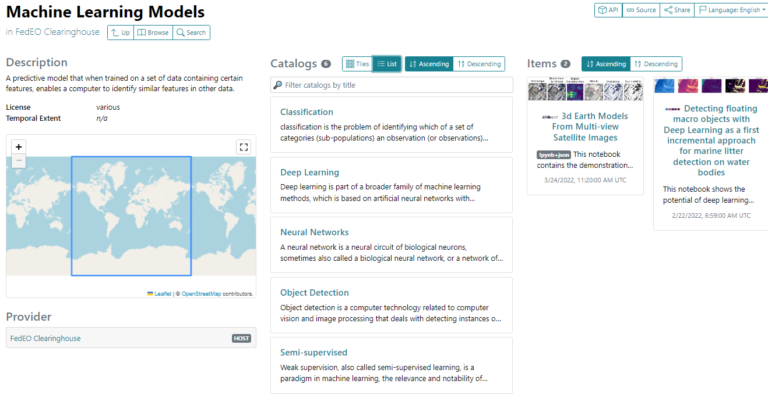
FedEO Tool and Service Registry
Tool and Service metadata to be annotated with controlled keywords (SKOS concepts).
ESA AI4EO notebook metadata available in FedEO in two ways:
Static STAC Catalogs (hierarchy)
STAC API
DRAFT
Notes:
https://radiantearth.github.io/stac-browser/#/external/emc.spacebel.be/concepts/tools/5881fd91-58e6-58cb-a4f3-014ae246c67b

Slide 9
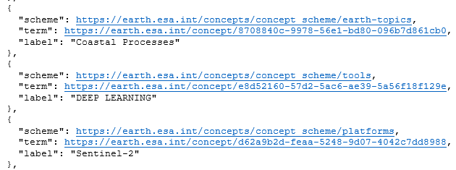
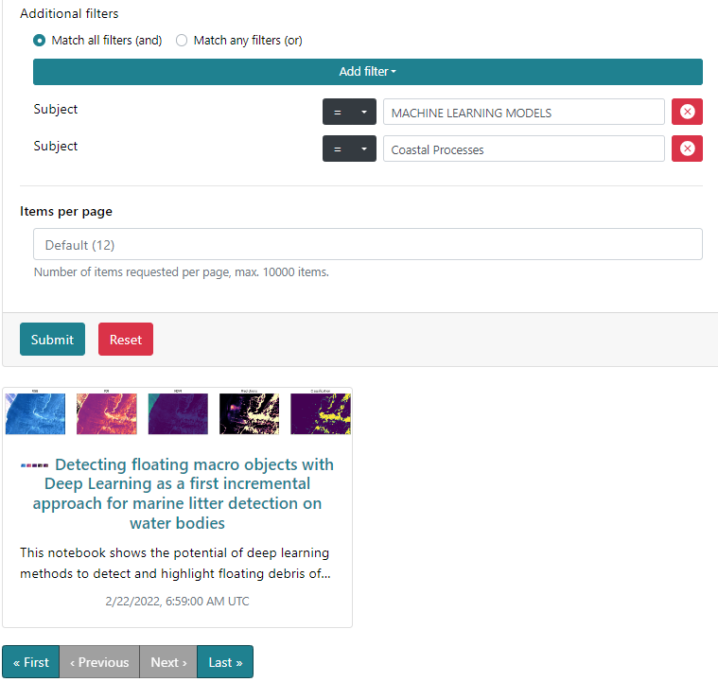
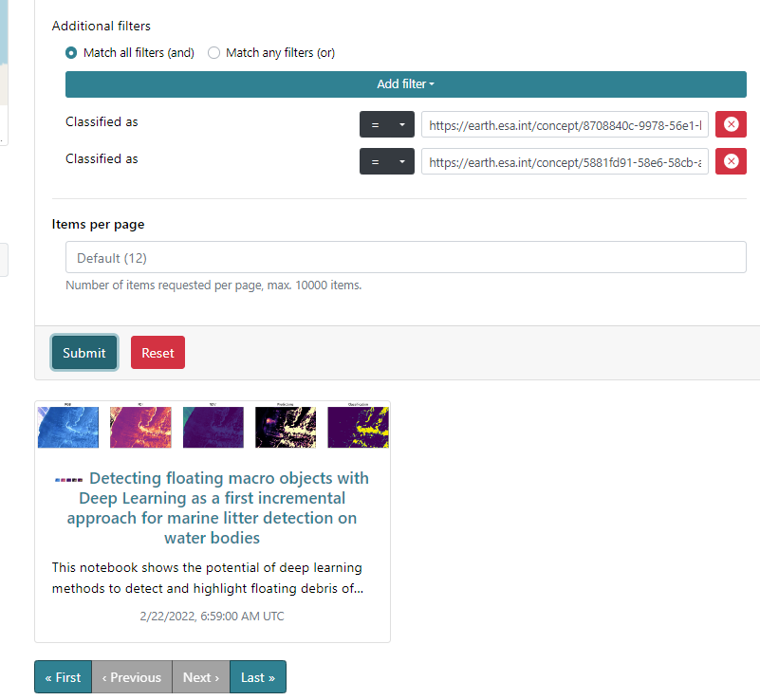
FedEO Tool and Service Registry
STAC API Search request (filter, CQL2) to find tools (“Machine learning”) about a subject (“Coastal processes”)
Free text search
Controlled keyword (concept) search

Slide 10
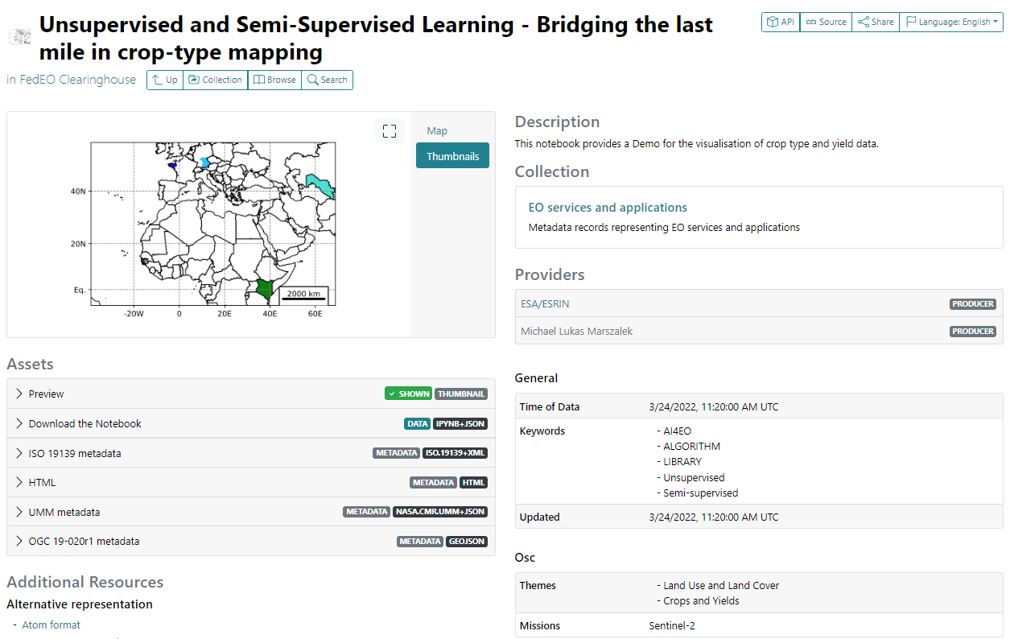
FedEO Tool and Service Registry
AI4EO Notebook metadata (STAC).
UMM Metadata allowing import into CEOS IDN
Incl. Controlled Keywords
Open Science STAC Extension
Open or Download the Notebook
Notes:
https://radiantearth.github.io/stac-browser/#/external/emc.spacebel.be/collections/services/items/ai4eo-crop-type-mapping?httpAccept=application%2Fgeo%2Bjson%3Bprofile%3Dhttps%3A%2F%2Fstacspec.org

Slide 11
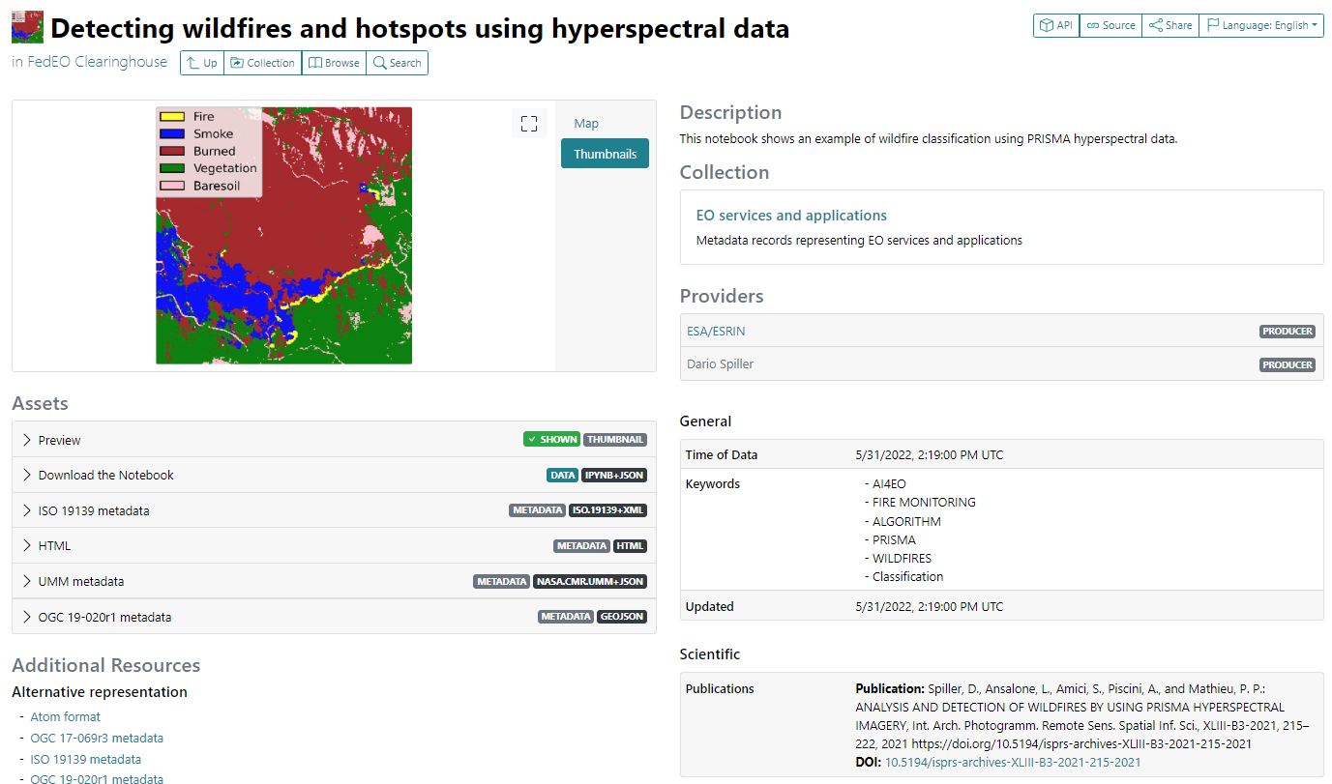
FedEO Tool and Service Registry
AI4EO Notebook metadata (STAC).
Download Notebook
Scientific STAC Extension (for associated DOI, e.g. publications)
Notes:
https://radiantearth.github.io/stac-browser/#/external/emc.spacebel.be/collections/services/items/ai4eo-detecting-wildfires?httpAccept=application%2Fgeo%2Bjson%3Bprofile%3Dhttps%3A%2F%2Fstacspec.org&.language=en

Slide 12
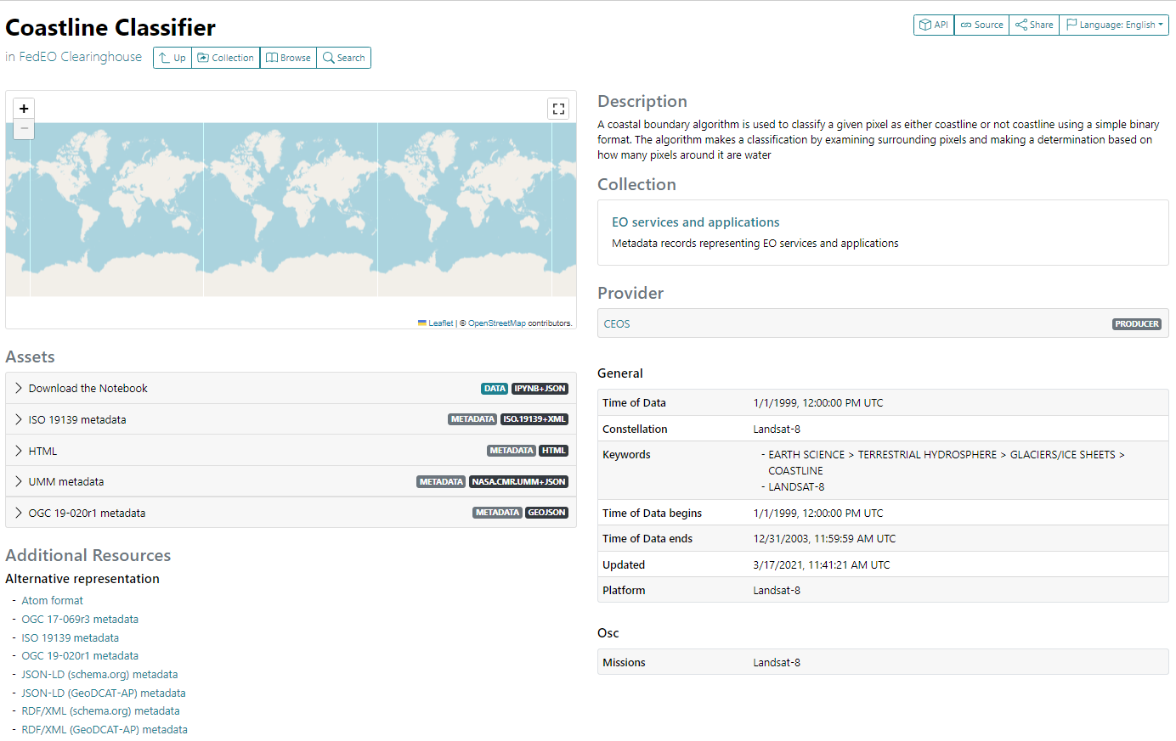
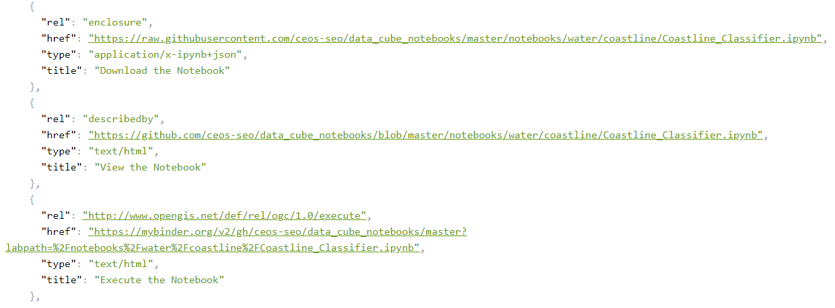
Notebook discovery – CEOS Example
Accessible via STAC API in STAC (item) format:
“View” (GitHub), “Download”, “Execute” (Binder)…
STAC Item representation of service/tool
Notes:
https://emc.spacebel.be/collections/services/items/coastline-classifier?mode=owc
https://radiantearth.github.io/stac-browser/#/external/emc.spacebel.be/collections/services/items/coastline-classifier?httpAccept=application%2Fgeo%2Bjson%3Bprofile%3Dhttps%3A%2F%2Fstacspec.org

Slide 13
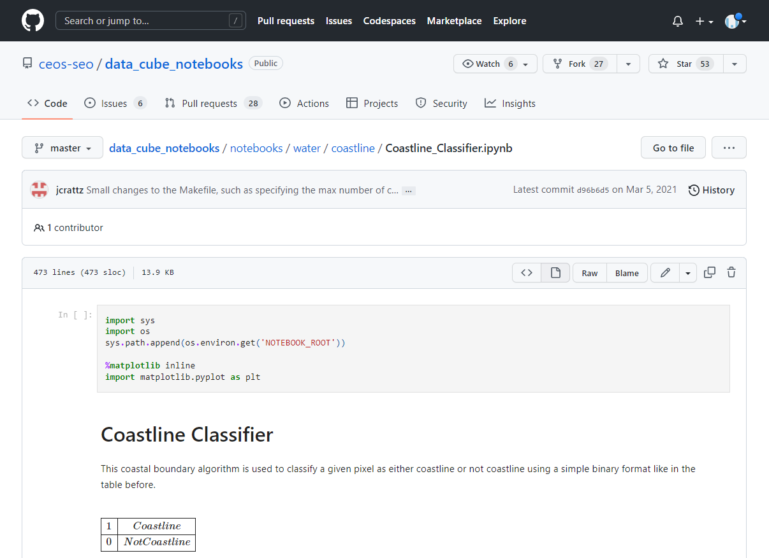
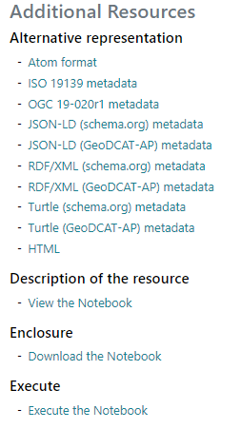
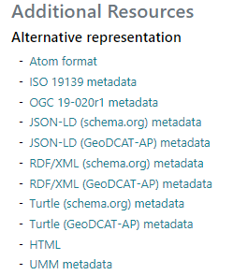
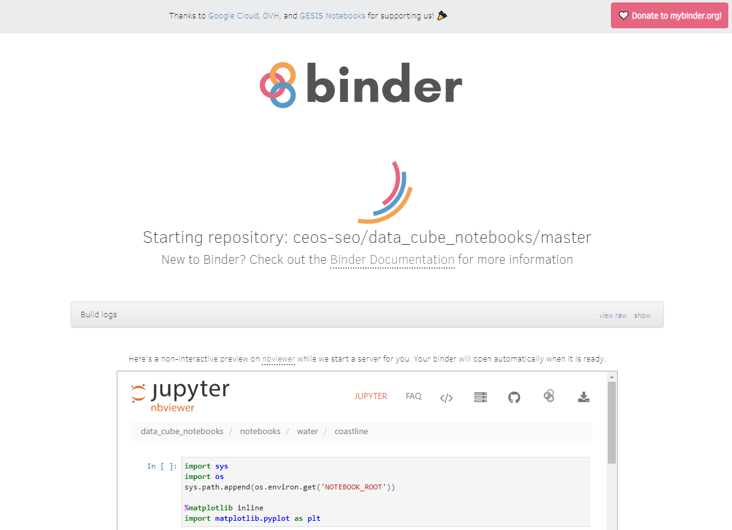
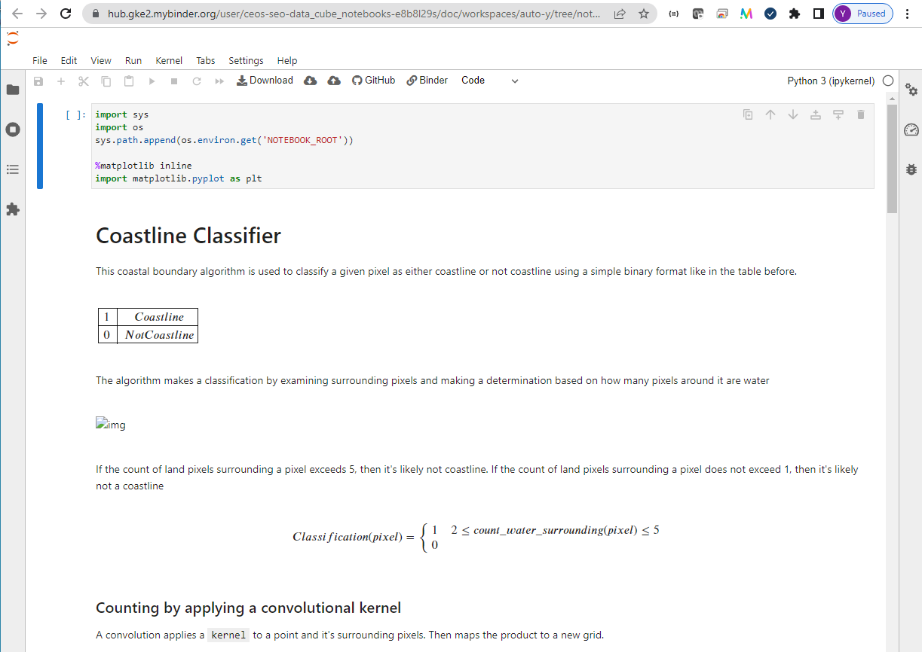
Notebook discovery – CEOS Example
Notes:
https://radiantearth.github.io/stac-browser/#/external/emc.spacebel.be/collections/services/items/coastline-classifier

Slide 14
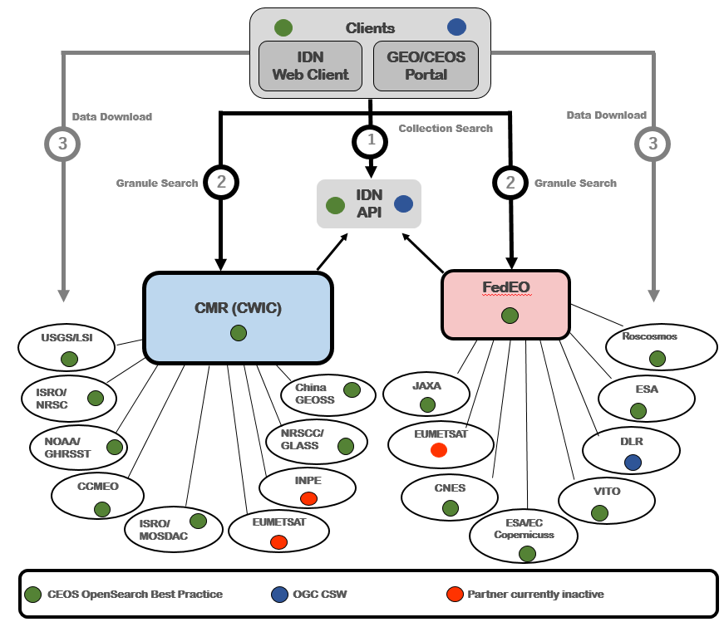
IDN/CMR
CEOS International Directory Network (IDN)
Global registry of free online metadata of scientific datasets (a.k.a. “collections”).
“granules” accessible via two-step search (OpenSearch Best Practice).
Distributed architecture and connected data assets from multiple agencies.
CWIC/CMR and FedEO are local registries, providing content to CEOS IDN via agreed metadata interchange format and access protocol.
Local registries provide their content in multiple metadata formats according to regional preferences and regulations.

Slide 15
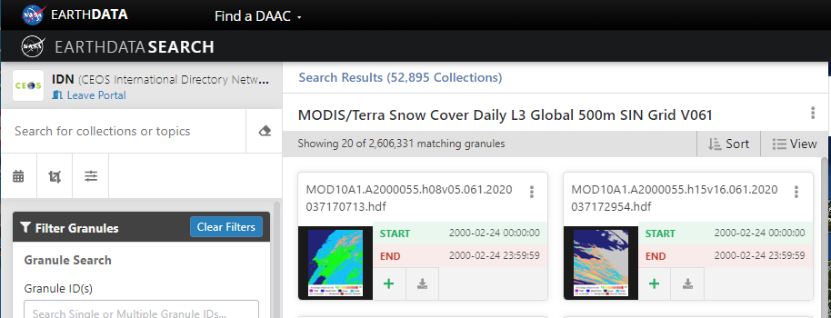
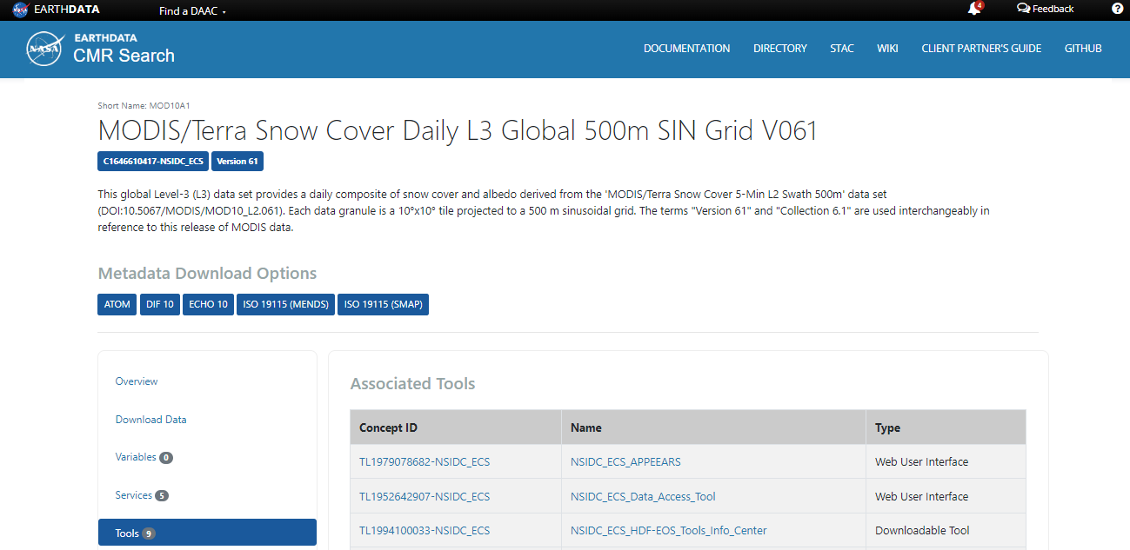
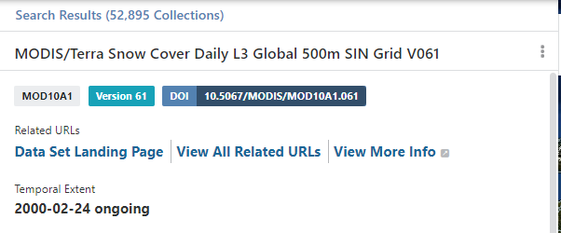
IDN/CMR Tool and Services Registry
Currently “Services” and “Tools” are discovered AFTER collection discovery.
These may include Notebooks
(1)
(2)
Notes:
https://search.earthdata.nasa.gov/search/granules?portal=idn&p=C1646610417-NSIDC_ECS&pg[0][v]=f&tl=1697719591.256!3!!

Slide 16
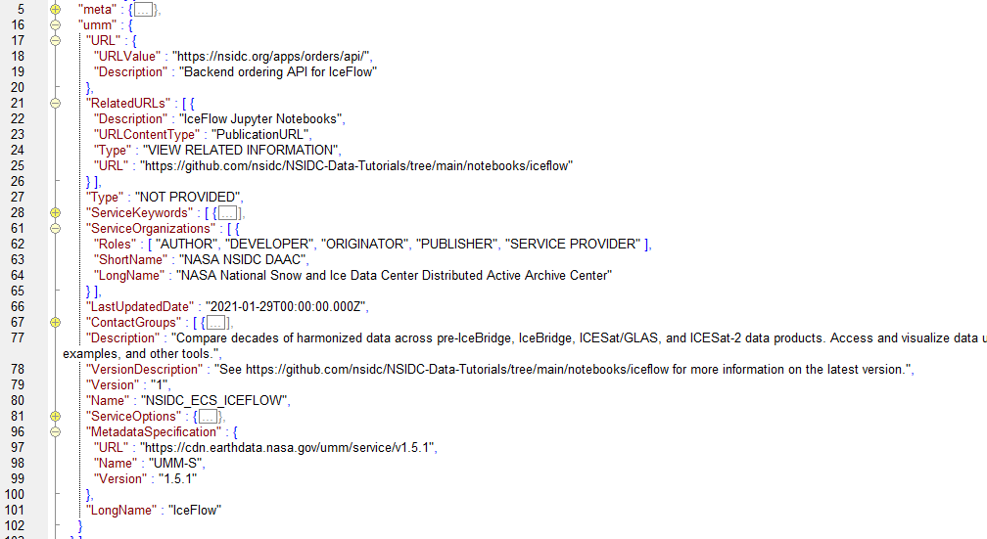
IDN/CMR Tool and Services Registry
Notebooks among tools/services described in IDN/CMR
Example (UMM-S): https://cmr.earthdata.nasa.gov/search/services.umm_json?concept_id=S2008499525-NSIDC_ECS&pretty=true

Slide 17
FedEO interface with IDN/CMR Registry
Exchange formats between IDN and FedEO:
Collection metadata: DIF-10
Service and tool metadata: UMM-JSON.
JSON encoding for UMM-T/-S
Requires annotation with GCMD “EARTH SCIENCE SERVICES” keywords.
Not foreseen to add controlled science keywords.
Is Jupyter Notebook a Tool or a Service from UMM point of view ?
Conventions for Notebook “viewing” link (e.g. GitHub), “download” link, “execution link” (Binder, Colab) to be agreed ?
FedEO will provide UMM-S or UMM-T (JSON) encoding according to the content of the metadata record.

Slide 18
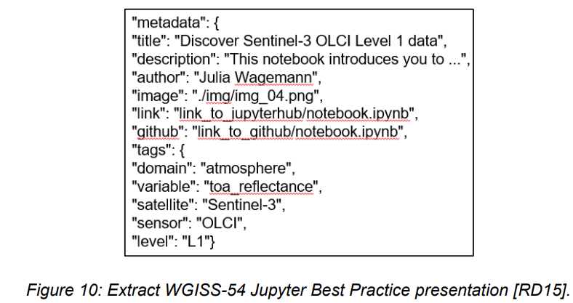
Future work
Notebook (internal) metadata:
Forthcoming “CEOS Jupyter Best Practice document” (Esther Conway).
Harmonization with CEOS Service metadata and discovery Best Practice ?
Use case:
Reuse internal metadata to create (draft) metadata record for Notebooks in catalogue.
Automated harvesting of Notebook metadata, e.g. from GitHub repository.

Slide 19
Conclusion
Jupyter Notebook metadata can be encoded and catalogued according to CEOS Best Practices for Service Metadata and Discovery.
FedEO catalogue will offer a Service and Tool registry
Service and Tool metadata as per above CEOS Best Practices.
Feedback about additional metadata properties relevant/required for Notebook discovery is welcome.
Resource coupling with collection metadata records is considered important.
Annotation with controlled keywords expected.
STAC API and STAC among available discovery interfaces.
Implementation of UMM interface towards CEOS IDN in progress.
Online UMM-JSON(S/T) validator would be useful (similar to DIF10 validation endpoint).
Forthcoming CEOS Jupyter Notebook Best Practice may recommend internal Notebook metadata.
Harvesting of Notebook’s internal metadata by catalogue from e.g. GitHub repository could be envisaged.

Slide 20
AOB

