Slide 1
WGISS Jupyter Notebooks Best Practice History and Status
Esther Conway, UKSA-NCEO
Agenda ID: 2023.10.26_13.30
WGISS-56
Paris, France (CNES)
24-26 October 2023

Slide 2



2019 a Question from Rob Woodcock CSIRO
Have you though about Jupyter notebooks
Have you thought about how WGISS could collaborate with CapD

Slide 3
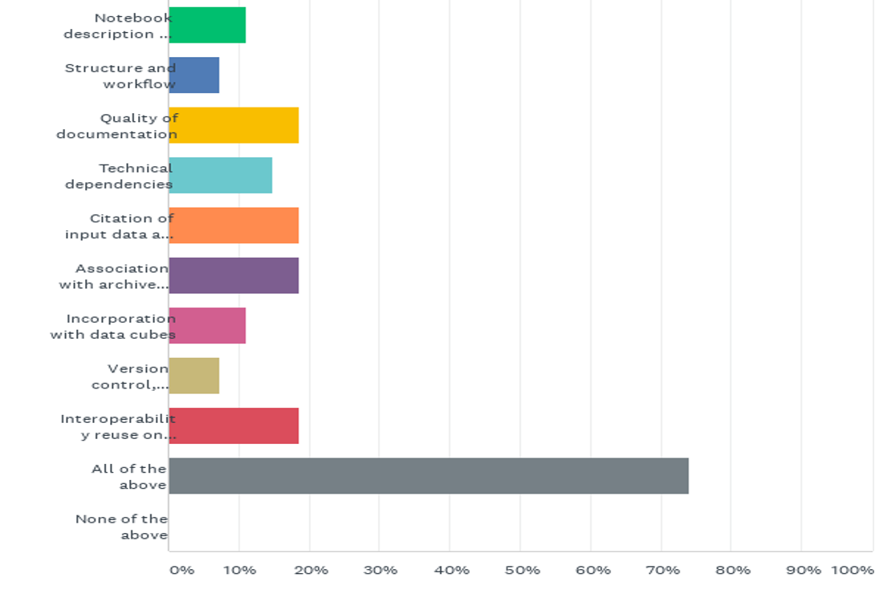

2020 Jupyter Technology Survey

Slide 4






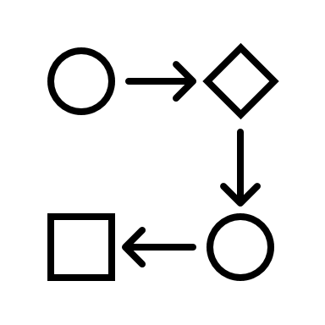





Tech Expo Overview Yousuke Ikehata
Data Preservation and Stewardship
Collaboration
Techniques
AI/ML
Federations
UI/UX
WGCapD
Data Discovery and Access
JupyterNotebook
Data Presentation?
(Potential Topic)
WGDisaster
Data Interoperability
and Use

Slide 5
Jupyter Strategy
CaoD , GEO ?, CODATA ?, WGISS
Actions !
5
Data Discovery and Access
Collaboration and developing a Community of Interest
Training Capabilities (online access to Jupyter Notebooks and Data)
Data Interoperability and Use
Best Practice Document
Tech Expo
Introduction to Jupyter Notebooks
Data Preservation and Stewardship
CaoD/WGISS
Preservation and CEOS repository
Domain Specific /CapD Webinars
Tech Expo Webinars
Tech Expo

Slide 6
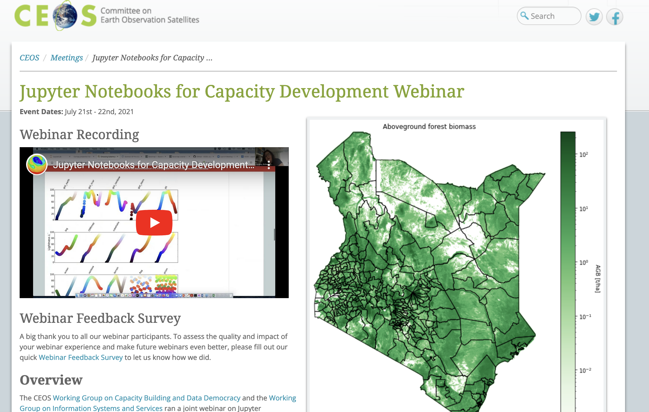
Jupyter Notebooks for Capacity Development Webinar

Slide 7
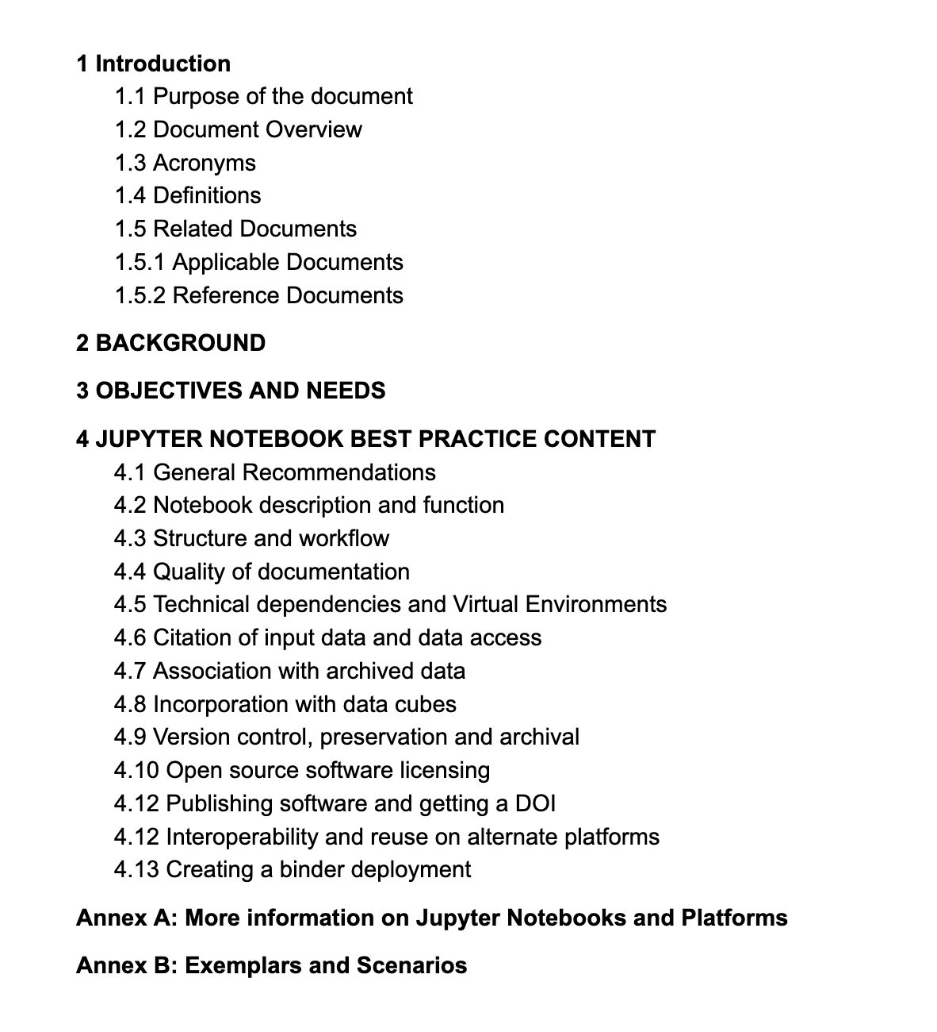


Best Practice Document Draft
https://docs.google.com/document/d/1b9HMAz1SewUjP7OTc6Hgez62Vn3BLj0Q-mPyhpZvQ18/edit

Slide 8
Jupyter Notebooks Day -Friday, October 21, 2022
14:00: Intro to CEOS WGISS Tech Expo - Yousuke Ikehata JAXA
14:10 Intro to CEOS CapD – Kenton Ross NASA DEVELOP
14:20 Overview Jupyter Notebooks Day – Esther Conway CEDA/UKSA
14:30 ESA PGDS – Simone Mantovani/Mattia Stipa ESA
14:50 Google Earth Engine – Brian Killough CEOS SEO
15:10 EUMETSAT- Julia Wagemann EUMETSAT
15:30 Coffee Break
15:45 Earth Analytics Interoperability Lab – Jonathan Hodges CSIRO
16:05 University of Alaska Fairbanks – Alex Lewandowski Alaska Satellite Facility
16:25 SLIDO Q&A from the broader group
16:45 Lunch/Dinner Break
17:15 Best Practice Discussion – Review of topic areas Esther Conway
18:00 Coffee Break
18:15 Global Training Discussion – Esther Conway CEOS WGISS & Kenton Ross CEOS CapD
19:00 Wrap up and further actions

Slide 9
Target Communities
Who will benefit from a Best Practice
Data Producers
Authors of Jupyter Notebooks
Providers of EO data training
Users of EO data
EO data archivers
Providers of Data Analysis Infrastructure

Slide 10
Objectives and Needs
Issues to be addressed:
Clear understanding the purpose of a notebook and deciding if it is a reusable asset. Successfully conveying how and why a notebook should be used by its intended community.
Encourage the development of good workflow and structure within notebooks along with quality documentation. Support their reuse and adaptation by new users
Support discovery of relevant notebooks in terms of dataset, domain, application/function and skill level
Delaying technical obsolescence and ensuring longevity of relevant notebooks
Maintaining the quality of archive by timely removal of redundant notebooks
Supporting interoperability of notebooks on different platforms
Lowering barrier for EO data exploitation and raising technical skill level
Slide 10

Slide 11
New Topic Areas
4 JUPYTER NOTEBOOK BEST PRACTICE CONTENT 9
4.1 Notebook description, purpose and discoverability 9
4.2 Structure, workflow, code and documentation 10
4.3 Technical dependencies and Virtual Environments 11
Platform/Service Specific Dependencies 11
4.4 Citation, access to and navigation of input data 13
4.5 Association with archived data 14
4.6 Archival, Preservation and Retirement 15
Review of notebooks 15
4.7 Open source software licensing 17
4.8 Publishing, Versioning and DOI

Slide 12

Contact
Best Practice Draft Document: https://docs.google.com/document/d/1b9HMAz1SewUjP7OTc6Hgez62Vn3BLj0Q-mPyhpZvQ18/edit
Contact: esther.conway@stfc.ac.uk
Slide 12

