Slide 1
WGCapD

Slide 2
WGCapD: What
The WGCapD will focus and unify CEOS efforts toward providing wider and easier access to Earth Observation data, increasing the sharing of software tools such as the use of open source software and open systems interface, increasing data dissemination capabilities, transferring relevant technologies to end users, and providing intensive capacity building, education, and training in multiple formats. WGCapD will therefore strongly collaborate with other CEOS Entities (Working groups, ad hoc teams, and virtual constellations).

Slide 3
WGCapD: How (1/3)
WGCapD Members
Event Calendar (https://training.ceos.org/) to enter an activity please use (CEOS Capacity Building/Training Events Calendar (wufoo.com))
CEOS WGCapD Resources Webpage
http://ceos.org/ourwork/workinggroups/wgcapd/resources-2/
  Best practices guide for conducting trainings
  Training report template
  Sample post-training questionnaire
  Links for various capacity building portals and web resources

Slide 4

WGCapD: How (2/3)
Distribution list – not only CEOS Members
EOTEC DevNet (EOTEC DevNet)

Slide 5
WGCapD: How (1/3)
Monthly meetings (invited presentations)
Annual meeting (usually happening in February – before CEOS SIT)
WGCapD Workplan

Slide 6
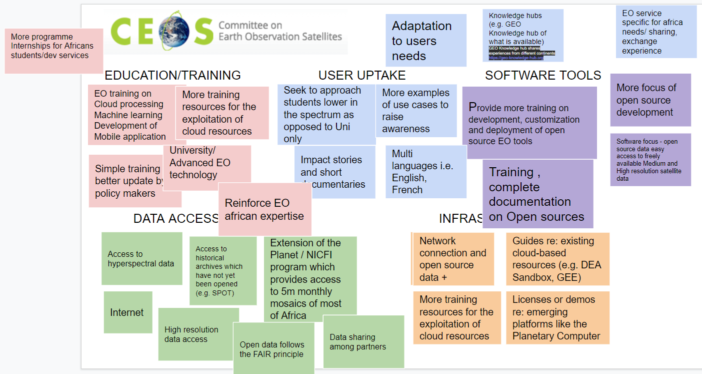
WGCapD: Annual meetings - #11

Slide 7
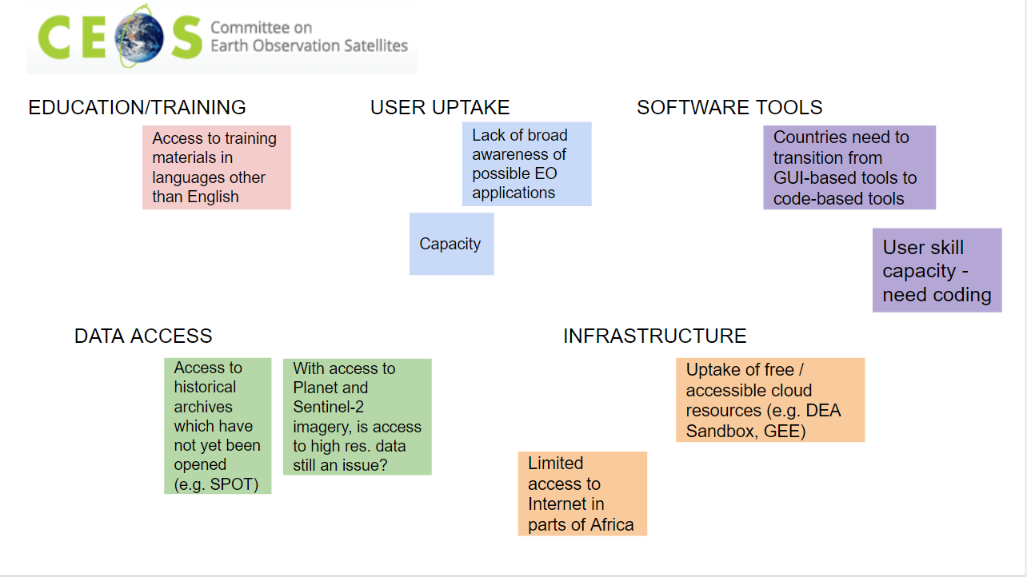
WGCapD: Annual meetings - #11
CEOS WGCapD-11_Report_DRAFT.docx - Google Docs

Slide 8
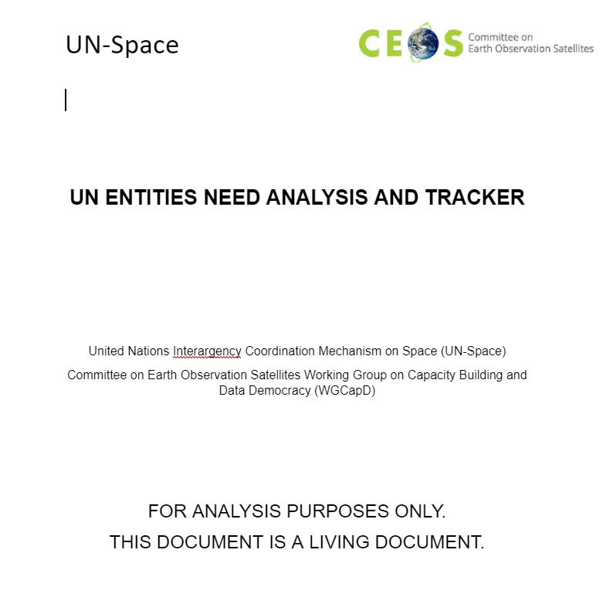
WGCapD: Annual meetings - #12
                UN_NEEDS_WGCapD.docx - Google Docs

Slide 9
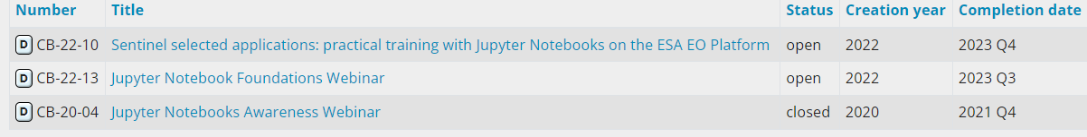
WGCapD: So far…
CB-20-04: Jupyter Notebooks Awareness Webinar
NASA, UKSA, JAXA, CSIRO, and ESA. Two sessions Americas/Europe/Africa and Asia/Oceania
Total of 288 attendees attended two sessions – 243 for the Americas/Europe/Africa session and 45 for the Asia/Oceania session

Slide 10
WGCapD: So far…
CB-20-04: Jupyter Notebooks Awareness Webinar
NASA, UKSA, JAXA, CSIRO, and ESA. Two sessions Americas/Europe/Africa and Asia/Oceania
Total of 288 attendees attended two sessions – 243 for the Americas/Europe/Africa session and 45 for the Asia/Oceania session

Slide 11
WGCapD: Happening today…
CB-22-13: Jupyter Notebooks Foundations Webinar
Today
Julio Castillo, incoming WGCapD Vice-Chair joining

Slide 12
WGCapD: Coming up…
CB-22-10: Sentinel selected applications: practical training with Jupyter Notebooks on the ESA EO Platform
Led by ESA. Jupyter notebooks are welcome

Slide 13
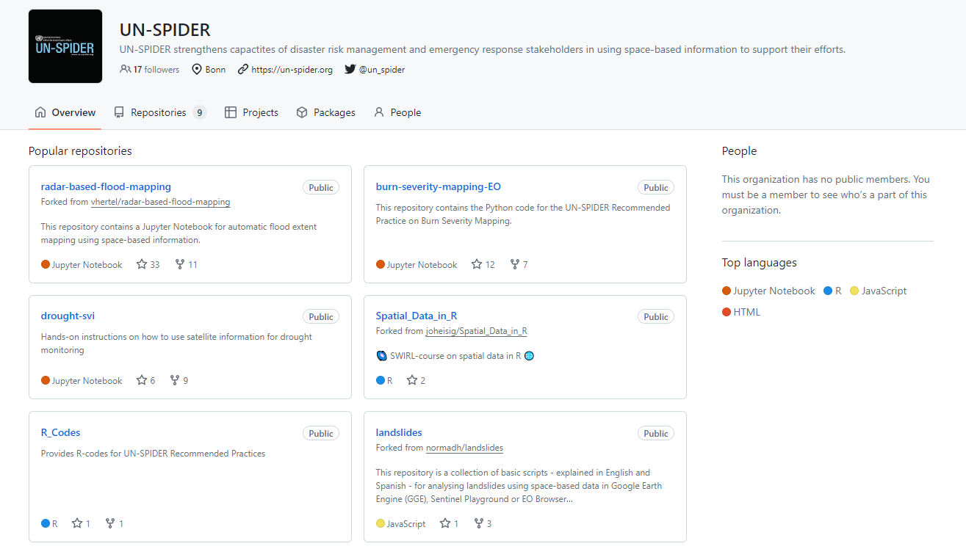
UNOOSA

Slide 14
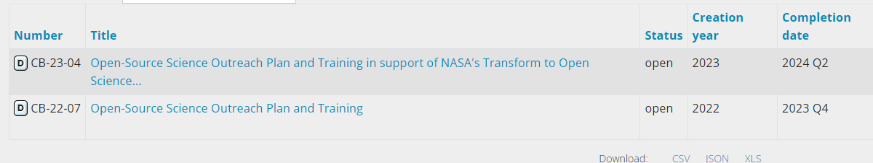
WGCapD: Coming up…
What is next?
UN_NEEDS_WGCapD.docx - Google Docs
Metadata standards and sharing of learning objects

Slide 15
WGCapD: Coming up…
What is next?
CB-23-04
CB-22-07
OPEN-SCIENCE RELATED ACTIVITIES BEING INVENTORIED
Chris Barnes: barnes@contractor.usgs.gov
Yasha Moz: moz_yasha@bah.com

Slide 16
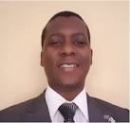
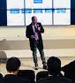
WGCapD: Coming up…
Julio Cesar Castillo Urdapilleta
AEM
Incoming WGCapD Vice-Chair
Dan Matsapola
SANSA
Incoming WGCapD Chair

