Slide 1
WGISS Chair Team Transition
Dr. Makoto NATSUISAKA, JAXA
Agenda ID: 2023.10.26_11.00
WGISS-56
Paris, France (CNES)
24-26 October 2023

Slide 2
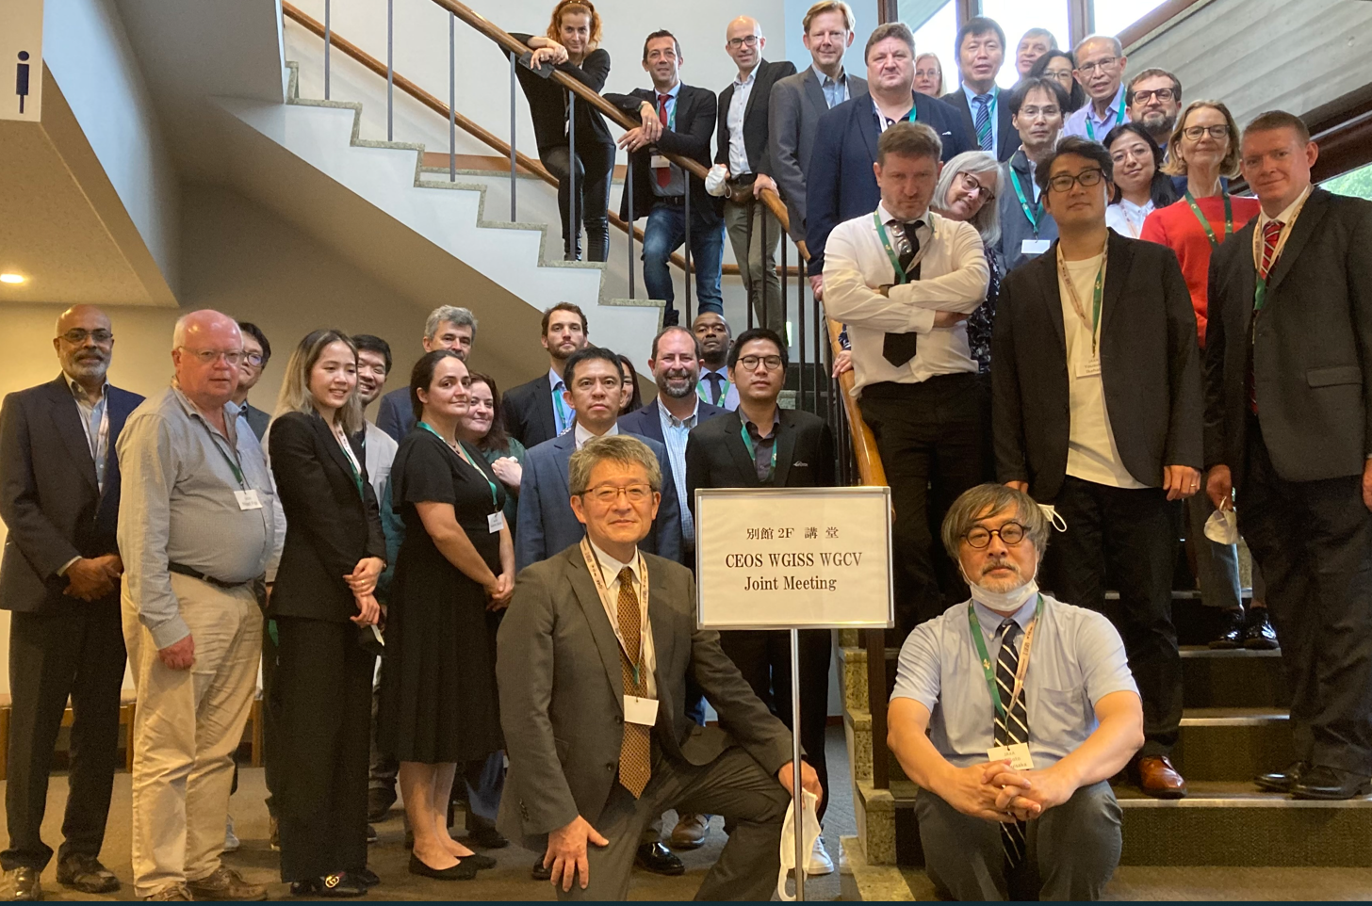
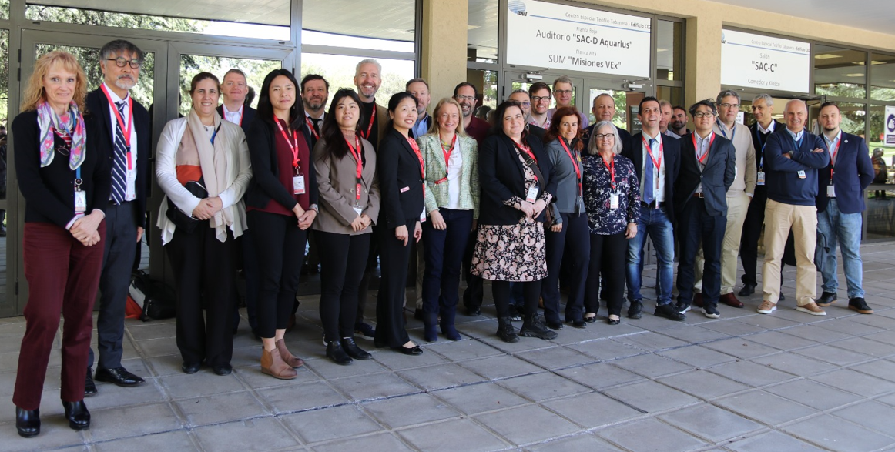
Planned WGISS Chair Team Transition
The current chair team will lead WGISS until 2023 (October/November) CEOS Plenary.
Chair: Makoto NATSUISAKA (JAXA)
vice Chair: Tom SOHRE (USGS)
Secretary: Michelle Piepgrass (JAXA)
The next chair team will begin their activities right after the 2023 CEOS Plenary. The new vice chair is to be nominated in the 2023 CEOS Plenary (November 2023).
Chair: Tom SOHRE (USGS)
vice Chair: Nitant Dube (ISRO)
Secretary: Libby Rose (USGS/Symbios)
WGISS-53 Virtual
WGISS-54 Tokyo
WGISS-55 Cordoba
Slide 2

Slide 3
CEOS Annual Process
Plenary; a meeting mainly for principals, decision, endorsement, etc.
SIT and SIT-TW; meetings mainly for working members
SEC; monthly meeting coordinated by SIT
SEC
New Work Plan to be issued
Jan.
Feb.
Oct.
Nov.
Dec.
Mar.
Sep.
Apr.
Aug.
May
Jul.
Jun.
SEC
SEC
WGISS
SEC
SEC
Plenary
SIT
SEC
SEC
SIT-TW
WGISS
Deliverables to be updated
SEC
SEC
SEC
SEC
SEC
Slide 3

Slide 4
WGISS vice Chair Task
4-year commitment (beginning after the CEOS plenary)
Initial 2 years as vice Chair
Next 2 years as Chair (beginning after the CEOS plenary)
Meeting Attendance
CEOS Plenary (once a year, October/November)
CEOS SIT (once a year, March/April)
CEOS SIT Technical Workshop (once a year, September/October)
CEOS SEC (monthly, remote)
Slide 4

Slide 5
WGISS Chair Task
2-year commitment
Lead WGISS activities
CEOS Work Plan update (once a year)
CEOS deliverables update (before SIT-TW)
Meeting Chair
WGISS Meetings (twice a year)
WGISS SEC Meetings (monthly)
Meeting Attendance
CEOS Plenary (once a year, October/November) ← WG Report
CEOS SIT (once a year, March/April)
CEOS SIT Technical Workshop (once a year, September)
CEOS SEC (monthly) ← WG Report
Maintain Secretary Service
Slide 5

Slide 6
Challenge as the WGISS Chair
Rebuilding WGISS IGs
Data Interoperability Use IG, Technology Exploration IG
WGISS Resource Update
Contribution to cross-CEOS Missions
CEOS Interoperability Framework, CEOS New Space Task Team, CEOS Engagement with Standardization Organizations, CEOS Ocean Coordination Group
Enhance WGISS Cooperation and Making Visible WGISS Activities
WGISS
CEOS/SIT
GEO
UNOOSA
WGCV
CGMS/WMO
WGDisaster
LSI-VC/
CEOS ARD OG
SEO
WGCapD
Slide 6

