Slide 1
CEOS WG Disasters an updated overview for WGISS#56
H de Boissezon, CNES
CEOS WG Disasters Chair
Presentation to WGISS#56
Oct 26th 2023

Slide 2
Overview
Update of WGDisasters activities after April 2023 presentation to WGISS
Very brief overview of WG Disasters objectives and priorities
WG Disasters workplan status and perspectives
Overview of Pilots and Demonstrators new achievements
Overview of planned post Demonstrators activities (for Plenary approval)
Notes:
The CEOS WGDisasters ensures the sustained coordination of disaster-related activities undertaken by the CEOS Agencies and acts as an interface between CEOS and the community of stakeholders and users involved in risk management and disaster reduction.
Who belongs?
Membership is open to all CEOS Agencies (Members and Associates).
Also experts from non-CEOS Agencies who have relevant expertise to contribute to the objectives of the WGDisasters.

Slide 3
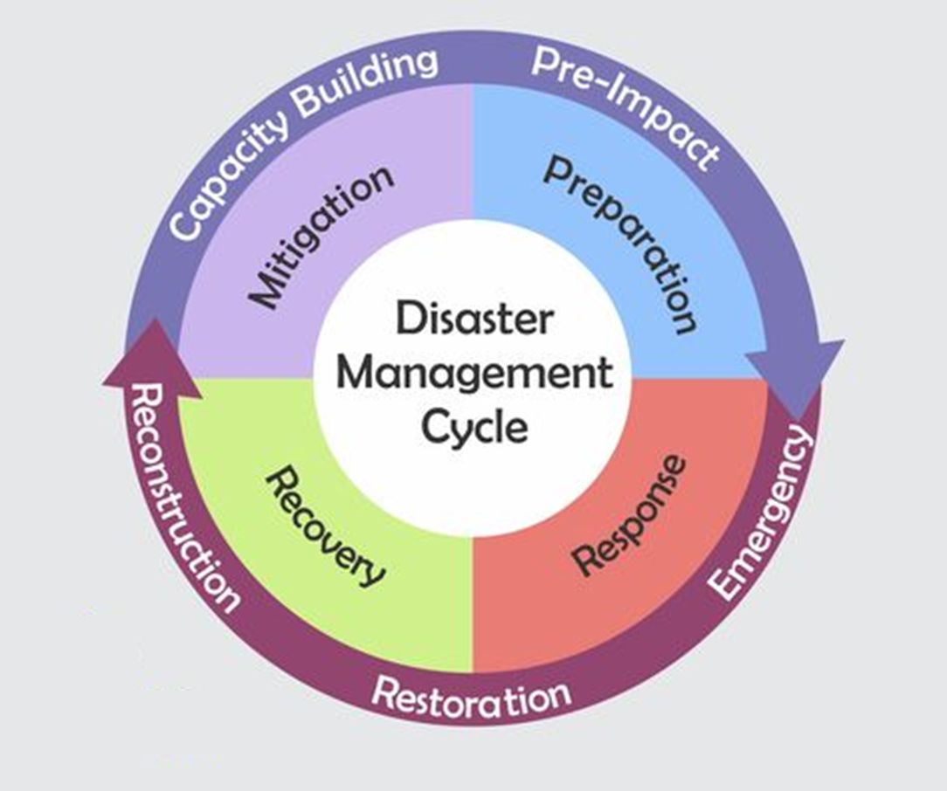


WGDisasters fundamentals
Earth observations enable identification of natural hazards, exposure of people, assets and livelihoods, and related vulnerabilities
CEOS WG Disasters Work Plan is aligned with the Sendai Framework on Disaster Risk Reduction
GEO4DRM
International Charter Space and Major Disasters
Notes:
Support the efforts of Disaster Risk Management (DRM) authorities in protecting lives and safeguarding property by means of satellite-based EO and science-based analyses
Support the implementation and monitoring of the UNDRR Sendai Framework, (mainly Priority1 “Understanding Risk”, more recently Priority4 “Build Back Better”)
Support the work of international initiatives such as GEO
Raise the awareness of politicians, decision-makers, and major stakeholders of the benefits of using satellite EO in all phases of DRM
Foster increased use of EO in support of DRM and DRR, and express related EO needs

Slide 4
WGDisasters Priorities 2022-2023
“The path to sustainability - Use cases for the operational uptake of satellite EO at the local scale ” Focus on Operational Uptake of WG successes to increase Resilience
  Demonstrators:
    Continue to demonstrate potential;
    Build path to post demonstrator sustainable operations – stronger ties to international stakeholders but also local actors
    Increase focus on capacity building in all demonstrator activities
  Strengthen ties to GEO WGs
  Explore linkages to Climate related activities, impact of CC / extreme events & local impacts
  Exploit new technology opportunities (new missions, new data exploitation techniques, …)
WG Disasters priorities 2024-2025 being defined by CONAE (incoming lead)
Slide 4
Notes:
Current CEOS Presidence : Paths to Sustainability: from CEOS Strategy to practical measures

Slide 5

Pilot and Demonstrator projects :
  Wildfire Pilot
  Flood (GEO/LEO/SAR) Pilot
  Landslide Demonstrator
  Volcano Demonstrator
  Seismic Hazards Demonstrator
  Recovery Observatory Demonstrator
  Contribution to GEO :
    GEO4DRM
    GSNL
…. Post Demo: G-VEWERS
…. Post Demo: Pre-operational RO

Slide 6


Geohazards Supersites & Natural Lab
Aims to improve geophysical scientific and geohazard assessment, promoting rapid and effective uptake of new science results for enhanced societal benefits in DRR
Voluntary international partnership.
Volcanoes : Hawaii ; Iceland; Etna; Campi Flegrei/Vesuvius; Taupo Ecuador; Southern Andes; Virunga; Kamchatka Kuriles
Faults / Earthquakes : Marmara Western North Anatolian fault ; San Andreas Fault NL; China Earthquakes; Nicaragua; Kahramanmaras Event Supersite
Lead : Stefano Salvi, INGV
Slide 6

Slide 7
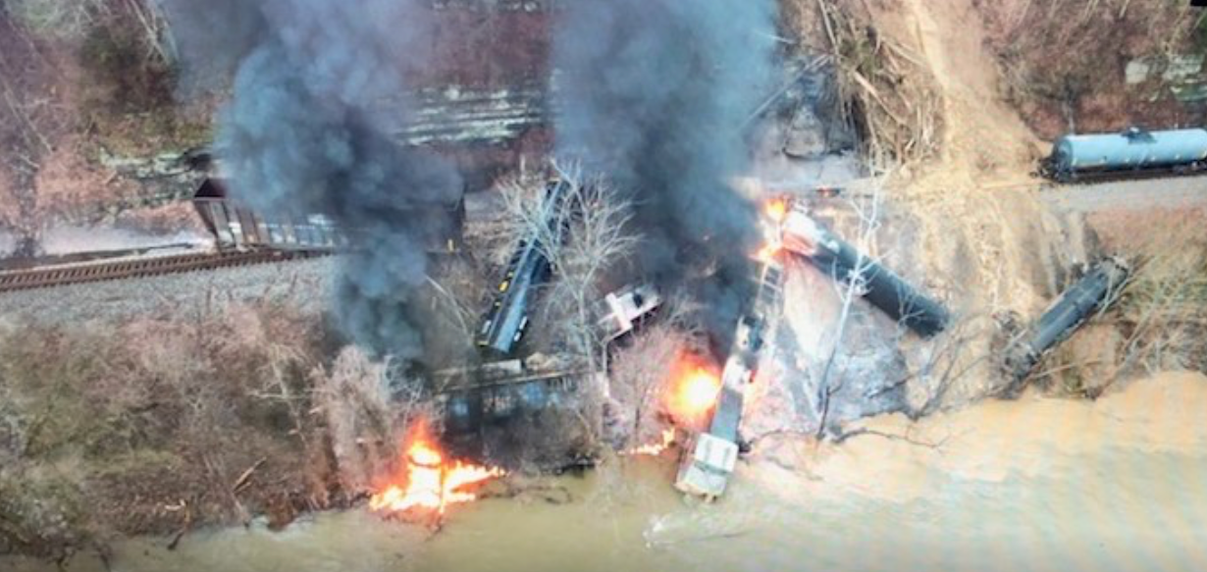
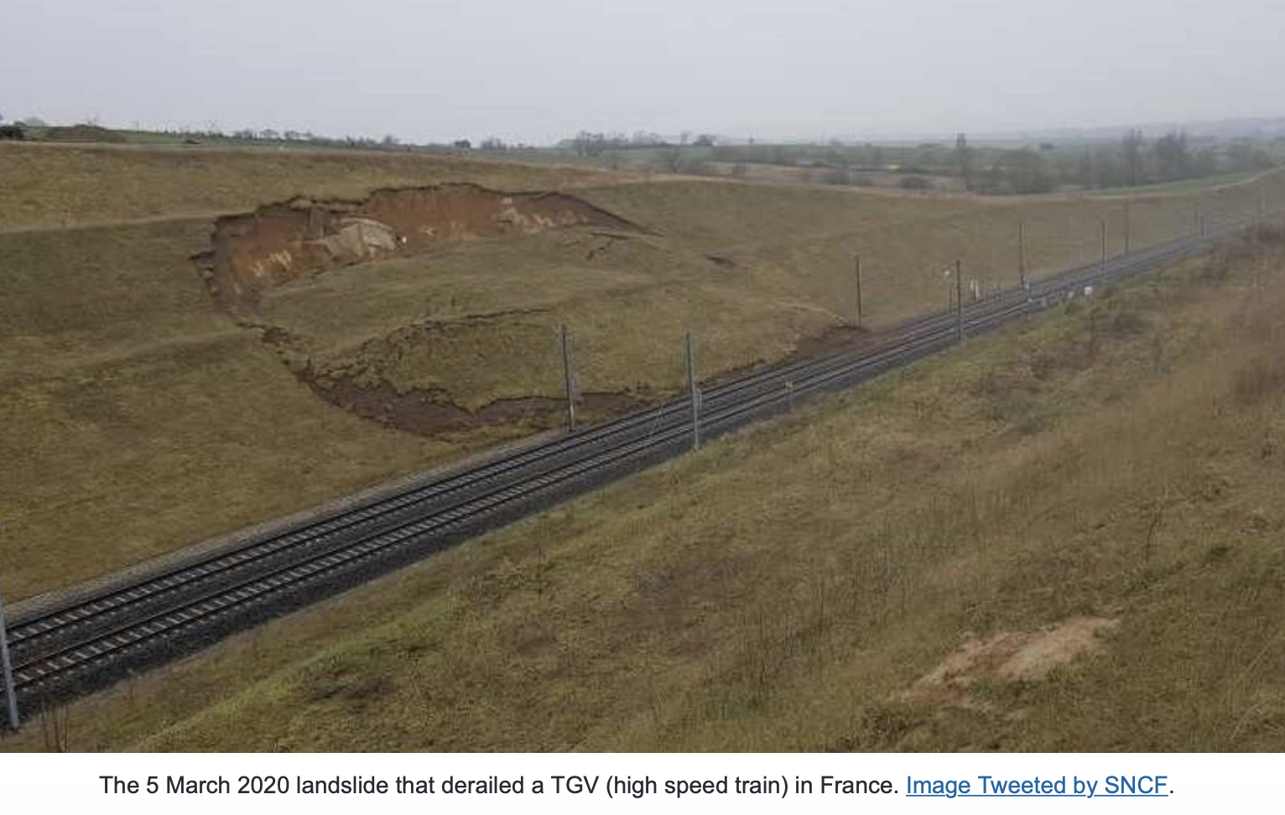
Landslide Demonstrator
Aims to demonstrate the effective exploitation of satellite EO across the full cycle of landslide disaster risk management (i. e. preparedness, response, and recovery at global, regional, and local scales), including the possibility of multi-hazard focus on cascading impacts and risk.
Elkhorn city (Kentucky, US) – February 2020 – shallow landslide / mudflow
Twofold approach with continued science globally but uptake of existing methodologies for insurance users (semi-commercial)
Demonstrator Leads: Pukar Amatya, NASA;
Jean-Philippe Malet, UNISTRA/EOST; Jonathan Godt, USGS
East France – March 2020 – landslide on high speed train TGV
Slide 7

Slide 8
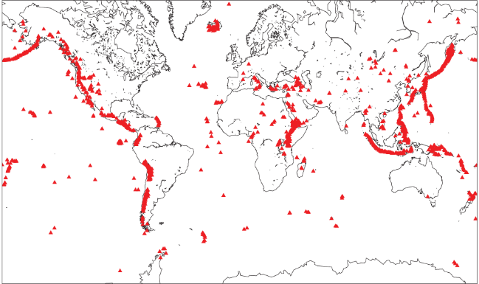
Volcano Demonstrator
Aims to evaluate the utility of remote sensing data for anticipating, detecting, and tracking volcanic eruptions.
Supports EO applications that promote volcanic disaster risk reduction worldwide.
Focus on high-risk volcanoes in areas where monitoring is not currently well developed (LAC, Africa, SE Asia).
Science driver with long-term science objectives and quick response. Evolution towards a virtual volcanoes observatory
Demonstrator Leads: Mike Poland, USGS; Simona Zoffoli, ASI; Susi Ebmeier, University of Leeds.
Slide 8

Slide 9
Volcano Proposal to CEOS Plenary 2023 : G-VEWERS
Q: How do we achieve the goals of the global volcanology community to better monitor volcanoes and mitigate their hazards?
A: Create a permanent Global Volcano Early Warning and Eruption Response System (G-VEWERS)
  Permanent virtual facility for remote volcano monitoring
  Biennial renewable quotas (akin to Supersites)
  Made possible by best-effort contributions from academic institutions, volcano observatories, and space agencies
  Leverage local capacity for monitoring and support local needs
  Timely response to hazardous volcanic eruptions (dozens per year, daily monitoring needed)
  Tracking of restless volcanoes (~200 per year, weekly monitoring needed)
  Background monitoring of quiescent volcanoes (~1400, quarterly to every few years needed)
Notes:
G-VEWERS is a response to several years of coordinated discussions within the Volcano community to identify the highest priority Satellite observations to meet international needs (Powell center report).
Like GSNL, G-VEWERS would become a permanent CEOS initiative, with biannual quotas and reporting
It focuses on monitoring Volcanoes at unrest and rapid response with science products during eruptions.

Slide 10
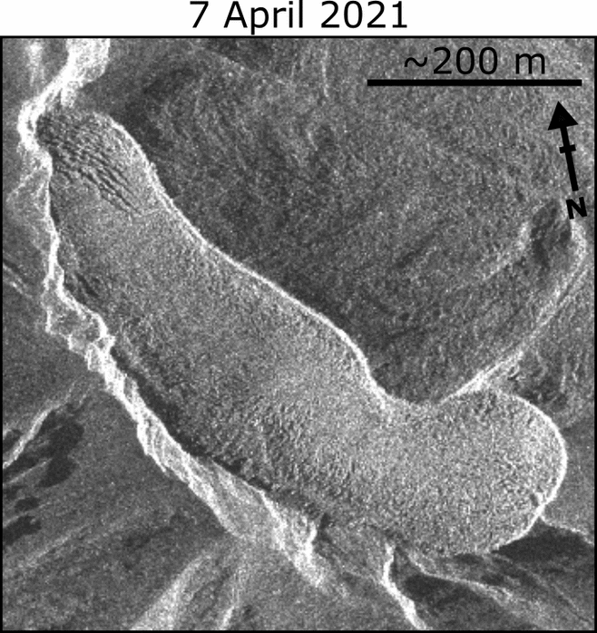
G-VEWERS: Partners and Management
G-VEWERS is a partnership
  Space Agencies (provide data and expertise)
  Academic institutions (develop new derived products and conduct capacity building)
  Volcano Observatories (utilize data products and build capacity to aid volcanic hazards mitigation)
Management and oversight will be provided by an advisory panel composed of scientists representing the above institutions
USGS will provide operational support
Soufriere St. Vincent
10x increase in extrusion rate ~48 hours before onset of
explosive eruption
Ultimate goal is a safer global society due to better monitoring and forecasting volcanic activity
Dualeh et al. (2023)
Notes:
G-VEWERS is proposed by USGS (Global Disasters Assistance Program), with Space agencies : ASI, CNES, DLR…., Universities and Volcano Observatories around the world, which is an opportunity for CEOS to provide CB.
An Advisory Panel made up of representatives from G-VEWERS partners and from the broader international V community will be created.

Slide 11
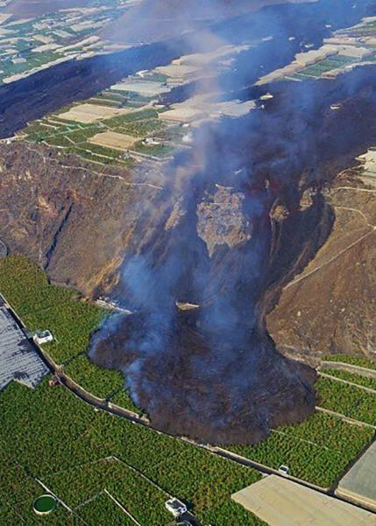
G-VEWERS: Requested Data Contributions from CEOS agencies
4000 scenes/year each for TSX and CSK for global volcano monitoring and early warning, provides for:
  Daily monitoring of erupting volcanoes (30 VEI2 eruptions per year, averaging 75 days each is 2300 scenes per year)
  Weekly monitoring of restless volcanoes (230 average restless volcanoes is 6000 scenes per year)
  Background monitoring of quiescent volcanoes (quarterly to every few years is 300 scenes per year)
TDX access for DEM generation
1000 scenes/year for SAOCOM (L-band for vegetated volcanoes)
20,000 km²/year for Pleiades (DEMs and change detection)
Access to SPOT6–7 (high-res change detection)
Archived SAR scenes as needed (hundreds per year)
Other data to be requested periodically through WG Disasters on as required basis (biannual quota)
Notes:
Data requests will go through the WGD Data Coordination Team (DCT), with best effort contribution reviews every 2 years.
Figures in the slide are INDICATIVE only.
Demonstrator tasking:
CSK: 900 scenes/year, archive and new tasking
TSX: 450 scenes/year, archive and new tasking (extended several times)
Pleiades: 20,000 km²
Focus on complementary capabilities
Make use of existing large archives
Need for coordination with GSNL – don’t want to count things twice

Slide 12
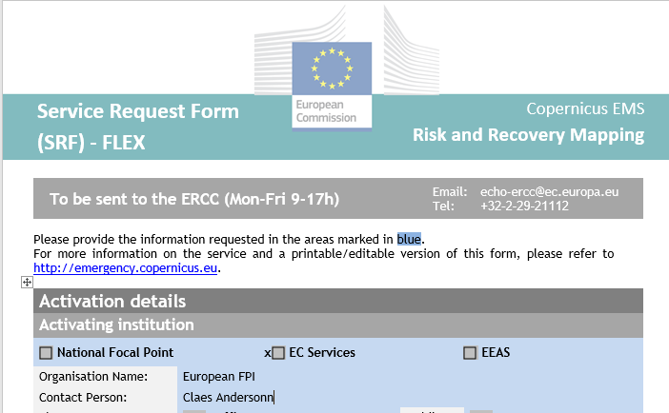
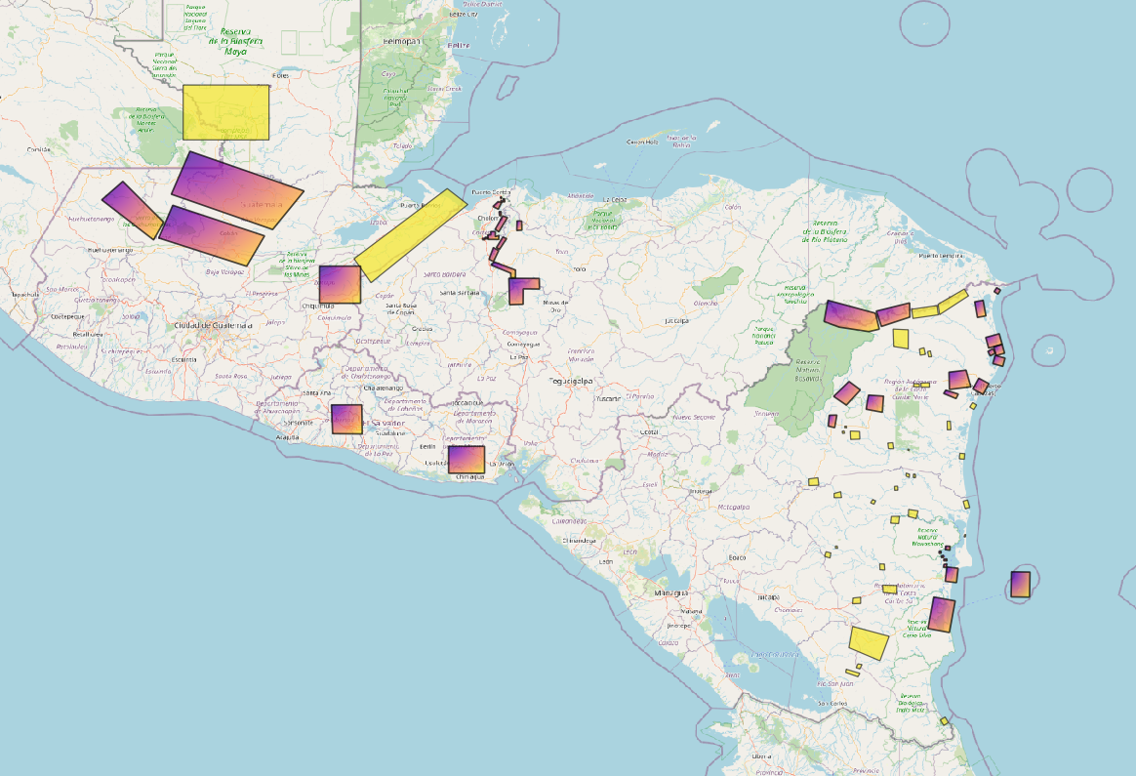
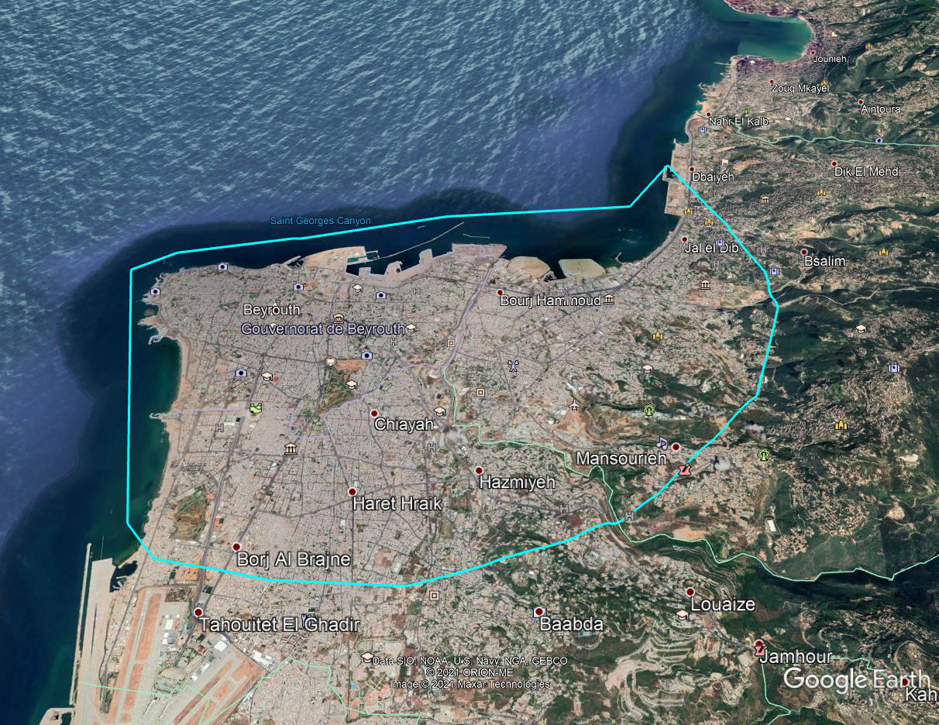
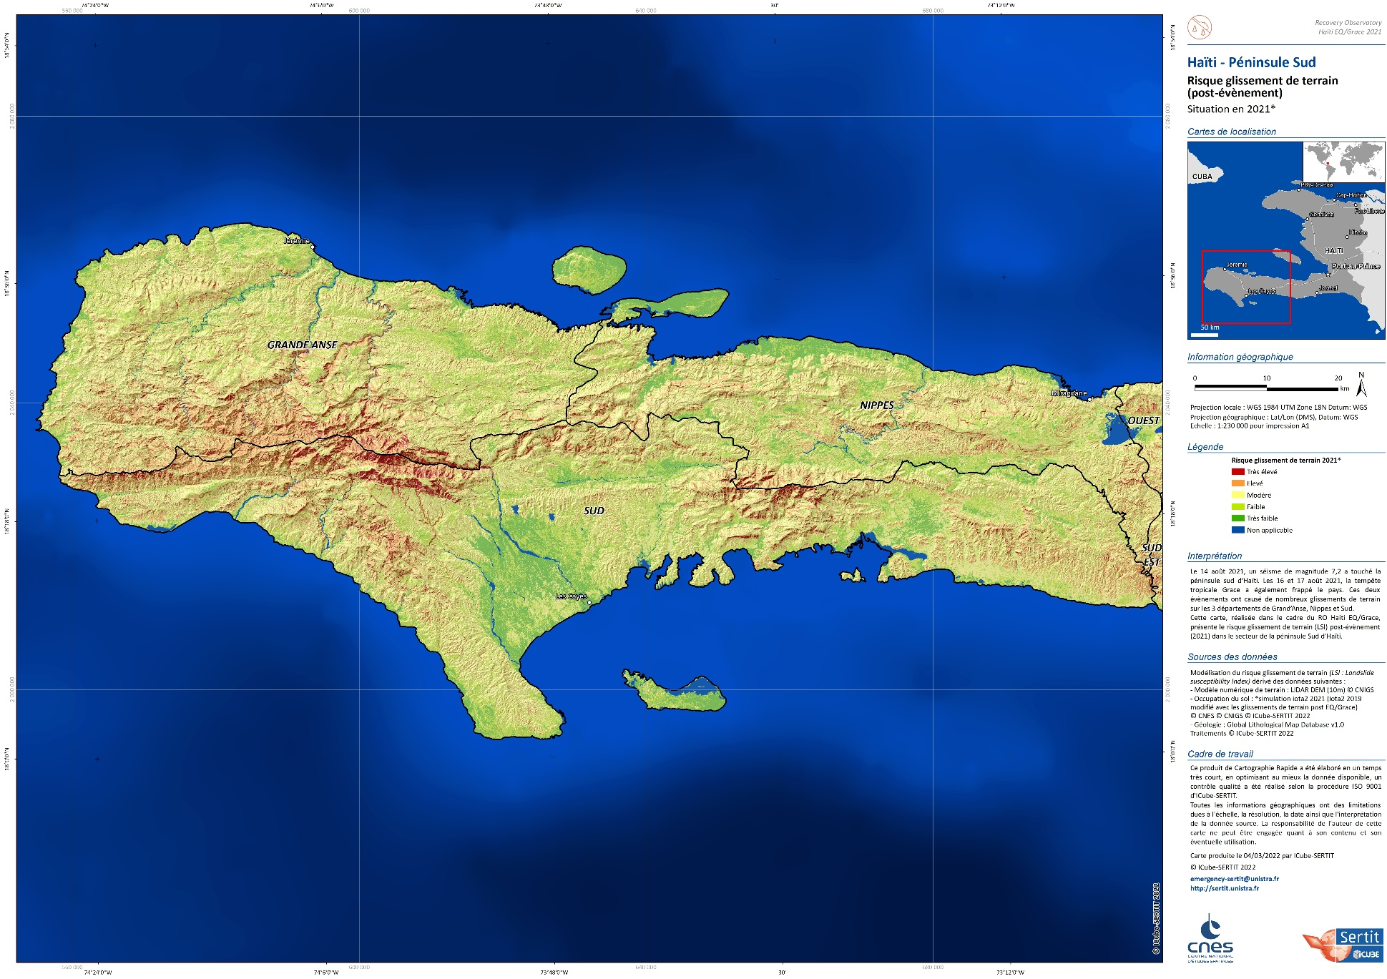
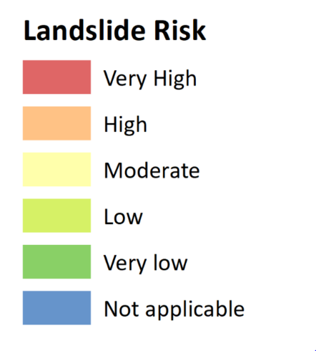
Recovery Observatory (RO) Demonstrator
Showcase contribution of satellite data and products to recovery efforts following major disaster events. Direct input to Post Disaster Needs Assessments and long-term contribution to Recovery Framework. Cited in Space Agenda 2030 (UN GA).
Pilot on Haiti (Matthew hurricane) 2017-2020;
Demonstrator objective : 3-5 ROs 2020-2023. To date:
                Beirut Explosion 2020
                Eta-Iota Central America 2020-21
                Haiti Earthquake 2021-22
                Pakistan Floods 2022
                Turkey/Syria EQ : linkages with UE/WB/UNDP - possible support to Recovery Framework activities
Co-construction of the post Demonstrator process with WN, UE, UNDP and others; incremental approach to leverage PDNA / DRM funds to provide value added products in support of near and medium-term recovery
2021
Demonstrator leads : Linda Tomasini, CNES; Rashmin Gunasekera; World Bank
Slide 12

Slide 13
Summary of RO Demo activations
Activation | Pros | Cons | Comments
1. Beirut blaze | Synthetic update of situation | Very small area not representative of typical activation | Coordination with Copernicus but no other added CEOS value
2. Eta-Iota hurricanes | Excellent. Multinational coordination. Innovative products (e.g. interferometry Sula Valley) | Request came months after events; no direct impact on early recovery | Demonstrated need for increased tripartite coordination
3. Haiti EQ | Activation in days; results in PDNA only input for agriculture and environment | None | Excellent showcase Successful Capacity Building example
4. Pakistan floods | Excellent quality of CEOS products for two areas retained for Phase 1; strong interest in DRF products (agriculture) | Lack of coordination; evolving need analysis led to gaps in EO products; poor uptake in PDNA | Large events (Pakistan, Nepal EQ, …), pose unique coordination challenges
Turkey/Syria EQ | Strong willingness of CEOS to contribute; linkages to GSNL | Complex political situation postponed decision to activate indefinitely | No activation but support provided in determining all remote sensing data available
Myanmar Mocha hurr. | Strong technical case for quality product | Impossible to deliver in proposed timeline | Need to fast-track activation requests
5. Libya floods : activated last Friday
Slide 13
Notes:
This slides sumarizes lessons-learnt from RO Demo activations :
Technical demonstrations show significant impact of EO sat and products to support PDNA and longer term Recovery
PDNA timelines are extremely challenging for CEOS best effort contributions. However, when well coordinated, sucesses can be achieved (see Haiti EQ)
CB : early assessment and planning for Longer Term activities, in connection withWGCapD or international organisations

Slide 14
RO Demo partner contributions
Openly available response data and products
  International Charter Space and Major Disasters
  Copernicus EMS RM
  Sentinel-Asia
  UNOSAT
  Open-source sat data (Landsat, Sentinels, DTM)
  Data bases (landcover, population,..)
Integrated Situational Awareness
to support recovery:
Inform PDNA;
Pre and post disaster baselines;
Recovery planning
Medium term monitoring;
Capacity Building assessment & plan.
CEOS best efforts RO data and products
  Dedicated acquisitions of commercial data
  Complex satellite products (e.g. SAR interferometry)
  RO liaison officer and overall coordination
  Value adding services
  Capacity building
Ad hoc contributions: academia, international organizations
(e.g. CEMS RRM, FAO, UN)
  Linkages to Copernicus Risk and Recovery Mapping
  Value adding services
  Expert analysis
  Integration of other advanced data sources (e.g. social media, drones, …)
Slide 14
Notes:
On the left side of the slide, we see the broad range of CEOS and other contributuions to the RO, which lead to a clear vision for a pre operational RO :
Inform PDNA;
Pre and post disaster baselines;
Medium term monitoring;
Capacity Building assessment & plan.

Slide 15
Establishment of Pre operational RO
Implementation Timeline
2020-2023
RO Demo
2024
Transition to pre-operational RO
2025-2026
Pre-operational RO
Approval sought at Plenary 2023
Permanent RO
(from 2027)
Notes:
The WGD proposes a 3 year continuation of the RO Demo, for a smooth ramp up :
A first transition year to start transferring RO leadership to international Recovery stakeholders
2 years continuing in a strong support role to ensure transition to a permanent RO
RO oversight continues to be provided by the RO team, made up of senior representatives from international Recovery community and contributing CEOS agencies

Slide 16
Action Plan Proposal for 2024-2026
Establishment of pre-Operational RO
Establish a capacity to provide 2 to 4 Recovery Observatories for the next three years beginning in 2024:
  Target :
    one event per semester in 2024;
    one event per quarter in 2025 and 2026;
  Initially provide resources through ad hoc best efforts mechanisms (as in demonstrator);
  Q1/Q2 2024 work with partners to establish mechanisms for private sector and intergovernmental organisation RO activation (operational Q1 2025)
    WB/GFDRR mechanism to activate pre-qualified private sector support in conjunction with CB in country
    Work with UNDP and UNDP Crisis Bureau to activate UNOSAT on regular basis for RO activations
    Work with EU to task Copernicus EMS RRM to rapidly respond to recovery intervention requests
    Access existing EU framework contracts on PDNAs to ensure PDNAs benefit from satellite support in a coordinated fashion
Slide 16
Notes:
We propose to ramp up from 3-5 activations over 3 years to 2 to 4 activations / year.
This is only possible with strong support from WB, EU, UNDP, as regards RO liaison officer role and value adding.
CEOS WGD is workins bilaterally with each organisation to establish specific collaboration mechanisms for each institution.

Slide 17









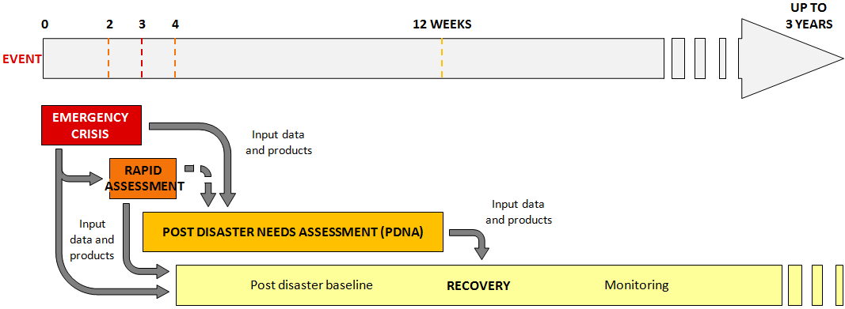




Outcome:
RO integrated into Recovery process
National
Recovery
Framework
Planning
  “Recovery Observatory” : Process allowing operational use of EO for Rapid Assessments, PDNA, Recovery planning & Recovery M&E

Slide 18
Sustainability Challenges
Two sub teams for addressing this issue :
        Recovery Observatory sustainability sub team :
    WB, EU, UNDP, UNOOSA, UNOSAT, ASI, CNES, ESA@WB, Copernicus EMS
WG Disasters sustainability sub team :
    Demonstrators and Pilot leads, GEO activities lead
On going Sustainability Survey :
    Community of Practice ? Vision for sustainable use of EO ? Key partners ?
    Main barriers ? Cost drivers ? Donor / Investor communities ? ….
Slide 18
Notes:
Is there a global and/or regional community of practice (CoP) in this area? How is it structured?
Is this CoP engaged in your activity? In what way?
What is the ideal vision for sustainable use of EO in your sector, built on your Pilot/ Demonstrator experience?
Have you estimated the types of data and annual volumes required for a sustainable ongoing use of EO to meet objectives? (at relevant geographical level: global, regional, national…)
In a sustainable perspective, who are the key partners that would exploit EO data / derived products / derived indicators?
What are the main barriers to sustainability? (scientific, technical, cost, human, ….)
What are the cost drivers associated with EO data exploitation that make this challenging?
Beyond the end user community, are there other potential donor communities that have a vested interest in the success of your activity (e.g. foundations, international financial institutions, insurance, etc)? Which ones would you consider most engaged or interested in your activity?
Are there “stepping stones” that would facilitate longer-term achievement of sustainability goals that could be envisaged in a post-demonstrator activity?
Do you know of successful examples of user partnerships where similar barriers have been overcome and how?
Do you have additional comment / feedback ?
subteam has been created within the WG to address sustainability issues. It will produce a final report later this year.

Slide 19


Links to other CEOS WGs and to GEO
Ties to CEOS WGs:
    WGCapD
    WG Climate
    WGISS, joint session in person WGISS-55, April 2023; joint work on Machine Learning for EO applied to Disasters (WildFire Pilot use case: ML for Wildfires)
New Space Task Team (NSTT)
Oceans Coordination Group/ future AHT
  DRR WG, RO : use cases for EO Risk Toolkit/RiX (UNDRR)
  New GEO 2025 thematic Incubators : WG Disasters working to develop use cases
Notes:
WildFire Pilot use case: ML for Wildfires
Yousuke Ikehata, JAXA
Mark de Jong, Cantin, Alan NRCAN

Slide 20
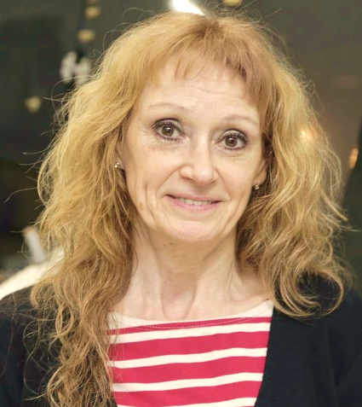
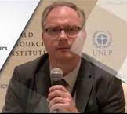
WG Disasters next Chair team (2024-2025)
Chair : Laura FRULLA (CONAE) co-Chair: Lorant CZARAN (UNOOSA)
Thank you for your attention

